Slide 1
About OMICS Group
OMICS Group International is an amalgamation of Open Access publications and worldwide international science conferences and events. Established in the year 2007 with the sole aim of making the information on Sciences and technology ‘Open Access’, OMICS Group publishes 400 online open access scholarly journals in all aspects of Science, Engineering, Management and Technology journals. OMICS Group has been instrumental in taking the knowledge on Science & technology to the doorsteps of ordinary men and women. Research Scholars, Students, Libraries, Educational Institutions, Research centers and the industry are main stakeholders that benefitted greatly from this knowledge dissemination. OMICS Group also organizes 300 International conferences annually across the globe, where knowledge transfer takes place through debates, round table discussions, poster presentations, workshops, symposia and exhibitions.

Slide 2
About OMICS Group Conferences
OMICS Group International is a pioneer and leading science event organizer, which publishes around 400 open access journals and conducts over 300 Medical, Clinical, Engineering, Life Sciences, Phrama scientific conferences all over the globe annually with the support of more than 1000 scientific associations and 30,000 editorial board members and 3.5 million followers to its credit.
OMICS Group has organized 500 conferences, workshops and national symposiums across the major cities including San Francisco, Las Vegas, San Antonio, Omaha, Orlando, Raleigh, Santa Clara, Chicago, Philadelphia, Baltimore, United Kingdom, Valencia, Dubai, Beijing, Hyderabad, Bengaluru and Mumbai.

Slide 3
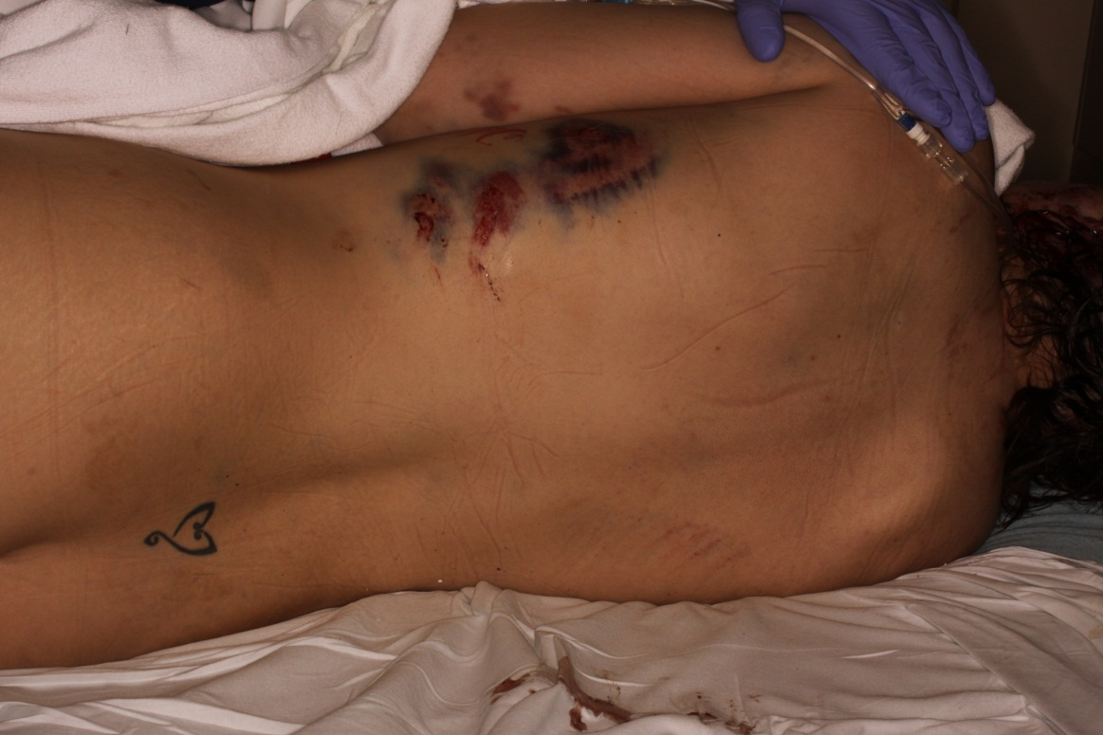
Have We Done All We Can Do?

Slide 4
Facts !
2012 • Women Killed: 114 • Family violence incidents: 188,992 • Adults sheltered: 11,994 • Children sheltered: 14,534 • Adults receiving nonresidential services (i.e., counseling, legal advocacy, etc.): 36,831 • Children receiving nonresidential services: 15,694 • Adults denied shelter (due to lack of space): 26.2% • Hotline calls answered: 191,301
(Texas Council on Family Violence)

Slide 5
Affects on Community
Drains our resources:
Private business
Agencies
Government
Community Groups
Individual Resources
Notes:
Cost anywhere from one to eight billion dollars annually

Slide 6
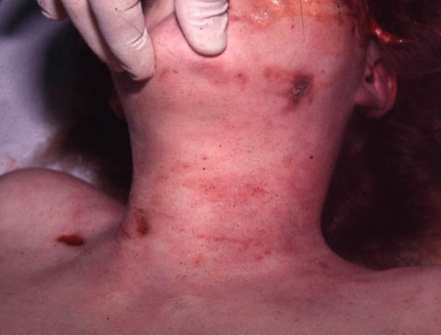
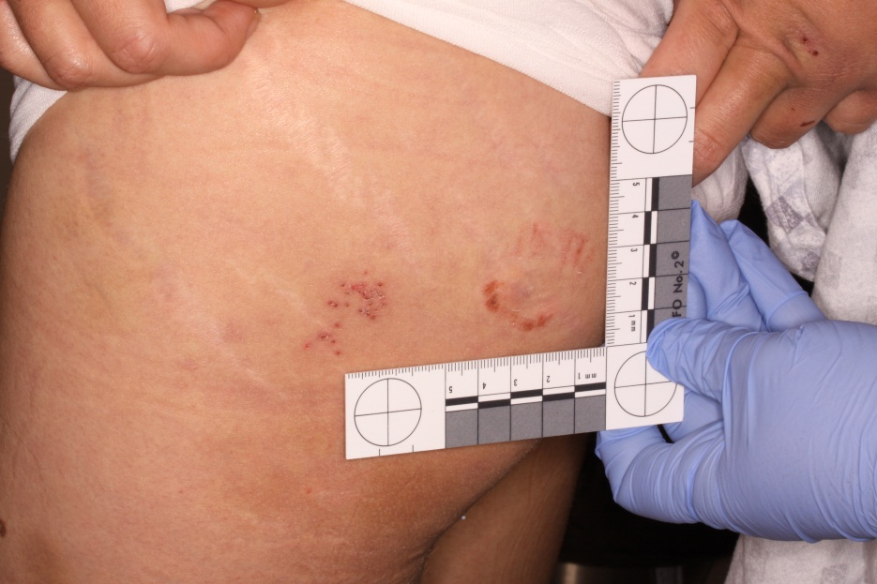
Affects Individuals
Pain
Hospitalization
Family and children
Job
Pets
Home
Fear

Slide 7
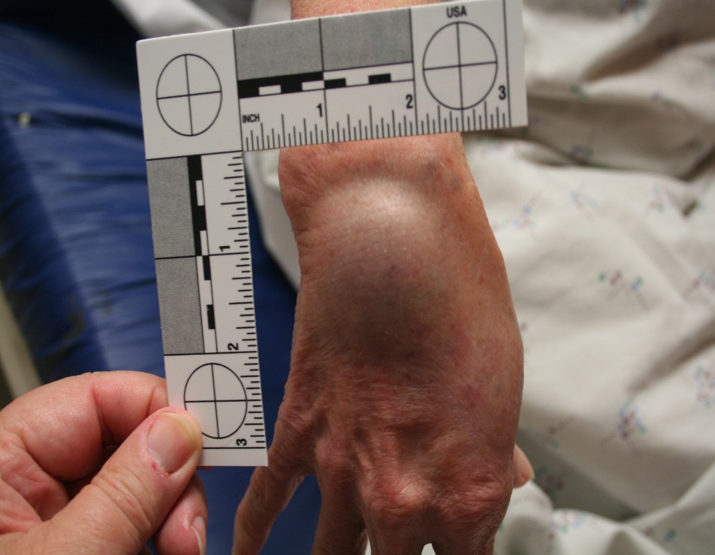
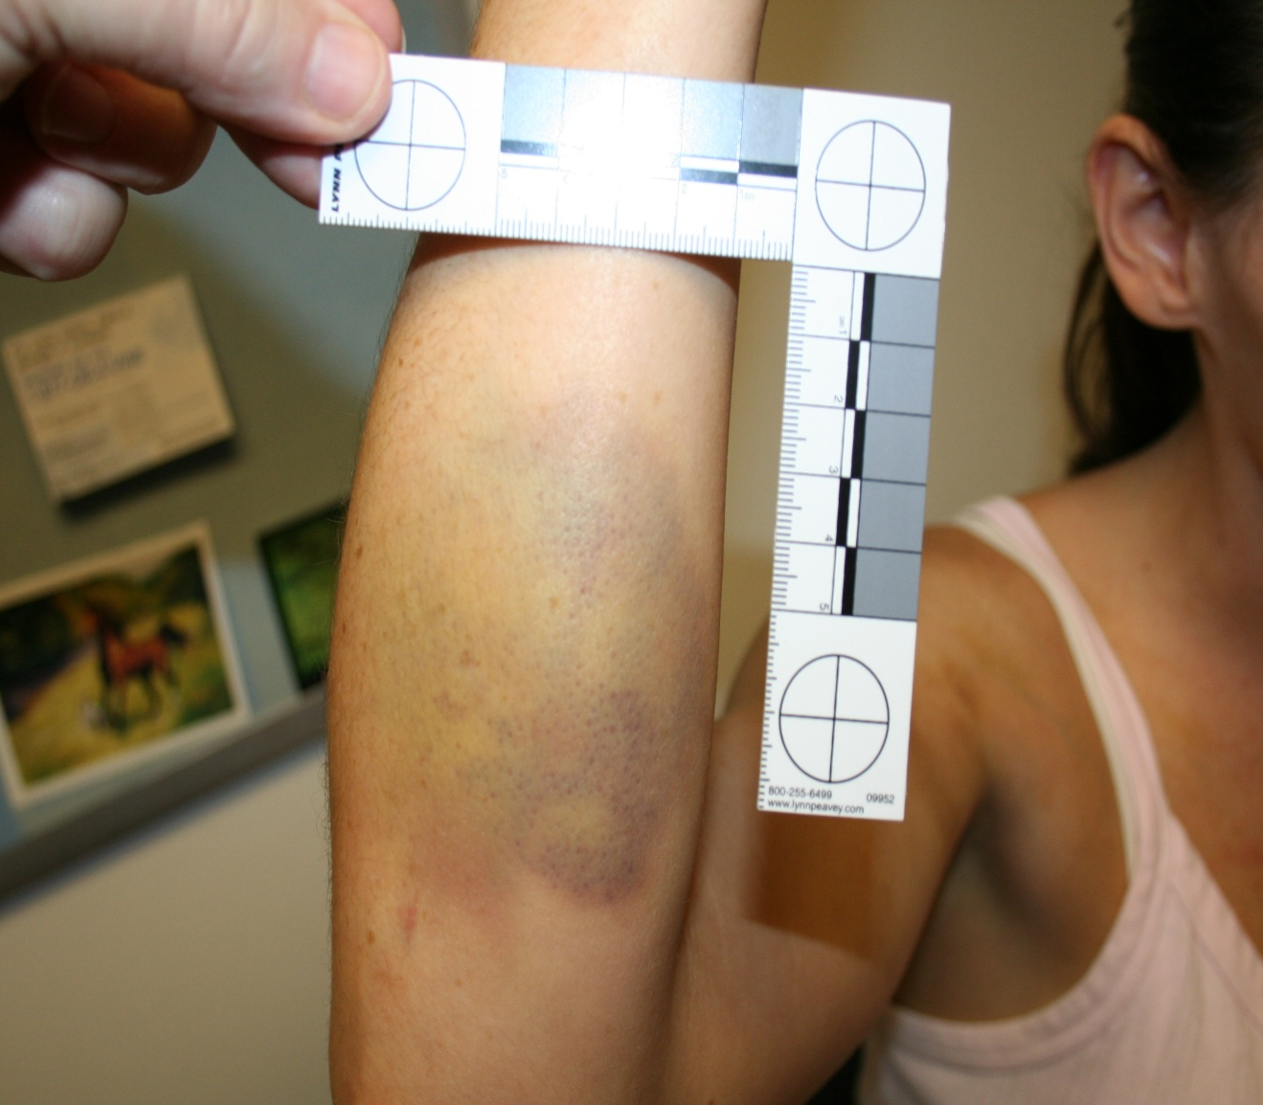
Our Responsibility
Recognition
Communication
Validation
Education
Documentation
Evidence Collection
Safety
Collaboration and Referrals
Be A Voice

Slide 8
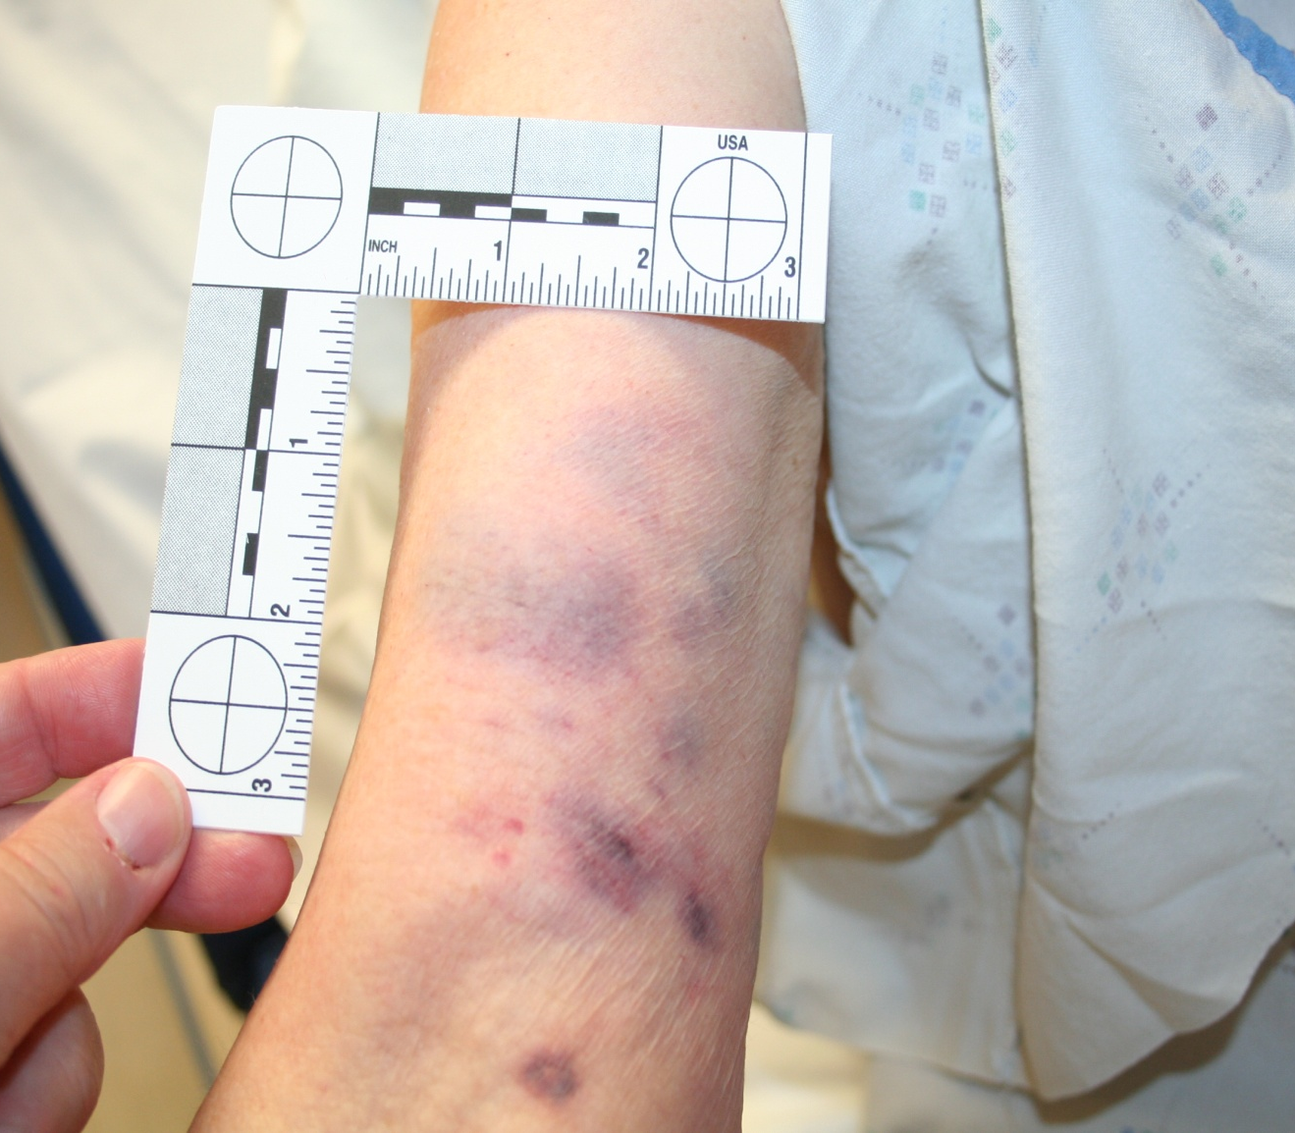
What More Can We Do?
Financial Support
Training Programs
Enforcement of Existing Laws
Private Business
Government
Community

Slide 9
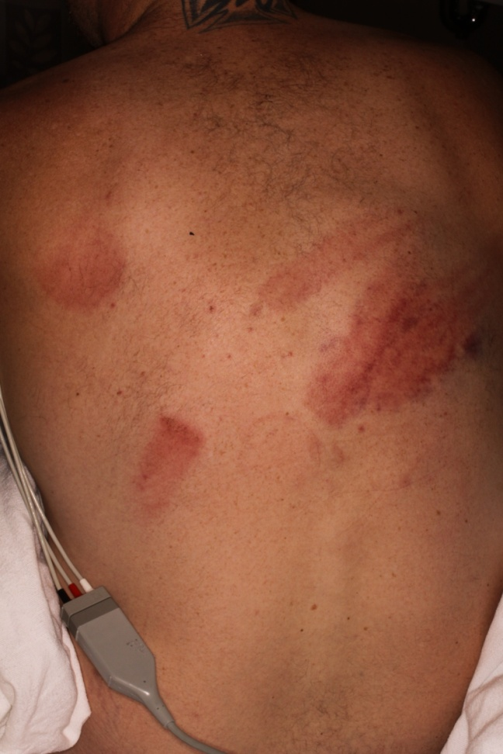
Impossible?
Will it End?
Diligence

Slide 11
Let Us Meet Again
We welcome you all to our future conferences of OMICS Group International
Please Visit: www.omicsgroup.com
www.conferenceseries.com

