Slide 1
Immune Responses to Human Papillomavirus Vaccines: What We Have Learned
Ligia Pinto, PhD
Senior Principal Investigator, HPV Immunology Laboratory
October 1, 2014

Slide 2
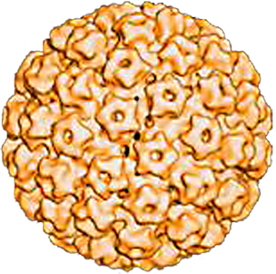
HPV
Non-enveloped double-stranded DNA virus
One of the most common sexually transmitted infections
>100 types identified
~30–40 mucosal
  ~15–20 oncogenic types
    HPV 16 and HPV 18 types account for 70% of cervical cancer cases
  Nononcogenic types
    HPV 6 and 11 are most often associated with external anogenital warts
Notes:
2/Schiffman/p. 930/col 2/¶3
3/Wiley/ p. S210/col 1/¶1
1/Howley/p. 2198/col 1/¶1
4/Muñoz/p. 522/col 2/¶5; p. 523/col 1/¶1
2/Schiffman/p. 930/col 2/¶3.
3/Wiley/p. S210/col 1/¶1; p. S211/col 1/¶2
3/Wiley/ p. S210/abstract; col 2/¶1
1/Howley/p. 2198/col 1/¶1
2/Schiffman/p. 930/col 2/¶3
4/Muñoz/p. 281/col. 1/¶1
3/Wiley/ p. S210/col 2/¶1
2/Schiffman/p. 930/col 2/¶3.
3/Wiley/p. S210/col 1/¶1
2/Schiffman/p. 930/col 2/¶3.
3/Wiley/p. S211/col 1/¶2

Slide 3
Most Common Cancers in Women
More developed countries
Less developed countries
Breast
Cervix
Ovary
Endometrium
Colon/rectum
Lung
Stomach
600
400
200
0
200
400
600
Annual number of cases (thousands)
Adapted from Parkin et al, Eur J Cancer 2001; 37 S4

Slide 4
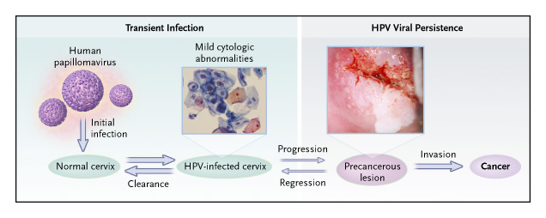
Cervical Pathogenesis
HPV persistence is the most important predictor of high grade cervical
cancer precursors

Slide 5
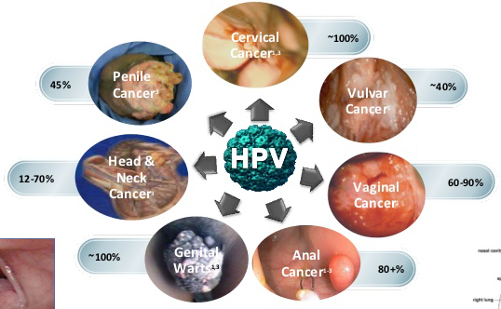
HPV Causes More than Cervical Cancer

Slide 6

HPV Associated Cancers, both Sexes, US 2005-2009
Notes:
6

Slide 7
Two Licensed Prophylactic HPV Vaccines
(L1 Virus-Like Particles)
Manufacturer | Merck | GlaxoSmithKline
Trade name | Gardasil® | Cervarix™
HPV types | 6, 11, 16, 18 | 16, 18
Adjuvant | AAHS | ASO4 Adjuvant (MPL + Alum)
Licensed | Female and males (ages 9-26yrs) | Females (ages 9-25yrs)
Expected coverage of protection | 70% of Cervical Cancer 90% Genital Warts | 70% of Cervical Cancer
3 intra-muscular injections over 6 months

Slide 8
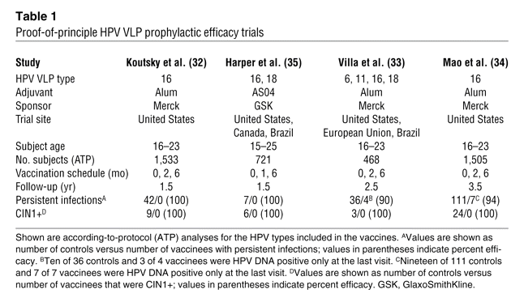
HPV Prophylactic Efficacy Trials
Lowy DR, Schiller JT. JCI 2006; 116: 1167

Slide 9
Two Prophylactic HPV Vaccines: Protection
Beyond Cervical Cancer
 | Gardasil (Quadrivalent) | Cervarix (Bivalent)
Cervix | High protection against HPV-infection and related disease
Vagina/Vulva | Protection against HPV-infection and related disease | Not evaluated
Penis | Protection against HPV-infection | Not evaluated
Anus | Protection against HPV-infection and disease | Protection against HPV-infection
Oropharynx | Not evaluated | Protection against HPV infection

Slide 10
Evolution of Recommendations for HPV Vaccination in the US
Quadrivalent Vaccine
Routine: females 11 or 12yrs*
and 13-26 yrs if not previously vaccinated
Quadrivalent or Bivalent
Routine: females 11 or 12yrs*
and 13-26 yrs if not previously vaccinated
WHO Advisory Group recommends a 2-dose schedule for girls, <15 years (0/6)
Quadrivalent
Routine: males 11 or 12yrs*
and 13-21 yrs if not previously vaccinated
May be given, 22-26 yrs
Quadrivalent
Maybe given
males 9-26yrs*
2006 2007 2008 2009 2010 2011 2012 2013 2014
Notes:
10

Slide 11
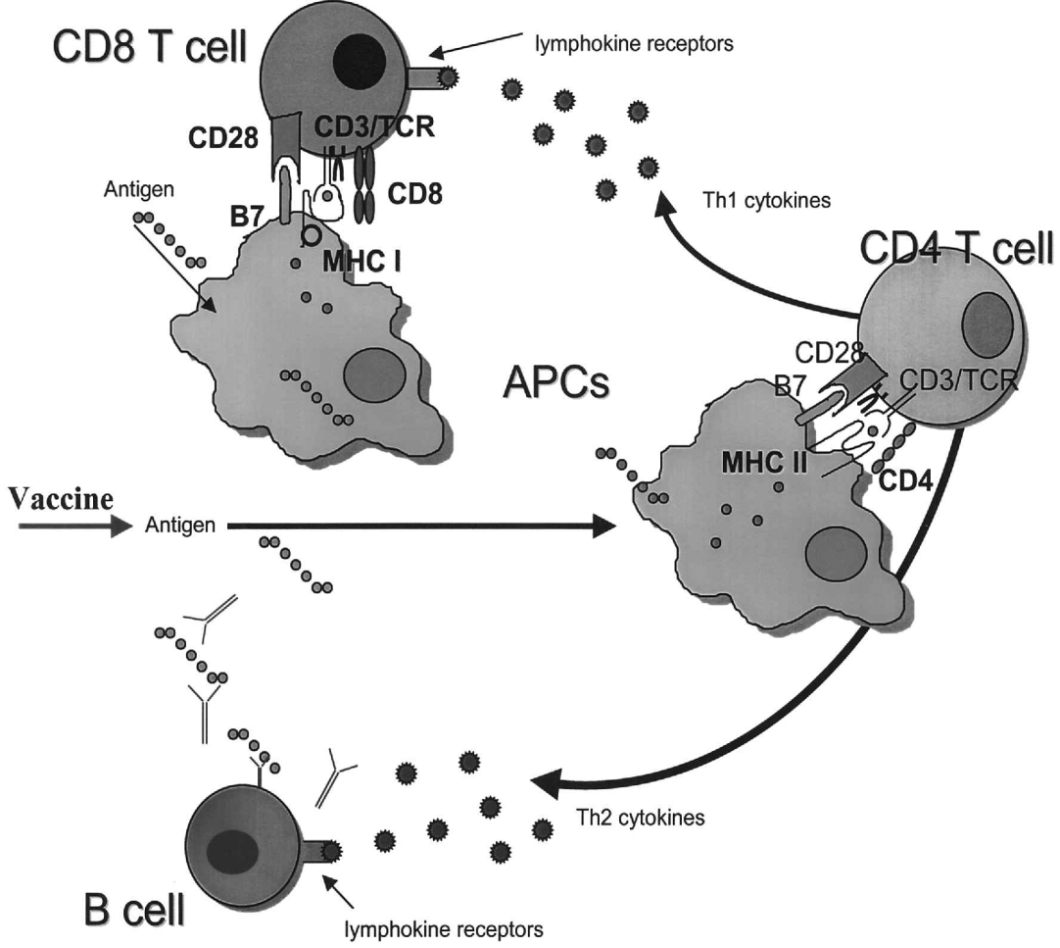

Potential Mechanisms of Vaccine-Induced
Protection Against Infection and Disease
  Humoral Immunity : Neutralizing Antibodies
  Cellular Immunity : CTL, T helper

Slide 12
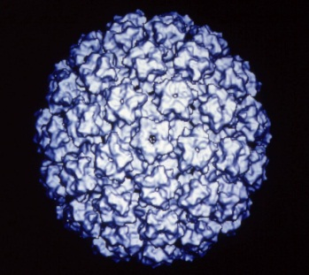
Cell-Mediated and Humoral Responses to HPV-16 L1 VLP vaccine
Immune Response to Vaccination:
  Type-specific neutralizing antibodies
  T-cell proliferation (CD4+ and CD8+ T cells)
  Complex cytokine responses (Th1, Th2 and inflammatory cytokines)
  Innate immune responses (DC activation)
(Pinto et al, JID 2003; García-Piñeres et al, EJI 2006;
García-Piñeres et al, CVI 2007, Garcia-Pineres et al, JI 2009)

Slide 13

NCI Costa Rican Vaccine Efficacy Trial:
Immunity Studies
7,466 Women
18-25 years old
Hepatitis A Vaccine
Havrix®
HPV-16/18 Vaccine
Cervarix®
10 total years of follow-up
Optimization and validation of assays (serum and
cervical secretions)
Monitor antibody responses and duration of protection
Understand immune mechanisms of protection and failure
  Cross-protection
  Immunogenicity of less than three doses

Slide 14
Validated Assays for Measurement of Antibodies in Serum and Cervix
HPV Serology Assays
Quantity:
  HPV IgG ELISA
Quality/Function:
  Pseudovirion neutralization assay
  ELISA antibody avidity assay
  Memory B cell ELISPOT
All assays used in-house produced
HPV VLPs, standards, and controls
HRP
HRP
HRP
HRP
VLP
SEAP
SEAP
293TT
SEAP

Slide 15
HPV-16/18 L1 VLP Vaccine Immunogenicity Study: Costa Rica Vaccine Trial
*
*
Months

Slide 16
Anti HPV-16 Antibody Over 5 Years Follow-Up (Quadrivalent vaccine)
10000
1000
Vaccine
Geometric Mean Antibody Titer
100
(Log Scale)
10
Natural infection
*
*
*
0
7
12
18
24
30
36
54
60
Time Since Vaccination 1 (Months)
Olsson S et al. Vaccine 2007; 25:4931
Villa L et al. Vaccine 2006; 24: 5571

Slide 17
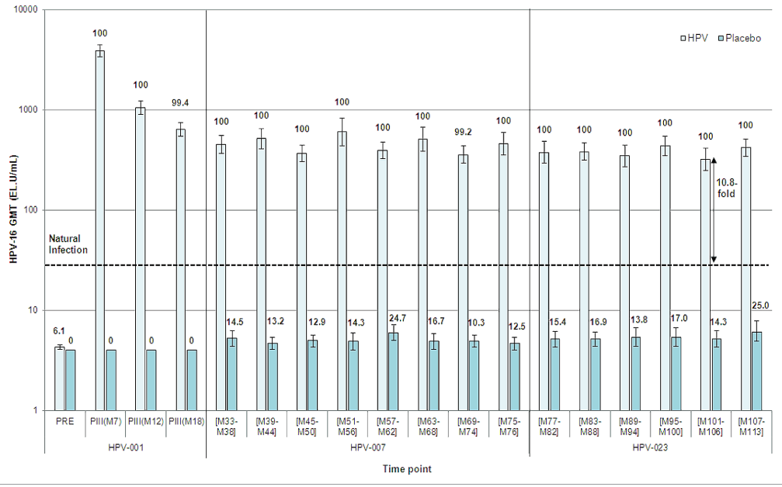
Durability of Antibody Response to 3 Doses
of the Bivalent Vaccine: 9.4 yrs
Vaccine
Placebo
HPV-16 GMT (EU/ml)
Naud PS et al. Hum Vaccin Immunother 2014

Slide 18
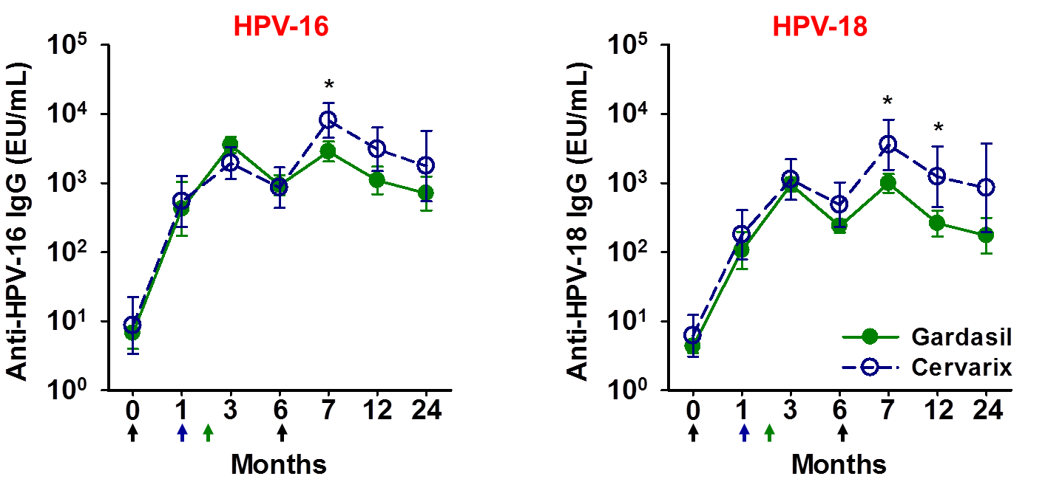
Antibody Titers in Gardasil® and Cervarix®
Recipients
* p<0.05, Mann-Whitney U test
Herrin et al. Hum Vaccin Immunother . In Press

Slide 19
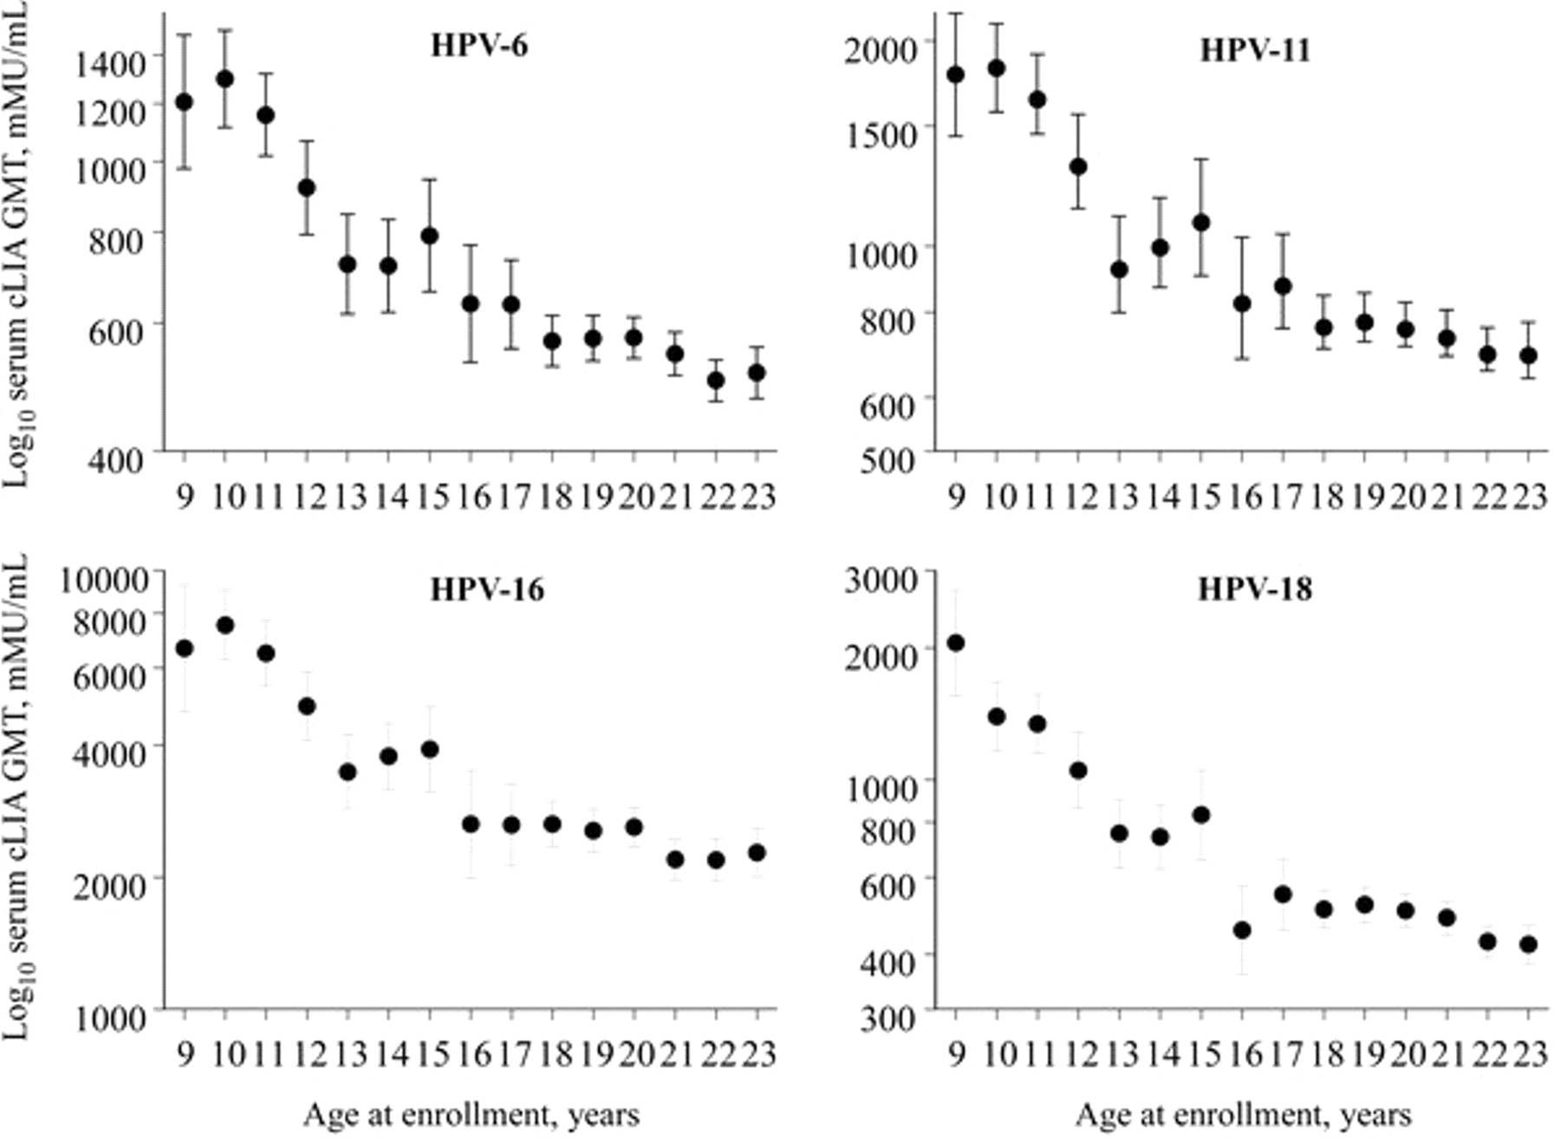
Influence of Age at Vaccination in Females
(HPV Quadrivalent Vaccine)
Giuliano A R et al. J Infect Dis. 2007

Slide 20
Levels of Antibodies in Serum Correlate Well with Levels in the Cervix
HPV-16
HPV-18
Serum
Cervix
Kemp et al., Vaccine, 2008
Notes:
20

Slide 21
Cross-Protection Against Persistent
Infection with Related High Risk HPV Types
Cervarix HPV16/18 Vaccine
ATP analysis; >7,000 per arm: 3.5 yrs follow-up
HPV Type | # Vaccine | # Placebo | Efficacy
31 | 21 | 102 | 79%
33 | 31 | 50 | 38%
45 | 10 | 27 | 76%
52 | 150 | 143 | -5%
58 | 64 | 56 | -15%
All of Above | 255 | 336 | 24%
*Paavonen et al,. Lancet 2009

Slide 22
Protection Beyond Vaccine Types:
HPV-16/18 L1 VLP Vaccine Induces
Cross-Neutralizing Antibodies
*
*
*
*
*p<0.001
Kemp et al., Vaccine, 2011
Kemp et al., Vaccine, 2012
Notes:
22

Slide 23
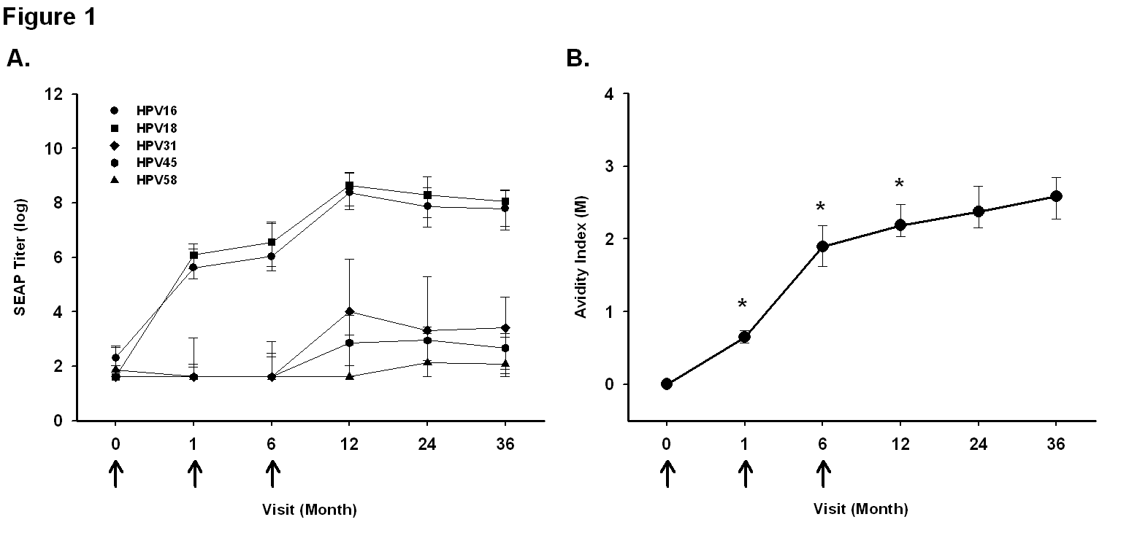
HPV-16 Antibody Avidity Increases after Vaccination over 36 Months of Follow-up
Kemp et al., Vaccine, 2012
Dauner et al., Mol Cell Probes, 2012

Slide 24
Vaccine Efficacy by Doses Received
Costa Rican Vaccine Trial
# of Doses | Arm | # of Women | # of persistent HPV16/18 infections | HPV16/18 VE (95%CI)
3 | Control | 3010 | 133 | 81% (71% to 88%)
 | HPV | 2957 | 25
2 | Control | 380 | 17 | 84% (50% to 96%)
 | HPV | 422 | 3
1 | Control | 188 | 10 | 100% (67% to 100%)
 | HPV | 196 | 0
Kreimer A.R. et al. JNCI 2011

Slide 25
HPV16 Antibody levels in Recipients of 1, 2
and 3 Doses of the bivalent HPV vaccine, Costa Rican Clinical Trial
3-doses
2-doses (0/6)
2-doses (0/1)
1-dose
Naturally infected
Seropositivity cutoff
9.0 fold
Safaeian M et al Cancer Prevention Research, 2013
Months

Slide 26
Summary
  High efficacy for preventing HPV infection
  Generally safe and tolerable
  High levels of immunogenicity
    >99% seroconversion rates in 9-26 years old
    Antibody titers higher than in natural infection
    Antibodies decline over time after the 3rd dose, but plateau by 18 months
    Stable antibody levels up to 9 years of follow-up
    Induction of T cell immunity and DC activation
    Non-inferiority of 2 doses, if given at 0, 6 month schedule
    The minimum protective antibody threshold not known
Current HPV vaccines will not eliminate the need for cervical cancer screening

Slide 27
There are Still Many Unanswered
Questions
Vaccine Performance
  Duration of protection/boosting requirements
  Alternative vaccination schedules/doses/adjuvant
  Immunogenicity and Efficacy in Males
Immunological Mechanisms of Protection/Failure
  Correlates of Protection/Effector mechanisms (neutralizing antibodies)
  Determinants of long-term protection (B/T-cell memory)
  Epitopes
  Surrogates for evaluation of second generation vaccines

Slide 28
Acknowledgments
HPV Immunology Laboratory,
Leidos Biomedical Research Inc./
FNLCR
Troy Kemp
David Pan
Gloriana Shelton
Martha Sklavos
Ken Matsui
Marcus Williams
Division of Cancer Epidemiology
and Genetics, NCI
Allan Hildesheim
Mahboobeh Safaeian
Laboratory of Cellular Oncology, NCI
Douglas Lowy
John Schiller
PEG, Fundacion Inciensa, Costa Rica
Rolando Herrero
Ana Cecilia Rodriguez
For additional questions:
Ligia Pinto
pintol@mail.nih.gov

Slide 29
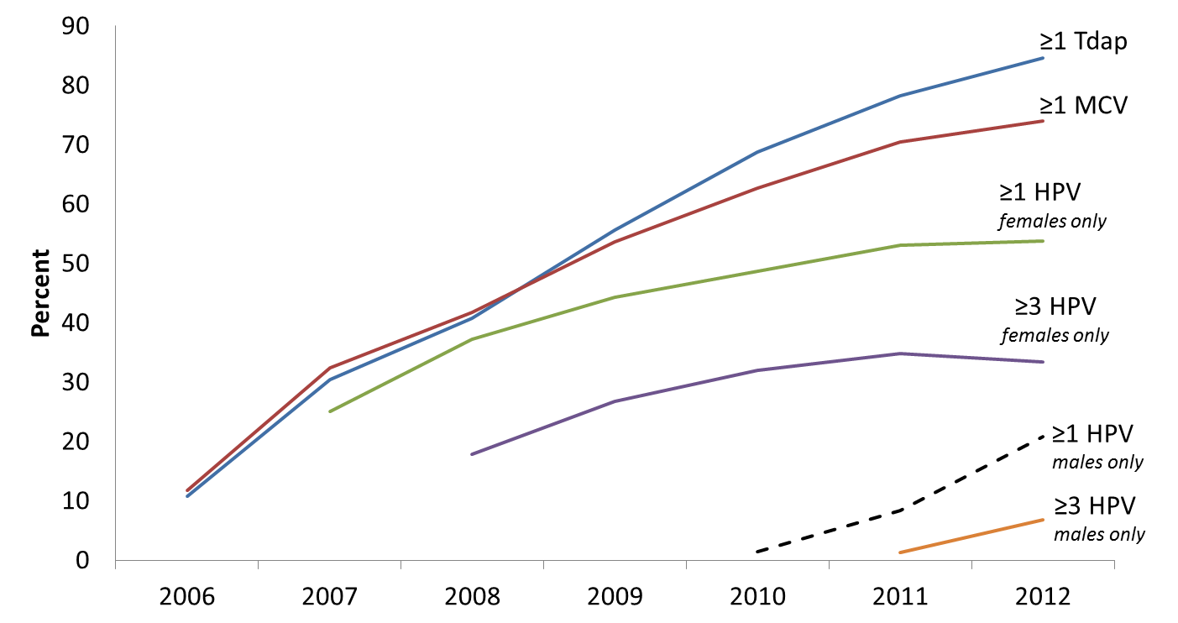
Adolescent Vaccine (13-17 Years Old),
United States, 2006-2012
Centers for Disease Control and Prevention. National and State Vaccination Coverage Among Adolescents Aged 13–17 Years — United States, 2012. MMWR. 2013;62(34);685-693; NIS-Teen
Notes:
29

