Slide 1
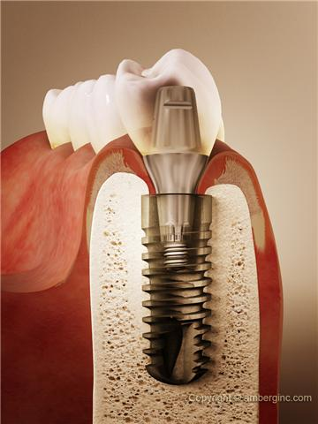
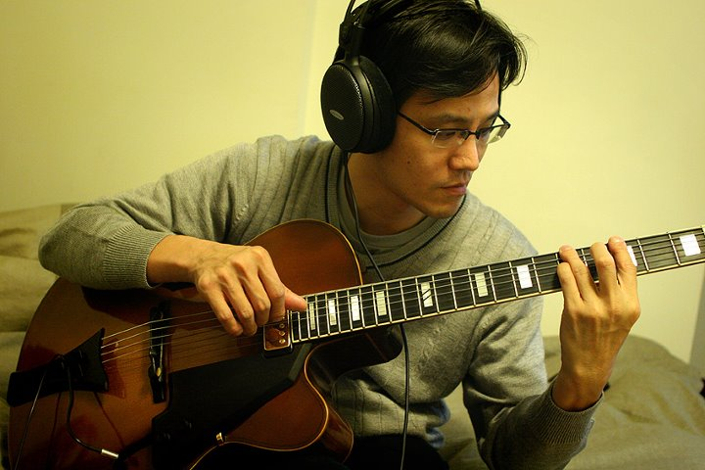
Intra-maxillary Drug delivery and Bio-sensing via Dental Implant and its considerations
Li, Yu-Jung
Lecturer of Anatomy, Physiology, and Pathology, St. Mary’s Junior College of Medicine, Nursing, and Management, Taiwan
2016. 07. 23
Doctoral Candidate, Institute of Electronic and Mechanical
Engineering, National Taipei University of Technology
Master of chemistry, Tamkang University
Master of biophysics, National Central University
Master of clinical dentistry, National Yang-Ming University
Training of oral and maxillofacial surgery
in Taipei Veterans General Hospital

Slide 3
Table of Content
Motivation: Current situations
Design: (1) Drug delivery module
(2) Bio-sensing module
Experimental results:
(1) Glucose monitoring
(2) Molecular pumping and delivery
(3) Canine model for insulin therapy
Discussions & Special considerations:
(1) Engineering
(2) Medical
(3) Dental

Slide 4
Current situation
Introduction
Geriatrics: The aging population as people > 65 years in Taiwan has reached to 10.7% in 2010, and will approach to 20.1% in 2025
Geriatrics: (1) Dentistry, (2) Critical + Chronic care
Medical monitoring and therapeutics:
(1) Non-invasive: BP, HR, RR monitoring + Oral tab
(2) Invasive (A) Blood monitoring + (B) Injections into blood
Diabetes Mellitus (DM):
(1) Triad: DM + CAD + Renal disease
(2) MDII: (4 One-touch blood sugar + 4 insulin injections) / Day
IVII: (12 One-touch blood sugar + 12 insulin injections) / Day
Pain origins from invasive procedures:
Drug Blood
(Macromolecule: cannot pass through GI tract)
(1) Mucosal + (2) dermal barriers
Proteins, functional polymers, etc.

Slide 5
Current situation
Introduction
Geriatrics: The aging population as people > 65 years in Taiwan has reached to 10.7% in 2010, and will approach to 20.1% in 2025
Geriatrics: (1) Dentistry, (2) Critical + Chronic care
Medical managements:
(1) Non-invasive
(2) Invasive (A) Blood monitoring + (B) Injections into blood
Diabetes Mellitus (DM):
(1) Triad: DM + CAD + Renal disease
(2) MDII: (4 One-touch blood sugar + 4 insulin injections) / Day
IVII: (12 One-touch blood sugar + 12 insulin injections) / Day
Pain origins from invasive procedures:
Drug Blood
Thinking about molecular delivery
in dentistry ?
(1) Mucosal + (2) dermal barriers

Slide 6
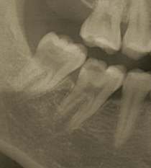
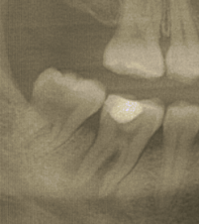
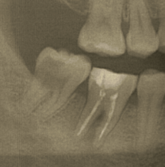
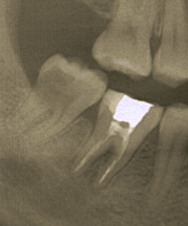
Intra-bony molecular slowly releasing: calcium hydroxide/iodoform paste (Vitapex ®) Application
2012. 10. 22
#46: Deep caries
s/p reversible pulpitis
IRM indirect capping
2015. 01. 16
#46: Apical lesion
s/p pulpitis; Pus (+)
Endodontic treatment
2015. 07. 16
#46: Apical lesion
s/p pulpitis; Pus (-)
Calcium hydroxide RCT
2016. 01. 26
#46: Apical lesion
s/p pulpitis; Pus (-)
New bone formation
38 Y/O male, Personal History: Smoking(+), Past history: Nil

Slide 7
Intra-bony molecular slowly releasing: calcium hydroxide/iodoform paste (Vitapex ®) Application
2012. 10. 22
#46: Deep caries
s/p reversible pulpitis
IRM indirect capping
2015. 01. 16
#46: Apical lesion
s/p pulpitis; Pus (+)
Root canal treatment
2015. 07. 16
#46: Apical lesion
s/p pulpitis; Pus (-)
Calcium hydroxide RCT
2016. 01. 26
#46: Apical lesion
s/p pulpitis; Pus (-)
New bone formation
Notice: Periodontal ligament (PDL) exists, Patient felt mild pain as paste delivery
Hint: For dentists, intra-bony molecular delivery is more than possible, or even familiar

Slide 8
Table of Content
Motivation: Current situations
Design: (1) Drug delivery module
(2) Bio-sensing module
Experimental results:
(1) Glucose monitoring
(2) Molecular pumping and delivery
(3) Canine model for insulin therapy
Discussions & Special considerations:
(1) Engineering
(2) Medical
(3) Dental

Slide 9
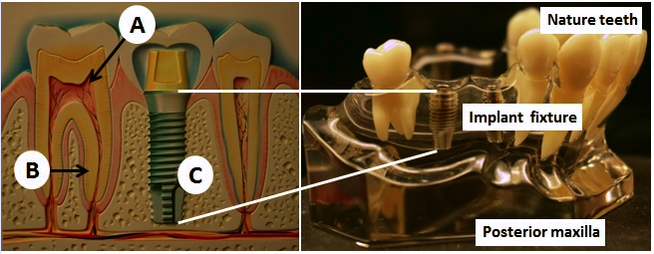
Dental implant & Pain origins
Introduction
Traditional pain origins: (A) Pulp, (B) Periodontal ligament (PDL) (C) Dental implant
Bone quality: Maxilla: Type III + Type IV Rich of bone marrow within blood pool
Mandible: Type I + type II
1. Cushion for injections 2. Avoid from thrombosis
Bicon® Implant system: Absence of screw threads between:
(A) prosthetic abutment (B) Implant fixture
4. Implant supported (1) Drug delivery module, and (2) Biosensor module

Slide 10
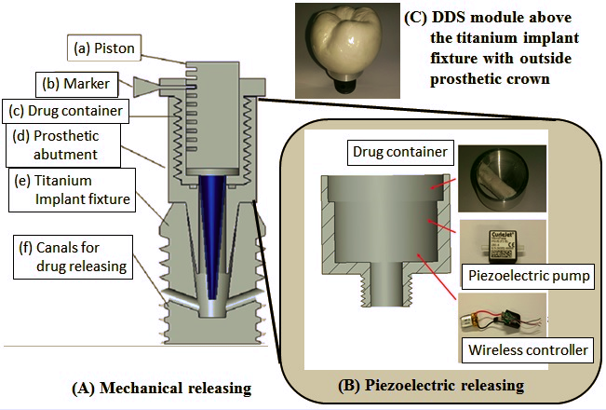
(1) Drug delivery module
Design

Slide 11
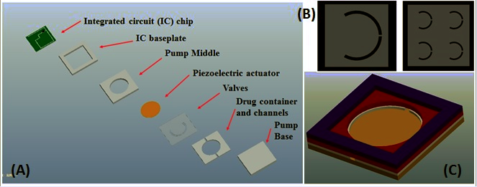
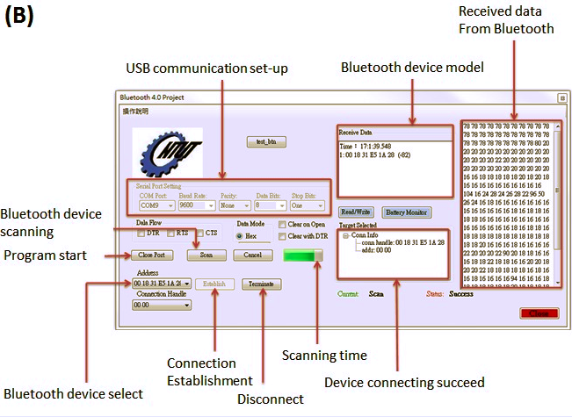
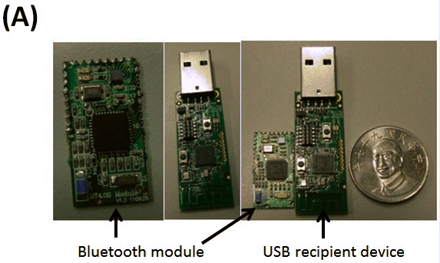
Piezoelectric micro-pump design & Bluetooth 4.0
Design
Structure of the piezoelectric
pump including valves inside
Bluetooth 4.0 module with
Software interface by C++

Slide 12
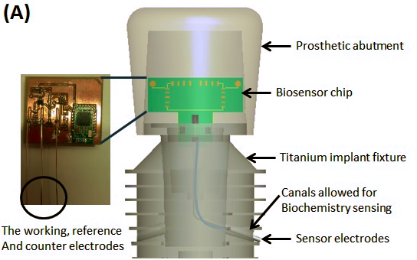
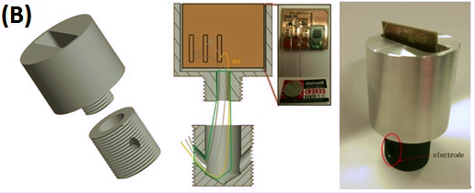
(2) Biosensor module
Design
Biosensor placed inside the
Prosthetic abutment, including:
Sensor IC
Bluetooth module
Power supply
Extend electrodes
Then the set of the electrodes
Extent outside the fixture by the
canals, including:
Working electrode
Counter electrode
Reference electrode

Slide 13
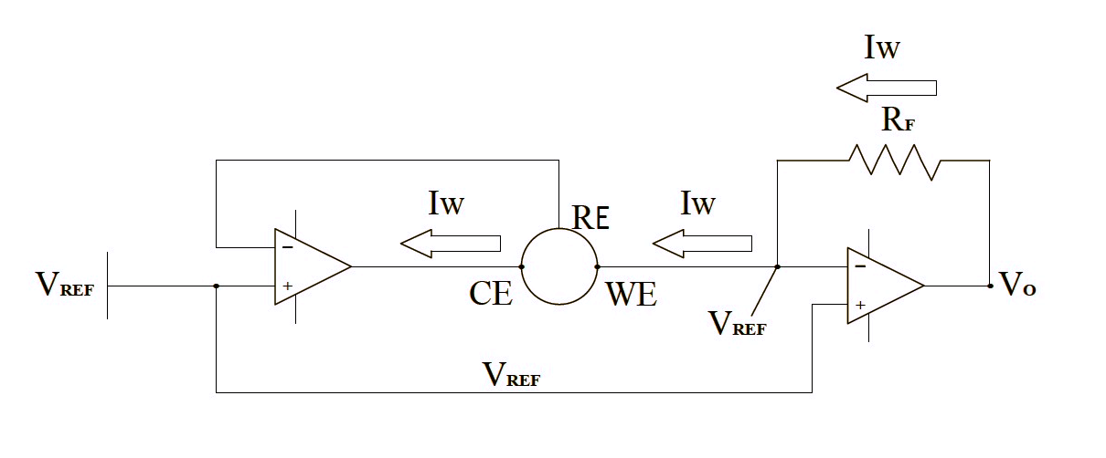
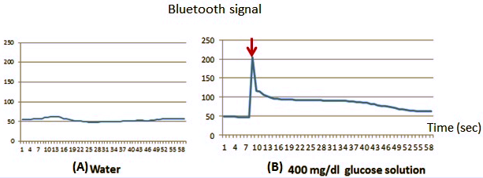
Glucose oxidase (GOD) coating & circuit design
Design
GOD coated over working electrode
for blood sugar sensing.
The current may change
Corresponding to the
Glucose concentrations.
The current changes are recorded
By the bluetooth 4.0 module.
And then they are transferred to
outside portable device, such as
computers or cell phones.

Slide 14
Table of Content
Motivation: Current situations
Design: (1) Drug delivery module
(2) Bio-sensing module
Experimental results:
(1) Glucose monitoring
(2) Molecular pumping and delivery
(3) Canine model for insulin therapy
Discussions & Special considerations:
(1) Engineering
(2) Medical
(3) Dental

Slide 15
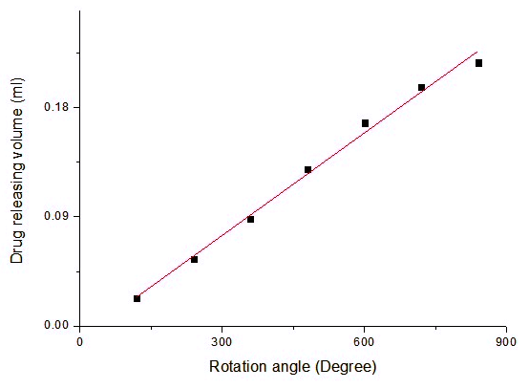
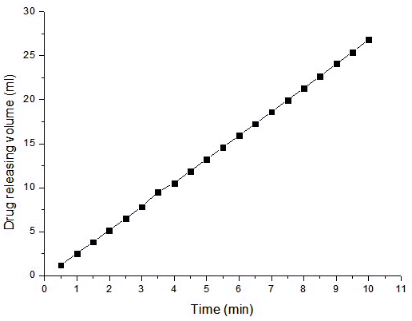
Drug delivery exp.
Preliminary result
(A) Mechanical drug delivery module (B) Piezoelectric drug delivery module

Slide 16
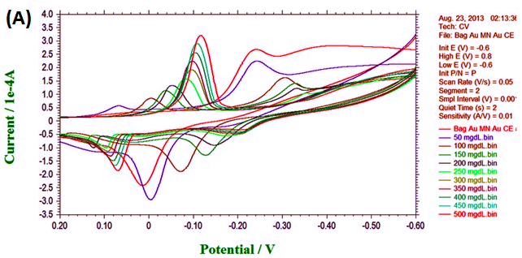
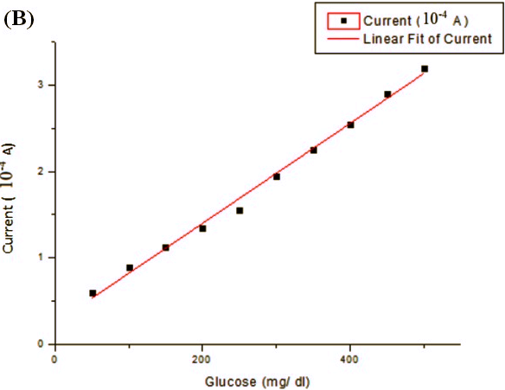
Bio-sensing exp.
Preliminary result
The cyclic voltammetry by different
glucose concentration, sweeping
From 0.2 to -0.6 V:
From 50 mg/dL to 500 mg/dL.
Peak value recorded and shows
highly linearity, with 4 mg/dL
increasing will elevate 1 μA of
the current.

Slide 17
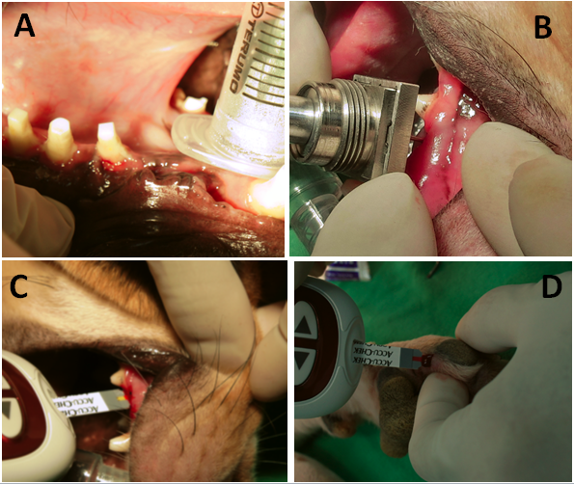
Preliminary canine study
Preliminary result
Canine model: After 1 month of osseointegration, 2nd stage surgical exposure
arranged to link the drug delivery and biosensing module. The blood sugar is
monitored over intra-oral biosensor and lower limb calibration.

Slide 18
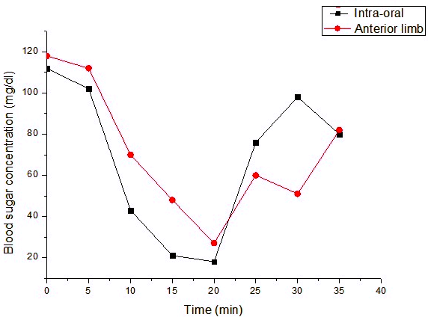
Preliminary canine study
Preliminary result
Initially 5 unit of the NPH (rapid onset insulin) is performed. Then the blood sugar is
monitoring every 5 minute from both intra-oral biosensing module and anterior lower
Limbs for calibrations. Blood sugar debonding at 25th minute may be due to glucagon
Releasing.

Slide 19
Table of Content
Motivation: Current situations
Design: (1) Drug delivery module
(2) Bio-sensing module
Experimental results:
(1) Glucose monitoring
(2) Molecular pumping and delivery
(3) Canine model for insulin therapy
Discussions & Special considerations:
(1) Engineering
(2) Medical
(3) Dental

Slide 20
Discussions
Discussions
Other invasive drug delivery device:
(1) Short-period (<2 wks): Central Venus Catheter (CVC)
(2) Long-term: Port-A-Catheter, dental implant supported DDS module
Advantages of the implant supported DDS and biosensor module:
(1) Relative painless during drug delivery ( vs CVP + Port-A )
(2) Fixed by surrounding bone, avoid from component loosening, and
internal bleeding ( vs Port-A )
(3) Non-invasive while drug reloading & module replaced (semi-implanted)
(4) Lead to creative drug releasing and bio-sensing therapy:
low volume and continuous ( drug releasing + blood monitoring )
(5) Free from thrombolism: Surrounding bone marrow structures
Diabetes Mellitus (DM):
As target disease due to frequently invasive therapy demanded.
(1) Biosensor: 4 mg/dL (+) lead to 1 μA increasing
(2) Drug releasing: 0.5 ml contains 5000 units insulin, meet 2 months demands
Myocardiac infarction (MI): CK, CKMB + troponin I continuous monitoring /5 min
lasting for 1-2 months

Slide 21
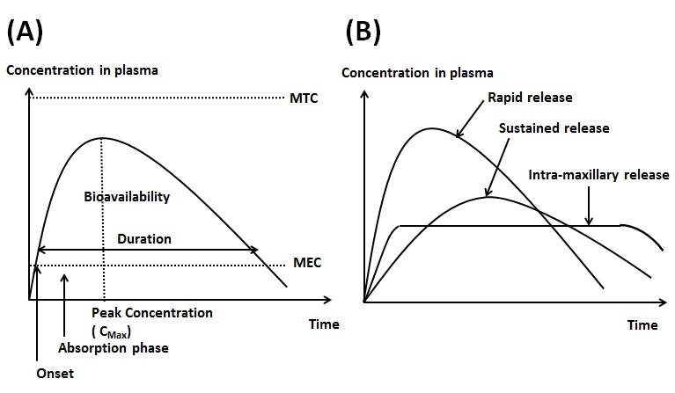
Discussions
Discussions
Restricts and constrains in implant supported DDS and biosensor module:
(1) Drug delivery type, volume, and speed is restricted
(2) It is limited for patient with frequently invasive procedure demands
(3) Dental and medical cooperation is needed to ensure safety & efficiency
(4) Frequently dental appointments for device debridement & drug reload
Further improvement:
(1) Module size & volume minimizing for practical applications
(2) Enzyme polymerization & improvement for long-term blood monitoring
(3) Accuracy improvement over IC design for further applications
(4) Safety concern: drug polymerization during releasing
(5) Pain evaluation experiments design

Slide 22
Special considerations
Discussions
Engineering
(Blood sugar)
(CK, CKMB)
Accuracy in monitoring: From mg/dl ng/dl, about 10⁻⁶ degree
Component sealing: Avoid infection status
Size minimization: CMOS + MEMS technology
+
Medical
Painless
Non-invasive
Continuous macromolecular delivery
Frequently blood monitoring
Geriatrics:
(1) Neurodegenerative disorders: 1. Alzheimer's 2. Parkinson’s disease
(2) Metabolic disorder: Diabetes mellitus
(3) Cardiovascular disease: Continuous CK + CKMB monitoring
Dental
Avoid from:
(1) Periodontitis: Remove infective status
(2) Excessive occlusal loading: Medical purpose
(3) Osseointegrative destructions: Combined + selective releasing
Calcium hydroxide + iodoform

Slide 23
Acknowledgements
Special thanks to Prof. Chih-Cheng Lu of National Taipei University of Technology and his advanced microsystem and device laboratory for the technological support. Valuable assistance from Prof. Jung-Tang Huang of National Taipei University of Technology is also acknowledged. This research received financial support under grants MOST 103-2221-E-027-017 and MOST 103-2218-E-027-012, Taiwan.
Reference
Lu, C.C.; Li, Y.J.; Tsai, W.L.; Chang, C.K. An implantable and painless drug delivery device for long-term operation. Taiwan Patent I488620, 21, June, 2015.
Sandeep, K.; Joakim, L. Measuring bluetooth® low energy power consumption. In Application note AN092; Texas Instruments: Dallas, TX, USA, 2012.
Li, D.; He, Q.; Cui, Y.; Duan, L.; Li, J. Immobilization of glucose oxidase onto nanoparticles with enhanced thermostability. Biochem. Biophys. Res.Commun. 2007, 355, 488–493.
Joseph, W. Glucose biosensors: 40 years of advances and challenges. Electroanalysis. 2001, 13, 983–988.
Laser, D. Santiago, J. A review of micropumps. J. micromechanics and microengineering. 2004, 35-64.

Slide 24
Mucosa VS. Skin
Discussions
Moist environment: Saliva flow contain bacteria retain
( Accumulation )
Saliva decrease ( Radiotherapy origin, etc. ) Dental caries, periodontitis
Provide possibility for long-term medical device placement (ex: dental implant)
Mucosal loaction: (1) Nasal, (2) Oral, (3) Anal, (4) Vaginal, (5) Urethra
Jaw bone supported
The biggest cavity
Well studied in Dental implant
Thrombosis prevention inside bone marrow
Antibody
Blood cells

Slide 25
(A)
Prosthetic abutment
Within micro-pump
Dialysis chamber
Implant fixture
Y
Semi-permeable
membrane
Y Y Y Y Y Y Y Y Y Y Y Y Y Y Y Y
Antibody
Y
Y
Blood flow
Y
Y
Y Y Y Y Y Y Y Y Y Y Y Y Y Y Y Y
Coated antigen
Y
Red blood cell

Slide 26
(B)
Dialysis chamber
Coated antigen
Semi-permeable
membrane

Slide 27
(C)
(1) Antibody trapping: SLE
Y
(2) Molecular trapping: Amyloidosis
Y Y Y Y Y Y Y Y Y Y Y Y Y Y Y Y Y Y Y Y Y Y Y Y Y Y Y Y Y Y Y Y Y Y Y
(3) Cellular trapping
Y Y Y Y Y Y Y Y Y Y Y

