Slide 1
HOW TO PLAN PUBLIC HEALTH SERVICES
?
EXPERIENCE WITH AN ECONOMIC FEASIBILITY STUDY FROM THE SLOVAK ARMED FORCES
CPT Peter LETANOVSKY, Dr. Michaela MACHAJOVA
Notes:
Dear Mr. Chairman, Ladies and Gentlemen, I would like to thank you for this opportunity. It is pleasure an honor for me. I would like to give you my personal experience with public health planning process which used specific tool.

Slide 2
WHAT A PROBLEM?
How to provide an occupational health service for 25 000 employees?
Notes:
The main problem was based on new occupational health and safety act which adopted new rules for occupational health services. The new act brought stronger accent on this services which has been implemented at every workplace. This brought question how to do it and how much it cost.

Slide 3
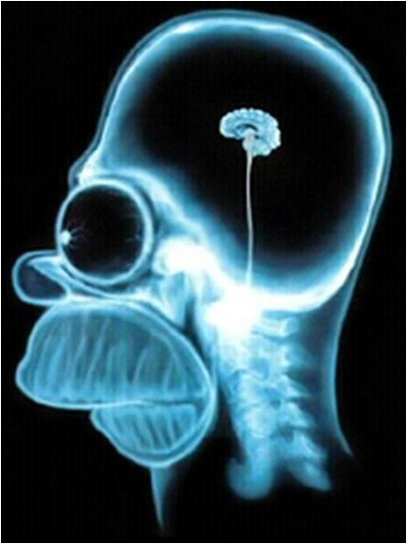
SOLUTION?
An economic feasibility study of course...
What is it?
Is it suitable for public health?
How can we do feasibility study?
Notes:
An economic feasibility study of course. But we had to answer on a few basic questions before work began. These questions were:
What is it feasibility study?
Is it suitable for public health?
And if yes, how can we do feasibility study for public health?
And of course who is able to do the study? Is it public health professional or economist or who?

Slide 4
FEASIBILITY STUDY
Many different types of feasibility studies are known
Common tool in business but rare in public health
Comes from industry
Notes:
Description of an economic feasibility study in general contains positive economic benefits to an organization and economic assessment which typically involves cost/benefits analysis. This type of studies is commonly used in business but they are rare in the field of public health. The whole concept of a feasibility study comes from industry and most notable paper is written by Behrens and Hawranek, which was published first time 1991 by UNIDO.

Slide 5
IN PUBLIC HEALTH...
Tailored for specific health policy
Health risk assessment and economic analysis
Abilities of public health professionals in specific fields of study
Notes:
What are the specific tasks of an economic feasibility study in the field of public health? The study has to be tailored for specific health policy or mission. The most important parts of the study are health risk assessment and economic analysis. If a public health professional wants to prepare the study he or she will be able to transform results from risk assessment to economics' parameters, which are cost and values mainly but not only, because health is not only an economic category in the state's statistics about GDP's and things like that.

Slide 6
STUDY DESIGN
SUPPORT or
FUNCTIONAL STUDIES
S
T
A
R
T
EXTRAMURAL ENVIRONMENT ASSESSMENT
INTERNAL ENVIRONMENT ASSESSMENT
GOALS AND FUNCTIONS OF HEALTH SERVICE
STRATEGIES HOW TO REACH GOALS
E
N
D
Notes:
Our study was prepared in 2008 and in 2014 follow up was done. The study contains huge amount of information. This is the reason why only basic design of the study is presented.
The chapter EEA contains information about national and international regulations or about health care and occupational health care providers.
The chapter IEA contains information about workers, health risks, the military health service and its capabilities in the field of occupational health.
The chapter GaFHS contains model of the occupational health service and time bound.
The chapter SHTRG contains information about strategies, their cost/benefit analyses, procedures how the strategies were judged, criteria for decision making process and assessment of the current situation and perspective which were done by SWOT analysis and Force field analysis.
Very important parts of the study were SUPPORT STUDIES please make a note about that in your memory.

Slide 7
MAIN OUTPUTS
Better understanding of workers' health
Feedback about cost effectiveness of health service
Strategies for middle and long-term planning
New knowledge for planning processes
Notes:
First main output is better understanding of health of workers and occupational hazards and risks. Second output is that a study gives you information and feedback about cost effectiveness of your health service and its functions. A study generates strategies for middle and long-term planning of health service because as we now health services are services which are planned for many years. New knowledge for planning processes with other military services for health promotion and health investments or intersectoral cooperation in general.

Slide 8
SUPPORT STUDIES
The marketing survey of occupational health services providers in Slovakia
The occupational risk assessment report
The support study about human resources
Notes:
If you remember the figure which shows study design on the right corner of the slide there was a blue box which name is „SUPPORT or FUNCTIONAL STUDIES“ Support or functional studies cover specific aspects of an investment project and are required as prerequisites for or in support of feasibility study. Under the light of our feasibility study these support studies were done:
-----------.
Health status, occupational diseases and injuries are involved.
This support study contains information about which human resources are available in the army and in the labour market and which are demanded in the light of the strategies which are generated in our feasibility study.

Slide 9
KEY MESSAGES
!
Notes:
And what are the key messages from our feasibility study which should be useable for my colleague?

Slide 10
“An economic feasibility study is tool which is very good suitable in the field of public health services“
“Transformation of epidemiological data helps to a decision maker makes decisions which promote health and provides good arguments why do investments of public or private sources to health“
“Decisions about public’s health often make people who are not health professionals (but they are owners of the money) in an environment where health has very low priority“
Notes:
I would like to give you only these three messages.

Slide 11
IS THIS THE END
?
Notes:
Of course not

Slide 12
FIVE YEARS FOLLOW UP...
The financial resources was cut down
The resource planning was done under the light of study
The occupational health service works
Notes:
After five years the follow up was done. Here are the most important results of our follow up. The financial resources were cut down because of changes which were done on national level I am talking about national occupational health and safety act. The results of the Cost - Benefit Analysis, the SWOT Analysis and the Force Field Analysis were confirmed. The resource planning was done under the light of study but the best strategy hasn't been implemented. But we anticipated these factors in the force field analysis because operation of health systems is planned for many years not only for short term period. For employer an occupational health service is “only economic and administrative weight”. The occupational health service works and main interest of the service have employees who work in high risk workplaces and the OHS is bought by the contract with military hospital.

Slide 13
THANK YOU FOR YOUR ATTENTION
peter.letanovsky@gmail.com

