Slide 1
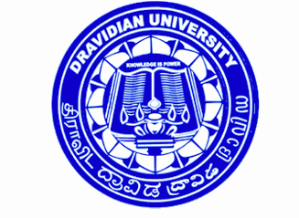
EVALUATION OF ANTI-DIABETIC PROPERTIES OF THE COMPOUNDS ISOLATED FROM MARINE MACROALGAE
Research Supervisor
Dr. Lokanatha Valluru
Assistant Professor
Research Scholar
R Lavanya
Department of Biotechnology
School of Herbal Studies and Naturo Sciences
Dravidian University
KUPPAM-517 426

Slide 2
INTRODUCTION
Diabetes is a disorder of metabolic causing excessive thirst and
production of large urine
Diabetes
Diabetes inspidus
(caused due to deficiency of vaopressin harmone)
Diabetes mellitus (DM)(caused due to insulin deficiency)
Type-1 Diabetes mellitus (IDDM)
Type-2 Diabetes mellitus (NIDDM)
Gestational diabetes (occurs during pregnancy)
Subtype-1A (immune mediated) DM
Maturity onset diabetes (MOD)
Subtype-2A (idiopathic) DM
Latent autoimmune diabetes of adults (LADA)

Slide 3
DIABETES MELLITUS
Diabetes mellitus is a chronic metabolic disorder to the man kind related to:
- Abnormal insulin production, or
- Impaired insulin utilization, or
- Both of the above
Leading cause of heart disease, stroke, adult blindness, and non-traumatic
lower limb amputations
Above 360 million people world wide, 66.3 million people in India were
suffering with DM because of over nutrition and sedentary life style.
(Himanshu et al., 2014; Nandakesav et al., 2015).
Even though there was tremendous development in modern medicine,
management of diabetes without any side effects is still challenge to medical
systems.
WHO expert committee recommended the traditional medicine and their
activity in bringing control on uncontrolled glycemic and other disorders
implicated in the diabetes.

Slide 4
MARINE MACROALGAE
Marine macroalgae have been used as drug source in folk medicine.
They are the producers of the oceans that have the unique ability to
with stand salt- triggered oxidative stress conditions, without any
oxidative damage in their structural components.
It was reported that the Polysaccharides, glycolipids, small molecular
weight bioactives, and phenolic components in these marine flora
were found to competitively inhibit metabolic activities in an
oxidative stress induced diabetic reactions, resulting in increased
production of insulin.
Marine macroalgae compounds were obtained from Dr. Kajal
Chakraborty labs, Central Marine Fisheries Research Institute,
Cochin, Kerala, India.

Slide 5
OBJECTIVES
To evaluate and screen various extracts of marine macroalgae for natural bioactive compounds for stress induced Diabetes mellitus with following objectives.
To collect and screen various bioactive extracts obtained from marine macroalgae on STZ induced diabetic rats.
To evaluate the anti-diabetic activity of the various bioactive extracts from marine macro algae.
To determine the effect of marine macroalgae bioactive extracts on anti-oxidant modulations during STZ-induced diabetes.

Slide 6
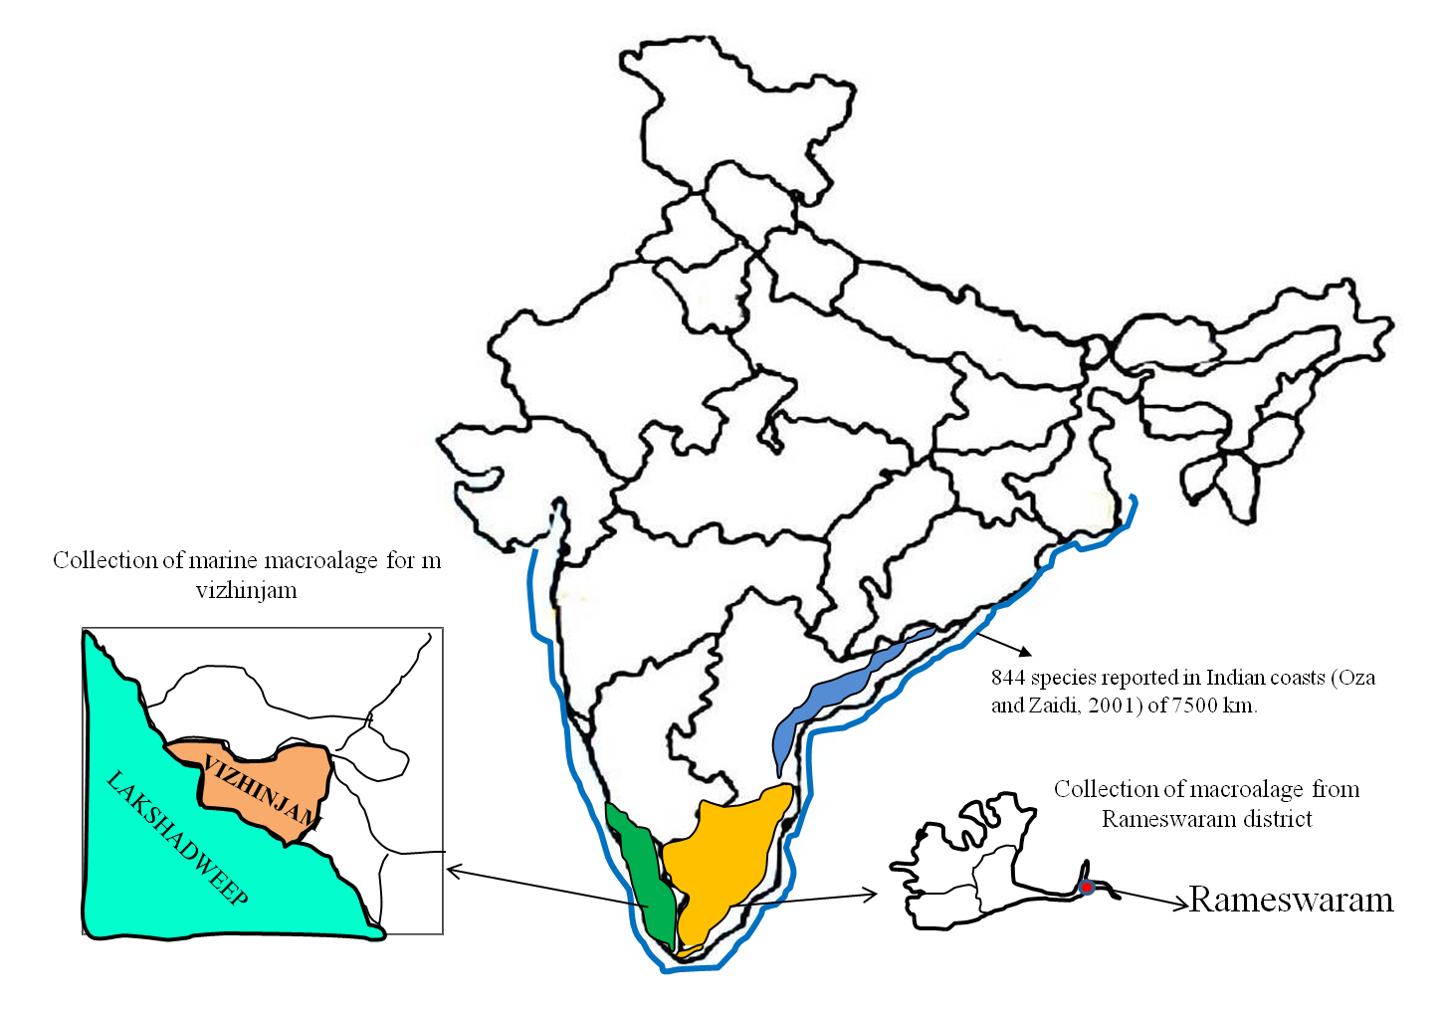
MATERIALS AND METHODS
Collection of marine macroalgae samples:

Slide 7
Solvent (methanol, ethanol) and aqueous extracts of red and brown seaweeds
Sample code | Genus name | Sample code | Genus name
Red seaweeds |  | Brown seaweeds
Aqueous extracts
FS4 | Gracillaria opuntia | PS1 | Turbinaria conoides
FS1 | Kappaphycus alverizii | A1 | Sargassam weightii
EM2 | Laurentia pailosa | A2 | Sargassam myriocystum
EM3 | Jania rubens | G1 | Padina gymnospora
FM1 | Kappaphycus alverizii | EM9 | Padina tetrastomatica
FM4 | Gracillaria opuntia | S3 | Turbinaria ornate
Methanolic extracts (MeOH)
F1 | Gracillaria opuntia | SF1 | Turbinaria conoides
K1 | Kappaphycus alverizii | PH1 | Sargassam weightii
MV1 | Laurentia pailosa | S2 | Sargassam myriocystum
MP1 | Jania rubens | F1 | Padina gymnospora
FS2 | Hypnea musciformis | S1 | Padina tetrastomatica
EM1 | Hypnea valentiae | S4 | Turbinaria ornate
Ethanolic extracts (MeOH)
FM2 | Gracillaria opuntia | S7 | Sargassum weightii
FM3 | Kappaphycus alverizii | AE3 | Turbunaria conoides
FS5 | Laurentia pailosa | SF | Sargassum myriocystum
 |  | S1 | Turbinaria ornate

Slide 8
Experimental design:
Experimental groups
Group-1 Normal control
Group-2
Diabetic control
Group-3
+ve control (STZ+Glibencalmide)
STZ+ marine macroalgae extracts (n=31)
Group-4
STZ+ marine macroalgae extracts (n=31)
STZ+conc. 125mg/Kg BW
Group-5
STZ+ marine macroalgae extracts (n=31)
STZ+conc. 175mg/Kg BW
The experiment was continued for 21 days

Slide 9
Estimation of Glucose levels by Accucheck method (Hugget and
Nixson, 1957)
Estimation of glycosylated hemoglobin by HbA1c assay (Karunanayake
and chandrasekar, 1985)
BIOCHEMICAL ANALYSIS
Assay of superoxide dismutase (SOD) by Misra and Fridovich, 1972
Assay of catalase (CAT) by Aebi and Packer, 1984
Assay of Glutathione Peroxidase (GPx) by Rotruck et al., 1973
Assay of Glutathione-S-Transferase (GST) by Habig et al., 1974
Estimation of Reduced glutathione (GSH) by Sedlak and Lindsay 1968
Assay of Lipid Peroxidase (LPx) by Hiroshi et al., 1979

Slide 10
RESULTS

Slide 12
After screening of 31 marine macroalgae extracts, five extracts (AE3, FS4, FM4, PH1 and SF1) has shown significant changes in blood glucose and HbA1c levels.
The perturbations of the anti-oxidant enzyme levels were studied by using the selected five potential extracts during STZ-induced diabetic rats.

Slide 13
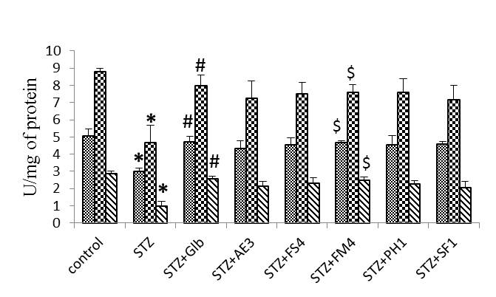
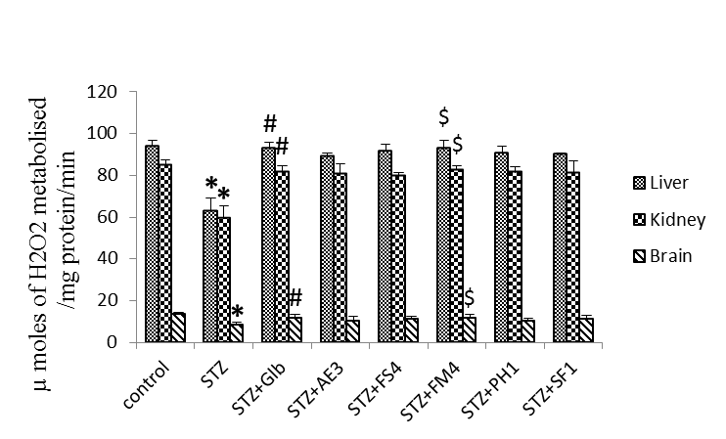
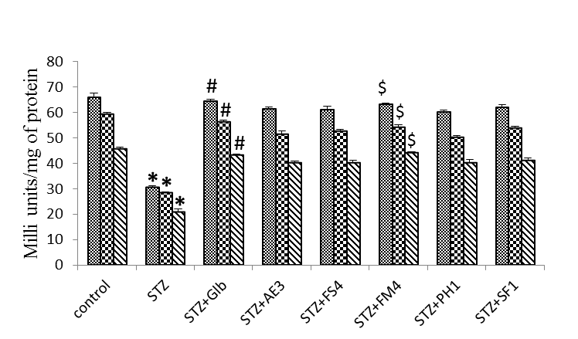
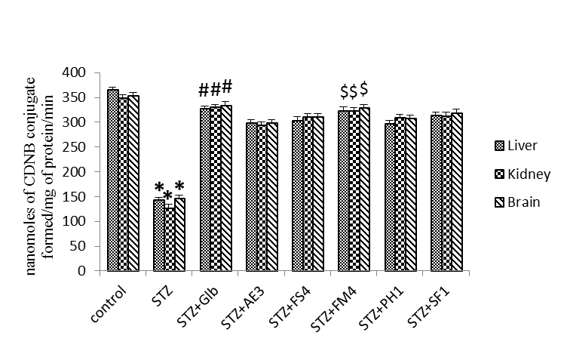
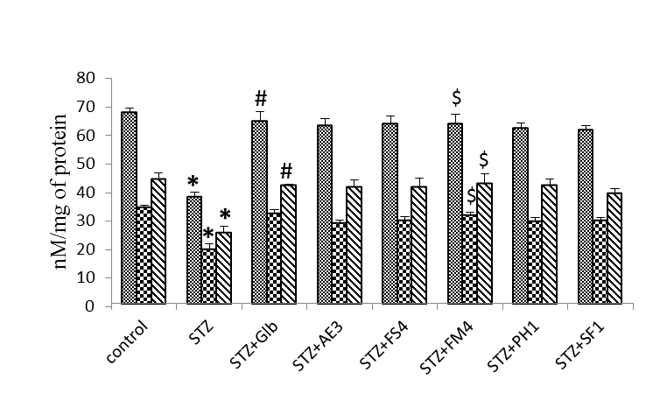
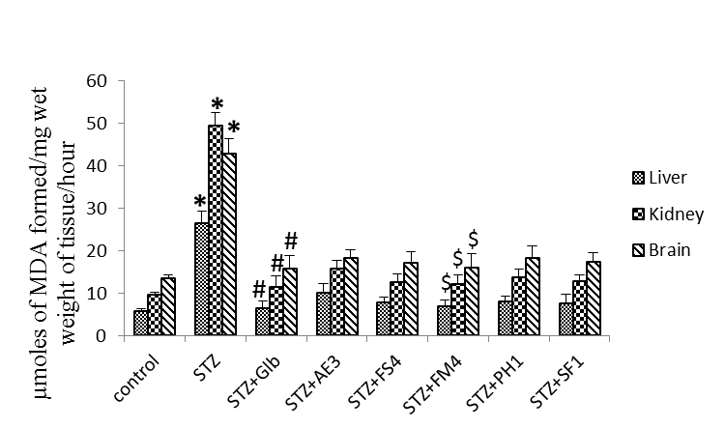
Antioxidant enzyme levels
SOD
CAT
GPx
GST
GSH
LPx

Slide 14
Based on the antioxidant enzyme activities, glucose, HbA1c levels and solubility of the extracts the results duly revealed that among five potential extracts G. opuntia (FM4) (aqueous) showed greater anti-diabetic properties.

Slide 15
CONCLUSION
Out of 31 marine macroalgae compounds the ethanolic extract of
T,conoides (AE3), methanolic extracts of S.weightii and T. conoides (PH1
and SF1), aqueous extract of G. Opuntia (FS4) and G. opuntia (FM4) have
significantly reduced the glucose, HbA1c and antioxidant enzymes
activity levels.
The crude extracts of marine macroalgae have capability of reducing the
diabetes and related oxidative stress.
Among the different marine macroalgae treatments, aqueous extracts of
G. opuntia (FM4) showed significantly greater anti-diabetic properties.

Slide 16
Acknowledgement
Authors R. Lavanya and Dr. Lokanatha Valluru, is highly thankful to DST- Science and Engineering Research Board (No.SR/S1/OC-96B/2013 Dt. 20.11.2013). Government of India, New Delhi, for providing financial assistance in the form of research grant.
We are also thankful to Dr. Kajal Chakraborty, CMFRI, Cochin for providing the marine macroalgae extracts.

