Slide 1
Nutritional support in early Alzheimer’s disease: what, why and when?
Laus Broersen, PhD
Senior Neuroscientist
Nutricia Research, Advanced Medical Nutrition
Utrecht, The Netherlands

Slide 2
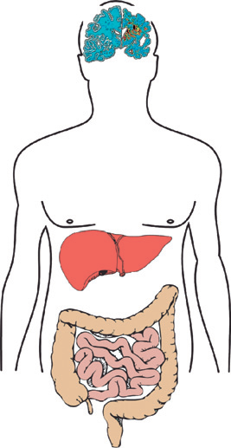
AD specific nutritional needs for membrane and synapse formation
1
AD-induced compromised nutrient availability
2
In AD a specific need exists to enhance synapse formation
A
Lower brain nutrient levels
A
Patients with AD show lower number of brain synapses
B
Lower blood nutrient levels
B
Patients with AD show lower level of neuronal membranes
C
Lower nutrient intake, uptake and metabolism
C
Membrane and synapse formation dependent on nutrient availability
3
AD specific nutrient requirement to meet the increased demand for synapse formation
4
Souvenaid addresses the nutritional need to support increased synapse formation in patients with AD

Slide 3
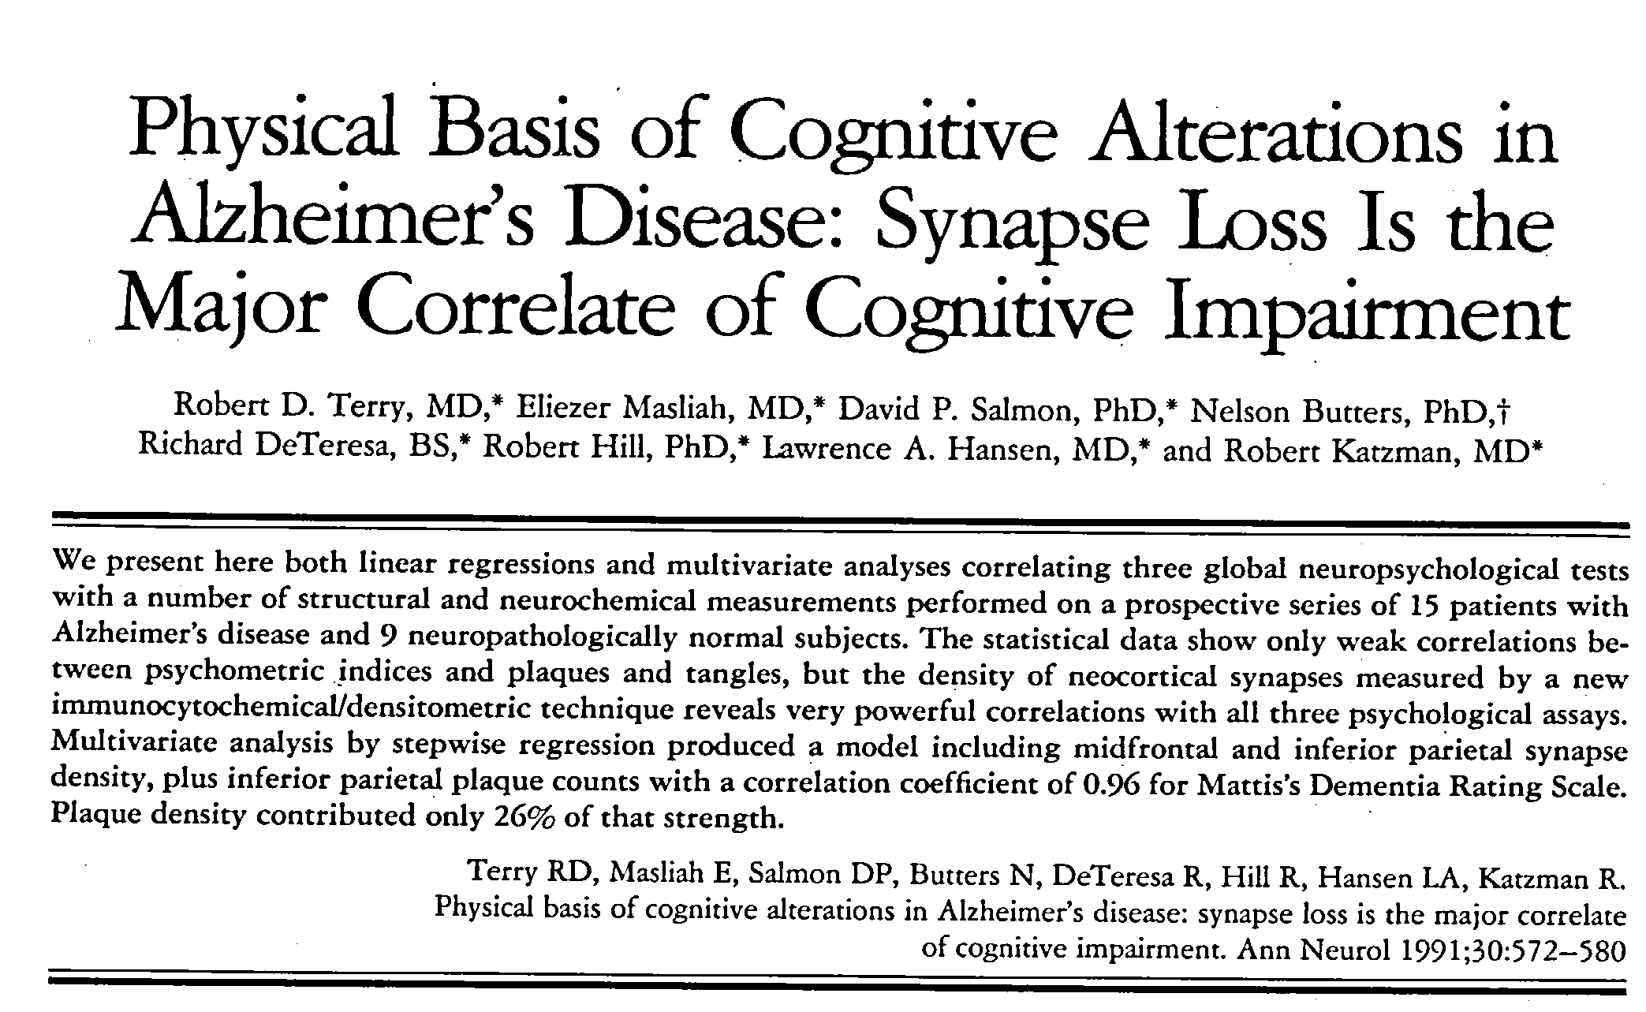
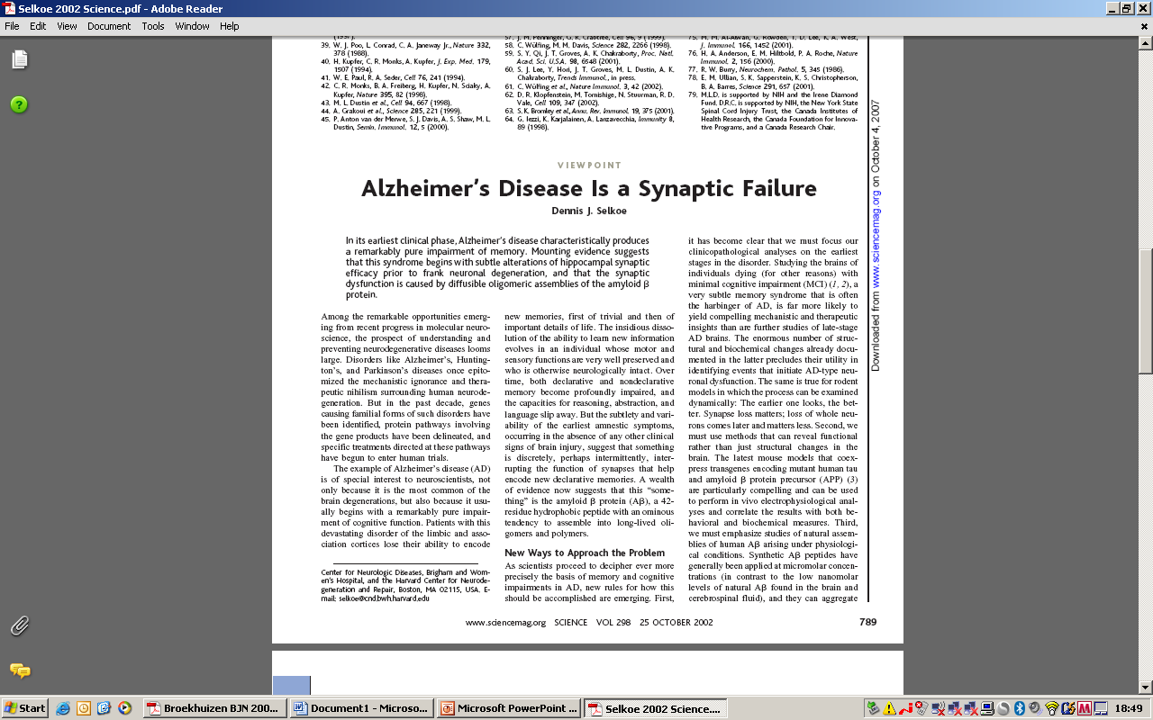
Synapse loss is structural basis of functional deficits in AD
Reduced number of synapses
*
10
# synapses dentate gyrus (x10¹⁰)
5
-13%
-44%
0
Control
MCI
AD
Synapse loss in AD is confirmed in >30 publications

Slide 4
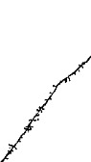
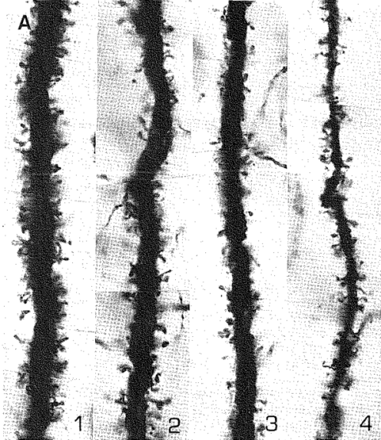
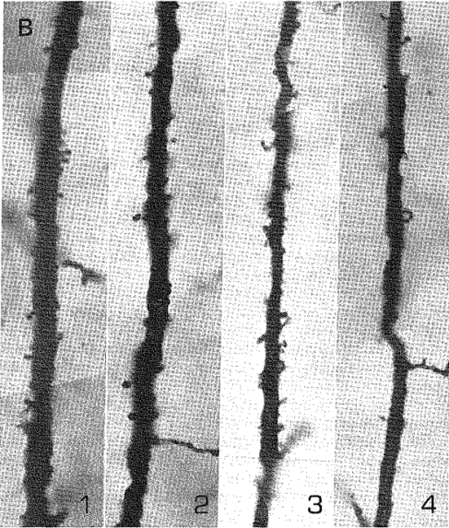
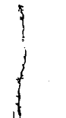
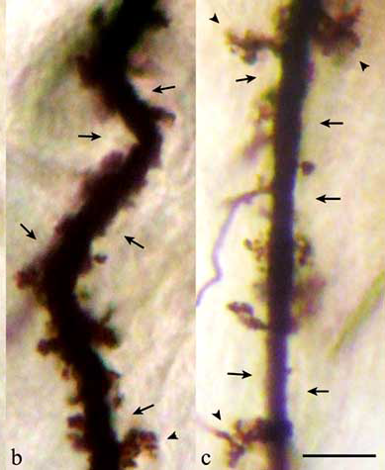
Loss of dendritic spines in AD
Control
AD
Control
AD
Control
AD
Control
AD
Catala et al (1988)
Hum Neurobiol
Einstein et al (1994)
J Neurosci
Mavroudis et al (2010)
Am J Alz Dis oth Dement
Tsamis et al (2010)
Curr Alzheim Res

Slide 5
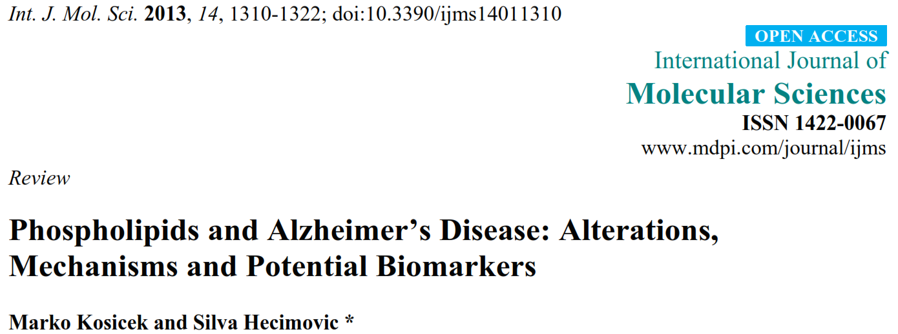
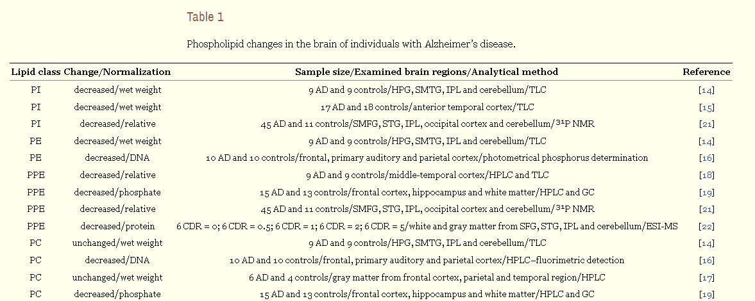
Decreased brain phospholipids in AD indicates disrupted membrane integrity
4. Conclusions
“… Phospholipids provide an optimal membrane environment for protein interactions, trafficking and function. There is increasing evidence that phospholipid changes occur during pathogenic processes in Alzheimer’s disease. …”
Notes:
Conclusion: Phospholipids provide an optimal membrane environment for protein interactions, trafficking and function. There is increasing evidence that phospholipid changes occur during pathogenic processes in Alzheimer’s disease.
Kosicek, M. and S. Hecimovic (2013). "Phospholipids and Alzheimer's disease: alterations, mechanisms and potential biomarkers." Int J Mol Sci 14(1): 1310-1322.
Brain is one of the richest organs in lipid content. Phospholipids (glycerophospholipids and sphingolipids) are important building blocks of cell membranes, which provide an optimal environment for protein interactions, trafficking and function. Because of that, alterations in their cellular levels could lead to different pathogenic processes in the brain, such as in Alzheimer's disease (AD), the most common type of dementia among older populations. There is increasing evidence that phospholipid changes occur during pathogenic processes in AD. It is known that lipids are tightly connected with metabolism of the Amyloid Precursor Protein (APP), which produces Amyloid-beta peptide (Abeta), the main component of senile plaques, which represent the main pathological hallmark of AD. However, the mechanism(s) of the lipid-effect on Abeta metabolism and AD pathogenesis is still not completely understood. This review summarizes the current knowledge on phospholipid changes occurring during normal aging and discusses phospholipid changes in the human brain associated with different stages of AD, as well changes in the cerebrospinal fluid and blood/plasma, which are interesting potential biomarkers for AD diagnosis and disease monitoring. At the end, we have discussed future perspectives of phospholipid changes as potential biomarkers and as targets for development of novel treatment strategies against AD.

Slide 6
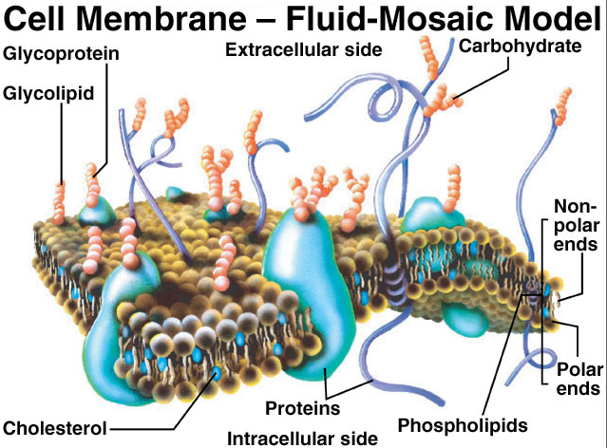
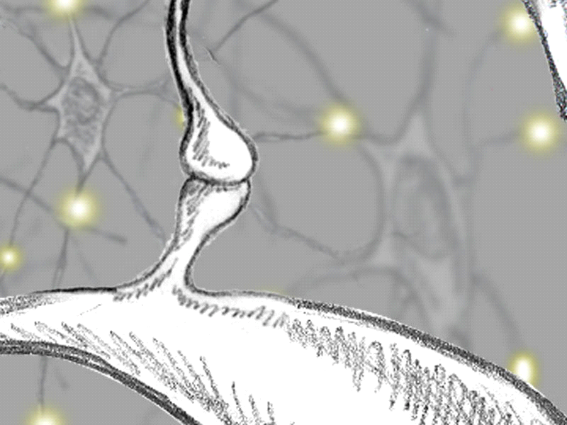
Dietary precursor control of neural membrane synthesis
The Kennedy pathway for biosynthesis of neuronal membrane
Membranes are main
constituents of synapses
Phospholipids
Choline
dendritic
Axon
terminal
spine
Uridine
Phosphocholine
Omega-3
fatty acids
neurite
Dendritic
spine
CDP-choline
Phosphatidylcholine
Axon
Neurite
New neuronal membrane
Notes:
As we know, the brain is not static: synaptic plasticity takes place. And for that, the brain needs synaptic membranes to be synthesized constantly.
For this, the brain uses a pathway shown on the left, that is called the Kennedy pathway. This pathway uses nutrients, dietary precursors, to make more membrane.
Importantly, this system is controled by low affinity enzymes, which means that by providing more precursors you get more endproduct: more synaptic membranes.
In addition, it means that you need a specific combination of nutrients for optimal membrane synthesis, and not single nutrients.

Slide 7
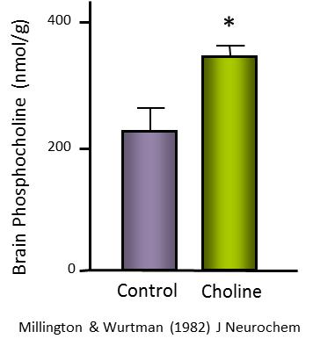
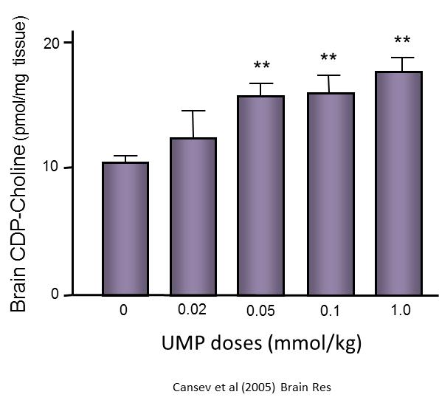
Dietary precursor control of neural membrane synthesis
The Kennedy pathway for biosynthesis neuronal membrane
Phospholipids
Choline
Uridine
Phosphocholine
Omega-3
fatty acids
CDP-choline
Phosphatidylcholine
New neuronal membrane
Kennedy & Weiss (1956) J Biol Chem
Notes:
Coming back to the Kennedy pathway, it is long known that giving more of the nutrient choline will increase phosphocholine in the brain,
However, giving only choline will produce a lot more membrane because of other rate-limiting steps, such as the one requiring the nucleotide uridine to make more CDP-choline.
Finaly, for going from CDP-choline to phospatidylcholine, you need specific polyunsaturated fatty acids, such as DHA, found in fish oil.

Slide 8

Dietary precursors can be rate-limiting:
Synergy between dietary precursors
***
120
100
*
80
Brain phospholipids (PE) (nmol/mg protein)
60
40
20
0
Control
UMP
DHA
UMP
DHA
Wurtman et al (2005, 2006) Brain Res
Notes:
So you need precursors to increase the synthesis of membranes. But, importantly, you need to give them all; otherwise one may become rate-limiting.
Indeed, in a series of experiments performed at MIT, the three precursors, Uridine, DHA, and Choline, were shown to act in synergy to increase brain phospholipids.
Example: feeding animals with only uridine or DHA will give a small increase in brain PLs, but combined feeding gives a much bigger increase: a classical example of synergy. The nutrients work together as an orchestra.
Next question: will increased membrane synthesis also lead to more membrane-dependent structures: e.g. Neurites and dendritic spines

Slide 9
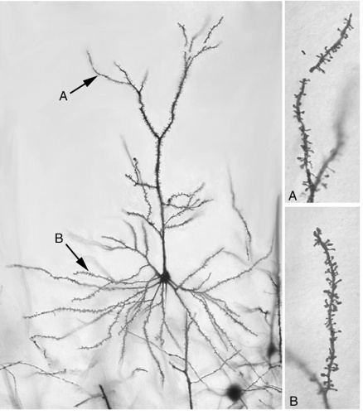
Dietary precursors increase membrane dominant structures: Dendritic spines
100
**
*
80
60
Spine Density hippocampus (for 50µM)
40
20
0
Control (choline)
UMP
DHA
UMP DHA
Sakamoto et al (2007) Brain Res
Notes:
Next it was shown that this also holds true for dendritic spines measured in vivo in the hippocampus. Again it was found that especially the combination of precursors increased dendritic spine density.

Slide 10
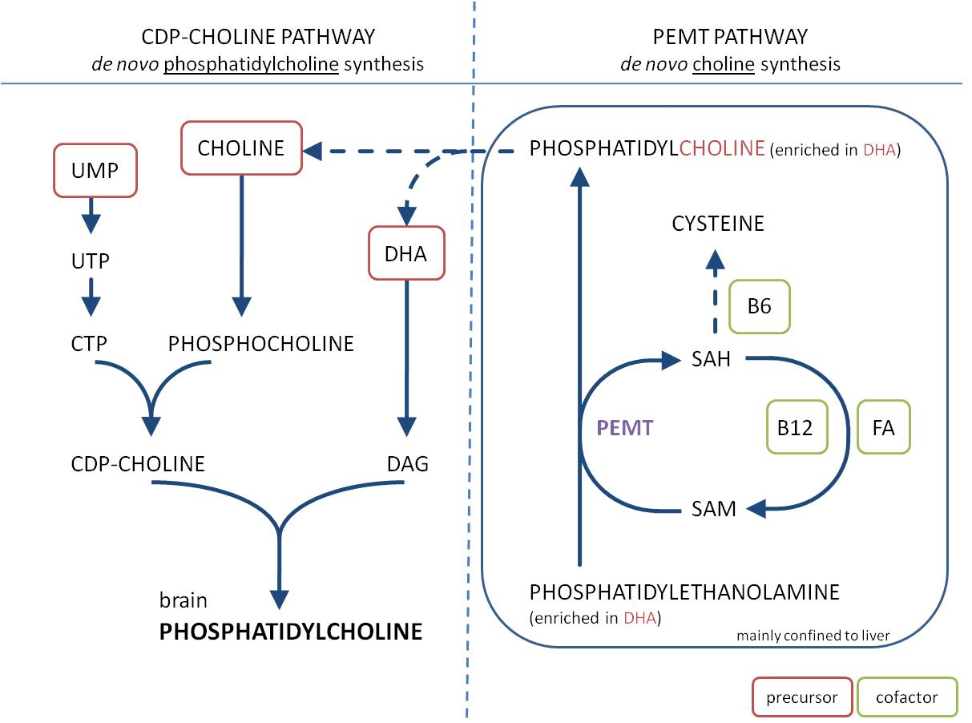
B-vitamins: cofactors for endogenous production of membrane precursors
PEMT = phosphatidylethanolamine-N-methyltransferase
Notes:
In order to stimulate membrane synthesis optimally, you not only need the precursors, but you also need so-called dietary cofactors, like B-vitamins.
B-vitamins 6, 12 and folic acid are crucial in the PEMT-pathway in the liver. By improving methylation-status, the B-vits help to increase the availability of Choline and DHA.

Slide 11
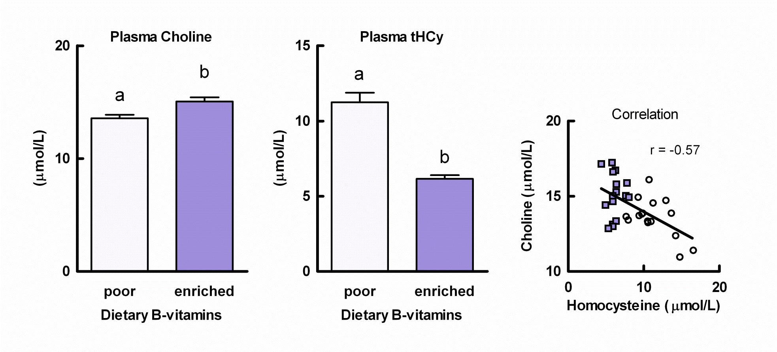
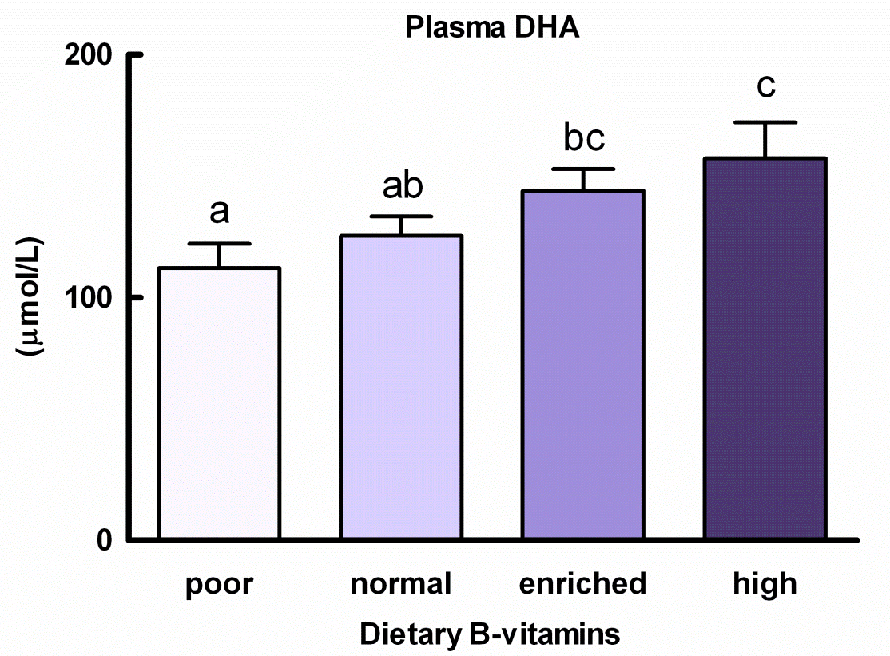
Precursor availability: B-vitamins increase plasma choline and DHA
B vitamins increase choline
B vitamins dose-dependently increase DHA
van Wijk et al (2011) Br J Nutr
van Wijk et al (2012) Nutr Metabol
Notes:
In separate experiments Van Wijk et al showed that supplementation of the 3 B-vitamins increased plasma choline and plasma DHA levels.
Do note that these diets did not contain DHA!

Slide 12
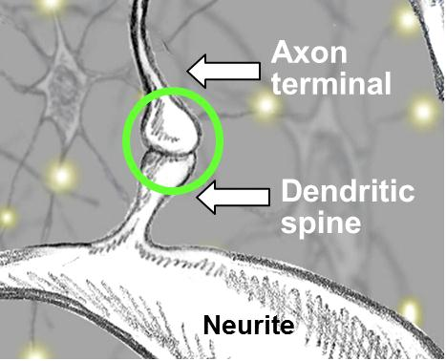
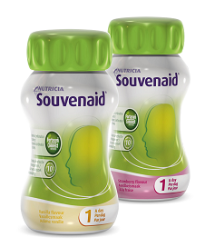
Nutritional precursors and cofactors: enhanced availability by Fortasyn Connect
Synapses are continuously being remodeled
Synapses are part of the neuronal membrane
Membranes consist of phospholipids
Phospholipid synthesis depends on the presence of uridine, choline and DHA
B-vitamins enhance precursor bioavailability
Antioxidants protect the neuronal membrane and maintain its integrity, stability and function

Slide 13
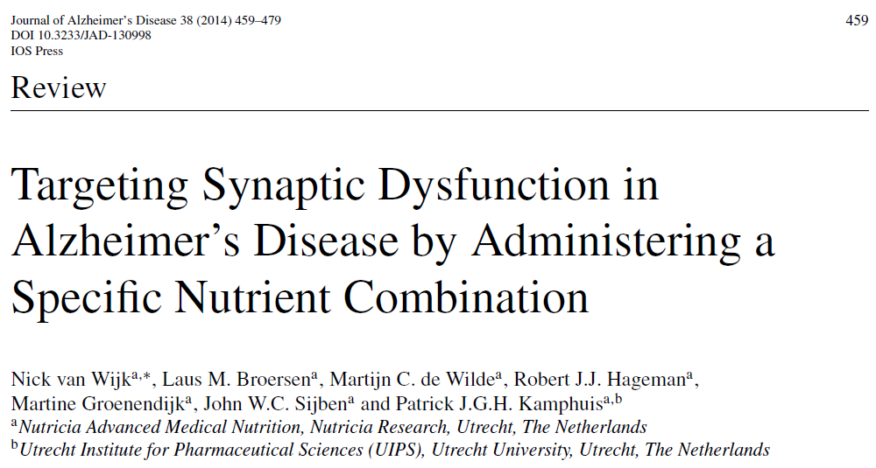
Precursors and cofactors enhance synapse formation and function – basic science data
Key phenomena being studied
Increase precursor supply
Co-factors increase precursor availability
Increase phosphatide / membrane synthesis
Improved membrane composition
Increase neurite outgrowth
Increase connectivity (grey and white matter integrity)
Increase synaptic proteins
Increase synaptic contacts
Increase neurotransmission (ACh synthesis, release, receptors)
Synergy between nutrients
Reduced abeta production/plaque formation/toxicity
Reduced neurodegeneration (immunoreactivty & NAA)
Improve learning & memory / behavior
Confirmed & Published
Nutrient combinations
Fortasyn Connect

1,2

18

3,4

2,5,8,11,17

19-22

11,23

19,22,23

6,7

24

25

2,5,7,8

21,26


8
27

2,6,9,10

19,21,28

5,7,8,17

24,26,28

11,12

19,23

19,22,23,29

11,13-17

19,22,29-31
Cansev (2005) Brain Res
Ulus (2006) Cell Mol Neurobiol
Van Wijk (2011) Br J Nutr
Van Wijk (2012) Nutr Metab
Wurtman (2006) Brain Res
Wang (2005) J Mol Neurosci
Pooler (2005) Neuroscience
Sakamoto (2007) Brain Res
Farkas (2002) Brain Res
Wang (2007) Brain Res
Kariv-Inbal (2012) JAD
Grimm (2011) JBC
Teather (2003) PNBP
de Wilde (2003) Brain Res
de Wilde (2002) Brain Res
de Bruin (2003) J Learn Mem
Holguin (2008) BehavBrainRes
van Wijk (2014) JAD
de Wilde (2011) J Alz Dis
Cansev (2012) data on file
Cansev (2013) data on file
Jansen (2013) PLOS ONE
Broersen (2013) J Alz Dis
Savelkoul (2012) AAIC
Zerbi (2013) Neurobiol Aging
Savelkoul (2011) ADPD
Verheijen (2012) data on file
Savelkoul (2012) J Neurochem
Jansen (2013) Brain Struc Fun
Koivisto (2013) in press
Wiesmann (2013) JAD

Slide 14
AD risk and nutrient intake
Observational studies suggest a link between Mediterranean diet & AD risk, but data not fully consistent
Mediterranean diet:
  High vegetables, legumes, fruits,
  and cereals
  High unsaturated fatty acids
  Low saturated fatty acids
  Moderately high fish
  Low-to-moderate dairy
  Low meat and poultry
  Regular but moderate amount of ethanol, primarily in the form of wine and generally, during meals
AD incidence by diet tertile
Scarmeas et al (2006) Ann Neurol
Scarmeas et al, Ann Neurol, 2006; Psaltopoulou et al, Public Health Nutr, 2008;
Feart et al, JAMA, 2009; Cherbuin et al, Am J Geriatr Psychiatry, 2011; Tangney et al, Am J Clin Nutr, 2011
Notes:
Some studies show an effect on MMSE and cognitive decline, others do not
Psaltopoulou et al, 2008: No difference in MMSE after 6-13 years
Better MMSE but not on other domains after 5 years
No difference in 4-year cognitive change
Tangney et al, 2011: Less cognitive decline over 7 years with high Mediterranean diet adherence

Slide 15
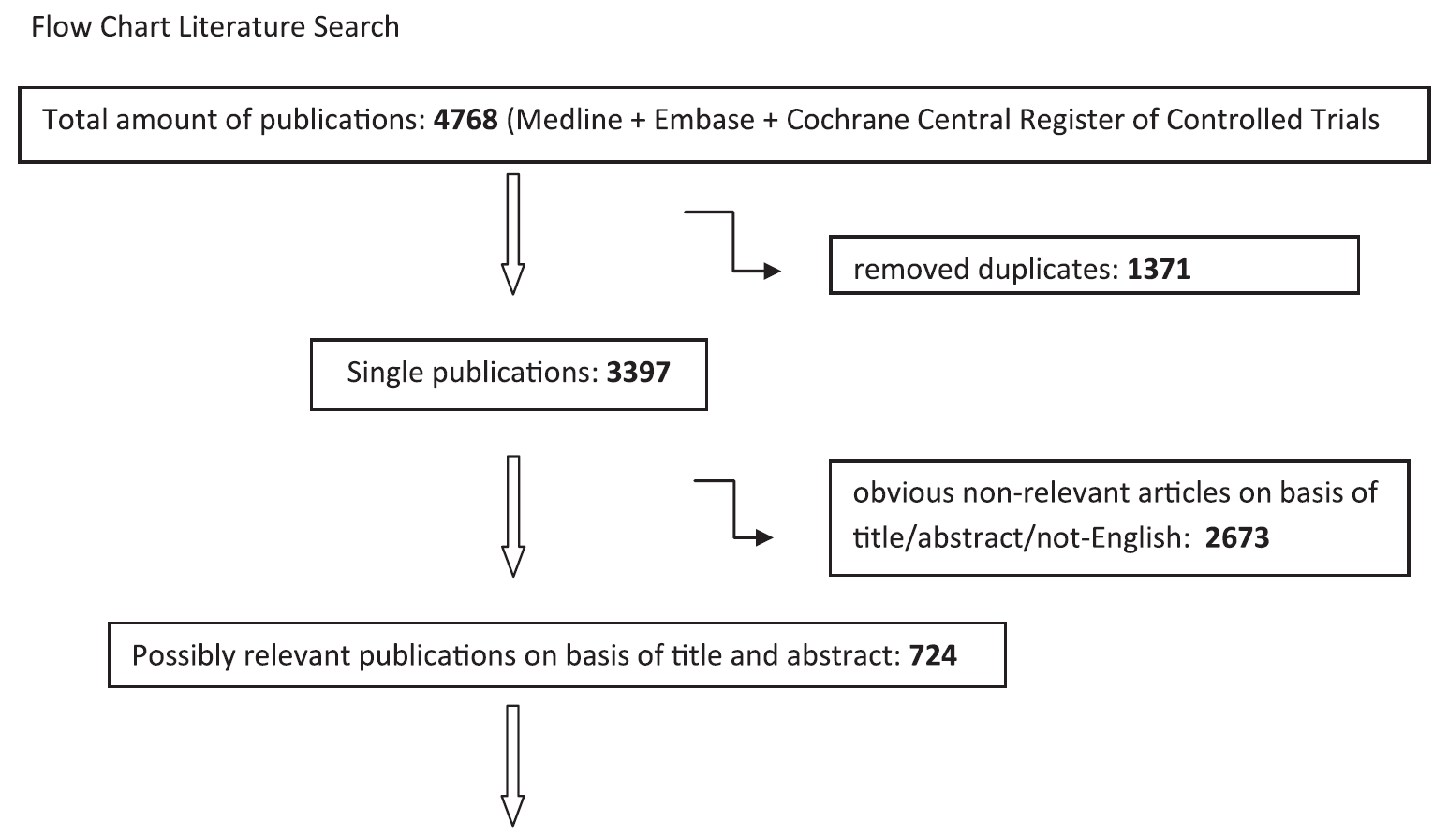
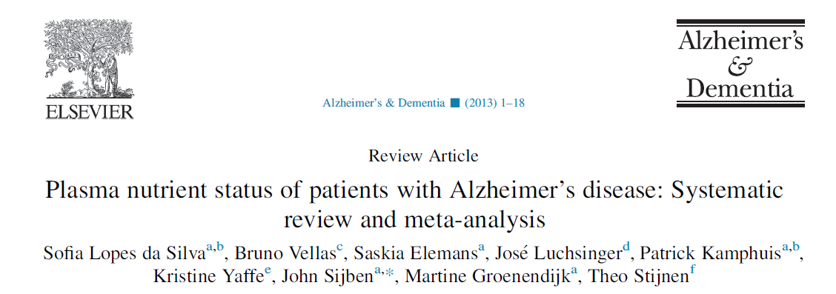
Systematic review and meta-analysis on nutrient availability in AD
According to Preferred Reporting Items for Systematic Reviews and Meta-Analysis (PRISMA) guidelines
Analyses by independent statisticians
Notes:
15-30% lower all together
Same found e.g. for vitamin E and C
DHA insufficient studies to do meta-analysis 3 out of 4 reported lower levels in AD

Slide 16
Systematic review and meta-analysis of literature: Lower plasma levels of precursors & cofactors in AD
Plasma nutrient status in AD
Meta-analyses, systematic review and observations
% Cognitive
Intact elderly
*¹
*²
*
*
*
***
***
***
***
*
90
80
70
60
2 studies
10 studies
10 studies
9 studies
6 studies
37 studies
31 studies
8 studies
20 studies
11 studies
50
Uridine
DHA
EPA
Choline
Vit B6
Vit B12
Folate
Vit C
Vit E
Selenium
1:Trushina (2013) PLOS
2:Olde Rikkert (2013)ADPD
Meta-analyses
Lin (2012) JCP
Meta-analyses
data on file
Meta-analyses
Lopes da Silva (2013) Alz Dement
Systematic review
Loef (2011) JAD
Notes:
The results of the meta-analyses for the whole set of papers (Left graph) and for the set of papers reporting no difference in protein/energy nourishment (Right graph) are presented as percentage of their respective elderly control groups.
The dotted line in these figures represents the 100% value as observed in the control groups for the different nutrients.
As can be observed from these figures the levels of the different nutrients in patients with AD are all below those of the control subjects (Left graph) even when only studies were selected that reported that protein/energy nourishment was unaffected (Right graph).

Slide 17
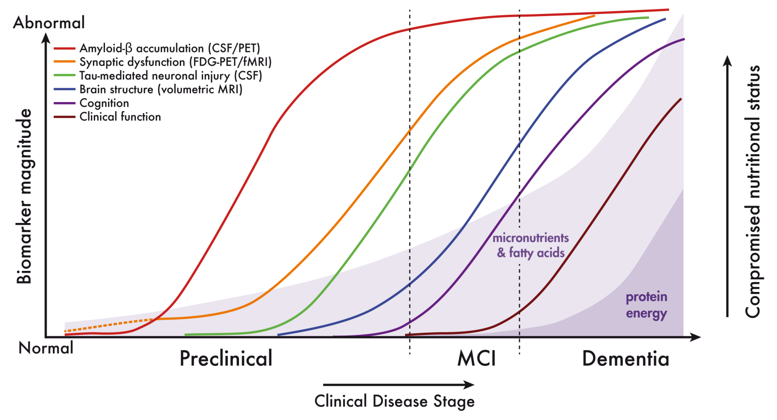
Lower nutrient status preceding classic protein energy malnutrition
Epidemiological relate dietary patterns with AD risk
Mi et al (2013) Nutrition
Notes:
Next slides I give a brief summary regarding the scientific data and arguments we have to address the requirements for FSMP and medical foods
This is the model that we use to define AD specific nutrietn requirements
As you will see in a minute the starting point re nutrient availability is lower in AD compard with age matched controls
We hypothesise that there are 3 phenomena that contribute to these lower levels and together accumulated in a distinct increased need
Nutrietn intake is well know to alter in some AD pateints, both qualitatively and quantitatively
There’s changes in nutrietn handling, changes in metabolism and uptake, will give example for this
Nutrietns needed to compensate for synaptic loss might be higher

Slide 18
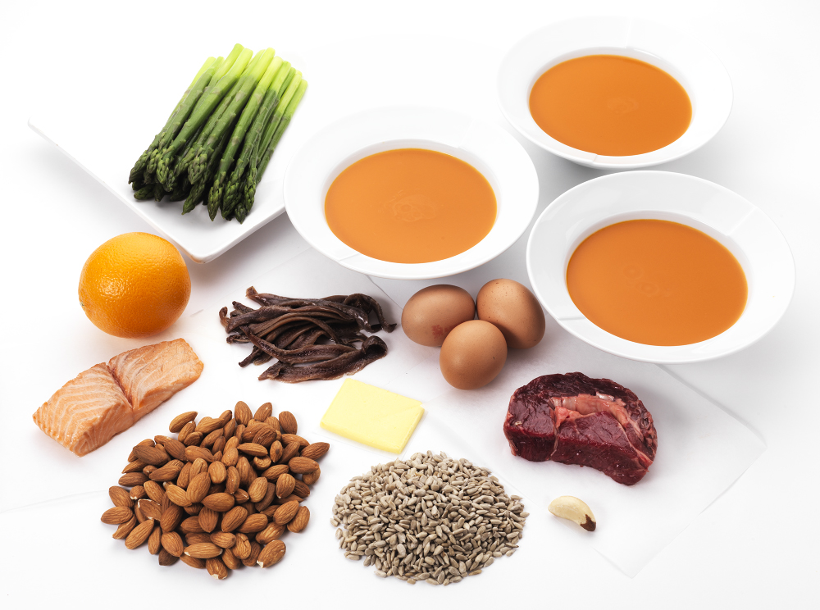

Development of Souvenaid: addressing AD specific requirements
Stimulating synapse formation requires specific nutrients
Lower Nutrient status & altered nutrient metabolism
Uridine (UMP), Omega-3 fatty acids, Phosholipids & Choline, B-Vitamins, Antioxidants
Increased nutritional need cannot be met by the regular diet
400 mcg Folate
625 mg UMP
300 mg EPA
400 mg Choline
80 mg Vit C
1200 mg DHA
3 mcg Vit B12
60 mcg Selenium
HYPOTHESIS:
Souvenaid successfully addresses an unmet nutritional need in people with AD by increasing their intake of these dietary precursors and co-factors
40 mg Vit E
106 mg Phospholipids
1 mg Vit B6

Slide 19




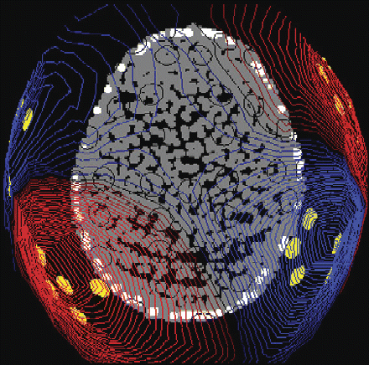
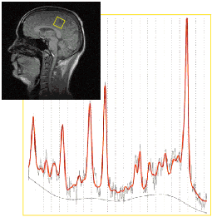
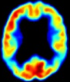

Souvenaid Clinical Development
Prodromal AD
Mild AD
Moderate AD
S-Connect
ADAS-cog
MMSE 14-24, stable on AD drugs
Souvenir I
WMS-r & ADAS-cog
MMSE 20-26, drug-naïve
Souvenir II
NTB + EEG
MMSE ≥ 20, drug-naïve
Open Label
Open Label Extension Study
Safety + Compliance
+ NTB
MEG study
MEG + EEG +NTB
MMSE ≥ 20, drug-naïve
MRS study
³¹P and ¹H-MRS
MMSE ≥ 20, drug-naïve
NL-Enigma
¹⁸FDG-PET
MMSE ≥ 20, drug-naïve
LipiDiDiet
NTB + MRI / CSF
MMSE ≥ 24, drug-naïve
Souvenir I received funding from NL STW
Souvenir II receives funding from the NL Food & Nutrition Delta project, FND N°10003
LipiDiDiet is funded by the EU FP7 project LipiDiDiet, Grant Agreement N° 211696
NL-Enigma funded by NWO NIHC project, N°057-13-003.

Slide 20

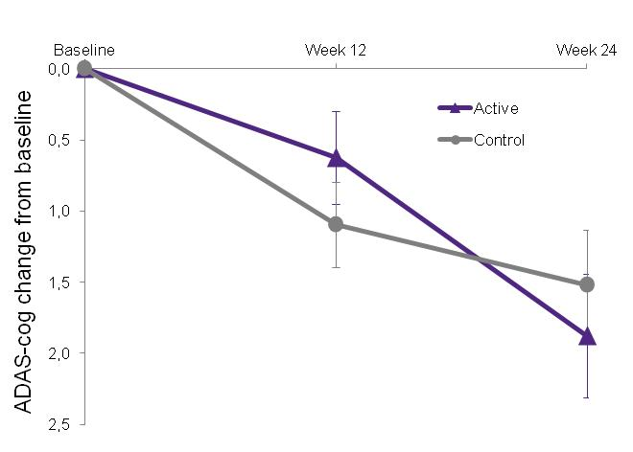
S-Connect study: mild to moderate AD on AD medication
Principle investigators: David Bennett and Raj Shah, Rush, Chicago
Multi-centre (48 sites in the US), randomized, controlled trial
Intervention 24 weeks
Primary outcome:
  ADAS-cog-11
Baseline Characteristics | Control (n = 262) | Active (n = 265)
Age (y) | 76.9 (8.2) | 76.6 (8.2)
Sex: males (n[%]) | 127 (48.5%) | 126 (47.5%)
Years of education on top of primary school | 6.4 (3.5) | 6.7 (3.6)
Total MMSE score | 19.3 (3.0) | 19.5 (3.2)
Duration AD since diagnosis (months) | 34.9 (29.6) | 32.7 (25.0)
Acetylcholinesterase inhibitors | 243 (92.7%) | 251 (94.7%)
NMDA antagonist | 170 (64.9%) | 177 (66.8%)
BMI (kg/m2) | 26.64 (4.56) | 26.19 (4.51)
Outcome parameters
Souvenaid (n=265)
n=527
Control (n=262)
t≤-3 t=0 12 24 wks
ITT, MMRM, data are mean ±SE
No significant effect (p=0.513) during 24 weeks
Values are mean ±SD, unless stated otherwise
Shah et al (2013) Alz Res Ther
Notes:
Next we conducted the S-connect trial in mild to moderate AD on AD medication. Unfortunately, Souvenaid did not improve ADAS-cog when given on top of AD medication.

Slide 21

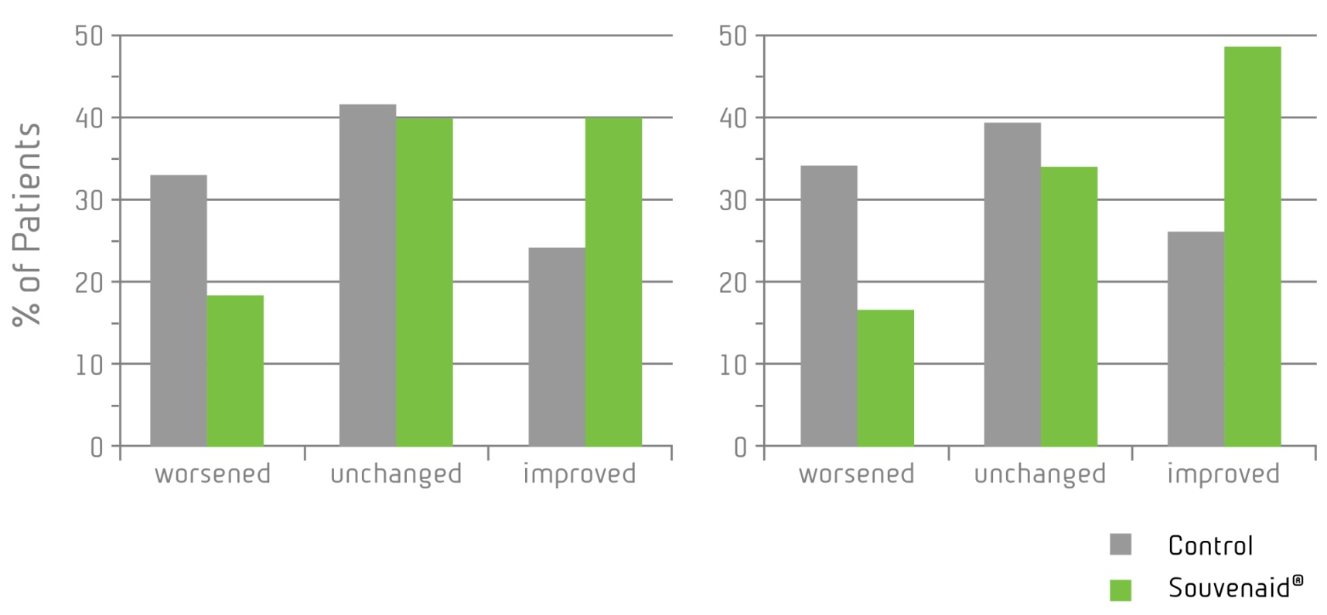
Souvenir I: Proof of concept study in drug-naive mild AD
Multi-country (NL, Bel, Ger, UK, US), randomized, controlled trial
Intervention 12 weeks (+ optional 12 wk extension)
Co-primary outcomes:
  WMS-r delayed verbal recall
  ADAS-cog-13
Baseline characteristics | Control (n = 106) | Souvenaid (n = 106)
Sex (male/female; counts) | 52 / 54 | 54 / 52
Age (y) | 73.3 ± 7.8 | 74.1 ± 7.2
BMI (kg/m2) | 26.2 ± 3.5 | 26.2 ± 4.8
Years of education on top of primary school | 6.0 ± 4.0 | 5.5 ± 3.9
Days since AD diagnosis (median) | 31.5 (0–1036) | 30.0 (0–1932)
Total MMSE score | 24.0 ± 2.5 | 23.8 ± 2.7
Change in WMS-r delayed verbal recall score
Outcome parameters
Souvenaid (n=106)
n=212
Control (n=106)
t≤-3 t=0 6 12 wks
Values are mean ±SD, unless stated otherwise
Significantly more responders after 12 weeks (p=0.021)
Scheltens et al (2010) Alzh Dement
Notes:
In our first clinical trial (Souvenir 1, PI=Philip Scheltens) we studied Souvenaid and control in drug-naïve mild AD, and found an improvement of memory as measured by the co-primary endpoint, the Wechsler Memory Scale revised after 12 weeks

Slide 22
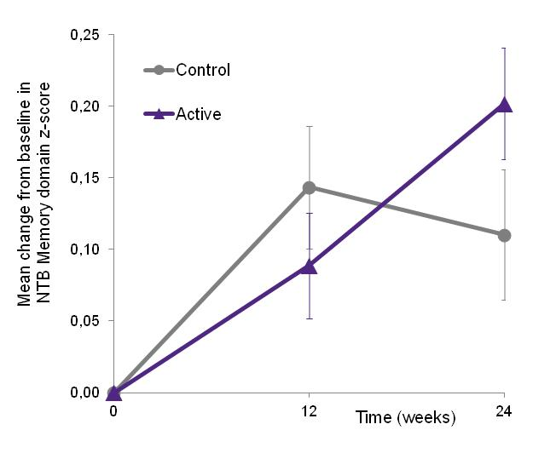
Souvenir II study: drug-naive mild AD
Multi-country (NL, Ger, Bel, Fr, It, Sp), randomized, controlled trial
Intervention 24 weeks
Primary outcome: Memory Domain NTB (z-score):
  RAVLT immediate, delayed, recognition and VPA immediate and delayed
Baseline characteristics | Control (n = 129) | Souvenaid (n = 130)
Age (y) | 73.2 (8.4) | 74.4 (6.9)
Sex: males (n[%]) | 64 (49.6) | 68 (52.3)
Years of education on top of primary school | 6.6 (4.6) | 6.5 (4.8)
Total MMSE score | 25.1 (2.9) | 25.1 (2.8)
Duration AD since diagnosis (months) (median[range]) | 2.0 (0.0 - 88.0) | 1.0 (0.0 - 70.0)
BMI (kg/m2) | 26.7 (4.2) | 26.1 (4.1)
Outcome parameters
Souvenaid (n=130)
n=259
Control (n=129)
t≤-3 t=0 12 24 wks
Significantly improved memory (p=0.023)
Memory domain score (z-score) of NTB
Values are mean ±SD, unless stated otherwise
Scheltens et al (2012) J Alzheimers Dis
Notes:
We continued with the Souvenir 2 study, to get confirmation of our findings in mild AD.
Now this study continued for 24 weeks, and again it was found that patients on the Active improved memory performance as compared to Control!
In this study population, we did 2 additional substudies of which I would like to share the first data with you:
we first looked with EEG to see whether we could obtain indications for improved functional brain connectivity in our patients,
And also performed an open label extension study in which both groups now continued on Souvenaid.

Slide 23
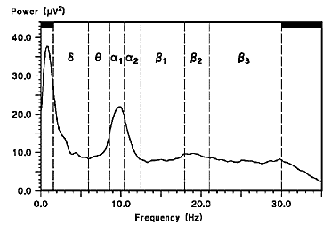
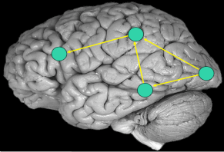
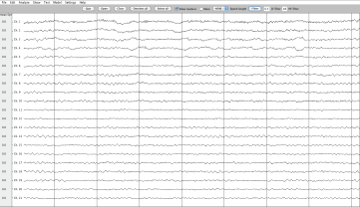
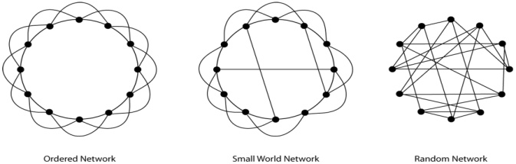

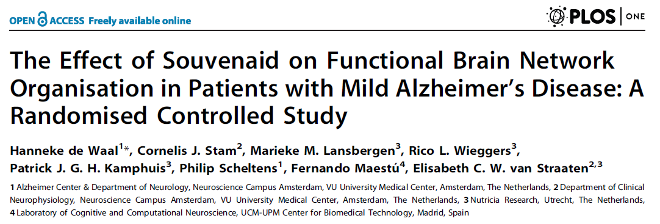
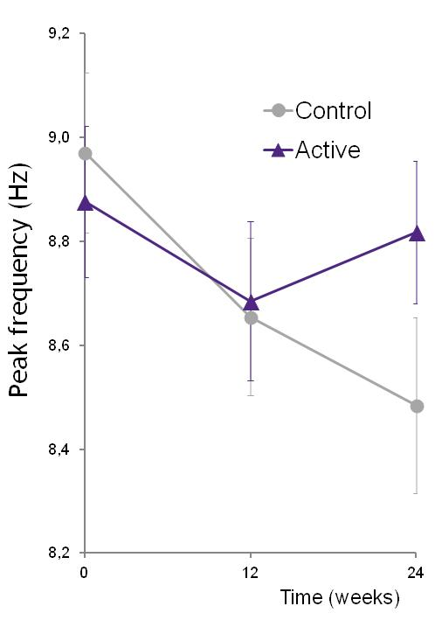
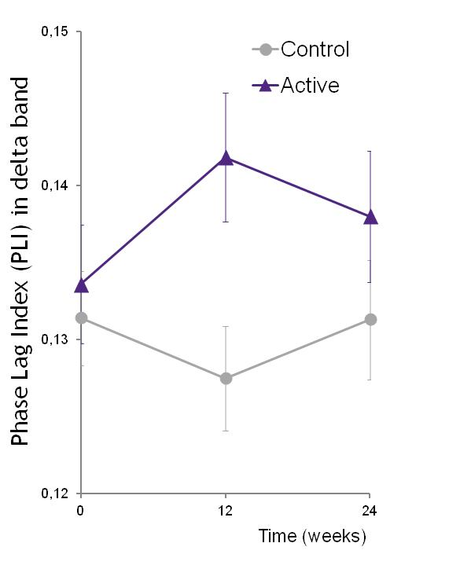
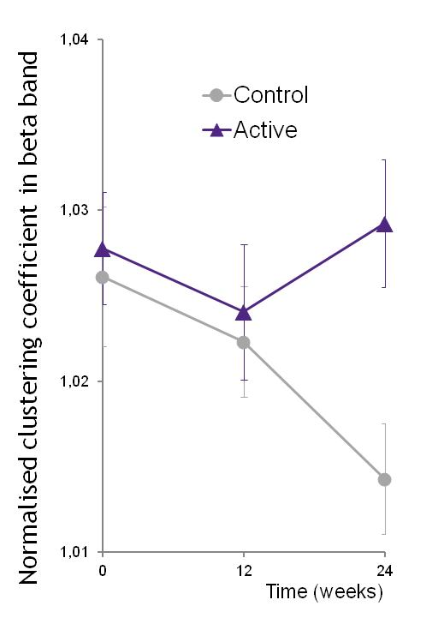
Electrical activity at the synapse – EEG biomarker for functional connectivity
Healthy
AD
PLI
Signal strength
Peak Frequency
Functional connectivity
Phase Lag Index (PLI)
Network Organization
Clustering / Path length
P=0.019
P=0.011
P=0.009
Scheltens et al (2012) J Alzheimers Dis; de Waal et al (2014) PlosOne
Notes:
van Straaten en Stam (Amsterdam) looked at various EEG measures that are known to be affected in AD: signal strength, functional connectivity and network organization.
Interestingly, several of these measures showed deterioration over the course of the 24 week study, but more importantly, Souvenaid was able to improve all measures.
These data indicate that in AD patients on Souvenaid similar effects on brain connectivity may occur as previously observed in animals on Fortasyn diet.

Slide 24
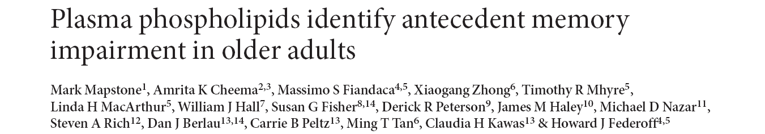

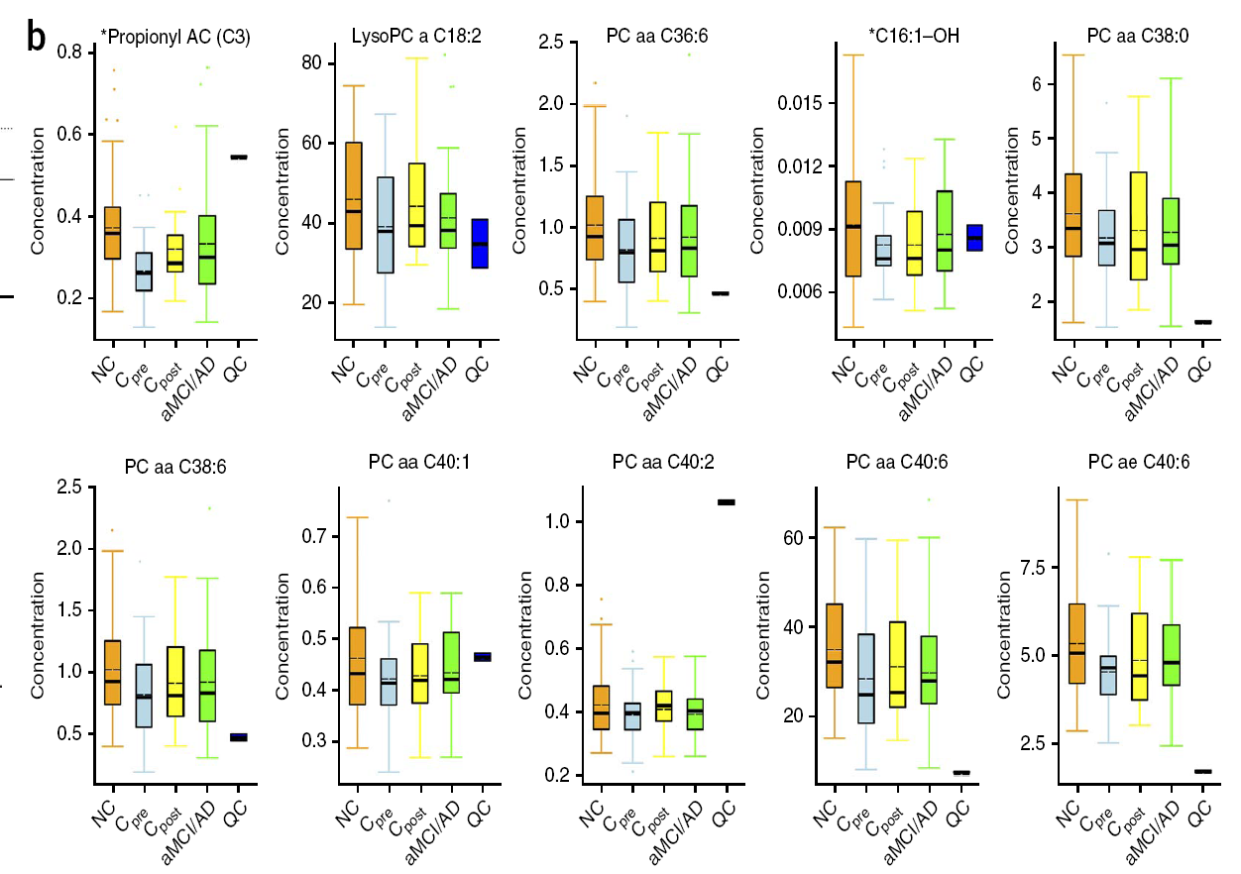

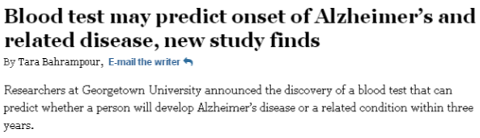



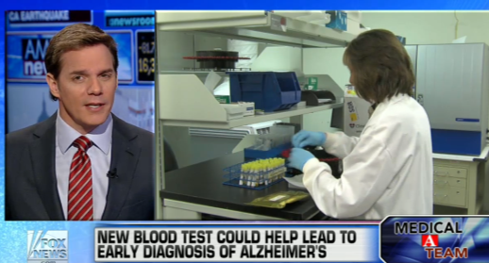
Mapstone et al. identified a biomarker panel of 10 plasma lipids that can predict conversion from cognitive healthy to MCI/AD within 2–3 years with >90% accuracy
Changes may reflect the breakdown of neuronal membranes
Highly publicitized findings
set of 10 plasma lipids, including 8 phospholipids
levels are lower in converters and MCI/AD subjects

Slide 25
Souvenaid increases levels of the biomarker phospholipids
Baseline and 24-week plasma samples from the Souvenir II study
Drug-naïve patients with very mild AD
Polar lipid profile
5 / 7 measured phospholipids reported by Mapstone significantly increased by Souvenaid
By providing nutrients which normally rate-limit phospholipid synthesis Souvenaid can:
  modify a biomarker profile reflecting disturbed phospholipid metabolism
  be useful in asymptomatic subjects with plasma lipid biomarker profiles predictive for conversion to AD
* P<0.001; Souvenaid vs. Control using ANCOVA

Slide 26
Souvenaid Clinical Development
Prodromal AD
Mild AD
Moderate AD
S-Connect
ADAS-cog
MMSE 14-24, stable on AD drugs
Souvenir I
WMS-r & ADAS-cog
MMSE 20-26, drug-naïve
Souvenir II
NTB + EEG
MMSE ≥ 20, drug-naïve
Open Label
Open Label Extension Study
Safety + Compliance
+ NTB
MEG study
MEG + EEG +NTB
MMSE ≥ 20, drug-naïve
MRS study
³¹P and ¹H-MRS
MMSE ≥ 20, drug-naïve
NL-Enigma
¹⁸FDG-PET
MMSE ≥ 20, drug-naïve
LipiDiDiet
NTB + MRI / CSF
MMSE ≥ 24, drug-naïve
Souvenir I received funding from NL STW
Souvenir II receives funding from the NL Food & Nutrition Delta project, FND N°10003
LipiDiDiet is funded by the EU FP7 project LipiDiDiet, Grant Agreement N° 211696
NL-Enigma funded by NWO NIHC project, N°057-13-003.

Slide 27
Thank you!

