Slide 1


Gut microbiota, bacterial metabolites and metabolite sensing GPCRs protect against food allergy
Laurence Macia, PhD
5th European Immunology & Innate Immunity

Slide 2
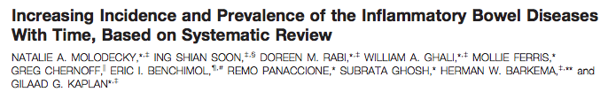
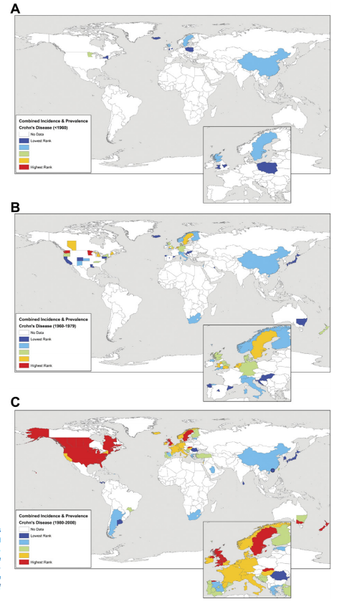
Increased prevalence of inflammatory diseases over the last 50 years
1960-1979
After 1980
Molodecky et al, Gastroenterology 2012

Slide 3
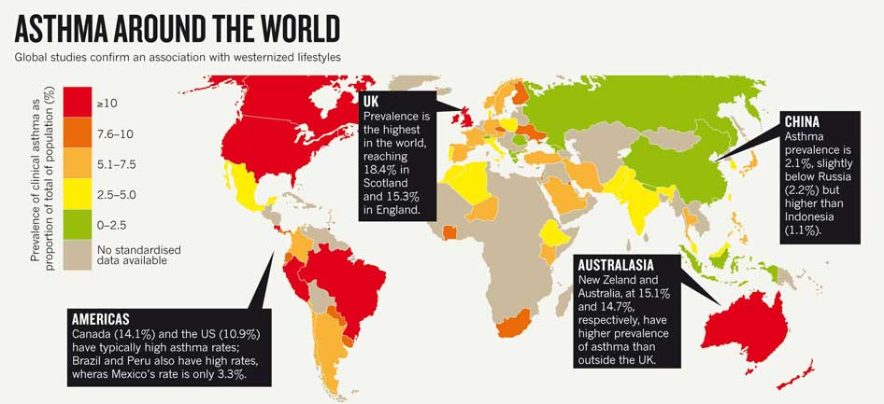
Increased prevalence of inflammatory diseases in western countries
MASOLI, M. ET AL, Nature, 2011, 479, S2–S4
THE GLOBAL BURDEN OF ASTHMA (2004)

Slide 4


Causes?
GENETIC
WESTERN LIFESTYLE
NUTRITION TRANSITION
Western diet: High carbohydrate, high saturated fat and low in fibre

Slide 5

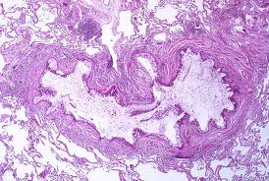
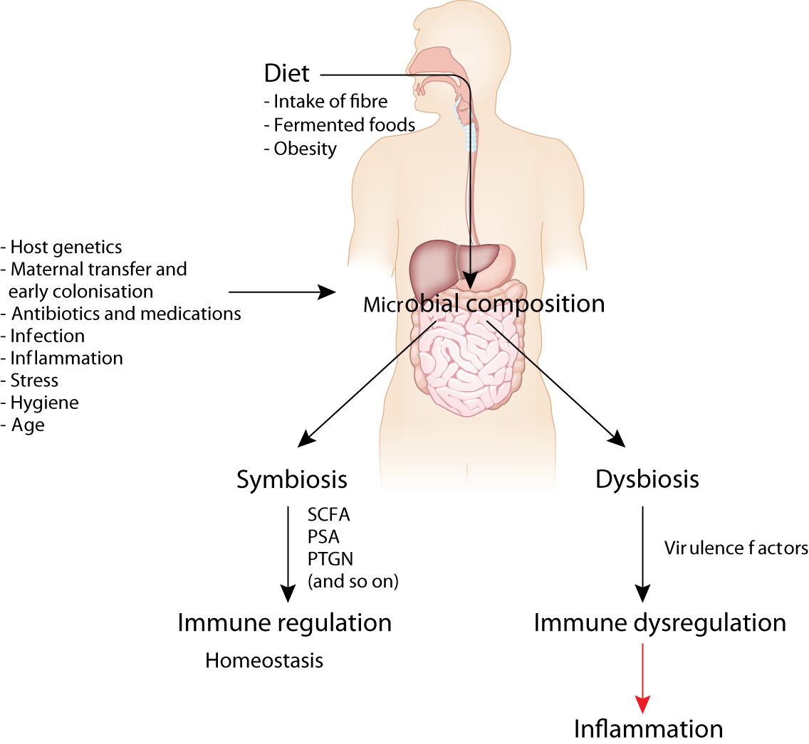
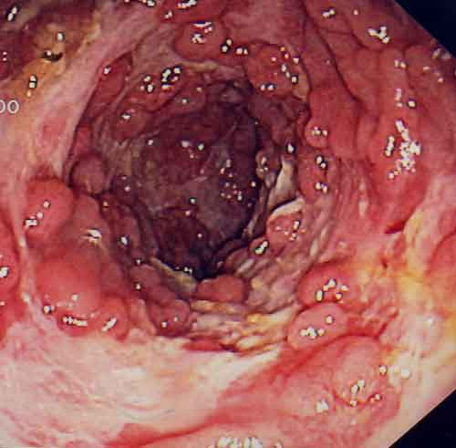
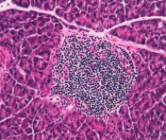
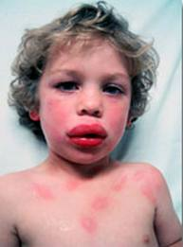
Diet and gut homeostasis as a basis for certain western lifestyle diseases
Asthma
IBD
Type 1 diabetes
Food allergies
From Maslowski and Mackay Nat. Immunol 2011
Notes:
2 main points I want to make in this introductory slide
--a. many studies now show that various factors, particularly diet, affect the composition of th gut microbiota
b The gut microbiota in turn affects gut homeostasis and inflammatory disease
Todays talk iaddresses molecular mechanisms whereby diet affects gut microbiota and immune responses

Slide 6

Role of diet and gut microbiota in food allergy
Current treatment=
Food avoidance

Slide 7

Food allergy
What is it: Inappropriate immune response to innocuous (food) antigen
Symptoms: Swelling, itching, wheezing, diarrhea, difficulty in breathing, anaphylaxis
Prevalence: High in Western countries, up to 1 in 10 affected
^{Cause?? Hygiene hypothesis}

Slide 8
Diet hypothesis
Extension of the hygiene hypothesis

Slide 9
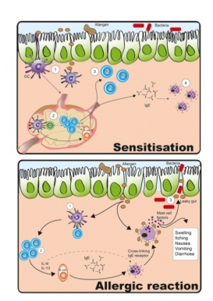
Key steps in allergic reaction
SENSITISATION
Uptake of allergen by dendritic cells
Migration to the mesenteric lymph node
Activation of specific T cells-Th2
IgE release
Pool of memory T cells
ALLERGIC REACTION
= 2nd encounter with the allergen
Anaphylaxis/inflammation/tissue damage

Slide 10
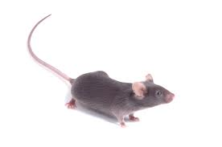
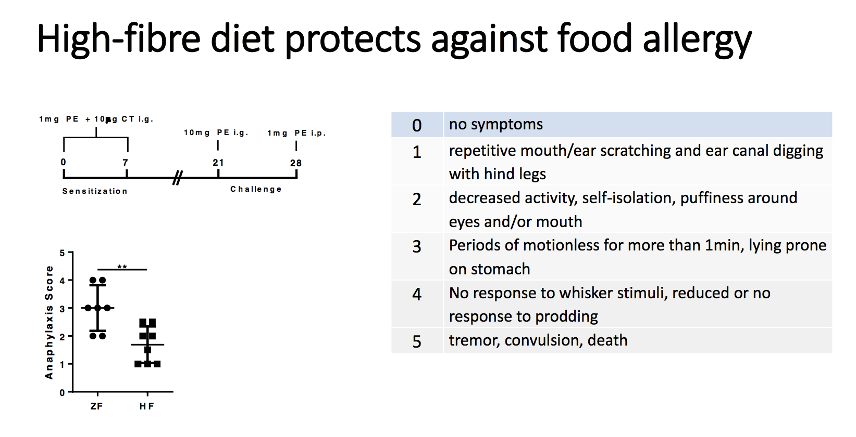

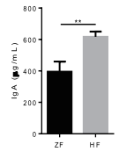
High fibre diet and peanut allergy
1st contact
with allergen
Diet deprived in fibre
Allergic reaction
or
Diet enriched in fibre
Total IgA (ug/ml)
ZF
HF
Dietary fibre is associated with decreased allergic reaction

Slide 11
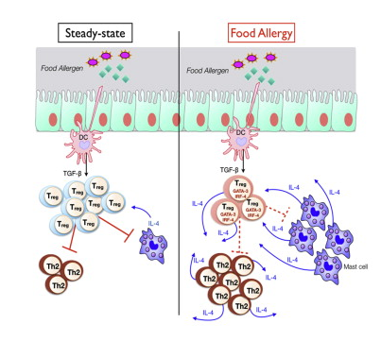
What controls allergy?
Treg
High fibre feeding is associated with increased Treg number in mesenteric LN

Slide 12
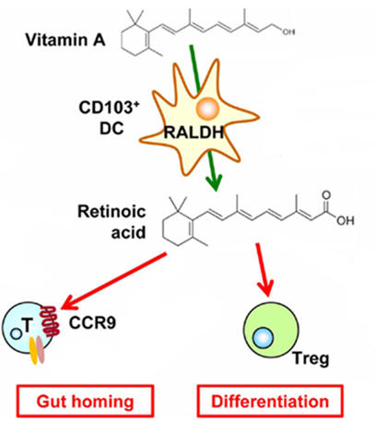
CD103⁺ DCs are key inducer of Treg in the gut

Slide 13
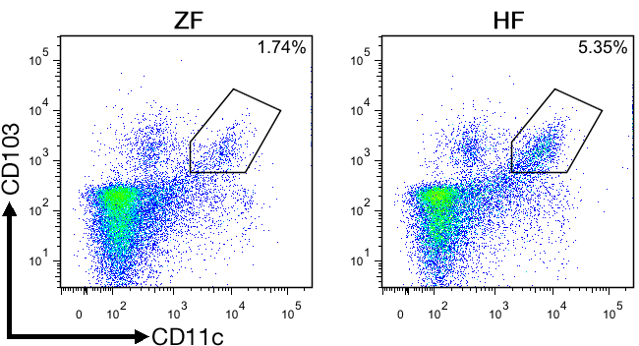
High fibre feeding and CD103⁺ DCs
% CD103⁺ dendritic cells under high fibre feeding conditions

Slide 14
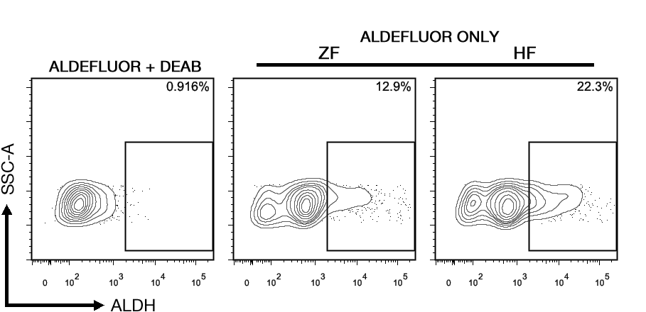
High fibre feeding and CD103⁺ DCs
  Cells are incubated with a special ALDH-substrate
  ALDH-substrate becomes fluorescent upon the action of
RALDH enzymes
High fibre feeding = more RALDH activity

Slide 15
Dietary fibre modulate CD103⁺ DCs proportion and activity
Dietary Fibre

Slide 16


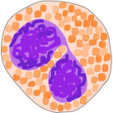


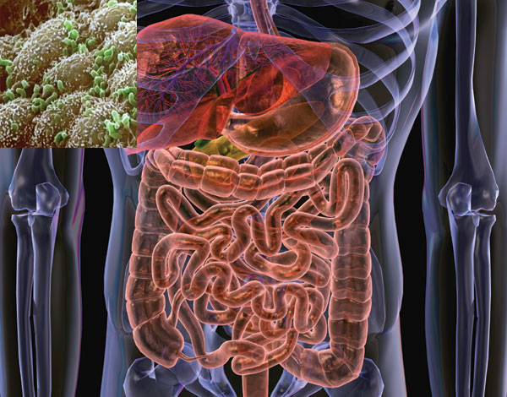

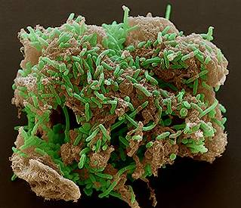




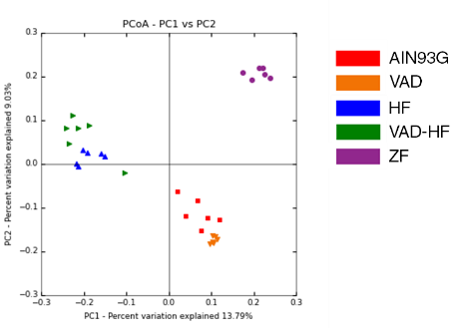
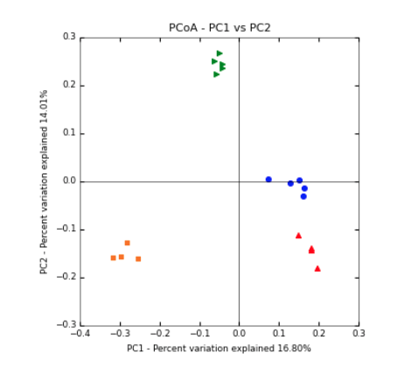
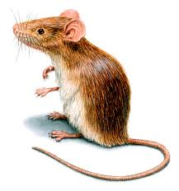
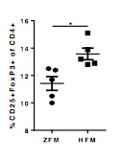
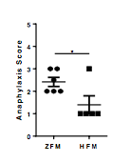
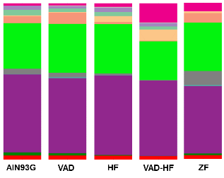
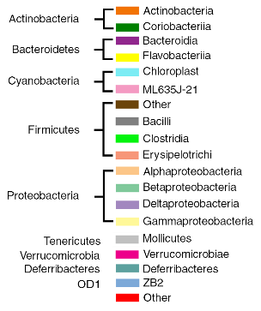
Mechanisms
?
Gut microbiota
GPR43
SCFA
Sodium Acetate
O
H₃C
C
ONa
ZFr
Unweighted UNIFRAC
Germ free
HFr
ZFd
HFd
HF microbiota
phyla
Germ free
HF
ZF microbiota

Slide 17
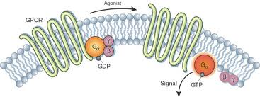
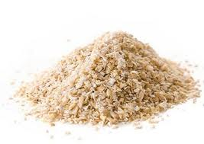
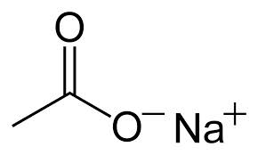
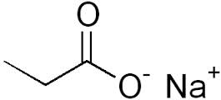
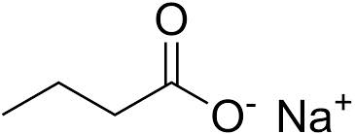
Mechanism of action of fibre: Short-chain fatty acids (SCFAs)?
SCFAs are major metabolites produced by the microbiota
?
SCFAs
GPCR activation
Acetate
GPR43
Dietary fibre
Commensal
bacteria
Propionate
GPR41
Butyrate
GPR109a

Slide 18

Role of SCFA in food allergy development
1st contact
with allergen
Allergic reaction
-21
200mM acetate
Or
100mM butyrate
Or
100mM propionate
Or
water

Slide 19
SCFAs effects in peanut allergy
200mM acetate, 100mM butyrate, 100mM propionate for 3 weeks in drinking water
Acetate and Butyrate have
beneficial effects:
Anaphylaxis
IgE
Acetate and Butyrate have
beneficial effects:
CD103⁺ DC
Treg

Slide 20
Mechanism of action of fibre: Short-chain fatty acids (SCFAs)?
SCFAs are major metabolites produced by the microbiota
SCFAs
GPCR activation
Dietary fibre
Acetate
GPR43
Propionate
GPR41
Commensal
bacteria
Butyrate
GPR109a

Slide 21
GPCR activation
Acetate
GPR43
Butyrate
GPR109a
GPR43 and GPR109A are implicated
In beneficial effects of fibre
Anaphylaxis
IgE
CD103⁺ DC
Treg

Slide 22
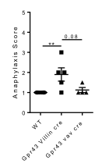
Which compartment?
Vav-CRExGpr43^{flox/flox}= deletion in the hematopoeitic compartment
Villin-CRExGpr43^{flox/flox}: deletion in the gut epithelium
GPR43 in the gut epithelium is important
HF fed mice

Slide 23
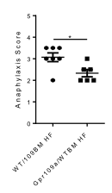
Which compartment?
Study of GPR109A using the model of bone marrow chimera mice
GPR109 is critical in the
hematopoeitic compartment

Slide 24
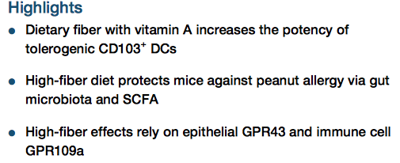
Conclusion
Tan et al., 2016, Cell Reports 15, 2809–2824
What’s next?
Is it true in human?
Bacterial candidate?
Targeting GPCR?

Slide 25



Acknowledgments
Carola Vinuesa
Charles Mackay
Jian Tan
Craig McKenzie
Peter Vuillermin

Slide 26

Laurence.macia@sydney.edu.au
Nutritional Immunometabolism group

