Slide 1
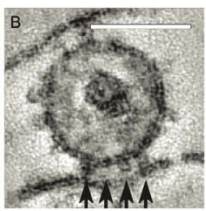
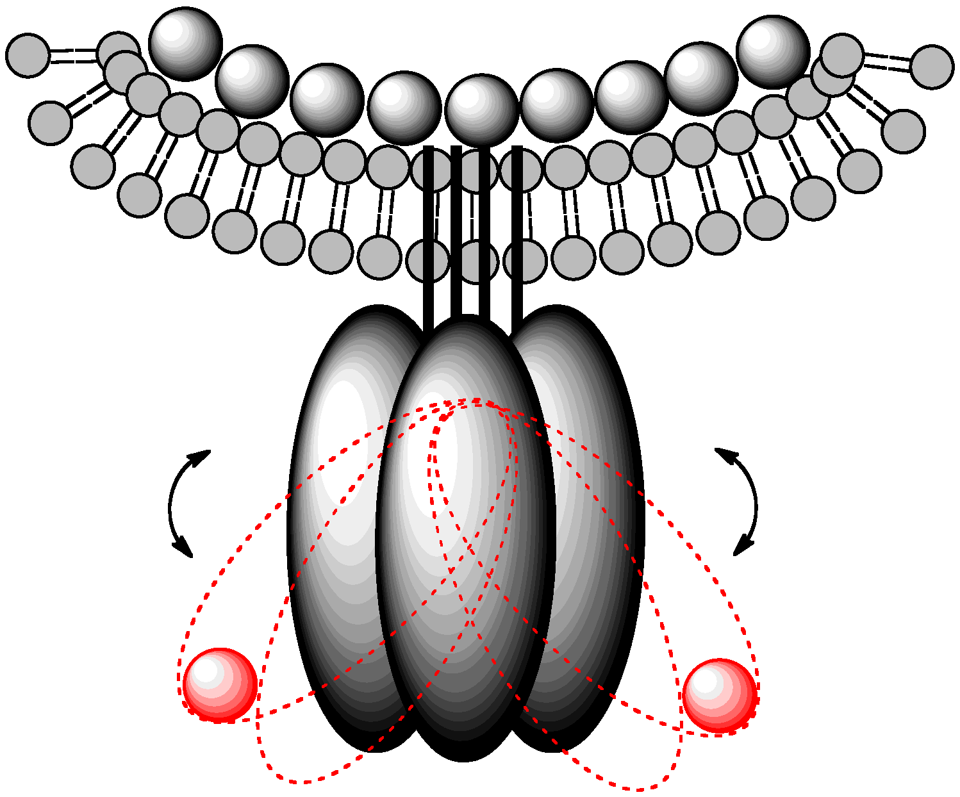
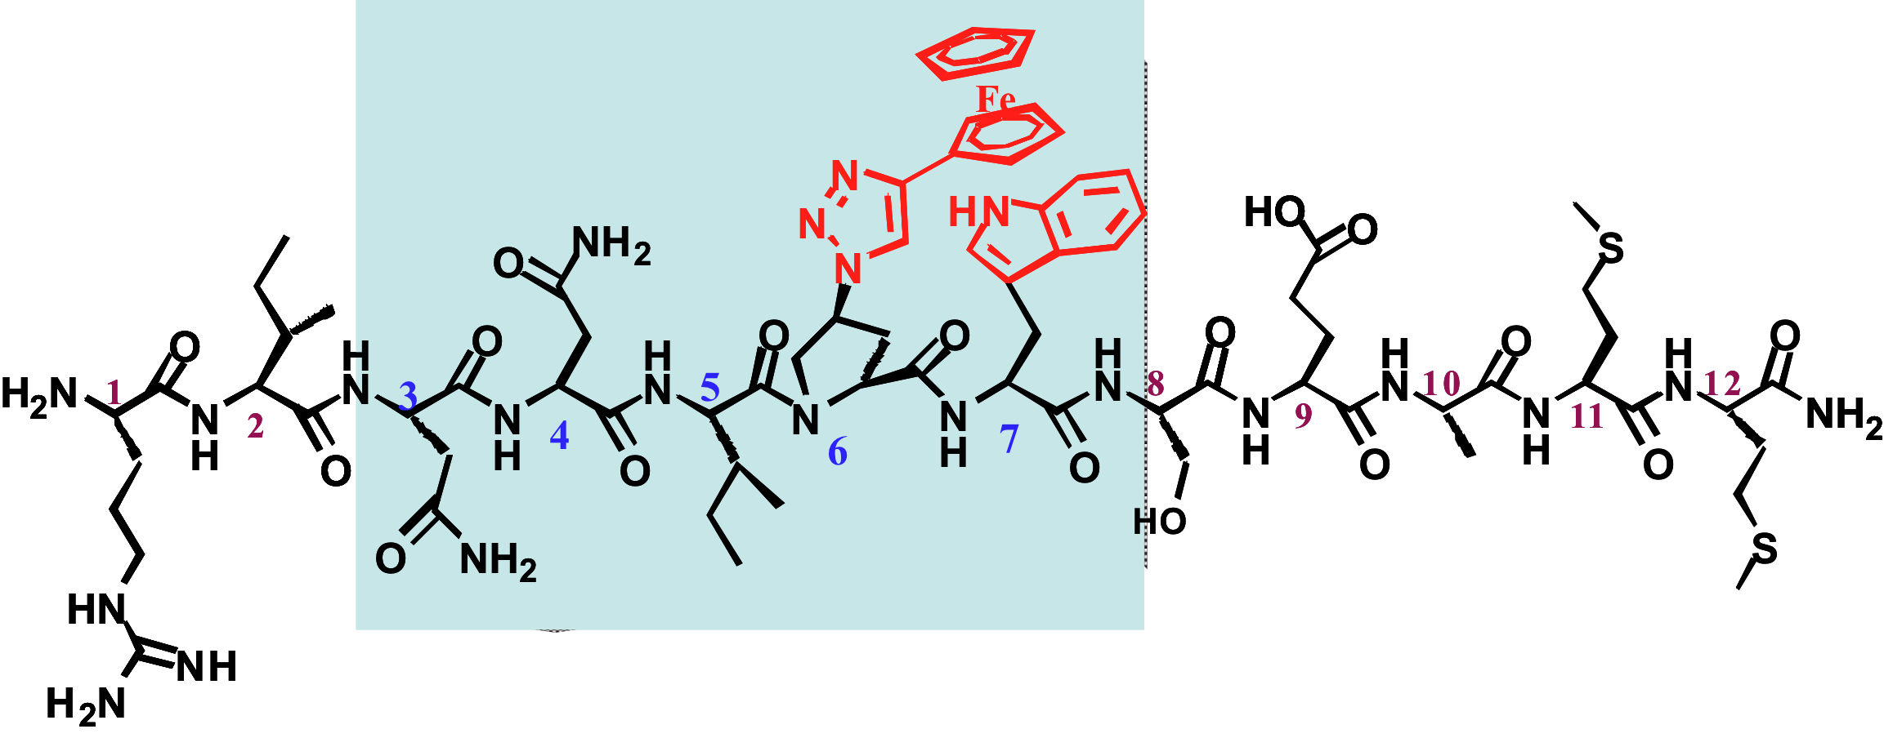
Attacking the HIV-1 Entry Machine
Mechanism of Virolysis Induced by Peptide Triazole Thiols

Slide 2
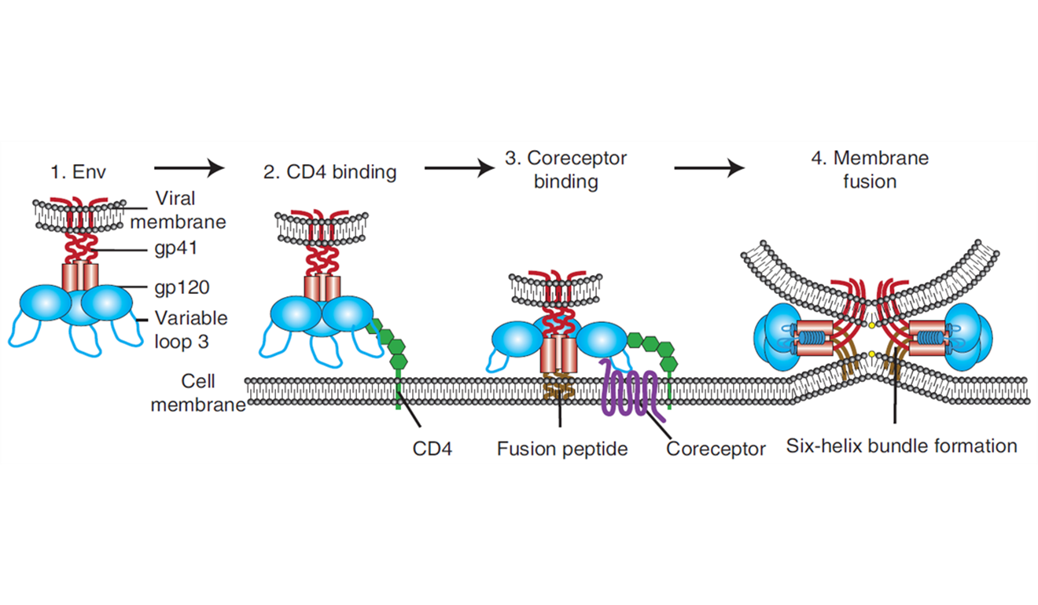
HIV-1 Uses Dual Receptor Encounter and
Metastability
To Effect Cell Entry and Infection
Can the Two Host Cell Receptors
Be Suppressed Coordinately?

Slide 3
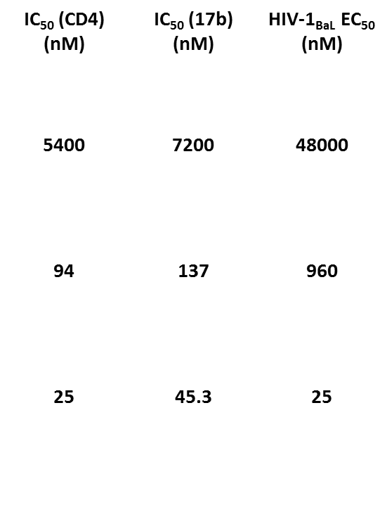
Origin of Peptide Triazole HIV-1 Env gp120 Inhibitors
KR13
Ferrer & Harrison, JVI 1999
Gopi et al., ChemMedChem 2006
Bastian et al., ChemMedChem 2010

Slide 4
Viral Inactivation by Peptide Triazoles
Preventative vaccine
Therapeutic vaccine
(Residual Virion with
antigenic gp41)
(Inactivation before host cell encounter)
Preventative microbicide
Bastian et al., Retrovirology 2013

Slide 5
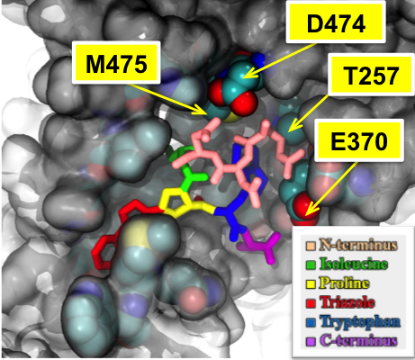
Peptide Triazole Binding in a Conserved Site of gp120 and the Conformational Entrapment Model of gp120 Antagonism
Entrapment of gp120 in ‘Open’ Inactivated State By Peptide Triazole
Unliganded
Activated
PT
Tuzer et al., Proteins 2013
Emileh et al., Biochemistry 2013

Slide 6
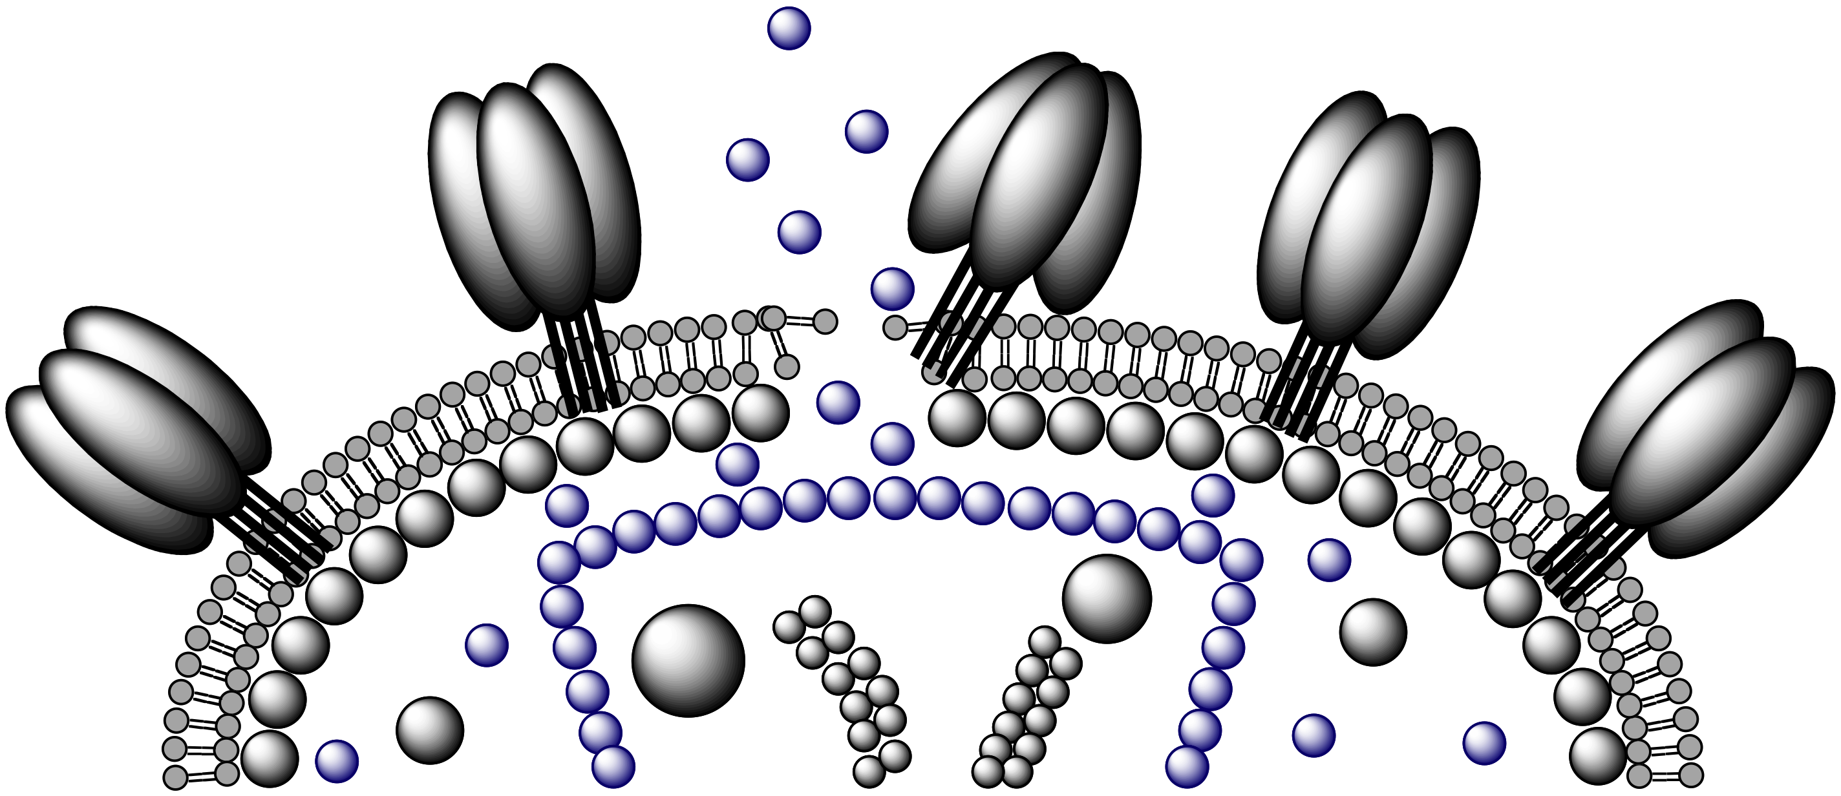
p24 Release Infers Virus Env Disruption
What’s the mechanism?
(non-Core CA p24 in virus: Briggs et al. Nature Struct Biol 2004)

Slide 7
Lysis Requires Free Thiol of KR13
KR13
KR13 Dimer

Slide 8
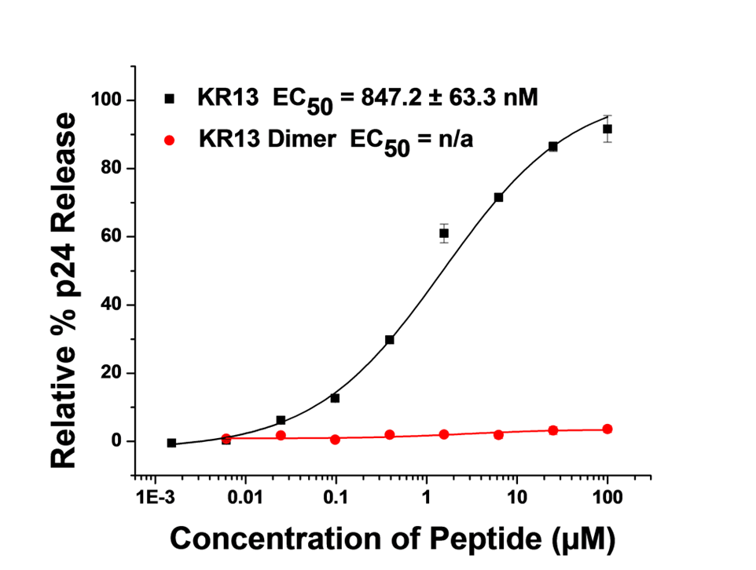
Mechanism of Lytic Inactivation KR13 vs KR13 Dimer

Slide 9
Peptide Triazole Thiols (PTT) Truncates

Slide 10
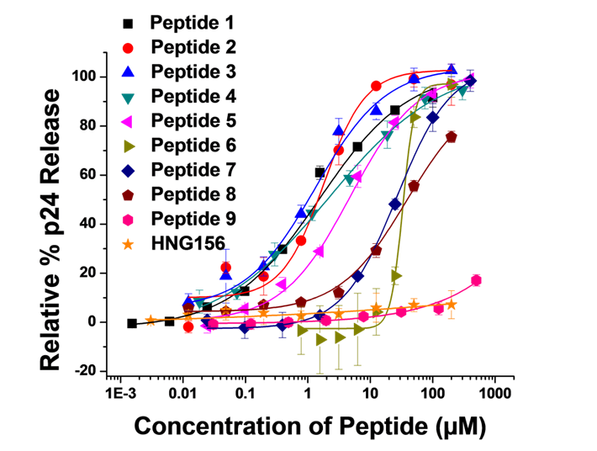
Functional Characterization of PTT Truncates

Slide 11
gp120 Protein Ligands Used to Deduce Likely Disulfides Targeted
2G12
697-30D
Cyanovirin

Slide 12
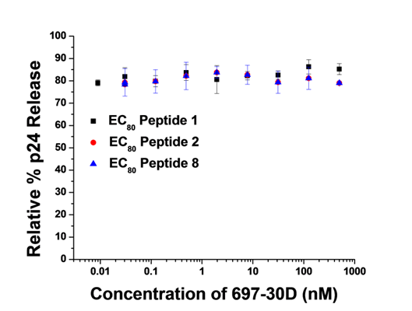
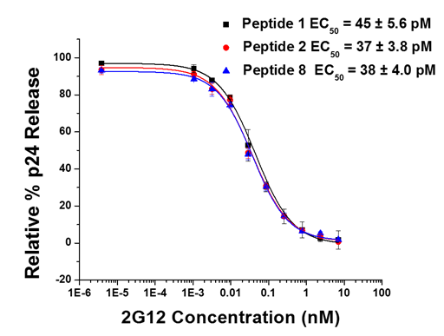
Effect of protein ligands on p24 release by PTTs

Slide 13
Molecular Docking Simulation
C385-C418: Blue
C378-C445: Yellow
C296-C331: Purple
C119-C205: Orange

Slide 14
Conclusions:
There is a discontinuous relationship between virolysis and peptide length, indicating that a minimal length is required for efficient virolysis.
The minimum linker length between PT pharmacophore and PT-SH appears needed to enable contact between SH and disulfides of the envelope protein.
V3 loop disulfide is implicated in the disulfide exchange process.
Our results support the hypothesis that thiol exchange occurs between the peptide C-terminal thiol group and a specific CD4 exposed disulfide cluster in gp120.
Key goals going forward are to refine the pharmacophore, identify the specific Env protein disulfides involved, investigate the disulfide exchange process of virolysis.

Slide 15
Thank you
Chaiken Lab
Dr. Rachna Aneja
Dr. Arangassery Rosemary Bastian
Dr. Mark Contarino
Caitlin Duffy
Dr. Ali Emileh
Andrew Holmes, PhD Candidate
Dr. Kantharaju Kamanna
Dr. Huiyuan Li
Dr. Adel A. Rashad
Ramalingam Venkat Kalyana Sundaram, PhD Candidate
Dr. Ferit Tuzer

