Slide 1
About OMICS Group
OMICS Group International is an amalgamation of Open Access publications and worldwide international science conferences and events. Established in the year 2007 with the sole aim of making the information on Sciences and technology ‘Open Access’, OMICS Group publishes 400 online open access scholarly journals in all aspects of Science, Engineering, Management and Technology journals. OMICS Group has been instrumental in taking the knowledge on Science & technology to the doorsteps of ordinary men and women. Research Scholars, Students, Libraries, Educational Institutions, Research centers and the industry are main stakeholders that benefitted greatly from this knowledge dissemination. OMICS Group also organizes 300 International conferences annually across the globe, where knowledge transfer takes place through debates, round table discussions, poster presentations, workshops, symposia and exhibitions.

Slide 2
About OMICS Group Conferences
OMICS Group International is a pioneer and leading science event organizer, which publishes around 400 open access journals and conducts over 300 Medical, Clinical, Engineering, Life Sciences, Pharma scientific conferences all over the globe annually with the support of more than 1000 scientific associations and 30,000 editorial board members and 3.5 million followers to its credit.
OMICS Group has organized 500 conferences, workshops and national symposiums across the major cities including San Francisco, Las Vegas, San Antonio, Omaha, Orlando, Raleigh, Santa Clara, Chicago, Philadelphia, Baltimore, United Kingdom, Valencia, Dubai, Beijing, Hyderabad, Bengaluru and Mumbai.

Slide 3

“When the “World Wide Web”
Entangles Media and Film
Presented by: LaSean Rinique Shelton

Slide 4

LaSean Rinique Shelton
Author
Coach
Consultant
Train the Trainer
Radio Personality
Television Personality
Motivational Speaker

Slide 5

Why it is so important
The Need
How it works
Key elements of this change is communication!

Slide 6
Communication is VITAL
Clear.
Concise.
Concrete.
Correct.
Coherent.
Complete.
Courteous.

Slide 7
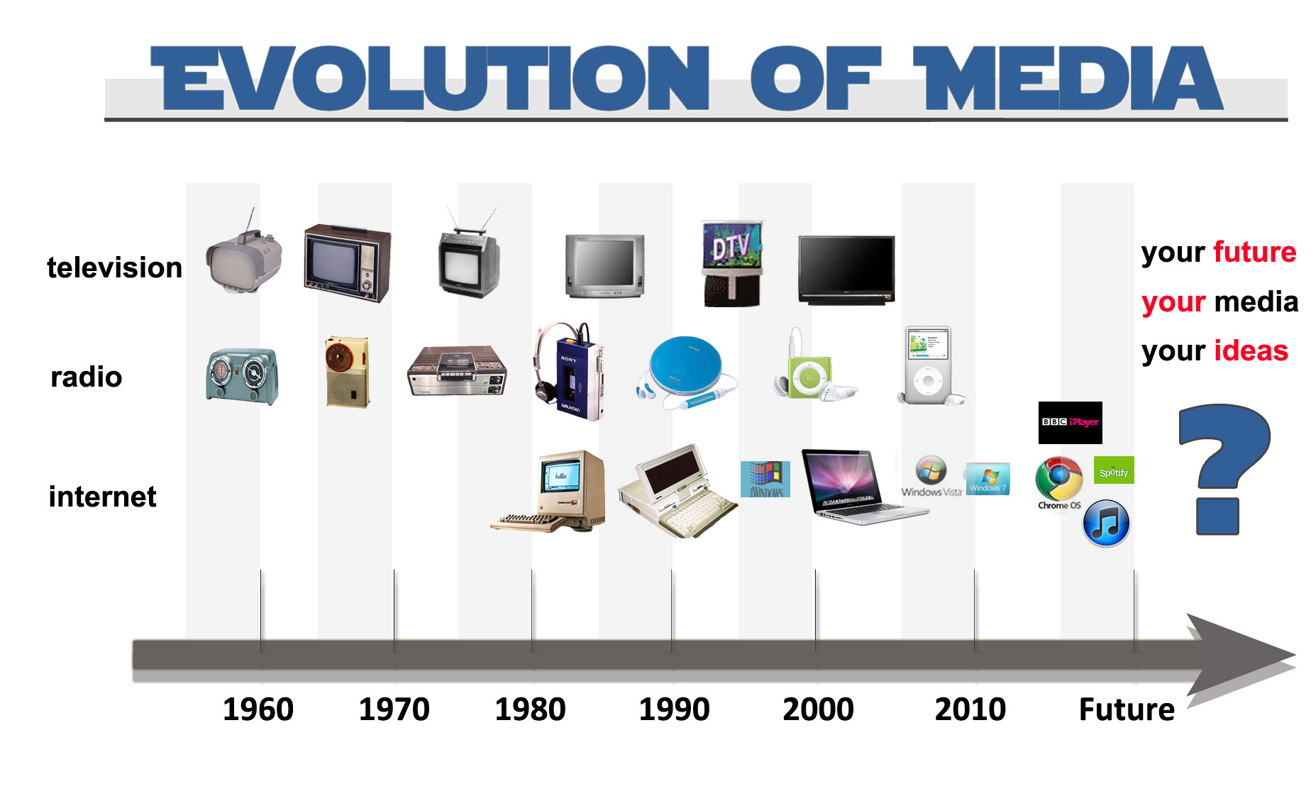
ev·o·lu·tion
evəˈlo͞oSH(ə)n/
Noun
the gradual development of something, especially from a simple to a more complex form.

Slide 8
What is the purpose of evolution?
Advance in Technology
Need for Change
Competitors
Obsolete product(s)
Financial gain

Slide 9


Slide 10

Need for Change
Human-Behavioral Changes
Culture of Society
Mission, Vision, & Strategy of the consumer and stakeholder
Financial Benefits

Slide 11

We have evolved into a microwave society- people want what they want and FAST!
No longer are people patient with delivery of media, they want a right now result thus the need to evolve.
New technology and more efficient and economical methods to perform work.

Slide 12
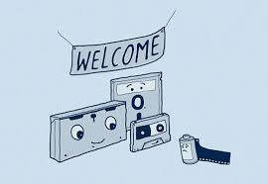
A Story About Obsolete Media
The Story of Kodak and their demise
In large part, Kodak's demise is due to their inability to recognize how powerful the threat of new technology would be to their core business.
As a company, they were at the forefront of developing digital imaging technology.
But understanding that this would destroy their core film business was a leap they were not willing to take. Other companies who weren’t first to the game but embraced digital technology passed Kodak at an amazing pace.
Even when the company experienced signs of weakness due to the expansion of digital, they still could not, or would not, make the radical decision to abandon film entirely and focus on digital. Once they eventually recognized the gravity of the situation, it was too late. American Express Open Forum-Mike Periu

Slide 13
Pro’s vs. Con’s of Media Evolution
PROS
High Visibility
High Profit Margin
Popularity of Product
Creativity
International reach
CONS
Job loss
Price of Technology
Lack of Confidence in brand and or technology
Lack of Knowledge

Slide 14
Competitors
The phenomenon of serial competition, the analysis of
the combined competitive impact of several ecological
units on a focal unit. In this case, analysis involves
charting the competitive impact of magazines, radio, TV, and
cable on newspapers and on the advertising macrodimension.
Media Competition and Coexistence: The Theory of the Niche
By John W. Dimmick

Slide 15

Financial gain
In order to avoid device-based fragmentation in online advertising, a new unit of trade is needed. As per TechCrunch, If an intent-based unit of trade can be used to monetize cross-device traffic, everyone wins. Advertisers and agencies will be able to maximize the reach and return of their campaigns, and they will benefit from cross-channel economies of scale. Publishers will monetize traffic better. And consumers will see ads that are more relevant to their intent.

Slide 16
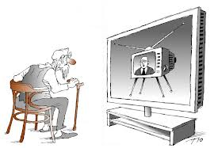
Evolution of the following Media
Television
Invention date
A Household Name
Now vs Then

Slide 17

Evolution of the following Media
Radio
Invention of the Radio
Evolution of a family fad
Evolution of the Radio

Slide 18

Evolution of the following Media
Newspaper/Books
How relevant are
printed publications?
2. Evolution of Print media

Slide 19

Television

Slide 20
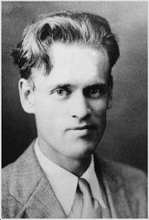
As per NYU, Electronic television was first successfully demonstrated in San Francisco on Sept. 7, 1927. The system was designed by Philo Taylor Farnsworth, a 21-year-old inventor who had lived in a house without electricity until he was 14.

Slide 21
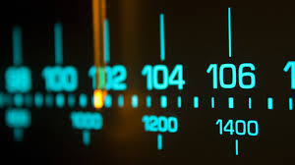
Radio

Slide 22
In 1904, The U.S. Patent Office reversed its decision, awarding Marconi a patent for the invention of radio, possibly influenced by Marconi's financial backers in the States, who included Thomas Edison and Andrew Carnegie. -Wiki
One of the first “scandals in media history!

Slide 23

Print

Slide 24
Publick Occurrences, Both Foreign and Domestick, the first newspaper published in America, was printed by Richard Pierce and edited by Benjamin Harris in Boston on September 25, 1690
The first magazine to be published in the American colonies was called The American Magazine. It began publication on February 13, 1741 in Philadelphia and covered proceedings of colonial government, in addition to moral, political and historical topics. Andrew Bedford was the publisher. The magazine lasted for three months.
A tiny book of psalms from 1640, believed to be the first book printed in what's now the United States

Slide 25
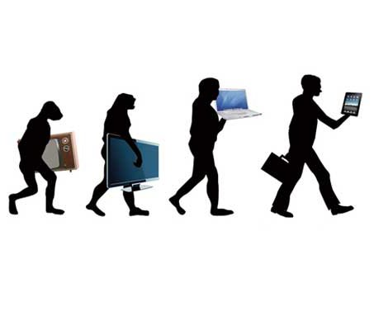
Advance in Technology

Slide 26
Today in television…
YouTube and other popular internet hosts has taken a huge chunk of terrestrial TV.
There are over thousands of web-series that internationally taking the viewers palettes by storm.
There are even web based commercials and commercial writers exclusively made for internet based shows.

Slide 27
Today in the Movies…
No more are we artist waiting for humongous budgets for film!
Uneasy Lies The Mind was shot using an iPhone 5 and a lens adapter The 88-minute film is being shown at the San Jose Cinequest Film Festival
The heat was on: The makers kept the iPhone under their arms to keep the phone working in the cold
The simple affordable approach is the “new” big thing

Slide 28
Today in Radio…
Internet Radio has such an advantage over Terrestrial stations! This outlet allows you a plethora of options related to historical data and sponsorship opportunities.
Internet radio allows you to:
Download shows
Share shows
Ability to have listeners around the world simultaneously
Archive and listen later shows
Utilize as promotional items and or paid products

Slide 29
Today in Print
When was that time you actually went to a book store, magazine shop or even subscribe to newspaper delivery?
Though it is still utilized, it is no longer the “norm”
Today, printed media has been awarded online views and opportunities to be viewed worldwide

Slide 30
The overall…
Today, a google hangout has allowed Board Meetings, and buy in products. Imagine if you will participating in a mastermind session with people everywhere all with a google app.
Skype has awarded us the treat have face to face conversations and marketing avenues.
Android and Iphone allows us to speak face to face and or record conversations- again with an app.

Slide 31
What say you…?
Still not convinced of change? How about some comparisons…

Slide 32
TV
Television Then
Television Now
Fewer channels
Shut off after dusk
Very monitored and censored
Black and white color
Huge
Needed a visible antenna
Thousands of channels
24/7 access
Less censored and at times needs parental blocks
HD, HDTV, sharp color
Antenna built in to catch signals
Can be viewed online

Slide 33
Radio
Radio then
Radio Now
FM or AM choice
FCC regulated
EITHER talk or music
Limit to airtime as per station
Can only be heard at that time! If you missed it….
Satellite, Digital, Online, as well as FM and AM
Free Speech
Can schedule shows at leisure
Can create networks
Can archive, share and rebroadcast

Slide 34
Film
Film then
Film now
Auditions needed
Huge investments
Big Production companies
Specified demographic
Professional equipment
Film from Phone, Tablet or computer
Lower budgets
Indie Artist and Producers
Can insert scenes from anywhere
A lens, plug in mic and dream.

Slide 35
Print
Print Then
Print Now
Typewriters
Word processors
Publisher Companies
Years before published
Longer time to become Best Seller
Voice Transcribe work
From phone
Independent publishing options
Over night Best Seller

Slide 36
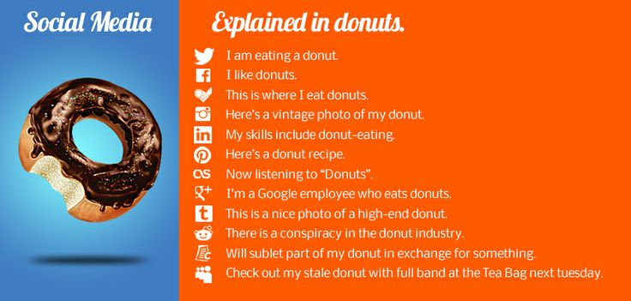
Social Media Explained
No
P
e
e
k
i
n
g

Slide 37
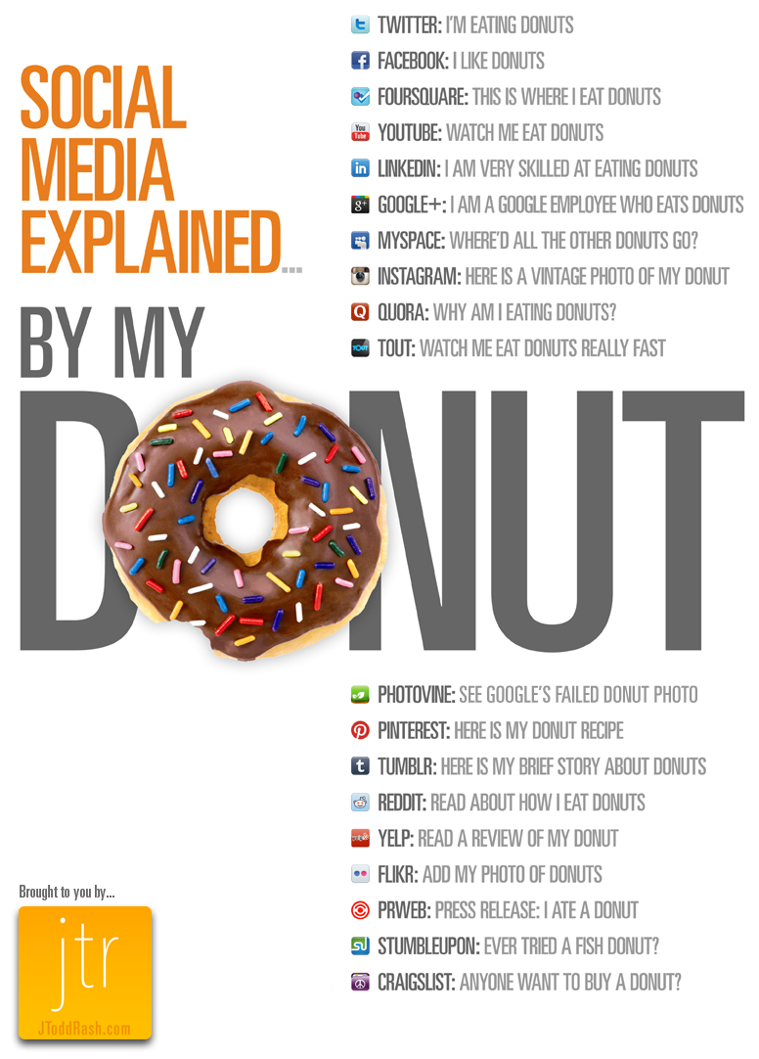

Slide 38
Advertisement
Social Media
YouTube
Facebook
Twitter
Pinterest
Yelp
LinkedIn
Tumblr
Craiglist

Slide 39


Slide 40

Where we are compared to then…what’s next?
We were exposed 30 years ago…are we paying
attention now?

Slide 41



To Contact Me
302-981-2607
302-729-2280
www.cyjlyj.com
www.awakethechampioninyou.org

Slide 42


