Slide 1
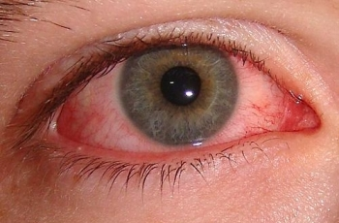
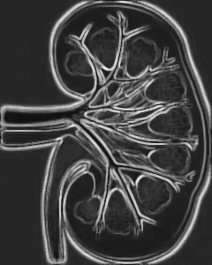
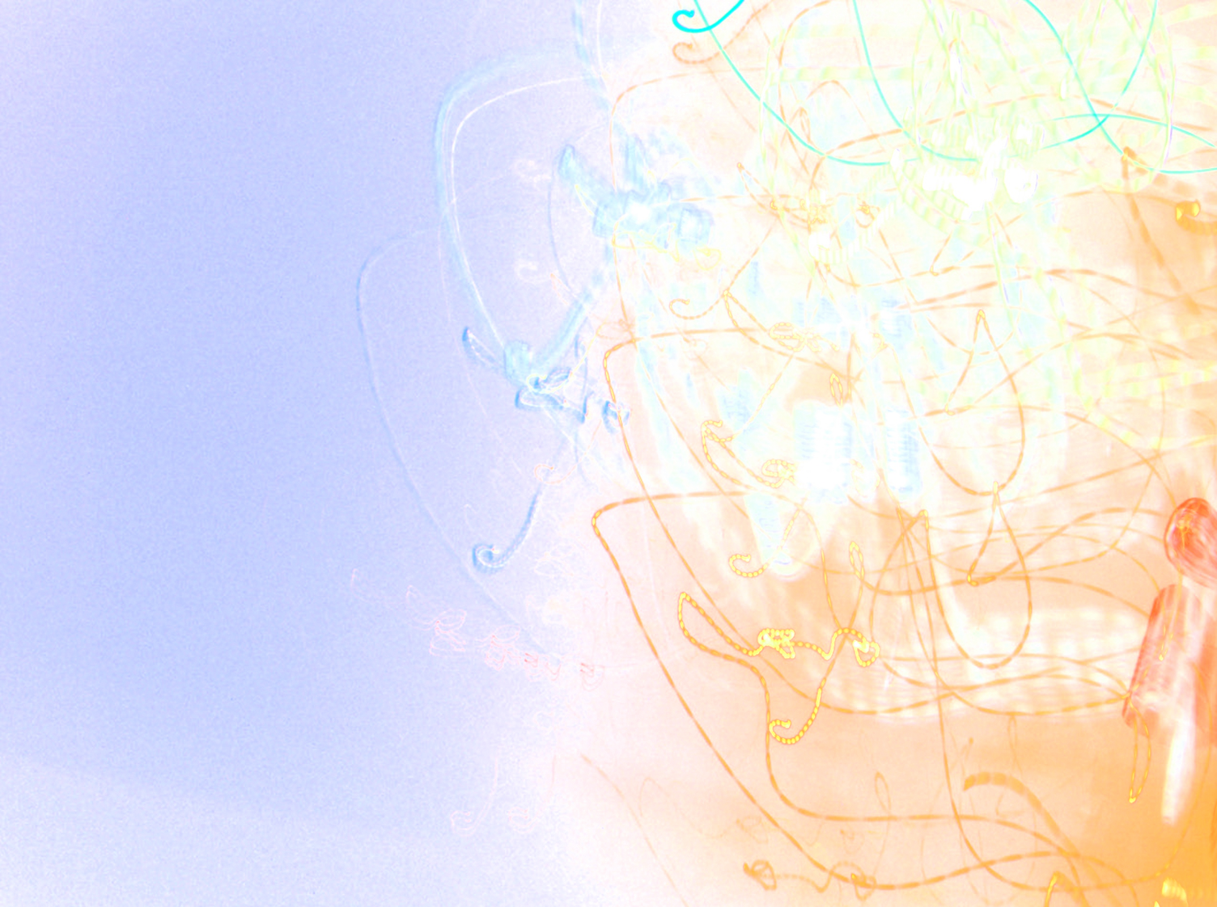
Acute renal failure and uveitis which diagnosis is most likely in internal medicine?
TINU syndrome
Through Two Observations
Dr Laidoudi Aicha
Department of Internal Medicine
Mohammad-Lamine-Debaghine hôspital, Algeria
Notes:
بسم الله الرحمن الرحيم Hi, I’m Dr Laidoudi,
In internal medecine, we are all the time confronted to rare diseases : auto immune diseases, vasculitis, orphan diseases, with a very very various manifestations and almost no specific laboratory test which can confirm the diagnosis … when is it 2 or 3 organs or more that manifest in the same time or separately within fiew months, we say … oh, perhaps it is a systemic disease, but the problem her is : how to confirm? There is diseases with diagnosis criteria, there is another with classification criteria, and some others diagnosis per exclusionem , in another words : we have to roll out all obvious diagnisis to retain this specific disease … TINU is one of this group of illness, and sometimes, it can cause a real problem when trying to eliminate other differential diagnosis … I have today 2 cases of TINU syndrome occuring in adults in which immunological disorders created differential diagnostic difficulties …

Slide 2
INTRODUCTION
TINU syndrome = rare combination : tubulo-interstitial nephritis (TIN) + uveitis(U).
Adolescent, young woman ++++(15y, 3/1 F/M).
pathogenesis = unknown
- autoimmune origin humoral and cellular immunity ?
Renal and eye damage tended to resolve with corticosteroid therapy
Notes:
TINU equal a rare combination : : tubulo-interstitial nephritis (TIN) + uveitis(U), in another words : inflammation of the kidney and inflammation of the eye, so what is the relationship between kidney and eye?, these two organs which are anatomically separated… we will see that the impairment of these organs is conducting separately in the time in almost all cases … so what is the link between kidney and eye? We will see that in the next slides …
Most patient with TINU are adolescent and yong woman, with a median age at the onset of 15 years, also : 3/1 female to male predominance … however … in some recent studies … males are now increasingly diagnosed
As far as we know, pathogenesis of TINU still unknown, TINU is most postulated to be the result of an auto-immune process … so it may involve both humoral and cellular immunity … with more evidence of cellular immunity … for humoral immunity, recently, auto-antibodies directed against renal tubular cells have been detected and have thrown a new light on the role of humoral immunity in TINU sd, and it is also postulated that renal tubular and ciliary body epithelia might share cross reactive auto-antigens … for that the same antibodie can cause both renal and eye damage …
In general, this damage respond well to corticosteroid therapy, which is the case with all diseases with immunological disorder, and thus reinforce the hypothesis of auto-immune origin

Slide 3
1st observation
Notes:
Lets move on and start the first observation

Slide 4
Nurse, 25 yo
No drugs
February 2014
Secondary hypertention?
Repeated nosebleeds
BP = 200/120mmHg
Anemia 9.3g/dl
Creat 23mg/l
GFR = 26
Ionogramme : nl
Prot = 450 mg/24h
TSH, ECBU (-)
ESR = 37mm/h
Renal echo = (-)
Renal artery echodopp (-)
Amlodipine 10mg/d
edema of the lower limbs
Irbesartan 150mg/d
Notes:
Very cute lady of 25 year old, she was a nurse, she was taking no medication, no non steroid anti inflammatory drugs, no antibiotic,…
In February 2014, she started to have nosebleeds with high blood pressure until 200/120mmHg, she was treated with amlodipine 10mg/d, after she started to have edema of the lower limbs which is a common adverse effect of calcic inhibitors, so she switched to Irbisartan 150mg/d
But she was a pretty lady, with no cardiovascular risk factor, why will she have a severe hypertension? Is there a secondary cause for this hypertension,
You see the biological findings her, creatinine level of 23 mg/l and estimated GFR of 26, proteinuria of 450mg/d and slight elevated ESR of 37 mm/h, echography of the kidneys and Doppler of the renal arteries show no abnormalities.

Slide 5
Nurse, 25 yo
No drugs
Fevrier 2014
March 2014
eye pain and redness
decreased visual acuity
photophobia
acute unilateral anterior uveitis
Ocular fundus = (-)
Local treatment
Notes:
On march, she experienced eye pain with redness, decreased visual acuity and phtophobia : cardinal signs of uveitis, it was actialy an acute unilateral anterior uveitis … for that she receved local treatment

Slide 6
Nurse, 25 yo
No drugs
Fevrier
April
March
Hospitalisation
Notes:
In april, she was reffered to us for futher exploration

Slide 7
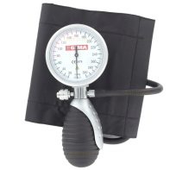
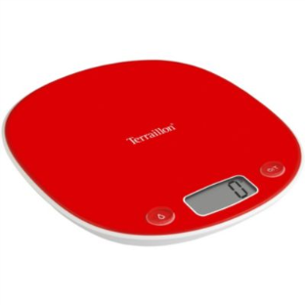
ocular fundus exam : grade I hypertensive retinopathy
class II dyspnea (NYHA), a holosystolic heart murmur in the mitral area without heart failure signs, pallor
afebrile
BP = 170/130mmHg
weight loss of 6 Kg
urine dipstick test finds traces of protein and hematuria
Notes:
When examining the patient, she was afebrile, with hight blood pressure class II and unwanted weight loss of 6Kg in less than 03 months, she was hapy with here weight loss
She presented an anaemic syndrome : pallor, dyspnea, holosystolic heart murmur in the mitral area without heart failure signs, she was having traces of protein and hematuria in the dipstick and ocular fundus showed grade I hypertensive retinopathy

Slide 8
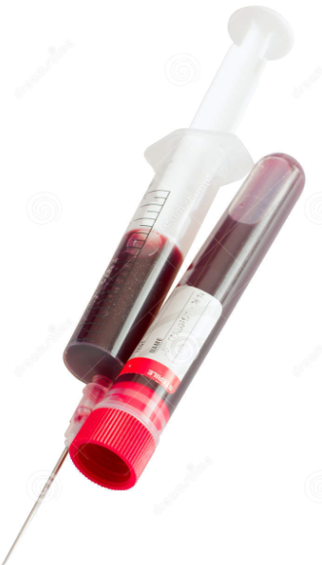
Biological Findings :
Hb = 11 g/dl
Urea = 0.53g/l ceat = 32.1mg/l
GFR of 18.71ml/mn/1.73m2
proteinuria = 540 mg/24h.
Erythrocyte sedimentation rate 37-76 mm (3-12) mm/hour
hypoCa = 73.2mg/l, hyperPO4=50.28mg/l
Inflammatory, liver function, hemostatic and lipide profile = nl
No auto-immune disorder, serology (-)
Notes:
Biological finding showed essentially a renal problem : elevated urea levels, creatinine of 32.1 mg/l and an estimated GFR of 18.71, so my lady was degrading her renal function, with signs of chronic kidney failure : anaemia, hypocalcemia, hyperphosphatemia
fortunately for her, no other signs of organ impairment and when searching for auto immune disorder, tests were negative, and also serological test were negative looking for an infectious agent spatially because my patient was a nurse and of curse she is exposed to high infectious risk .

Slide 9
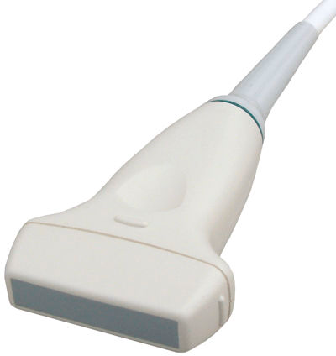
Imaging studies
EKG and echocardiography= non vontricular hypertrophy.
increased renal cortical echogenicity
Echodoppler of renal arteries : nl.
Kidney biopsy with histological examination showed a non caseating granuloma in the interstitial tissue with presence of rare hyaline casts in the kidney tubules, and tubulointerstitial nephritis with granulomatous lesions in the medullary parenchyma.
Pulse IV CTC followed by high-dose daily CTC
Irbesartan, Nicardipine.
Notes:
Because of severe hypertension, we looked for ventricular hypertrophy using echo and EKG … negative results, and Doppler of renal arteries was normal,
When doing a renal echography, patient started to have an increased renal cortical echogenicity, remember … echo of 2 months ago was normal
Kidney biopsy with histological examination showed a non caseating granuloma in the interstitial tissue with presence of rare hyaline casts in the kidney tubules, and tubule-interstitial nephritis with granulomatous lesions in the medullary parenchyma.
If I summarize : renal function impairment which goes quickly and TIN, my patient needed urgent treatment, she was flashed pulse IV corticosteroid 500 mg/d, 3 consecutive days followed by high-dose daily CTC 1mg/kg/d, with the other treatment an of curse Irbesartan, Nicardipine, for reducing hypertension

Slide 10
FURTHER EXPLORATION
mainly oriented to sarcoidosis and tuberculosis and the other differential diagnosis was all negative.
TB Skin test = 07mm
Uricult (-)
angiotensin-converting enzyme
Chest and abdominal computed tomography scanning : nl
Bronchoscopy : non specific inflammatory mucosa
bronchial aspirate : KB (-)
mutiples biopsies : liver, bronchial mucosa, accessories salivary glands ➔No other sites of granulomas.
but Quantiferon was 10 times normal with negativity of all other examinations to KB (koch’s bacillus).
Notes:
So double organ impairment: renal and eye, is it a TINU syndrome? Actually, we in internal medicine love rare diseases … but to retain this diagnosis, we must role out all diseases which can cause uveitis and TIN … essentially sarcoidosis and tuberculosis because Algeria is TB endemic countries, but there is no genital functional signs, Skin test is only 07mm , Uricult (-), Chest and abdominal computed tomography scanning was normal showed no pulmonary lesions, no lymphadenopathy, Bronchoscopy : nonspecific inflammatory mucosa; and in bronchial aspirate : KB (-),angiotensin-converting enzyme was in normal level, multiple biopsies : liver, bronchial mucosa, accessories salivary glands showed No other sites of granulomas.
But but Quantiferon was 10 times normal with negativity of all other examinations to KB (koch’s bacillus).

Slide 11
FURTHER EXPLORATION
Urinary Beta 2 microglobulin was 47 times normal

Slide 12
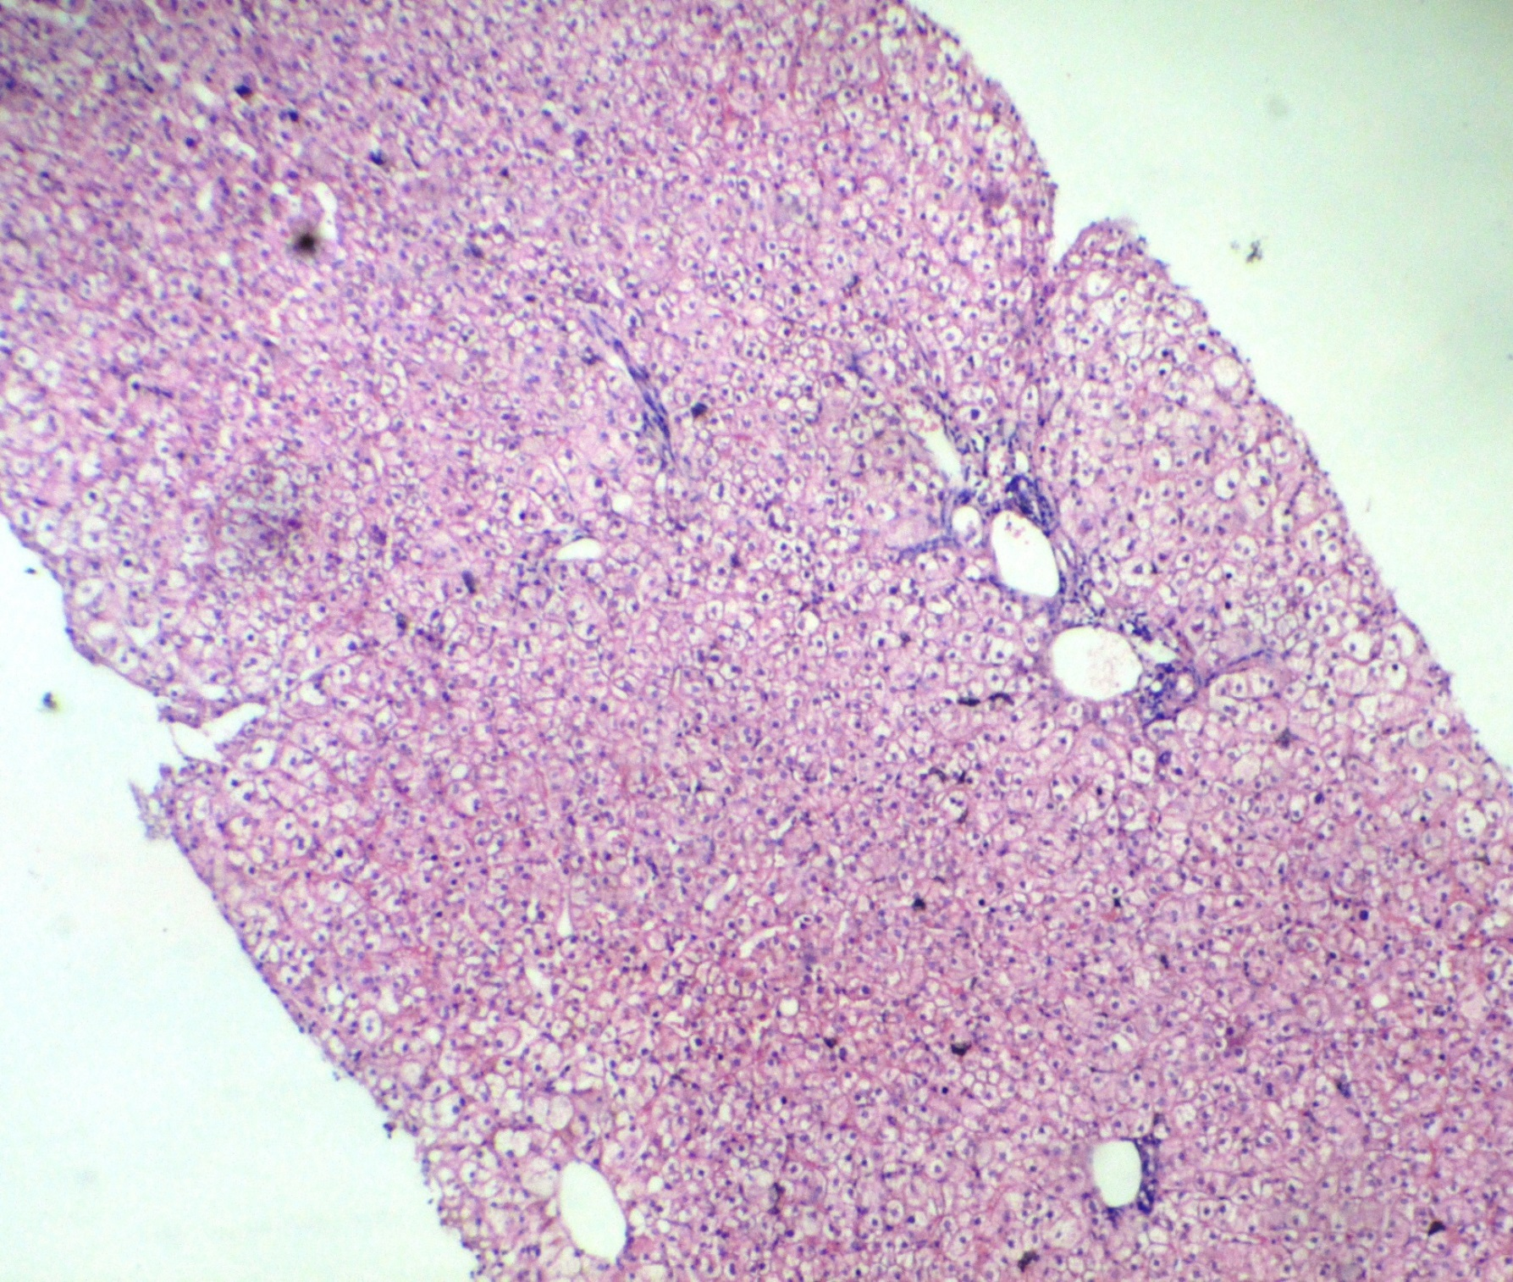
Pr Djennane, Pr, Baba Ahmed, anatomo-pathology, Mohammad-Lamine-Debaghine Hospital, Algeria
Notes:
This biopsy of the liver shewing respected structure, no inflammatory cell in the field, no granuloma.

Slide 13
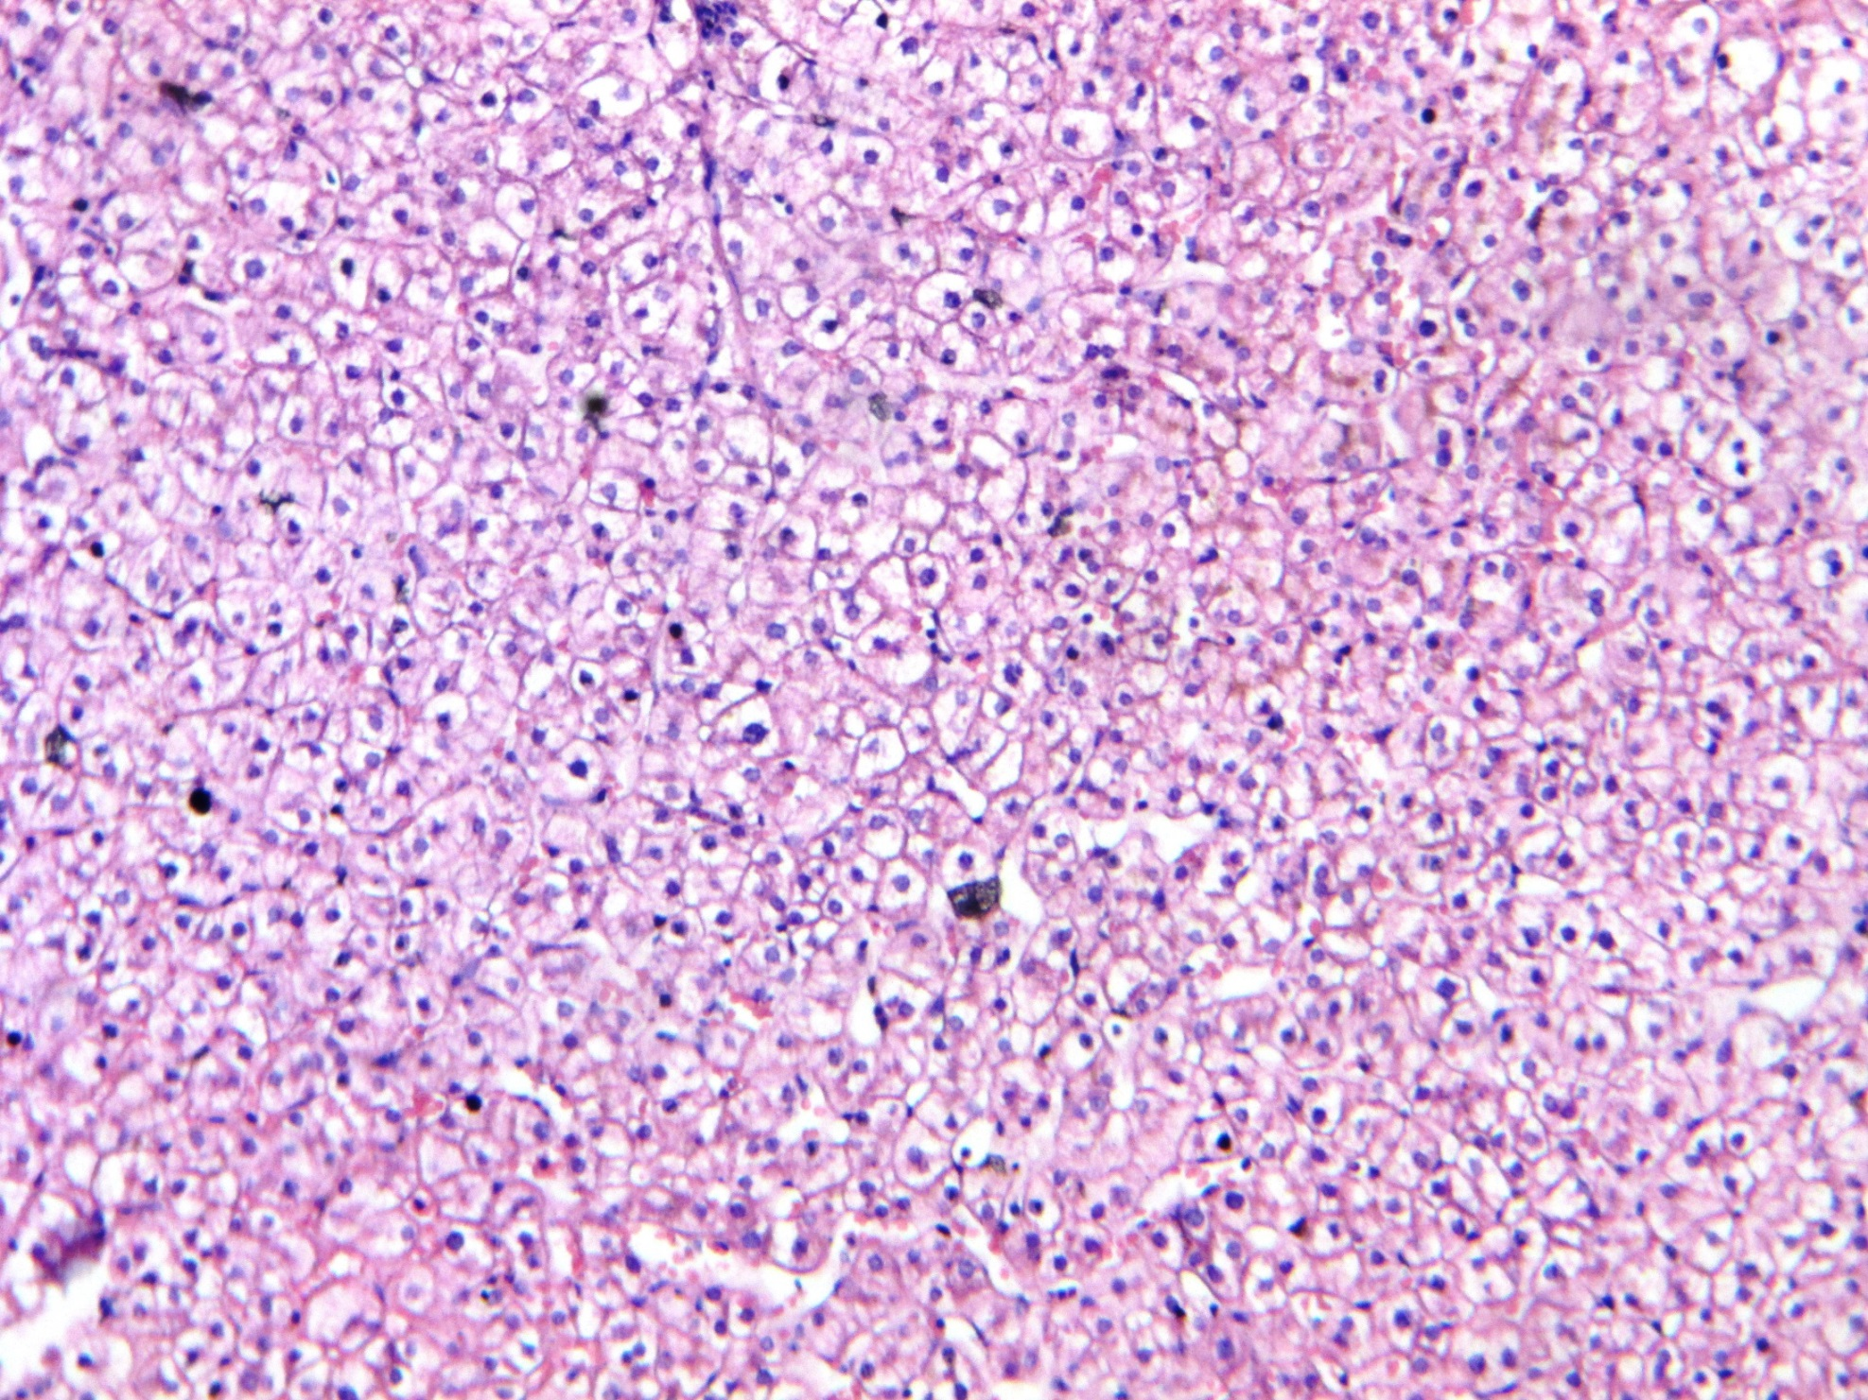
Pr Djennane, Pr, Baba Ahmed, anatomo-pathology, Mohammad-Lamine-Debaghine Hospital, Algeria
Notes:
This is another photo of the biopsy of the liver … no granulomatous lesions

Slide 14
CTC interrupted
Notes:
This curb illustrate the course of creatinine levels and eGFR in the time … you see here at the onset of illness : creatinine was about 28 … then after treatment … it deceased slowly and here at that time … after 4 months of treatment
The patient untimely stopped corticosteroids so she increased again her creatinine levels with of corse decreased renal function, it is actually a relapse that required a 2nd pulse then high-dose daily glucocorticoids. And then Glucocorticoid-sparing was provided by mycophenolate mofetil (MMF). Currently, creatinine levels are between 17-18mg/l
The patient remained well without renal recurrence and without recurrence of uveitis 2 years later but without complete recovery of renal function

Slide 15
2d observation

Slide 16
PATIENT
46 year old woman
professional lab
without specific personal history
mother = died of chronic kidney failure
recurrent anterior uveitis + increase in serum creatinine
Notes:
She was a professional lab, 46year old and more than 20years experience in her job … no specific medical history, but when looking in the familiar history her monther actially died of chronic kidney failure, she experienced recurrent anterior uveitis, associated with an increase in serum creatinine

Slide 17
PATIENT
Clinical examination is unremarkable.
Xerostomia (-) xerophthalmia (-)
Urine dipstick :
proteinuria (+)
glycosuria: traces
pH à 6
blood (-)
nitrites (-)
leucocytes (-)
Notes:
So the clinical examination was unremarkable : no cutaneous manifestations, no cardiac or pulmonary signs, no arteritis or arthralgia, so no clinical manifestation for systemic disease or vasculitis, no xerostomia no dry mouth and no xerophtalmia no dry eye ,
Urine dipstick showed proteinuria and traces of glycosuria, urinary pH was at 6, no blood, no leucocytes, no nitrites.

Slide 18
BIOLOGY FINDINGS
kidney failure :
Urea = 0.55 g/l
Creatininemia = 36 mg/l
eGFR of 14 mL / min/1.73m2.
Inflammatory syndrome,
CRP = 58.8 mg/l
fibrinogène = 5.5g/l
serum protein electrophoresis: hyper alpha 2 = 9.5 g/l, slight hypergammaglobulinemia= 14.1g/l.
Notes:
Biological findings was surprising , kidney failure, urea at the upper limite, but creatinine level was elevated with estimated GFR of only 14, in addition, she was having an inflammatory syndrome : elevated fibrogene and CRP, with hyper-alpha 2 and slight hypergamma large wide based of 14 g/l

Slide 19
BIOLOGY FINDINGS
Proteinuria of 650 mg /day.
Urinary urea =7.93 g/24h, creatininuria = 833 mg/24h.
Infectious agents (-).
Auto-immunity (AAN, ANCA, RF): (-) AntiSSA, antiSSB negative.
Notes:
Proteinuria was about 650mg/d, urinary analysis showed organic kidney insiffisiency , no infectious agent was detected, and no autoimmunity origin , I emphathisize : negative results for antiSSA and antiSSB

Slide 20
IMAGING STUDIES
Chest X ray : nl
Abdominal-pelvic ultrasound : nl.
Gallium scintigraphy : no sarcoidosis inflammatory signs.
Notes:
IMAGING STUDIES showed no nodules, no lesions, no lyphadenopathy, and the Gallium scintigraphy did not find any signs suggesting a type of sarcoidosis inflammatory.

Slide 21
HISTOLOGICAL STUDIES
Renal biopsy : tubulointerstitial nephritis lesions in subacute stage.
Biopsy of the salivary glands : stage III chronic lymphocytic sialadenitis (the Chisholm and Mason classification).
Notes:
No explenation for the the kidney impairment, for that, a renal biopsy was done which showed the presence of tubulointertitial nephritis in subacute stage
salivary glands biopsy was performed essentially looking for sarcoidosis lesion, and surprise … stage III chronic lymphocytic sialadenitis just like we can see in Sjogren syndrom …

Slide 22
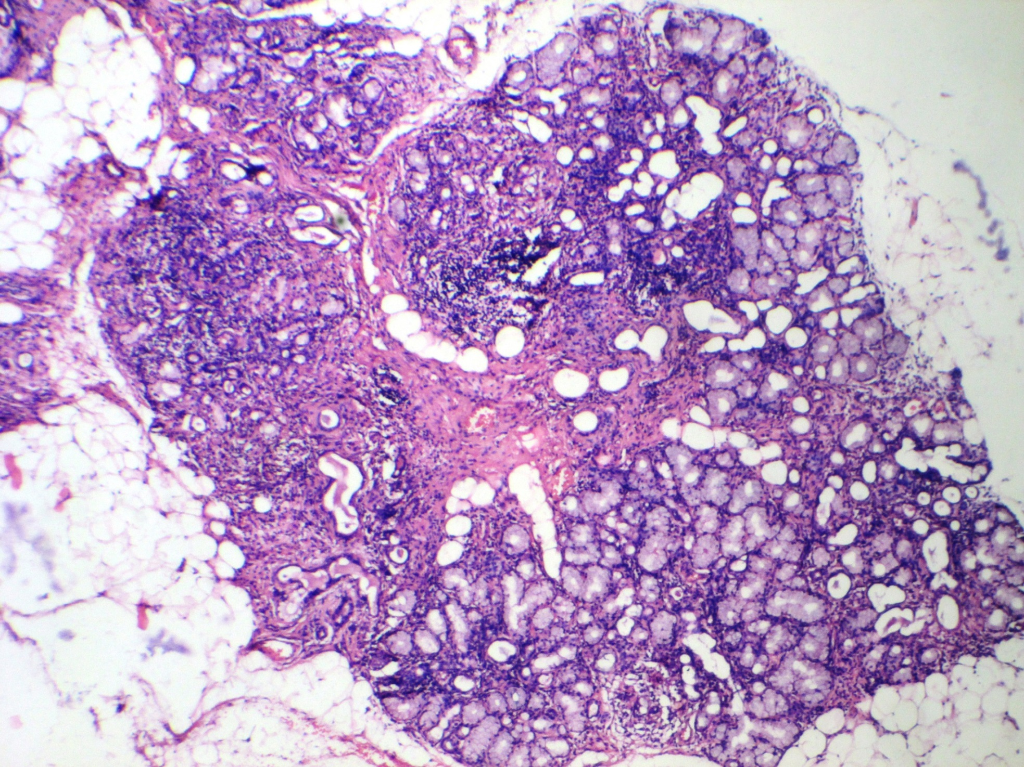
Pr Djennane, Pr, Baba Ahmed, anatomo-pathology, Mohammad-Lamine-Debaghine Hospital, Algeria
Notes:
This is the salivary gland biopsy, this a normal tissu, and here, you see all this purple color which reflect a dense infiltration of inflammatory cells , and also here, and when quantifying nb of these focus, we conclude that it is actually stage III

Slide 23
TREATMENT AND FOLLOW UP
The patient received corticosteroid treatment (high dose then gradually tapered).
Serum creatinine improved quickly with normalization 2 months later.
The patient remained well without recurrence of the disease 6 years later.
Notes:
The patient received high dose of corticosteroid and she improved quickly her serum creatinine, and as it is well known, TINU synrome respond well to corticosteroid, she normalize her renal function within 2months, and also, she did not experienced any renal of ocular recurrence after 6years of follow up

Slide 24
DISCUSSION
Renal biopsy
Tubulo-interstitial nephritis
Ocular fundus
Anterior uveitis
No Other diagnosis
No drugs
No systemic diseases
TINU syndrome
Notes:
In our tow patients the clinical and histologic features of the TINU syndrome were similar to those in the cases described earlier in the literature. The presence of TIN in the renal biopsy, recurrent anterior uveitis, and exclusion of other diagnoses leads to the diagnostic of TINU syndrome.

Slide 25
DISCUSSION
positivity of Quantiferon ?
TINU syndrome is associated with elevation of serological markers in the absence of their corresponding diseases.
Abed L, Merouani A, Haddad E, et al. Presence of autoantibodies against tubular and uveal cells in a patient with tubulointerstitial nephritis and uveitis (TINU) syndrome. Nephrol Dial Transplant 2008; 23:1452
Notes:
The big problem was: for the 1st observation: what about tuberculosis? We found that quantiferon was 10 times normal … what is quantiferon test? quantiferon test allowed us to detect and mesure interferon gamma secreted by lymphocyts T CD4+ and CD8+ , these two inflammatory cells are impicated in the pathogenesis of tuberculosis desease, this test highly specific for tuberculosis
We looked for KB : no clinical signs of tuberculosis, no concept of contagion, TB skin test was negative, negative results of uricult, imaging finding showed no lesions, bronchoscopy with bronchial aspirate did not find KB, all results were negative, and also, patient received immunosuppressive treatment and she improved her renal function . so tuberculosis was far to be the real diagnostic.
The explanation is that, in some articles, they talked about elevation of serological markers in the absence of their corresponding diseases, so here, quantiferon is positive in the absence of tubercuolsis.

Slide 26
DISCUSSION
stage III chronic lymphocytic sialadenitis ➔ histological disorders in the absence of Sjogren syndrome.
Abed L, Merouani A, Haddad E, et al. Presence of autoantibodies against tubular and uveal cells in a patient with tubulointerstitial nephritis and uveitis (TINU) syndrome. Nephrol Dial Transplant 2008; 23:1452
Notes:
For the second patient, most important differential diagnosis was Sjogren syndrome, in which diagnosis is based on the presence of some criteria, basically the sicca symptoms must be present, which is not the case of my patient, and also, no antibodies were detected : negative results for anti SSA and anti SSB, so the histological lesions were isolated without clinical manifestations or positive biological tests, so Sjogren syndrome was also far to be the real diagnostic.

Slide 27
what did the literature said about TINU SYNDROME
Notes:
what actially does the literature say about TINU sd? we gonna go into the theoretical part,

Slide 28
RENAL MANIFESTATIONS
Acute interstitial nephritis.
Flank pain, sterile pyuria, hematuria, proteinuria (usually subnephrotic range), renal insufficiency, and acute renal failure (ARF).
Multiple proximal and distal tubular defects can be commonly seen, resulting in polyuria, nocturia, aminoaciduria, glucosuria, phosphaturia, and acidification defects.
Koike K, Lida S, Usui M, et al. Adult-onset acute tubulointerstitial nephritis and uveitis with Fanconi syndrome. Case report and review of the literature. Clin Nephrol 2007; 67:255
Ying Tan a,b, Feng Yu a,b, Ming-Hui Zhao, Autoimmunity of patients with TINU syndrome, REVIEW ARTICLE, Hong Kong Journal of Nephrology 2011
Notes:
Every single one of you is familiar with Renal manifestations … it’s simply sings of tibulointerstitial nephritis : Flank pain, sterile pyuria, hematuria, proteinuria (usually subnephrotic range), renal insufficiency, and acute renal failure (ARF).
And also, it can be commonly seen Multiple proximal and distal tubular defects with all this signs mentionned

Slide 29
OCULAR MANIFESTATIONS
bilateral non-granulomatous anterior uveitis
The uveitis has been observed to occur :
- before
- concurrently
- after the onset of the interstitial nephritis.
Intraocular complications have been noted, these include
- posterior synechiae, optic disc swelling,
- cystoid macular edema, chorioretinal scar formation,
- cataracts, glaucoma.
Mandeville JT, Levinson RD, Holland GN. The tubulointerstitial nephritis and uveitis syndrome. Surv Ophthalmol 2001; 46:195
Notes:
Most cases suffered from bilateral non-granulomatous anterior uveitis with eye redness, pain, blurred vision, and photophobia, and this uveitis can occur before, concurrently or after the onset of the interstitial nephritis
The problem of the uveitis of TINU sd is that recurrence rate is elevated, it’s about 40%. And for that, complications are not rare.
And These recurrences happened in most cases during tapering corticosteroids , so uveitis of TINU is a little bit corticodependent

Slide 30
LABORATORY FINDINGS
Leukocyturia, eosinophilia
anaemia
slightly abnormal liver function tests
elevated erythrocyte sedimentation rate (ESR) and C-reactive protein (CRP).
Glycosuria may be observed (1)
Antibodies against both tubular and uveal cells(2).
There are no specific serum markers or laboratory findings that are unique to patients with TINU.
(1)Conz PA, Milan M, Bragantini L, et al. TINU syndrome associated with reduced complement levels. Nephron 2001; 89:340
(2)Abed L, Merouani A, Haddad E, et al. Presence of autoantibodies against tubular and uveal cells in a patient with tubulointerstitial nephritis and uveitis (TINU) syndrome. Nephrol Dial Transplant 2008; 23:1452
Notes:
Commonly, we can see tubular signs: Leukocyturia, eosinophilia, and inflammatory biological syndrome : Glycosuria may also be observed, slightly abnormal liver function tests that we can not explain.
Unfortunately, no specific marker is here to tell us there is TINU sd, and no laboratory findings that are unique to diagnose TINU sd …
In TINU sd, many articles talked about some specific antibodies and markers that are detected in the sera of patient with TINU sd especially in the acute phase but they are not well proved and Immunofluorescence studies failed to show the presence of these antibodies in most cases,

Slide 31
LABORATORY FINDINGS
Elevations have been found in serum levels of beta-2 microglobulin, Krebs Von Den Lunge-6 (KL6) and mCRP antibodies(1).
Associations of TINU with a variety of serologic markers in the absence of their correspondent disease have been reported (ANCA, ANA, RF, autoantibody directed against renal tubular cells, hypocomplementemia)(2).
(1)Kase S, Kitaichi N, Namba K, et al. Elevation of serum Krebs von den Lunge-6 levels in patients with tubulointerstitial nephritis and uveitis syndrome. Am J Kidney Dis 2006; 48:935
(2)Abed L, Merouani A, Haddad E, et al. Presence of autoantibodies against tubular and uveal cells in a patient with tubulointerstitial nephritis and uveitis (TINU) syndrome. Nephrol Dial Transplant 2008; 23:1452
Notes:
These antibodies are essencially Krebs Von Den Lunge-6 (KL-6) and mCRP antibodies, B2 microglobiline is an inflammatory protein, which is a component of the major histocompatibility complex class I, it can be detected in many biological fluids such as urine, and it can be used to distinguish between glomerular and tubular disorders of the kidney, its levels increase also when the immune system is activated, so this marker is not specific for TINU sd
Krebs von den Lunge-6 (KL-6) is a human glycoprotein secreted by type II alveolar cells in the lung, and it is increase in patients with pneumonia of various causes, as well as ocular sarcoidosis … it is also nonspecific for TINU sd.
The B2 microglobiline and KL6 decrease after the commencement of treatment and for that, they are considered to reflect the renal lesion,
mCRP antibody has been found with elevated titers in both the active phase of tubulointerstitial nephritis and right before the relapse of uveitis, which suggests that it might be a potentially useful biomarker for diagnosis and monitoring of disease activity .
many articles reported the Associations of TINU with a variety of serologic markers in the absence of their correspondent disease, don’t forget that there is some innocent antibodies which are present but without clinical symptoms, we can see for example AAN without lupus

Slide 32
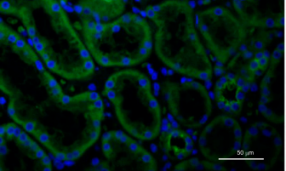
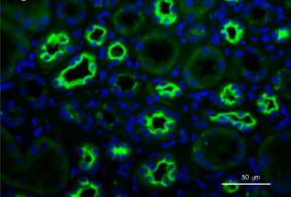
Immunofluorescence staining of KL-6 (green) on renal tissues from patients with ATIN
Cui Li, Tao Su, Rong Chu, Xiaomei Li, and Li Yang, Tubulointerstitial Nephritis with Uveitis in Chinese Adult, Clin J Am Soc Nephrol 9: 21–28, 2014. doi: 10.2215/CJN.02540313
Notes:
This picture here in the left show Renal tissue adjacent to tumors presents weakly positive staining of KL-6 in a few tubules. But here in the right : More positive tubules of KL-6 were seen in renal tissue of patients with TINU

Slide 33
HISTOLOGICAL FINDINGS
Interstitial inflammatory cell
infiltration
Interstitial edema
Tubulitis, fibrosis
Notes:
Typical renal biopsy findings include interstitial inflammatory cell infiltration, interstitial edema with plasma cells, lymphocytes and eosinophil infiltration, tubular injory, fibrosis, tubuitis, tubular atrophy and focal loss of peritubular capillaries.
Granuloma, as we said before can sometimes be seen in biopsy specimen, since first description in 1975, when non caseating granuloma has been defined in the bone marrow of patient with TINU, I insist on the non caseating character because the presence of caseoma is specific of tuberculosis.

Slide 34
HISTOLOGICAL FINDINGS
Interstitial inflammatory cell
infiltration
Interstitial edema
Tubulitis, fibrosis
Notes:
Typical renal biopsy findings include interstitial inflammatory cell infiltration, interstitial edema with plasma cells, lymphocytes and eosinophil infiltration, tubular injory, fibrosis, tubuitis, tubular atrophy and focal loss of peritubular capillaries.
Granuloma, as we said before can sometimes be seen in biopsy specimen, since first description in 1975, when non caseating granuloma has been defined in the bone marrow of patient with TINU, I insist on the non caseating character because the presence of caseoma is specific of tuberculosis.

Slide 35
GENETIC ?
Familal forms?
monther and her son
Seblings
Twins
Association : HLA
Ying Tan a,b, Feng Yu a,b, Ming-Hui Zhao, Autoimmunity of patients with TINU syndrome, REVIEW ARTICLE, Hong Kong Journal of Nephrology 2011
Notes:
No definitive identified familial, genetic, or geographic clustering has been reported, and only some sporadic cases have been described, TINU sd in a mother and her son, 2pair of twins boys and girls. And in 2 seblings , which perhaps indicates the inheritance of HLAlinked risk factors of TINU syndrome
A strong association was noted with HLA-A24, Cw3, A2, DR6

Slide 36
DIAGNOSIS
AIN + uveitis + exclusion of differential diagnistic
AIN should be diagnosed histopathologically or clinically.
onset of bilateral anterior uveitis less than 2 months before or no more than 12 months after AIN.
TINU syndrome is a diagnosis
per exclusionem
Ying Tan a,b, Feng Yu a,b, Ming-Hui Zhao, Autoimmunity of patients with TINU syndrome, REVIEW ARTICLE, Hong Kong Journal of Nephrology 2011
Notes:
How can we diagnose TINU sd? The diagnosis of TINU syndrome requires the presence of both AIN and uveitis and the exclusion of other known systemic diseases that can cause interstitial nephritis or uveitis : AIN should be diagnosed histopathologically or clinically. And for uveitis, the onset of bilateral anterior uveitis should be diagnosed less than 2 months before or no more than 12 months after AIN.
And also remonber TINU syndrome is a diagnosis per exclusionem

Slide 37
DIFFERENTIAL DIAGNOSIS
TINU syndrome is a diagnosis per exclusionem
Sarcoidosis
Sjögren's syndrome
Systemic lupus erythematosus
Wegener's granulomatosis
Behçet’s syndrome
Infectious diseases : tuberculosis, brucellosis, toxoplasmosis, EBV, syphilis, and histoplasmosis
Notes:
What does this means? All other known systemic diseases that can cause interstitial nephritis or uveitis should be excluded … as you know excluding systemic diseases is a little bit more hard, these tow target organs of TINU can be targeted by these systemic diseases which can manifest firstly with renal and eye damage. The most important differential diagnosis are sarcoidosis and Sjogren sd and also … infectious deseases .
Many of these disorders may present with additional ocular findings that are distinct from uveitis, as well as evidence of other organ involvement, which can help to suggest the correct diagnosis.
However, sarcoidosis and Sjögren's syndrome share similar findings with TINU, making accurate diagnosis difficult in the absence of characteristic involvement of other organs.

Slide 38
TIN MANAGEMENT
Renal disease in patients with TINU is generally believed to be self-limited (1) .
Patients with progressive renal insufficiency are typically treated with prednisone at a dose of 1 mg/kg per day (typically between 40 to 60 mg/day) then slowly tapered.
relapses are more likely to occur in TINU syndrome.
(1)Takemura T, Okada M, Hino S, et al. Course and outcome of tubulointerstitial nephritis and uveitis syndrome. Am J Kidney Dis 1999; 34:1016.
Notes:
Renal disease in patients with TINU can resolve without treatment, especially in children
And when starting treatment, In general, patients respond well to corticosteroids, but if there is progressive renal insufficiency, high dose is necessary, so patients in these conditions are typically treated with prednisone at a dose of 1 mg/kg per day then slowly tapered
However, relapses are more likely to occur in TINU syndrome because of the potential immunologic basis of the disease and the lack of a possible culprit agent.

Slide 39
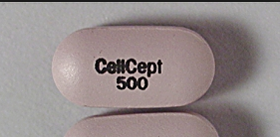
TIN MANAGEMENT
Mycophenolate mofetil:
limited number of patients
acute interstitial nephritis
one reported patient with TINU for the treatment of progressive renal insufficiency.
Preddie DC, Markowitz GS, Radhakrishnan J, et al. Mycophenolate mofetil for the treatment of interstitial nephritis. Clin J Am Soc Nephrol 2006; 1:718.
Notes:
for steroid-resistant or intolerant patients, MMF seems to be a useful therapeutic option
MMF has immunosuppressive and immunomodulatory properties that result from reducing lymphocyte proliferation, downregulating the expression of cell surface adhesion molecules, and decreasing antibody production
Mycophenolate mofetil has been used in a limited number of patients with acute interstitial nephritis and in one reported patient with TINU for the treatment of progressive renal insufficiency.

Slide 40
RENAL PROGNOSIS
multiple variables :
degree of tubulointerstitial fibrosis (1)
eGFR at 12 months
Age
ESR
leukocyturia
serum creatinine at the time of biopsy (2)
(1) van Leusen R, Assmann KJ. Acute tubulo-interstitial nephritis with uveitis and favourable outcome after five months of continuous ambulatory peritoneal dialysis (CAPD). Neth J Med 1988; 33:133.
(2)Li C, Su T, Chu R, et al. Tubulointerstitial nephritis with uveitis in Chinese adults. Clin J Am Soc Nephrol 2014; 9:21
Notes:
The prognosis appears to be dependent upon multiple variables : degree of tubulointerstitial fibrosis, eGFR at 12 months correlated with these different factors : age; presence of thyroid disease; erythrocyte sedimentation rate (ESR); leukocyturia; and serum creatinine at the time of biopsy

Slide 41
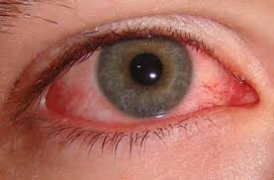
UVEITIS MANAGMENT AND PROGNOSIS
Topical and systemic corticosteroids = success.
steroid-sparing immunosuppressive agents are sometimes needed.
Ying Tan a,b, Feng Yu a,b, Ming-Hui Zhao, Autoimmunity of patients with TINU syndrome, REVIEW ARTICLE, Hong Kong Journal of Nephrology 2011
Notes:
Topical and systemic corticosteroids have been used for uveitis with success.
Infrequently, steroid-sparing immunosuppressive agents such as cyclosporine, methotrexate, and Mycophenolate Mofetil are needed.
As we said before … Recurrences and relapses of uveitis are common.

Slide 42
CONCLUSION
TINU syndrome is a rare entity?
Pathogenesis autoimmune origin.
TINU syndrome is secondary to immunological disorders as evidenced interstitial infiltrate of the renal parenchyma, the inflammatory disease of the uvea and good response to corticosteroid therapy.
Notes:
Is TINU syndrome realy rare or it is under-estimated and under diagnosed?
Why pathogenesis still unkown? Is it related to auto-immune origin? To unswer to this question, we need studies based on lage numbre of patients which is a little bit difficult
Can mCRP levels replace renal biopsy which is an invasive procedure?
Some others said that TINU syndrome is secondary to immunological disorders as evidenced interstitial infiltrate of the renal parenchyma, the inflammatory disease of the uvea and good response to corticosteroid therapy. Can these words be transformed to a diagnosis creteria? Perhaps research of next years will unswer to all these questions … thank you

