Slide 1
About OMICS Group
OMICS Group International is an amalgamation of Open Access publications and worldwide international science conferences and events. Established in the year 2007 with the sole aim of making the information on Sciences and technology ‘Open Access’, OMICS Group publishes 400 online open access scholarly journals in all aspects of Science, Engineering, Management and Technology journals. OMICS Group has been instrumental in taking the knowledge on Science & technology to the doorsteps of ordinary men and women. Research Scholars, Students, Libraries, Educational Institutions, Research centers and the industry are main stakeholders that benefitted greatly from this knowledge dissemination. OMICS Group also organizes 300 International conferences annually across the globe, where knowledge transfer takes place through debates, round table discussions, poster presentations, workshops, symposia and exhibitions.

Slide 2
About OMICS Group Conferences
OMICS Group International is a pioneer and leading science event organizer, which publishes around 400 open access journals and conducts over 300 Medical, Clinical, Engineering, Life Sciences, Phrama scientific conferences all over the globe annually with the support of more than 1000 scientific associations and 30,000 editorial board members and 3.5 million followers to its credit.
OMICS Group has organized 500 conferences, workshops and national symposiums across the major cities including San Francisco, Las Vegas, San Antonio, Omaha, Orlando, Raleigh, Santa Clara, Chicago, Philadelphia, Baltimore, United Kingdom, Valencia, Dubai, Beijing, Hyderabad, Bengaluru and Mumbai.

Slide 3



UMR 6226 CNRS_Université de Rennes1
Correlation Between Magnetism and Luminescence in Redox Active Single Molecule Magnet.
Conductivity
Magnetism
Lahcène Ouahab
Multifunctional Materials
Spin cross-over
Luminescence

Slide 4
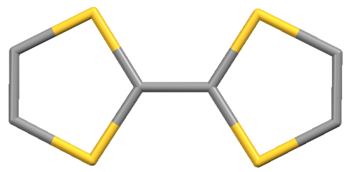
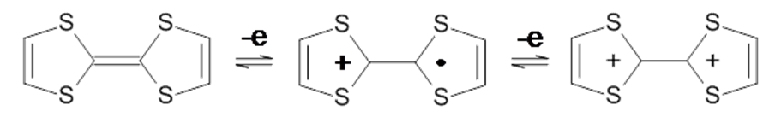
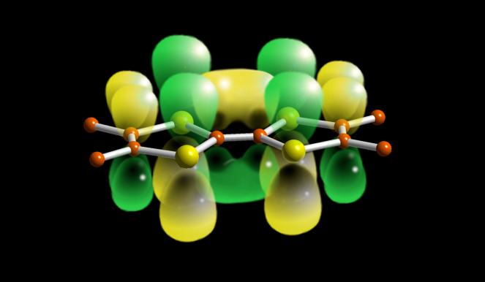
Multifunctional Molecular Systems : Molecules and Materials
π
3d
Lanthanides
Luminescence
High magnetic moment
Strong Anisotropy
TTFs
Planar molecules
Delocalized π systems
accessible redox potentials
Stable radical cations
Charge transfer complexes
Mixte valence compounds
M
4f
SMM and SIM
* Use of TTF derivatives as organic antenna for the sensitization of the Ln Luminescence
* TTF containing Ln complexes as redox-active S M M
* Combination of luminescence and magnetism and conductivity

Slide 5

OUTLINE
Introduction
TTF for sensitization of Ln(III) Luminescence
SMM in 4f complexes with TTFs
Solid state vs. solution
Radical cation
[Ln(hfac)₃(L)₂] ;
Ln(III) = Er, Yb
Redox-active Luminescente SMM
[Yb(hfac)₃(L¹)]₂
[Yb(tta)₂(μ-L²)(L³)]₂•2(CH₂Cl₂)
Conclusion

Slide 6

LUMINESCENCE
Due to the weak absorption coefficient for the f-f transitions, the luminescence of the lanthanides is sensitized via a π system
hν ~ 20000 cm⁻¹
E
ET
relaxation
¹CT
Ln
Acceptor
¹CT*
energy transfer
ILCT
Absorption
²F_{5/2}
Fluorescence
Use of the TTF core as organic antenna
Luminescence
²F_{7/2}
Limited choice to the Near IR emissive lanthanide ions due to absorption in the visible energy range
Emission
Coord. Chem. Rev. 2012, 256, 1604

Slide 7
LUMINESCENCE OF LANTHANIDES
Oblate : Pr(III), Nd(III), Tb(III), Dy(III)
Prolate : Er(III), Yb(III)
Yb(III)
J.-C. G. Bünzli et al. Chem Rev. Soc. 2005, 34, 1048

Slide 8
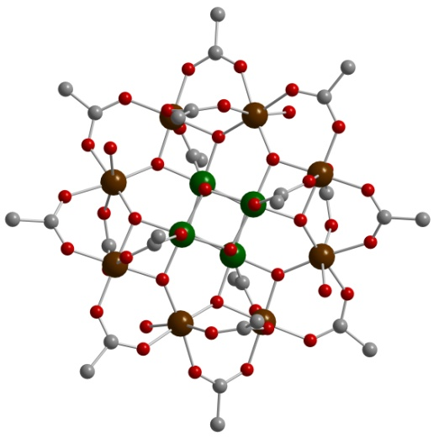


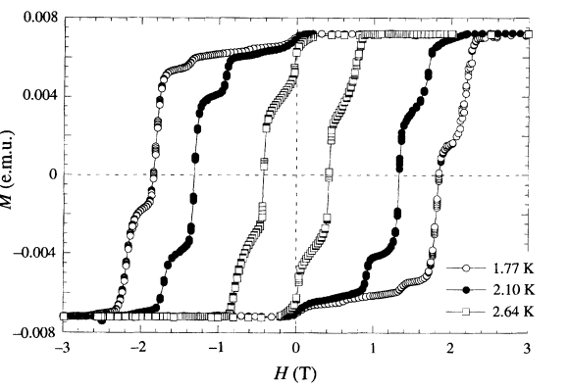
Single Molecule Magnet
Molecule exhibiting a slow relaxation of the magnetization induced by the combination of High spin value (S) + magnetic anisotropy (D). These features create an energy barrier between S up and S down, leading to a hysterisis loop with reversal of the magnetization
H=0
ΔE
Mn₁₂O₁₂(Oac)₁₆(H₂O)₄
M=S+2
Tunneling
M= -S+2
M=S+1
M= -S+1
M=S
M= -S
up
ΔE=|DS²|
down
(4Mn^{IV} + 8Mn^{III})
S = 10
T. Lis, Acta Cryst. (1980). B36, 2042 , R. Sessoli, D. Gatteschi et al. Nature, 1993

Slide 9

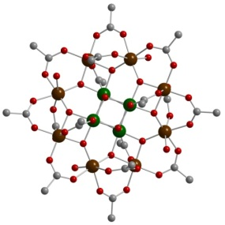
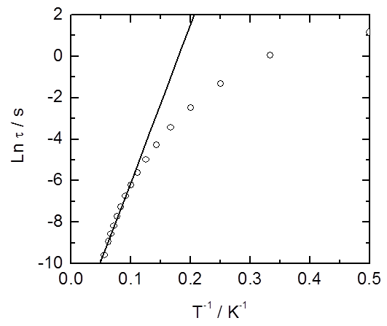
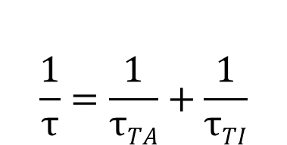
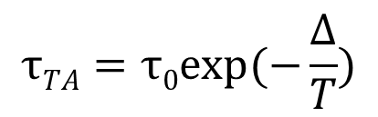

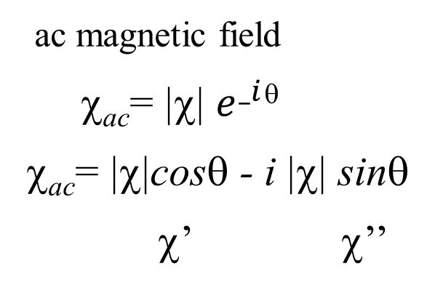
How to Evidence Single Molecule Magnet
acmagneticfield
χ_{ac}= |χ| $e^{_i}$^{θ}
χ_{ac}= |χ|cosθ - i |χ| sinθ
χ’ χ’’
H
● χ_{M}’
○ χ_{M}’’

Slide 10
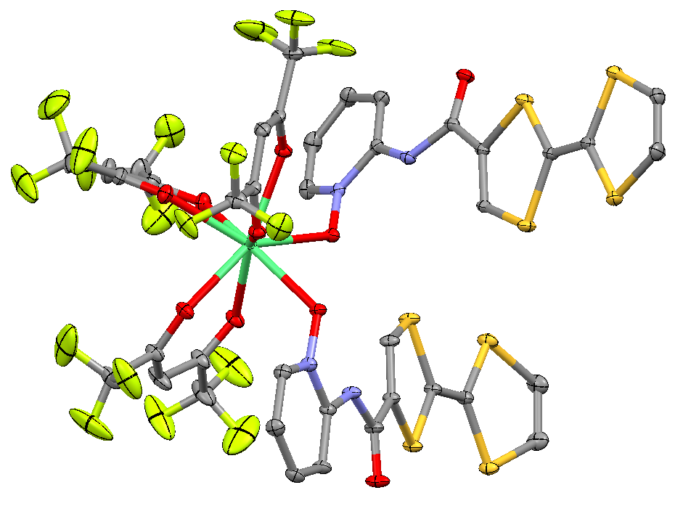
TTFs as antenna for the sensitization of Ln luminescence
[Ln(hfac)₃(H₂O)_{n}]
+
+
(L)
3-chloro-benzoïc acid
[Ln(hfac)₃(L)₂]
Ln(III) = Dy, Y, Er , Yb
Chem. Eur. J. 2010, 16, 11769

Slide 11
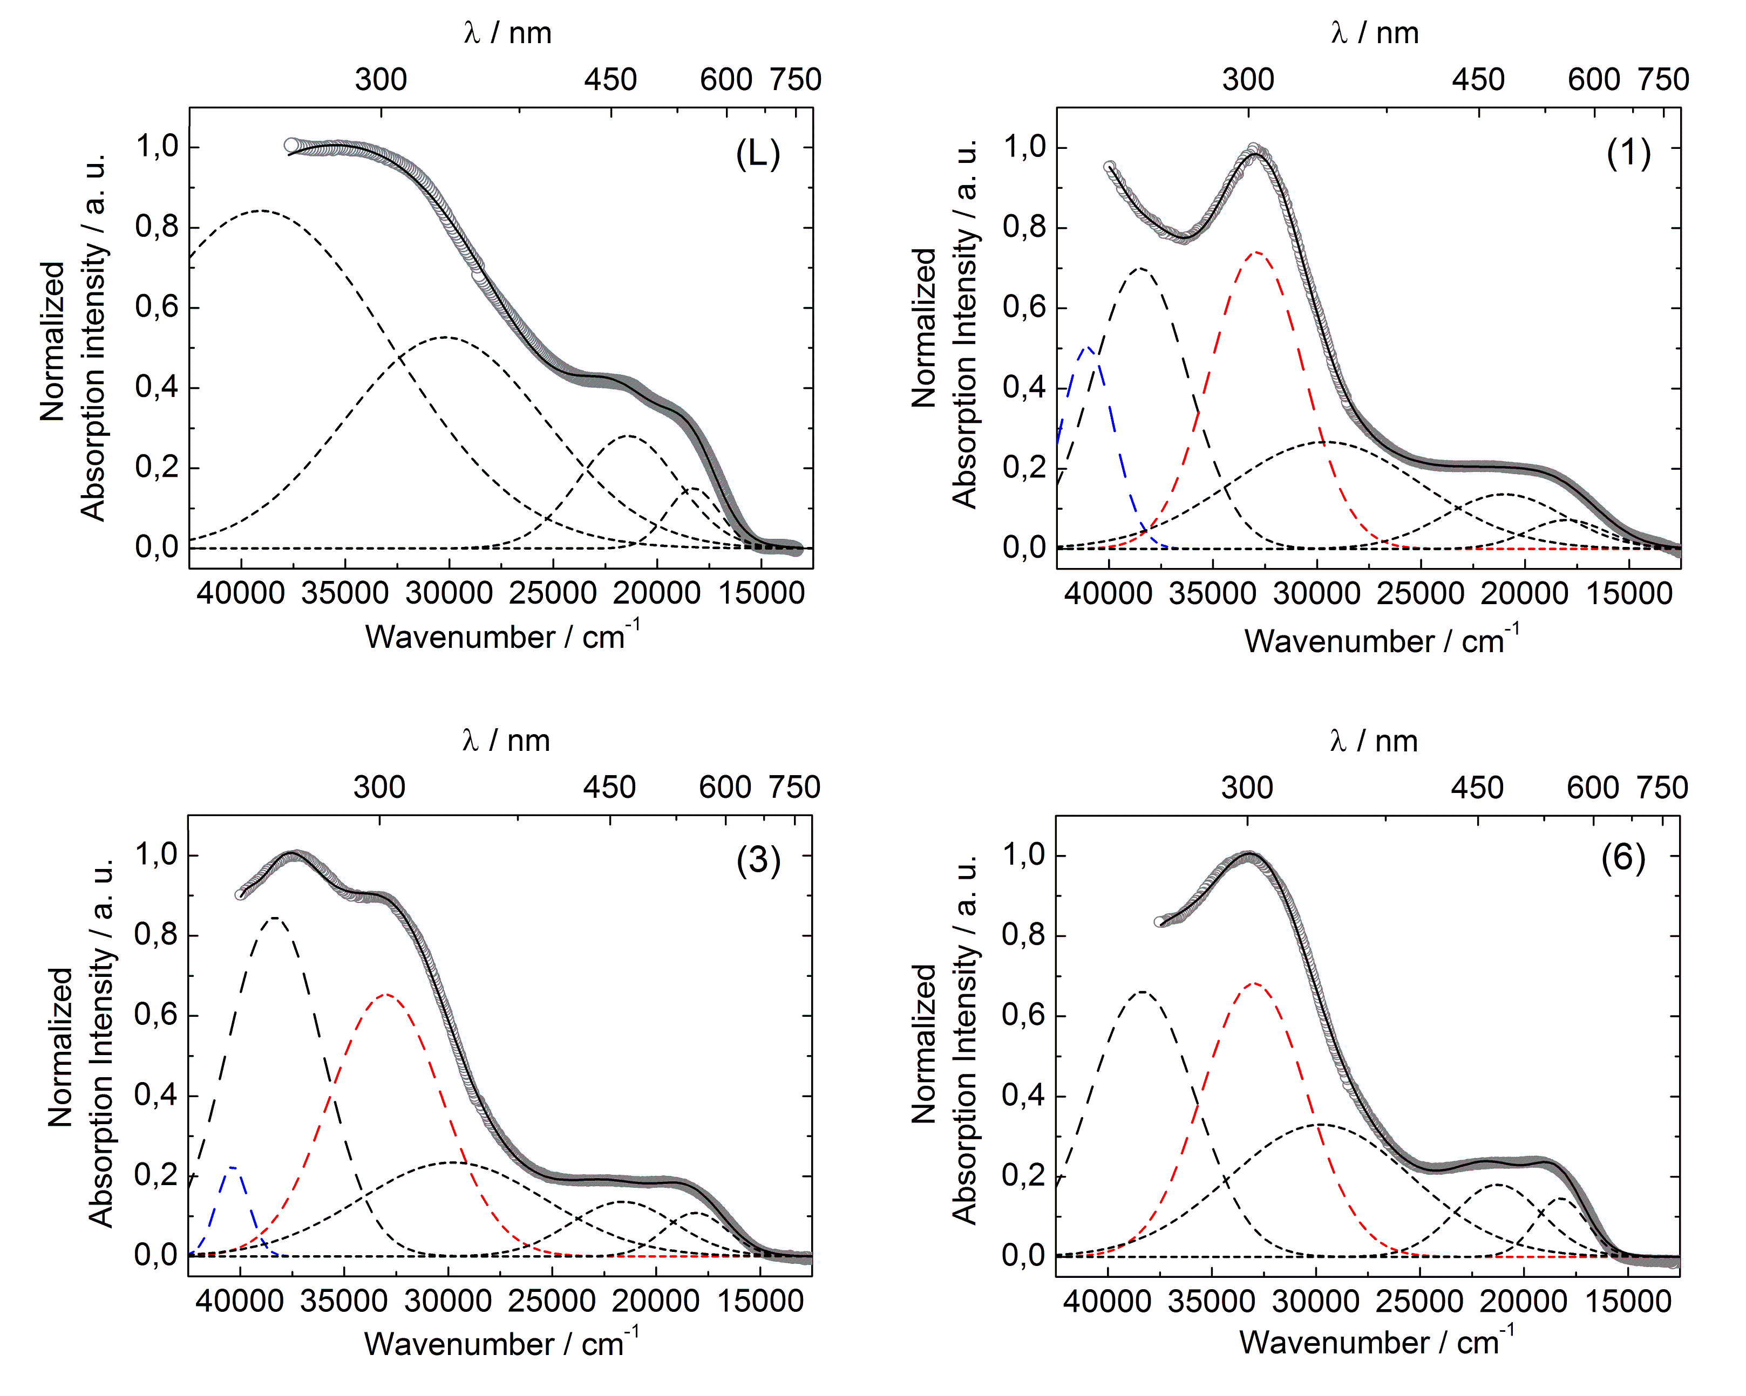

ABSORPTION PROPERTIES
Complexes
DACT
Measurements done in solid-state to prevent any risks of dissociation for the coordination complexes

Slide 12
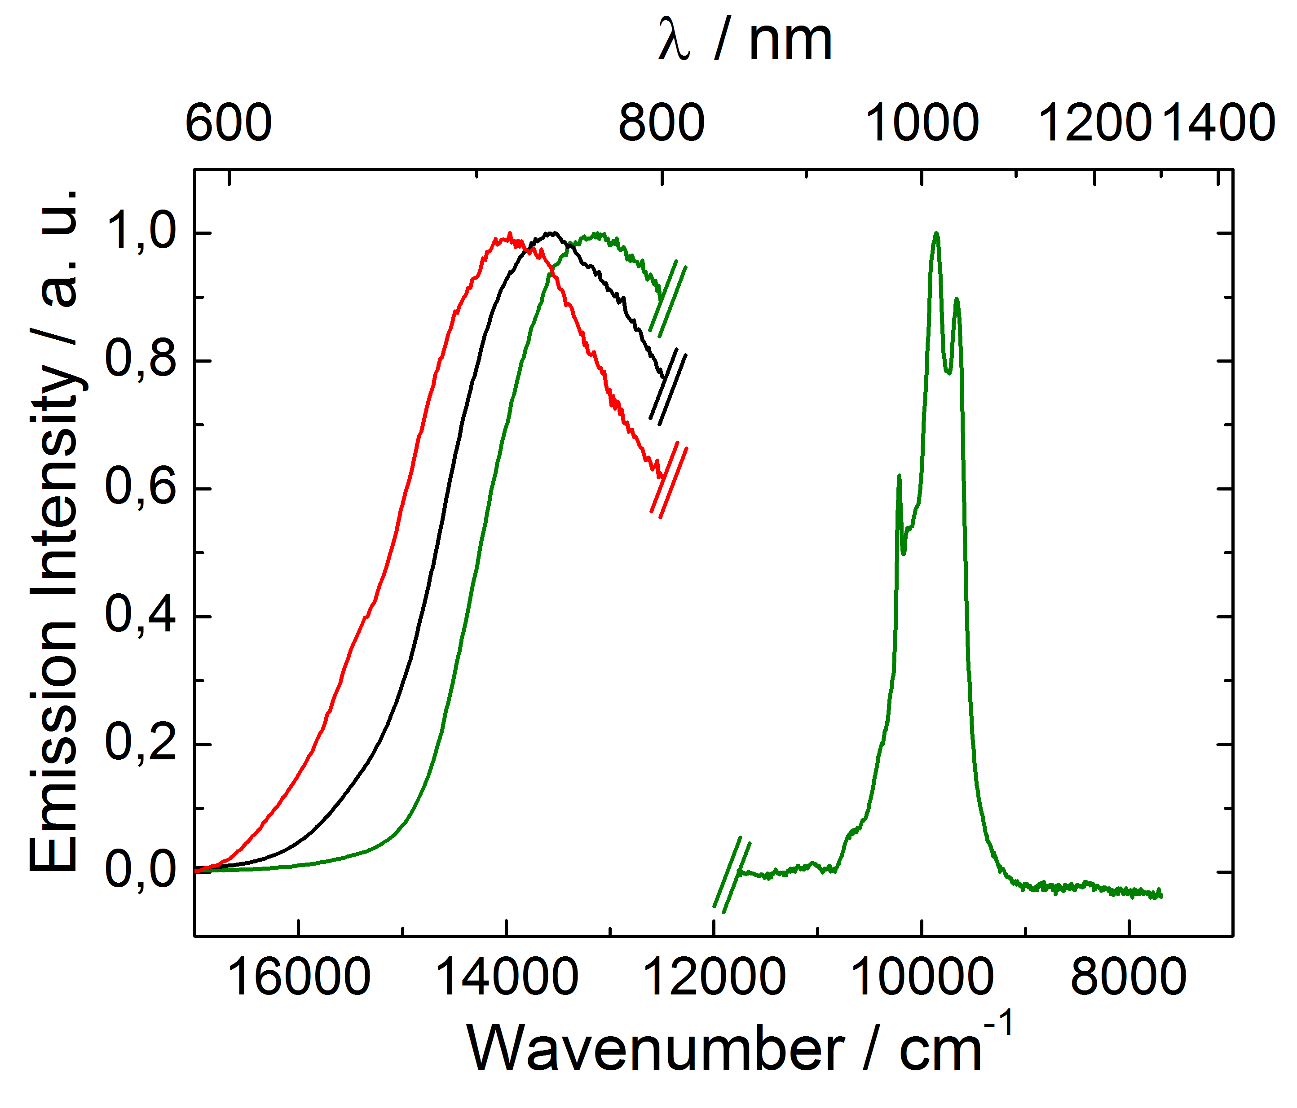
EMISSION PROPERTIES
Free Ligand Y(III) complex Yb(III) complex
Irradiation at 19600 cm⁻¹
Fluorescence of the ligand at 13986, 13568 and 13157 cm⁻¹
+
Luminescence of the Yb(III) ion at 9860 cm⁻¹ attributed to the ²F_{5/2} → ²F_{7/2} excitations

Slide 13
Ln(III) / TTF-BASED
SINGLE MOLECULE MAGNET
Mn₁₂O₁₂(Oac)₁₆(H₂O)₄
thousands papers
(4Mn^{IV} + 8Mn^{III})
S = 10
R. Sessoli, D. Gatteschi et al. Nature, 1993

Slide 14
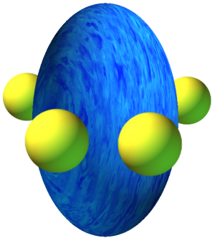
Electro-active
Luminescente
Single Molecule Magnets
Dy(III), Tb(III) SMM but Luminescence in yellow-orange-green
where TTF ligands absorb
Yb(III), Nd(III) Luminescence in NIR
But not convenient for SMM
Yb(III)
Equatorial environnement might be a serious candidate
to promote ising type anisotropy
J. D. Rinehart and J. R. Long, Chem. Sci., 2011, 2, 2078.
Prolate

Slide 15

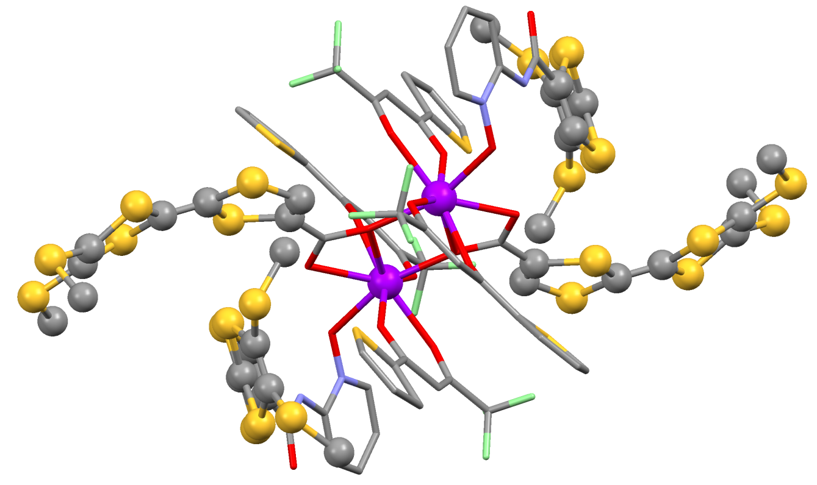
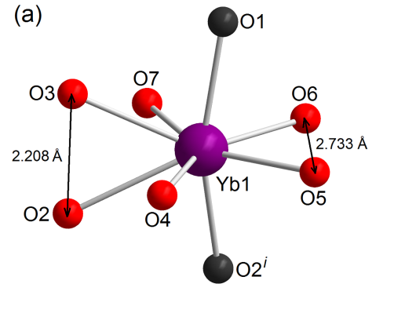
[Yb(tta)₂(μ-L²)(L³)]₂•2(CH₂Cl₂)
L³ = bismethylthio-tetrathiafulvalene-amido-2-pyridine-N-oxide
L² = bismethylthio-tetrathiafulvalene-carboxylate
Planar distortion of the D_{2d} dodecahedron
Chem Commun., 2013, 49, 615-617

Slide 16
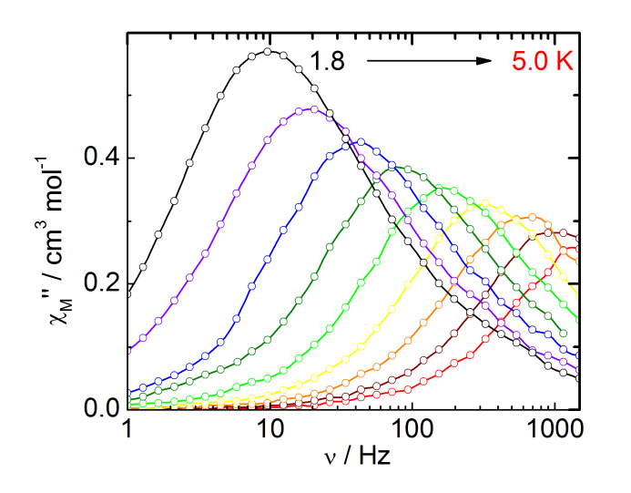
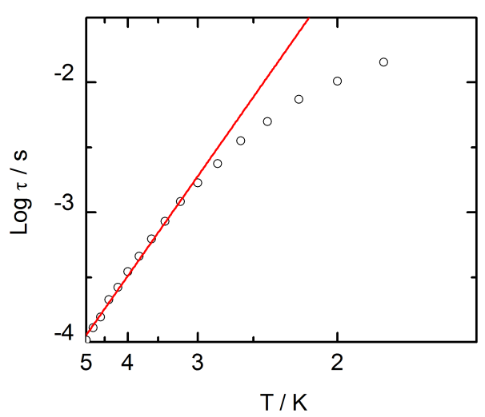
DYNAMIC MAGNETIC PROPERTIES
τ₀ = 1.7(3)×10⁻⁶ s
= 14.7(5) cm⁻¹

Slide 17
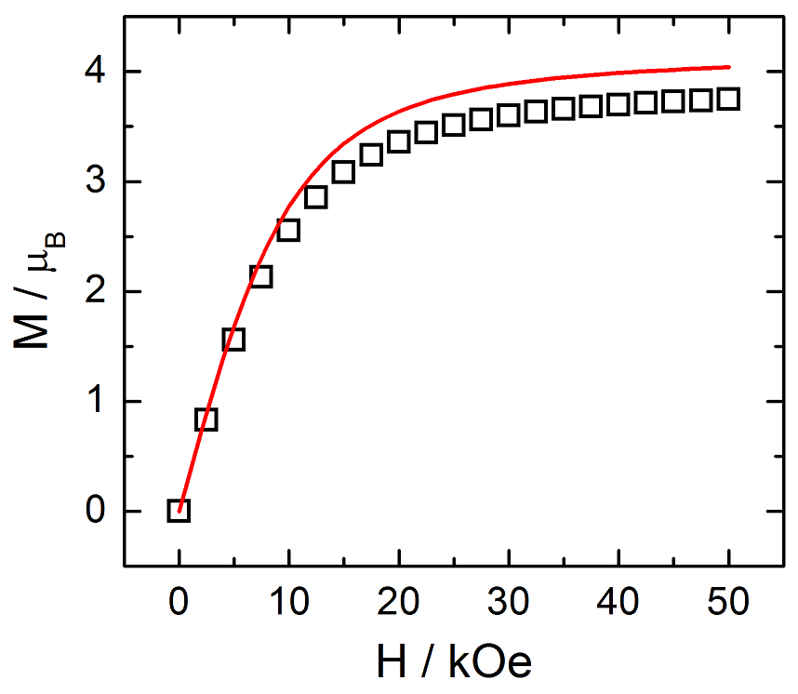
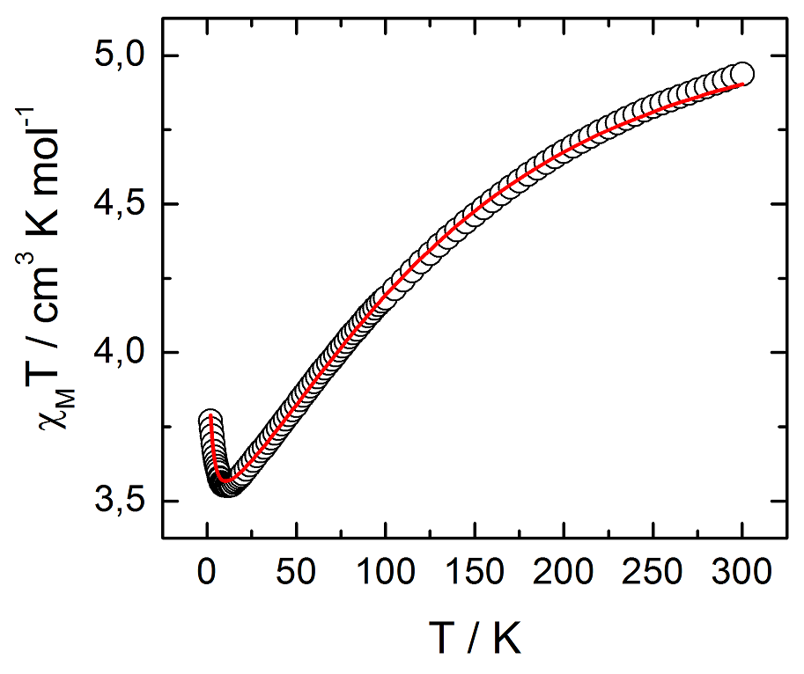
STATIC MAGNETIC PROPERTIES
Steven’s Technique
The ground state is M_{J} = ± 7/2

Slide 18
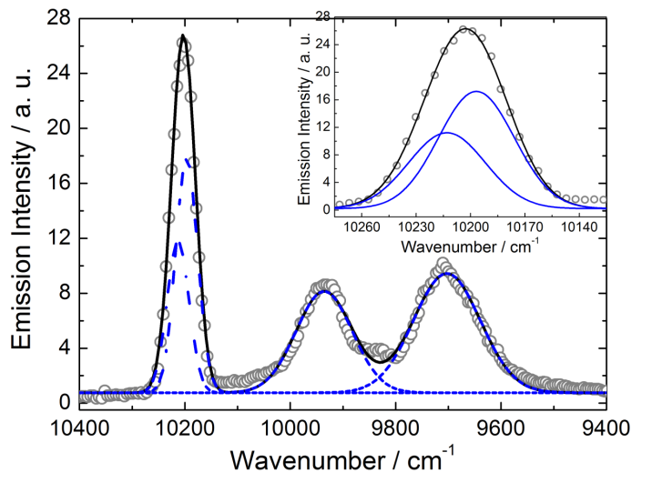
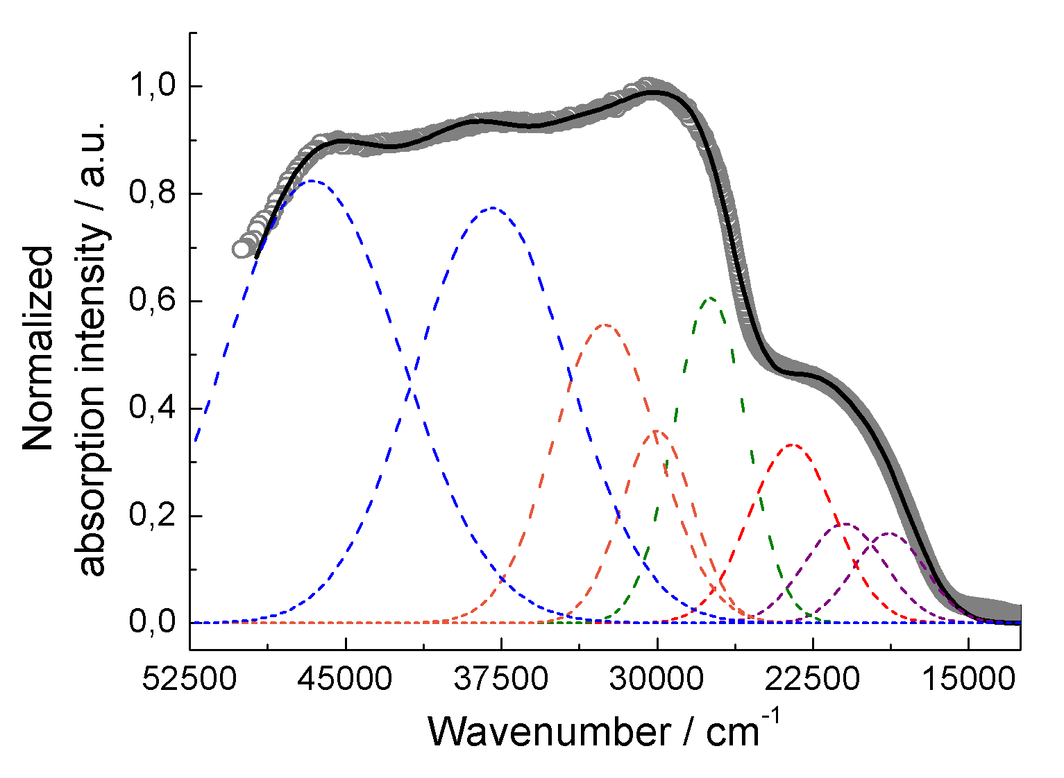
PHOTO-PHYSICAL PROPERTIES
EMISSION
ABSORPTION
Irradiation at 20000 cm⁻¹
²F_{5/2}
±7/2
DACT (L²)
±1/2
LLCT (L² vers tta)
±3/2
±5/2
±5/2
±3/2
²F_{7/2}
±1/2
±7/2
Luminescence of the Yb(III) ion at 9860 cm⁻¹
attributed to the ²F_{5/2} → ²F_{7/2} excitations

Slide 19
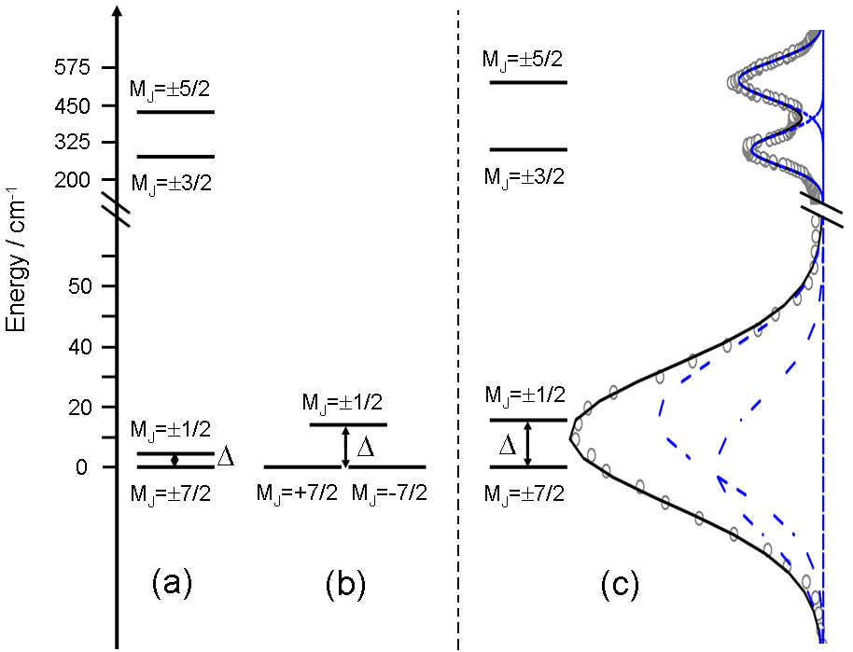
MAGNETO-EMISSION CORRELATION
Energy splitting of the M_{J} level of the ²F_{7/2} ground state multiplet determined from the dc fit (Δ=2.57 cm⁻¹) (a) ac fit (Δ=14 cm⁻¹) (b) and luminescence spectrum (Δ=16 cm⁻¹) (c).
redox-active luminescent Yb(III) SMM with very good agreement between magnetic and optical properties
Chem Commun., 2013, 49, 615-617

Slide 20
…. In solution memory effect

Slide 21
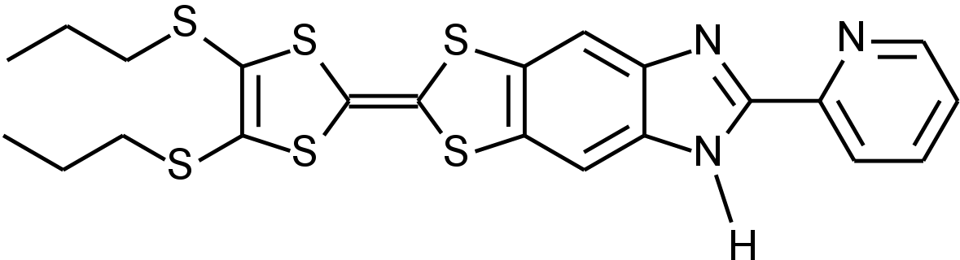
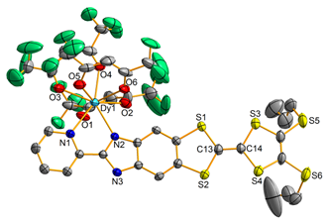
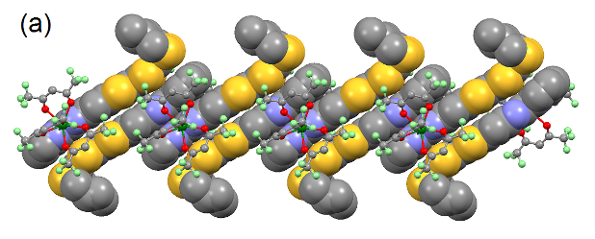
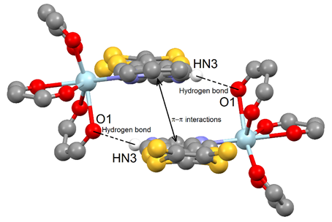
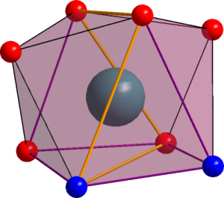
+
Ln(hfac)₃•2H₂O
L²
Ln(hfac)₃L²; Ln^{III} = Y, Dy, Er, Yb
Deformed C_{2v} symmetry
O_{hfac}…H_{NH} = 2.93Å

Slide 22
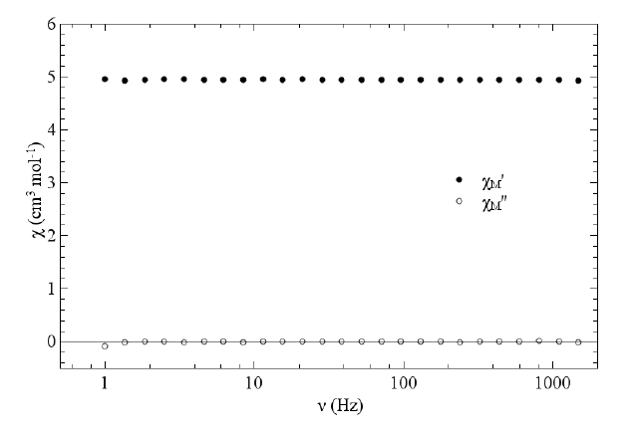
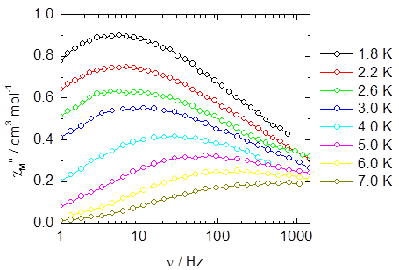
Dy(hfac)₃L²
Solid state
In solution
Δ= 12(1) K
τ₀= 1.9(4).10⁻⁶ s)

Slide 23
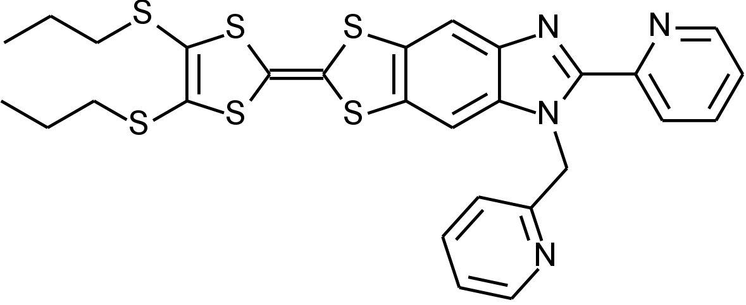
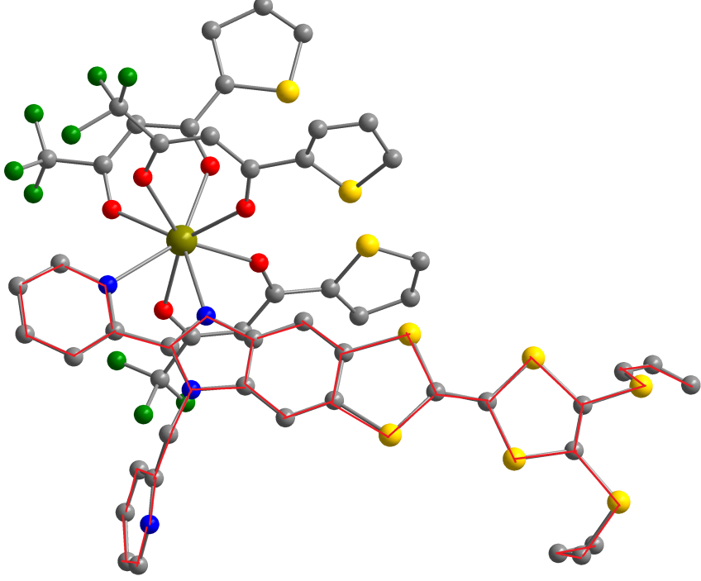
L³
+
Ln(tta)₃•2H₂O
[Dy(tta)₃(L₃)]·C₆H₁₄

Slide 24
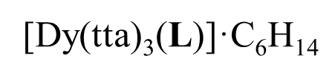
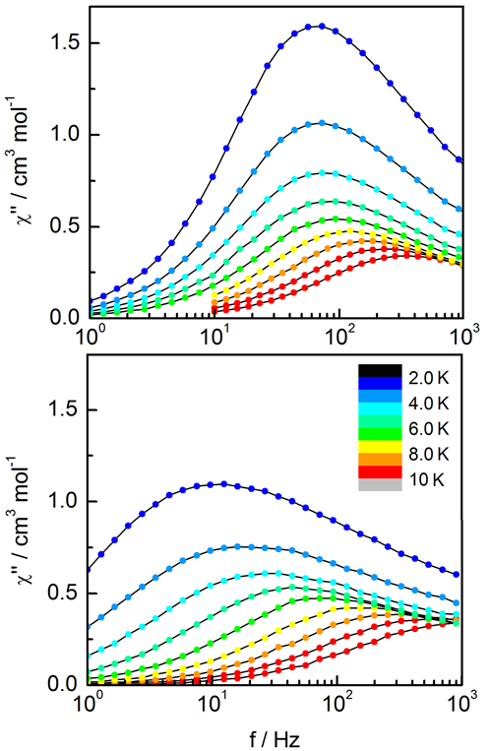
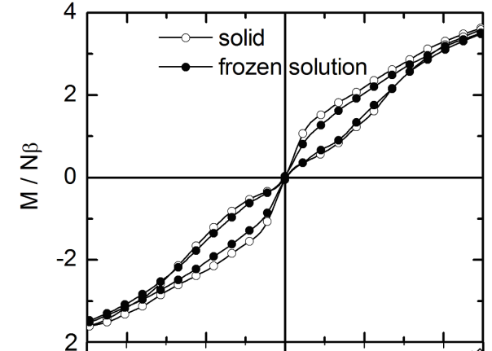

solid
Frozen solution
J. Am. Chem. Soc. 2013 , 135, 16332

Slide 25



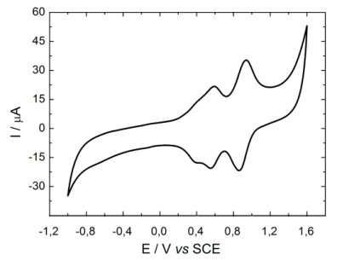

SUMMARY
Redox active luminescent SMM
*
SMM
redox
Luminescence
±7/2
²F_{5/2}
2.5 nm
(L²)²⁺/(L³)²⁺
±1/2
(L³)^{•+}
±3/2
±5/2
(L²)^{•+}
±5/2
±3/2
>
±1/2
²F_{7/2}
±7/2
*
SMM and memory effect in solution

Slide 26






The Multifunctional Molecular Materials Group in Rennes1
F. Pointillart
Dr. Olivier Maury; ENS Lyon
B. Lefeuvre
O. Cador
S. Golhen
Fany
Dr. Borris Leguennic; Rennes
Feng
Anjara
Putri
Soussi
Dekura
Julie Jung, Rennes
G. Cosquer
Y. Le Gal
CNRS
Université de Rennes 1
Région Bretagne
Rennes Métropole
ANR
Notes:
5.- Conclusion

Slide 27



ICCC 2016
Dr. Lahcène OUAHAB, chair
Dr. Yves LE MEST, co-chair
Dr. Françoise CONAN
Dr. Véronique GUERCHAIS
Dr. Cédric FISCHMEISTER
42nd International Conference
on Coordination Chemistry
Brest
Hosted by :
FRANCE
Convention Center
July 3-8, 2016
http://iccc2016.sciencesconf.org

Slide 29
+
Ln(hfac)₃•2H₂O
L²
Ln(hfac)₃L²; Ln^{III} = Y, Dy, Er, Yb
Deformed C_{2v} symmetry
O_{hfac}…H_{NH} = 2.93Å

Slide 30
Dy(hfac)₃L²
Solid state
In solution
Δ= 12(1) K
τ₀= 1.9(4).10⁻⁶ s)

Slide 31
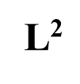
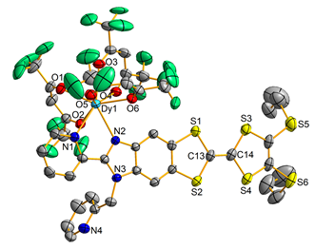
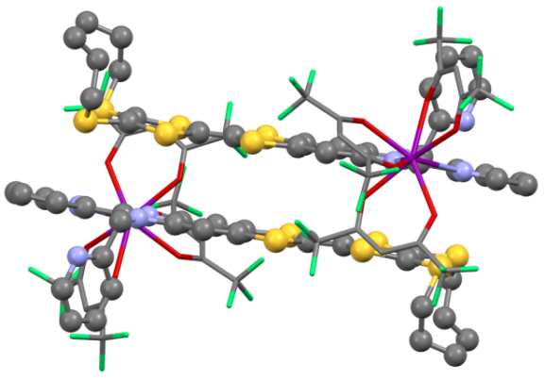
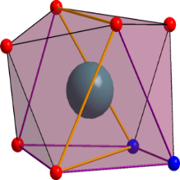
L³
+
Ln(hfac)₃•2H₂O
Ln(hfac)₃L³; Ln^{III} = Y, Dy, Er, Yb
Deformed C_{2v} symmetry
No hydrogen bonds

Slide 32
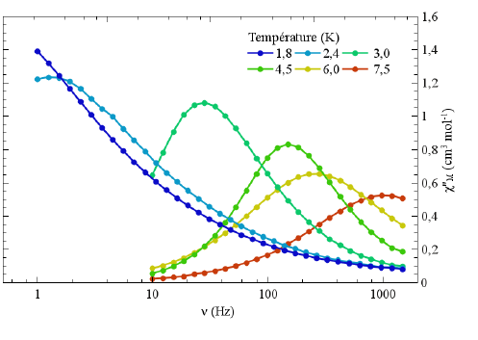
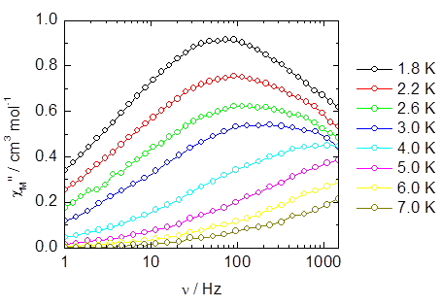
Dy(hfac)₃L³
In solution
Δ= 15(2) K
τ₀= 1.5(3).10⁻⁶ s)
Solid state
Δ= 17(2) K
τ₀= 9.5(2).10⁻⁶ s)

Slide 33
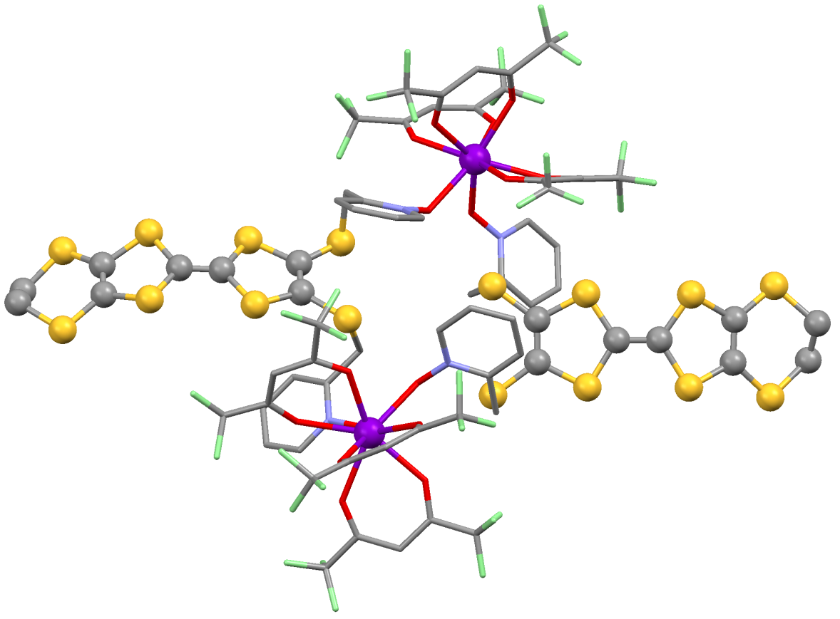
[Yb₂(hfac)₆(L¹)₂]
[Yb₂(hfac)₆(L¹)₂]
L¹ = ethylenedithio-tetrathiafulvalene-dimethylthio-2-pyridine-N-oxide
Dodecahedron with a D_{2d} symmetry
Inorg. Chem., 2013, 52, 5978

Slide 34
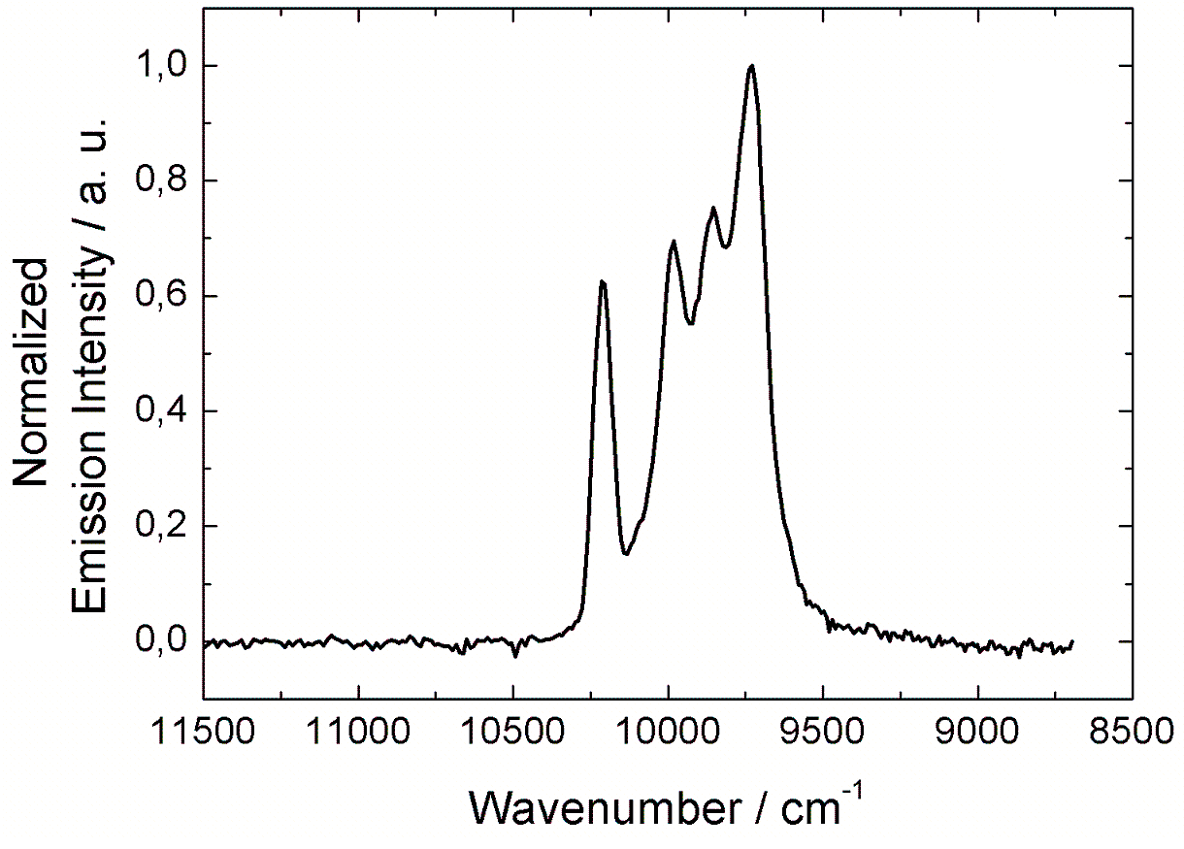
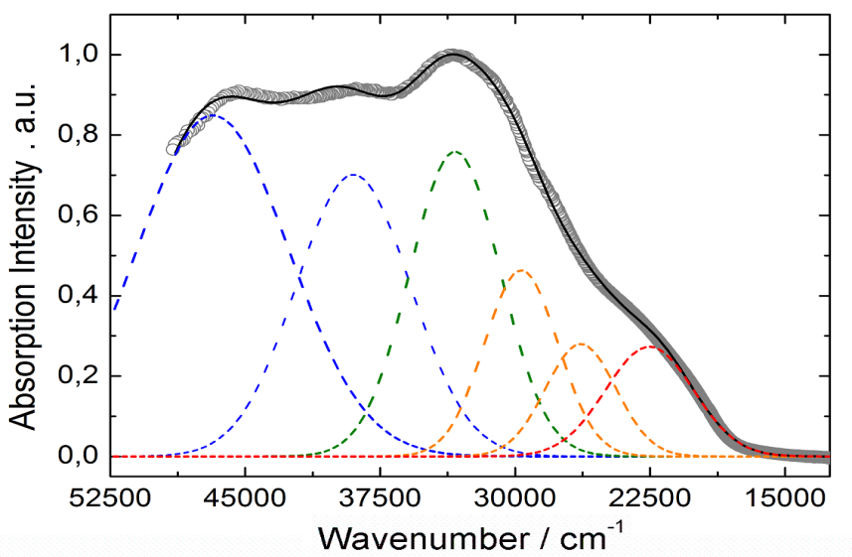

PHOTO-PHYSICAL PROPERTIES
Absorption
Emission
²F_{5/2}
λ_{ex} = 20835 cm⁻¹
²F_{7/2}
TTF to Py-N-oxide charge Transfer
Luminescence of the Yb(III) ion at 9860 cm⁻¹ attributed to the ²F_{5/2} → ²F_{7/2} excitations
Intra-TTF transitions
Intra-hfac transitions
Intra-Py-N-oxide transitions

Slide 35
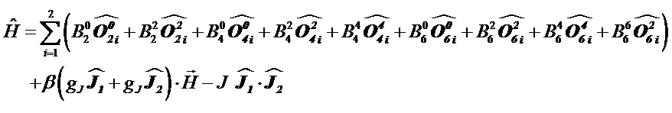
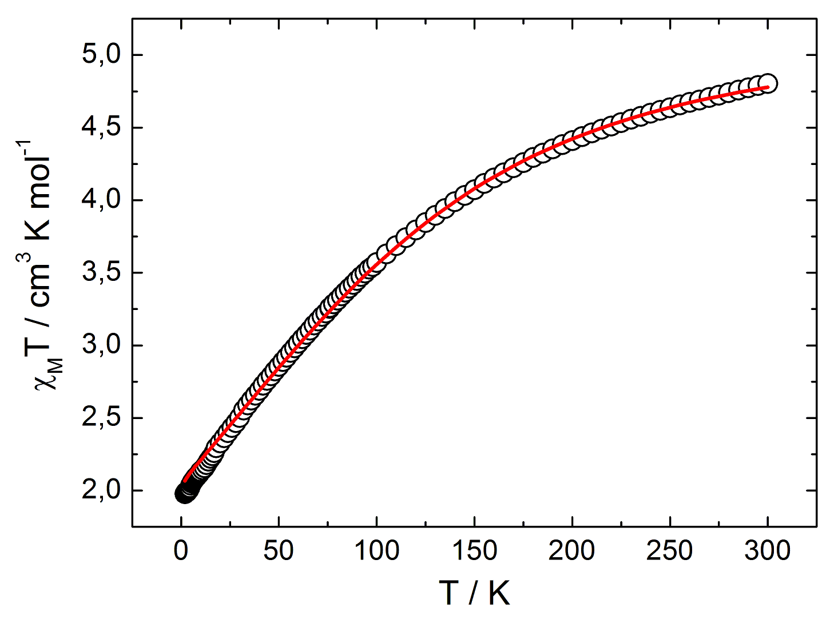
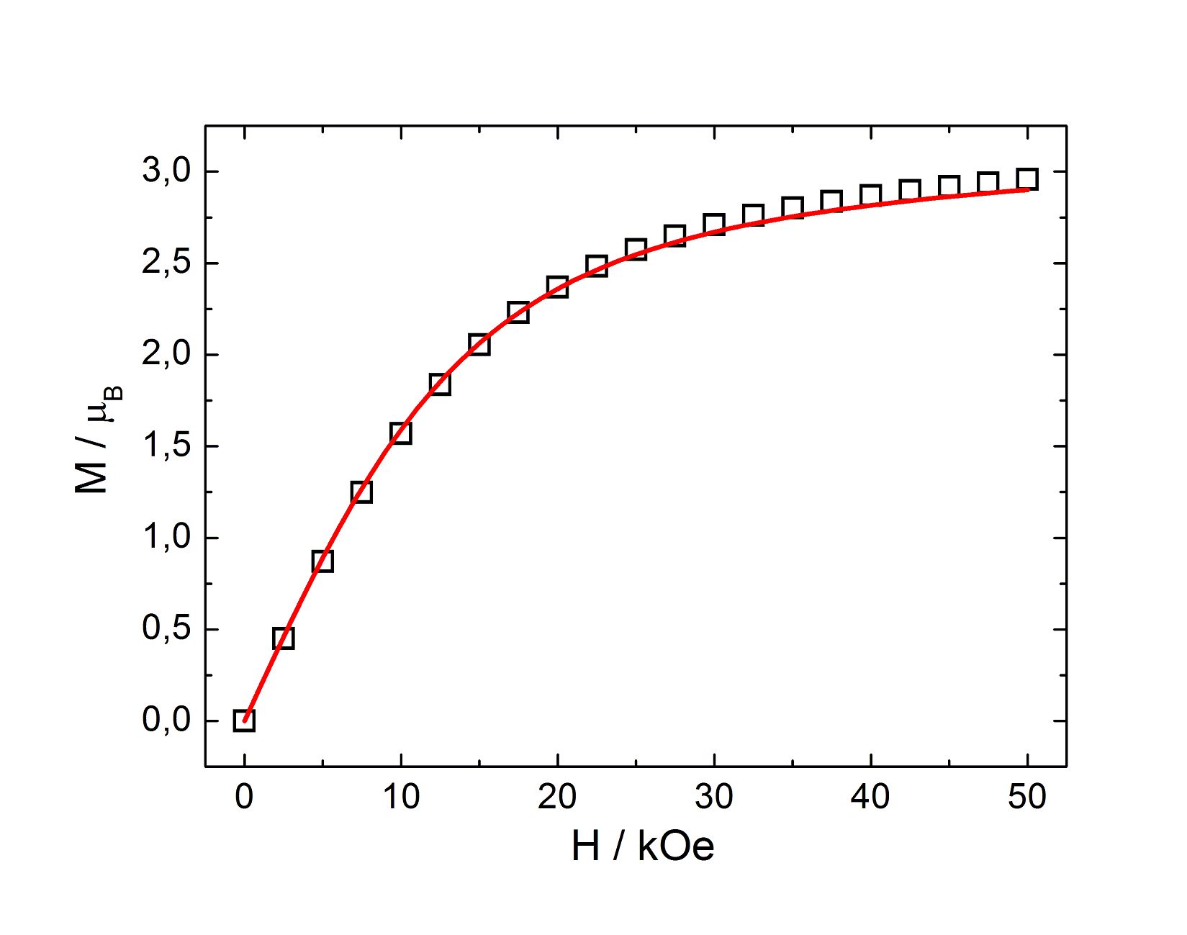
dc MAGNETIC PROPERTIES
1.8 K
No out-of-phase signal
 | 0.4826 cm⁻¹
 | 0.316 cm⁻¹
 | 2.313×10⁻³ cm⁻¹
g | 8/7 (fixed)
J | 0 cm⁻¹ (fixed)
The ground state is M_{J} = ± 5/2

Slide 36
Let Us Meet Again
We welcome you all to our future conferences of OMICS Group International
Please Visit:
http://materialsscience.conferenceseries.com/
Contact us at
materialsscience.conference@omicsgroup.us
materialsscience@omicsgroup.com

