Slide 1
Kyoung-Jae Won, Ph.D. Sep 8 2014 Genomics 2014
Genome-wide analysis of enhancer-RNA transcription reveals regulatory mechanisms by an anti-diabetic drugs (TZD) in adipocytes
Notes:
We have heard a lot of interesting stories about epigenomic data including histone.. DNA.
Obviously, we are expecting to have more and more epigenomic data.
Given that we have multiple epigenomic data across multiple cell types, how can we use it. That was the start of this project

Slide 2
Non-coding RNA Annotation in ENSEMBL
tRNA
Mt-tRNA
rRNA
scRNA
snRNA
snoRNA
miRNA
Misc_RNA
lincRNA
eRNA
(enhancer driven RNA)

Slide 3
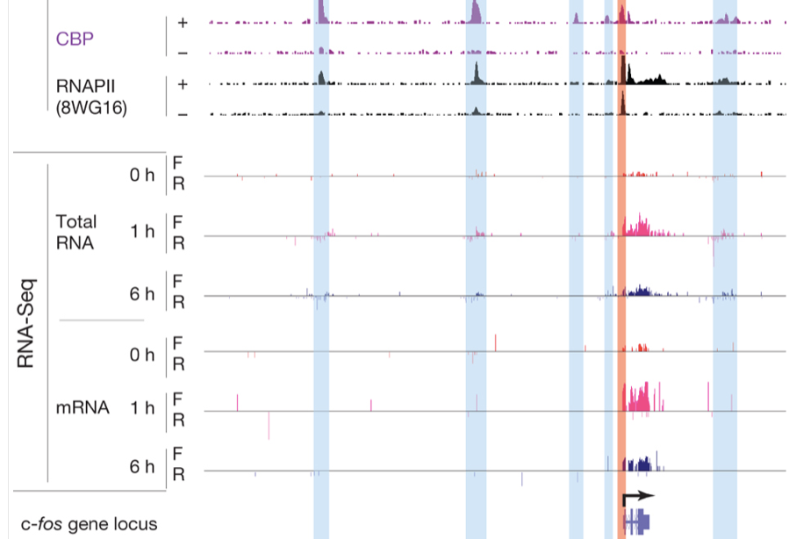
Discussions
eRNA: Transcripts at enhancers
Kim et al (2010) Nature
Notes:
Greenberg

Slide 4
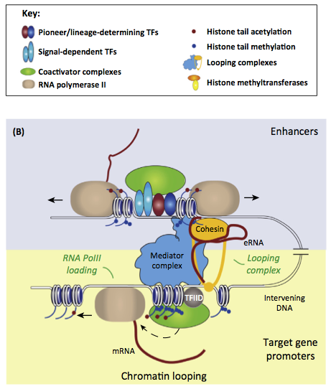
Enhancer-driven RNAs (eRNAs) are an important factor for gene regulation
Function of eRNA
: noise ?
: activating role ?
: scaffold ?
At least eRNAs show
enhancer activity
Lam et al (2014)
Trends in Biochemical Sci.

Slide 5
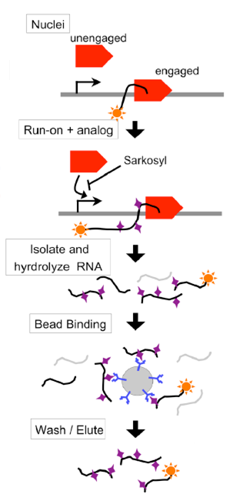
Transcription: An Understudied Step in Gene Regulation
Gene Regulation
Transcription
Steady-state
mRNAs
GRO-seq
Global Run On – sequencing
Isolate all newly synthesized RNAs in a cell
• Measures active transcription rather than steady state mRNA levels
• Maps the position and orientation of new transcripts
• Earliest changes can identity primary target genes rather than secondary targets
• Unbiased detection of novel transcripts, including non-coding RNAs
• detects enhancer RNAs
Core et al, Science, 2008

Slide 6
Thiazolidindiones (TZDs)
Activates PPARs (peroxisome proliferator-activated receptor)
Effective anti-diabetic drugs: increase insulin sensitivity
Side effect: weight gain, cardiac loads, peripheral edema
Still widely used for the treatment of diabetes
despite its notorious side-effects

Slide 7
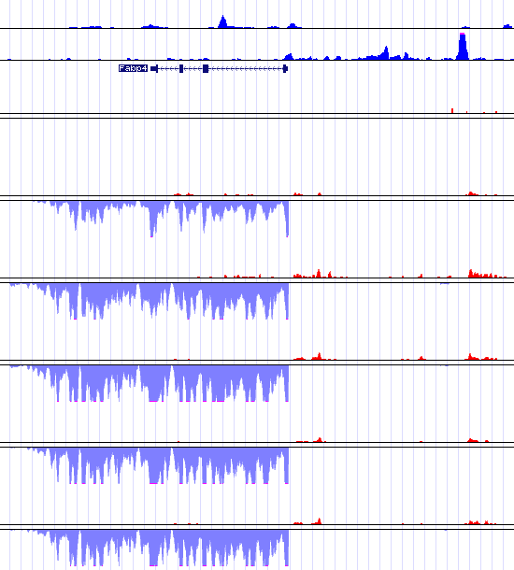
Up Regulation of Transcription Due to Rosi
CEBPα
PPARγ
Fabp4
Pre-Adipocyte
+ strand
+ strand
Before Rosi
Rosi + 10m
Rosi + 30m
Rosi + 1h
Rosi + 3h

Slide 8
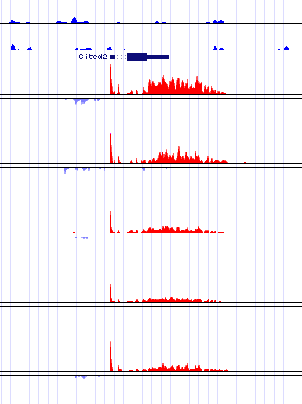
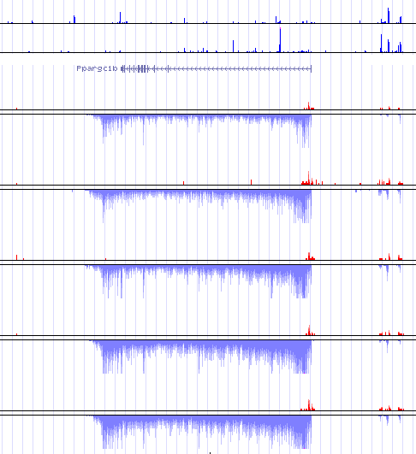
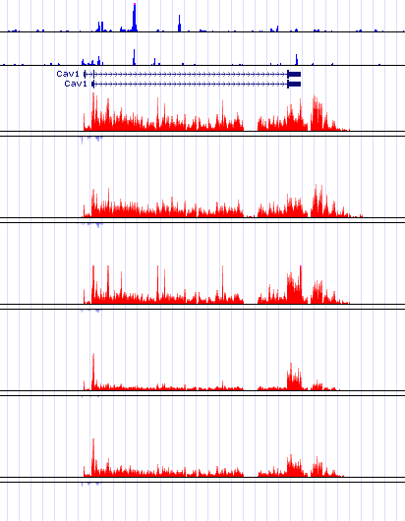
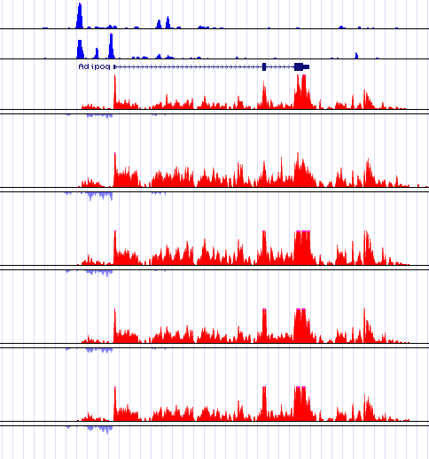
Up and Down Regulation of Transcription Due to Rosi
Log2-FoldChange in Gene Body
Cited2: ↓
Ppargc1b: ↑
1384
Cav1: ↓
Adipoq: ↑
567

Slide 9
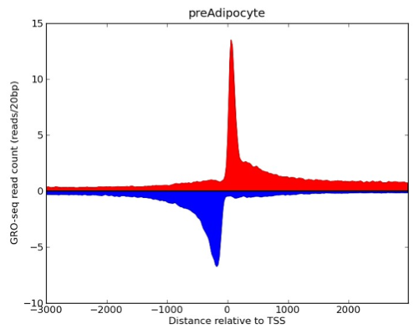
GROseq Profiles at TSS in Adipocyte

Slide 10
Nascent Transcription Changes Precedes mRNA Regulation
Log2-FoldChange in Gene Body
Nascent
Gene Transcript
Steady-state
mRNA
GROseq vs Steady-state mRNA
Log2 Fold Change Over Rosi + 0
Steady-state mRNA
30m
10m
30m
1h
3h
GROseq

Slide 11
Nascent Transcription Changes Precedes mRNA Regulation
Log2-FoldChange in Gene Body
Nascent
Gene Transcript
48h
36h
Steady-state
mRNA
24h
GROseq vs Steady-state mRNA
Log2 Fold Change Over Rosi + 0
12h
Steady-state mRNA
6h
2h
1h
30m
10m
30m
1h
3h
GROseq

Slide 12
Nascent Transcription Change Precedes mRNA Regulation
Log2-FoldChange in Gene Body
48h
48h
36h
36h
24h
24h
12h
12h
Steady-state mRNA
Steady-state mRNA
6h
6h
2h
2h
1h
1h
30m
30m
10m
30m
1h
3h
10m
30m
1h
3h
Gene Body Transcript

Slide 13
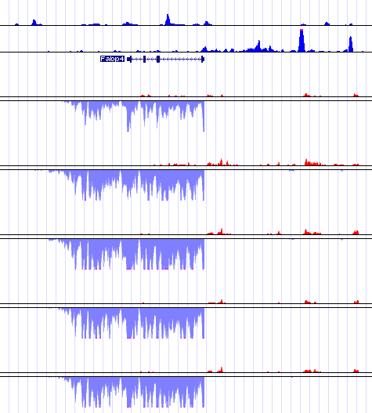
Enhancer RNAS (eRNAs)
Log2-FoldChange in Gene Body
CEBPα
PPARγ
eRNA
Before Rosi
+ strand
- strand
Rosi + 10m
Rosi + 30m
Rosi + 1h
Rosi + 3h

Slide 14
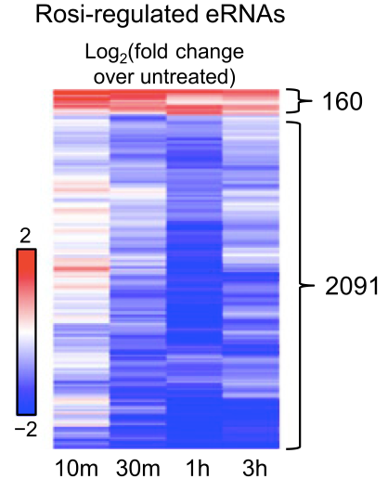
Rosi-regulated eRNAs

Slide 15
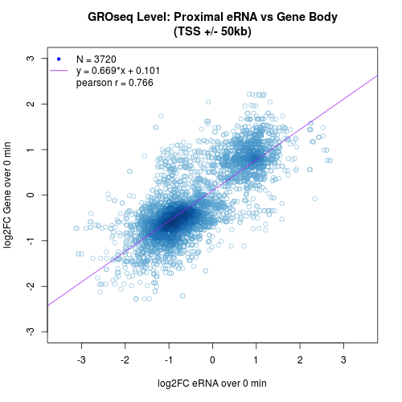
Regulation of eRNAs and Nascent Transcription by Rosi
log2FC(Gene Transcript)
log2FC(eRNA)

Slide 16
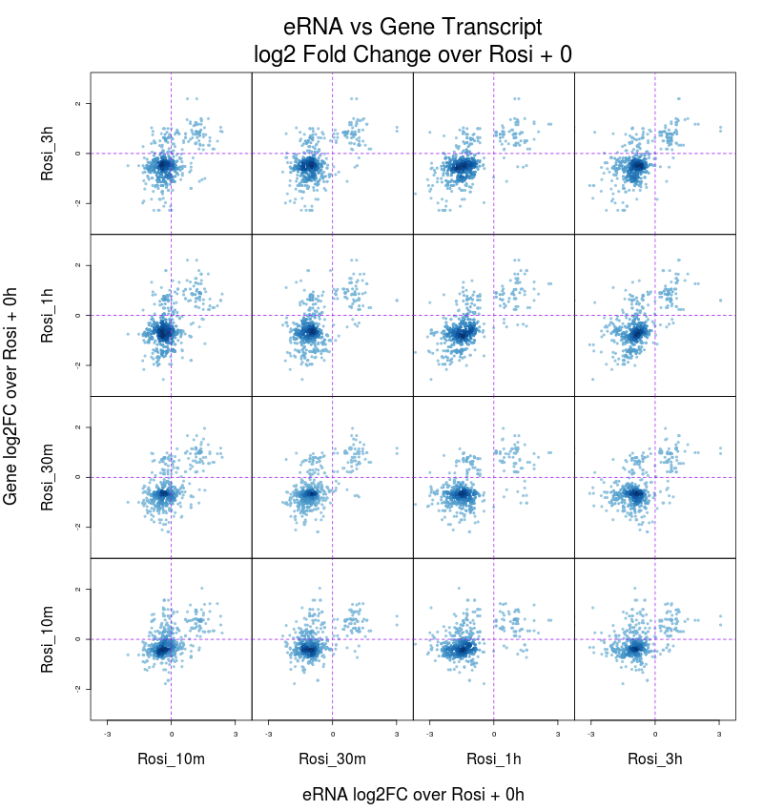
eRNA Changes Precede Nascent Gene Transcript
Enhancer
RNA
Nascent
Gene Transcript
Steady-state
mRNA
Correlation between eRNA and gene regulation
2
0
3h
−2
2
0
1h
−2
Gene transcript
Gene transcript
2
0
30m
−2
2
0
10m
−2
−3
0
3
−3
0
3
−3
0
3
−3
0
3
10m
30m
1h
3h
10m
30m
1h
3h
eRNA
eRNA

Slide 17
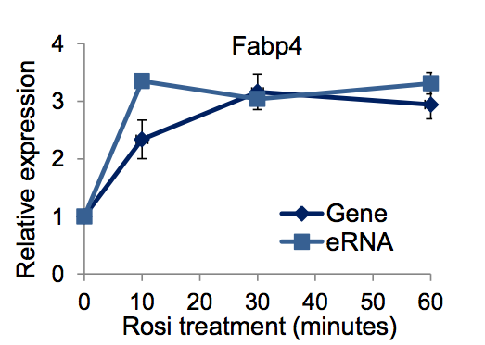
eRNA induction preceeds gene induction

Slide 18
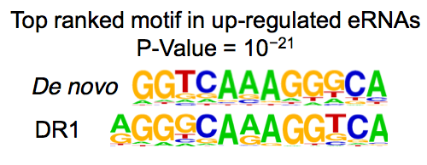
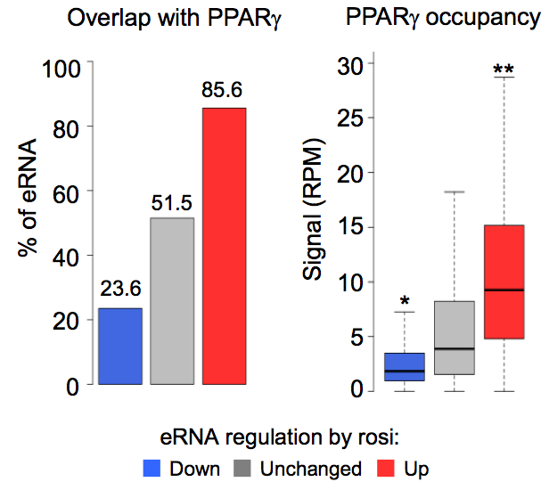
eRNAs up-regulation is associated with PPARγ

Slide 19
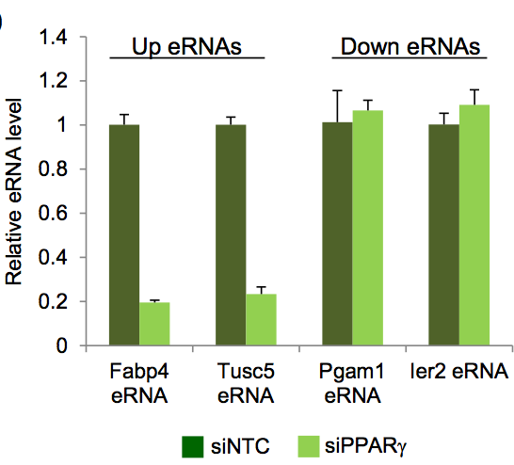
eRNAs up-regulation is associated with PPARγ

Slide 20
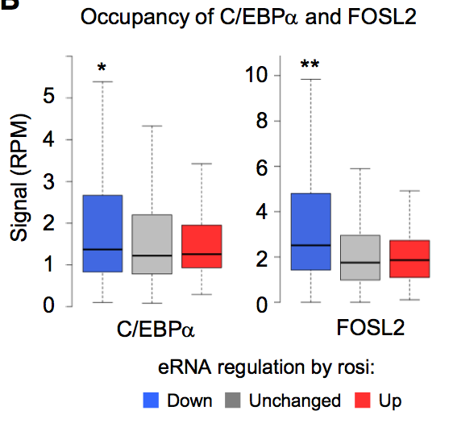
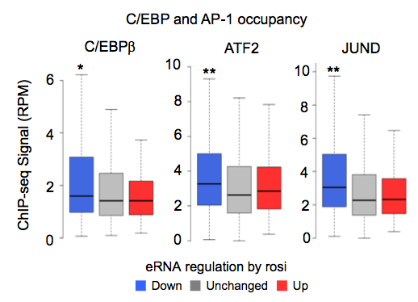
eRNAs down-regulation is associated with multiple-factors including C/EBP, Fosl2,JunD and ATF2
: Repression is not directly mediated by PPARγ

Slide 21
Strength of binding did not change upon rosi treatment

Slide 22
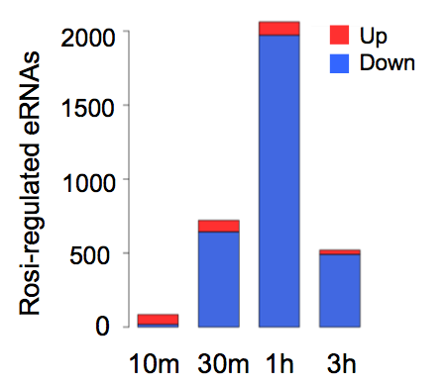
The majority of eRNA are upregulated by 10 minutes
: downregulated eRNAs can be secondary

Slide 23
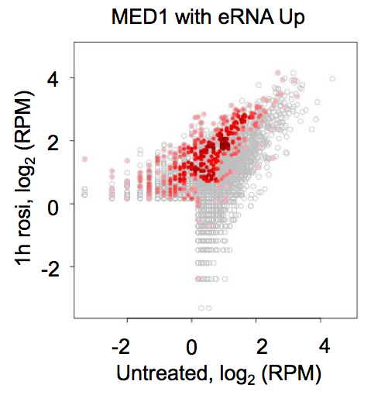
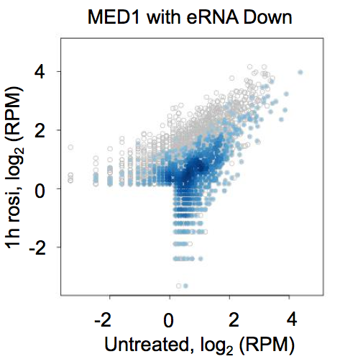
eRNA changes are associated with Med1 change

Slide 24
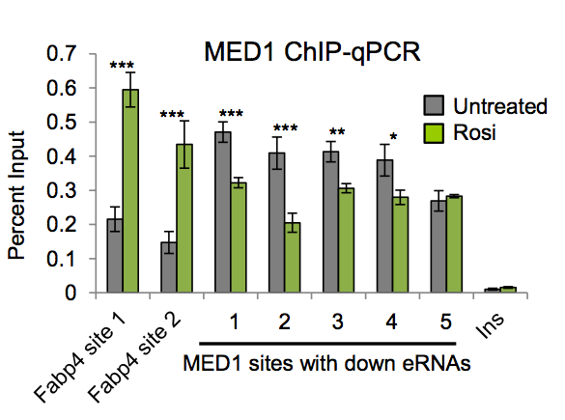
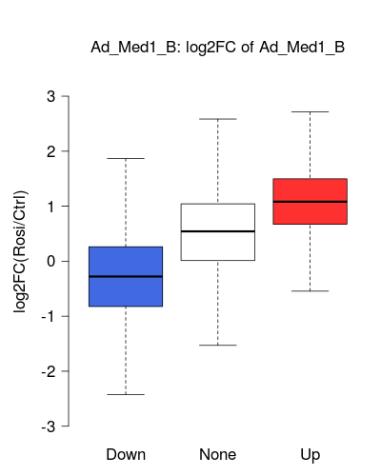
Upon rosi treatment Med1 recruitment significantly decreased at downregulated eRNAs and increased at upregulated eRNAs relative to unregulated eRNAs
Med1 ChIP-seq
3
**
**
2
1
log₂(tag counts[rosi/untreated])
0
-1
-2
-3
Down
Unchanged
Up
eRNA regulation by rosi

Slide 25
Squelching
is a biological phenomenon in which a transcriptional activator acts to inhibit the expression of another gene.

Slide 26
Discussions
GROseq measures the level of eRNAs and gene transcript
Integrative studies using GROseq revealed the rosi-associated regulatory mechanisms
Gene transcription levels needs time until they reach to steady state levels
eRNA fires before transcriptional initiation
up-regulation is mediated by PPARγ
Multiple TFs are associated with down-regulation
down-regulation is mediated by co-activator redistribution
Step et al. (2014) Genes and Development

Slide 27
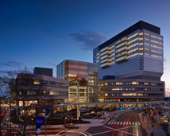
Thanks to
UPENN
Mitchell Lazar
Sonia Stem
Patrick Seale
David Steger
Klaus Kaestner
Rinho Kim
Nha Nguyen
Hee-Woong Lim
Shuo Li
Inchan Choi
Supported by
NIH/NIDDK,
Institute for Diabetes Obesity and Metabolism
at the University of Pennsylvania
Pharma Foundation

Slide 28
In the lab..
Metabolic Biology
Mitchell Lazar, Klaus Keastner
Patrick Seale, David Steger
Stem Cell
Kennett Zaret, Montserrat Aguera
Chromatin remodelers, histone variants
Benjamin Garcia, Hua-Ying
Epigenetic landscapes
Wei Wang, Bing Ren (UCSD)
Cancer biology
Cathryn Wellen, Mariuz Wasik
Integrative studies
RNAseq, GROseq
ChIPseq, ChIP-exo
CLIP-seq
mC, 5hmC,
Histone modification

