Slide 1

Expressing membrane antibody reporter
in the islet cells of nonobese diabetic mice
to noninvasive image the disease progression
of autoimmune diabetes
Graduate Institute of Pharmacognosy
Speaker: Kuo-Hsiang Chuang, Ph.D. (莊國祥)
khchuang@tmu.edu.tw

Slide 2
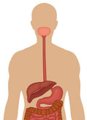
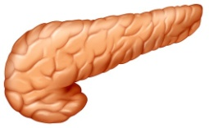
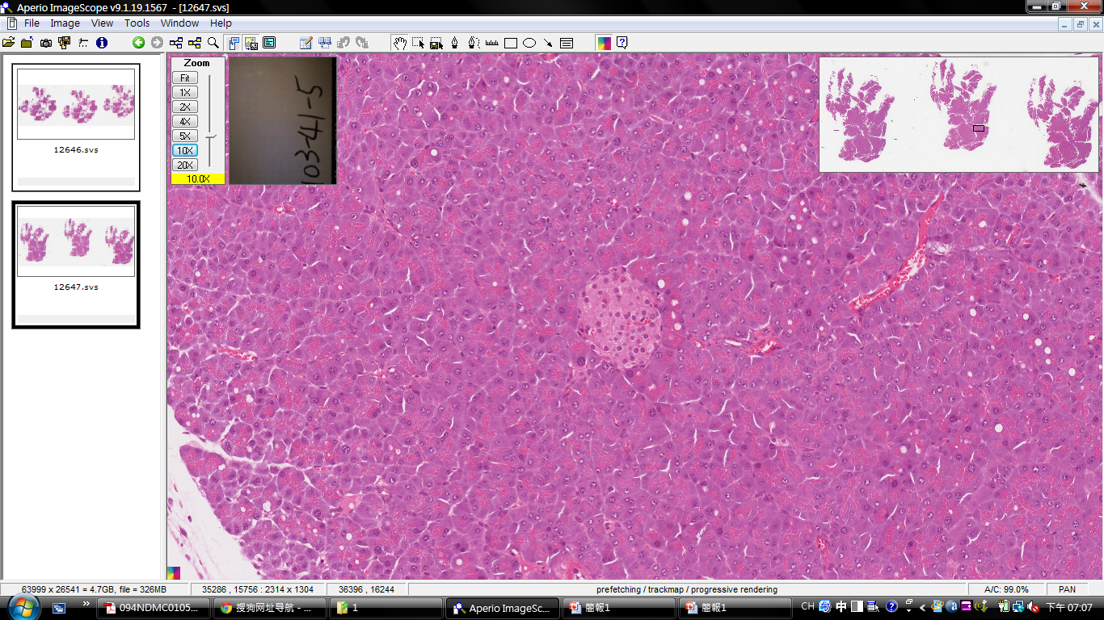
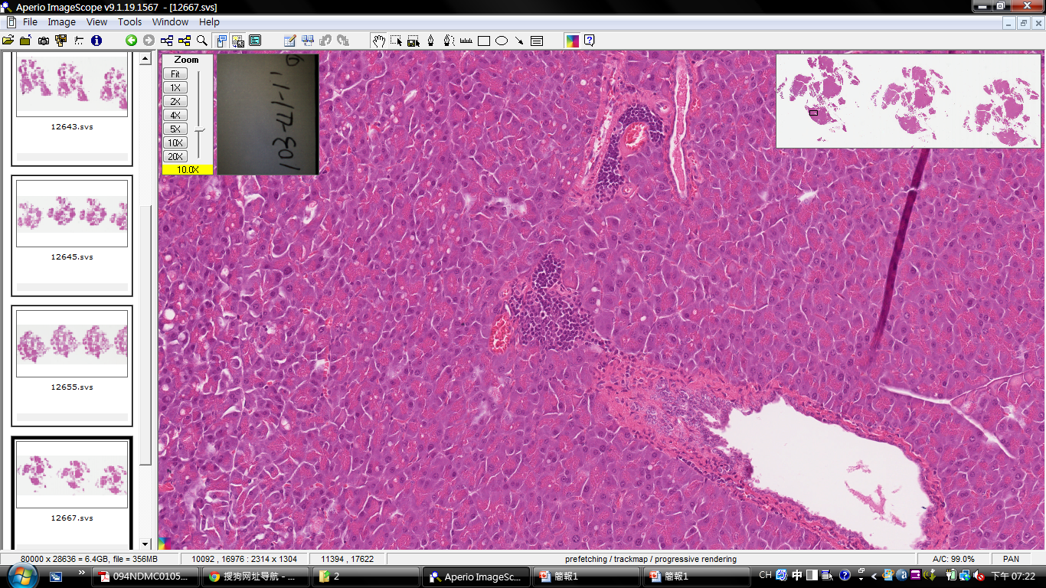
Type 1 Diabetes (T1D): Autoimmune Diabetes
pancreas
T cell
T cell
T cell
islet
islet
β cell
β cell
β cell
β cell
pancreas
stomach
T cell
normal
infiltration
Notes:
第一型糖尿病是一種自體免疫疾病，在第一型糖尿病的患者，胰臟中的胰島細胞會被自身的免疫系統所攻擊，使得胰島細胞遭到破壞

Slide 3


Type 1 Diabetes (T1D): Autoimmune Diabetes
pancreas
T cell
T cell
islet
T cell
T cell
islet
β cell
β cell
β cell
β cell
insulin
pancreas
stomach
glucose
Hyperglycemia
artery
Notes:
而被自身免疫系統攻擊的胰島細胞會受到破壞後會失去其功能，使得beta-cell無法分泌胰島素到血液中作用，而無法被代謝的葡萄糖會開始累積，血液中葡萄糖濃度失衡，最終會導致高血糖的症狀

Slide 4
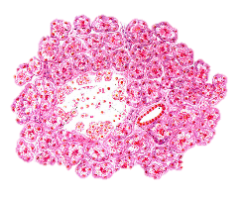
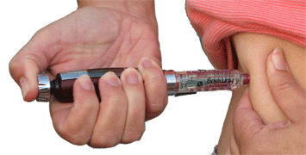

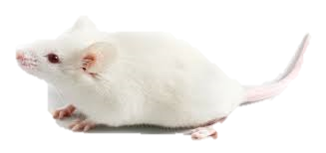
Type 1 Diabetes (T1D): Autoimmune Diabetes
T cell
T cell
T cell
Irreversible
Islet
Islet
Diabetes Complications
Diabetic nephropathy
Diabetic retinopathy
Cardiovascular disease
Insulin
pancreas
stomach
Strategy to protect pancreatic islet
Drugs
T cell
islet
islet
β cell
β cell
β cell
β cell
Protect Islet
Genes
Type I diabetes
NOD mice
Notes:
受到免疫系統所攻擊的β細胞，無法自行修復導致不可逆的受損。
第一型糖尿病的患者若是血糖持續失衡則會引起併發症，像是酮酸中毒糖尿病腎病變等，而病人為了維持正常生理機能，唯一的治療方法就是施打胰島素，但是施打胰島素這種治療方式是非常被動的。
因此目前研究專研於開發藥物去保護胰島不被自體免疫系統攻擊，使得施打胰島素不在是第一型糖尿病患者唯一的治療方法。
而目前在研究開發第一型糖尿病的藥物在進入臨床之前都須經過動物實驗之測試，而目前研究第一型糖尿病的指標性疾病動物模式為NOD小鼠。

Slide 5
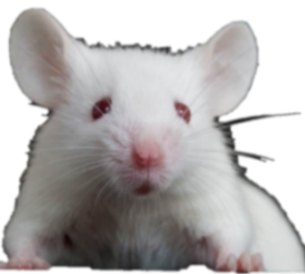




Non-Obese Diabetic (NOD) mice
T cell
pancreas
Standard animal model for T1D study
Diabetes incidence:
female (80%) > male (20-30%)
The incubation period ranges:
16-20 weeks (islet loss )
T cell
islet
liver
β cell
β cell
islet
insulin
β cell
β cell
pancreas
Vessel
Blood glucose↑
Disadvantage
Need to sacrifice mice weekly (> 100 mice for 1 study )
Individual differences (can not observe the same mouse)
Time-consuming
Inhumanity
Islet survival?
Noninvasive imaging of islet survival…
…
NOD mice
Disease progression of T1D
Notes:
NOD小鼠為非肥胖型糖尿鼠，是一種可自發性產生胰島素依賴型糖尿病的疾病動物模式，NOD小鼠T cell會不斷的攻擊破壞自己的胰島導致胰島素無法分泌，糖尿病發病機制與人類相似，因此為現今研究第一型糖尿病疾病動物model
NOD母鼠的發病率大於公鼠，母鼠發病率約為80%而公鼠約為20%，因此常使用母鼠來進行研究。
但是NOD小鼠在研究上會有遇到一些問題，像是不易觀察胰島細胞在體內存活的情形，需每週犧牲老鼠取出胰臟做染色切片來觀察，而一種藥物可能要花大量的老鼠來測試，因此是非常耗費時間且不人道，而且也無法連續觀察同一隻小鼠的胰臟所以會有個體差異上的問題。
因此！有沒有什麼方法，能夠以非侵犯性的造影來即時觀察胰島存活的情形？那為了達成能夠此目的以方便地進行第一型糖尿病的研究，我們可能需要報告基因的輔助。

Slide 6

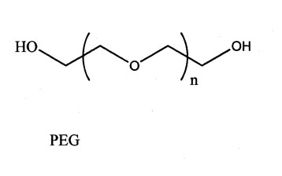


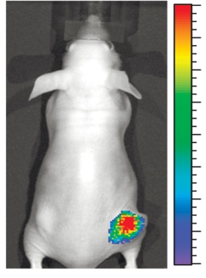
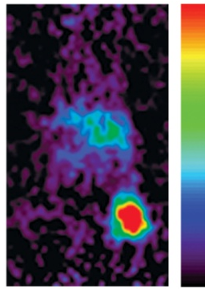
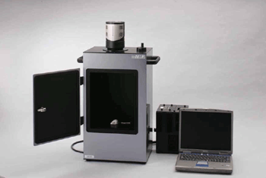
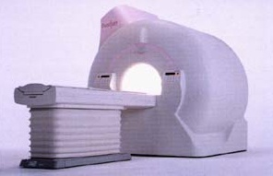

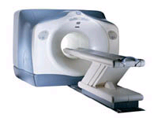
An Universal Anti-Polyethylene Glycol Reporter
αPEG reporter
Taiwan patent(I390040)
US patent (US8507207 B2)
Polyethylene Glycol
(murine)
Transfection
Where ?
V_{H}
V_{L}
anti-PEG Ab
viral vector
non-viral vector
(ZFN, TALEN)
Mamminal cells
PEG-probes
CH₃O-(CH₂-CH₂-O)_{n}-probes
(PEG-Isotope, PEG-NIR, PEG-SPIO…)
Commercial
Phase II
Depend on probes
Non-invasive imaging systems
Optical
MRI
EJ/ αPEG
EJ/αPEG
EJ/αPEG
PET

Slide 7
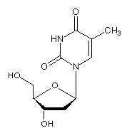
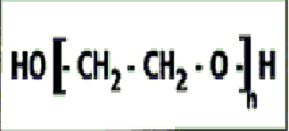
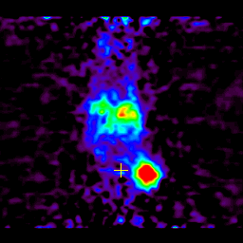
Comparisons between αPEG and HSV-tk reporters
PEG-isotope (¹²⁴I, ¹⁸F)
αPEG reporter
Thymidine
Isotope-FIAU
HSV-tk
P
P
P
Cells
Cells
1. Endogenous
2. Membrane anchored
Gamma, PET imaging
Faults :
Viral gene ➔ immunoresponse
Probes uptake ➔ cytotoxicity
7

Slide 8
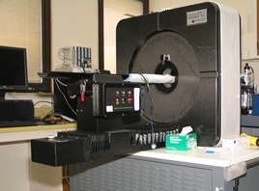
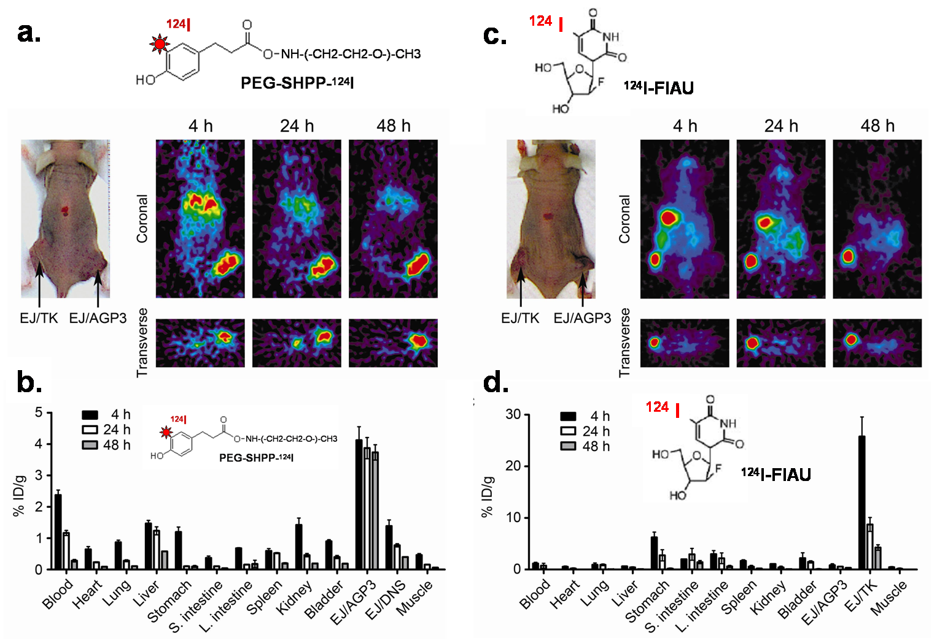
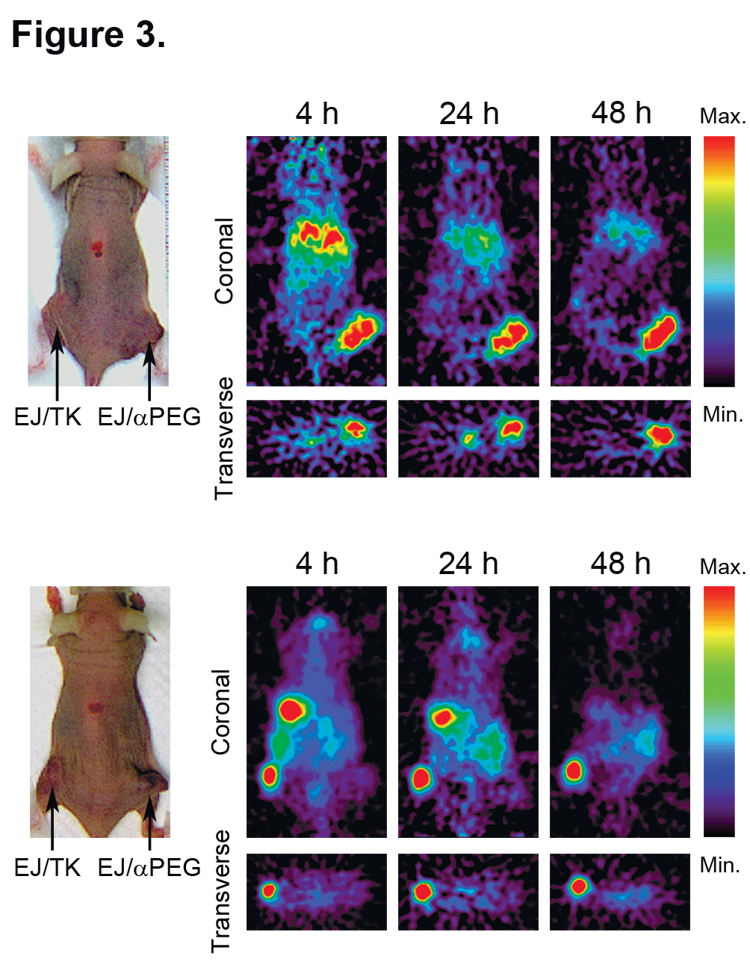
α PEG reporter vs. HSV-TK : Imaging Specificity
Dr. Hsin-Ell Wang (NYMU)
In vivo micro-PET
PEG-SHPP-¹²⁴I
Micro-PET system
The αPEG reporter displayed an imaging specificty comparable
to HSV-tk
8

Slide 9
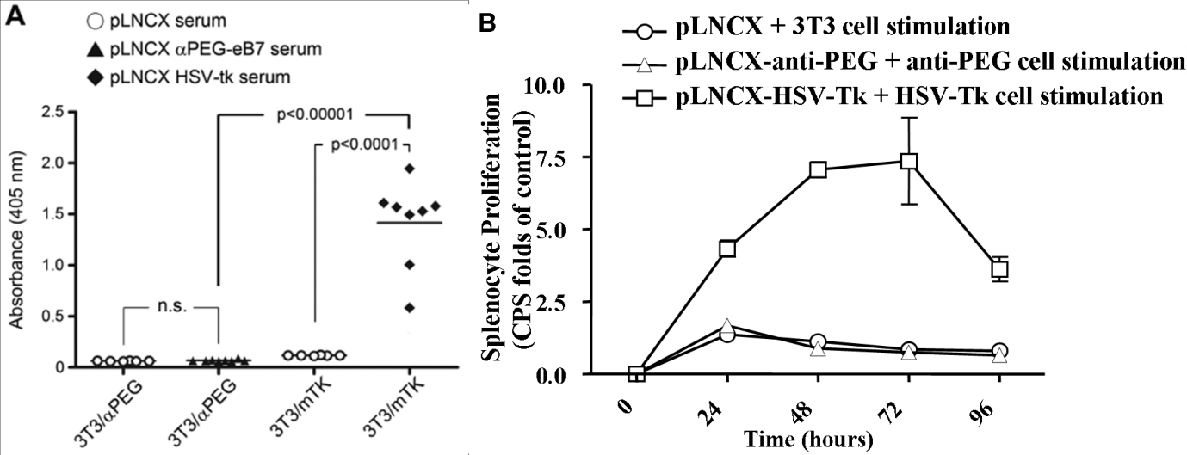
α PEG reporter vs. HSV-TK : Immunogenecity
Humoral immunity
(Antibody response)
αPEG reporter gene
HSV-tk gene
Hydrodynamic treatment
(10 μg / 2ml)
HSV-TK
Balb/c mouse
Anti-PEG
Test anti-reporter antibody
αPEG Ag
TK Ag
Mouse Anti-PEG reporter : Non-immunogenic in mouse
9

Slide 10
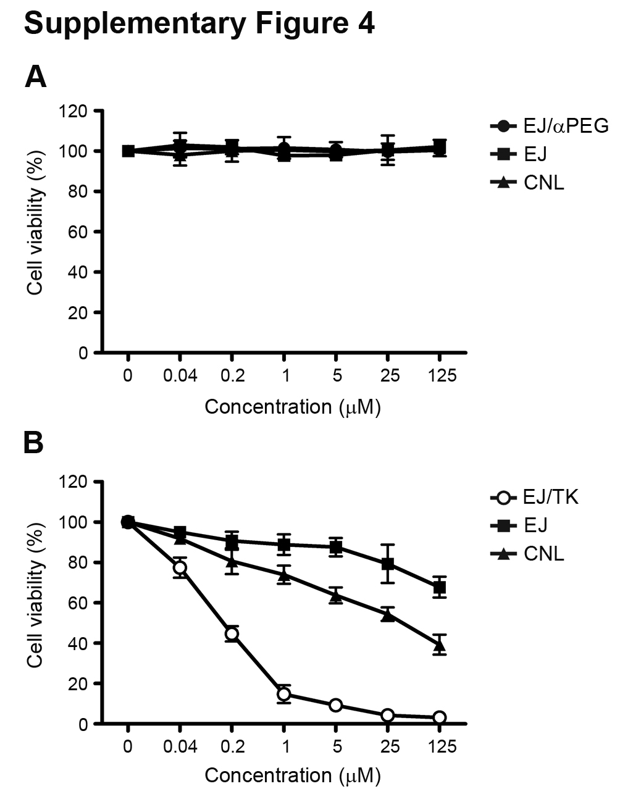
α PEG reporter vs. HSV-TK : Probe Toxicity
PEG-SHPP
FIAU
PEGylated probes displayed little toxicity to mammalian cells but the dose of HSV-tk probes should be carefully adjusted
10

Slide 11
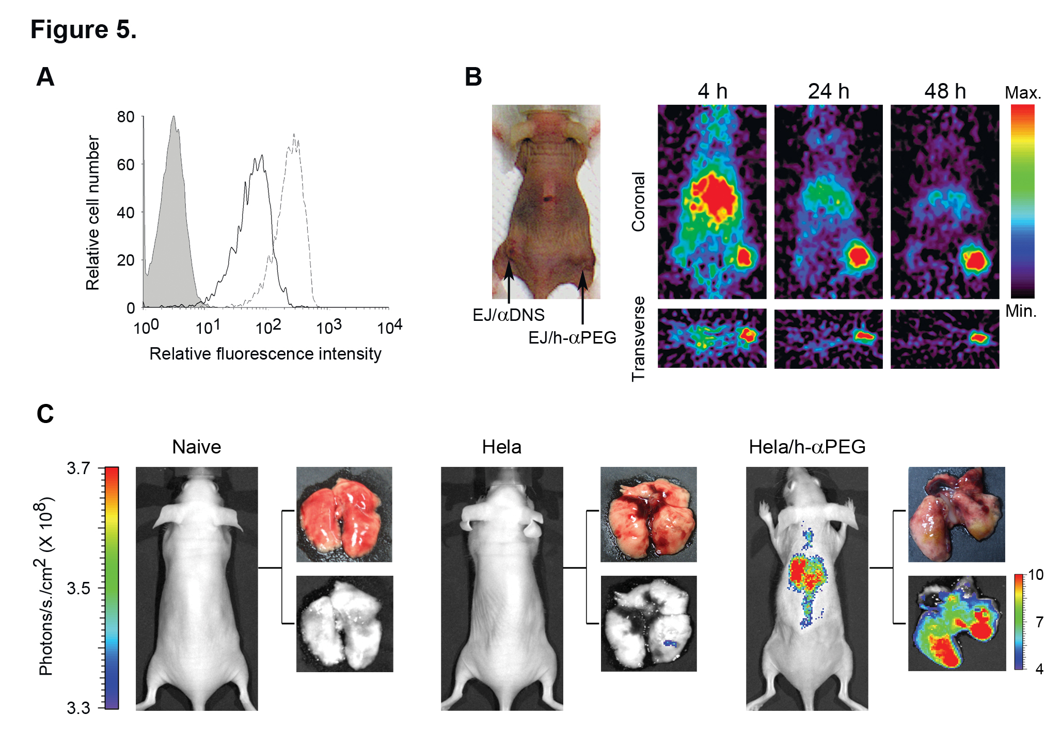
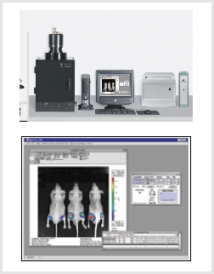
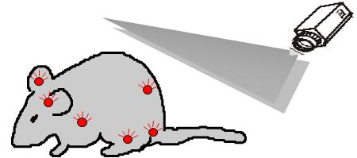
In vivo Imaging of metastatic Hela/h-αPEG cells
Cells
or
Cells
Optical imaging
HeLa/αPEG
HeLa
PEG-probe
Anti-PEG reporter strategy possesses potential advantages:
High specificity
2. Low immunogenicity
➔ Antibody : endogenous gene
αPEG
reporter
3. Non-toxic imaging probes
➔ PEG has been approved by FDA
V_{H}
Cells
V_{L}
anti-PEG Ab
Journal of Nuclear Medicine 2010 Jun;51(6):933-41 (IF: 6.16) RADIOLOGY, NUCLEAR MEDICINE & MEDICAL IMAGING (4/125))

Slide 12
Strategy
Expressing αPEG reporter in the islet cells of nonobese diabetic mice to noninvasive image the disease progression of autoimmune diabetes
Only need 5-10 mice for each experiments
Real-time imaging of islet survival
Continuously study the same mouse
Humanity

Slide 13

Flow chart
Gene construction of
pIns-anti-PEG reporter gene
(2) Development of NOD/pIns-αPEG mice
Insulin promoter
anti-PEG reporter gene
Genomic DNA PCR
Radiation
?
NOD/pIns-αPEG mice
Fluorescent microscopy
plasmid
Function
β cell
(3) Imaging of pancreatic islet in
NOD/pIns-αPEG mice
(4) Compare the physiology and pathology of NOD/pIns-αPEG mice to NOD mice
Physiology
PEG-Probes
Islet number / size
Invasive imaging
Insulin secretion
NOD/pIns-αPEG mice
Noninvasive imaging
Pathology
V.S.
Disease incidence
Lymphocyte infiltration
Autoimmune response
-B cell (autoantibody)
NOD/pIns-αPEG mice
NOD mice
Notes:
首先我們先只會專一性地於胰島β細胞表現的anti-PEG reporter
接下來我們將篩選出具有anti-PEG reporter高表現的anti-PEG小鼠
然後利用造影系統來追蹤胰島存活率
最後比較NOD/anti-PEG mice生理與病理模式和wild-type NOD之間有無差異

Slide 14
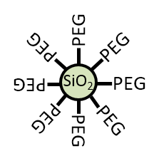
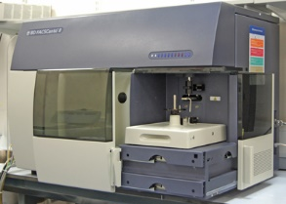
Specific expression of anti-PEG reporter
in pancreatic islet β cells
Provide by professor Huey-Kang Sytwu
subclone
gene
CMV promoter
anti-PEG reporter gene
human insulin promoter
anti-PEG reporter gene
(pCMV)
cloning
(pIns)
Ubiquitously express in mammalian cells
Specifically express
in islet β cells
human insulin promoter
anti-PEG reporter gene
PEG-Q-dot
pIns-αPEG
3T3 cells
transfection
(mouse fibroblasts)
CMV promoter
anti-PEG reporter gene
NIT1 cells
Detect anti-PEG reporter expression by flow cytometry
(pancreatic beta-cell line)
pCMV-αPEG
Notes:
為了建構出只會專一性地於胰島β細胞表現的anti-PEG reporter
我們利用基因克隆技術將原本在帶有CMV promoter上的anti-PEG 報告基因subclone到帶有insulin promoter的載體上（此載體由國防醫學大學司徒惠康教授提供）。
CMV promoter是會於所有哺乳細胞表現，而insulin promoter則是只會在胰島β細胞表現
將此兩種帶有不同promoter的plasmid分別轉染到3T3 cell(老鼠的纖維母細胞)和NIT1 cell(beta-cell line)中，加入PEGQ-dot，利用流式細胞儀來偵測其功能。此實驗與鄭達俊博士共同協助完成。

Slide 15

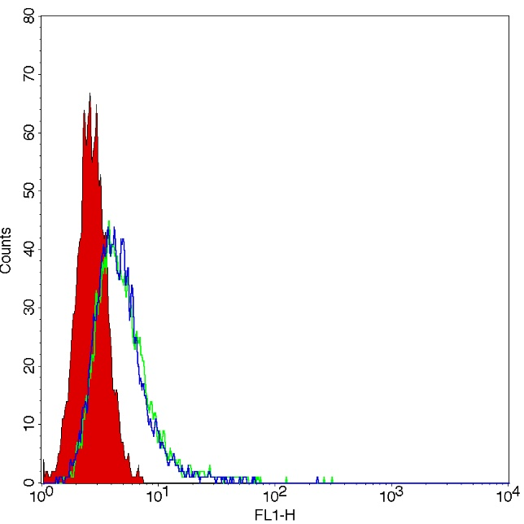
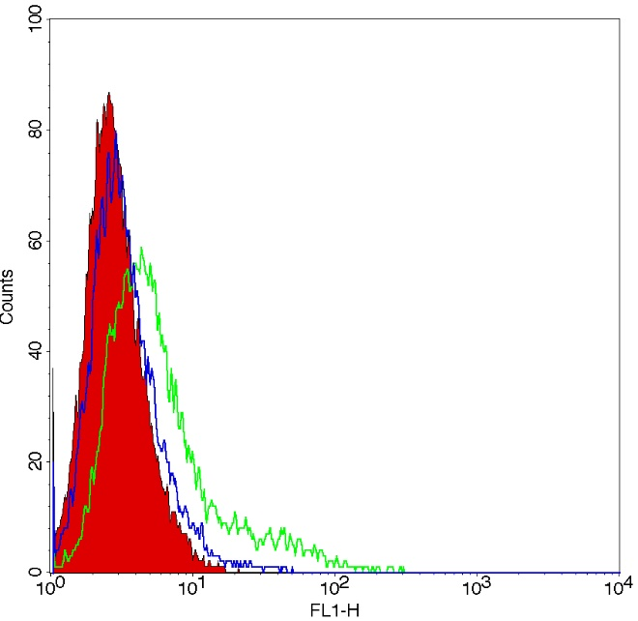
Specific expression of anti-PEG reporter
in pancreatic islet β cells
CMV promoter
anti-PEG reporter gene
PEG-Q-dot
PEG-Q-dot
pCMV-αPEG
pCMV-αPEG reporter
pCMV-αPEG reporter
Ubiquitously express in mammalian cells
NIT-1 cell
3T3 cell
NIT-1 cell
3T3 cell
(pancreatic beta-cell line)
(mouse fibroblasts)
NIT-1 empty
NIT-1 pCMV-αPEG
NIT-1 pIns-αPEG
3T3 empty
3T3 pCMV-αPEG
3T3 pIns-αPEG
pCMV-αPEG
pCMV-αPEG
Notes:
左圖為在NIT1 cell為pancreatic beta-cell line，右圖為3T3 cell為老鼠纖維母細胞，紅色為negative control，螢光位移表示細胞的anti-PEG reporter上具有辨認PEG的功能
首先先看轉染CMV promoter的組別，CMV promoter會在所有哺乳細胞表現，所以兩株細胞均會表現anti-PEG reporter，在我們加入PEG-Q-dot後，皆會和anti-PEG reporter 結合，因此兩株細胞皆會有螢光訊號產生。

Slide 16
Specific expression of anti-PEG reporter
in pancreatic islet β cells
human insulin promoter
anti-PEG reporter gene
PEG-Q-dot
pIns-αPEG
pIns-αPEG reporter
Specifically express
in islet β cells
NIT-1 cell
3T3 cell
NIT-1 cell
3T3 cell
(pancreatic beta-cell line)
(mouse fibroblasts)
NIT-1 empty
NIT-1 pCMV-αPEG
NIT-1 pIns-αPEG
3T3 empty
3T3 pCMV-αPEG
3T3 pIns-αPEG
pIns-αPEG
pIns-αPEG
Anti-PEG reporter driven by insulin promoter can specifically express in the pancreatic islet β cells.
Notes:
接下來看轉染insulin promoter的組別，insulin promoter只會在胰島beta 細胞表現，所以僅NIT-1細胞會表現anti-PEG reporter，在我們加入PEG-Q-dot後，只會和NIT-1細胞上的anti-PEG reporter結合，因此結果只有NIT-1細胞有螢光位移
表示帶有insulin promoter的anti-PEG reporter能專一的表現於胰臟β細胞上

Slide 17


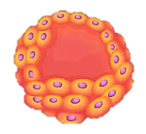
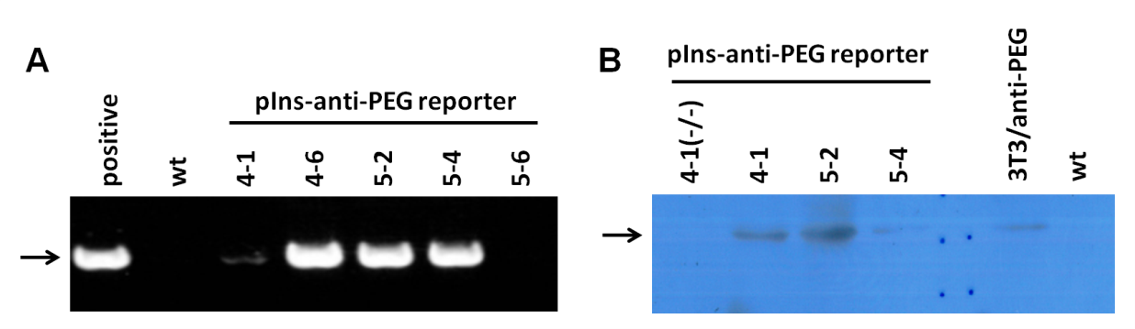
Development of NOD/pIns-αPEG mice
Insulin promoter
anti-PEG reporter gene
National Laboratory Animal Center (NLAC),
Taiwan
micro-injection
Pins-αPEG plasmid
NOD/pIns-αPEG mice
zygote
NOD/pIns-αPEG1 (4-1)
NOD/pIns-αPEG2 (5-2)
NOD/pIns-αPEG3 (5-4)
C57BL/6
mice
0/0
(nontransgene)
Genotyping by PCR
chromosome
NOD mice
(wild type)
Anti-PEG reporter expression
NOD/pIns-αPEG
mice
Tg/0
(hemizygous)
(transgene)
chromosome
Notes:
我們將subclone好的anti-PEG reporter gene 委託南部國家動物中心，利用micro-injection技術，將質體送到NOD的受精卵中，再把受精卵送到代理孕母的子宮，即會繁殖出帶有anti-PEG reporter gene的NOD小鼠，我們稱為NOD/pIns-anti-PEG mice。
而轉殖出的老鼠分為三個line，命名為anti-PEG1, anti-PEG2, anti-PEG3
那此三個LINE的NOD/anti-PEG mice，染色體單股帶有轉殖基因，我們又稱為Tg/0小鼠，
之後將此三個line的小鼠分別和wild-type(0/0)的NOD小鼠交配，生下的小鼠會有1/2的機率會帶有轉殖基因，為了鑑定小鼠是否帶有轉殖基因，因此收集小鼠的指頭，抽出Genomic DNA，利用ＰＣＲ的方式來做基因鑑定，而我們使用的primer 5’端為insulin transgene, 3’端為transgene VL

Slide 18
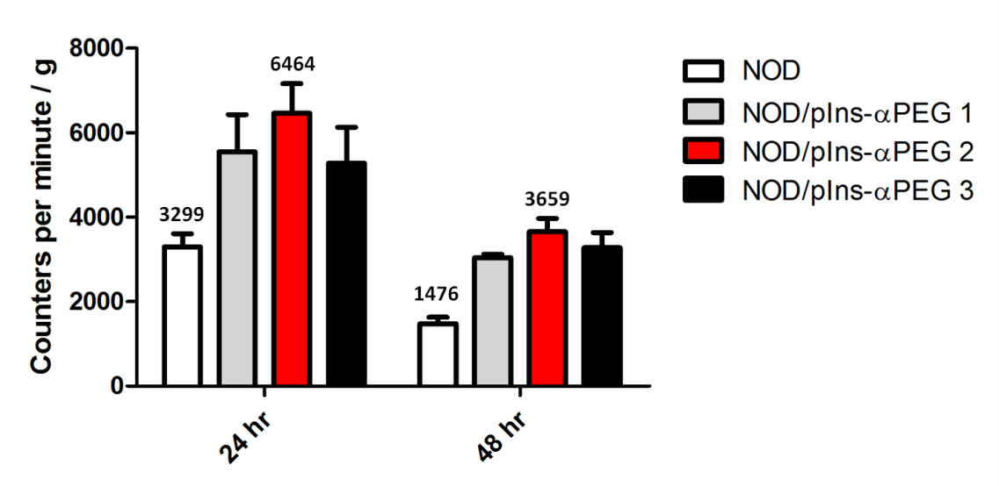
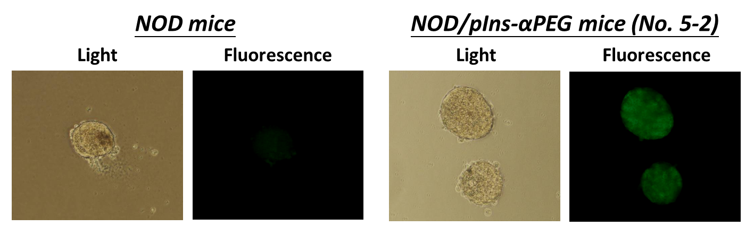
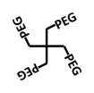

Selective accumulation of PEGylated probes
at pancreatic islets of NOD/pIns-αPEG mice
PEG-¹³¹I
Radiation intensity in pancreas
Intravenous
injection
PEG-FITC
Islet

Slide 19
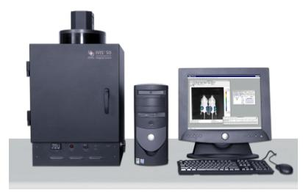

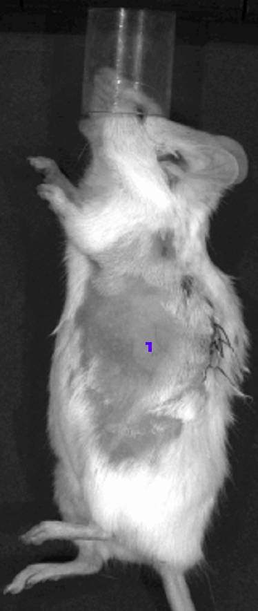
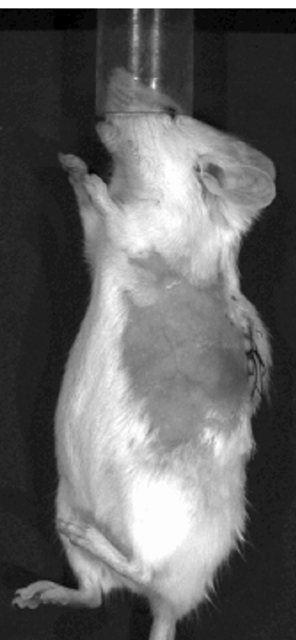
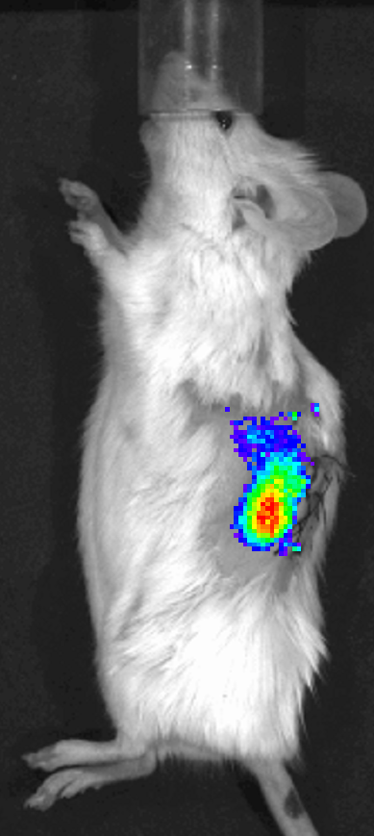
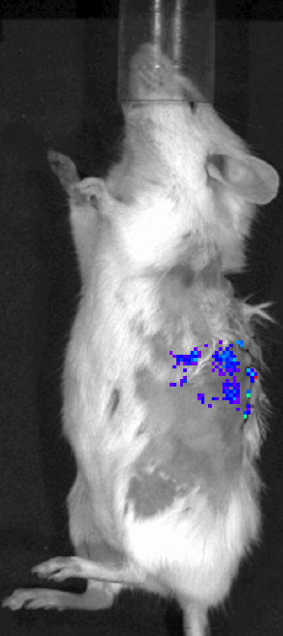
Optical image the progression of autoimmune diabetes
in NOD/pIns-αPEG mice
PEG-NIR
20 weeks
Intra-pancreatic
injection
Optical
imaging
24 h
Healthy
or
Diabetes (Blood sugar >200 mg/dL)
NOD mice
NOD/pIns-αPEG mice
Wild-type NOD
NOD/pIns-αPEG2
PEG-NIR797
PEG-NIR797
anti-PEG reporter
β Cell
β Cell
Healthy
Diabetes
Healthy
Diabetes
PEG-NIR can specifically localize at anti-PEG reporter expressing islets

Slide 20
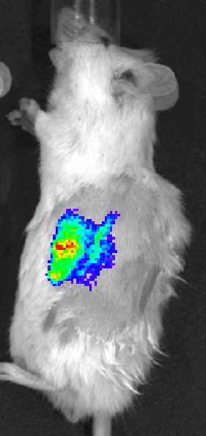
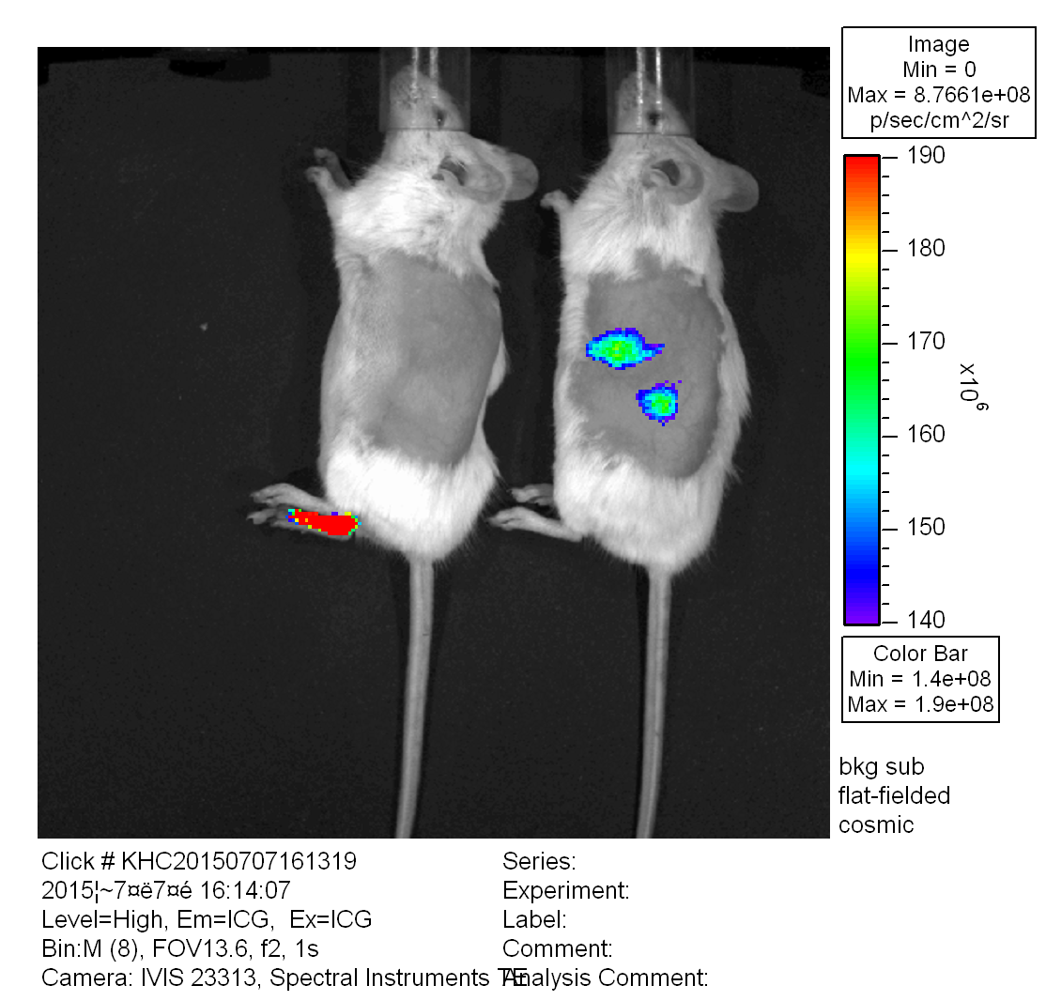
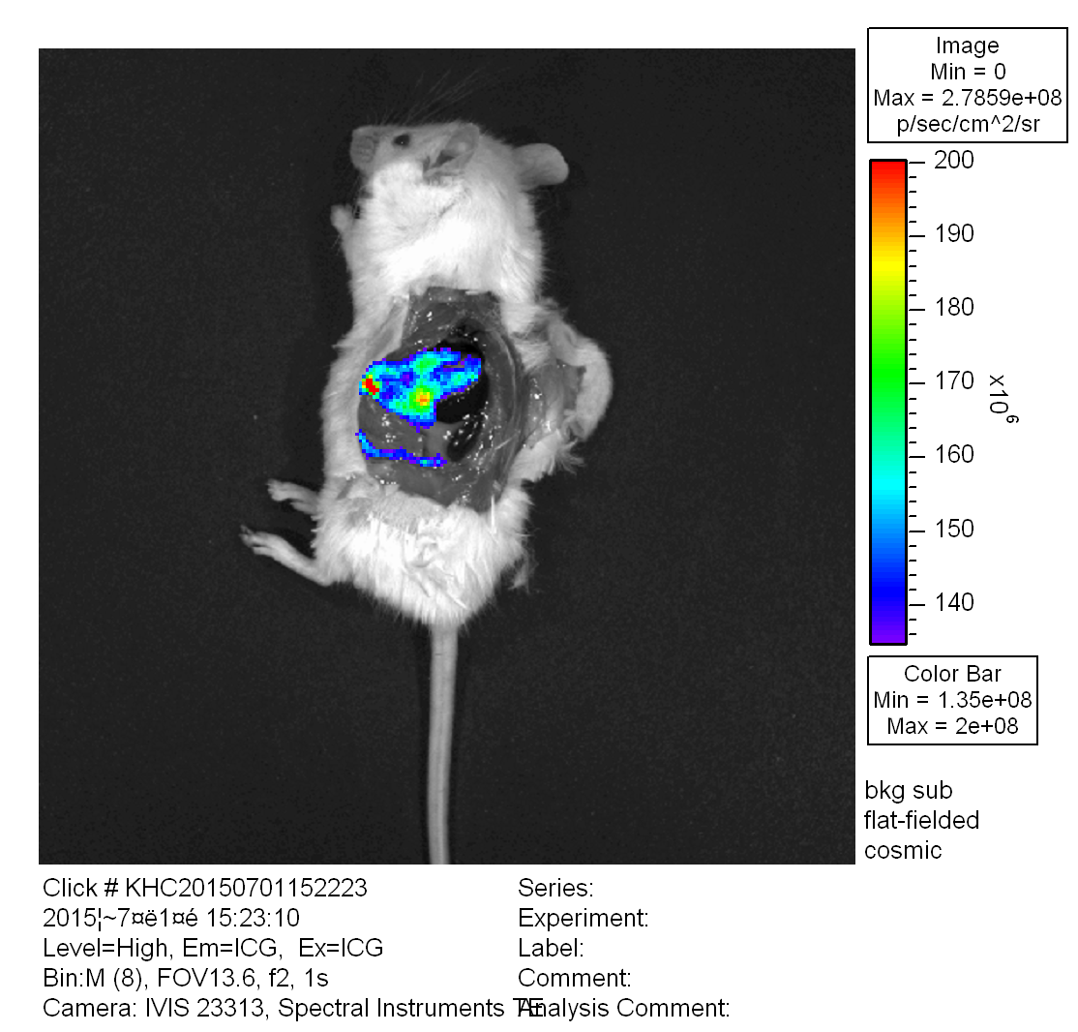
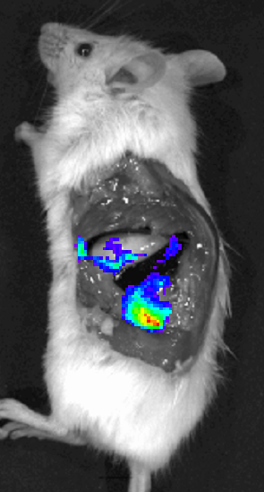

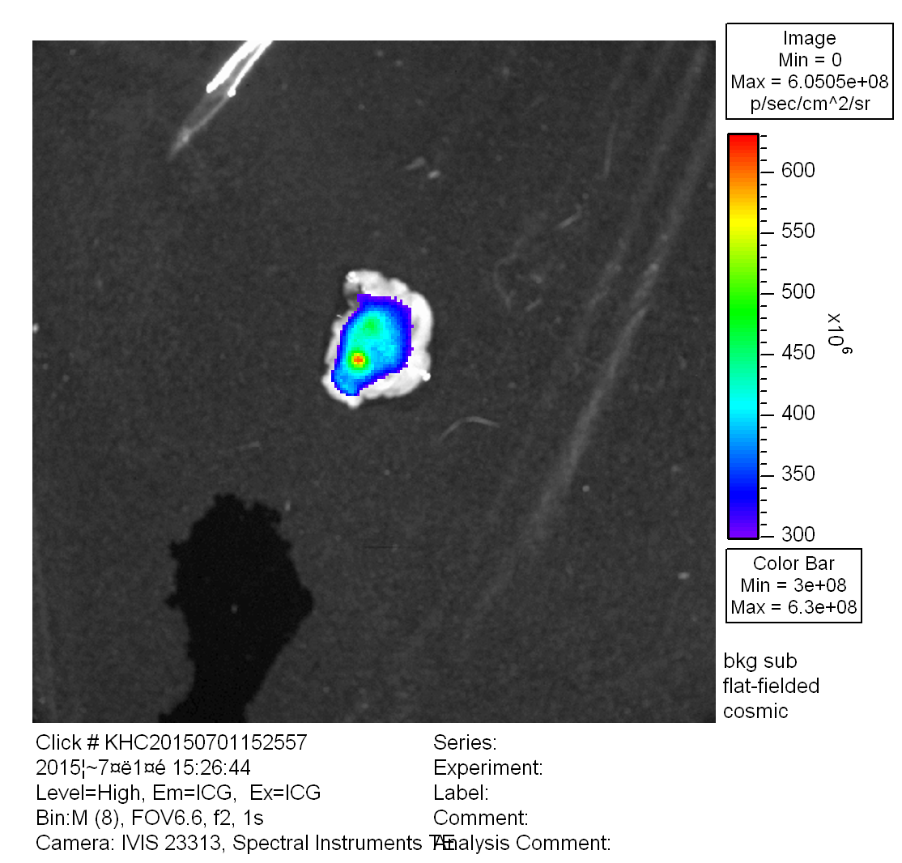
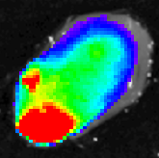
Noninvasive image the pancreatic islets in NOD/pIns-αPEG mice
by PEG-NIR probe combined an optical imaging system
NOD mice
NOD/pIns-αPEG
Healthy
NOD mice,
NOD/pIns-αPEG mice
Intraperitoneal
injection
PEG-NIR
48 h
Sacrifice
Optical
imaging
pancreas
pancreas

Slide 21
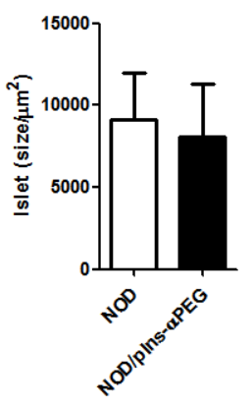
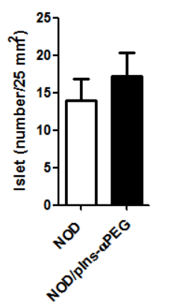
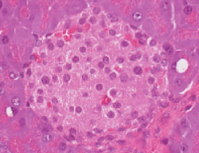
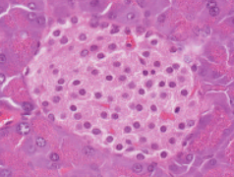
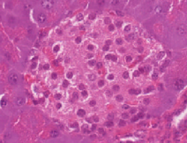



To assess the size and number of pancreatic islets
in NOD and NOD/pIns-αPEG mice
10 weeks
measure the size and number of islets by H&E stain
NOD mice,
NOD/pIns-αPEG mice
A
B
Islet size
C
Islet number
NOD
NOD/pIns-αPEG
50 μm
(n=5)
(n=5)
The size and number of pancreatic islets in NOD/pIns-αPEG mice is identical with wild-type NOD mice.
Notes:
為了觀察在胰島細胞表現anti-PEG reporter是否會影響胰島細胞的生理模式，因此本實驗測量了胰島細胞的大小與數目以評估NOD/anti-PEG小鼠胰島細胞之生理模式與wild-type NOD是否有差異。
首先我們先測量胰臟中胰島於的大小
我們將NOD及NOD/anti-PEG mice於10週齡時，將胰臟取出後利用H&Estain進行染色觀察並記錄小鼠胰島之大小。
此圖為NOD與NOD/anti-PEG小鼠的胰臟染色切片圖，右邊為統計之量化圖，白色bar為NOD黑色bar為NOD/anti-PEG，縱軸為胰島大小。
從染色切片圖可以看到，NOD與NOD/anti-PEG 小鼠之胰島大小沒有太大的差異，之後我們將此胰島大小量化並利用統計分析後得到之量化圖確認NOD與NOD/anti-PEG 小鼠胰島大小在統計數據上並無差異。

Slide 22


To exam the function of pancreatic islets in NOD and NOD/pIns-αPEG mice
Glucose
(1.5 g/Kg)
fasting
food
8 hours
NOD mice,
NOD/pIns-αPEG mice
Measure Glucose level by glucometer
NOD mice,
NOD/pIns-αPEG mice
Expressing anti-PEG reporter on the pancreatic islets does not affect the function of pancreatic islets.
(n=5)
Notes:
為了去評估胰島β細胞上表現anti-PEG reporter是否會影響胰島β細胞分泌胰島素的能力，因此利用葡萄糖耐量試驗來進行觀察。
首先我們將NOD及NOD/pIns-antiPEG mice小鼠禁食8小時,8小時後給予1.5g/kg的葡萄糖，然後於不同時間進行尾端採血並利用血糖機測量血液中葡萄糖含量，得到以下結果
橫軸為時間點，第０點為給予葡萄糖前的血糖濃度，其餘時間點為給予葡萄糖後測量的時間點，縱軸為血糖濃度
可以從結果看到，在給予葡萄糖30分鐘後，NOD及NOD/anti-PEG小鼠的血糖值均有升高，在６０分鐘後皆有慢慢回復血糖值，而在120分鐘時，兩者血糖均有回復到接近起始血糖值。
因此從此結果確認，在胰島β細胞上表現anti-PEG reporter並不會影響β細胞上分泌胰島素的能力。

Slide 23







To detect lymphocyte infiltration in the pancreatic islets of NOD and NOD/pIns-αPEG mice
20 weeks old
Infiltration
level
NOD mice
NOD/pIns-αPEG
normal
50 μm
25%
50%
Level 0: normal
Level 1: < 25% lymphocyte infiltration
Level 2: 25 - 50% lymphocyte infiltration
Level 3: > 50% lymphocyte infiltration
Level 4: complete lymphocyte infiltration
100%

Slide 24

Confirmation of diabetes and anti-insulin autoantibody in the NOD/pIns-αPEG mice
(Blood sugar >200 mg/dL)
NOD/pIns-αPEG mice have similar diabetes progression and
autoantibody response to NOD mice

Slide 25

Conclusion
anti-PEG reporter
Real-time imaging of pancreatic islet survival
PEG-probes
β Cell
Continuous observation of the same mice
β cell
NOD/pIns-αPEG mice
Increase convenience and accuracy
Noninvasive imaging
anti-PEG reporter
Physiology: islet number/size, insulin secretion
NO difference to NOD mice
β cell
Pathology: lymphocyte infiltration, autoantibody
, diabetes incidence
T cell
T cell
Insulin
Applications of NOD/pIns-αPEG mice
Tracing the disease progression of T1D by noninvasive imaging systems.
Assess the islet protective effect of therapeutic drugs
Evaluate disease mechanism of T1D by crossing NOD/pIns-αPEG mice with other NOD transgenic mice
Notes:
在本研究中我們使NOD小鼠的beta細胞表現anti-PEG reporter利用PEG造影劑搭配光學造影，即時且連續地以非侵犯性造影觀察同一隻小鼠胰島的存活情形，因此可增加觀察胰島細胞的方便性與準確性。
此外，在胰島細胞上表現anti-PEG reporter，並不會影響胰島的數目及大小。而在病理模式上，像是胰島被免疫細胞浸潤的情形或是分泌胰島素的能力、產生自體免疫抗體及發病率等，均與傳統NOD小鼠的胰島沒有差異。
因此，我們相信NOD/pIns-αPEG mice可加速研究追蹤NOD mice罹患第一型糖尿病之病程，並且進一步為全世界藥廠與藥物研發單位提供一種糖尿病藥物篩選平台。

Slide 26

Acknowledgement
Prof. Tian-Lu Cheng
(Kaohsiung Medical University)
Prof. Steve Roffler
(Academia Sinica)
Prof. Hsin-Ell Wang
(National Yang-Ming University)
Prof. Huey-Kang Sytwu
( National Defense Medical Center)
Funding Supports
1. Ministry of Health and Welfare
(NHRI-EX103-10238SC)
2. Ministry of Science and Technology
(NSC 102-2320-B-038-043-MY2)
Anti-PEG Abs
αPEG reporter
➔ Isotope labeling
National Laboratory Animal Center (NLAC),
Taiwan
➔ NOD mice / T1D
➔ NOD/pIns-αPEG mice
Lab members
Post Dr.
Dr. Ta-Chun Cheng
R.A.
Wen-Shiuan Guo
Ph.D. student
Yi-Rou Chang
Michael Chen
M.S. student
Deng-Chao Yang
Chang-Hong Wang
Yi-Shan Tsai
Ming-Shiuan Lin
B.S. student
Zhe-Yi Chen
Yu-Chiao Lin

Slide 27
Thanks for your attention !
We welcome your questions and discussions
Kuo-Hsiang Chuang : khchuang@tmu.edu.tw
27

Slide 29





Polyethylene Glycol (PEG)
CH₃O
CH₃O-[CH₂CH₂O]_{n}-H
Anti-CH₃O-PEG (2 Abs)
Anti-PEG backbone (8 Abs) (different repeat/m.w.)
a water-soluble, non-toxic and non-antigenic polymer
*PEG-macromolecules
*PEG-small molecules
PEG-protein :
PEG-INF-2α, PEG-G-CSF
, PEG-EPO
PEG-chemical drugs
CPT、SN-38
paclitaxel
Indomethacin
PEG-imaging probes
Fluorescent probes
Isotope (¹²⁴I, ¹¹¹In)
Improve the therapeutic efficiency
PEG
PEG-nanoparticle
PEG-SPIO (MRI) ➔ clinical phase II
PEG-liposome / micelle
Lipo-Dox
Doxil
commercial
29
Notes:
29

Slide 30

Membrane anchored anti-PEG reporter
Fab
αPEG reporter

Slide 31

A self-processing FMDV 2A peptide
furin
VL-CK
RA KR APVKQTLNFDLLKLAGDVESNPG P
VH-CH1
Furin cleavage site
FMDV 2A peptide
Nat Biotechnol. 2005 May; 23(5):584-90.

Slide 32


A functional reporter gene
PEG-quantum dots
Retrovirus
Cells
Cells
1. αPEG reporter
2. αDNS reporter
EJ/αPEG
EJ/αDNS
In vivo function
In vitro function
EJ/αPEG
EJ/αDNS
EJ/αPEG
EJ/αDNS
The αPEG reporter could specifically trap PEGylated probes.
32

Slide 33

In vitro and In vivo optical imaging
XENOGEN IVIS50 imaging system
PEG-NIR797 selectively retained at EJ/αPEG tumor, but not EJ/DNS tumor

Slide 34


In vitro and In vivo MR imaging
A.
Parameters:
TR = 5000 ms
TE = 70 ms
B.
7.0T MR scanner

Slide 35

A functional humanized αPEG reporter
a.
b.
4-arm PEG-SHPP-¹²⁴I
The humanized αPEG reporter possessed effective and
specific imaging in vitro and in vivo.

Slide 36




anti-PEG reporter can specifically express in pancreas
human insulin promoter
LS
αPEG Fab
mB7
anti-PEG reporter
Transgenic expression of decoy receptor 3 protects islets from spontaneous and chemical-induced autoimmune destruction in nonobese diabetic mice. The Journal of experimental medicine 199, 1143-1151 (2004).
Wang, C.J., et al. Protective role of programmed death 1 ligand 1 (PD-L1)in nonobese diabetic mice: the paradox in transgenic models. Diabetes 57, 1861-1869 (2008).

Slide 37

Transgenic mice V.S Knock-out (or knock-in) mice
Knock-out mice (or knock-in)
Transgenic mice
plasmid
mouse embryonic stem (ES) cells
zygote
mouse embryo
uterus of mouse
uterus of mouse
Chimeric mice
Wild-type
Transgenic mice
Knock-out (or knock-in) mice

Slide 38
0/0 cross Tg/0
Tg/0 cross Tg/0
Tg/0
Tg/0
0/0
Tg/0
(transgene)
(transgene)
(transgene)
(nontransgene)
chromosome
chromosome
chromosome
chromosome
NOD mice
NOD/pIns-αPEG mice
NOD/pIns-αPEG mice
NOD/pIns-αPEG mice
0/0
0/0
Tg/0
Tg/0
Tg/Tg
Tg/0
Tg/0
0/0
Complexity
Unstable

Slide 39

THE PANCREAS: Structure
Pancreatic islet contain 3 types of hormone-secreting cells
  Alpha cells (25%) Beta cells (60%)
  Delta cells (10%) F cells (PP cells) (5%)
The islets are organized around small capillaries into which the cells secrete their hormones

