Slide 1
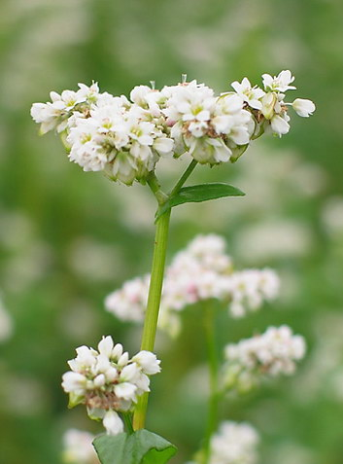
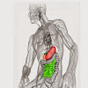
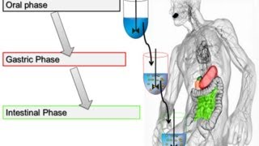
The Binding of Bile Acids by Biscuits with Bioactive Substances during In Vitro Digestion
Krzysztof Dziedzic, Danuta Górecka, Artur Szwengiel, Marzanna Hęś, Patrycja Komolka
Poznan University of Life Sciences

Slide 2
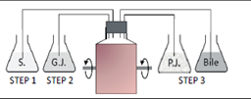
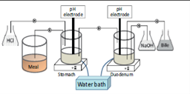
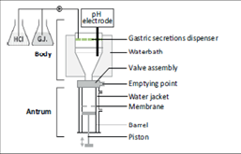
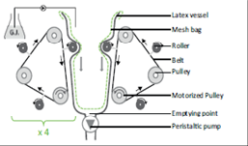
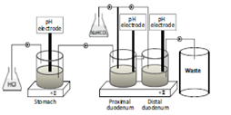

Slide 3
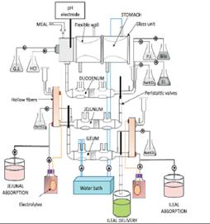

Slide 4
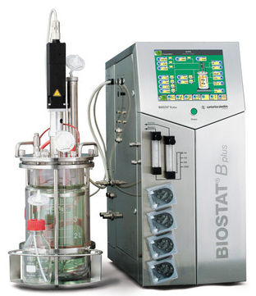
Bioreactor used during in vitro digestion- singel chamber static model
Sampling system
Peristaltic pomps
pH electrode
Stirrer
Water jacket

Slide 5
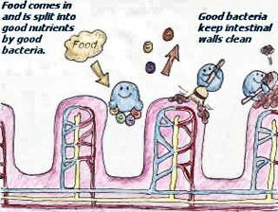
www.naturalvigour.com

Slide 6
E. faecalis
E. coli
www.buzzle.com

Slide 7
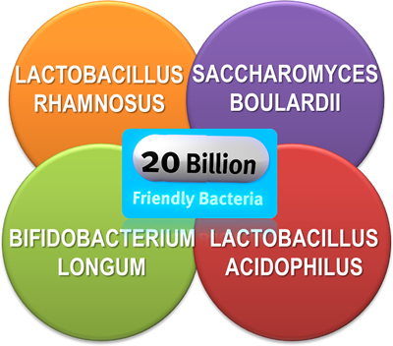
www.buzzle.com

Slide 8
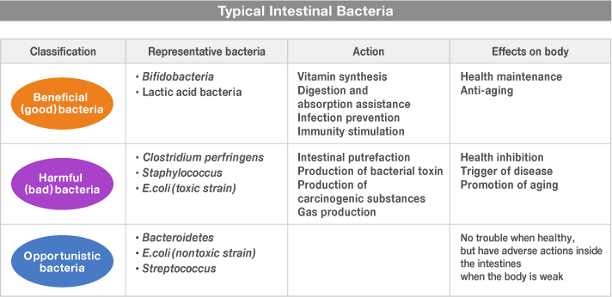
www.otsuka.co.jp

Slide 9
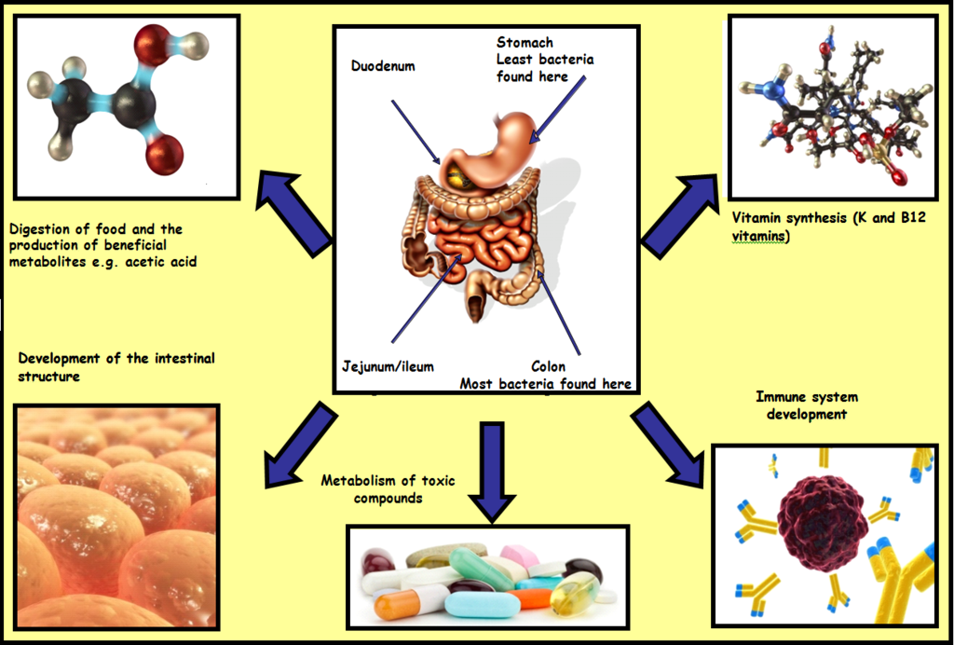
www.publish.ucc.ie

Slide 10
The aim of study
determination of bile salts binding ability by pastry goods during in vitro digestion
Dietary fiber assays:
Total dietary fiber
Insoluble dietary fiber
Soluble dietary fiber
Neutral detergent fiber
Cellulose
Hemicellulose
Lignin
Bile salts assays:
Cholic acid
Deoksycholic acid
Lithocholic acid

Slide 11
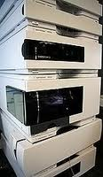
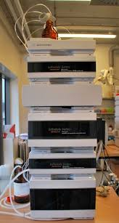
Methods
Neutral detergent fiber, cellulose (C), hemicellulose (H) and lignin (L) was assayed using Van Soest method;
Total dietary fiber (TDF), soluble (SDF) and insoluble (IDF) fractions were assayed using Asp method
The ability to bind bile acids was estimated using UHPLC equipment
1. Van Soest, P.J. 1963. Use of detergents in the analysis fibrous feeds. I. Preparation of fiber residues of low nitrogen content. J. AOAC Int. 46: 825-835.
2. Van Soest, P.J. 1967. Use of detergents in the analysis of fibrous feeds. IV. Determination of plant cell wall constituents. J. AOAC Int. 50: 50-55.
3. Asp N.-G., Johansson C.-G., Hallmer H. and Siljestrom M. 1983. Rapid enzymatic assay of insoluble, and soluble dietary fiber. J. Agr. Food Chem. 31: 476-482.
4. Asp N.-G. 1996. Dietary carbohydrates: classification by chemistry and physiology. Food Chem. 57: 9-14.
5. Wang, W., Onnagawa, M., Yoshie, Y., Szuzuki, T. 2001. Binding of bile salts soluble and insoluble dietary fibers of seaweeds. Fishieries Science. 67: 1169-1173.

Slide 12
The Samples
Control biscuits (CB)
Bioactive biscuits (BB1)
Bioactive biscuits (BB2)

Slide 13
Table 1. Ingredients of biscuits.
 | CB | BB1 | BB2
Plant butter | 20 | 10 | 10
Innulin | - | 2 | 2
Water | - | 4 | 4
Egs | 20 | 21 | 21
Sugar | 17 | 17 | 17
Wheat flour | 43 | 23 | 33
Buckwheat flour | - | 21 | 11
Buckwheat hull | - | 2 | 2

Slide 14
Table 1. Ingredients of biscuits.
 | CB | BB1 | BB2
Plant butter | 20 | 10 | 10
Innulin | - | 2 | 2
Water | - | 4 | 4
Egs | 20 | 21 | 21
Sugar | 17 | 17 | 17
Wheat flour | 43 | 23 | 33
Buckwheat flour | - | 21 | 11
Buckwheat hull | - | 2 | 2

Slide 15
Table 1. Ingredients of biscuits.
 | CB | BB1 | BB2
Plant butter | 20 | 10 | 10
Innulin | - | 2 | 2
Water | - | 4 | 4
Egs | 20 | 21 | 21
Sugar | 17 | 17 | 17
Wheat flour | 43 | 23 | 33
Buckwheat flour | - | 21 | 11
Buckwheat hull | - | 2 | 2

Slide 16
Table 1. Ingredients of biscuits.
 | CB | BB1 | BB2
Plant butter | 20 | 10 | 10
Innulin | - | 2 | 2
Water | - | 4 | 4
Egs | 20 | 21 | 21
Sugar | 17 | 17 | 17
Wheat flour | 43 | 23 | 33
Buckwheat flour | - | 21 | 11
Buckwheat hull | - | 2 | 2

Slide 17
Model of research
 | Organic acids | Phenolic compounds | Bile salts | carbohydrates
Stomach (pH 2,0; after 10min) | x | x |  | x
Stomach (after 2h) | x | x |  | x
Small intestine (pH 6,0; after 30 min) |  |  | x
Small intestine (pH 7,4 ) | x | x | x | x
Large intestine (pH 8.0; start) | x | x | x | x
Large intestine (pH 8.0; final) | x | x | x | x

Slide 18
Model of research
 | Organic acids | Phenolic compounds | Bile salts | carbohydrates
Stomach (pH 2,0; after 10min) | x | x |  | x
Stomach (after 2h) | x | x |  | x
Small intestine (pH 6,0; after 30 min) |  |  | x
Small intestine (pH 7,4 ) | x | x | x | x
Large intestine (pH 8.0; start) | x | x | x | x
Large intestine (pH 8.0; final) | x | x | x | x

Slide 19
Model of research
 | Organic acids | Phenolic compounds | Bile salts | carbohydrates
Stomach (pH 2,0; after 10min) | x | x |  | x
Stomach (after 2h) | x | x |  | x
Small intestine (pH 6,0; after 30 min) |  |  | x
Small intestine (pH 7,4 ) | x | x | x | x
Large intestine (pH 8.0; start) | x | x | x | x
Large intestine (pH 8.0; final) | x | x | x | x

Slide 20
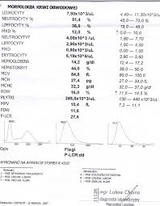
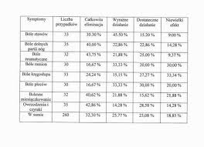
Results

Slide 21
Tab.1. Content of neutral dietary fiber (NDF) and its fraction.
 | Control biscuits (CB) | Bioactive biscuits (BB1) | Bioactive biscuits (BB2)
NDF | 3.53^{b} | 5.20ª | 4.83^{c}
Cellulose | 0.95^{c} | 1.99^{ab} | 1.37^{bc}
Hemicellulose | 0.78^{bc} | 0.84^{ab} | 0.20^{c}
Lignin | 1.80^{c} | 2.38^{b} | 3.26ª
Sample
Fraction

Slide 22
Tab.1. Content of neutral dietary fiber (NDF) and its fraction.
 | Control biscuits (CB) | Bioactive biscuits (BB1) | Bioactive biscuits (BB2)
NDF | 3.53^{b} | 5.20ª | 4.83^{c}
Cellulose | 0.95^{c} | 1.99^{ab} | 1.37^{bc}
Hemicellulose | 0.78^{bc} | 0.84^{ab} | 0.20^{c}
Lignin | 1.80^{c} | 2.38^{b} | 3.26ª
Sample
Fraction

Slide 23
Tab.1. Content of neutral dietary fiber (NDF) and its fraction.
 | Control biscuits (CB) | Bioactive biscuits (BB1) | Bioactive biscuits (BB2)
NDF | 3.53^{b} | 5.20ª | 4.83^{c}
Cellulose | 0.95^{c} | 1.99^{ab} | 1.37^{bc}
Hemicellulose | 0.78^{bc} | 0.84^{ab} | 0.20^{c}
Lignin | 1.80^{c} | 2.38^{b} | 3.26ª
Sample
Fraction

Slide 24
Tab.2. Content of total dietary fiber (TDF) and its fractions.
 | Control biscuits (CB) | Bioactive biscuits (BB1) | Bioactive biscuits (BB2)
Total Dietary Fiber | 8.7^{c} | 11.2^{ab} | 12.8ª
Insoluble Dietary Fiber | 4.5^{c} | 7.5ª | 7.4^{ab}
Soluble Dietary Fiber | 4.2^{b} | 3.8^{c} | 5.4ª
Sample
Fraction

Slide 25
Tab.2. Content of total dietary fiber (TDF) and its fractions.
 | Control biscuits (CB) | Bioactive biscuits (BB1) | Bioactive biscuits (BB2)
Total Dietary Fiber | 8.7^{c} | 11.2^{ab} | 12.8ª
Insoluble Dietary Fiber | 4.5^{c} | 7.5ª | 7.4^{ab}
Soluble Dietary Fiber | 4.2^{b} | 3.8^{c} | 5.4ª
Sample
Fraction

Slide 26
Tab.3. Bile acid binding capacity by pastry goods.
 |  | Control (mg/mL) | CB (mg/mL) | BB1 (mg/mL) | BB2 (mg/mL)
Cholic acid | Small intestine | 3265 | 2257 (-31%) | 3087 (-5%) | 274 (-92%)
 | Large intestine | 3055 | 3458 (+13%) | 3332 (+9%) | 1250 (-59%)
Deoksycholic acid | Small intestine | 11181 | 848 (-92%) | 765 (-93%) | 29 (-99%)
 | Large intestine | 2696 | 3527 (+31%) | 3136 (+16%) | 301 (-89%)
Lithocholic acid | Small intestine | 320 | 91 (-72%) | 126 (-61%) | 182 (-56%)
 | Large intestine | 2223 | 2675 (+20%) | 3576 (+61%) | 3458 (+56%)
„-” means decrease of bile acid in comparison to control sample , „+” means increase of bile acid in comparison to control sample.

Slide 27
Tab.3. Bile acid binding capacity by pastry goods.
 |  | Control (mg/mL) | CB (mg/mL) | BB1 (mg/mL) | BB2 (mg/mL)
Cholic acid | Small intestine | 3265 | 2257 (-31%) | 3087 (-5%) | 274 (-92%)
 | Large intestine | 3055 | 3458 (+13%) | 3332 (+9%) | 1250 (-59%)
Deoksycholic acid | Small intestine | 11181 | 848 (-92%) | 765 (-93%) | 29 (-99%)
 | Large intestine | 2696 | 3527 (+31%) | 3136 (+16%) | 301 (-89%)
Lithocholic acid | Small intestine | 320 | 91 (-72%) | 126 (-61%) | 182 (-56%)
 | Large intestine | 2223 | 2675 (+20%) | 3576 (+61%) | 3458 (+56%)
„-” means decrease of bile acid in comparison to control sample , „+” means increase of bile acid in comparison to control sample.

Slide 28
Tab.3. Bile acid binding capacity by pastry goods.
 |  | Control (mg/mL) | CB (mg/mL) | BB1 (mg/mL) | BB2 (mg/mL)
Cholic acid | Small intestine | 3265 | 2257 (-31%) | 3087 (-5%) | 274 (-92%)
 | Large intestine | 3055 | 3458 (+13%) | 3332 (+9%) | 1250 (-59%)
Deoksycholic acid | Small intestine | 11181 | 848 (-92%) | 765 (-93%) | 29 (-99%)
 | Large intestine | 2696 | 3527 (+31%) | 3136 (+16%) | 301 (-89%)
Lithocholic acid | Small intestine | 320 | 91 (-72%) | 126 (-61%) | 182 (-56%)
 | Large intestine | 2223 | 2675 (+20%) | 3576 (+61%) | 3458 (+56%)
„-” means decrease of bile acid in comparison to control sample , „+” means increase of bile acid in comparison to control sample.

Slide 29
Tab.3. Bile acid binding capacity by pastry goods.
 |  | Control (mg/mL) | CB (mg/mL) | BB1 (mg/mL) | BB2 (mg/mL)
Cholic acid | Small intestine | 3265 | 2257 (-31%) | 3087 (-5%) | 274 (-92%)
 | Large intestine | 3055 | 3458 (+13%) | 3332 (+9%) | 1250 (-59%)
Deoksycholic acid | Small intestine | 11181 | 848 (-92%) | 765 (-93%) | 29 (-99%)
 | Large intestine | 2696 | 3527 (+31%) | 3136 (+16%) | 301 (-89%)
Lithocholic acid | Small intestine | 320 | 91 (-72%) | 126 (-61%) | 182 (-56%)
 | Large intestine | 2223 | 2675 (+20%) | 3576 (+61%) | 3458 (+56%)
„-” means decrease of bile acid in comparison to control sample , „+” means increase of bile acid in comparison to control sample.

Slide 30
Tab.3. Bile acid binding capacity by pastry goods.
 |  | Control (mg/mL) | CB (mg/mL) | BB1 (mg/mL) | BB2 (mg/mL)
Cholic acid | Small intestine | 3265 | 2257 (-31%) | 3087 (-5%) | 274 (-92%)
 | Large intestine | 3055 | 3458 (+13%) | 3332 (+9%) | 1250 (-59%)
Deoksycholic acid | Small intestine | 11181 | 848 (-92%) | 765 (-93%) | 29 (-99%)
 | Large intestine | 2696 | 3527 (+31%) | 3136 (+16%) | 301 (-89%)
Lithocholic acid | Small intestine | 320 | 91 (-72%) | 126 (-61%) | 182 (-56%)
 | Large intestine | 2223 | 2675 (+20%) | 3576 (+61%) | 3458 (+56%)
„-” means decrease of bile acid in comparison to control sample , „+” means increase of bile acid in comparison to control sample.

Slide 31
Tab.3. Bile acid binding capacity by pastry goods.
 |  | Control (mg/mL) | CB (mg/mL) | BB1 (mg/mL) | BB2 (mg/mL)
Cholic acid | Small intestine | 3265 | 2257 (-31%) | 3087 (-5%) | 274 (-92%)
 | Large intestine | 3055 | 3458 (+13%) | 3332 (+9%) | 1250 (-59%)
Deoksycholic acid | Small intestine | 11181 | 848 (-92%) | 765 (-93%) | 29 (-99%)
 | Large intestine | 2696 | 3527 (+31%) | 3136 (+16%) | 301 (-89%)
Lithocholic acid | Small intestine | 320 | 91 (-72%) | 126 (-61%) | 182 (-56%)
 | Large intestine | 2223 | 2675 (+20%) | 3576 (+61%) | 3458 (+56%)
„-” means decrease of bile acid in comparison to control sample , „+” means increase of bile acid in comparison to control sample.

Slide 32
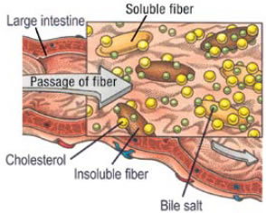
www.skinmed.com

Slide 33
Conclusions
Biscuits containing bioactive ingredients were characterized by a higher content of NDF and TDF dietary fibre, as compared with the control samples
It was found that the ability to bind bile acids depended both on the type of tested product and the type of bile acid
The highest cholic and deoksycholic acid binding ability was observed in case of bioactive biscuits 2
The content of cholic, deoksycholic and lithocholic acid in the large intestine section increased in case of control biscuits and bioactive biscuits 1.

Slide 34
Thank You

