Slide 1
Allium cepa L. act as acid-base indicators
Acid-base indicator is a weak base or weak acid. The colour change of indicator occurs over a range of hydrogen ion concentrations. This range is termed the colour change interval. It is expressed as a pH range. (Anne Marie Helmenstine, 2014)

Slide 2
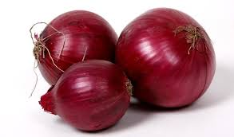
What is Allium cepa L . ?
RED ONION

Slide 3
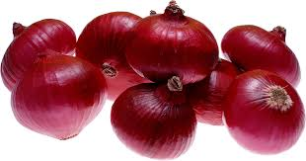
Why we choose onion ?
Safety awareness
Can be found in many dishes .
Cheap and easily available
Around 170 cultivate onions for domestic uses.
Can be planted in various type of soil but best cultivated in the soil that are fertile.
Can be planted in almost any season.

Slide 4
ABSTRACT
based on red onion as acid-base indicator
determine whether the pigment, anthocyanins in red onion can act as an acid-base indicator
prepared a light purplish juice from the extraction of red onion

Slide 5
If added with HCl, colour change to red
If added with NaOH, colour change to yellow
If added with distilled water, no observable change
The changes of colour in the red onion juice shows that red onion can function as acid-base indicator!!!
Keywords: - acid-base indicator
- anthocyanins
- red onion juices

Slide 6
1.2 literature review
Anthocyanins
Widely distributed classes of flavonoids in plants. (Harborne & Williams,2000)
Synthesized in the cytoplasm and eventually stored at the vacuole of plant cell. (Hrazdina,1992; Matern etal, 1986; Wagner and Hrazdina, 19)
Can found the anthocyanins in all tissues of higher plants, including roots ,leaves ,stems ,fruits and flower. (Williams CA, Grayer RJ. 2004)

Slide 7
How anthocyanins help in determing PH of enviroment?
(Maurizio Mulas et al.2013. )
Anthocyanins are sensitive towards the pH of the environment
(Brouillard and Delaporte 1997 , Lapidot et al, 1999)
It may show red, purple or blue under different pH.
This is because anthocyanins will switch the structure under different pH.
It exhibits different colour at different pH.

Slide 8
(Maarit, 2005; Wada, 2002)
≤

Slide 9
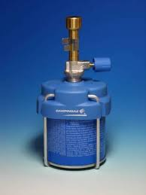
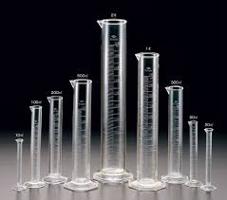
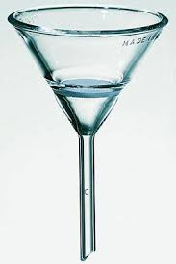
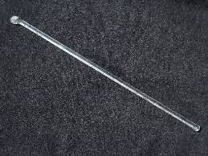
2.0 : METHODOLOGY
2.1 Apparatus & Materials
Apparatus: Measuring cylinder, knife, beaker, Bunsen burner,
wire gauge, retort stand, tripod stand, filter funnel,
test tubes, test tube rack, stirrer, dropper

Slide 10
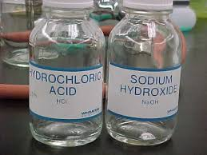
Materials: Allium cepa.L, distilled water,
1.0M of HCL, 1.0M OF NaOH, filter paper

Slide 11
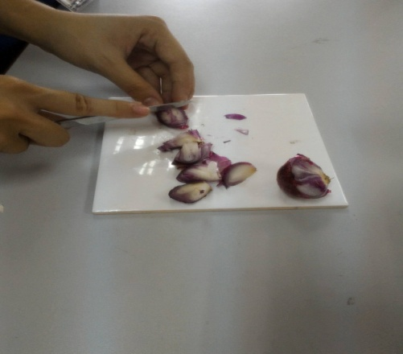
2.2 Procedure
a)Allium cepa L. is cut into small pieces after being washed.
Figure 1: Allium cepa L. is cut into small pieces after being washed.
b) Solution is boiled in 50ml of distilled water
c) The mixture is filtered

Slide 12
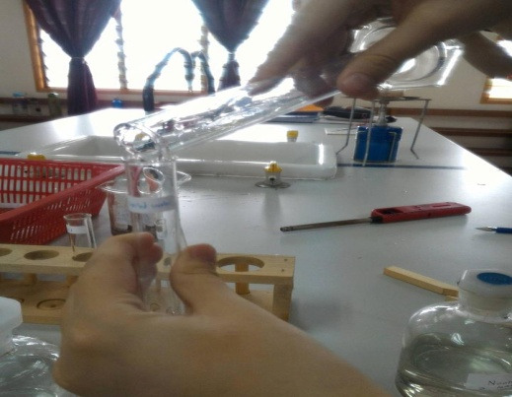
d) -added 2 cm³ filtrate
-into 6 test tubes (3 for concentrated juices & 3 for diluted juices)
Figure 2. The filtrate was transferred to 3 different test tubes.

Slide 13
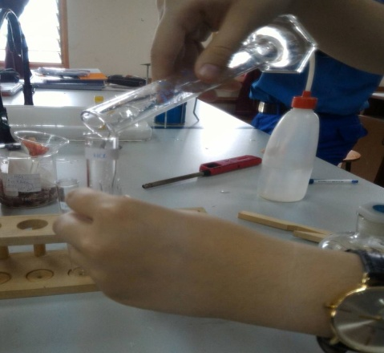
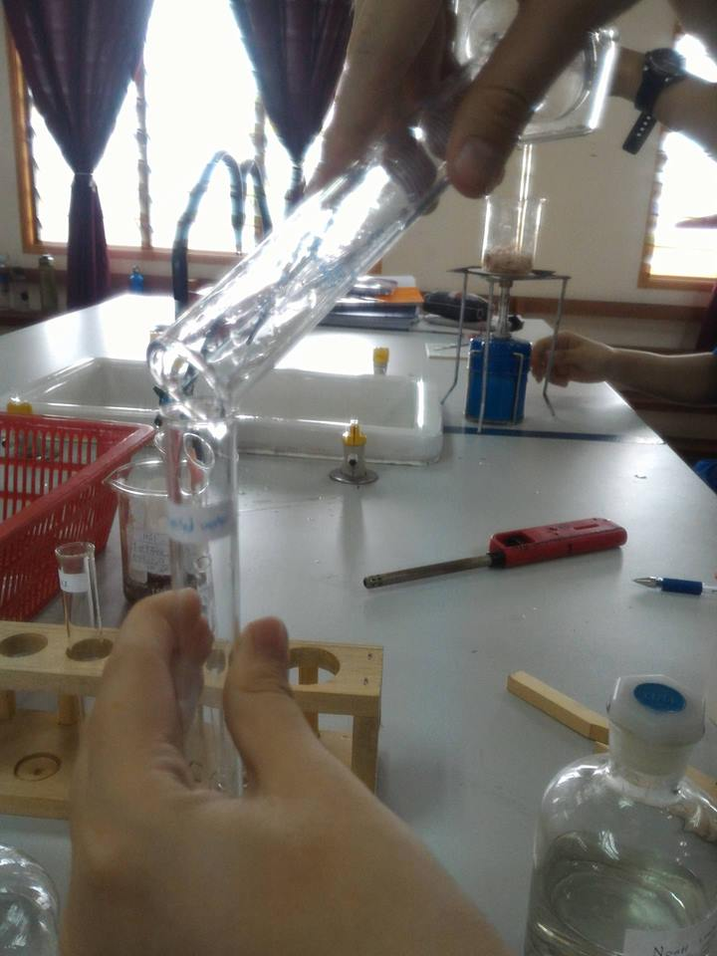
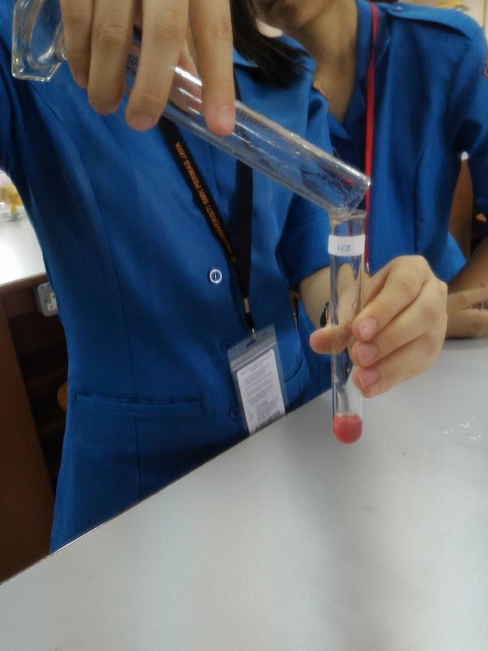
e) For the 3 diluted juices:
-Test tube 1 with 2 cm³. of 1.0M of HCl
-Test tube 2 with 2cm³. of 1.0M of NaOH
-Test tube 3 with 2 cm³. of Distilled water
Figure 3.1 Test tube 1 with 2 cm³ of 1.0M of HCl
Figure 3.2 Test tube 2 with 2 cm³ of 1.0M of NaOH
Figure 3.3 Test tube 3 with 2 cm³ of distilled water

Slide 14
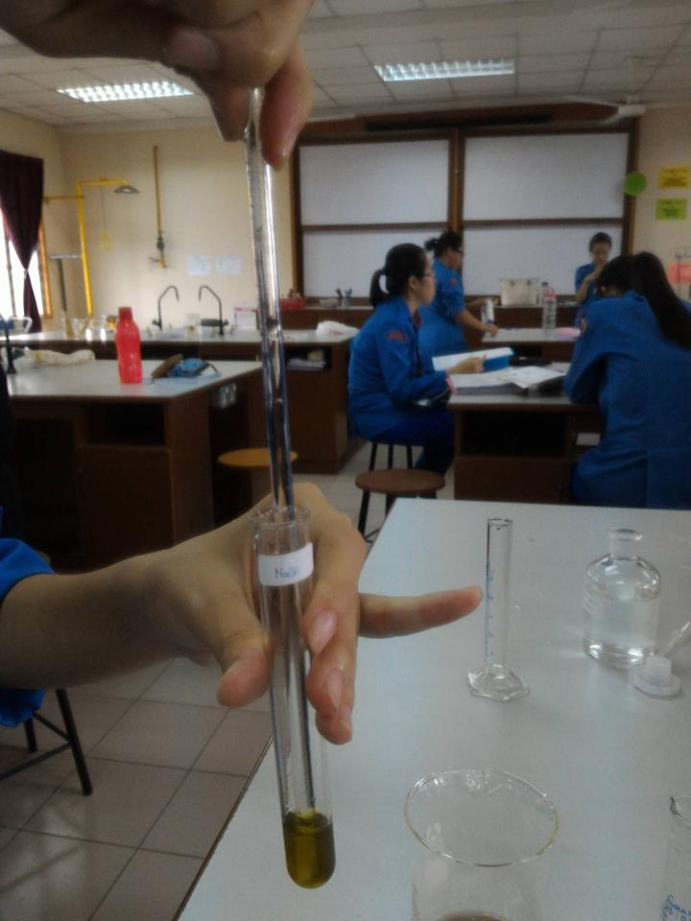
f)For the 3 concentrated juices:
-Test tube 4 with 2 cm³. of 1.0M of HCl
-Test tube 5 with 2cm³. of 1.0M of NaOH
-Test tube 6 with 2 cm³. of 1.0M of Distilled water
g) Each of the solution is stirred by using stirrer
Figure 4. Each of the solution is stirred by using the glass rod.

Slide 15
3.0 RESULT AND DISCUSSION

Slide 16
3.1 RESULT AND OBSERVATION
The colour changes of diluted Allium cepa L. solution in different types of solution
Test tube | Observation | Chemical property (acid-base)
Distilled water | Yellowish solution is formed. | Neutral
Hydrochloric acid | Light pink solution is formed. | Acid
Sodium hydroxide solution | Dark yellow solution is formed. | Basic

Slide 17
The colour changes of concentrated Allium cepa L. solution in different pH solution
Test tube | Observation | Chemical property (acid-base)
Distilled water | Purplish solution is formed. | Neutral
Hydrochloric acid | Reddish-pink solution is formed. | Acid
Sodium hydroxide solution | Dark yellow solution is formed. | Basic

Slide 18
3.2 INTERPRETATION AND DISCUSSION
Allium cepa L. juice act as pH indicator to test properties of the common solutions
Can be used to identify properties of household item
Undergoes colour change when added with acidic solution, alkaline solution and neutral solution
due to the pigments called anthocyanins which undergo change in the chemical structure in response to the change of pH

Slide 19
concentrated Allium cepa L. juices show the colour change in a higher intensity
increase anthocyanin concentration promotes higher colour stability

Slide 20
4.0 Conclusion
The natural acid-base indicator that is made by Allium cepa L. show the change of colour with the change of pH.

Slide 21
In different solution
In neutral solution, the Allium cepa L. juice show no visible change
In acidic solution, purplish Allium cepa L. juice change into red colour
In basic solution, purplish Allium cepa L. juice change into yellow colour

Slide 22
In different concentration
Higher concentration of Allium cepa L. juice will affect the colour change of Allium cepa L. solution.
It will give a darker colour change.

Slide 23
Commercialisation potential
Convenient and low cost with fast-obtaining results.
Target user : Those who have skin allergic.
: Students
: Researcher

Slide 24
The end thanks for your attention…

