Slide 1

Seismic Resistant Design of Connections with the use of Perforated Beams
Institute of Resilient Infrastructure
School of Civil Engineering
Faculty of Engineering
Dr Konstantinos Daniel Tsavdaridis
MEng, MSc, DIC, PhD, CEng, EUR ING, MASCE, MIASS, FHEA
Assistant Professor of Structural Engineering
k.tsavdaridis@leeds.ac.uk
World Congress and Exhibition on CONSTRUCTION AND STEEL STRUCTURE
November 16-18, 2015
Dubai, UAE

Slide 2
Fact
In the era of sustainable and resilient infrastructures, where the concept of redundancy plays a significant role, we should reconsider optimising every single structure to the best of its efficiency.
This can be called as:
Sustainable design
Resilience
Efficiency
Optimisation
Performance-based design
Adaptive (eg. pneumatic) design
Indeed the one-off nature of every civil-structural engineering project necessitates the use of rigorous studies and advanced techniques in the global and local level (as well as the material level) to drive efficiencies on the increasingly complex projects of today.
Tsavdaridis, K.D. Seismic Resistant Design of Novel RWS Connections

Slide 3

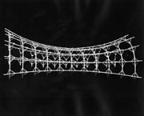


Inspired from…
Robert le Ricolais, 1894-1977
An apparently simple sentence, The art of structure is where to put the holes, is his point of departure for an exposition on strength without weight in a tube shape that might create a new kind of subway tunnel.
David Hovey, Architect
I have spent my career thinking about how to design buildings economically and efficiently!
Tsavdaridis, K.D. Seismic Resistant Design of Novel RWS Connections

Slide 4
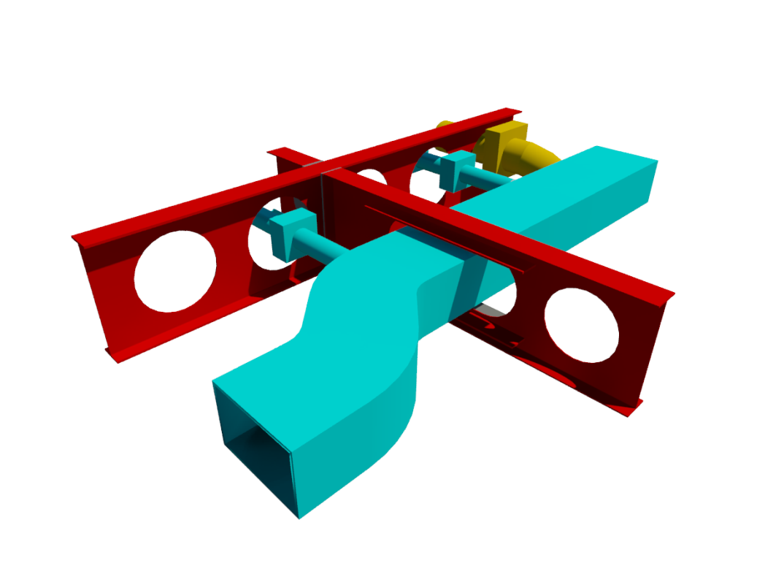
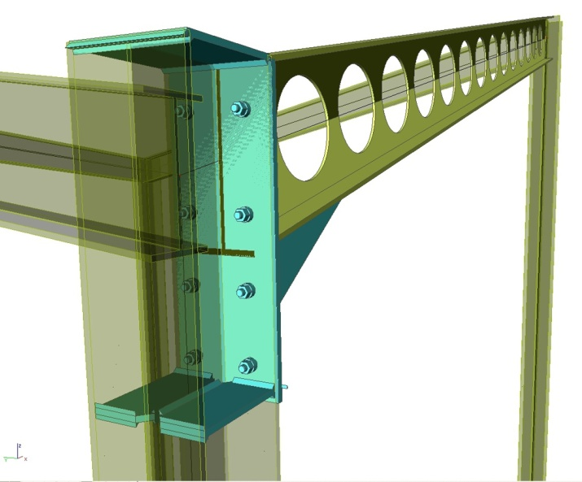
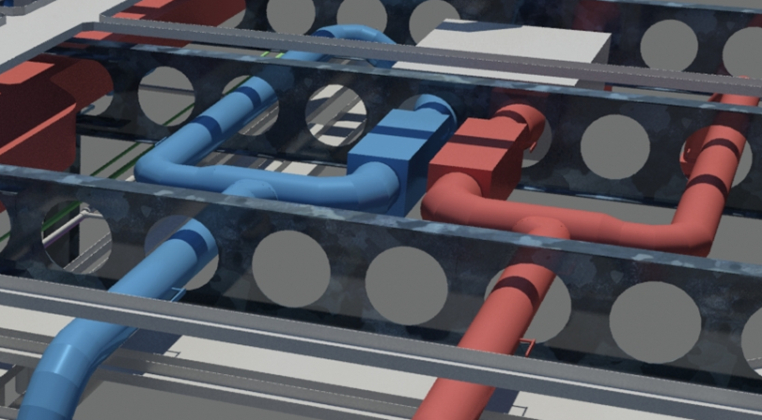
Perforated Beams
Perforations in the webs of steel beams are widely used nowadays in building construction due to their ability to provide lighter structural members, reduced material costs, in addition to the provision for greater flexibility in structural layouts particularly in the floor-to-ceiling height.
Tsavdaridis, K.D. Seismic Resistant Design of Novel RWS Connections
Notes:
Add positives in using novel elliptically-based web openings

Slide 5
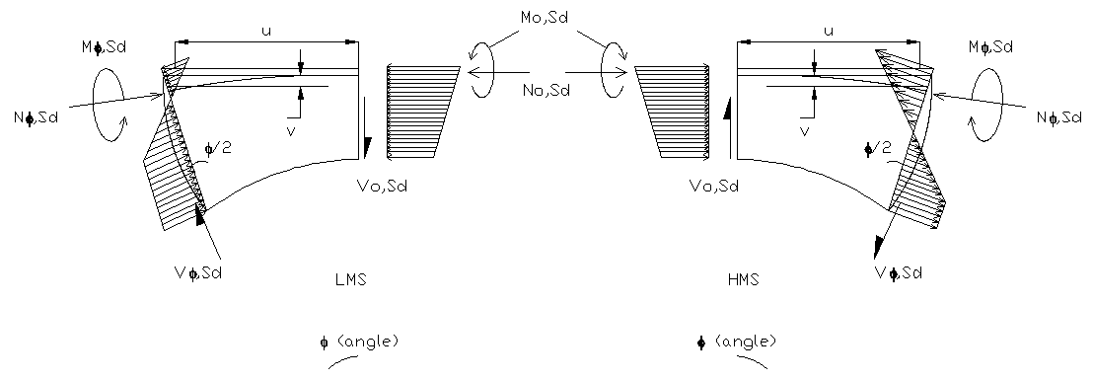
Perforated Beams (since 2005…)
Tsavdaridis, K.D. Seismic Resistant Design of Novel RWS Connections

Slide 6
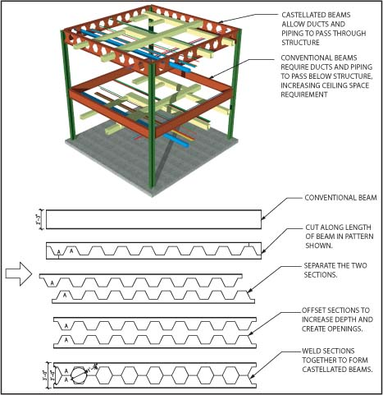
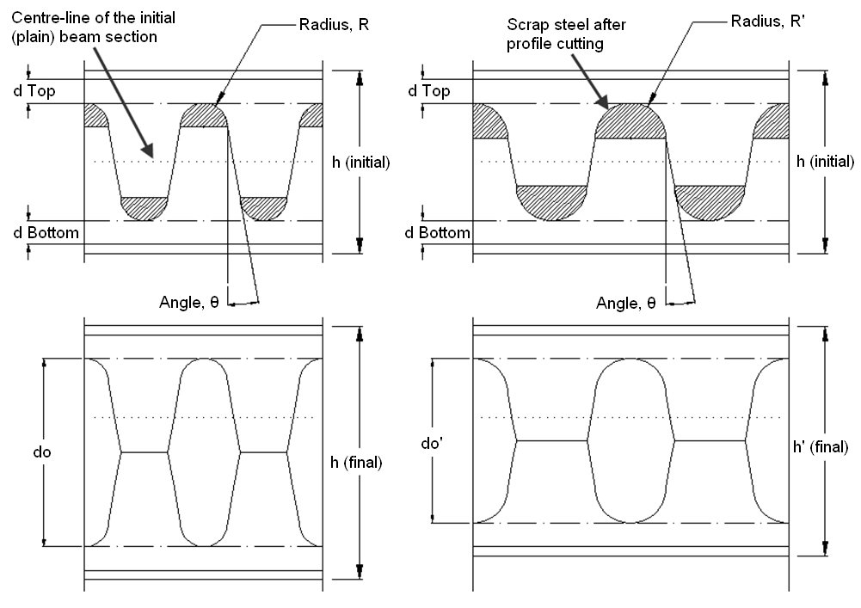
Perforated Beams (since 2005…)
Tsavdaridis, K.D. Seismic Resistant Design of Novel RWS Connections

Slide 7
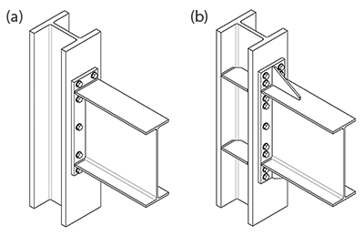
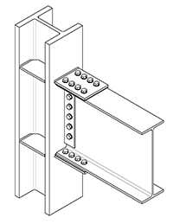
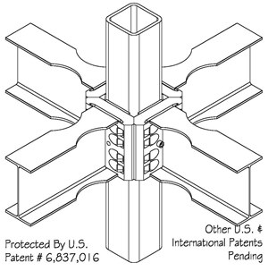
Strengthening Techniques
In order to enhance of (post-Northridge) connections, researchers provided high level of ductility and assured operation in connections by:
Connection reinforcement/strengthening; a number of connections have been proposed in FEMA 350 such as the:
  Bolted Flange Plate (BFP)
  Bolted Unstiffened End-Plate (BUEEP)
  Stiffened Extended End-Plate (BSEEP)
  CONXTECH CONX and KAISER Bolted Bracket (KBB)
Excess reinforcement leads to:
  increasing welding and bolting processes
  increasing connections rigidity and panel zone stresses
  increase in weight and hence the seismic effects
Tsavdaridis, K.D. Seismic Resistant Design of Novel RWS Connections

Slide 8
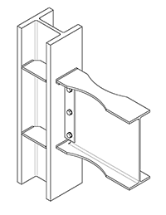
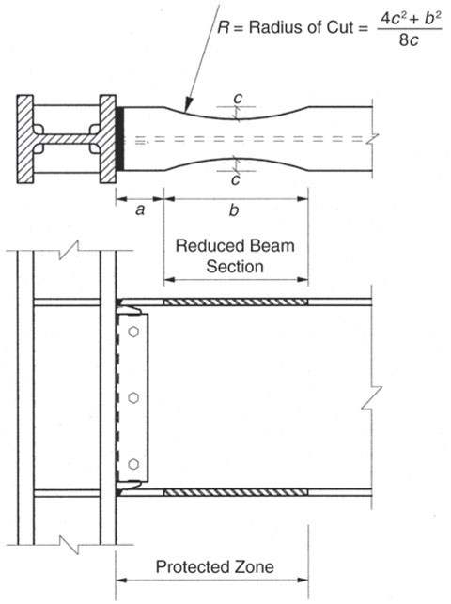
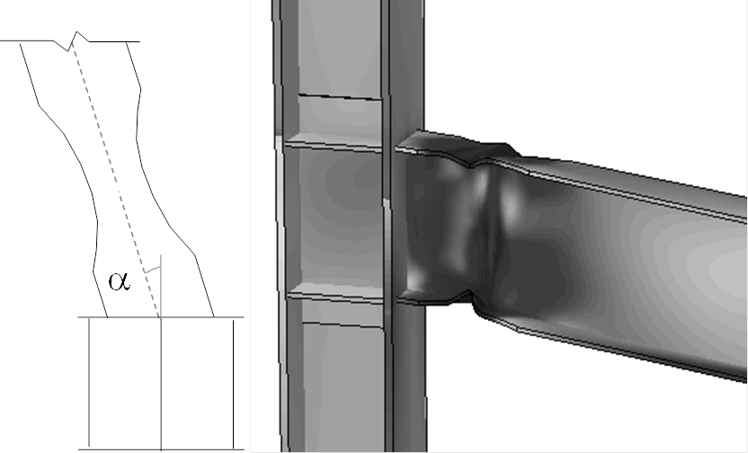
Weakening Techniques - RBS
Beam weakening by reducing the cross-sectional area of the beam locally at a certain distance from the connection to shift the stresses away from the column’s face. One method to achieve this is by removing portions of the flanges locally, referred to as Reduced Beam Section (RBS). → Economical solution !!
FEMA 350 & EC8
Tsavdaridis, K.D. Seismic Resistant Design of Novel RWS Connections

Slide 9
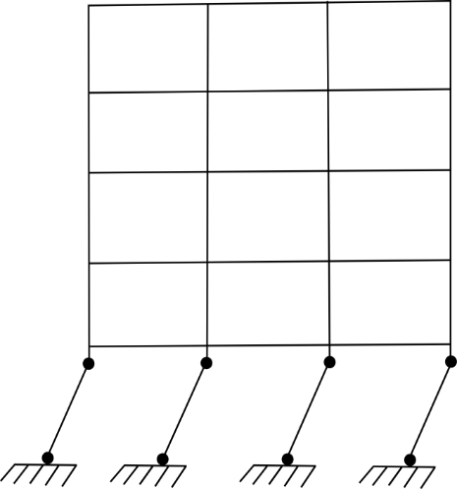
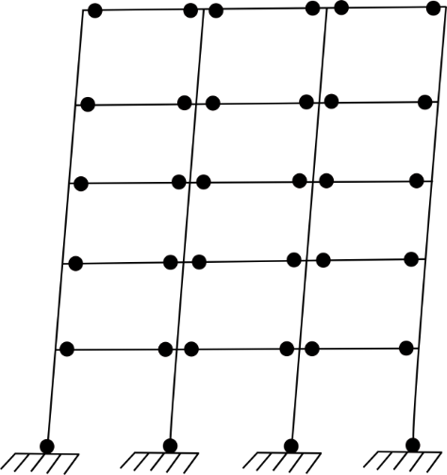
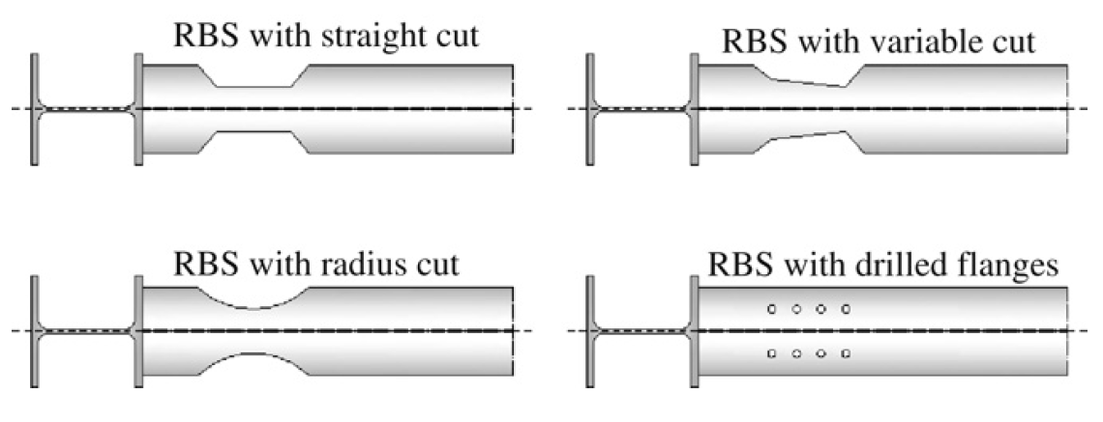
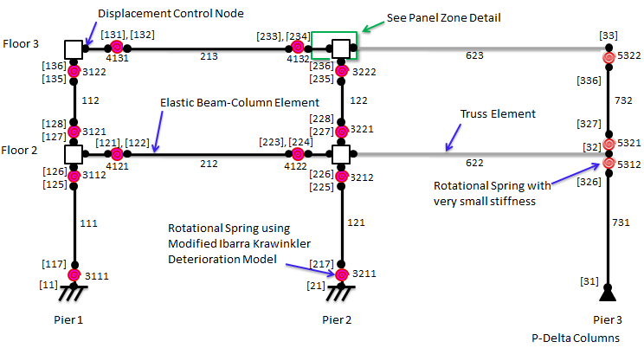
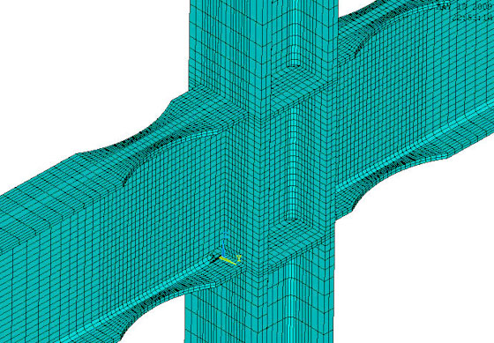
Modelling of RBS
Strong column – weak beam
Tsavdaridis, K.D. Seismic Resistant Design of Novel RWS Connections

Slide 10
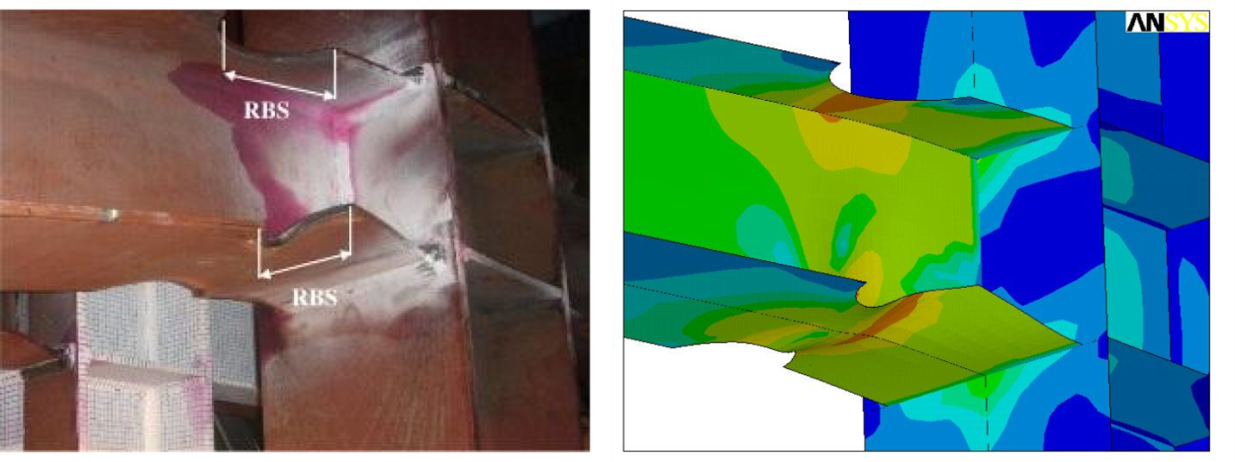
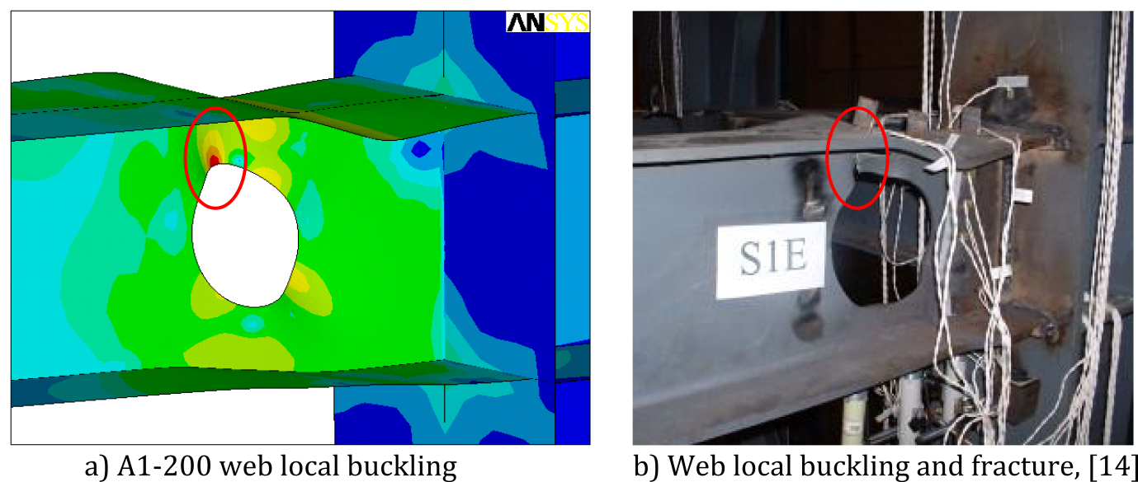
RBS vs RWS
RBS
Increased shear capacity
Close to the connection
Global instability issues (LTB)
Time and cost of rehabilitation can be increased due to the slab
Pachoumis et al., 2009. Reduced Beam Section Moment Connections, Engineering Structures
Reduced Web Section - RWS
Easy access to cut during retrofitting (cut-out procces)
Full shear connection between composite slab-shear studs-top flange (not affected)
Easy to inspect & maintain
Accomodate services...
Tsavdaridis et al., 2014. Perforated Steel Beam-to-Column Connections, Journal of Earthquake Engineering
Yang et al., 2009. Aseismic behaviours of steel MRF with opening in beam web, J. Con. Steel. Res.
Tsavdaridis, K.D. Seismic Resistant Design of Novel RWS Connections

Slide 11
Study 1 (2011)
Fully-Welded Connections with isolated web openings
Tsavdaridis, K.D. Seismic Resistant Design of Novel RWS Connections

Slide 12
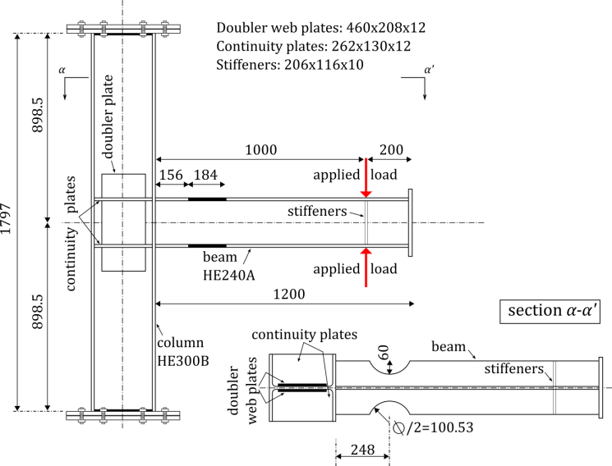
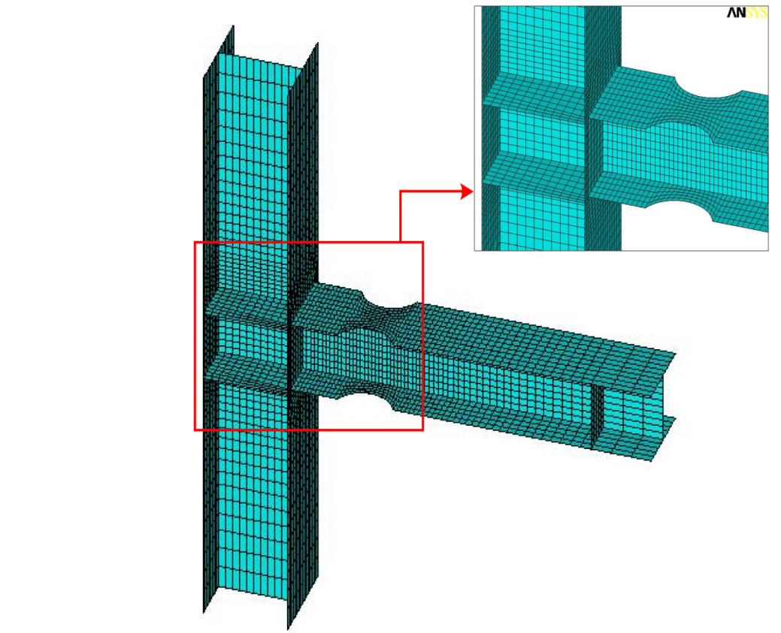
Test Apparatus
4-node Shell elements
Manual (mapped) meshing
Mesh convergence
Eigen buckling employed
Tsavdaridis, K.D. Seismic Resistant Design of Novel RWS Connections

Slide 13
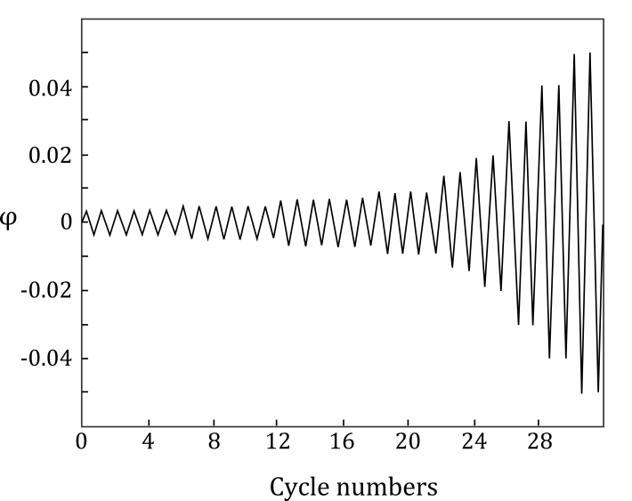
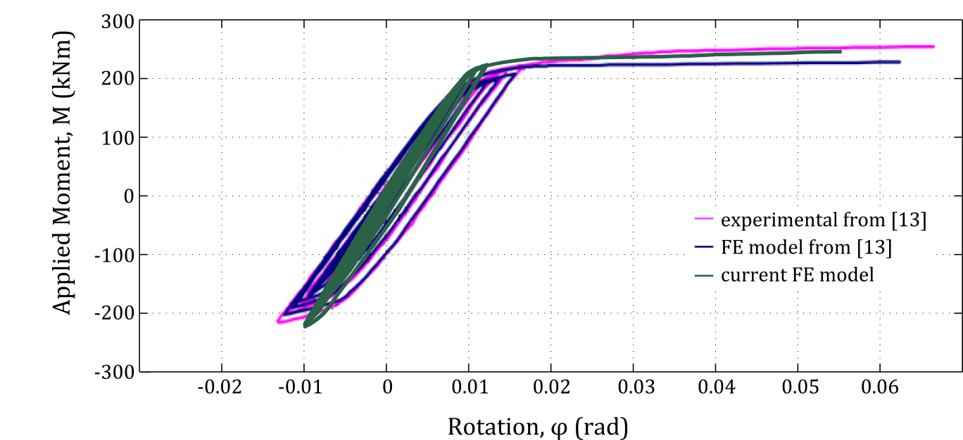
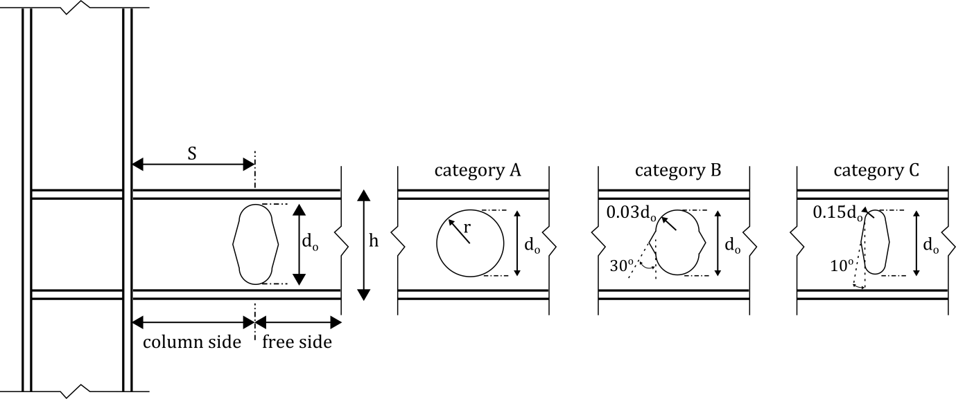
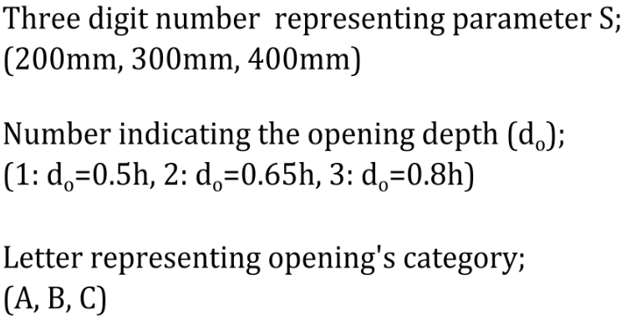
Parametric Study
SAC protocol, FEMA 350/AISC
FE model vs. Experimental
Tsavdaridis, K.D. Seismic Resistant Design of Novel RWS Connections

Slide 14
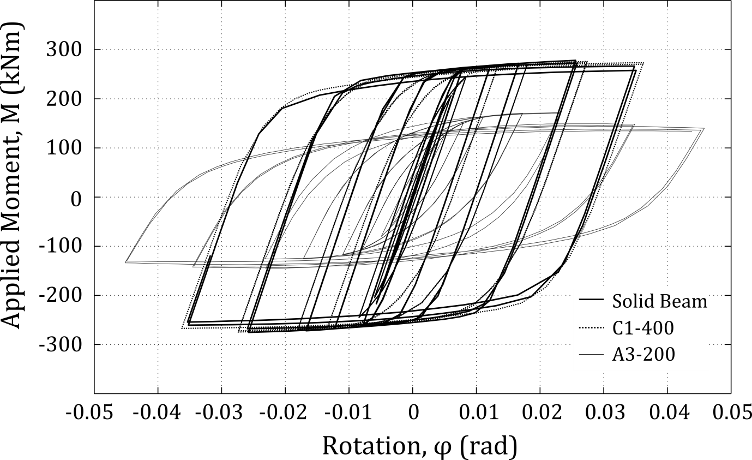
Hysteretic Behaviours
C1-400
A3-200
Tsavdaridis, K.D. Seismic Resistant Design of Novel RWS Connections

Slide 15
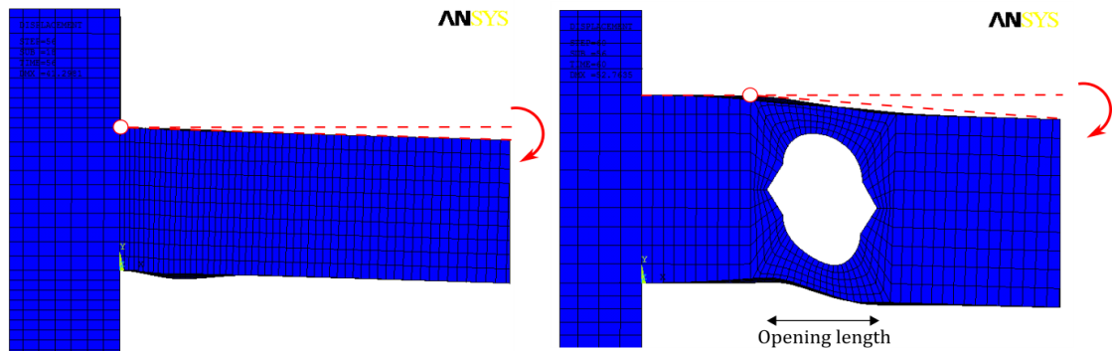
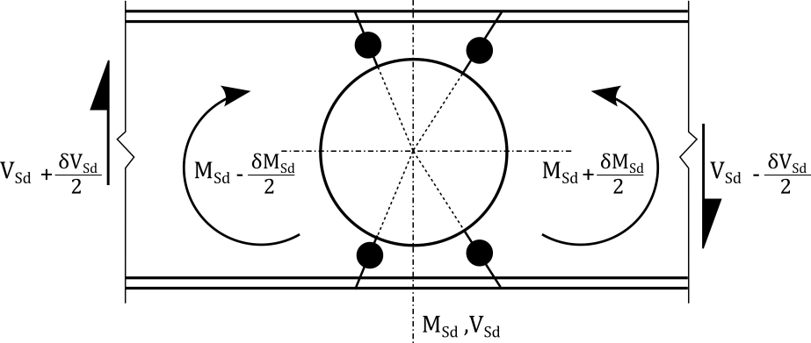
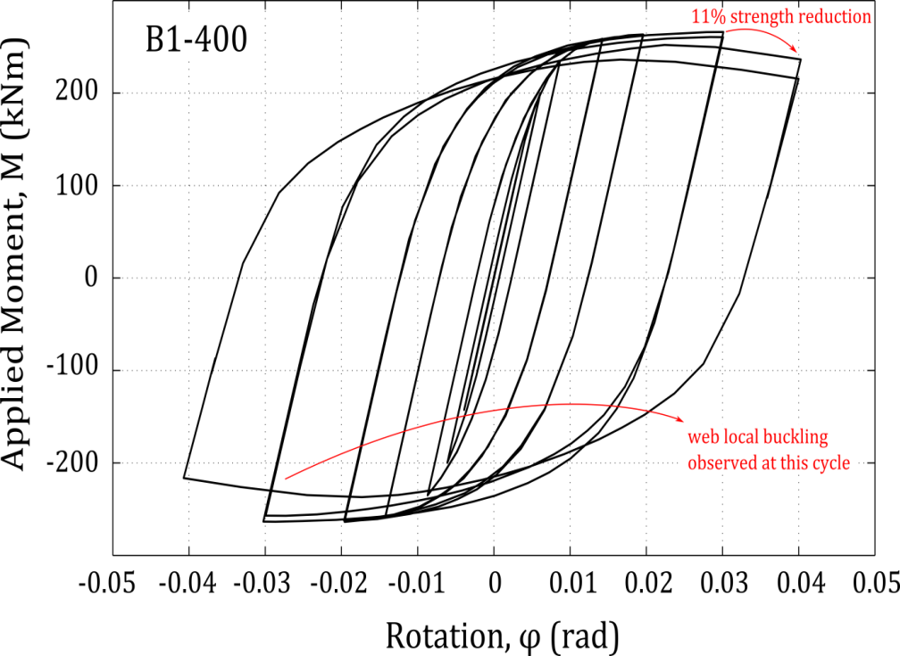
Rotational Capacity
The higher the critical opening length,c → the higher is the strength degradation.
Tsavdaridis, K.D. Seismic Resistant Design of Novel RWS Connections

Slide 16
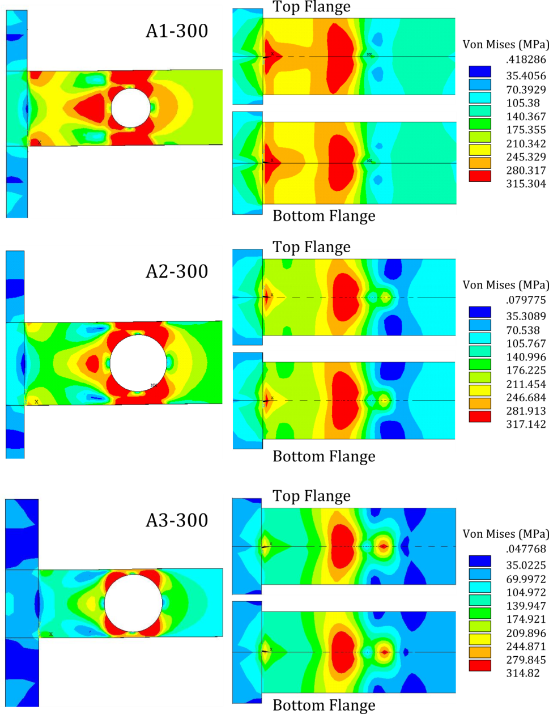
Vierendeel (Vert. Shear) Mechanism
Vierendeel deformation is introducing additional rotation to the RWS connections at the position of the opening, unlike to the connections with solid beams.
This is the well-known Vierendeel mechanism and it is controlled by the critical opening length, c.
Traditional cellular beams showed a premature formation of plastic hinges compared to the novel perforated beams.
c
Tsavdaridis, K.D. Seismic Resistant Design of Novel RWS Connections

Slide 17
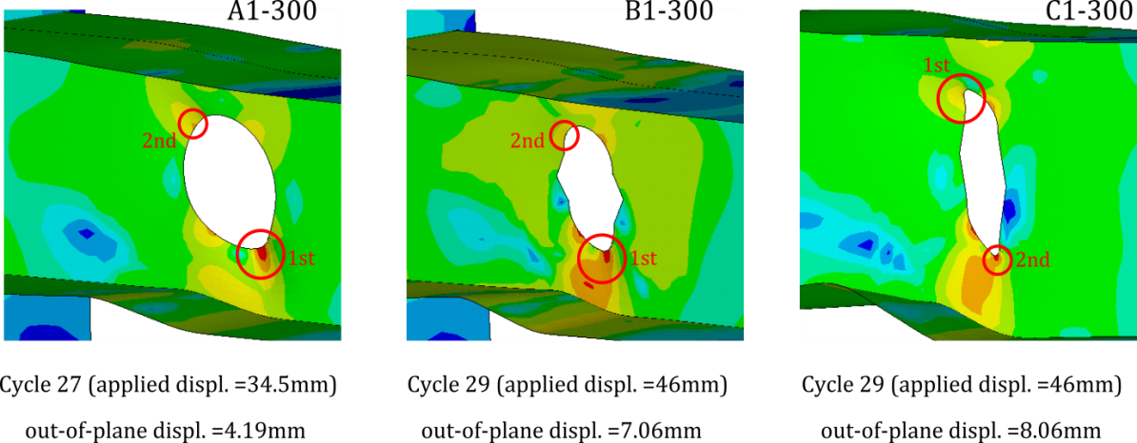
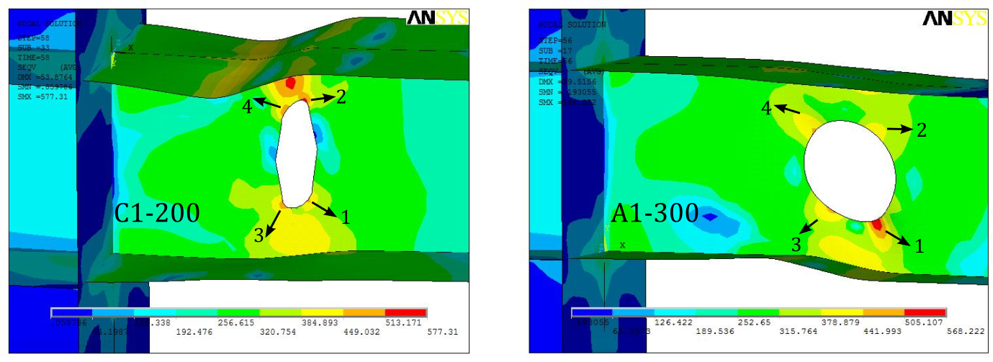
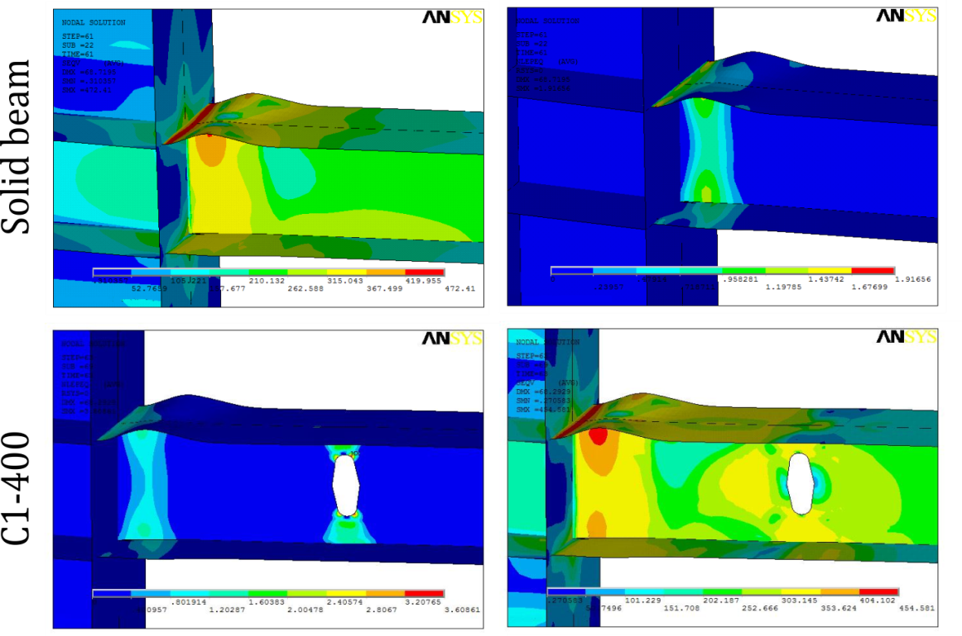
Position and Movement of Plastic Hinges
Von-Mises stress contour plot and Plastic hinge formation; left: at cycle 29, right: at cycle 27
Web local buckling
Von-Mises stress (left) and EPEQ (right) contour plots at cycle 31 (loading at 57.5mm)
Tsavdaridis, K.D. Seismic Resistant Design of Novel RWS Connections

Slide 18
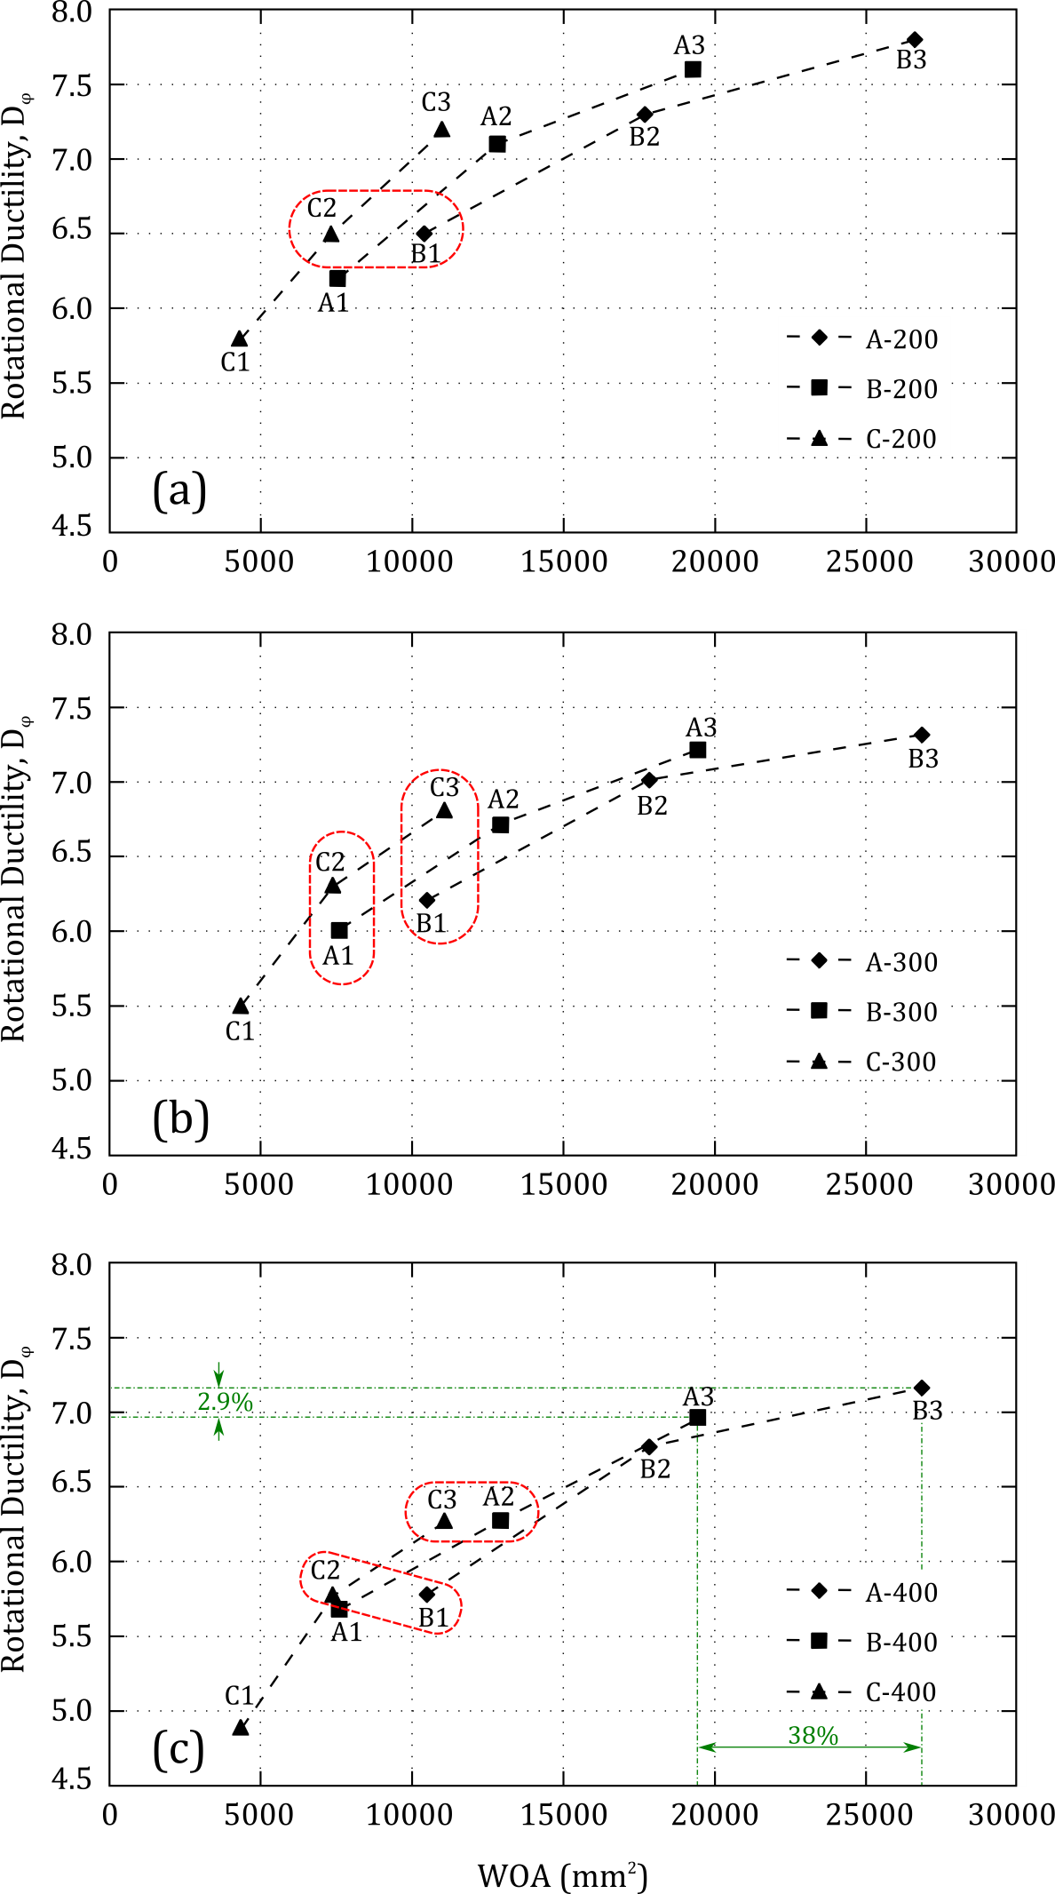
Effect of WOA on Ductility
Tsavdaridis, K.D. Seismic Resistant Design of Novel RWS Connections

Slide 19
Geometric Parameters
Parameter do
Parameter S
Ideal Design
Balance
Large novel B,C or
Medium circular A
Bigger
Smaller
Vierendeel
Vierendeel
Controlled Vierendeel
Reducing stress from the joint
Reducing stress from the joint
Controlled Plasticity
Tsavdaridis, K.D. Seismic Resistant Design of Novel RWS Connections

Slide 20
Concluding Remarks
The study presented examined the behaviour of isolated web openings in enhancing the ability of a pre-Northridge connection.
Introduction of the web openings resulted in some reduction of strength.
When small web openings were used, there was not any beneficiary effect.
Isolated large web openings can prevent excessive shear deformation as well as reduce the stress intensity in the vicinity of the beam-to-column weld in contrast to other reinforcing methods (eg. stiffeners and double plates).
Specimens with novel openings, compared to the traditional circular openings, were found to be stronger and attain a higher ultimate rotation for the same opening depth.
RWS connections achieved higher inelastic rotational capacity in comparison to the RBS connection and they are capable of reaching beyond 0.035 radian [FEMA 350; GSA 2003; DoD 2005].
Tsavdaridis, K.D. Seismic Resistant Design of Novel RWS Connections

Slide 21
Study 2 (2012)
Welded Unreinforced Flange-Bolted web (WUF-B) Connections with isolated web openings
Tsavdaridis, K.D. Seismic Resistant Design of Novel RWS Connections

Slide 22
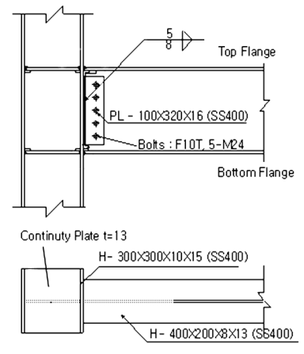
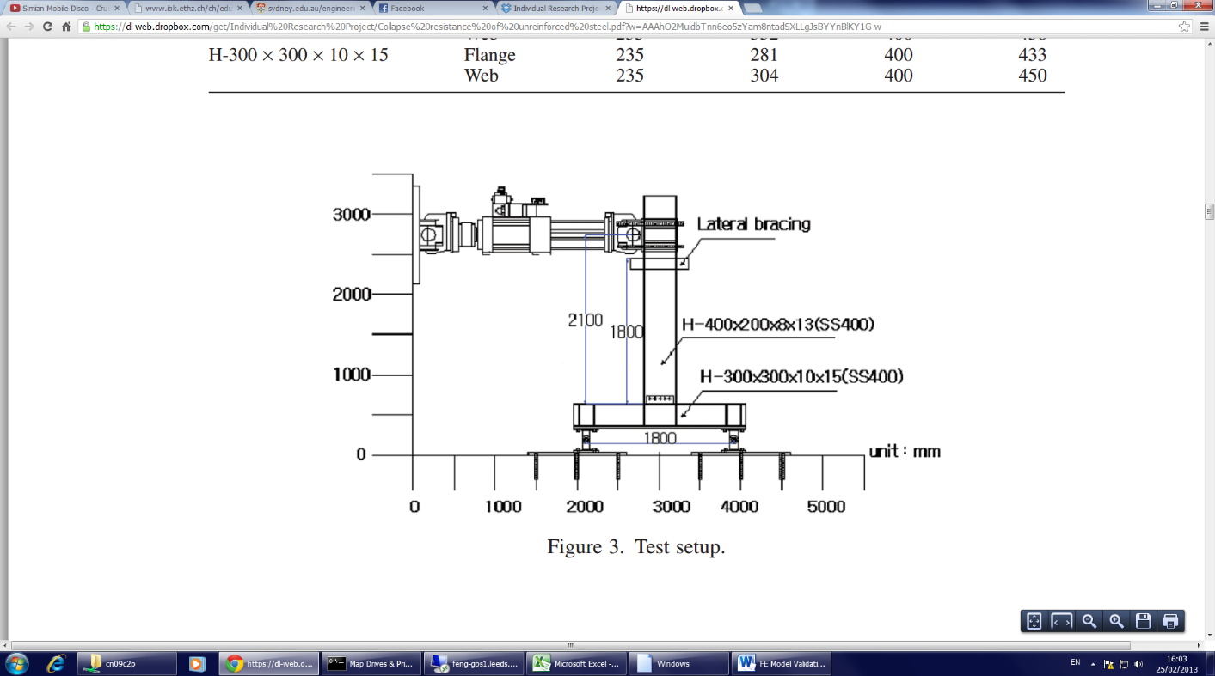
Test Apparatus
Member | Component | Yield Strength, f_{y} [MPa] | Ultimate Strength, f_{u} [MPa]
Beam | Flange | 281 | 423
 | Web | 332 | 438
Column | Flange | 281 | 433
 | Web | 304 | 450
Kim et al., 2012. Collapse resistance of unreinforced steel moment connections, The Struct. Design of Tall and Special Build., 21(10), 724-735
Tsavdaridis, K.D. Seismic Resistant Design of Novel RWS Connections

Slide 23
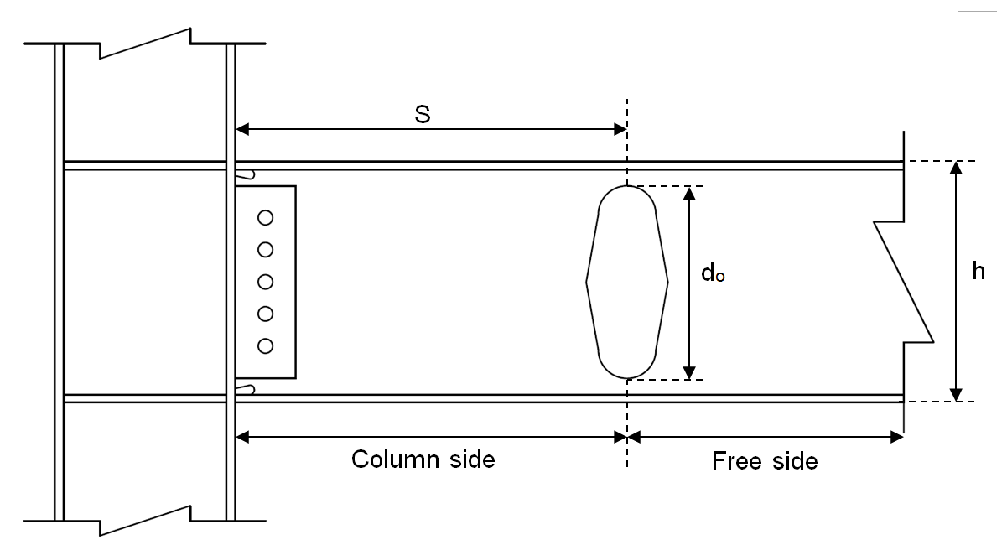
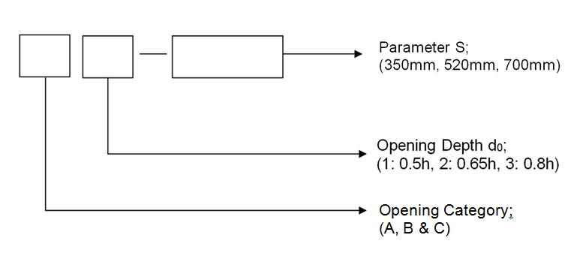
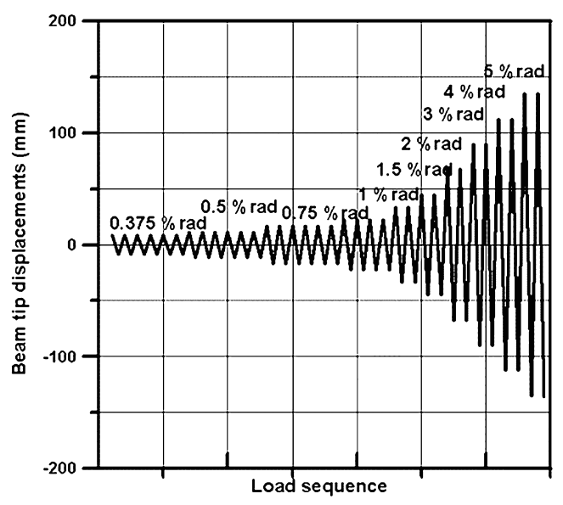
Parametric Study
SAC protocol, FEMA/AISC
Tsavdaridis, K.D. Seismic Resistant Design of Novel RWS Connections

Slide 24
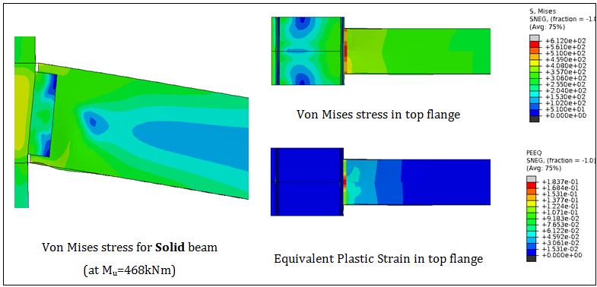
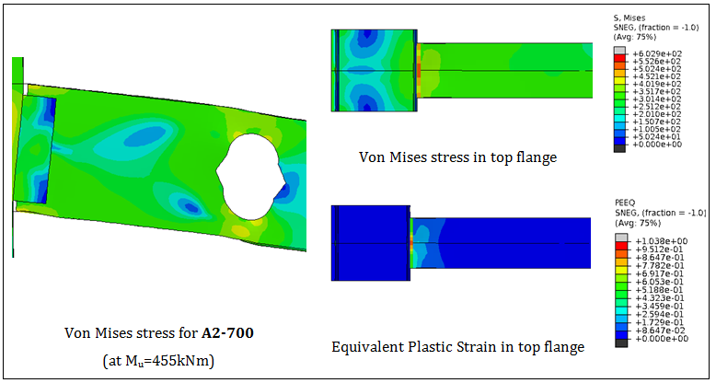
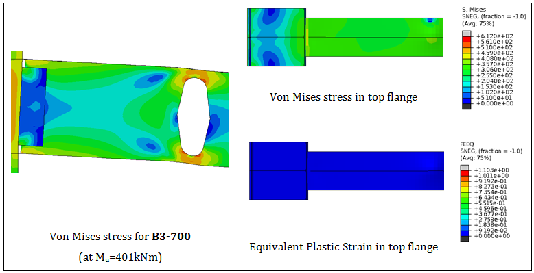
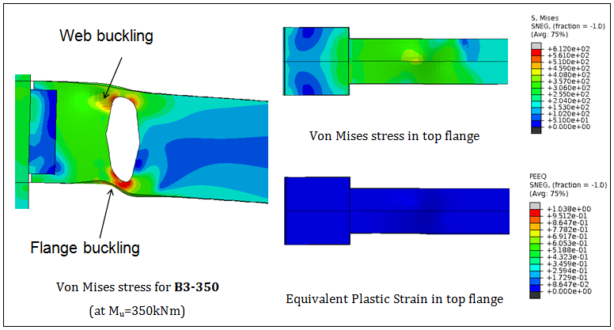
Vierendeel (Vert. Shear) Mechanism
Tsavdaridis, K.D. Seismic Resistant Design of Novel RWS Connections

Slide 25
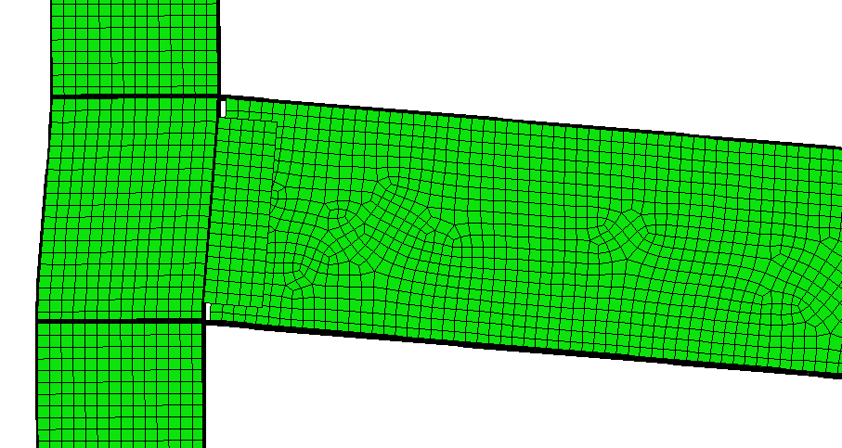
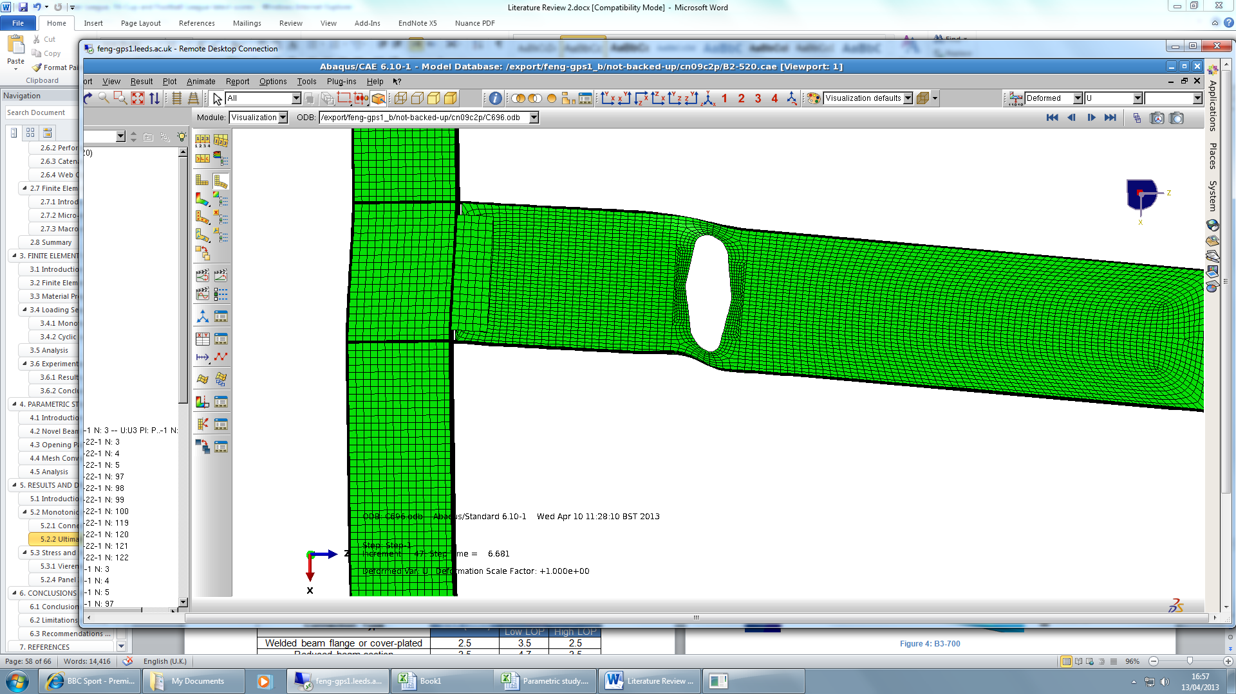
Rotational Capacity
The higher the critical opening length, c → the higher is the strength degradation.
Centre of rotation for solid and perforated beams.
Critical opening length, c
Tsavdaridis, K.D. Seismic Resistant Design of Novel RWS Connections

Slide 26
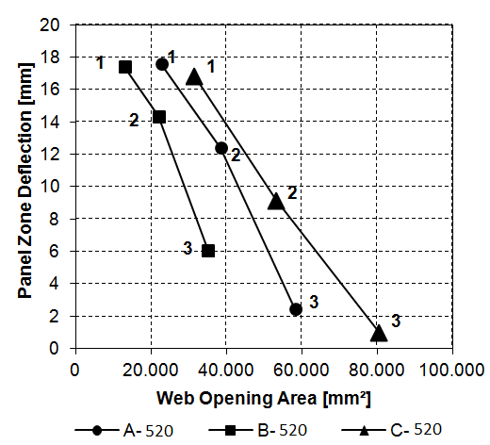
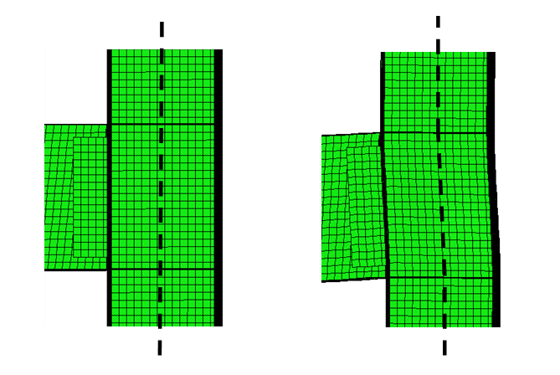
Panel Zone Deformation
S increases
Medium and Large web openings placed near the connection.
Cheaper solution instead of using stiffeners...
Relative panel zone deformation from column centreline
Tsavdaridis, K.D. Seismic Resistant Design of Novel RWS Connections

Slide 27
Geometric Parameters
Parameter do
Parameter S
Ideal Design
Balance
Large novel B or
Medium A, C
Bigger
Smaller
Vierendeel
Vierendeel
Controlled Vierendeel
Reducing stress from the joint
Reducing stress from the joint
Controlled Plasticity
Tsavdaridis, K.D. Seismic Resistant Design of Novel RWS Connections

Slide 28
Further Concluding Remarks
The use of large openings was found to be the most effective at moving the plastic region away from the column’s face and the bolts, while reducing the shear zone panel deflection.
The most effective design was considered when a large narrow elliptically-based web opening was employed.
The use of such narrow novel openings is ideal as the connection is not that sensitive to geometric changes.
The actual position, shape and size of the perforation is of critical importance to the effective ductile design.
Tsavdaridis, K.D. Seismic Resistant Design of Novel RWS Connections

Slide 29
Study 3 (2013)
Extended End-plate Bolted Connections with isolated as well as periodically spaced circular web openings
Tsavdaridis, K.D. Seismic Resistant Design of Novel RWS Connections

Slide 30
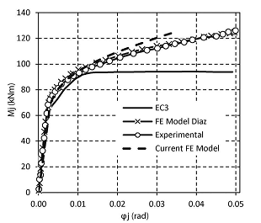
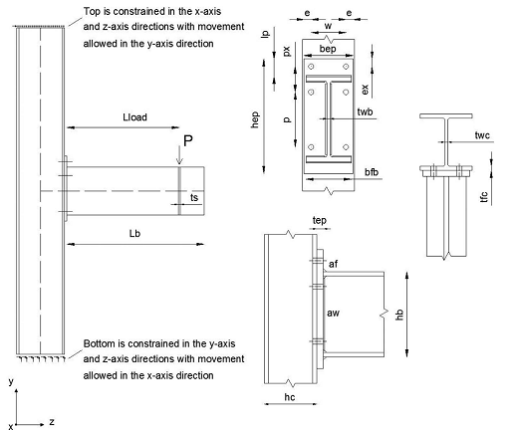

Test Apparatus
Tsavdaridis, K.D. Seismic Resistant Design of Novel RWS Connections

Slide 31







Parametric Study on Circular Openings
Tsavdaridis, K.D. Seismic Resistant Design of Novel RWS Connections

Slide 32
Comparison
Tsavdaridis, K.D. Seismic Resistant Design of Novel RWS Connections

Slide 33




Additional Innovative Designs
Tsavdaridis, K.D. Seismic Resistant Design of Novel RWS Connections

Slide 34



Further Concluding Remarks
The position of the first from the support web opening is again critical.
Providing there are not web openings close to the supports, there is no mobilisation of the high stresses from the shear panel zone.
The concept of the “fuse mechanism” with controlled damage and replacement can be realised.
Completing the experimental campaign on RWS will lead us to the incorporation of such connections to EC8 and other design guidelines.
Tsavdaridis, K.D. Seismic Resistant Design of Novel RWS Connections

Slide 35









Aknowledgments (funding & technical support)
Tsavdaridis, K.D. Seismic Resistant Design of Novel RWS Connections

Slide 36
References
Tsavdaridis, K.D. and Pilbin, C. FE Parametric Study of WUF-B Moment Connections with Single Mixed Shape Beam Web Openings under Monotonic and Cyclic Loading. International Journal of Steel Structures. 2016
Tsavdaridis, K.D. and Papadopoulos, T. A FE Parametric Study of RWS Beam-to-Column Bolted Connections with Cellular Beams. Journal of Constructional Steel Research, Vol. 116, 2016, pp. 92-113
Tsavdaridis, K.D. Strengthening Techniques: Code-Deficient Steel Buildings, to the section: Structural Engineering - Structural Design, Encyclopedia of Earthquake Engineering, Springer Verlag, 2014, pp. 1-26
Tsavdaridis, K.D., Faghih, F. and Nikitas, N. Assessment of Perforated Steel Beam-to-Column Connections Subjected to Cyclic Loading. Journal of Earthquake Engineering, Vol. 18, Issue 8, 2014, pp. 1302-1325
Tsavdaridis, K.D. Seismic Resistant Design of Novel RWS Connections

Slide 37






Dilemma…
Dog-Bone Connection
Black (White) Hole Connection?
Eye connection?
Donut Connection?

