Slide 1



Dispersion of non-B HIV-1 subtypes in Northeast - Brazil
SPEAKER: KLEDOALDO OLIVEIRA DE LIMA.
Federal University of Pernambuco – Recife – PE – Brazil.
Research Group:
Kledoaldo Oliveira de Lima, Élcio Leal, Ana Maria Salustiano Cavalcanti, Daniela Medeiros Salustiano, Ana Carolina Zarelle Monteiro, Heloísa Ramos Lacerda.
Email: kledoaldo@gmail.com

Slide 2
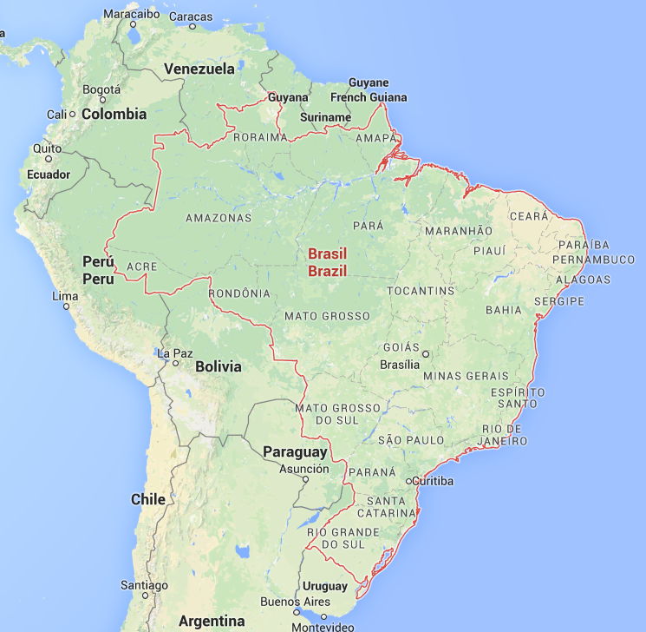
BRAZIL x HIV-1
» ~70% of HIV cases in South and Central America.
» More than 650,000 cases of AIDS.
» Concentrated epidemic: IDU, MSM, SW.
» Subtypes B, F1 and C.
» Multiple CRFs: 28, 29, 39, 40, 72_BF and 31_BC.
» Other subtypes: A, D.
» Other recombinants: CRF02_AG, FD, FC…

Slide 3
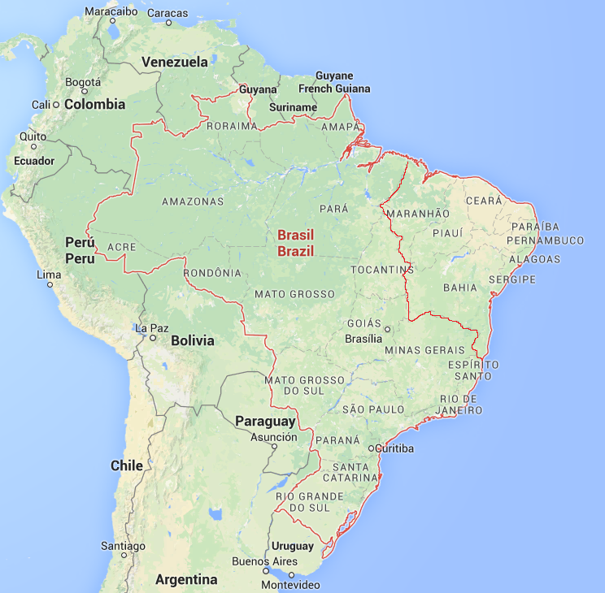
NORTHEAST – BRAZIL:
» Second most populated region in the country (53 million inhabitants);
» Worst Human Development Index (HDI) / Brazil (largest increase in 15 years);
» Economic growth X Emigration (USA, Germany, Spain, France, Italy, Portugal, UK);
» Largest industrial pole of the northern part of the country;
» Tourist and cultural center (carnival).

Slide 4
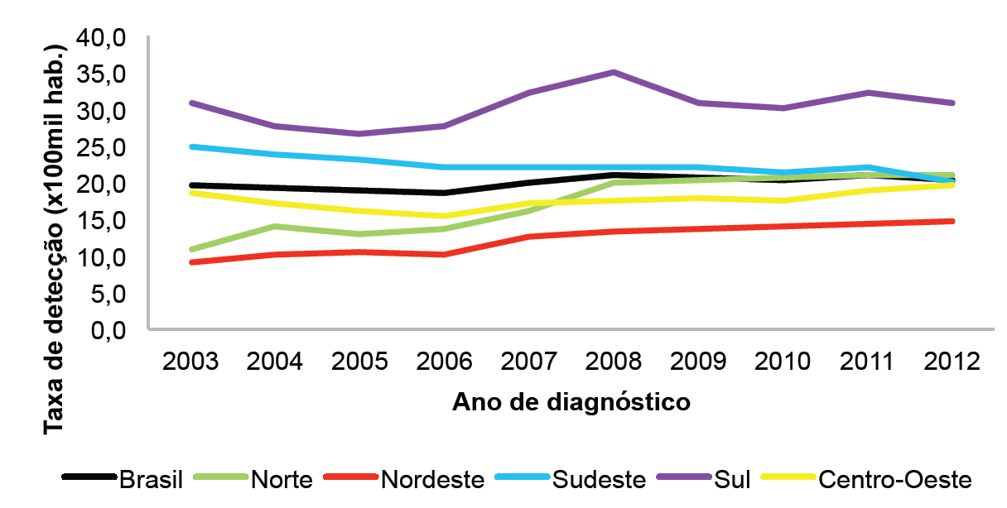
NORTHEAST – BRAZIL
Rates of AIDS cases by region of residence and year of diagnosis, Brazil, 2003 – 2012.

Slide 5
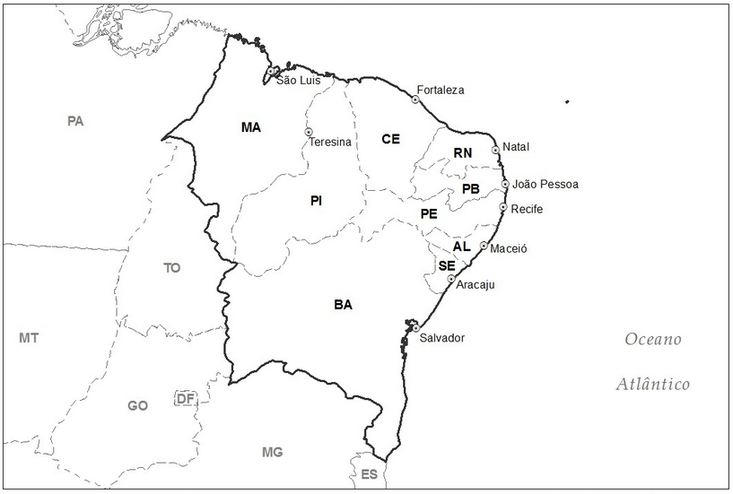
NORTHEAST – BRAZIL
B, F, C, BF
B, F, C, BF, D
B, F, C, BF, BC, BD
Geographical distribution of HIV-1 subtypes in the Northeast - Brazil. In red are highlighted the most prevalent subtypes for each location.

Slide 6
HIV-1 SUBTYPES IN THE NORTHEAST – BRAZIL:
Authors / Years | City / State | Sampling year | Sample size (N) | Viral gene | ART / Naive | Subtypes (%)
Couto-Fernandez et al. 1999 | Salvador / BA | 1994 – 1996 | 126 | Env | Naive | B (92.1) F (1.6) BC (0.8) BF (5.5)
Dourado et al. 2007 | Salvador / BA | 1998 – 2000 | 19 | env, pol, gag | Naive | B (57.9) BF (10.5) ND (31.6)
Gadelha et al. 2003 | Fortaleza / CE | 2000 | 149 | env, gag | - | B (81.2) F (2.7) BF (2.7) ND (13.4)
Pedroso et al. 2007 | Salvador / BA | 2000 – 2004 | 166 | pol env | Naive | B (84) F (8) C (2.5) BF (14) BC (0.5)
Monteiro et al. 2009 | Salvador / BA | 2002 | 261 | env, gag | - | B (81.7) F (0.6) BF (17.1) BD (0.6)
Medeiros et al. 2006 | Recife / PE | 2002 – 2003 | 84 | pol | Naive | B (72.6) F (22.6) C (1.2) BF (3.6)

Slide 7
HIV-1 SUBTYPES IN THE NORTHEAST – BRAZIL:
Authors / Years | City / State | Sampling year | Sample size (N) | Viral gene | ART / Naive | Subtypes (%)
Cavalcanti et al. 2007 | States of PI, CE, RN, PB, PE and AL | 2002-2004 | 502 | pol | TARV | B (82.4) F (11.8) C (1.0) BF (4.6) D (0.2)
Araújo et al. 2010 | Salvador / BA | 2006 | 61 | env, gag | - | B (91.8) F (4.9) BF (3.3)
Santos et al. 2011 | Salvador / BA | 2006 | 57 | pol | TARV / Naive | B (78.9) F (5.3) BF (15.8)
Inocêncio et al. 2009ª | Salvador / BA | 2007 / 2008 | 34 | pol | Naive | B (70) F (21) C (3) BF (3)
Santos et al. 2009 | Feira de Santana / BA | 2008 - 2009 | 52 | pol | TARV / Naive | B (63.5) F (7.6) C (1.9) BF (26.9)
Arruda et al. 2011 | Fortaleza / CE | 2008 – 2009 | 64 | pol | Naive | B (85.1) F (8.1) C (5.4) BF (1.4)

Slide 8
HIV-1 SUBTYPES IN THE NORTHEAST – BRAZIL:
Authors / Years | City / State | Sampling year | Sample size (N) | Viral gene | ART / Naive | Subtypes (%)
Cavalcanti et al. 2012 | Recife / PE | 2007 – 2009 | 130 | pol | Naive | B (56.9) F (37.7) C (3.1) BF (2.3)
Alencar et al. 2013ª | Recife/ PE | 2009 – 2011 | 110 | pol | Naive | B (73) F (24) C (2) BF (1)
Soares et al. 2014ª | Salvador / BA | 2009 – 2010 | 47 | Pol | Naive | B (70.2) F (14.9) C (4.3) BF (10.6)

Slide 9
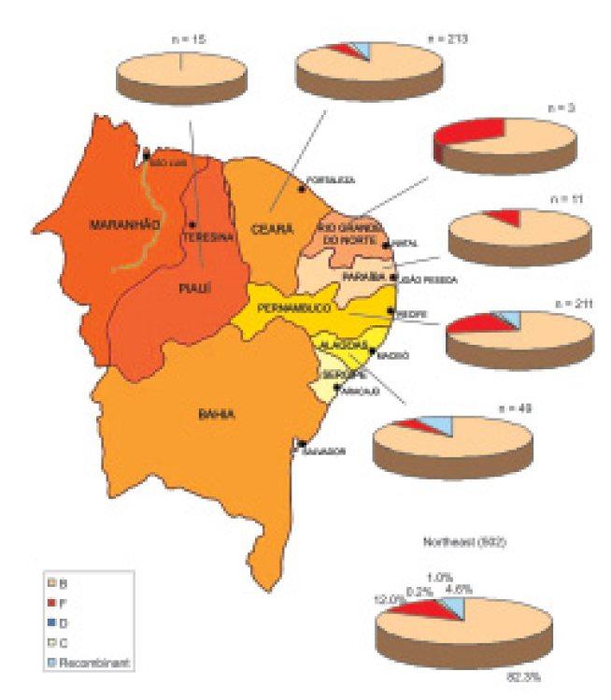
HIV-1 SUBTYPES IN THE NORTHEAST – BRAZIL:
233
15
03
HIV-1 F1:
PE= 22%
PB=10%
AL=6.7%
CE=6%
11
211
43

Slide 10
HIGH PHYLOGENETIC DIVERSITY IN NORTHEAST – BRAZIL:
Estimate of the relative proportion of HIV-1 B and F in the period 2002-2003 and 2007-2009.
 | HIV-1 Subtype
 | B N (%) | F N (%)
Time 1: 2002/2003 | 48 (77.4) | 14 (22.6) | p=0.01²
Time 2: 2007-2009 | 55 (58.5) | 39 (41.5)
 | HTS |  | MSM
Years | B | F | B | F
2002/2003 | 27 (40,9%) | 11 (25,6%) | 19 (55,9%) | 03 (30,0%)
2007/2009 | 39 (59,1%) | 32 (74,4%) | 15 (44,1%) | 07 (70,0%)
OR (95%CI) | 2,01 (0,80 – 5,11) |  | 2,96 (0,54 – 17,7)
p-value | 0,102 |  | 0,155
OR_{MH}* | 2,21 (1,00 – 4,94)
p-value | 0,051
*ODDS MATEL-
HAENSZEL.

Slide 11
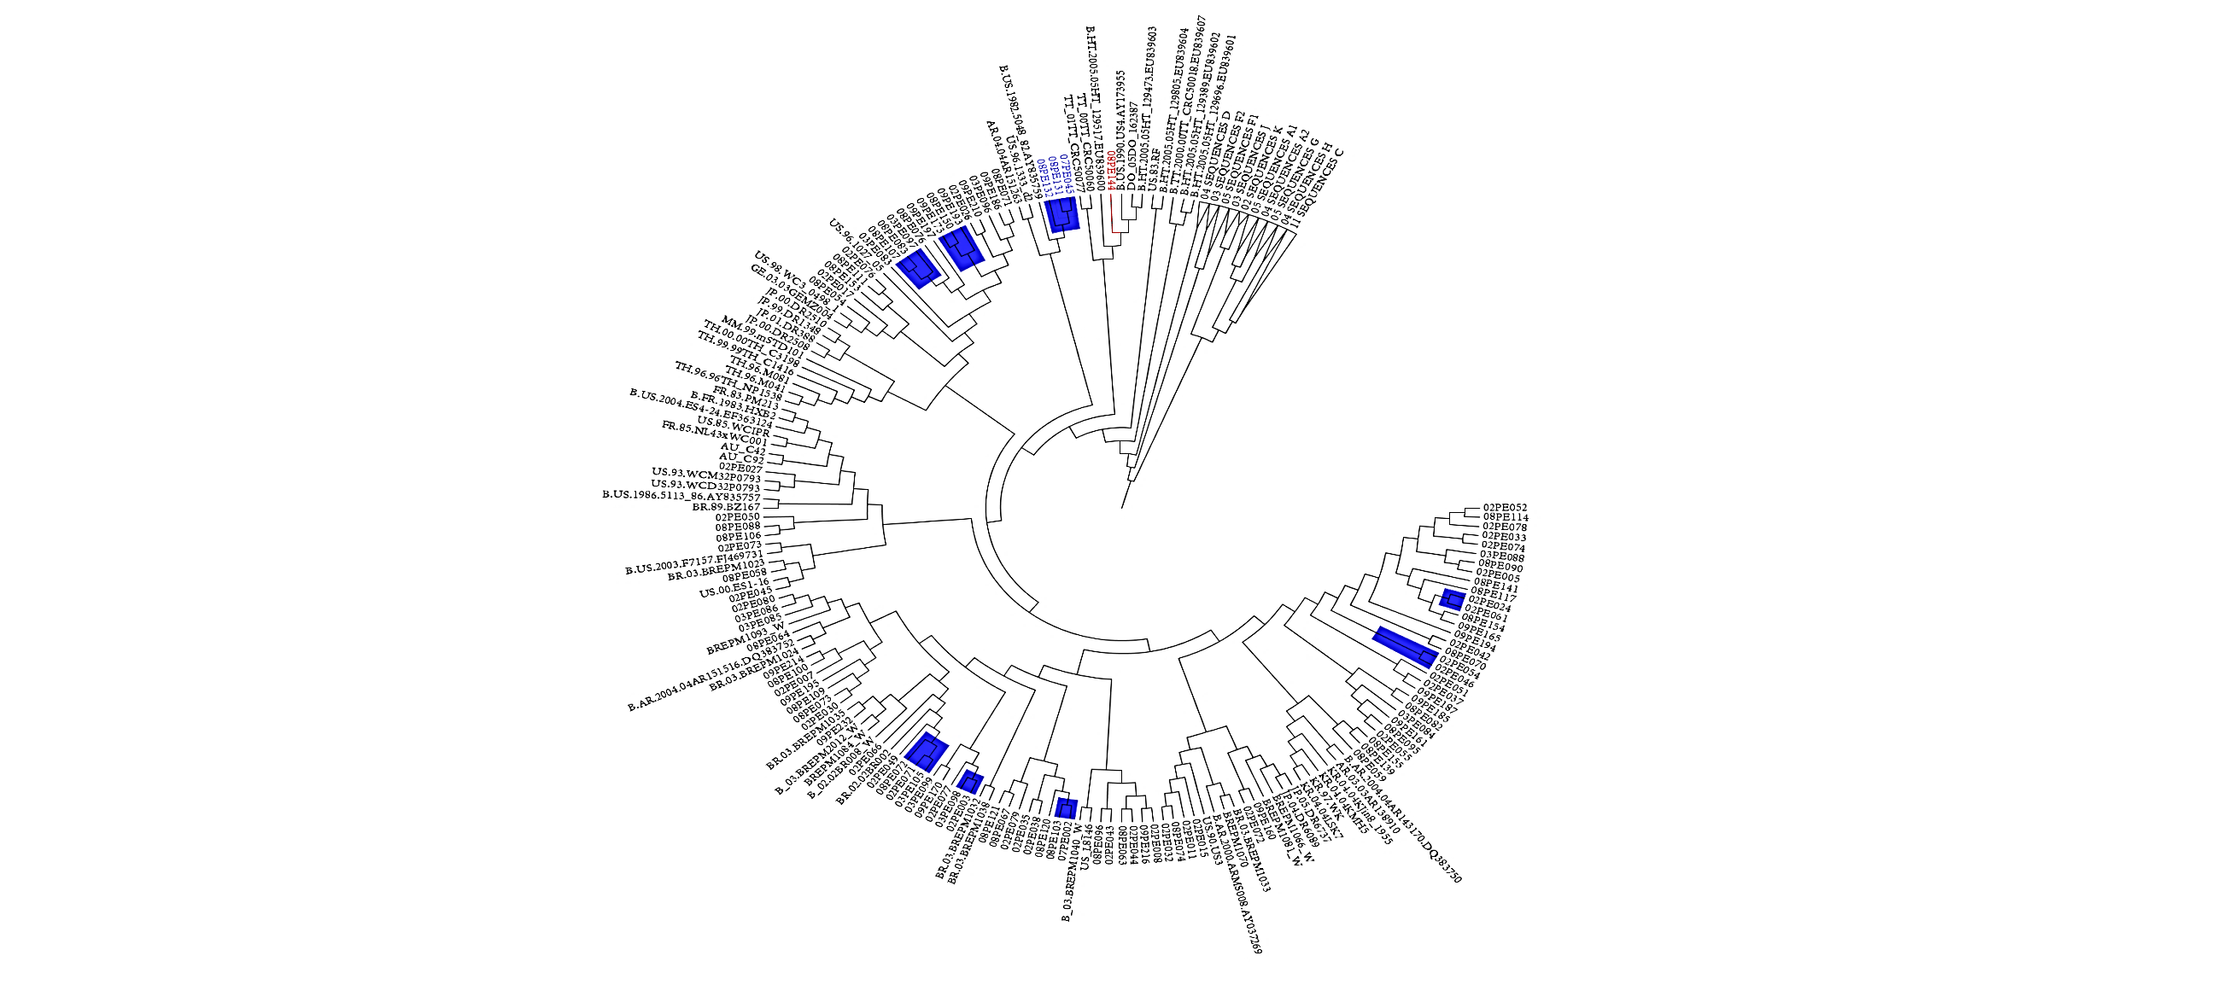
HIGH PHYLOGENETIC DIVERSITY IN NORTHEAST – BRAZIL:
Subtype B
» N = 103 (60.9%)
» Position basal of HT strains / 08PE144
» Weak geographical correlation
» Isolated GWGR and GPGR distributed in tree
» 23 patients (08 clusters): 13 men / 05 MSM

Slide 12
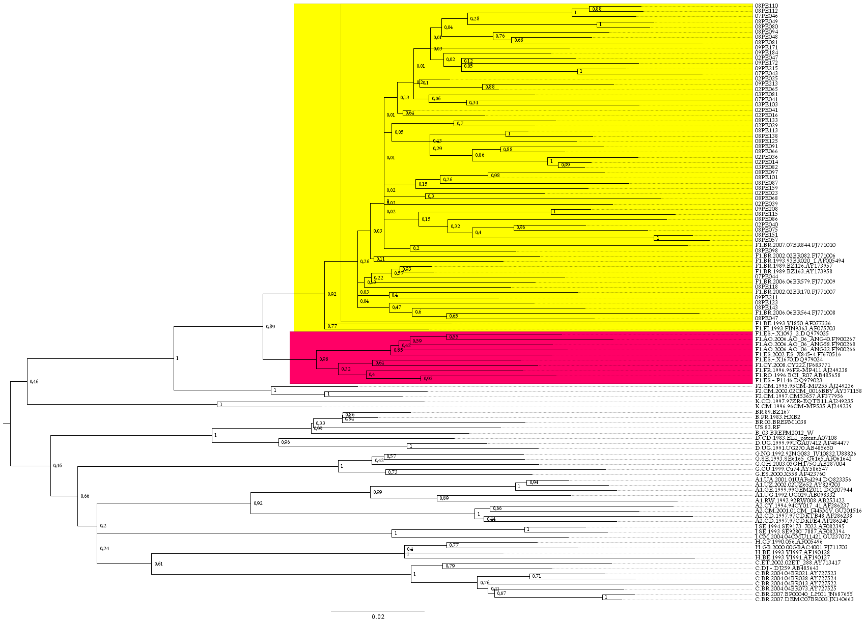
HIGH PHYLOGENETIC DIVERSITY IN NORTHEAST – BRAZIL:
Subtype F
» N = 53 (31.4%)
» Clusters with Brazilian sequences
» Most of the sequences were from heterosexual men (26/53, 49%) and women (15/53, 32%)
» HIV-1 F: Co-infection syphilis (19.4%)
and HBV (22.2%)

Slide 13
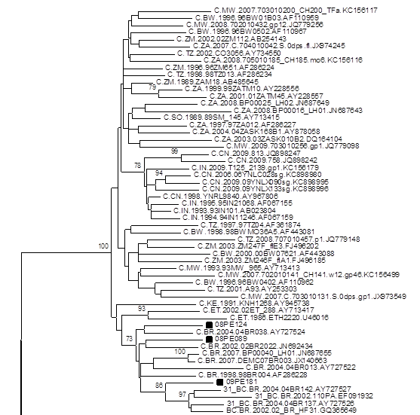
HIGH PHYLOGENETIC DIVERSITY IN NORTHEAST – BRAZIL:
Subtype C
» N = 02 (1.2%)
» 01 CB Recombinant (like-31BC)
» 09PE181 = Recent Infection

Slide 14
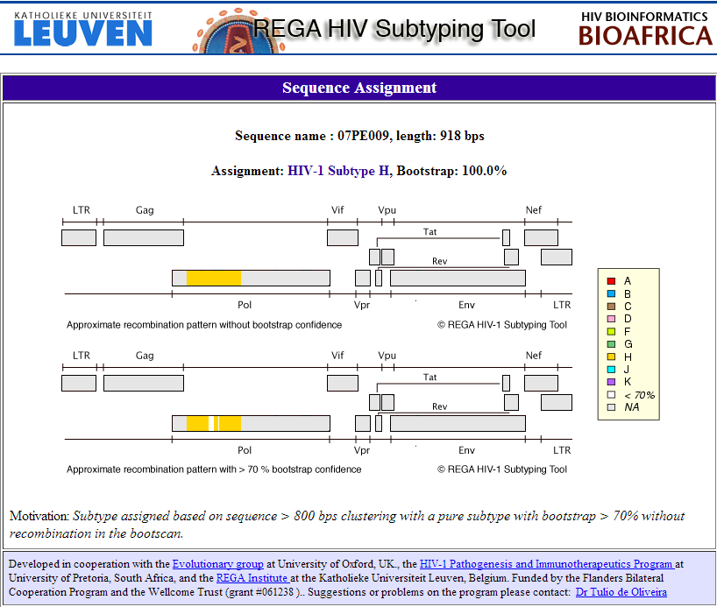
HIGH PHYLOGENETIC DIVERSITY IN NORTHEAST – BRAZIL:
Subtype H

Slide 15
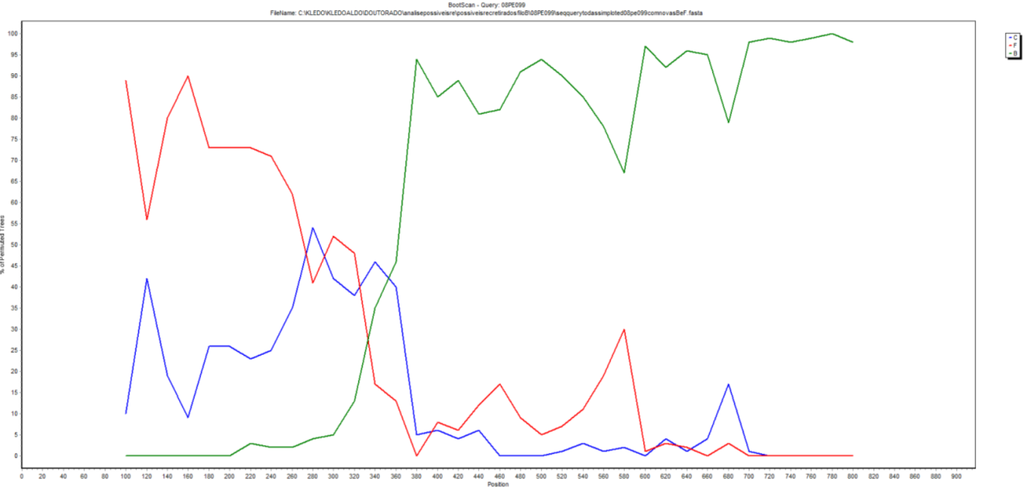
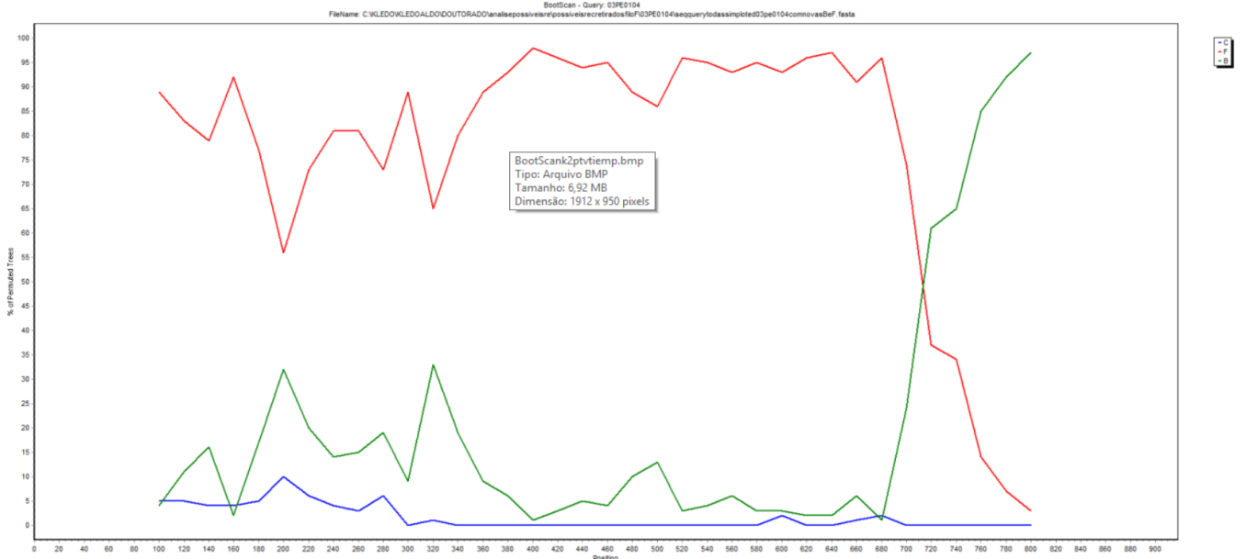
HIGH PHYLOGENETIC DIVERSITY IN NORTHEAST – BRAZIL:
BF recombinants

Slide 16
HIGH PHYLOGENETIC DIVERSITY IN NORTHEAST – BRAZIL:
Caractheristics:
» No statistical differences in antiretroviral resistance;
» Mutations more prevalents in subtype F: 211 (NRTI), 110 (NNRTI), 20 PI;
» Association between subtype F and infection in women (p <0.001);
» HIV-1 F and BF more associated with HTLV and vaginitis.

Slide 17
OBRIGADO!
THANK YOU!

