Slide 1
About OMICS Group
OMICS Group International is an amalgamation of Open Access publications and worldwide international science conferences and events. Established in the year 2007 with the sole aim of making the information on Sciences and technology ‘Open Access’, OMICS Group publishes 400 online open access scholarly journals in all aspects of Science, Engineering, Management and Technology journals. OMICS Group has been instrumental in taking the knowledge on Science & technology to the doorsteps of ordinary men and women. Research Scholars, Students, Libraries, Educational Institutions, Research centers and the industry are main stakeholders that benefitted greatly from this knowledge dissemination. OMICS Group also organizes 300 International conferences annually across the globe, where knowledge transfer takes place through debates, round table discussions, poster presentations, workshops, symposia and exhibitions.

Slide 2
About OMICS Group Conferences
OMICS Group International is a pioneer and leading science event organizer, which publishes around 400 open access journals and conducts over 300 Medical, Clinical, Engineering, Life Sciences, Phrama scientific conferences all over the globe annually with the support of more than 1000 scientific associations and 30,000 editorial board members and 3.5 million followers to its credit.
OMICS Group has organized 500 conferences, workshops and national symposiums across the major cities including San Francisco, Las Vegas, San Antonio, Omaha, Orlando, Raleigh, Santa Clara, Chicago, Philadelphia, Baltimore, United Kingdom, Valencia, Dubai, Beijing, Hyderabad, Bengaluru and Mumbai.

Slide 3

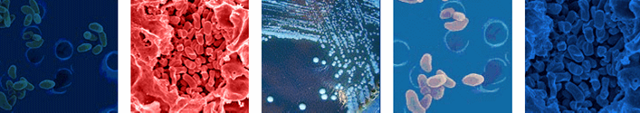


The cellular basis of protective immunity against experimental infection caused by Francisella tularensis
Kubelkova K., Orlikova A., Krocova Z., Pejchal J., Macela A., Stulik J.
Faculty of Military Health Sciences, University of Defense, 500 01 Hradec Kralove, Czech Republic
Notes:
The role of antibodies in the course of intracellular bacterial infections is still a matter of debate. We have studied this question on the experimental model of murine tularemia.

Slide 4
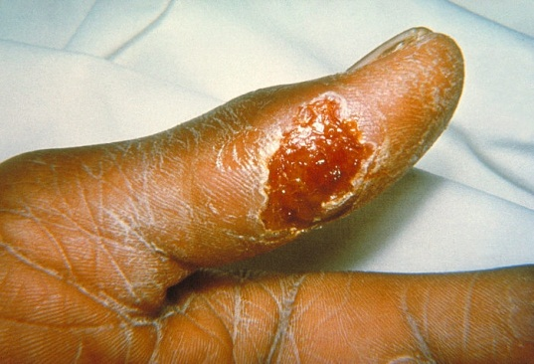
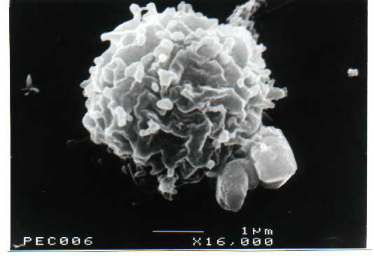
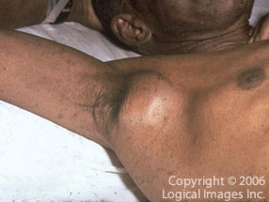
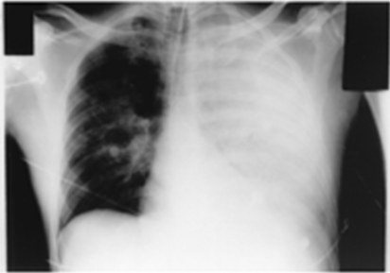
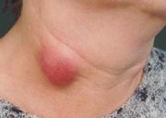

Francisella tularensis
Francisellae – facultative intracellular bacterial pathogens
Small, nonmotile, obligate anaerobe
One of the most infectious bacterial agens (10 CFU)
Francisella proliferates inside macrophages, neutrophils, dendritic cells and hepatocytes
Geographic distribution of four existing Francisella tularensis subtypes (holarctica – Type B, tularensis – Type A1 and A2, mediasiatica, novicida)
Zoonotic infection
Vectors – mainly ticks and mosquitoes
Broad spectrum of clinical manifestations with dominant symptoms – granulomas and secondary atypical pneumonia
Treatment – ATB (Gen, Tet)
Tularemia
The cellular basis of protective immunity against experimental infection caused by Francisella tularensis
Notes:
Tularemia is a highly infectious zoonotic disease with the broad spectrum of clinical manifestation. Dominant symptoms are granulomas and secondary atypical pneumonia.

Slide 5
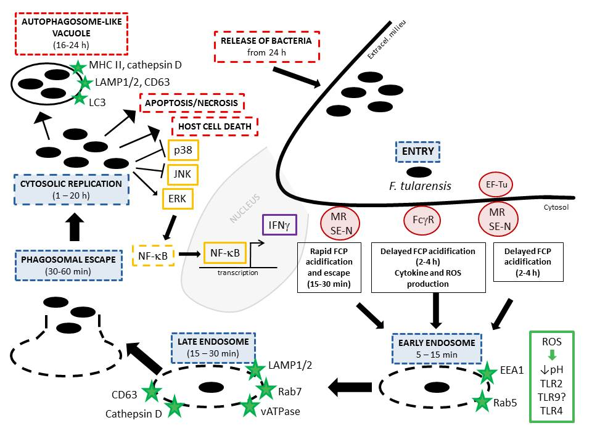
Kubelkova K. and Macela A.: Putting Jigsaw Together - A Brief Insight Into the Tularemia, Open Life Sciences, 2015, Ready to publish.

Slide 6
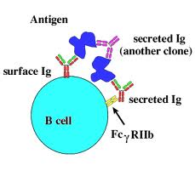
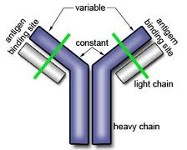
B cell involvement
B cells and antibodies are necessary for mice to develop their natural resistance to primary and secondary LVS infections
….The role of antibodies in the protection against intracellular pathogen F. tularensis still remains poorly understood !
Extracellular phase in the host, which makes it accessible to humoral immune responses
Ab responses containing both Th-1 and Th-2 antibody isotypes are detectable as early as 3 days following i.d. infection
Confer early as well as long term immunity
Immune response against LPS (as a major protective antigen)
No naturally B cell-deficient murine strain has been identified yet
Serum Ab against bacterial proteins – FopA, OmpA, DsbA, GroEL, KatG etc.
Notes:
Tularemia is a highly infectious zoonotic disease with the broad spectrum of clinical manifestation. Dominant symptoms are granulomas and secondary atypical pneumonia.

Slide 7
The role of antibodies in protective immune response
Traditional view
  Antibodies have little (if any) protective role against tularemia
Late 1970ies
  Antibodies can confer protection against attenuated Francisella tularensis strains and can confer some degree of protection against virulent strains of holarctica subtype /Macela A.: Thesis, 1980.
Late 1990ies
  B-cells but not circulating antibodies are indispensable in protective immunity against tularemia /Elkins K.et al: Infect Immun.,1999.
New millennium:
  Passive transfer of immunity protects against the same subtype
  Passive transfer of immunity against tularemia is possible
  Antibody-dependent cell-mediated cytotoxicity (ADCC)
  / Fulop M. et al: Vaccine, 2001. , Stenmark S. et al: Microb Pathog., 2003., Sanapala et al. 2012, Kubelkova K. et al. Microbial Pathogen, 2012

Slide 8
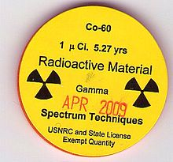
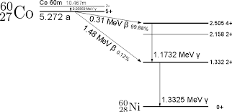

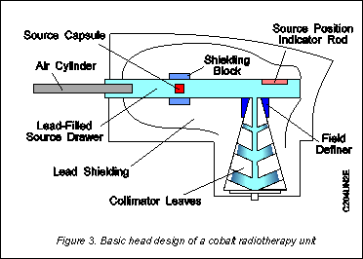
The role of antibodies in protective immune response
Balb/c mice
Cobalt 60
Dose of 4 Gy

Slide 9
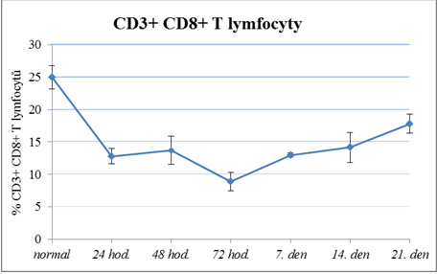
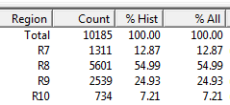
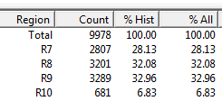
Fenotypization of spleen cells of immunosuprimmised Balb/c mice
CD3+ CD8+ T cells
Obr.č.3: CD3+CD8+T lymfocyty
Notes:
CD3+CD8+T lymfocyty - pokles
celkové CD3+T lymfocyty - mírný nárůst
obnovení fyziologických hodnot od 21. dne

Slide 10
Passive transfer of antibodies protects irradiated mice against F. tularensis holarctica LVS infection
Co⁶⁰
(4 Gy)
Immune or normal sera
(0.2 ml serum, i.p.)
Francisella tularensis LVS
(1.3 x 10² live microbes, s.c.)
48 hrs
2 hrs
21 days

Slide 11
Passive transfer of immunity protects irradiated mice against primary as well as secondary F. tularensis infection
Co⁶⁰
(4 Gy)
Immune or normal sera
(0.2 ml serum, i.p.)
Francisella tularensis LVS
(1.3 x 10² live microbes, s.c.)
3 days
2 hrs
22 days
21 days
Francisella tularensis SchuS4
(1.2 x 10² live microbes, s.c.)

Slide 12
Live microbes induce protective Abs in immunosuprised individuals
 | Number of mice | Irradiation | Interval of immunization | Route immun. | Immunization [200ul] | Infection | Dose LVS [200ul] | Route infect.
1KL | 10 | - | 2 hod. before infection | i.p. | Ab 4Gy+LVS | F. tularensis LVS | 10⁶ bb/mouse | s.c.
2KL | 10 | - | 2 hod. before infection | i.p. | Ab 4Gy+LVS | F. tularensis LVS | 10⁷ bb/mouse | s.c.
3KL | 10 | - | 2 hod. before infection | i.p. | Ab 4Gy+LVS | F. tularensis LVS | 10⁸ bb/mouse | s.c.
4KL | 10 | - | 2 hod. before infection | i.p. | Ab 4Gy+LVS | F. tularensis LVS | 10⁹ bb/mouse | s.c.
5KL | 10 | - | 2 hod. before infection | i.p. | PBS | F. tularensis LVS | 10⁷ bb/mouse | s.c.
6KL | 10 | - | 2 hod. before infection | i.p. | PBS | F. tularensis LVS | 10⁸ bb/mouse | s.c.
7KL | 10 | - | 2 hod. before infection | i.p. | PBS | F. tularensis LVS | 10⁹ bb/mouse | s.c.
Notes:
Kaplan-Meier survival curves were plotted to compare time to death following lethal F. tularensis challenge and log-rank (Mantel-Cox) test was used to compare survival of different groups. This analysis was performed using GraphPad Prism version 5.01 software (GraphPad Software; San Diego, CA).

Slide 13
Live microbes induce protective Abs in immunosuprised individuals
 | Number of mice | Irradiation | Immunization [200ul] | Interval of immunization | Route/ immun. | Infection | Dose LVS [200ul] | Route/infect.
1B | 10 | 4 Gy | Ab 4Gy+LVS | 2 hod. before infection | i.p. | F. tularensis LVS | 10² CFU/mouse | s.c.
2B | 10 | 4 Gy | Ab 4Gy+LVS | 2 hod. before infection | i.p. | F. tularensis LVS | 10³CFU/mouse | s.c.
3B | 10 | 4 Gy | Ab 4Gy+LVS | 2 hod. before infection | i.p. | F. tularensis LVS | 10⁴CFU/mouse | s.c.
4B | 10 | 4 Gy | PBS | 2 hod. before infection | i.p. | F. tularensis LVS | 10² CFU/mouse | s.c.
5B | 10 | 4 Gy | PBS | 2 hod. before infection | i.p. | F. tularensis LVS | 10² CFU/mouse | s.c.
More efficient protection - using Ab 4Gy+LVS in irradiated animals

Slide 14
Live microbes induce protective Abs in immunosuprised individuals
 | Number of mice | Gy | Immunization | Time | Route/immun. | Infection | Route/inf. | Dose LVS [200ul]
1A | 5 | - | Ab 4Gy+LVS | 2 hod. before infection | i.p. | F. tularensis LVS | s.c. | 10⁸ CFU/mouse
2A | 5 | - | Ab 4Gy+LVS | 2 hod. before infection | i.p. | F. tularensis LVS | s.c. | 10⁹CFU/mouse
3A | 5 | 4 Gy | Ab 4Gy+LVS | 2 hod. before infection | i.p. | F. tularensis LVS | s.c. | 10³ CFU/mouse
4A | 5 | 4 Gy | Ab 4Gy+LVS | 2 hod. before infection | i.p. | F. tularensis LVS | s.c. | 10⁴ CFU/mouse
5A | 5 | 4 Gy | PBS | 2 hod. before infection | i.p. | F. tularensis LVS | s.c. | 10¹ CFU/mouse
Secondary infection with hypervirulent F. tularensis SchuS4 strain
 | Number of mice | Infection | Route of infection | Dose SchuS4 [200ul] | Protection
1A | 5 | F. tularensis SchuS4 | s.c. | 10² CFU/myš | 100%
2A | 5 | F. tularensis SchuS4 | s.c. | 10² CFU/myš | 100%
3A | 5 | F. tularensis SchuS4 | s.c. | 10² CFU/myš | 100 %
4A | 5 | F. tularensis SchuS4 | s.c. | 10² CFU/myš | 100 %
5A | 5 | F. tularensis SchuS4 | s.c. | 10² CFU/myš | 0 %

Slide 15
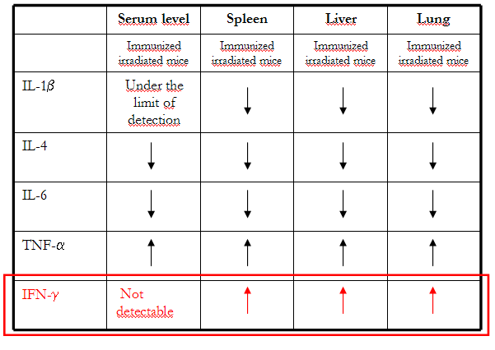
Cytokine profile of immunocompromised mice
The description of cytokine changes as a factor of importance during Francisella infection in naïve and immunocompromised mice
ELISA kits (Invitrogen) – IL-1β, IL-4, IL-6, TNF-α, IFN-γ
Passive transfer of immunity rather normalize the cytokine levels
Dominant disproportion exists in the levels of IFN-γ in blood and tissue homogenates, which suggests the high consumption of this cytokine in the sites of production

Slide 16
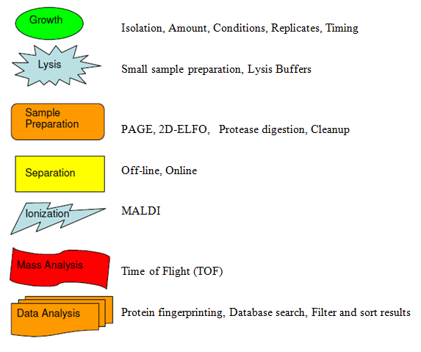
Identification of immunoreactive Francisella proteins
GPS Explorer™ Software v. 3.6 (Applied Biosystems), which integrates the Mascot search algorithm against
F. tularensis LVS
genome databases
http://www.ncbi.nlm.nih.gov/COG/old/xognitor.html
http://www.cbs.dtu.dk/services/SignalP
http://www.psort.org/psortb/

Slide 17
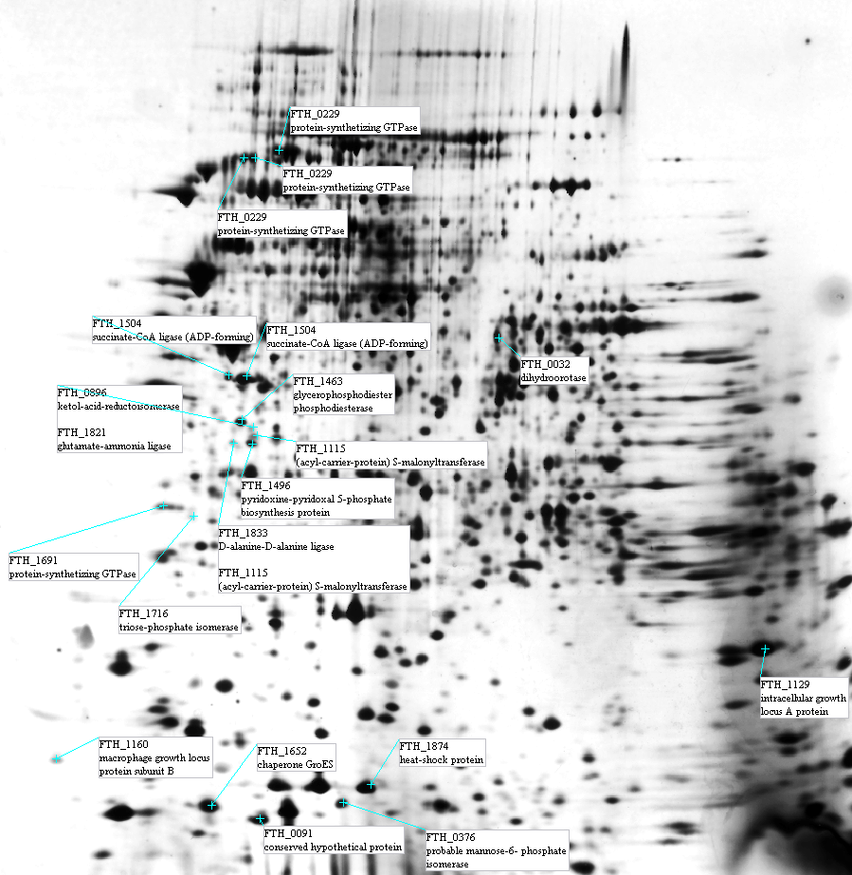
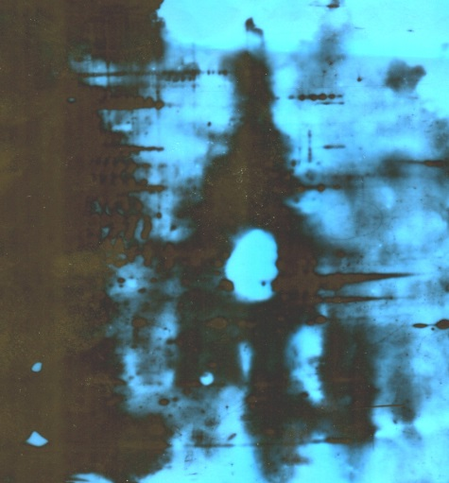
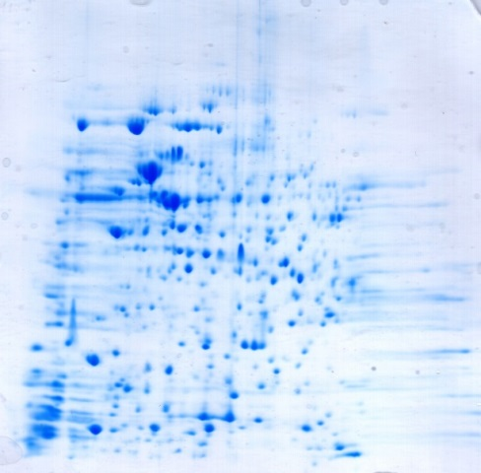
Identification of immunoreactive Francisella proteins
http://www.ncbi.nlm.nih.gov/COG/old/xognitor.html

Slide 18
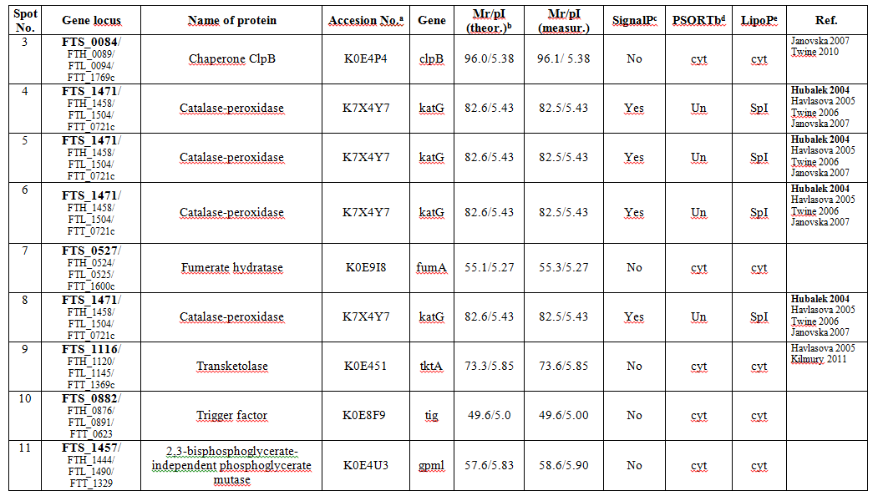
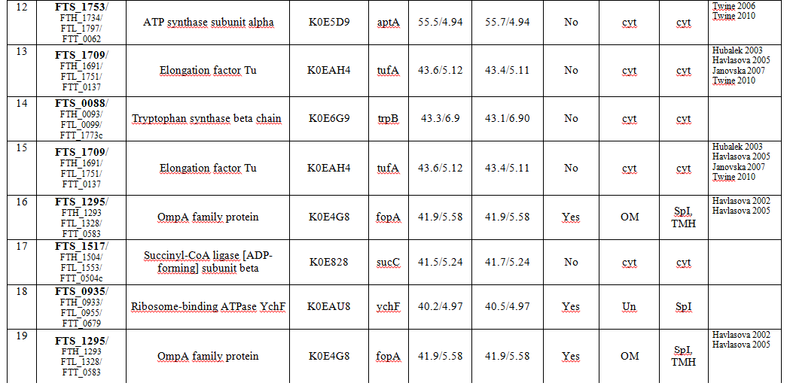
Conserved hypothetical proteins:
FTT0086
FTT0848
FTT0655

Slide 19
The result applications
Changing the vaccine strategy
  Important role of circulating antibodies during the interaction of F. tularensis with host immunoregulatory system
  Passively protected mice were also able to survive primary LVS and the subsequent challenge with the hypervirulent strain F. tularensis SchuS4
  Functional passive immunization protocol for naïve, as well as immunocompromised animals
  Cytokine production of immunocompromised mice has been characterized as a part the host response to Francisella infection
  Combination of passive transfer of antibodies and subsequent active immunization represents the safety way to protective immunity against tularemia
  New immunoreactive proteins – monoclonal Abs

Slide 20



With thanks to colleagues and collaborators
UNIVERSITY OF DEFENCE FDA, CBER
Macela Ales Elkins Karen
Stulik Jiri DePascalis Roberto
Krocova Zuzana Kurtz Sherry
Safarova Maria
Zakova Jitka
Kubelkova K., Krocova Z., Balonova L., Stulik J., Macela A.: Specific antibodies protect gamma-irradiated mice against Francisella tularensis strain 15 and live vaccine strain (LVS) infection. Microbial Pathogenesis, 2012, 53, 259-268.
Kubelkova K., Krocova Z., Plzakova L., Macela A.: The Role of B cells in Intracellular Bacterial Pathogen Infection, B cells: Molecular Biology, Developmental Origin and Impact on the Immune Systém. 2013, ISBN: 978-1-62808-541-9, p.1-44.
Plzakova L., Kubelkova K., Krocova Z., Zarybnicka L., Sinkorova Z., Macela A.: B cell subsets are activated and produce cytokines in the course of early phases of Francisella tularensis LVS infection. Microbial Pathogenesis, 2014, http://dx.doi.org/10.1016/j.micpath.2014.08.009.
Kubelkova K. and Macela A.: Putting Jigsaw Together - A Brief Insight Into the Tularemia, Open Life Sciences, 2015, Ready to publish.
This work was supported by the Grant “Long-term organization plan 1011” received from the Czech Ministry of Education, Youth and Sports and by Grant No. P302/11/1631 from the Czech Science Foundation.

Slide 21
Let Us Meet Again
We welcome you all to our future conferences of OMICS Group International
Please Visit:
www.omicsgroup.com
www.conferenceseries.com

