Slide 1
The Global Harmonization Initiative (GHI)
Food safety regulations based on science
Kirsten Brandt & Huub Lelieveld

Slide 2
Safe and authentic food
Food must correspond to ‘what it says on the tin’ and not contain banned substances
Otherwise it is adulterated or contaminated
Such food is considered fraudulent or unsafe or both
When discovered, the food containing the illegal constituents is usually confiscated and destroyed

Slide 3
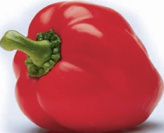
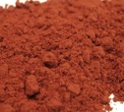
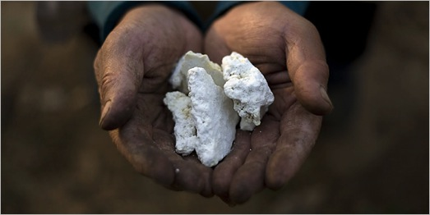
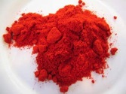
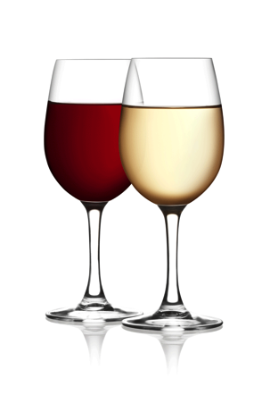
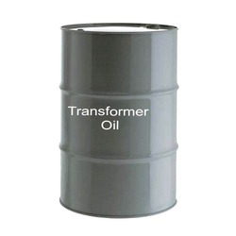
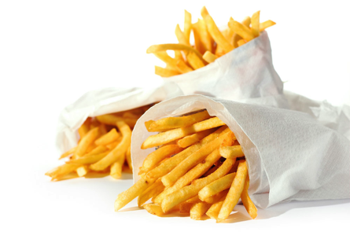
Intentional illegal additives
Lead oxide
Hungary 1994
Melamine
China 2008
French fries
Belgium 1999
Diethylene Glycol
Austria 1985
Notes:
1. In Hungary, in 1994, lead oxide was added to dried paprika to enhance the colour and that way made low-quality product look better. Source: Williams Carol J. Market Focus : Tainted Paprika Poisons Hungary's Culinary Pride : Fifty-nine people are arrested in the scandal, which sent 46 to the hospital. The health of the industry is also at stake. Los Angeles Times, 11 October 1994.
2. This is a well known, similar case. Adding melamine and water to increase the apparent amount of milk, the nitrogen content being adjusted by the melamine. It increased the nitrogen value (Kjeldahl analysis) giving the impression that the protein concentration was correct.
3. In spring 1999, it was found that some 500 tons of feed contaminated with polychlorinated biphenyls (PCBs) and dioxins were fed to farm animals in Belgium and to a lesser extent in the Netherlands, France and Germany.
4. Diethylene Glycol in wine (Austria) and toothpaste.

Slide 4
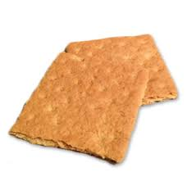
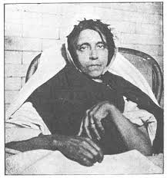
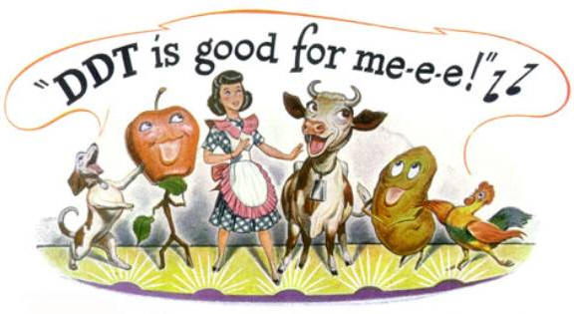
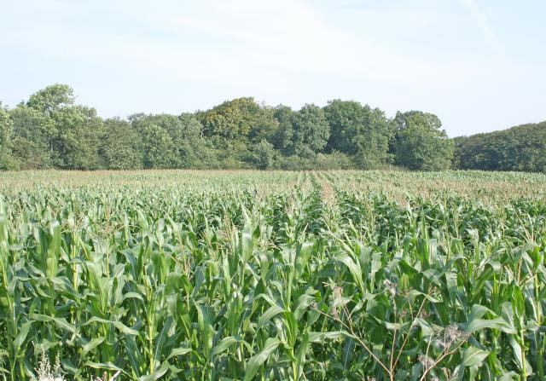
Unintentional illegal constituents
Arsenic in beer
Manchester 1900-1
Acrylamide
Worldwide 2011
DDT in fish
Worldwide since 1965
GM pollen
USA 2003-
Notes:
1. Sugar can be isomerised with sulphuric acid to form a glucose syrup, which can be used as an artificial ingredient for the production of beer
This process is safe if the ingredients are pure
Around 1900, some brewers started using the cheapest grade of sulphuric acid available, without knowing it contained arsenic
More than 6000 people fell ill, and at least 70 died, before the cause was discovered and alleviated – initially it was assumed to be a new type of alcoholism
Commercial beer production in England fell to one third for almost a year before trust was restored
2. ….
3. DDT is very persistent in the environment, so even today some areas and fish species are so heavily contaminated that the advice is to limit the consumption
The advert is for ‘Penn Salt Chemicals’

Slide 5
In some cases it is evident that consumption of the food would entail a health risk for the consumer
In other cases this is not the case, and destruction of the food is an unjustifiable waste of food and money
Science should be used to define appropriate distinctions between safe and unsafe food
National regulations should be harmonised to prevent unnecessary waste of safe food

Slide 6
Chemicals that are not allowed but nevertheless present in food are not necessarily additives. Most man-made chemicals occur in nature in concentrations that can be detected now, but not previously. They are produced by
animals
microbes (bacteria, fungi, parasites)
plants
geochemical processes (e.g. volcanos)
This includes chlorinated organic compounds. More than 5000 different natural organic halogens have been identified in nature
G.W. Gribble. Chemosphere 52 (2003), 289–297 and Heterocycles, 84 (1) (2011), 157-207.

Slide 7
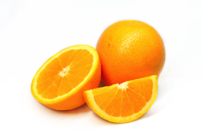
30-03-2012 USA:
Carbendazim in orange juice
Carbendazim is approved as pesticide in many countries, but not the United States.
MRLs (maximum residual levels) for carbendazim
EU: 100 ppb - 700 ppb
Canada: 500 - 6000 ppb
USA: 10 ppb
US Environmental Protection Agency:
“... consumption of orange juice with carbendazim at the low levels that have been reported does not raise public health concerns.”
GHI
Notes:
Requiring absence makes that the methods of analysis determine how much is allowed. In the past 50 or so years, the detection limits for many chemicals have gone down by a factor of about a million. That means that absence not is a million time less that 50 years ago. Not because of scientific evidence of toxicity, but only because of the improvement in analysis. Gthe slide shows detection capability of antibiotics in milk (examples).

Slide 8
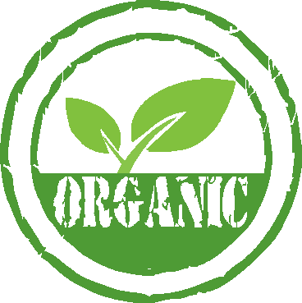
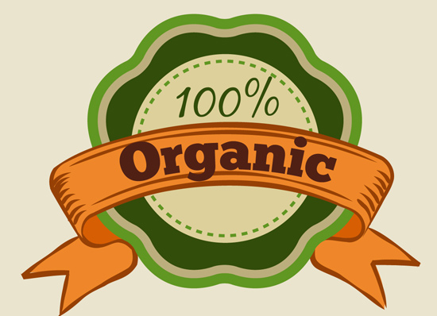
Organic food contain more natural pesticides than conventional food
Organic food contain more natural pesticides than conventional food
Most pesticides
are organic

Slide 9
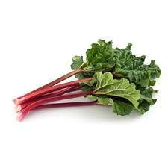
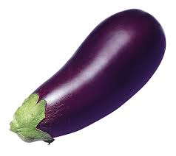
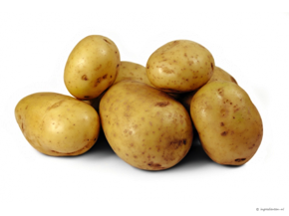
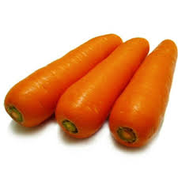
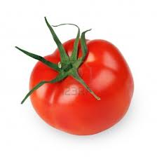
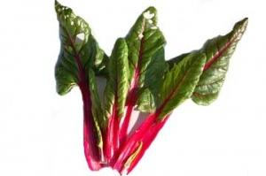
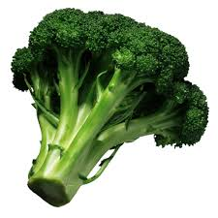
Natural, potentially toxic substances in food
solanine (potatoes, tomatoes, aubergines)
tomatine (tomatoes)
oxalates (rhubarb, chard)
polyacetylenes (carrots)
glucosinolates such as progoitrin (broccoli)
Notes:
All food contains substances (chemicals) that are toxic if consumed in too high amounts. This and the next two slides give examples. There ar no exceptions. People who do not eat food with potentially chemicals will starve to death.

Slide 10
Acetaldehyde
Benzaldehyde
Benzene
Benzofuran
Benzo(a)pyrene
Caffeic Acid
Caffeine
Catechol
Formaldehyde
Furan
Furfural
Hydroquinone
Isoprene
Limonene
Styrene
Toluene
Xylene
Etc.
Notes:
Some of the chemicals in coffee. All potentially (geno)toxic, but toxicity is a matter of amounts. See later.

Slide 11
Differences in regulations
result in needless destruction of healthy food in a world where a billion people have very little or no food
hamper international trade and innovation

Slide 12
The making of food safety regulations
The main problem is the lack of understanding of toxicity by
politicians
general public
activists (antis)
press
and the strong influence of professional lobbyists
Notes:
Politicians have a strong tencency to promise to do what makes them look good so that they will be re-elected. They do not use time to look at facts and most of them find scientists just troublemakers who they do not trust.
The general public has the information from newspapers. Most journalist prefer to publish negative messages, because that is what the publisher wants, it sales better. Writing in a newspaper that all is fine and right does not sell.
Many activists are just against.The topic often does not matter. In the case of food. Everything is wrong, because goverments want to control people and industries wnat to make money, all at the expense of the people. So they try to make “the people” believe this and be against,agains e-numbers, preservatives, processed food, etc. etc.
With - in most countries - just a few exceptions, the press cares about how many copies they can sell, not about correctness of the information. Checking the information takes too much time.

Slide 13
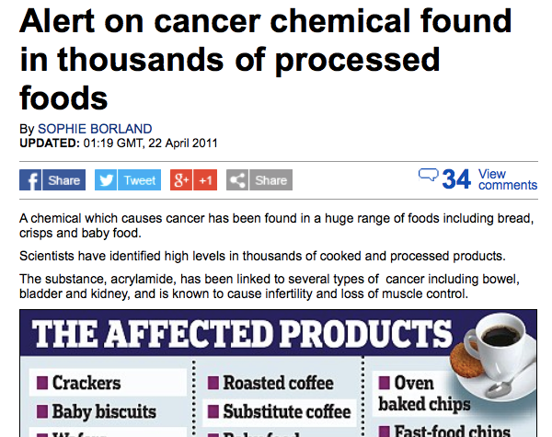
Notes:
No further explanation required, or?

Slide 14
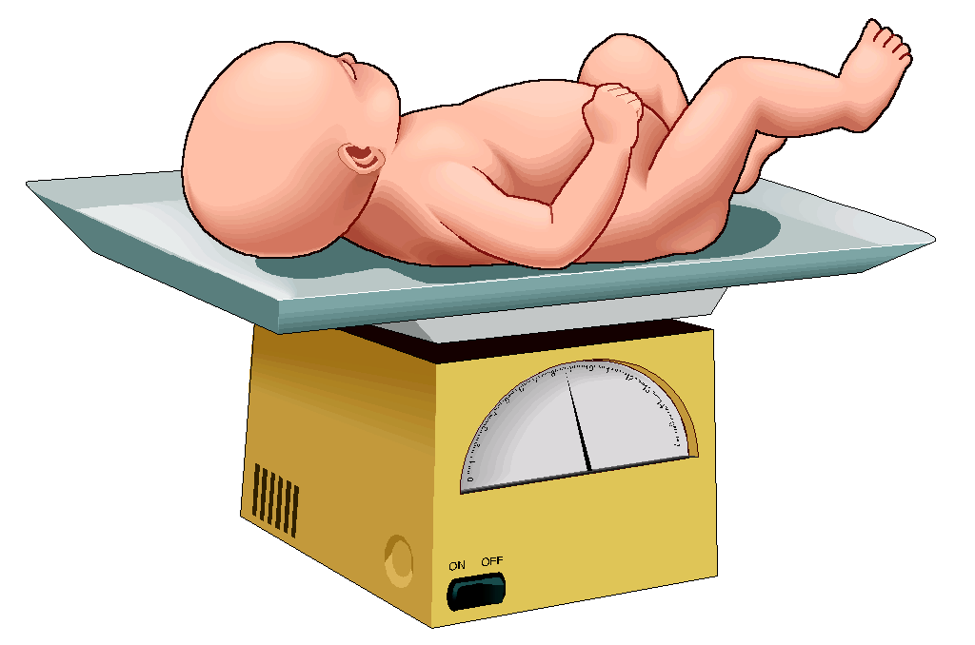
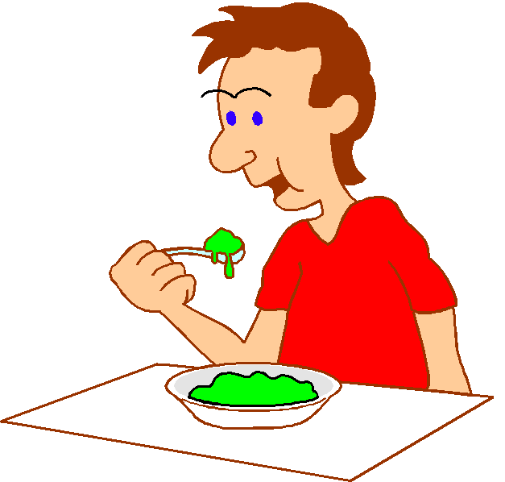
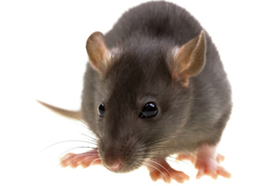
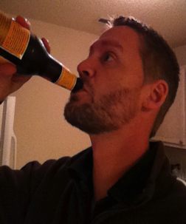
Absurd regulations
ZERO-TOLERANCE
Antibiotics in food
Sudan Red
= ABSENCE OF ...
20.000 kg/day
800.000 kg/day
ppt* in products with ingredients from China
* About 1 grain of 2mm in an
Olympic swimming pool)
800 l per day life long
Notes:
Antibiotics may no be added to food and therefore, if present in food, governments seize to food and dsteroy it. Even entire shiploads. The amount of antibiotics, however, is very far below the level at which it can do harm. The same antibiotics are gioven to people and even baies in million times higher amounts. For a very small chance of harm, a baby would have to eat life-long 20,000 kgs of the antibiotic-containing food per day the rest of its live. Adutls even more of course. It is absurd – the regulations are in sucg cases absutd. If an antibiotic is added to food and that is illegal, the perpetrator should be prosucuted, but destoying the food is totally useless – senseless.
The same applies to many other chemicals present in food (added ot naturally prresent). Soudan Red is an example of absurd measures taken by a govenment. A person who drinks 800 liter per day pf worchester sauce (just an example) for the rest of his life has a chance to suffer damage from the chemical. Nevertheless, the UK government at the time demanded the recall and destruction of huge amounts of food, worths more than € 15,000,000.

Slide 15
The Netherlands, June 2014
Furazolidon from feed into meat
Average exposure to humans eating meat 1.2 μg per meal (and worst case 8 μg per meal)
Internationally recognised potential harm at 3 μg per day during a life time (i.e. 50 or 70 years)
There are NO reports of harmful effects of therapeutic doses of 200 mg per day during 21 days (WHO) - this is 25,000 times more than the worst case amount
Conclusion: the meat is safe
Destruction of 2474 calves and 100 companies closed
Source: Netherlands Food and Consumer Product Safety Authority
Notes:
Another example. An antibioticum in feed for calves (and other animals). Conclusion of the food safety authority is that the meat of the calves is safe. Nevertheless the government orders the destruction of almost 2500 healthy calves.

Slide 16
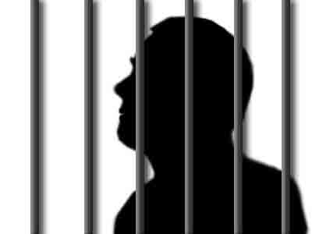
If chemicals have been added illegally:
those responsible should be prosecuted
the product should be confiscated
but if safe, the product should not be destroyed

Slide 17
Now
ACTIVISTS
General public
LOBBYISTS
PRESS
Politicians
Scientists
Regulators
Notes:
Politicians get most of the signals on which they base their decisions from Activists and lobbyists. The activists receive their donations from that part of the public that is easily influence by activists. The regulations are paid to do that the politicians have decided. Scientists communicate with each other but hardly with those who could make a difference.

Slide 18
Future
ACTIVISTS
General public
LOBBYISTS
PRESS
Politicians
Scientists
Regulators
Notes:
Scientists and their organisations need to learn communicate with the stakeholders. That way politicians eventually may make better decisions of food safety issues. This is what GHI strives to do.

Slide 19
The Global Harmonization Initiative wants to improve food regulations and remove absurd regulations by obtaining global scientific consensus
and convincing those who need to know

Slide 20
Damage
Dose
The perception of the general public
Notes:
This figure shows the interpretation of toxicity by the general public: a toxic substance does damage independent of the dose, i.e. damage can be prevented only if the substance is totally absent. This leads to absurd regulations, as those that lead to the destruction of safe and nutritious food. Also some chemicals are no longer allowed for use in packaging materials or process equipment even when the concentration resulting from leaching into the food is so low (sometimes below the natural concentration in the food), that harm is not possible and indeed never has been reported.

Slide 21
Damage
Dose
Understanding of most politicians and policy makers
Notes:
This figure shows what most politicians and policy makers may believe and make the regulators apply: the higher the concentration the more damage to health, but a very low concentration where e.g. only one person on a million will suffer is acceptable. Still the idea is that there is always damage and no damage will require total absence.

Slide 22
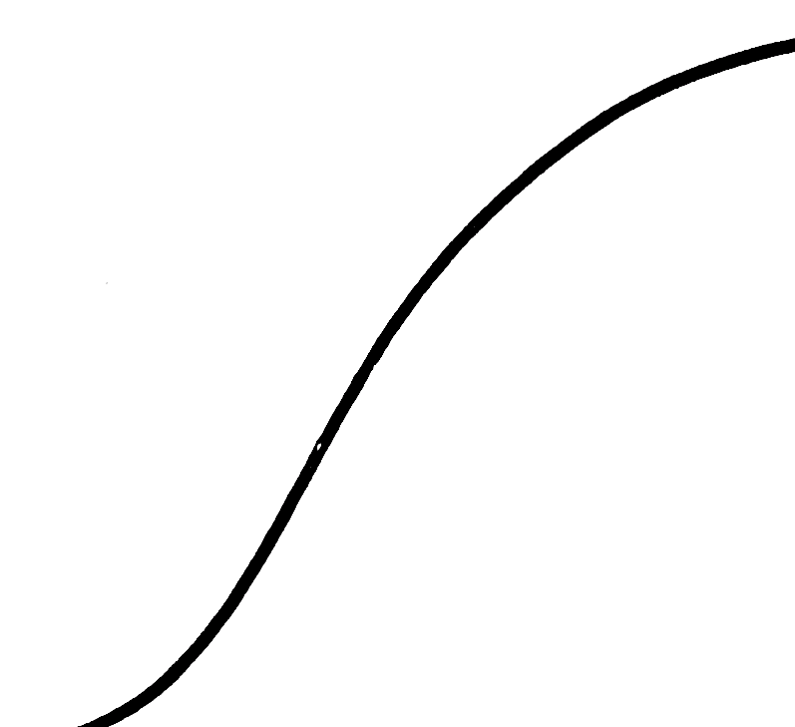
Damage
Dose
Threshold
Toxicologists: agree there is a threshold of no concern (NOAEL: No Observed Adverse Effect Level). All food contains toxins.
Notes:
This figure shows the evidence-based opinion of toxicologists: there is a threshold below which there is no effect. That means below a certain dose there will be no damage. That is why the human body for instance has a liver and kidneys.

Slide 23
Evolution
Humans and their predecessors have been exposed to all those most scary chemicals for millions of years and developed a biological system (with liver, kidneys, etc.) to cope with them or even use them beneficially.
The system, however, can be overloaded and then the chemical becomes toxic.

Slide 24
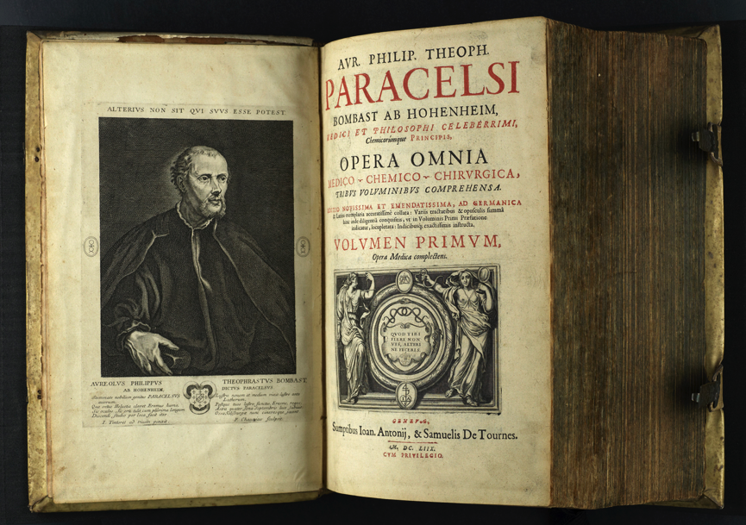
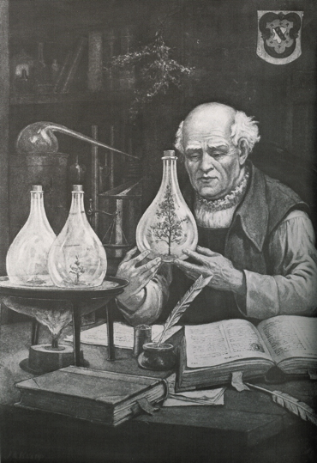
‘Poison is in everything, and no thing is without poison. The dosage makes it either a poison or a remedy.’
Or as we would say it today:
There are no toxic substances, only toxic doses
Notes:
Already about 500 years ago, Paracelsus had concluded that toxicity depends on amounts.

Slide 25
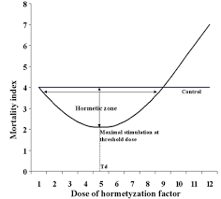
Two-stage-linear
Threshold (hockey-stick shape)
Hormesis (J-shaped)
From: http://ehp.niehs.nih.gov/1408244/
Scientists: Still debating the detailed shape at low doses
A more detailed look at the hormetic response (note: Not consensus among GHI scientists!)
Notes:
This figure shows the evidence-based opinion of toxicologists: there is a threshold below which there is no effect. That means below a certain dose there will be no damage. That is why the human body for instance has a liver and kidneys.

Slide 26
Example with actual data-
Natural pesticide
Effect of the polyacetylene falcarinol on viability of normal mammalian cells (Brandt et al. TIFS 2004)
Concentration range in human plasma
Mitogenic response
(relative to basal medium)
Falcarinol concentration (ng ml⁻¹)

Slide 27
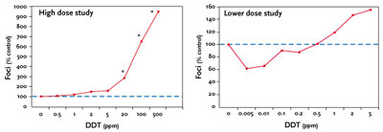
Example with actual data-
Synthetic pesticide
Effect of DDT on formation of pre-cancerous lesions in the presence of a carcinogen
From http://www.ufrgs.br/imunovet/molecular_immunology/generaltoxicology.html

Slide 28
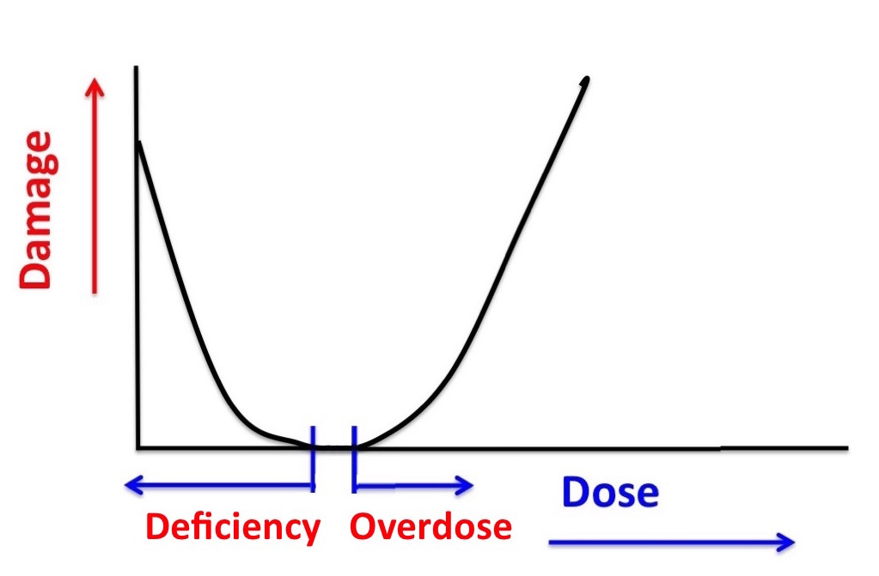
Many substances are harmless or beneficial in the right amounts but harmful if too much or not enough
Notes:
For many substances the situation is as Paracelsus discovered: if the dose is too high, damage is done. However sometimes a too low dose of the substance is also a health risk, as it is the case with vitamins and minerals. Without them we get ill and may die, but too high a dose has the same results.

Slide 29
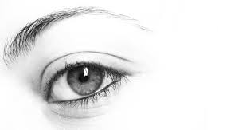
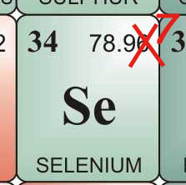
Vitamin A
Adults: needed 1 mg per day
harmful at 3 mg per day
Selenium
Adults: needed 50-150 μg per day
harmful at 300 μg per dag
(Netherlands Health Council)
Notes:
Examples:
Vitamin A and Selenium are essential for your health but too much is hamrful. The amount consumed determines whether it is healthy or toxic. Sometimes the difference is very small.

Slide 30
Development of improved methodology
GHI: WG Genetic toxicology
Chair: Firouz Darroudi
Currently evidence of safety of new food products, new ingredients and new technologies is typically obtained by animal testing.
Testing using animals is not popular, it is slow and expensive.
The alternative, developed in the past three decades is in vitro testing, using intact human liver cells. It is:
more accurate
relevant to humans (not test animals)
cheap
fast
But it is NOT IN CURRENT REGULATIONS

Slide 31
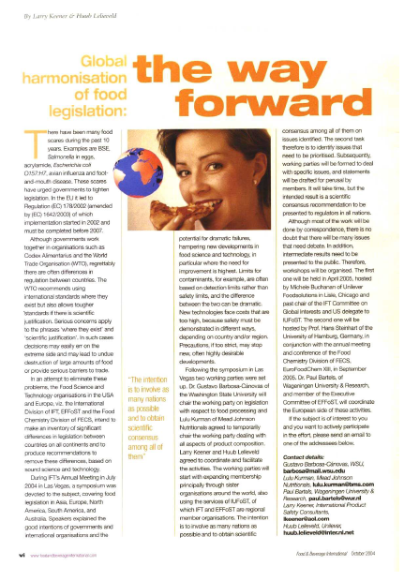
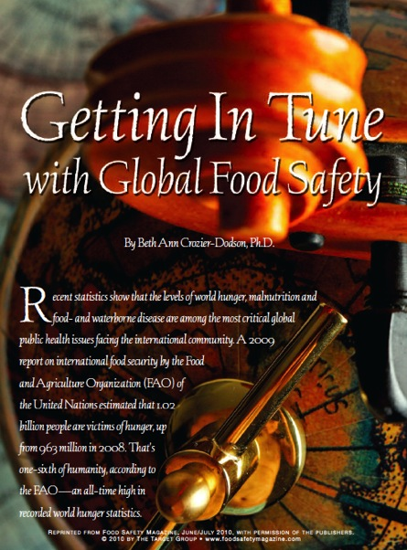
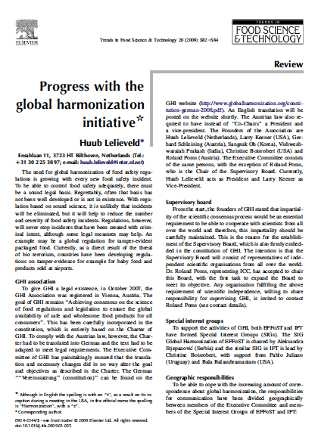
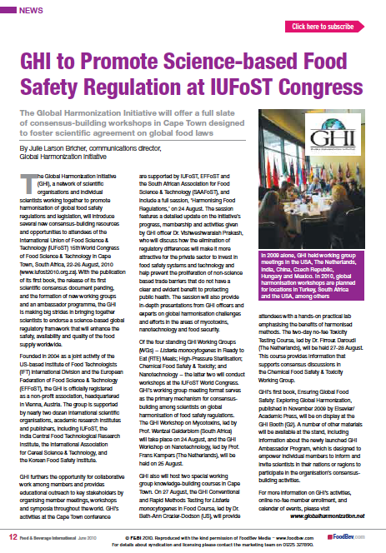
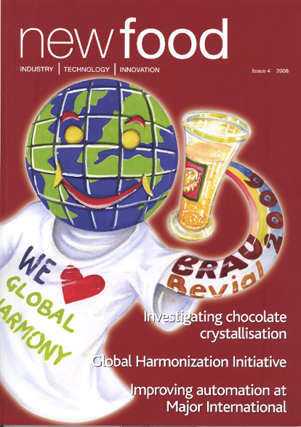
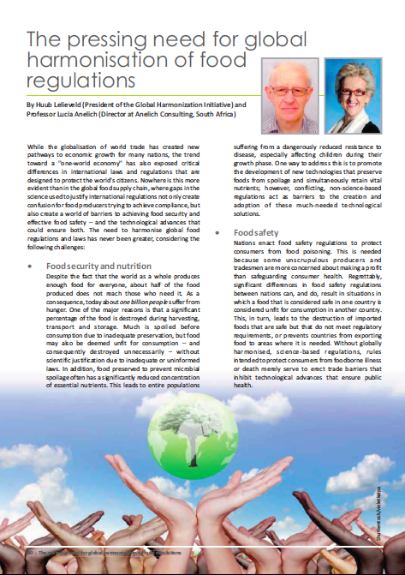

Slide 32
If you are not a member, you are invited to join GHI, just go to

www.globalharmonization.net/user/register
and if you forgot, email
Info@globalharmonization.net
There is no fee, you only need to qualify as a food scientist
You will influence the future
Z

Slide 33
Development of improved methodology
If the dose-response is actually hormetic:
Then it is not so important to know which doses are harmful, since they should be avoided anyway.
We just need to know which doses are beneficial!
Most tests of harm are not suitable for measuring benefits.
Most tests that are suitable for measuring benefits are not routinely applied to toxins.
There is no scientific reason for this, and lots of options
Just get on with it and produce some data!
This will change the world as we know it!

Slide 34
Thank you for your interest!
Any questions?

