Slide 1
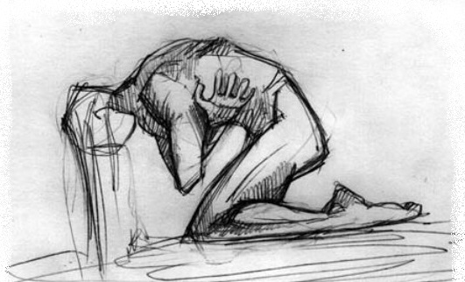
Kirill Shlyapnikov, MD, Echinacea Clinic, Russia, Moscow Fibromyalgia and Chronic Fatigue Syndrome: Pathogenesis, Detecting Predisposed Persons, Preventive and Rehabilitation Treatment
2nd International Conference on Predictive, Preventive and Personalized Medicine & Molecular Diagnostics. November 03-05, 2014, Las Vegas, USA

Slide 2
Due to the lack of objective criteria, Chronic Fatigue Syndrome (CFS) and Fibromyalgia (FM) have not been recognized as nosology for a long time.
It is known that patients suffering from CFS and FM have rheumatoid muscle aches, in-morning stiffness, abnormal fatigue, sleep disorders, increased anxiety and/or depression, chronic pharyngitis and tonsillitis, often associated with HHV6, CMV and EBV.

Slide 3
Epidemiology. According to international statistics, about 6% of the world population have symptoms of CFS and FM, and those indices tend to grow and is probably underestimated due to low awareness of clinicians. Thus, examination of able-bodied working patients initially admitted to our Clinic with complaints of musculoskeletal pain of various localization revealed clinical criteria of CFS and FM in 42.3% of the overall applicants.

Slide 4
Five-step CFS/FM pathogenesis
Our Clinical team is dealing daily with CFS and FM patients. We have some ideas redarding this type of disorder and those the criteria. We have found a number of clinical patterns to be summarized below:
Stage 1. Onset of CFS and FM. Hyperactivation of protective resourses.
Stage 2. Immunodeficiency and postInfectious triggering of autoaggession.
Stage 3. Autoimmune Enthesitis.
Stage 4. Autoimmune Dysfunction wihin the Neurotransmitter Systems.
Stage 5. "Vicious Circle" Formation.

Slide 5
Step 1. Onset of CFS and FM. Hyperactivation of protective resourses.
CFS and FM typically start at a period of long-lasting hyperactivation of protective resourses of the nervous system and immunity (mental stress, sleep deprivation, surgery or trauma, infectious disease, tumor chemotherapy, etc).
There is always observed:
Increased anxiety with simultaneous sympathicotonia and asthenia.
Increased daily production of catecholamines.
Deficiency of slow wave sleep (SWS) or/and REM-sleep correlating with the intensity of pain and fatigue.

Slide 6
Step 2. Immunodeficiency and postInfectious triggering of autoaggession.
Clinical Observations
The patients are susceptible to infections which are typically chronic inflammation of the mucous membranes of the respiratory tract, digestive tract or the genitourinary system.
Usually the inflammatory process regardless to type is associated with a number of typical infections.
Naive T-cells predominate over the memory T-cells.
Increased percentage of CD19+CD5+ cells to the total CD19 subset, and this index correlates with the pain intensity as well.

Slide 7
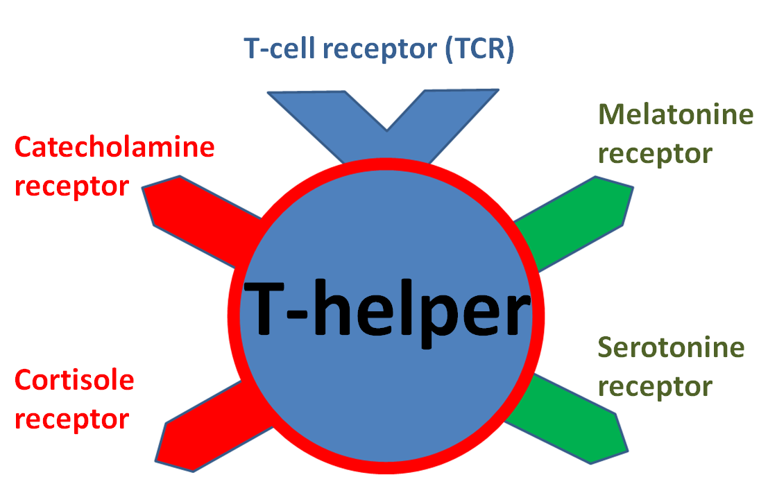
It appears to be connected to the function of receptors for serotonin, melatonin, catecholamines and glucocorticoids on T-helpers. Antigen presentation by a dendritic cell to a T-helper is inhibited at stress: weak stimulation of receptors for serotonin and melatonin and active stimulation of receptors for catecholamines and glucocorticoids on T-helpers.

Slide 8
Physiologic antigen presentation by a dendritic cell to a T-helper. Dendritic cell (DC) phagocytose antigen, then migrates to lymphatic node and present antigen to T-helper.
DC
T-helper

Slide 9
Physiologic antigen presentation by a dendritic cell to a T-helper. Dendritic cell (DC) phagocytose antigen, then migrates to lymphatic node and present antigen to T-helper.
DC
T-helper

Slide 10
Physiologic antigen presentation by a dendritic cell to a T-helper. Dendritic cell (DC) phagocytose antigen, then migrates to lymphatic node and present antigen to T-helper.
DC
T-helper

Slide 11
Physiologic antigen presentation by a dendritic cell to a T-helper. Dendritic cell (DC) phagocytose antigen, then migrates to lymphatic node and present antigen to T-helper.
DC
T-helper

Slide 12
Physiologic antigen presentation by a dendritic cell to a T-helper. Dendritic cell (DC) phagocytose antigen, then migrates to lymphatic node and present antigen to T-helper.
DC
T-helper

Slide 13
Physiologic antigen presentation by a dendritic cell to a T-helper. Dendritic cell (DC) phagocytose antigen, then migrates to lymphatic node and present antigen to T-helper.
DC
T-helper

Slide 14
Physiologic antigen presentation by a dendritic cell to a T-helper. Dendritic cell (DC) phagocytose antigen, then migrates to lymphatic node and present antigen to T-helper.
DC
T-helper

Slide 15
Physiologic antigen presentation by a dendritic cell to a T-helper. Dendritic cell (DC) phagocytose antigen, then migrates to lymphatic node and present antigen to T-helper.
DC
T-helper

Slide 16
Physiologic antigen presentation by a dendritic cell to a T-helper. Dendritic cell (DC) phagocytose antigen, then migrates to lymphatic node and present antigen to T-helper.
T-helper
DC

Slide 17
Physiologic antigen presentation by a dendritic cell to a T-helper. Dendritic cell (DC) phagocytose antigen, then migrates to lymphatic node and present antigen to T-helper.
DC
T-helper

Slide 18
Antigen presentation by a dendritic cell to a T-helper: disabled in stress...
DC
T-helper
Catecholamines + Cortisole

Slide 19
… enabled in relaxation. Antigen presentation most active in the SWS / REM-sleep.
Melatonine + Serotonine
DC
T-helper

Slide 20
Briefly commenting, immune system whilst under stress is lesser securing mucous membranes whilst being prepared to provide an assistance in servicing skin wound healing.
Stress response in its nature should be short and result in the outcome. If the response delays, the activity of mucosal immunity is reshuffled.

Slide 21
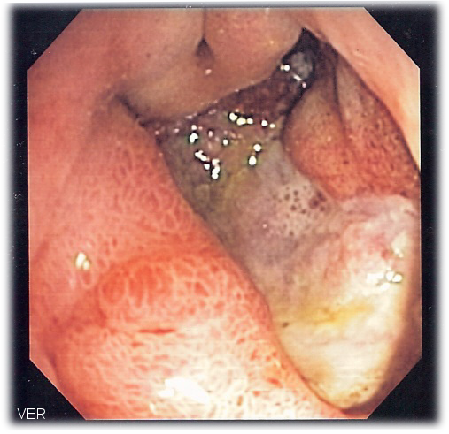
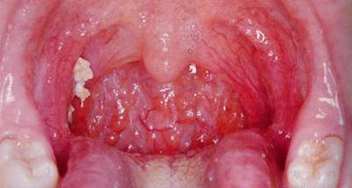
The clinical outcome observed: opportunistic infections and chronic inflammatory processes of the various mucous membranes (pharyngitis, cystitis, gastritis, vulvovaginitis, stomatitis, etc.). Dendritic cells phagocytose the microbial flora and actively migrate to the lymph nodes, but cannot share the cooperative effects with T-helpers.

Slide 22
Features of endomicrobiota as applicable to CFS/FM

Slide 23
The inflammatory processes mentioned would require an immune response to bypass the blocked link "dendritic cell - T-helper". It causes compensatory increase in production of "specialized" CD19CD5 B-lymphocytes (B1-cells).
B1-CELL
CD19+ CD5+
DC
T-helper
Antimicrobial antibodies
Catecholamine + Cortisole

Slide 24
Step 3. Autoimmune Enthesitis.
Upon the setting of CD19CD5 B1-cells activation and infectious processes we observed a clinical pattern resembling reactive arthritis without evolving the joints, but with enthesis inflammation. It results in pain and muscle stiffness of rheumatic type in typicaly tender zones.
Antimicrobial antibodies
B1-CELL
CD19+ CD5+
DC
T-helper
Catecholamine + Cortisole
Autoantibodies

Slide 25
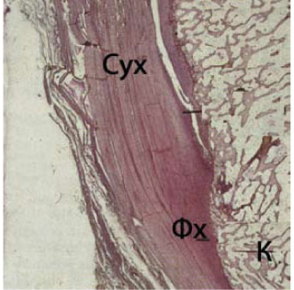
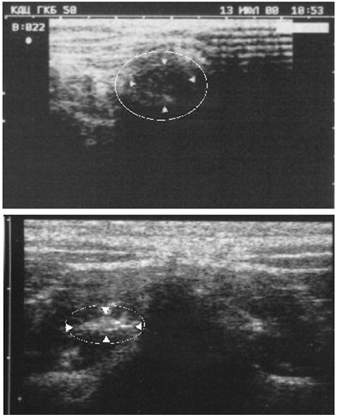
Enthesis Entesitis on US-scans
swell
(active entesitis)
petrification
(remission)

Slide 26
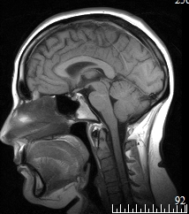
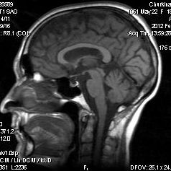
MRI
Pharyngitis with B1-cells hyperactivity. Swelling / fatty degeneration of the bone marrow at the area of primary autoimmune sensitization to enthesis.
Normal bone

Slide 27
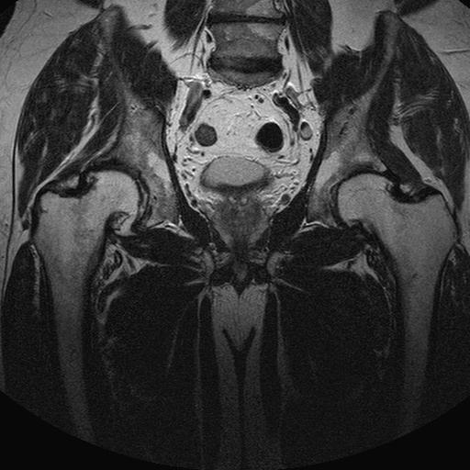
Genitourinary infection with B1-cells hyperactivity. Swelling / fatty degeneration of the bone marrow at the area of primary autoimmune sensitization to enthesis.

Slide 28
Step 4. Autoimmune Dysfunction of the Neurotransmitter Systems.
Clinical Observations
Abolishing of the starting stress does not affect the patient's condition.
Reception of melatonin does not result in the marked improvement.
Psychopharmacotherapy is often poorly tolerated due to adverse reactions and the absence of the effect expected.
After intravenous infusion of IL-2 psychopharmacotherapy is significantly better tolerated and bring therapeutic effect.

Slide 29
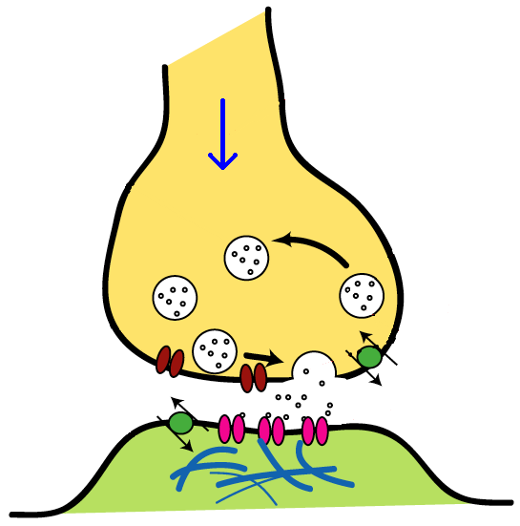
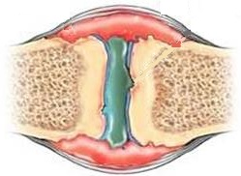
CD19CD5 B1-cells associate with autoimmune conditions. In particular, a number of researchers stressed the ability of CD19CD5 to produce antibodies against neurotransmitters, hormones and their receptors. Apparently, the activation of CD19CD5 cells triggers the production of autoantibodies against serotonin, melatonin, and possibly against other neurotransmitters.
Autoantibodies
B1-CELL
CD19+ CD5+
Antimicrobial antibodies

Slide 30
It results in restructuring of the central nervous system with increased fatigue, decrease the pain threshold, asthenia and depression (antiserotoninergetic effect), further reshuffling of sleep (antimelatoninergetic effect). The enthesitis induced pain easily overcomes the reduced pain threshold.
The blockade of serotonin and melatonin receptors causes:
Further “getting stuck" of the nervous system in the state of stress response without sufficient objective preconditions;
Poorly therapeutic effect and adverse reactions during melatonin, serotonin and melatonin reuptake inhibitors medication.

Slide 31
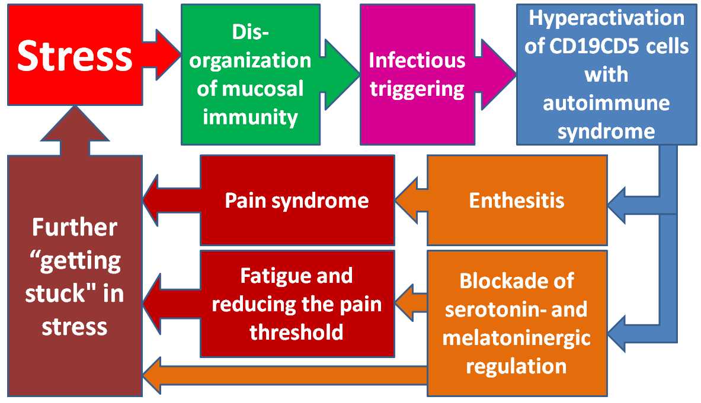
Step 5. "Vicious Circle" Formation.
Stress – reprogramming of mucosal immunity - infectious trigger attack - hyperactivation of CD19CD5 cells with autoimmune syndrome - enthesitis and blockade of serotonin and melatoninergic regulation - fatigue and pain syndrome with reducing the pain threshold - further "stacking" in stress .

Slide 32
Biomarkers to pre-select the predisposed persons
Until now we had no obvious understanding of the CFS and FM pathogenesis, therefore there were no criteria proven to support the validity of the biomarkers and to thus suit the clinical mades.
The major aim of our Clinic is to develop standards able to secure CFS / FM diagnosis, treatment and prevention. We are working to pre-select a set of biomarkers to be standartized and then be implemented into clinical practice.

Slide 33
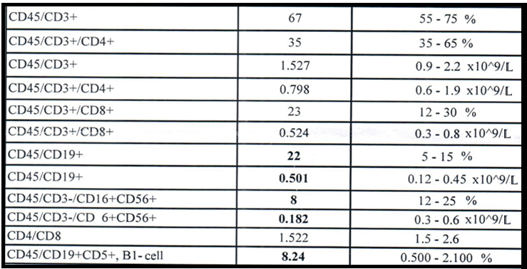
Typical CFS/FM patient. HHV6 detected in saliva.
Patient
Normal rate

Slide 34
Typical CFS/FM patient. HHV6 detected in saliva.
Deficiency of NK

Slide 35
Typical CFS/FM patient. HHV6 detected in saliva.
Deficiency of NK High % of CD19CD5 cells

Slide 36
Percentage of CD19CD5 cells to the total CD19 subset
increased in CFS/FM sufferers and predisposed persons
CFS/FM sufferers
CFS/FM in remission
Predisposed persons
Controls (radicular pain)
Normal CD19CD5 diapazone ≤ 2.1%

Slide 37
Currently, we use 4 main key biomarkers to monitor CFS and FM patients:
1. Compliance of the clinical presentation to the regular CFS and FM criteria;
2. SWS / REM sleep deficiency (found with night sleep EEG or sleep questionary);
3. Increase of percentage of CD19CD5 cells to the total CD19 subset;
4. Persistance of triggering infection.

Slide 38
Combinatorial Biomarker of CFS / FM risk and severity. For assessment by the risk and severity scale and the selection of treatment modes, we have outline a new combinatorial (not simple) biomarker to be utilized broadly. Here we have summarised our experience, the psychometric testing data and outcome of monitoring and treatment as well as statistical database.
Biomarker | Scores
Average number of active pairs of tender points | Number of pairs х 0.5
Abnormal slow wave sleep / REM-sleep | 2
% CD19CD5 relative to the total amount of CD19 (normal rate 2.1%) | X - 2.1
HSV in saliva and / or urine (PCR) | 0.5
HHV6 in saliva and / or urine (PCR) | 1
CMV in saliva and / or urine (PCR) | 2
EBV in saliva and / or urine (PCR) | 1
Chlamydia trachomatis / pneumonia, positive IgM or IgA in blood plasma | 2
Mycoplasma hominis / pneumonia, positive IgM or IgA in blood plasma | 2
Borrelia burgoferi / garinii / afzelii - positive western blot or immunochip | 4
High Antistreptolysin «О» | 1
Hepatitis B, C, D, G, infection with one / two types of viruses | 4
Yersinia enterocolitica, positive IgA in blood plasma | 1
Integrated index | Mild - up to 11 scores Medium severity - 12-18 scores Severe - 19 scores or more

Slide 39
Combinatorial Biomarker of CFS / FM in sleep disorders cohort shows 32% of the predisposed persons
Deficiency of SWS or/and REM-sleep
n=47
32% - Combinatorial Biomarker ≥ 11 (risk of CFS/FM debute)
68% - Combinatorial Biomarker < 11 (normal rate)
Prevention of CFS/FM debute is possible and easier than treatment: elimination of the triggering infection + restoration of normal sleep duration is enough usually.

Slide 40
Experience in Treating CFS and Fibromyalgia.
Clinical recovery is possible.

Slide 41
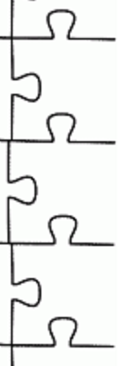
Our “three-in-one” method of treating CFS and fibromyalgia is based on three principles:
1. Eliminating the actual stressor, reducing the anxiety level, restoration of normal night sleep duration.
2. Restoration of adequate immunological maintenance of mucous membranes.
3.Elimination of the triggering infection.
All of this simultaneously.

Slide 42
Eliminating the actual stressor, reducing the anxiety level, restoration of normal night sleep duration. Use of serotonin and melatonin reuptake inhibitors at CFS and FM is rather difficult. Probably, this is due to an autoimmune blockade of serotonin and melatonin synapses / receptors. At the same time, in most cases, it is possible to restore normal response of patients to psychopharmacotherapy by intravenous administration of IL-2 drugs with/without IVIG.
Restoration of the appropriate immune resources in mucous membranes. Based on the results of immune screening of individuals, we successfully use alpha interferon (in inhalation, rectally), IVIG, IL-2 or other immunomodifiers.
Elimination of the triggering infection. In case of laboratory confirmation of the specific infections we prescribe appropriate antibiotic and/or antiviral treatment.

Slide 43
Experience in Treating CFS and Fibromyalgia.
“Three-in-one” method.
Brief comments. A stepwise control of the treatment efficacy in 3-4 months from its initiation point shows a stable decline, or absence of pain syndrome, and positive dynamics by the scale of combinatorial biomarker of CFS/FM severity. In 38% of cases we can talk about clinical recovery in 6 months (data of 2013).

Slide 44
Thank you
for your attention

Slide 45
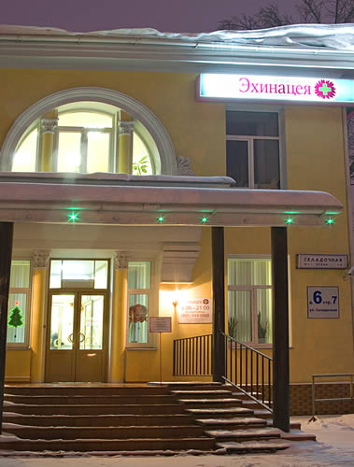
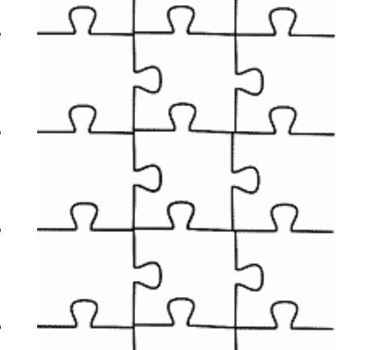
Echinacea Clinic
Neurology
Immunology
Rheumatology
Endocrinology
Medical genetics
Psychiatry
Russia, Moscow, www.ehinaceya.ru

