Slide 1

About OMICS Group
OMICS Group International is an amalgamation of Open Access publications and worldwide international science conferences and events. Established in the year 2007 with the sole aim of making the information on Sciences and technology ‘Open Access’, OMICS Group publishes 400 online open access scholarly journals in all aspects of Science, Engineering, Management and Technology journals. OMICS Group has been instrumental in taking the knowledge on Science & technology to the doorsteps of ordinary men and women. Research Scholars, Students, Libraries, Educational Institutions, Research centers and the industry are main stakeholders that benefitted greatly from this knowledge dissemination. OMICS Group also organizes 300 International conferences annually across the globe, where knowledge transfer takes place through debates, round table discussions, poster presentations, workshops, symposia and exhibitions.

Slide 2
About OMICS Group Conferences
OMICS Group International is a pioneer and leading science event organizer, which publishes around 400 open access journals and conducts over 300 Medical, Clinical, Engineering, Life Sciences, Pharma scientific conferences all over the globe annually with the support of more than 1000 scientific associations and 30,000 editorial board members and 3.5 million followers to its credit.
OMICS Group has organized 500 conferences, workshops and national symposiums across the major cities including San Francisco, Las Vegas, San Antonio, Omaha, Orlando, Raleigh, Santa Clara, Chicago, Philadelphia, Baltimore, United Kingdom, Valencia, Dubai, Beijing, Hyderabad, Bengaluru and Mumbai.

Slide 3
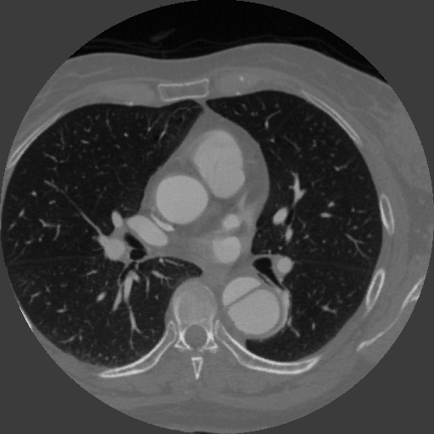

Computational Study of Hemodynamic Effect of False Lumen Partial Thrombosis of Type B Aortic Dissection for various Tear Size and Configuration
Khalil Khanafer, PhD
Mechanical Engineering Department
Australian College of Kuwait
10/7/2015

Slide 4
Significance of Computational Analysis
Computational hemodynamics has become a powerful and attractive tool in investigating various vascular diseases such as brain aneurysm and aortic aneurysm and dissection
Measuring the hemodynamic factors such as wall shear stress and pressure is still beyond the capabilities of in vivo measurements or experiments.
With high resolution 3D medical imaging, it is now possible to simulate pulsatile blood flow in physiologically realistic geometries derived from in vivo imaging in relation to their pathogenesis and treatment.

Slide 5
Research Interests

Slide 6
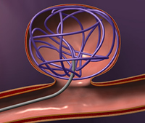
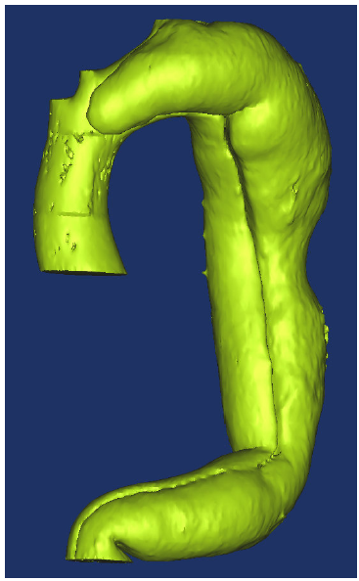
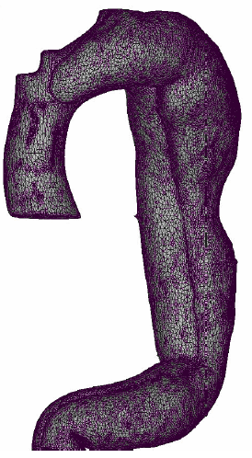
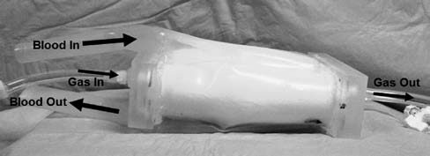
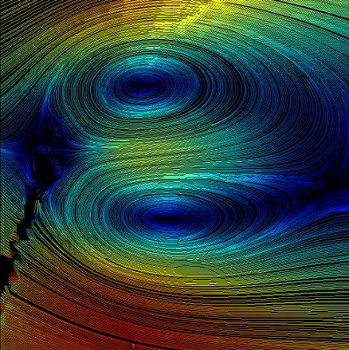
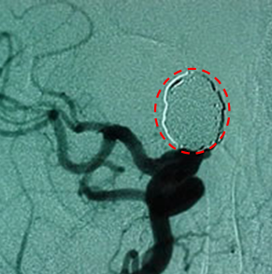
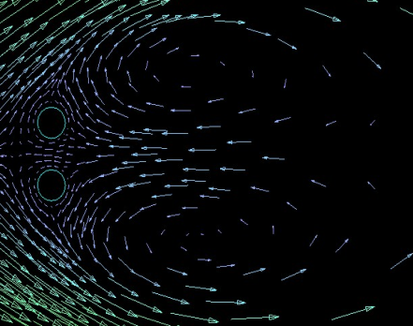
Brain aneurysm
Aortic Dissection
Artificial Lung

Slide 7
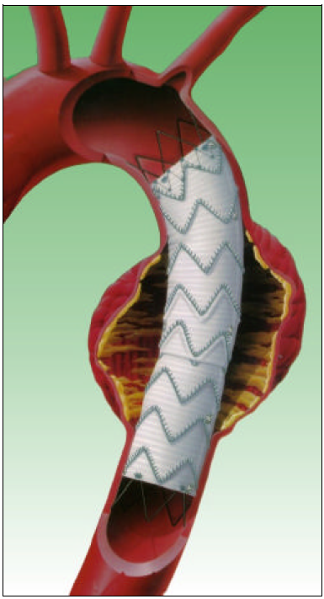
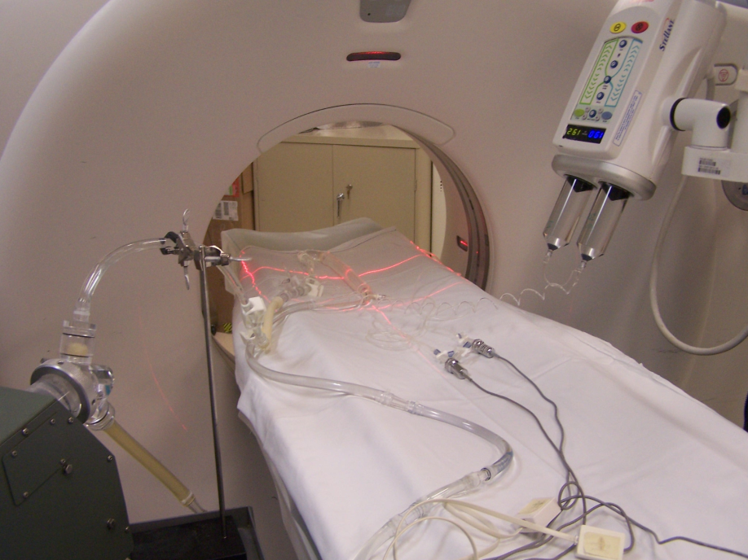
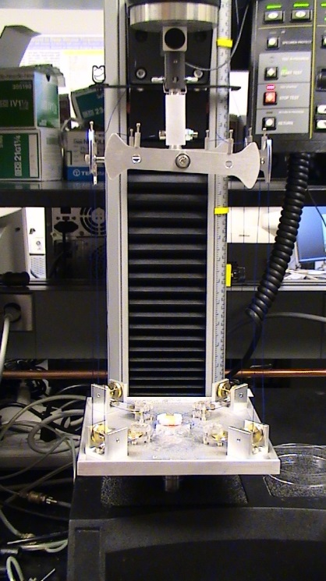
Stent-Graft
In vivo Measurements of Elasticity
Tissue Testing

Slide 8



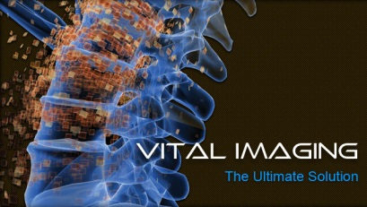

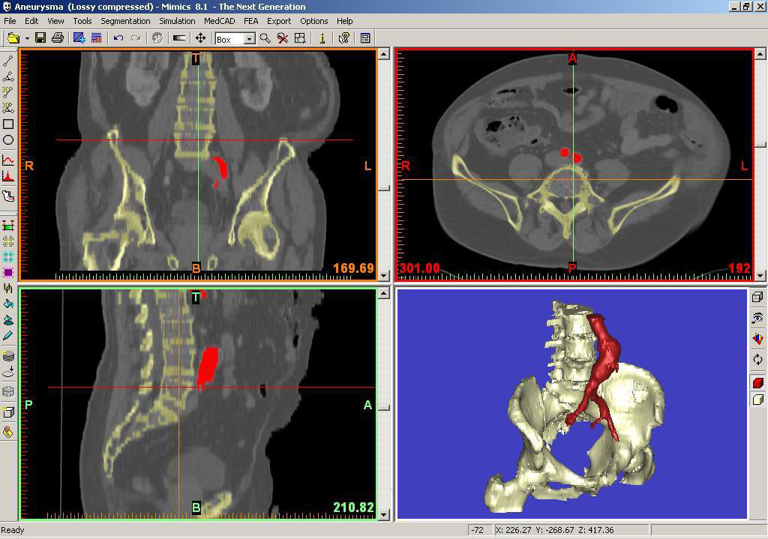
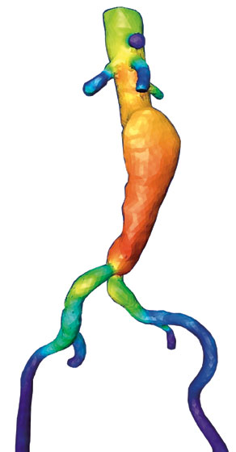
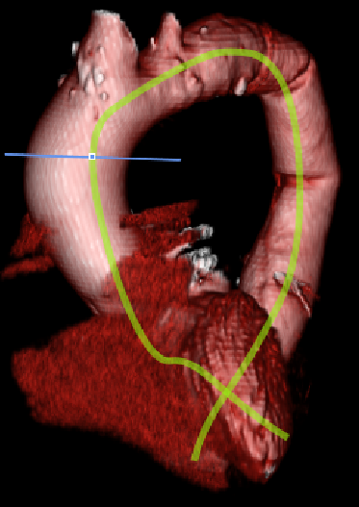
Numerical Capabilities
Image Processing Software

Slide 9
Aortic Dissection

Slide 10
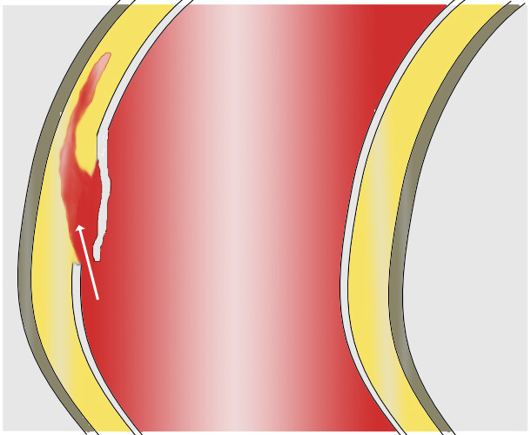
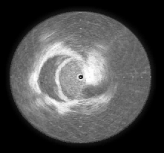
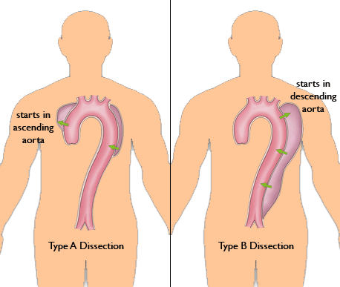
An aortic dissection is a tear in the wall of the aorta that allows blood to flow within the layers of the aorta.
Certain types (Type A) of dissections, if left untreated, kill 33% of patients within the first 24 hours, 50% of patients within 48 hours, and 75% of patients within 2 weeks.
Type B Dissection

Slide 11

The Geometry of Aortic Dissection
True Lumen
False Lumen

Slide 12
History of 3D Printing with a Look into the Future
Notes:
ABS
3D systems
OES Novi for ABS

Slide 13
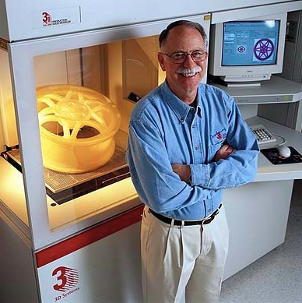
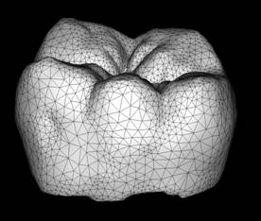
1984: Charles Hull invented STereoLithography (STL format) which is a printing process that enables a 3D object to be created from digital data
STL files describe only the surface geometry of a three dimensional object using triangles characterized by normal vector and vertices

Slide 14
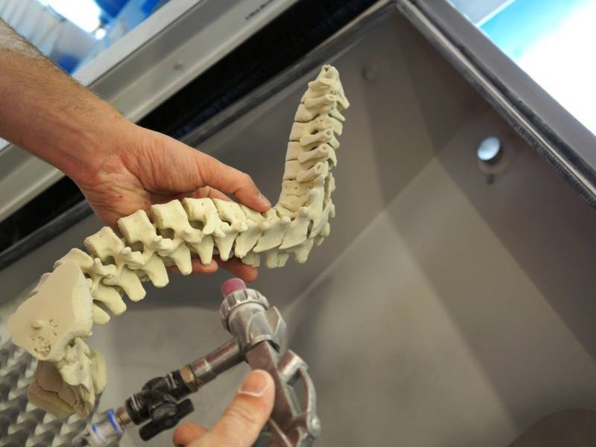
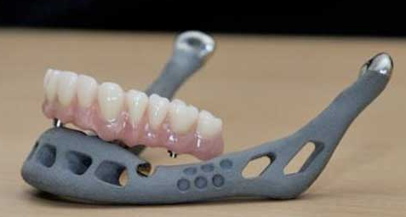
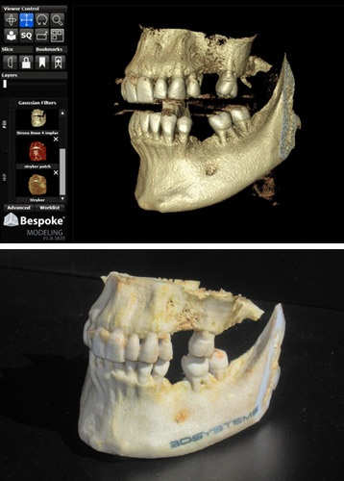
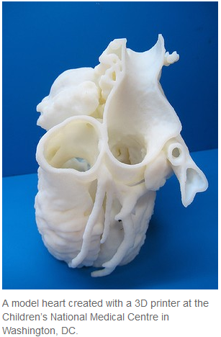
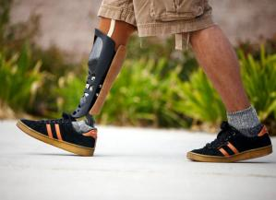
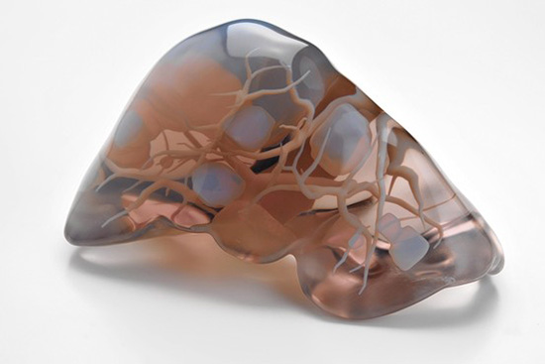
Applications
Notes:
ABS
3D systems
OES Novi for ABS

Slide 15
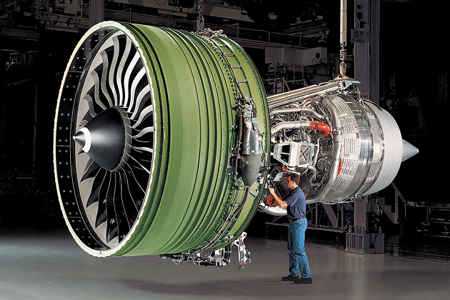
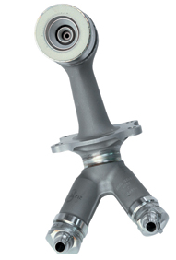

GE plans to 3D print about 40,000 nozzles annually for its aircraft engines in the coming years
Notes:
ABS
3D systems
OES Novi for ABS

Slide 16
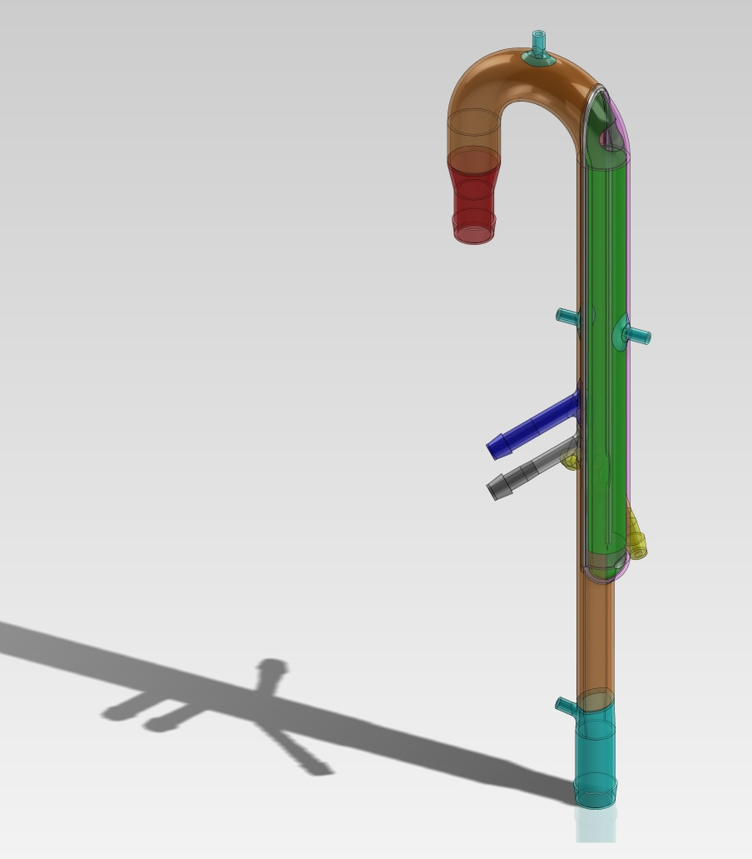
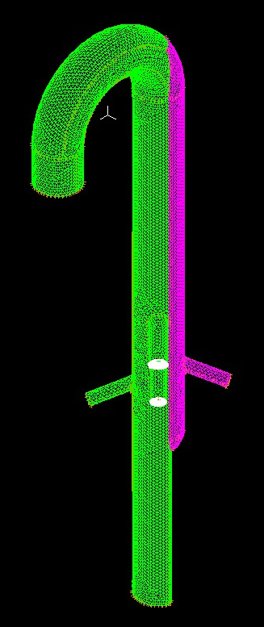

Acute Dissection
A dissection is defined as acute if it is diagnosed within two weeks of the start of symptoms

Slide 17
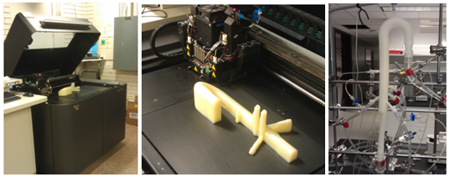
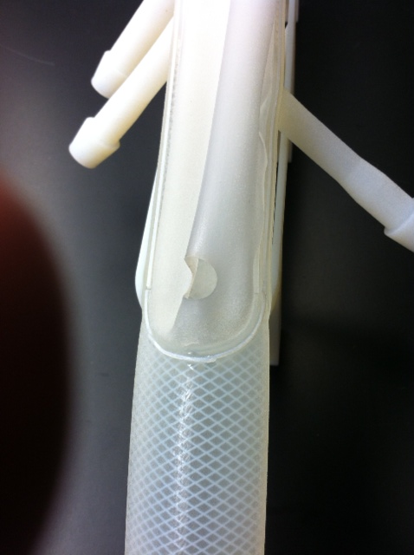
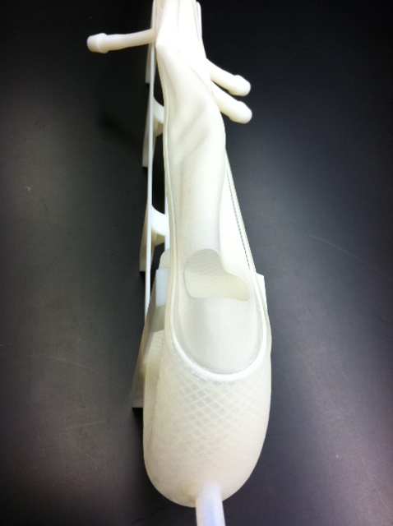

Slide 18
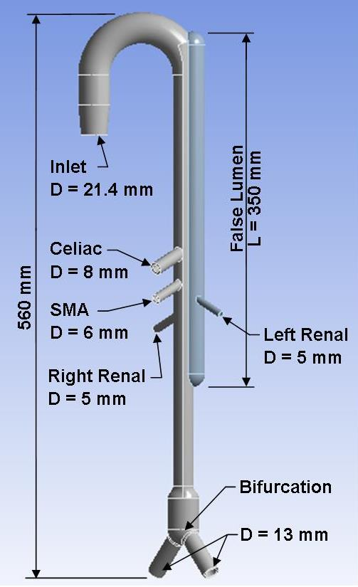
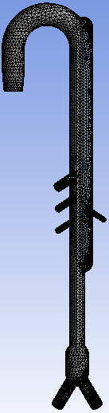

Slide 21
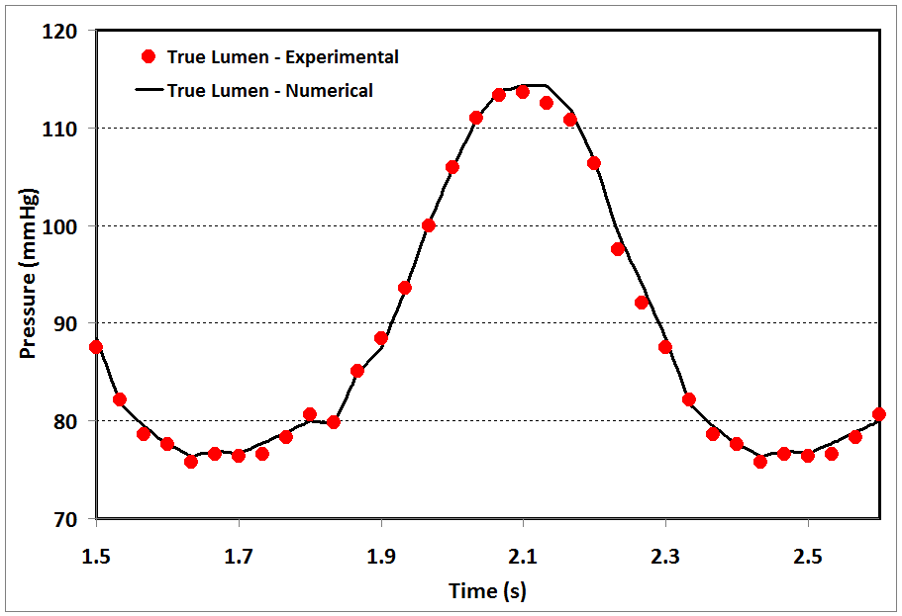
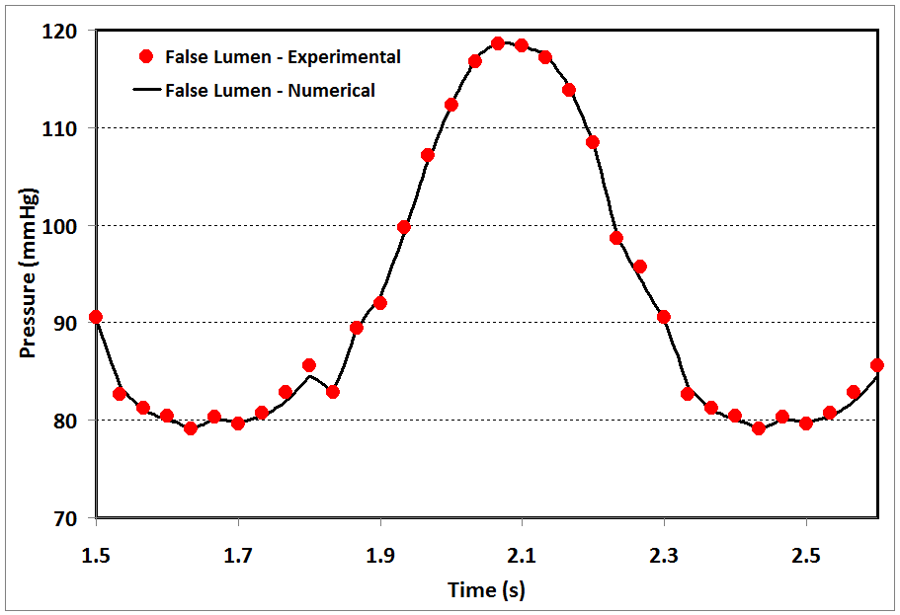
Comparison of the pressure in true and false lumena between experimental and numerical results (proximal tear = 65 mm², distal tear = 20 mm²)

Slide 22
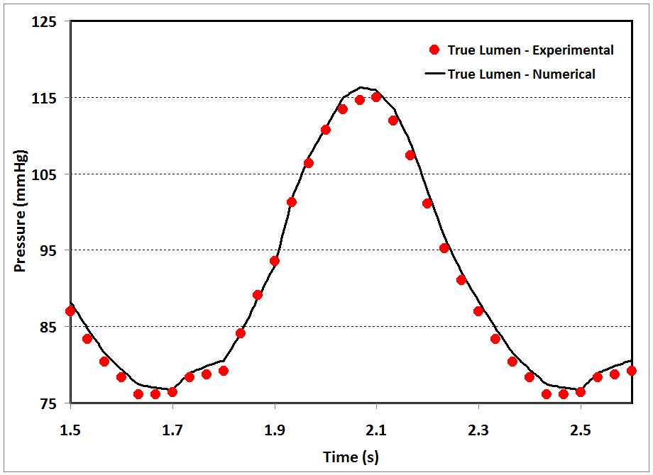
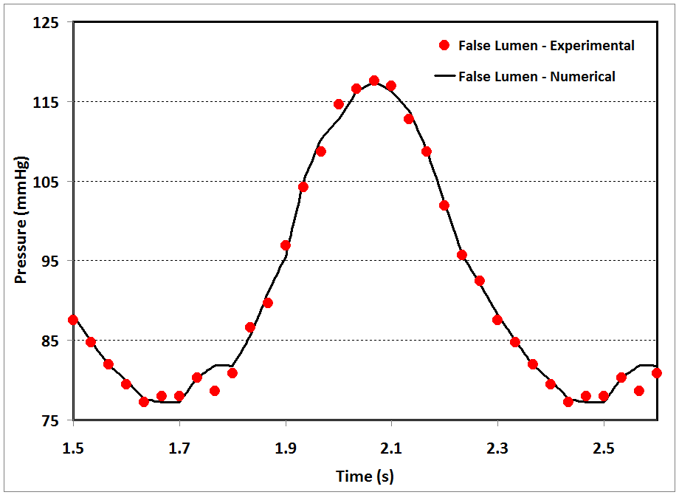
Comparison of the pressure in true and false lumena between experimental and numerical results (proximal tear = 145 mm², distal tear = 40 mm²)

Slide 23
Thank you

