Slide 1

About OMICS Group
OMICS Group International is an amalgamation of Open Access publications and worldwide international science conferences and events. Established in the year 2007 with the sole aim of making the information on Sciences and technology ‘Open Access’, OMICS Group publishes 400 online open access scholarly journals in all aspects of Science, Engineering, Management and Technology journals. OMICS Group has been instrumental in taking the knowledge on Science & technology to the doorsteps of ordinary men and women. Research Scholars, Students, Libraries, Educational Institutions, Research centers and the industry are main stakeholders that benefitted greatly from this knowledge dissemination. OMICS Group also organizes 300 International conferences annually across the globe, where knowledge transfer takes place through debates, round table discussions, poster presentations, workshops, symposia and exhibitions.

Slide 2
About OMICS Group Conferences
OMICS Group International is a pioneer and leading science event organizer, which publishes around 400 open access journals and conducts over 300 Medical, Clinical, Engineering, Life Sciences, Pharma scientific conferences all over the globe annually with the support of more than 1000 scientific associations and 30,000 editorial board members and 3.5 million followers to its credit.
OMICS Group has organized 500 conferences, workshops and national symposiums across the major cities including San Francisco, Las Vegas, San Antonio, Omaha, Orlando, Raleigh, Santa Clara, Chicago, Philadelphia, Baltimore, United Kingdom, Valencia, Dubai, Beijing, Hyderabad, Bengaluru and Mumbai.

Slide 3



FSI & Flutter Analysis of a Solar Powered HALE UAV
Dr. Kevin R. Anderson*, Mr. Sukwinder Singh*,
Mr. Steve Dobbs**, Dr. Donald Edberg**,
California State Polytechnic University at Pomona
*Department of Mechanical Engineering
Non-linear FEA/CFD Multiphysics Lab Rm. 17-2236, Bldg. 17
**Department of Aerospace Engineering
Presented at
Mech Aero 2015, San Francisco, CA

Slide 4
Introduction
Problem Statement
Model Set-up
Free Vibration Analysis
Forced Vibration Analysis
Fluid Structure Interaction (FSI)
Flutter Analysis
Conclusions
Future Work

Slide 5
Problem Statement
Achieving a 24/7 HALE (High Altitude Long Endurance) UAV Solar drone
  Can be used for defense services to gather intel or to perform stealth reconnaissance
  Can be used for agricultural GPS related studies to enhance water resource management
Use of embedded actuators in wing of UAV to aid in the flight
  Solar Panels are installed on the airfoils to power the aircraft using super capacitors to store and power the battery during the day time
  Vibration based generators (embedded actuators) can be used to power the aircraft by utilizing the vibrational motion of the airfoil, those vibrations can be forced or unforced for e.g. buffeting or using shakers to induce controlled vibrations on the airfoil

Slide 6
Problem Statement
UAV using solar cells assisted with embedded actuators (vibration generators) enabling 24/7 flight times
The vibration generators can be positioned inside the wing at various locations to be excited by gusts and control surface pulses to produce structural vibrations to produce power to the aircraft storage devices
In order to aid the further design of UAV with embedded actuators, a FEM based flutter analysis study has been carried out and is presented in this paper
This current Mech Aero 2015 presentation refers to the work of
  Anderson et al., July 2015
  Singh, et al. 2015
  Anderson et al. 2016
  Anderson et al. Sep. 2015

Slide 7
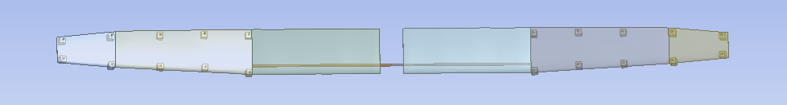
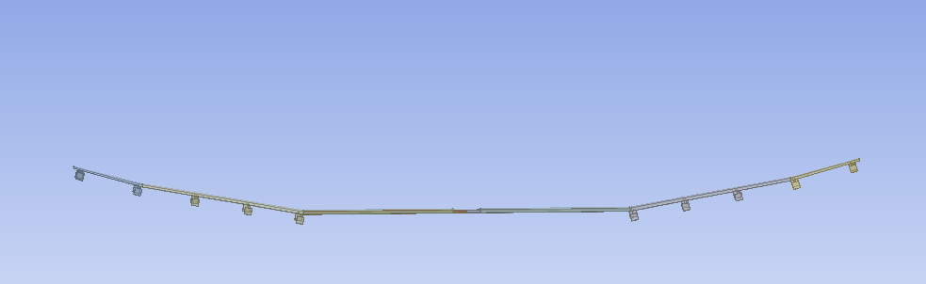
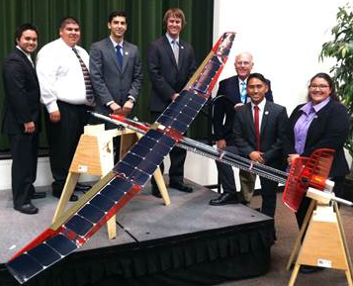
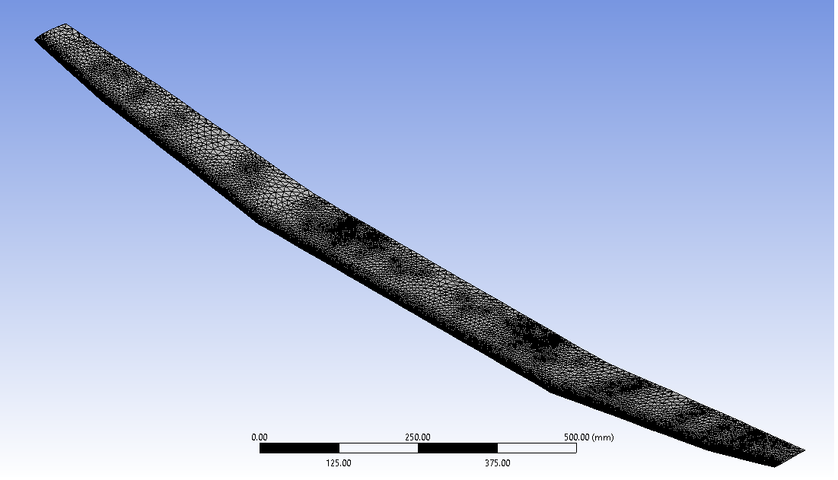
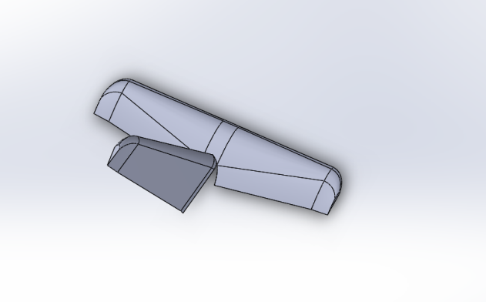
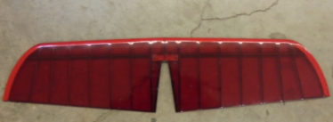
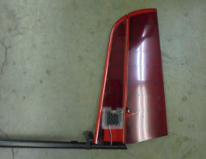
Model Set-up
ANSYS wing geometry
Geometry and Mesh
UAV Wing span = 10 ft
100K Tet elements,
Min. Size 12 mm
UAV & undergraduate team
Flutter Analysis Geometry
Elevator
Rudder

Slide 8
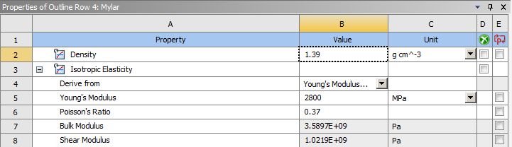
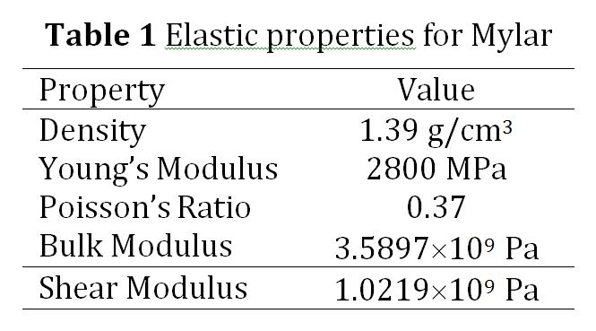
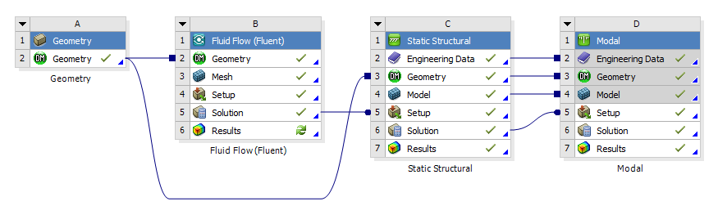
Free Vibration Analysis
Model Set-up

Slide 9
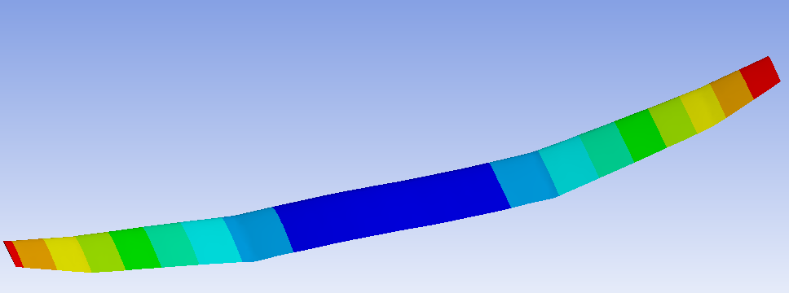
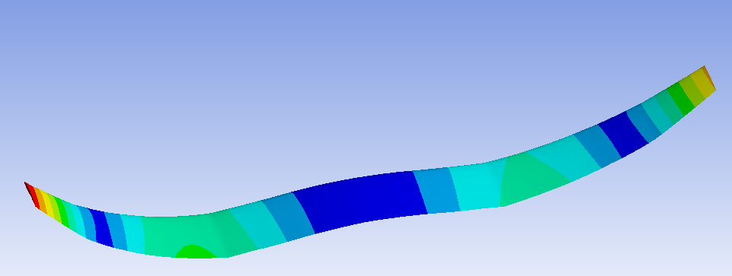
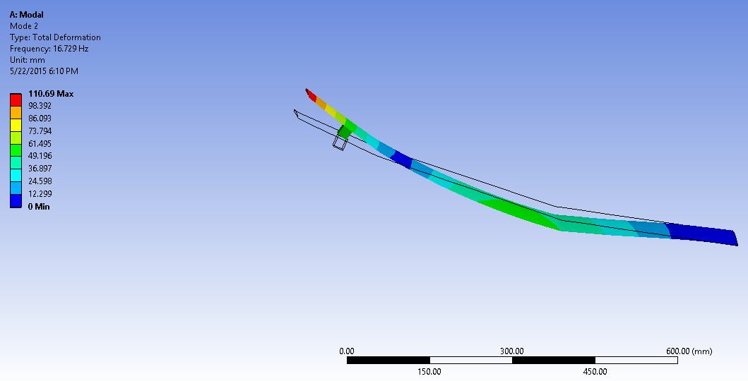
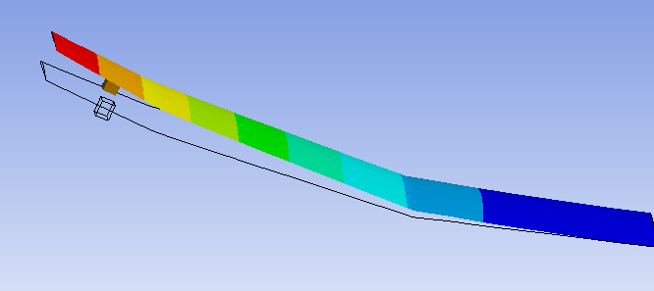
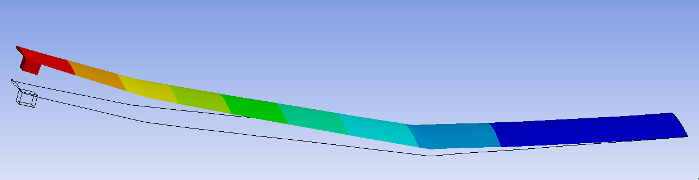
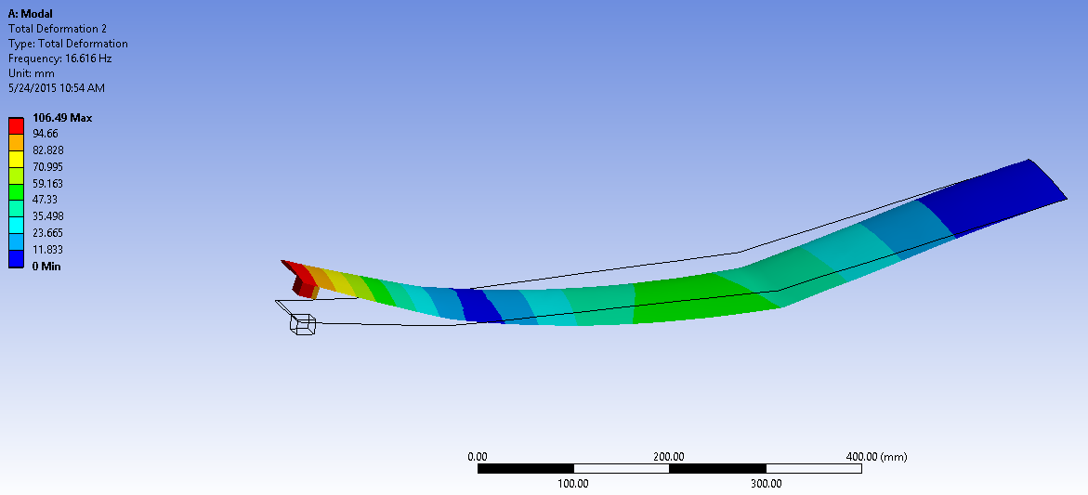
Free Vibration Analysis
Bending mode for free vibration, 6 Hz
2nd bending mode shape without lumped mass, 17.72 Hz
2nd bending mode shape with lumped mass at location 1, 16.73 Hz
1st Bending mode shape with lumped mass at location 1,
16.73 Hz
Bending mode shape with lumped mass at location 2, 16.62 Hz
2nd bending mode shape with lumped mass at location 2, 16.62 Hz

Slide 10
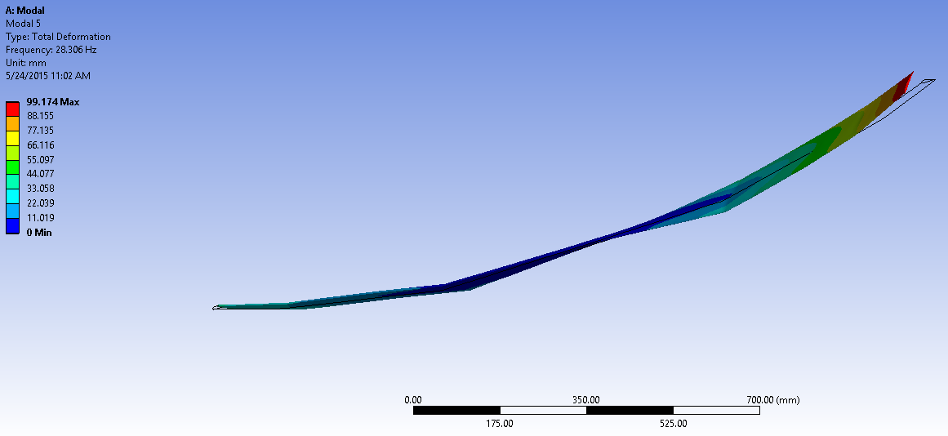
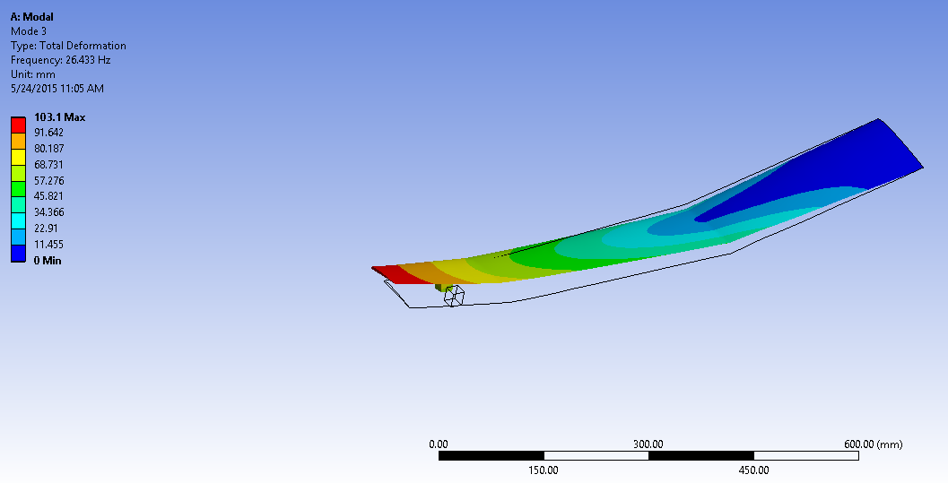
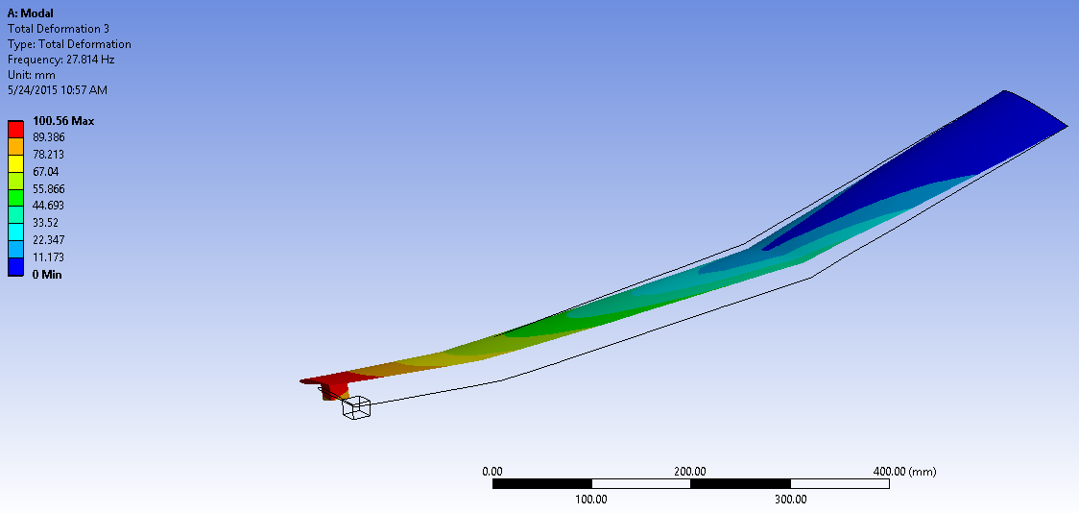
Free Vibration Analysis
Torsional mode shape for free vibrations,28.3Hz
Torsional Modal Shape with lumped mass at location 1, 26.43 Hz
Torsional Modal Shape with lumped mass at location 2, 27.814 Hz

Slide 11
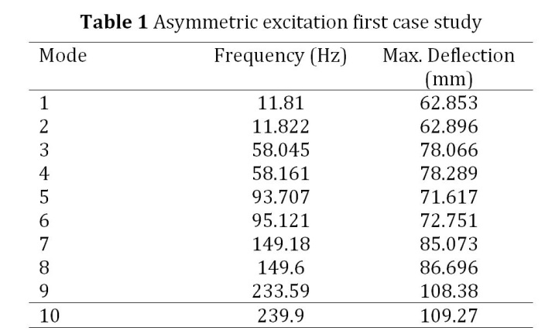
Forced Vibration Analysis
Configuration scenario I for actuators
Mesh and actuator placement
Deformation and mode shapes for 5th torsional mode
Deformation and mode shapes for 6th torsional mode

Slide 12
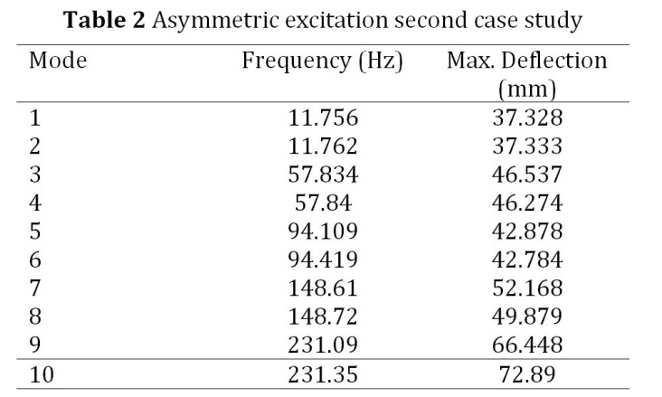
Forced Vibration Analysis
Configuration scenario II for actuators
Mesh and actuator placement
Deformation and mode shapes for 5th torsional mode
Deformation and mode shapes for 6th torsional mode

Slide 13
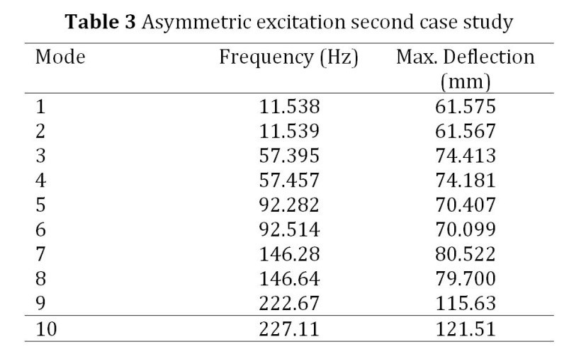
Forced Vibration Analysis
Configuration scenario III for actuators
Mesh and actuator placement
Deformation and mode shapes for 5th torsional mode
Deformation and mode shapes for 6th torsional mode

Slide 14
Forced Vibration Analysis
The results from the embedded actuator forced vibration study indicate that for the first asymmetric loading case in which five actuators each having 5 N force (generators) were located on the leading edge of the left wing and five generators were placed on the trailing edge of the right wing of the airfoil, the first, second and third modal frequencies are 11.81 Hz, 11.822 Hz, and 58.045 Hz corresponding to maximum deflections of 62.853 mm, 62.896 mm, and 78.066 mm, respectively
For the second asymmetric loading case whereby five actuators were staggered spatially on the left wing and five generators were staggered spatially on right wing of the airfoil, the first, second and third modal frequencies are 11.756 Hz, 11.762 Hz, and 57.834 Hz corresponding to maximum deflections of 37.328 mm, 37.333 mm, and 46.537 mm, respectively
For the third asymmetric loading case where five actuators were staggered arranged spatially concentrated near the outboard region on the left wing and five generators were arranged spatially concentrated in the vicinity of the outboard area of the right wing of the airfoil, the first three modal frequencies are 11.538 Hz, 11.539 Hz, and 57.395 Hz corresponding to maximum deflections of 61.575 mm, 61.567 mm and 74.413 mm, respectively
Hence, it is clear that the architectural layout and placement of the embedded actuators has a profound effect on the vibrational characteristics of the UAV airfoil

Slide 15

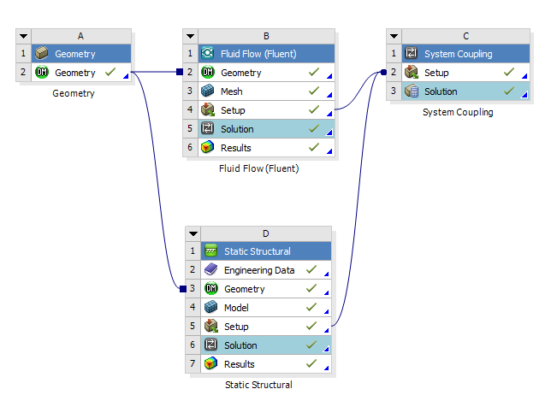
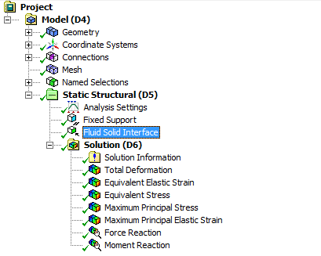
Fluid Structure Interaction (FSI) Analysis
ANSYS 2-way FSI Set-up

Slide 16
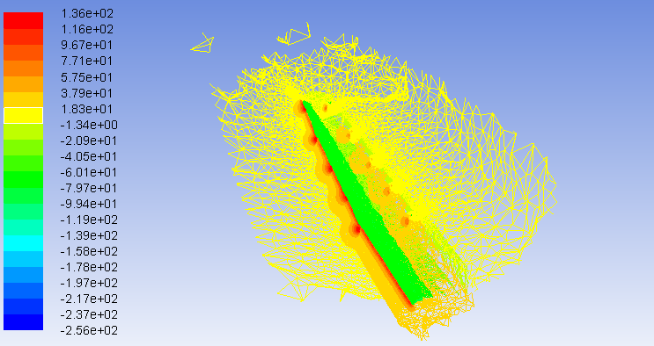
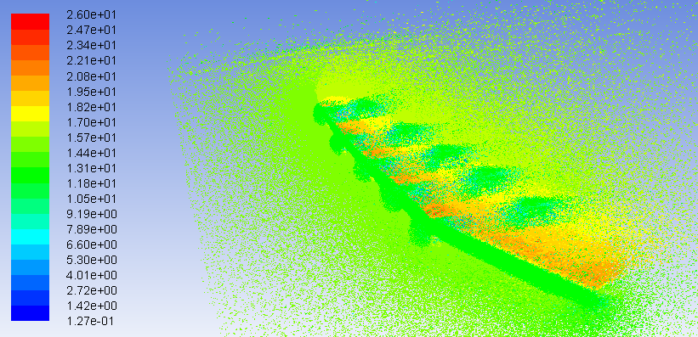
FSI Analysis
Pressure Field
Velocity Field

Slide 17
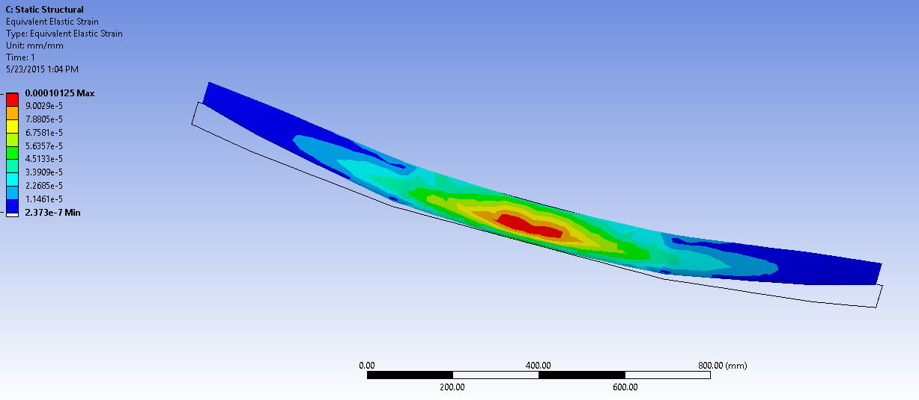
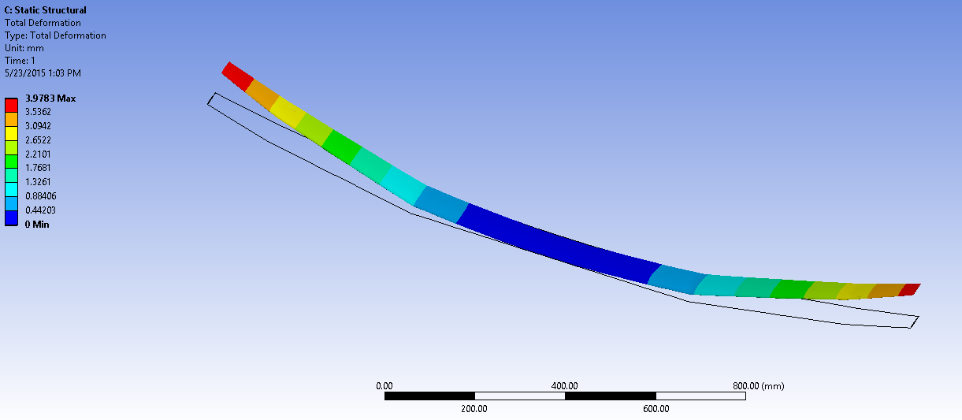
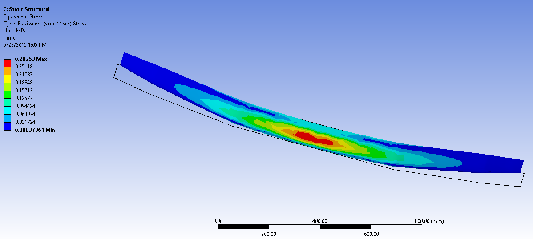
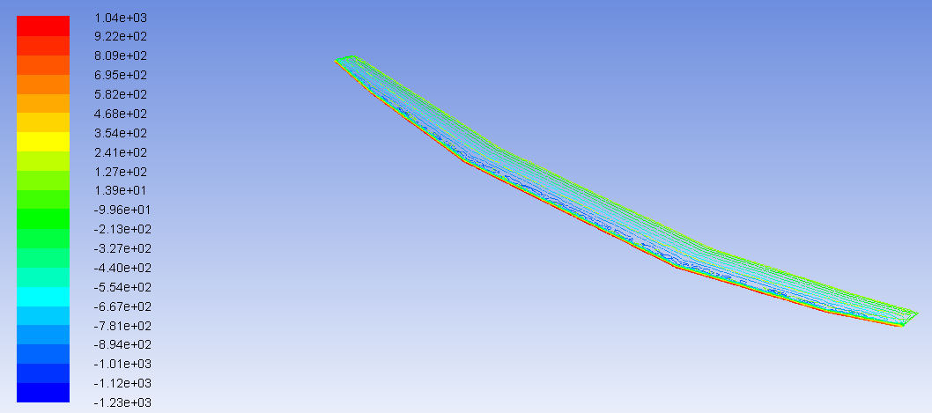
FSI Analysis
Elastic Strain Contours, max. strain ε =0.000101 mm/mm.
Total Deformation Contours,
0 < w < 3.4 mm
Von Mises Stress Contours,
0.00037 < < 0.282 MPa
Pressure Contours,
-1.44 kPa < p < 1.23 kPa

Slide 18
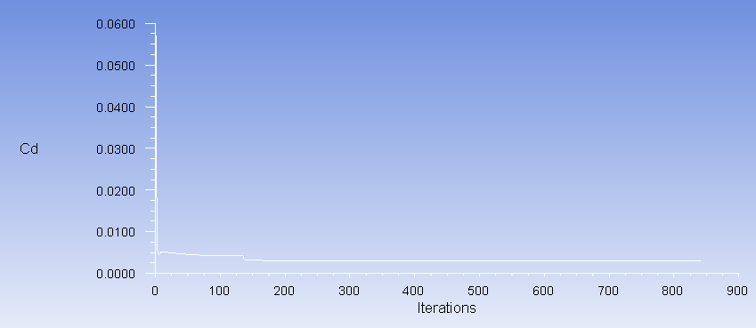
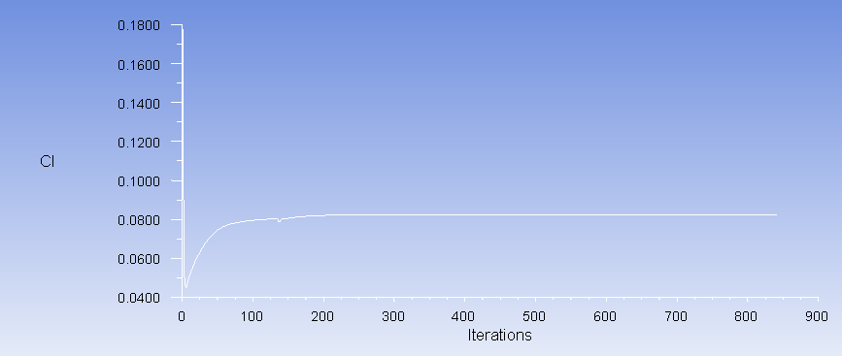
FSI Analysis
Coeff. Of Drag
Coeff. Of Lift

Slide 19
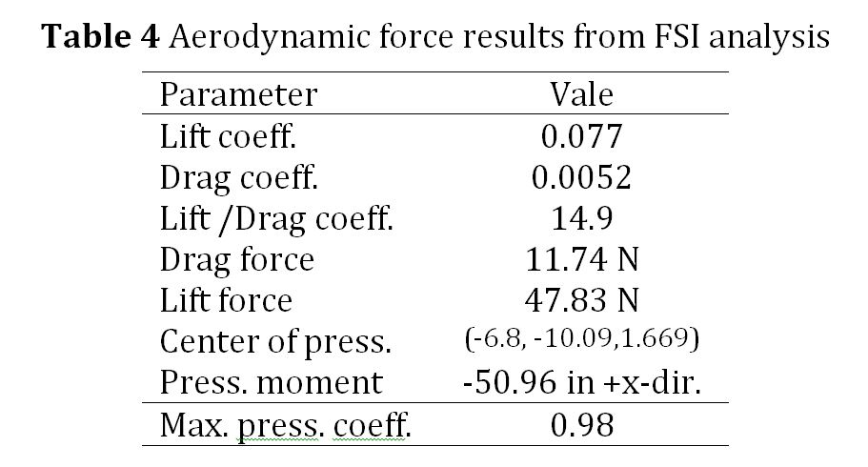
FSI Analysis

Slide 20
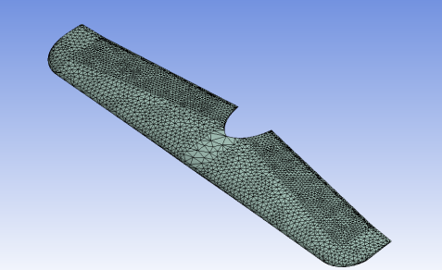
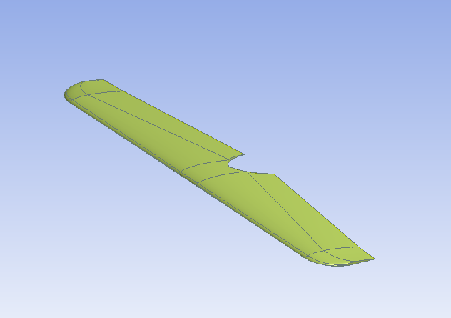
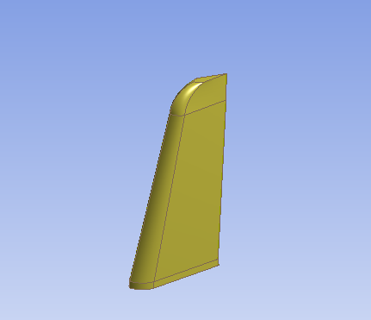
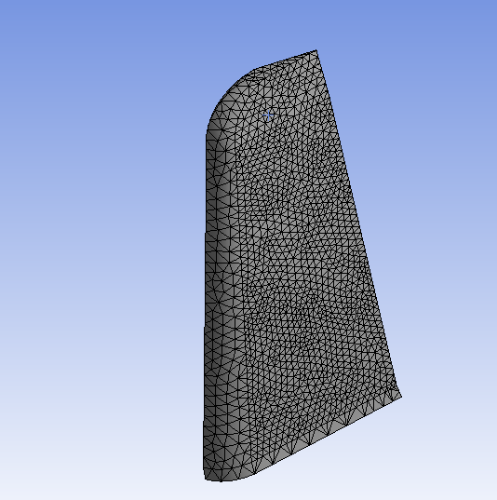
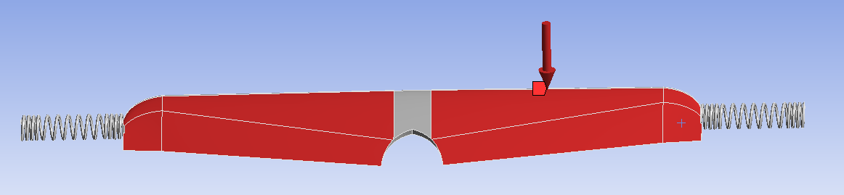
Flutter Analysis
Elevator
Mesh
17.5K Tet elements
Min. size 9 mm
Elevator Geometry
Geometry/Mesh
The pressure profile is transferred
from the CFD analysis of the
elevator with angle of attack
maintained at α=5°
Flutter Geometry
Rudder
Geometry
Rudder
Mesh
15,K Tets
Min. size
9 mm
Flutter Pressure Model

Slide 21
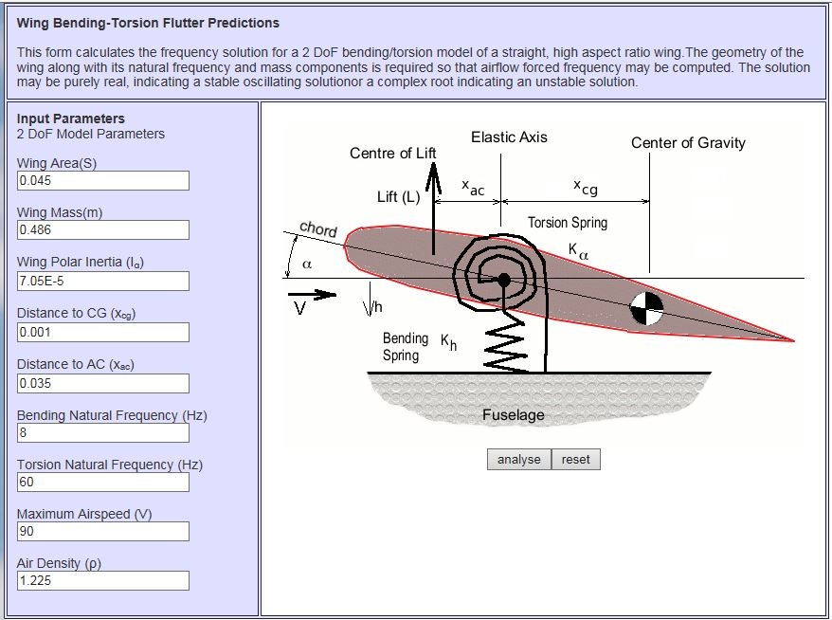
Flutter Analysis
Flutter Theory
cf. https://sites.google.com/site/aerodynamics4students/table-of-contents/aeroelasticity

Slide 22
Flutter Analysis
Flutter Theory

Slide 23
Flutter Analysis
Flutter Theory (continued)

Slide 24
Flutter Analysis
Analytic Flutter Analysis Wing Bending-Torsional Predictions software of The University of Sydney http://aerodynamics.aeromech.usyd.edu.au/
  Eccentricity, E = 0.001 m
  Mass of the Elevator, m = 0.149 kg
  Density of Air, ρ = 1.225 kg/m³
  Polar Moment of Inertia, J = 3.6E-5 kg/m²
  Axis Locations, A = -0.2
  Semi chord of the Elevator, B = 0.06 m
  Aerodynamic center, B/2 = 0.03
  Elastic axis from the leading edge, [(1+A) B] = 0.048 m
  Center of gravity (C.G.) from the leading edge, [(1+E)B] = 0.066
  Distance between aerodynamic center and elastic axis, X_{ac} = 0.012 m
  Distance between elastic axis and C.G., X_{cg} = 0.012 m
  Reduced frequency k = 0.2 (Fung (1969))

Slide 25
Flutter Analysis
Analytical Flutter Results for Elevator
Flutter Determinant, (Bislinghoff et al. (1962))
Critical flutter speed, m/s (Fung (1969))
Divergence speed, V = 32.7 m/sec
Eigenvalues for 1st and 2nd modes are plotted on next chart

Slide 26
Flutter Analysis
Frequency for vs. flutter speed 1st Mode
Frequency for vs. flutter speed 2nd Mode

Slide 27
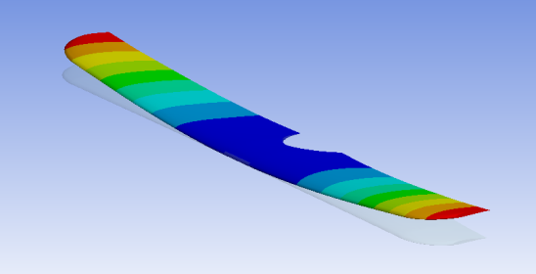
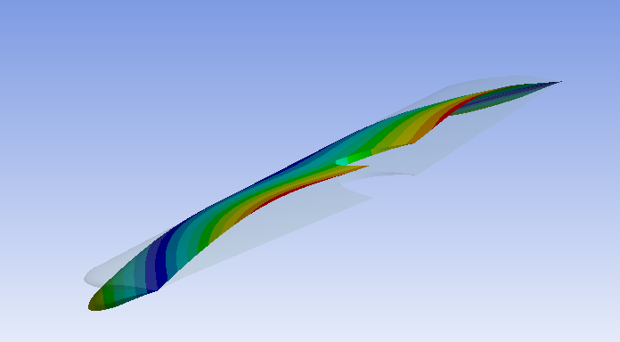
Flutter Analysis
ANSYS Results
Mode Shape for the elevator with bending frequency of 10 Hz
1st torsional Mode for Elevator with torsional frequency of 30 Hz

Slide 28
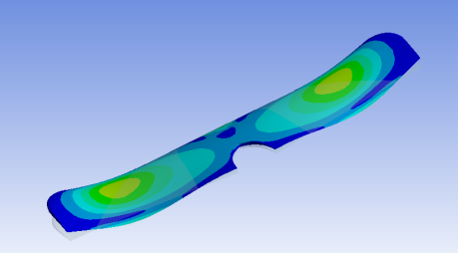
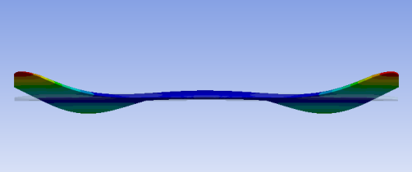
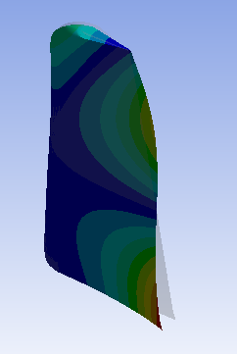
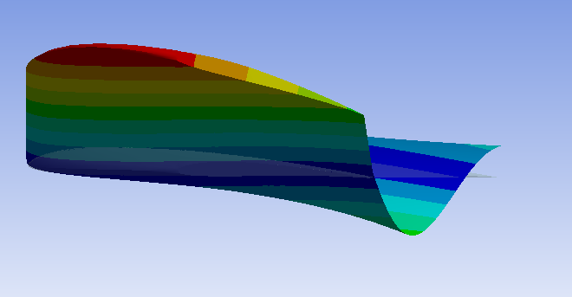
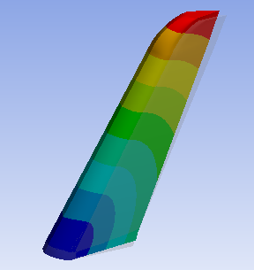
Flutter Analysis
Numerical flutter analysis equivalent stress contours
ANSYS Results
Numerical flutter of the elevator front view, bending and torsional frequencies 10 Hz and 30 Hz, respectively.
Numerical torsional mode for the rudder
bending and torsional modes for the rudder were 60 Hz and 110 Hz, respectively
Numerical bending frequency of the rudder,
critical speed = 75 m/sec,
divergence speed = 65 m/sec
Numerical flutter of the elevator side view, divergence speed = 32.7 m/sec.

Slide 29
Flutter Analysis Results Summary
Analytical flutter analysis is performed to verify the FEA results. The analytic flutter analysis gives the divergence speed to be 32.7 m/sec
The numerical flutter analysis of the rudder shows the bending and torsional modes for the rudder were 60 Hz and 110 Hz, respectively
The numerical flutter analysis of the rudder shows the maximum critical speed to be 75 m/sec and the divergence speed to be 65 m/sec

Slide 30
Conclusions
Free vibrations performed on UAV airfiol to obtain natural frequencies
Forced vibrations on UAV airfoil using differing configurations of embedded actuators in order to help define a control algorithm
FSI analysis performed of UAV airfoil in order to bound the interaction of the UAV with its environmental surroundings
Flutter Analysis perfromed on UAV elevator and rudder to understand possible failure modes
  Analytic and numeric flutter analysis is in quantitative agreement

Slide 31
Future Work
Fly UAV with instrumentation (accelerometers and strain gages) and correlate FEA model for Vibration and Flutter
Finalize design of embedded actuators (MEMS, Vortex shedders, etc.)

Slide 32
References
Textbooks
Fung, Y. 1969. An Introduction to the Theory of Aeroelasticity. New York: Dover Publications.
Bisplinghoff, Raymond, and Holt Ashley. 1962. Principles of Aeroelasticity. New York: Wiley
Peer Reviewed Journal Articles
K. Anderson, S. Singh, D. Edberg, and S. Dobbs, “Vibration analysis of an embedded actuator based UAV”, Journal of Vibration Analysis, Measurement, and Control, accepted for publication July 2015.
"Flutter study of a high-altitude UAV using ANSYS" by Sukwinder Singh, Kevin R. Anderson, Steven K. Dobbs, Donald Edberg submitted to International Journal of Structural Mechanics and Finite Elements, in review September, 2015.
Conference Proceedings
“Numerical and Theoretical Aeroelastic Flutter Analysis of a HALE UAV” by Kevin R. Anderson*, Sukwinder Singh*, Steve Dobbs**, and Don Edberg**, *Mechanical Engineering, **Aerospace Engineering, Cal Poly Pomona, accepted for presentation at 16th Intl. Conf. on Mechanical and Aerospace Engr. (ICMAE) Feb. 13, 2016, Convenient Grand Hotel, Bangkok, Thailand
“Fluid-Structure Interaction (FSI) & Flutter Analysis of a Solar Powered UAV” by Dr. Prof. Kevin R. Anderson, Mr. Nouh Anies, Ms. Shilpa Ravichandra, Mr. Sukhwinder Singh Sandhu, Mechanical Engineering, Non-linear FEA/CFD Multiphysics Simulation Lab, Prof. Steve Dobbs, Dr. Prof. Donald Edberg, Aerospace Engineering, Cal Poly Pomona abstract accepted to the 3rd Intl. Mech-Aero Conference, San Francisco, CA, USA, Oct. 2015, Track 3-5 Airship Design and Development – Design.
Vibration Analysis of a Solar Powered UAV” by Dr. Prof. Kevin R. Anderson, Mr. Nouh Anies, Ms. Shilpa Ravichandra, Mr. Sukhwinder Singh Sandhu, Mechanical Engineering, Non-linear FEA/CFD Multiphysics Simulation Lab, Prof. Steve Dobbs, Dr. Prof. Donald Edberg, Aerospace Engineering, Cal Poly Pomona, The 17th International Conference on Theoretical and Applied Mechanics (ICTAM), Los Angeles, CA, Sep. 28-29, 2015.
Webpages
https://sites.google.com/site/aerodynamics4students/table-of-contents (last accessed 10/3/15)

