Slide 1
Catalysis with High Density Molecular Monolayer
for Organic Transformation
Kenji Hara
Department od Applied Chemistry,
School of Engineering,
Tokyo University of Technology

Slide 2
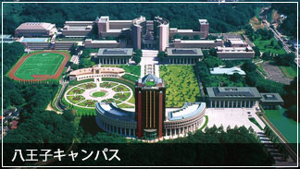
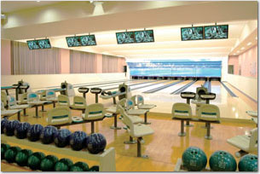
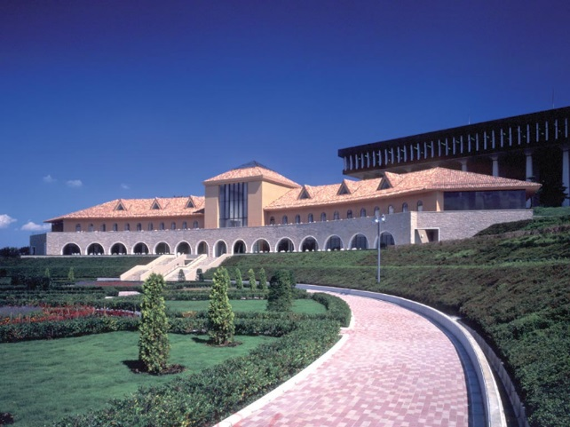
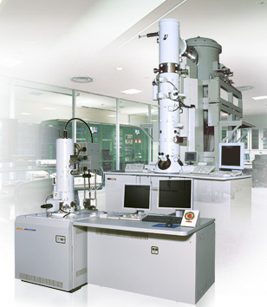
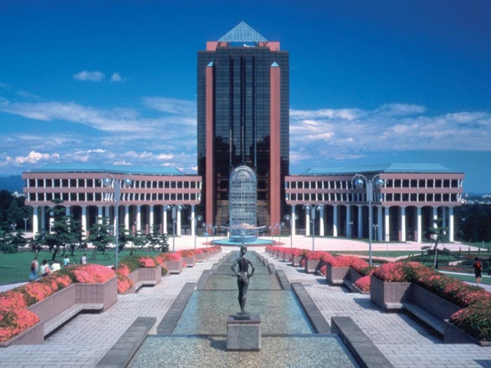
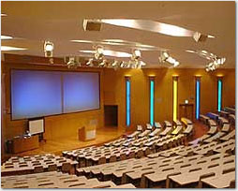
Notes:
Good afternoon, professors, Today, my defense topic is low temperature complete oxidation of ethylene and selective hydrogenation of phenylacetylene over supported Pt catalysts.

Slide 3
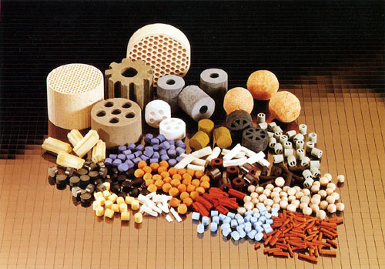
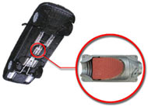
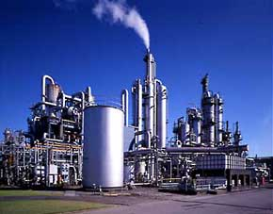
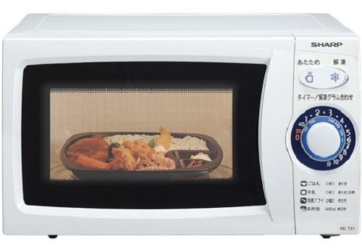
Catalysts in Our Daily Life
Automobile gas purification
（Elimination of NOx）
Petrochemical Plants
（From oil to gasoline, plastic, rubber etc. ）
Internal wall in microwave oven
（Decomposition of CO and bad smells）
3
Notes:
3
In contrast, catalyst has several advantages. Catalyst is not expensive and shows high activity. And we can apply a wide range of reaction conditions such as temperature, solvent, reactor, etc.

Slide 4
Formal Classification of Metal-Involving Catalyst
Homogeneous Catalyst
Heterogeneous Catalyst
· Designability
· Diversity
· Separation, Recovery
· Stability
Solid-Supported Catalyst
Mixed-Monolayer Catalyst
Monolayer Catalyst

Slide 5
Densely Packed Monolayer Catalysts on Flat Surface
Enhancement of catalyst turnover;
but not always due to their high densities.
LB film on glass
thiolate monolayer on Au
monolayer on SiO₂

Slide 6
Chem. Commun. 2007, 4280.
Chem. Lett. 2006, 35, 870.
Angew. Chem. Int. Ed. 2008,
47, 5627.
Chem. Commun. 2014, 50, 5046.

Slide 7
Self-Assembled Monolayer of Alkanethiol on Gold Surface
Self-Assembled Monolayer
(SAM)

Slide 8
Compact Phosphine
—Key Molecule for Unique Catalysis in Monolayer—
Newly-Designed Phosphine
Reported Metal-Phosphine
Monolayer on Au surface
Au
Angelici et al. Can. J. Chem.
2001, 79, 578.
Org. Lett. 2003, 5, 2671.

Slide 9
Catalytic Dehydrogenative Silylation of Alcohols
catalyst
[RhCl(C₂H₄)₂]₂
Au
5 x 5 mm²
(in CH₂Cl₂)
“Recyclable”
TON = 4,100
TON = 10,000
K. Hara et al. Angew. Chem. Int. Ed. 47, 2008, 5627.
“Deactivated”
TON = catalyst turnover number per Rh atom
Notes:
Here shows the effects of metal precursor in hydrosilylation reaction.
Rhodium chloride ethylene complex shows the best catalytic activity.
Monovalent rhodium complexes except for cation complex afford better catalytic activity than other rhodium species.

Slide 10
Catalytic Dehydrogenative Silylation of Alcohols
—Competitive Reaction between 1ﾟ vs 2ﾟ Alcohols—
catalyst
Au
(in CH₂Cl₂)
Au
Substrate/Catalyst
Yield (%)
1° selectivity (%)
86,000
67
>99.5
200
100
73
86,000
44
80
Notes:
Here shows the effects of metal precursor in hydrosilylation reaction.
Rhodium chloride ethylene complex shows the best catalytic activity.
Monovalent rhodium complexes except for cation complex afford better catalytic activity than other rhodium species.

Slide 11
Catalytic Dehydrogenative Silylation of Alcohols
—Competitive Reaction between 1ﾟ vs 2ﾟ Alcohols—
catalyst
Au
Catalyst Tunover Number
1° selectivity (%)
58,000
>99.5
46
98
Notes:
Here shows the effects of metal precursor in hydrosilylation reaction.
Rhodium chloride ethylene complex shows the best catalytic activity.
Monovalent rhodium complexes except for cation complex afford better catalytic activity than other rhodium species.

Slide 12
Homogeneous Catalyst
· Designability
· Diversity
Au
Monolayer Catalyst

Slide 13
Chem. Commun. 2007, 4280.
Chem. Lett. 2006, 35, 870.
Angew. Chem. Int. Ed. 2008,
47, 5627.
Chem. Commun. 2014, 50, 5046.

Slide 14
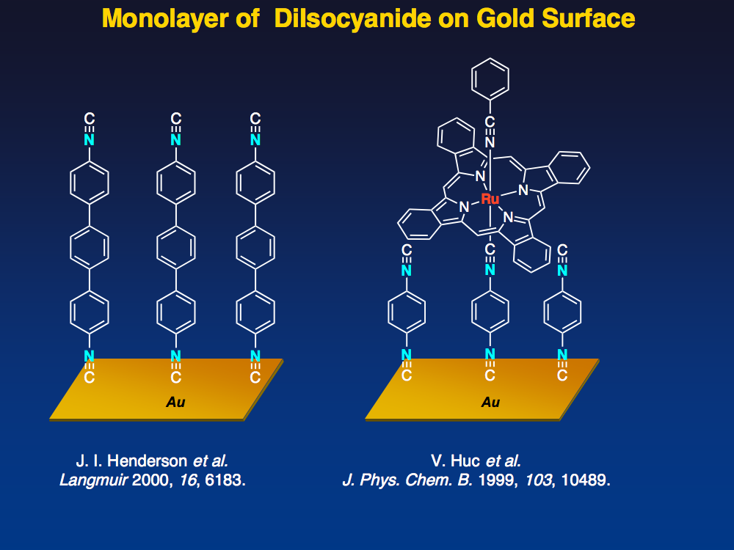

Slide 15
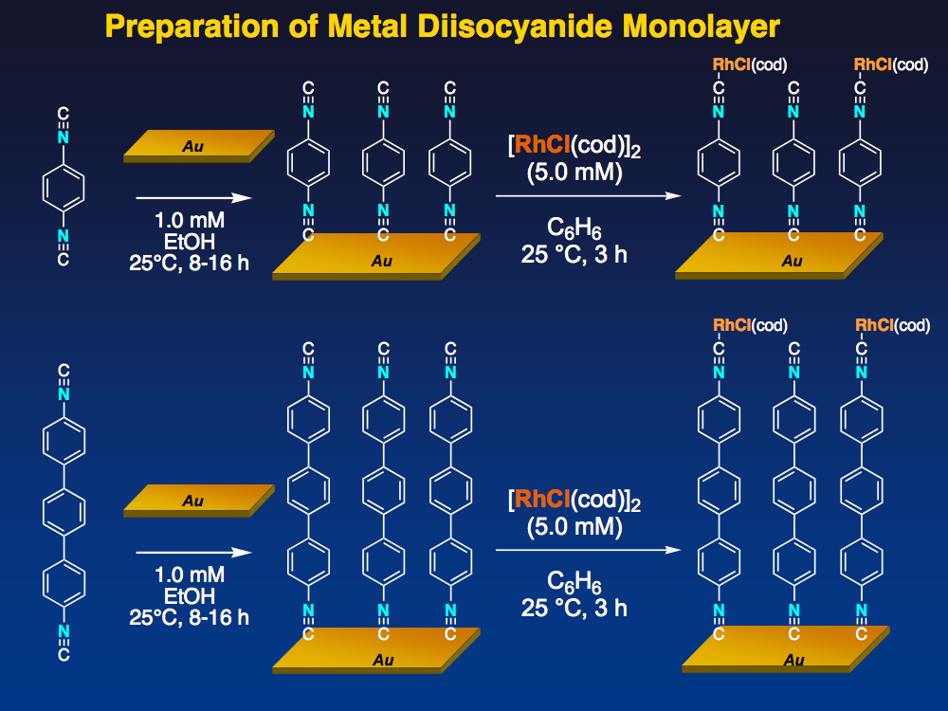

Slide 16
XPS and ICP-MS Analyses of Metal Diisocyanide Monolayer
N 1s Rh 3d 5/2 Cl 2p
Intensity (a.u.)
Binding energy (eV)
Intensity (a.u.)
Binding energy (eV)
The longer linker molecule, the more ordered structure.

Slide 17
Rh Complexiation with [RhCl(cod)]₂
top view
side view
About 50% complexation between Rh and CN
Density of isocyanide:
About 0.7 nmol/cm²
(4 × 10¹¹ cm⁻²)

Slide 18
Rh Complexiation with [RhCl(CO)₂]₂
Rh density (ICP-MS)
0.66 nmol/cm²
(4.0 × 10¹¹ cm⁻²)
top view
N : Rh : Cl = 2.0 : 1.3 : 1.6
side view
About 100% complexation between Rh and CN
Density of isocyanide:
About 0.7 nmol/cm²
(4 × 10¹¹ cm⁻²)

Slide 19
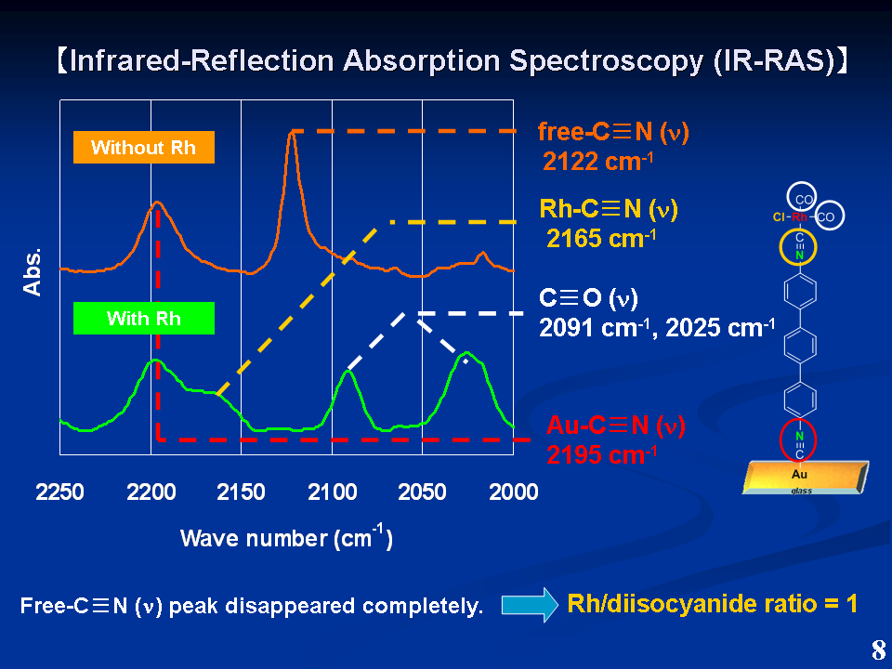

Slide 20
C=C Hydrogenation of α,β-Carbonyl Compounds
enone / Rh
= 72,000
Catalyst
[RhCl(CO)₂]
Au
Au
Time (h)
Conversion (%)
Selectivity (%)
(c-hexanone)
12
0
--
12
100
97
12
100
57
2
32
87
12
45
35
20
20
Chem. Commun. 2014, 50, 5046.

Slide 21
C=C Hydrogenation of α,β-Carbonyl Compounds
Conversion (%)
Selectivity (%)
100
100
100
100
100
100
100
100
100
100
69
98
69
91
Chem. Commun. 2014, 50, 5046.

Slide 22
Chem. Commun. 2007, 4280.
Chem. Lett. 2006, 35, 870.
Angew. Chem. Int. Ed. 2008,
47, 5627.
Chem. Commun. 2014, 50, 5046.

Slide 23
Homogeneous Catalyst
Heterogeneous Catalyst
· Designability
· Diversity
· Separation, Recovery
· Stability
Mixed-Monolayer Catalyst
Monolayer Catalyst

Slide 24
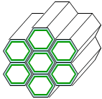
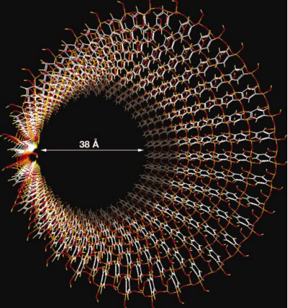

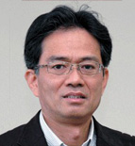
Periodic Mesoporous Organosilica (PMO)
S. Inagaki et al.,
Nature, 416, 304 (2002).
Uniform mesopore (2-30 nm) consisting of crystal-like
ordered arrays of organic
moiety bridged by
siloxane bond
S. Inagaki et al., Angew. Chem. Int. Ed. 50, 11667 (2011).
Dr. Shinji Inagaki

Slide 25
SEM/TEM Images of BPy-incorporated PMO
J. Am. Chem. Soc., 2014, 136, 4003.

Slide 26
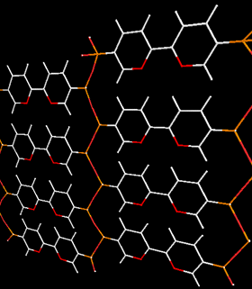
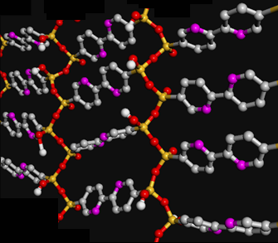
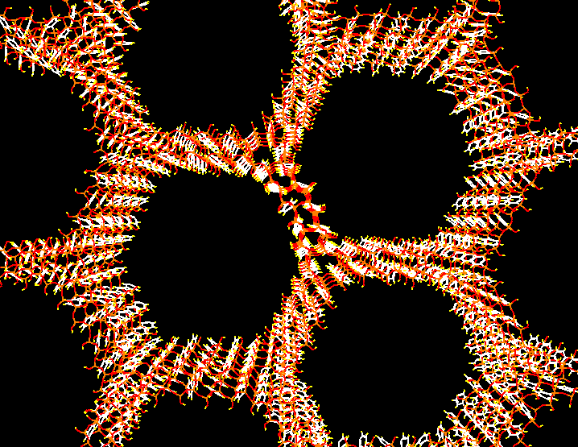
Structure of BPy-incorporated PMO
2,2’-bipyridine units are densely arranged in mesopore channel.
Si-O-Si
2,2’-Bipyridine
BPy-PMO
0.44 nm
3.8 nm
1.16 nm
J. Am. Chem. Soc., 2014, 136, 4003.

Slide 27
ビピリジンを骨格とするPMOを芳香族C-Hボリル化に活用
Catalytic Aromatic Borylation by Ir-immobilized PMO
80℃, 12 h
Waki, M.; Maegawa, Y.; Hara, K.; Goto, Y.; Shirai, S.; Yamada, Y.; Mizoshita, N.; Tani, T.; Chun, W.-J.; Muratsugu, S.; Tada, M.; Fukuoka, A.; Inagaki, S.
J. Am. Chem. Soc., 2014, 136, 4003.

Slide 28
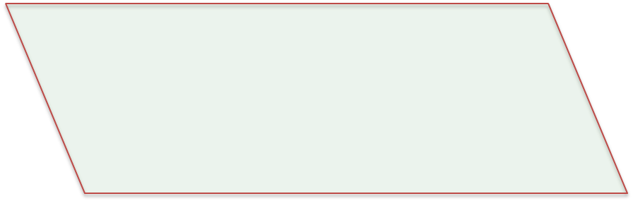

Immobilization of Ru Complex on PMO
(Ru/surface bpy = 1 )
BPy-PMO
THF
reflux, 3 h
S. Inagaki et al., J. Am. Chem. Soc.,136, 4003(2014).
Ru:15 mol%
(per surface bpy
from EDX)
0.30 mmol g⁻¹ (3.0 wt%)
Ru-BPy-PMO
Notes:
5:18:71

Slide 29
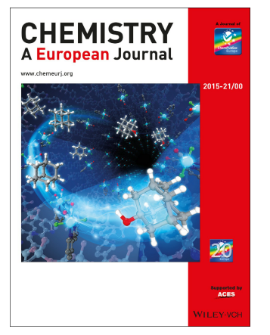
Selective Alkane Oxidation
Catalyzed by Ru-immobilized PMO
Chem. Eur. J., 2015, 21, 15453. (Cover Page)

Slide 30
Selective Alkane C-H Bond Oxidation
① Selective oxidation of tertiary C-H bond
of adamantane
Ru-BPy-PMO
Pharmaceutical intermediate
Fine chemicals for functional materials
② Stereoselective oxidation C-H bond
of cis-decalin
Ru-BPy-PMO
Applicable for selective oxidation of steroids
Notes:
9:04:86

Slide 31
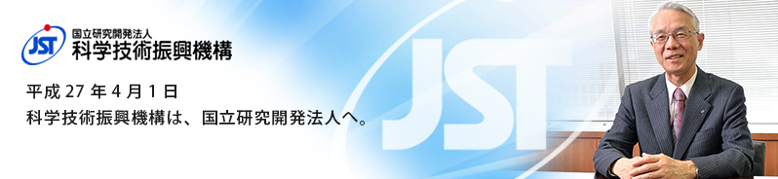

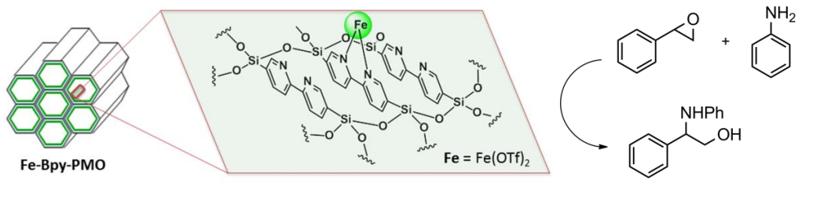
Fe-immobilized Periodic Mesoporous Organosilica
in Catalytic Synthesis of Amino Alcohols
Pushkar Shejwalker^{1,2}, Kenji Hara^{1,2}*, Yoshifumi Maegawa³,
Shinji Inagaki^{2,3}
¹ Department od Applied Chemistry, School of Engineering,
Tokyo University of Technology
² JST/ACT-C
³ Toyota Central R&D Labs. Inc.
*haraknj@stf.teu.ac.jp
Notes:
Good afternoon, professors, Today, my defense topic is low temperature complete oxidation of ethylene and selective hydrogenation of phenylacetylene over supported Pt catalysts.

Slide 32
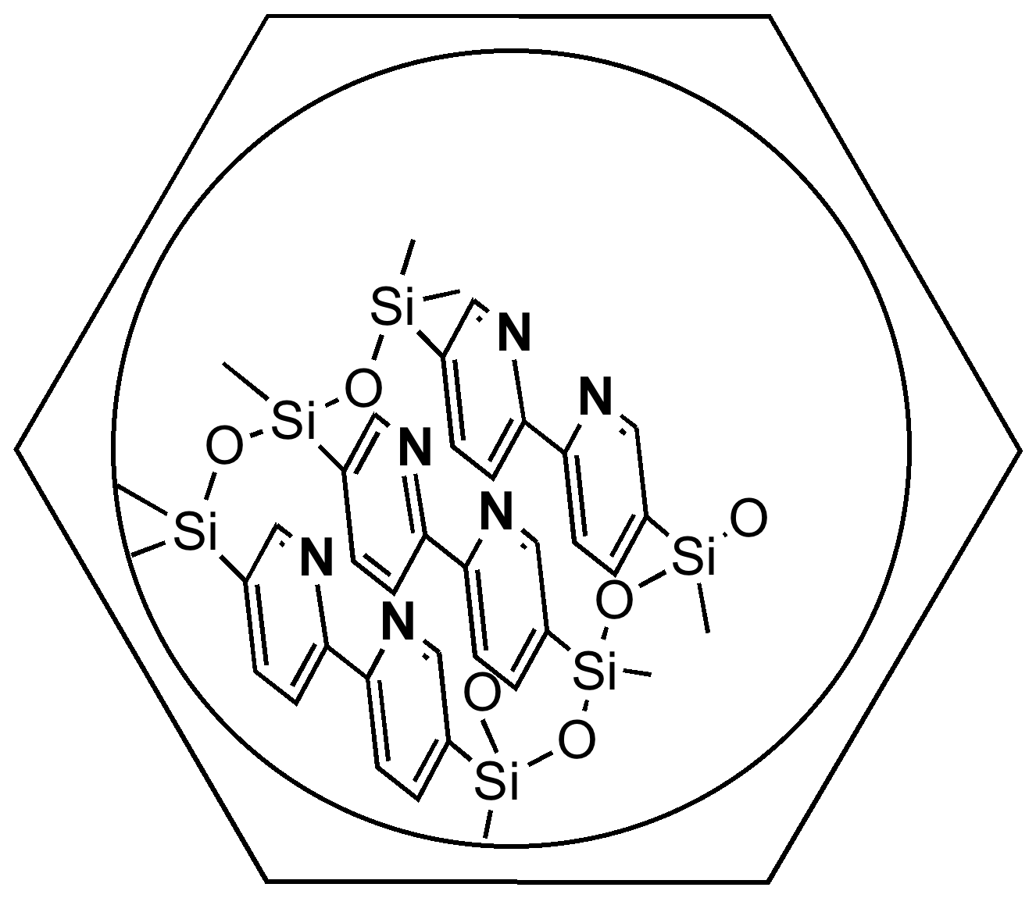
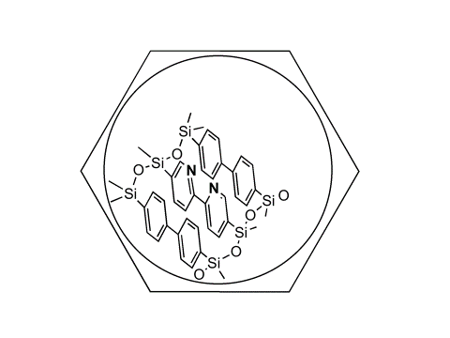
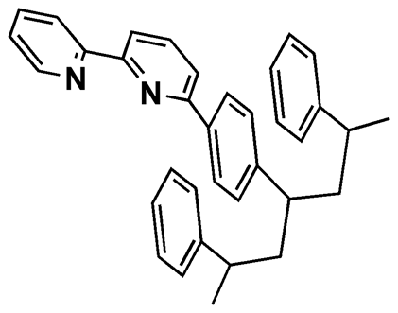
Amino Alcohol Synthesis
Catalyzed by Fe-immobilized PMO
Catalyst | mol% | Time (h) | Yield (%)
Fe(OTf)₂ | 5.0 | 18 | 0 (+byproducts)
Fe(bpy)₃Cl₂ | 5.0 | 18 | 0
FeCl₂(dmBPy) | 2.2 | 4 | <1
FeCl₂(TriIsoPhBPy) | 2.2 | 4 | 19
Fe(OTf)₂+TriIsoPhBPy | 2.2 | 4 | <1 (+byproducts)
FeCl₂BPy-PMO | 8.9 | 4 | 36
Fe(OTf)₂BPy-PMO | 4.0 | 4 | 89
Fe(OTf)₂BPBPy-PMO | 4.0 | 4 | 59
Fe(OTf)₂BPy-PS | 4.0 | 4 | 9
BPy-PMO
dmBPy
TriIsoPhBPy
BPBPy-PMO
Fe-immobilization on the PMO mesopore acilitates epoxide opening with aniline.
BPy-PS

Slide 33
Possible Mechanism of Catalysis with Fe-immobilized PMO
Concerted activation with Lewis acid site on Fe and the neighboring Bronsted acid sites on pyridinium
Proton transfer
on pyridine
Proton transfer over pyridine arrays

Slide 34
Homogeneous Catalyst
Heterogeneous Catalyst
· Designability
· Diversity
· Separation, Recovery
· Stability
Mixed-Monolayer Catalyst
Monolayer Catalyst

Slide 35
Thiol to Isocyanide
Metal-Phosphine Terminated Thiolate
Metal- Diisocyanide

Slide 36
Periodic Mesoporous Organosilica (PMO)
S. Inagaki et al.,
Nature, 416, 304 (2002).
Uniform mesopore (2-30 nm) consisting of crystal-like
ordered arrays of organic
moiety bridged by
siloxane bond
S. Inagaki et al., Angew. Chem. Int. Ed. 50, 11667 (2011).
Dr. Shinji Inagaki

Slide 37
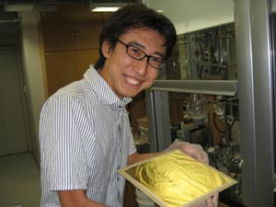
Collaborators & Acknowledgment
Prof. Masaya Sawamura
Dr. Ryuto Akiyama
Ms. Yuriko Ishiguro
Collaboration
Prof. Kohei Uosaki
Dr. Toshihiro Kondo
Dr. Satoru Takakusagi
Dr. Takuya Masuda
XAFS
Prof. Kiyotaka Asakura
Prof. W. J. Chun
XPS
Prof. Katsuaki Shimazu
Dr. YusukeYoshinaga
Prof. W. J. Chun

Slide 38
Collaborators & Acknowledgment
Prof. Atsushi Fukuoka
Dr. Sachin Jagtap
Mr. Yoshinori Kaji
Mr. Kotaro Namba
Au Surface
XAFS
Prof. Kohei Uosaki
Dr. Hidenori Noguchi
Prof. Katsuaki Shimazu
Dr. Toshikazu Kawaguchi
Prof. Kiyotaka Asakura
Prof. W. J. Chun
HREELS
Prof. Maki Kawai
Dr. Hiroyuki Kato

Slide 39
Ru-Immobilized Periodic Mesoporous Organosilica as Selective Catalyst in Alkane Oxidation
Kenji Hara^{1,2,3,4}*, Nobuhiro Ishito², Yoshifumi Maegawa^{4,5},
Shinji Inagaki^{4,5} and Atsushi Fukuoka^{2,3}
¹ School of Engineering, Tokyo University of Technology
² Catalysis Research Center, Hokkaido University
³ Graduate School of Chemical Sciences and Engineering, Hokkaido University
⁴ JST/ACT-C
⁵ Toyota Central R&D Labs. Inc.
Notes:
Good afternoon, professors, Today, my defense topic is low temperature complete oxidation of ethylene and selective hydrogenation of phenylacetylene over supported Pt catalysts.

Slide 40
Fe-immobilized Periodic Mesoporous Organosilica
in Catalytic Synthesis of Amino Alcohols
Pushkar Shejwalker^{1,2}, Kenji Hara^{1,2}*, Yoshifumi Maegawa³,
Shinji Inagaki^{2,3}
¹ Department od Applied Chemistry, School of Engineering,
Tokyo University of Technology
² JST/ACT-C
³ Toyota Central R&D Labs. Inc.
*haraknj@stf.teu.ac.jp
Notes:
Good afternoon, professors, Today, my defense topic is low temperature complete oxidation of ethylene and selective hydrogenation of phenylacetylene over supported Pt catalysts.

Slide 41
Catalysis with High Density Molecular Monolayer
for Organic Transformation
Kenji Hara
Department od Applied Chemistry,
School of Engineering,
Tokyo University of Technology

