Slide 1
Linking Tissue Microarchitectures to Rationalized Molecular Diagnostics in Glandular Cancers
Kelvin K. Tsai , M.D., Ph.D.
Laboratory for Tumor Epigenetics and Stemness (TES Lab)
NATIONAL INSTITUTE OF CANCER RESEARCH
NATIONAL HEALTH RESEARCH INSTITUTES (NHRI), TAIWAN

Slide 2
Problems with current molecular diagnostics
Oncotype DX®: Knowledge-based but biased toward preselected markers
MammaPrint® or PAM50: Computation-derived; not directly linked to tumor biology or pathways (cancer stemness, differentiation, etc.)
None of them can guide the use of targeted therapeutics.

Slide 3
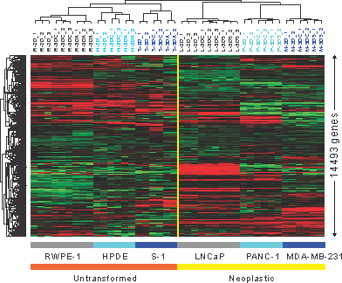
Modeling stem cells differentiation into tissue microarchitectures
Structure
Cell clusters
Acini/ducts
Normal
Structure differentiation
Cell clusters
Tumor spheroids
Neoplastic
Cell-cell interaction
HPDE (pancreatic ductal)
RWPE-1 (prostatic glands)
S-1 (mammary glands)
PANC-1 (pancreatic cancer)
LNCaP (prostate cancer)
MDA-MB-231 (breast cancer)
The TES Lab, National Health Research Institutes

Slide 4
Recapitulating tubular differentiation of pancreatic stem cells
Gastroenterology 2013;145:1110

Slide 5
Molecular profiling of pancreatic tubular differentiation
*panSC: pancreatic stem cells; panCSCs: pancreatic cancer stem cells
*HPDE, human pancreatic ductal epithelial cells; *DEG, differentially expressed genes
Gastroenterology 2013;145:1110

Slide 6
A tubulogenesis-specific prognostic signature in pancreatic cancer
*PDAC, pancreatic ductal adenocarcinoma
*RS, Risk Score for poor survival
Gastroenterology 2013;145:1110

Slide 7
The PanGUIDE genes
Cancer stemness
ASPM
Undisclosed stem cell marker
Reference
RPL13A
GAPDH
To be chosen by data set testing
Differentiation
ATP9A
ACOX3
CDC45L
SLC40A1
AGR2
USPTO No. 61/824,679; PCT/US2014/38504

Slide 8
Survival prediction by the PanGUIDE assay
 | Patient 1 | Patient 2 | Patient 3 | Patient 4
Risk Score | -2.900 | -0.774 | -0.042 | 5.177
Expected survival (year) | 3.086 | 1.730 | 1.347 | 0.263
Observed survival (year) | 3.841 | 1.730 | 1.292 | 0.178
Likelihood of survival beyond 1 year | 90.4% | 70.8% | 59.0% | < 0.1%
Survival beyond 1 year | Yes | Yes | Yes | No
*Overall survival and one-year survival rate of selected patients in the UCSF cohort as predicted by the PanGUIDE.
USPTO No. 61/824,679; PCT/US2014/38504

Slide 9
Prognostic accuracy of the PanGUIDE
 | Accuracy | 95% CI | P value
University of California, San Francisco cohort
Clinico-pathological criteria | 80.2% | 72.0%-88.4%
PanGUIDE | 95.0% | 89.6%-100.0% | 0.001
62-gene PDAssigner | 80.5% | 69.2%-91.9% | 0.477
6-gene metastasis signature | 57.3% | 40.2%-74.4% | 0.993
Johns Hopkins Medical Institutions cohort
Clinico-pathological criteria | 57.4% | 49.1%-65.6%
PanGUIDE | 83.3% | 66.3%-100.0% | 0.002
62-gene PDAssigner | 58.6% | 44.8%-72.4% | 0.431
6-gene metastasis signature | 68.4% | 56.9%-79.8% | 0.084
Northwestern Memorial Hospital cohort
Clinico-pathological criteria | 67.2% | 57.4%-77.1%
PanGUIDE | 81.2% | 67.8%-94.6% | 0.032
62-gene PDAssigner | 68.6% | 58.8%-78.4% | 0.410
6-gene metastasis signature | 64.0% | 53.8%-74.3% | 0.678
Gastroenterology 2013; Nat Med 2011; PLoS Med 2010

Slide 10
ASPM as a poor prognostic marker in PDAC
Gastroenterology 2013;145:1110

Slide 11
ASPM bolsters Wnt activity by stabilizing the dishevelled proteins
Gastroenterology 2013;145:1110

Slide 12
ASPM maintains pancreatic cancer stemness
Gastroenterology 2013;145:1110

Slide 13
ASPM contributes to pancreatic cancer aggressiveness
Gastroenterology 2013;145:1110

Slide 14
Summary of the PanGUIDE assay
A 7-gene prognostic signature the PanGUIDE in pancreatic cancer.
Stemness- and differentiation-associated; highly accurate
Applicable to patients with localized or metastatic pancreatic cancer due to shared tumor biology.
Detected on fresh frozen or FFPE samples.
Multiplex qPCR, RNA-seq or NanoString
Outputs: 1. Standardized Risk Score 2. Overall survival 3. Yearly survival rate

Slide 15
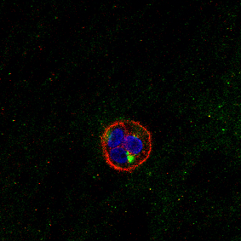
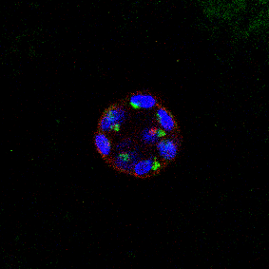
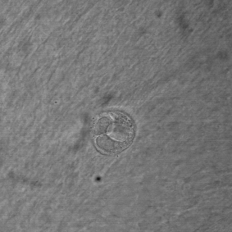
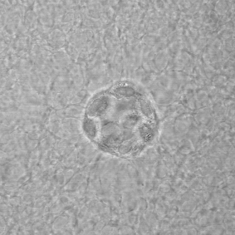
Structural and functional differentiation of prostatic glands ex vivo
Aggregates
Acini
α 6-integrin
GM130
Hoechst
Am J Pathol 2013;182:363

Slide 16
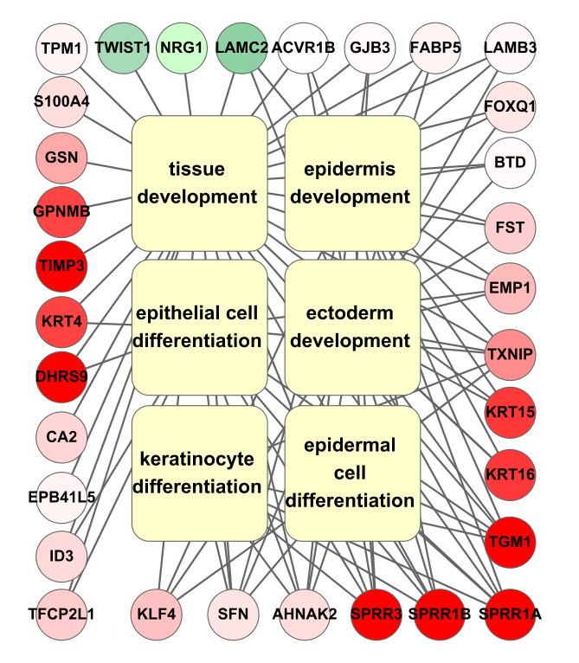
Transcriptional alterations specific to prostate acinar differentiation
Am J Pathol 2013;182:363

Slide 17
A tissue microarchitecture-specific prognostic signature of prostate cancer
RS: relapse score
HR: hazard ratio for post-OP relapse
BWH: Brigham and Woman’s Hospital
SU: Stanford University
KI: Karolinska Institute
JHU: Johns Hopkins University
Am J Pathol 2013;182:363

Slide 18
PDCD4, KLF6 and ABCG1 as differentiation- specific prognostic markers in prostate cancer
Am J Pathol 2013;182:363

Slide 19
ProsGUIDE: a 3-gene prognostic signature in prostate cancer
Am J Pathol 2013;182:363

Slide 20
Prediction accuracy of the ProsGUIDE
 | Accuracy | 95% CI | P value for C-index | P value vs. clinical
The Brigham and Women’s Hospital cohort
Clinico-pathologic criteria* | 61.7% | 42.8-80.6% | 0.113
ProsGUIDE | 93.9% | 86.2-100.0% | < 0.001 | 0.002
The Chimei Foundational Medical Center cohort
Clinico-pathologic criteria* | 69.5% | 53.7-85.4% | 0.0079
ProsGUIDE | 95.1% | 85.9-100.0% | < 0.0001 | 0.001
*Includes age, stage, PSA, and Gleason score.
Am J Pathol 2013;182:363

Slide 21
Survival prediction by the ProsGUIDE assay
 | Patient 1 | Patient 2 | Patient 3 | Patient 4
Recurrence score by ProsGUIDE | 4.645 | 3.546 | -1.132 | -2.216
Predicted recurrence-free survival (years) | 0.31 | 0.52 | > 4.61 | > 4.61
Observed recurrence-free survival (years) | 0.31 | 1.13 | 3.85 | 5.55
Predicted 3-year recurrence rate | 96.6% | 80.2% | 6.8% | 3.3%
Observed recurrence before 3 years | Yes | Yes | No | No
Three-year recurrence rates and recurrence-free survival of selected patients in the Brigham and Women’s Hospital cohort as predicted by ProsGUIDE.
US 13/853,548; PCT/US13/34411

Slide 22
Summary of the ProsGUIDE assay
A 3-gene prognostic signature for prostate cancer
Differentiation-specific; highly accurate
Applicable to patients with localized or metastatic prostate cancer due to shared tumor biology.
Fresh frozen or FFPE samples
Multiplex qPCR, RNA-seq, NanoString or IHC
Output: 1. Standardized Risk Score 2. Recurrence-free survival 3. Yearly recurrence rate

Slide 23
Clinical utility of PanGUIDE and ProsGUIDE
Provides an individualized and accurate risk assessments that supersede clinico-pathologic criteria.
Selects patients with early disease relapse or mortality for more aggressive neoadjuvant or adjuvant therapy.
Guides clinical decision-making and patient-tailored treatment plans.
Potentially improves the treatment outcome and/or the successful rate of clinical trials.

Slide 24
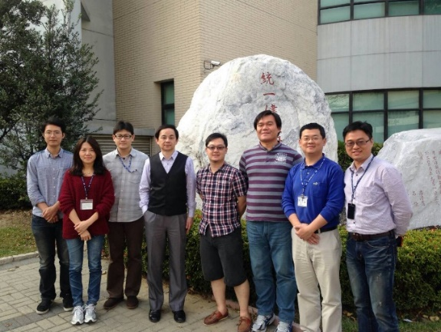
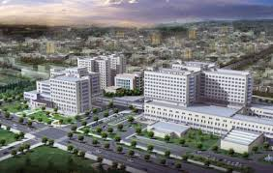
Acknowledgement
The TES Lab, NHRI
Prof. Valerie M. Weaver
Center for bioengineering and tissue regeneration, UCSF (3D culture models)
Dr. Yan-Shen Shan, NCKUH (pancreatic cancer specimen and clinical data), Prof. Chi-Rong Li, Chung Shan Medical U (bioinformatics, statistics)
http://teslab.nhri.org.tw/
Funding sources:
National Health Research Institutes
Department of Health, Taiwan
Ministry of Science and Technology
Contact: Dr. Kelvin K. Tsai (tsaik@nhri.org.tw)
Notes:
24

