Slide 1
Stress Response to Surgery Under General Anesthesia in Type 2 Diabetic Patient
Dr Kawsar Sardar, MD
Associate professor
Department of Anesthesiology, BIRDEM, Bangladesh
Joint secretary, Bangladesh Society of Anesthesiologists

Slide 2
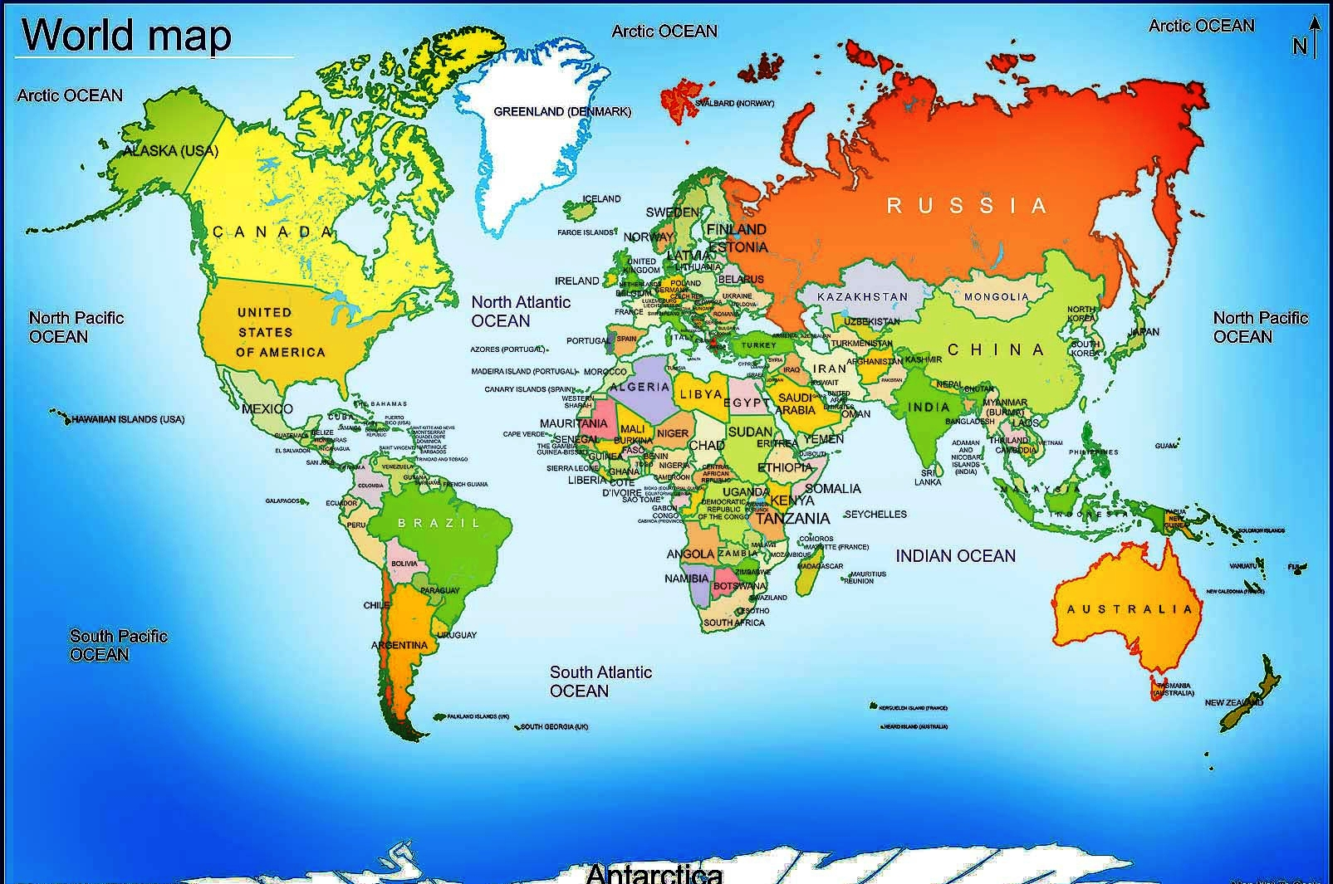
BANGLADESH

Slide 3
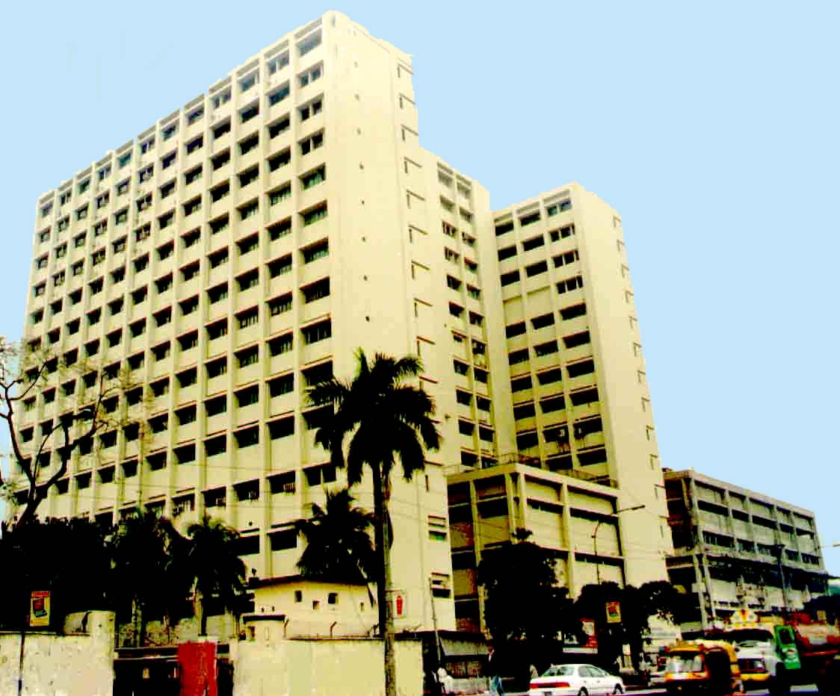
Bangladesh Institute of Research & Rehabilitation in Diabetes, Endocrine and Metabolic Disorders (BIRDEM)
Central Location
700-bed multidisciplinary hospital
Very large OPD (4500 patients /day)
60-70 diabetic patients under went operative procedure everyday
WHO Collaborating Centre for Research on Diabetes and its complications (Till 2014)

Slide 4
Uniqueness of BADAS
One of Largest diabetes care provider in the world
One of Largest non-profit health care network outside Govt. in the world
Provide healthcare through a network of hospitals & educational institutions of its own

Slide 5
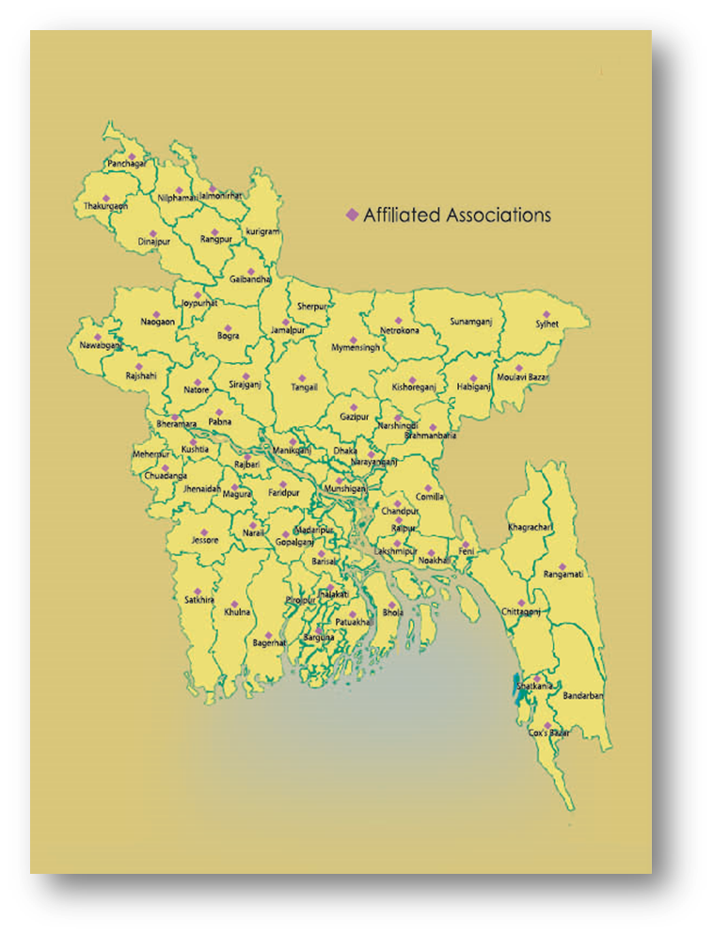
Our network all over the country

Slide 6
Diabetes Mellitus
One of the major chronic diseases affecting mankind all over the world
It has been declared as an epidemic in developing countries by both the World Health Organization and International Diabetes Federation

Slide 7
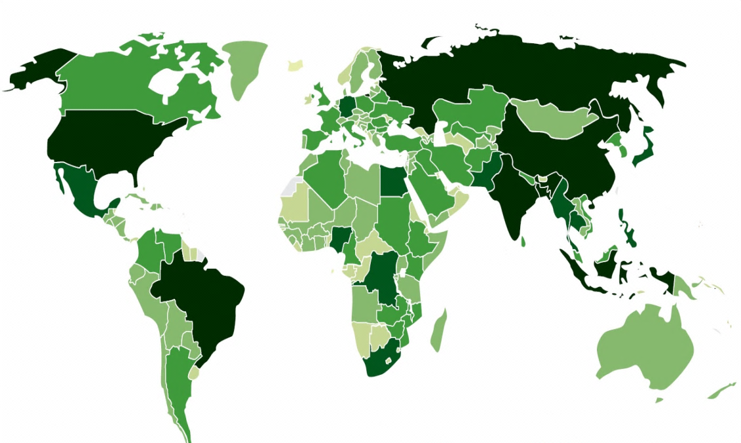
Diabetes – Global Epidemic
Killer Facts:
More than 382 million (8.3%) people live with diabetes – by 2035 will be 592 (9.9%) million
80% live in low- and middle-income countries (LMCs)
4.6 million deaths each year
Every 8 seconds, someone in the world dies from diabetes
HIGHEST ABSOLUTE NUMBERS
CHINA 90 million ●
INDIA 61 million ●
HIGHEST PREVALENCES RATE
● MIDDLE EAST 1 in 5 adults
HIGHEST REGIONAL INCREASE BETWEEN 2011 - 2030
● AFRICA – 90% increase
Diabetes Atlas

Slide 8
Diabetes in Bangladesh
The estimated prevalence of diabetes in Bangladesh is around 6.8%
Mostly Type 2 diabetes (99%)
Notes:
which is similar to the average prevalence in many other countries.

Slide 9
Fifty percent of all diabetic patients present for surgery during their life time

Slide 10
Inevitably, diabetic patients presenting for incidental surgery, or surgery related to their disease, will place an increasing burden on anesthetic services

Slide 11
Perioperative morbidity and mortality are greater in diabetic than in nondiabetic patients

Slide 12
In response to stress during surgery and anesthesia- the biochemical parameters like stress hormone being altered

Slide 13
The neuroendocrine system comes into play to maintain fuel requirements by glycogenolysis and gluconeogenesis through stress hormones catecholamines, glucagon, cortisol, and growth hormone

Slide 14
The endocrine hormones like cortisol, thyroxin, glucagon, and growth hormone are released due to surgical stress under hypothalamopituitary control

Slide 15
Surgery elicits a stress response that is directly proportional to the degree of tissue trauma

Slide 16
Why Stress response to surgery under anesthesia is complicated in diabetic patients?
Insulin deficiency
Counter regulatory hormones activity
Autonomic neuropathy
Electrolytes transport
Preoperative fasting states
Dehydration

Slide 17
These lead to abnormal metabolism of carbohydrate, protein and fat as well as electrolyte imbalance

Slide 18
Anesthesia also principally affects glucose metabolism through the modulation of sympathetic tone

Slide 19
Our study
It was designed to explore the metabolic and stress response to lower abdominal surgery under general anesthesia in type 2 diabetic subjects with particular focus on
Serum glucose
C-peptide
Cortisol
Electrolytes
It also investigated the stress response in different treatment variability

Slide 20
OBJECTIVES
To investigate the glycemic response to surgery in type 2 diabetic subjects under general anesthesia.
To investigate the serum cortisol response to surgery in type 2 diabetic subjects under general anesthesia.

Slide 21
OBJECTIVES
To investigate the stress response in insulin and combined insulin-OHA treated type 2 diabetic subjects during surgery under general anesthesia.
To investigate the stress response in hypertensive and normotensive type 2 diabetic subjects during surgery under general anesthesia.

Slide 22
Study design
The study was a cross sectional prospective study

Slide 23
Study subjects
100 subjects who were admitted in BIRDEM hospital in fit physical condition (ASA Class II) were received total abdominal hysterectomy under general anesthesia

Slide 24
Exclusion criteria
Influencing variable like patients taking steroid or analgesics
Pre operative plasma glucose <5 mmol/l and >10 mmol /l
Patients of ASA Class III, IV, V and E
Obese and malnourish

Slide 25
Design of general anesthesia
Induction: Thiopental, fentanyl, vecuronium
Maintenance: Halothane, nitrous oxide with oxygen

Slide 26
Sample collection
Three samples (8-10 ml) were collected
The first sample- just before anesthesia
2nd sample- 10 minutes after incision
3rd sample- 10 minutes after extubation

Slide 27
Control
First sample of each subject were served as a control

Slide 28
Analytical methods
Plasma glucose was measured by glucose oxidase method (Randox, UK).
Serum electrolytes were measured by Dry Chemistry method (DT-60, USA).
Serum C-peptide was measured by chemiluminescent immunoassay (Immulite, USA).
Serum cortisol was measured by chemiluminescent immunoassay (Immulite, USA).

Slide 29
STATISTICAL ANALYSIS
Statistical analysis was performed using SPSS (Statistical Package for Social Science) software for Windows version 17 (SPSS Inc., Chicago, Illinois, USA).

Slide 30
RESULTS AND OBSERVATIONS

Slide 31
*
Figure: Perioperative glycemic and insulinemic status of the study subjects

Slide 32
*
Figure: Perioperative serum cortisol status of the study subjects

Slide 33
Figure: Perioperative serum electrolytes level of the study subjects

Slide 34
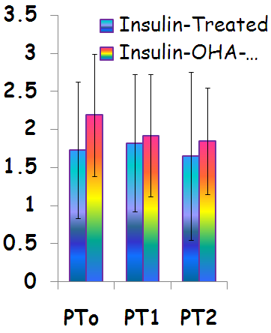
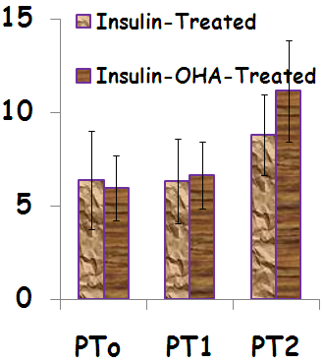
*
*
C-Peptide (ng/ml)
Serum Glucose (mmol/L)
*
Figure: Perioperative glycemic and insulinemic status of insulin and insulin-OHA treated subjects

Slide 35
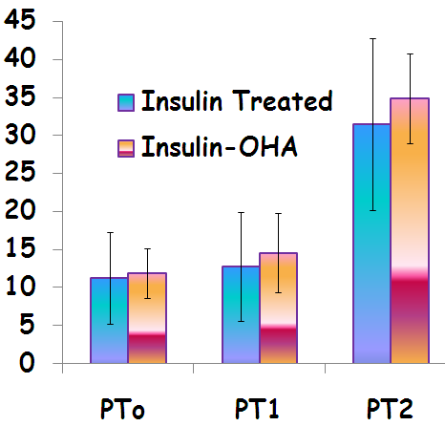
*
*
Serum Cortisol (ng/ml)
Figure: Perioperative serum cortisol status of insulin and insulin-OHA treated subjects

Slide 36
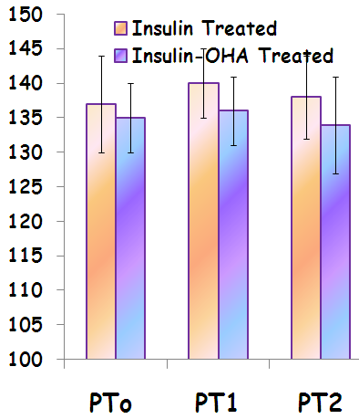
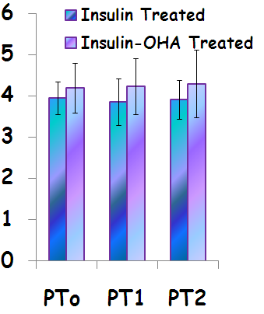
Serum Na⁺ (mmol/l)
Serum K⁺ (mmol/l)
Figure: Perioperative serum electrolytes status of insulin and insulin-OHA treated subjects

Slide 37
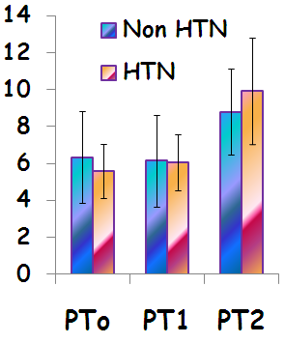
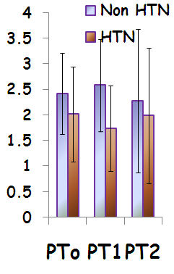
*
*
Serum Glucose (mmol/l)
Serum C-Peptide (ng/ml)
Figure: Perioperative glycemic and insulinemic status of hypertensive and normotensive study subjects

Slide 38
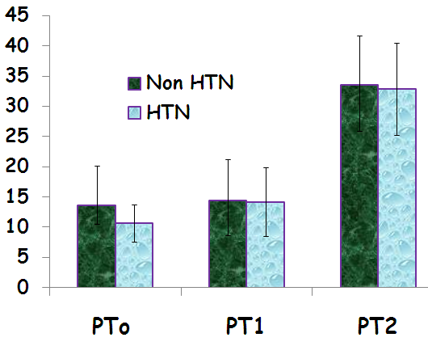
*
*
Serum Cortisol (ng/ml)
*
Figure: Perioperative serum cortisol status of hypertensive and normotensive study subjects

Slide 39
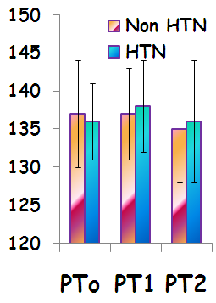
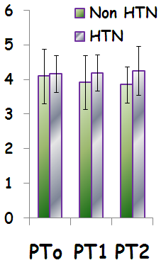
Serum Na⁺ (mmol/l)
Serum K⁺ (mmol/l)
Figure: Perioperative serum electrolytes status of hypertensive and normotensive study subjects

Slide 40
The data lead to following conclusions
1. Lower abdominal surgery under general anesthesia in well controlled type 2 diabetic subjects is accompanied by a hyperglycemic response which results from rise of insulin antagonists like cortisol rather than fall of insulin secretion.

Slide 41
The data lead to following conclusions
2. Insulin treatment alone is more effective than insulin-OHA combination to control blood glucose in type 2 diabetic subjects undergoing surgery under general anesthesia; but the two treatment modalities lead to similar cortisol response.
3. Coexisting hypertension is associated with insulin hyposecretion leading to hyperglycemia in type 2 diabetic patients undergoing surgery under general anesthesia.

Slide 42
RECOMMENDATIONS
1. Insulin rather than insulin-OHA may be a good choice of treatment for preoperative glycemic control.
2. Special attention should be given regarding perioperative glycemic control in type 2 diabetic coexisting hypertensive patients.

Slide 43
RECOMMENDATIONS
3. Other stress hormones like glucagon, catecholamines, growth hormone and heat shock proteins may be measured for better quantification of the surgical stress.
4.To reduce the stress response- premedication and other anesthetic drugs, by increasing the dose of same anesthetic agents or anesthetic procedure may be applied for better management of type 2 diabetic subjects.

Slide 44
T
U
H
O
A
Y
N
K

