Slide 1
Patient Education and Anticoagulation Therapy in a Cardiac Population
Katie Kok, RN
Millikin University School of Nursing
2nd International Conference on Nursing & Healthcare
November 17-19, 2014
Notes:
My name is Katie Kok. I am from the US here in Illinois actually. I just want to say what a privilege it is to be presenting here today. Thank you so much for having me.
I will be presenting on Patient Education and Anticoagulation Therapy in a Cardiac Population. This project was completed at Christie Clinic in Champaign Illinois in partial fulfillment of my master’s of nursing degree.

Slide 2
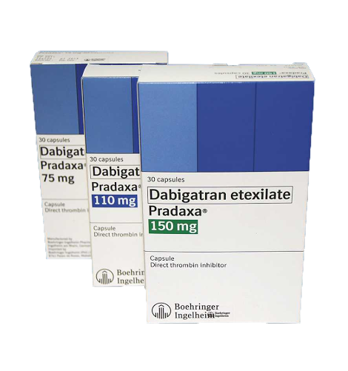
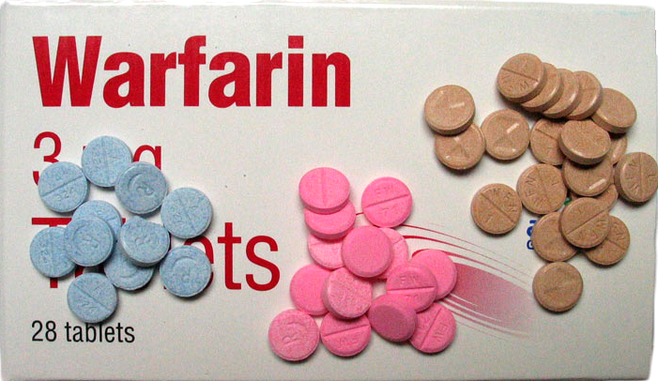
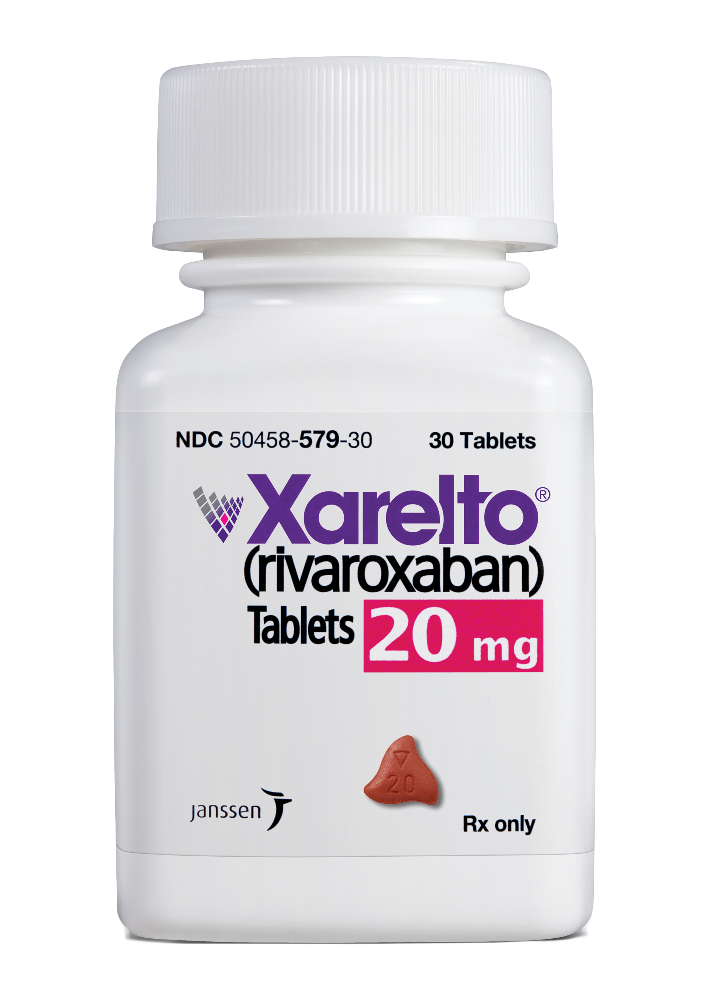
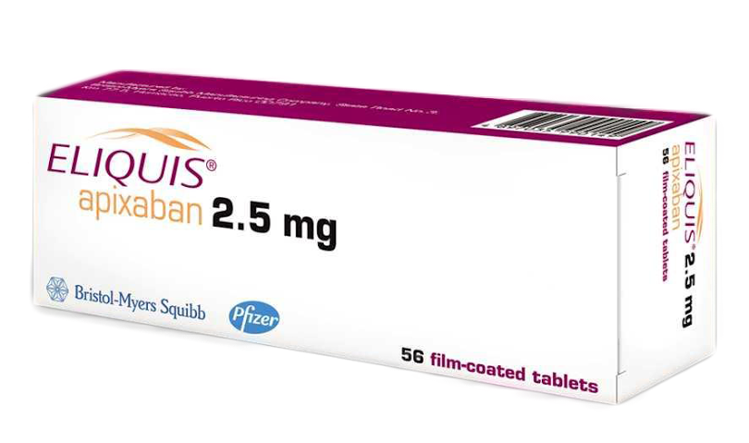
Anticoagulation Therapy
4.2 million Americans
18% of adults over 65
Notes:
Anticoagulation medications, such as warfarin (Coumadin), or the new anticoagulants like dabigatran, rivaroxaban, or apixaban, are meant to prevent blood clot formation, and in turn, prevent complications like stroke in a variety of cardiac conditions like atrial fibrillation or implantation of a mechanical heart valve.
In 2007, over 4.2 million Americans were on an anticoagulant
More recently, in 2012, census showed that 18% of adults over 65 were on anticoagulation therapy

Slide 3
Anticoagulation Therapy
Efficacy
Decreases risk of stroke by 68%
Decreases risk of death by 25%
Difficulties with Therapy
warfarin
dabigatran, rivaroxaban, apixaban
(Agency for Healthcare Research and Quality, 2009; Centers for Disease Control and Prevention, 2010; Gladstone et al., 2009; Grunau, Wiens, & Harder, 2011; National Center for Health Statistics, 2012)
Notes:
This is a very common therapy
The use of AT decreases risk of stroke by 68% and decreases risk of death by 25% (CDC, 2010; Gladstone et al., 2009; Grunau, Wiens, & Harder, 2011).
Unfortunately, although anticoagulation therapy is highly effective, there are several difficulties associated with therapy.
With warfarin, difficulties include having a
Narrow therapeutic index requires frequent monitoring, physician visits, and dose adjustments to remain between the INR of 2-3
The lack of anticoagulation control can have significant adverse reactions of stroke or bleeding
Side effects
Dietary precautions
Close attention to prevent adverse drug-to-drug interactions
Cessation of the drug prior to any medical procedures
Difficulties with therapy: New anticoagulants—no rescue drug in case of emergency; problems of adherence due to many being twice a day; no long term evidence of effect.
Furthermore, with the the dangers associated with missing a dose being so detrimental for these new anticoagulants, compared to warfarin—they also require frequent blood work, visits for patient education, and other monitoring as well.
Nevertheless, even with all these difficulties, the degree to which anticoagulation therapy is able to prevent stroke and death requires its use be optimized.

Slide 4
Patient Education
Importance
Barriers
Lack of time
Lack of resources
Over-estimation of prior knowledge
Notes:
With the difficulty involved in the management of long-term anticoagulation therapy, patient education is particularly important.
There are also several barriers to patient education in the clinical setting, including the time it takes to educate, the resources needed, and HCP over estimation of patients’ ability to learn and their prior knowledge.

Slide 5
Health Literacy
Definition:
“The degree to which individuals have the capacity to obtain, process, and understand basic health information and services needed to make appropriate health decisions.”
Prevalence of Inadequate Health Literacy
Effect on Anticoagulation Therapy
(Berkman, Sheridan, Donahue, Halpern, & Crotty, 2011; Diug et al., 2011; Estrada, Martin-Hryniewicz, Peek, Collins, & Byrd, 2004; Fang, Machtinger, Wang, & Schillinger, 2006; Institute of Medicine, 2004)
Notes:
One major barrier associated with patient education is inadequate health literacy.
The Institute of Medicine provides this definition of defines health literacy.
You can see that health literacy encompasses much more than the reading level or education of patients, but rather the ability to understand, work through, and comprehend their disease in order to make good health-promoting choices when outside of the healthcare system.
The Institute of Medicine reports that over 90 million people in the United States—have an inadequate health literacy (IOM, 2004)
It is also a problem worldwide: For example, according to the World Health Organization, nearly half of all Europeans have inadequate and problematic health literacy skills.
For patients on anticoagulation therapy, a complicated and potentially dangerous medication, HL presents as a particular barrier to adequate management associated with therapy. In fact, research shows that inadequate health literacy has been linked to poor anticoagulation control and higher bleeding risk (of as much as 3.4-fold). (Diug et al., 2011) Fang, Machtinger, Wang, and Schillinger (2006) Estrada, Martin-Hryniewicz, Peek, Collins, and Byrd (2004)

Slide 6
Research Study
Purpose:
To examine health literacy and patient knowledge as they relate to anticoagulation therapy in a cardiac population.
Research Questions: For patients with a cardiac condition who are on anticoagulation therapy—
What is their health literacy?
What is their knowledge regarding anticoagulation therapy?
What are their preferred learning methods?
Notes:
Purpose:
To examine health literacy and patient knowledge as they relate to anticoagulation therapy in a cardiac population.
This study sought to answer three research questions: For patients with a cardiac condition on anticoagulation therapy—
What is their health literacy?
What is their knowledge regarding anticoagulation therapy?
What are their preferred learning methods?

Slide 7
Methods
Design
Pilot study with a prospective, descriptive design
Patient Sample
Convenient Sample (n = 35)
Inclusion Criteria
Setting and Procedure
Electrophysiology clinic in the Midwest
Questionnaire
Notes:
Design:
Pilot study with a prospective, descriptive design
Patient Sample:
Convenient Sample (n = 35)
Inclusion Criteria: Cardiac diagnosis; on anticoagulation therapy; alert and oriented; speaks English; ≥ 18-years-old; under the care of an electrophysiologist; and able to provide implied consent.
Setting

Slide 8
Data Collection
Instrument (25 Questions):
Brief Health Literacy Screening Tool
Self-Developed Questions:
Demographics
Learning Methods
Education Received from Providers
Patient Adherence
Patient Knowledge of Anticoagulation Therapy
Recommendations for Future Education Methods
(Chew et al., 2008)
Notes:
The instrument used in this study was a 25 question survey including the
The Brief Health Literacy Screening Tool was established as reliable and valid with an interval range of from .72-.84. Prior to the study, permission to use the tool was obtained.
The self-developed questions had a Cronbach’s Alpha of about .6—showing good reliability and validity for a first time use.

Slide 9
Health Literacy Assessment
Brief Health Literacy Screening Tool
How often do you have someone help you read hospital materials?
How confident are you filling out medical forms by yourself?
How often do you have problems learning about your medical condition because of difficulty understanding written information?
Scoring:
Inadequate, Marginal, Adequate
(Chew, Bradley, & Boyko, 2004)
Notes:
the Brief Health Literacy Screen Tool asks three screening questions to detect limited health literacy.
Covering Needing Help Reading, Confidence with forms, and problems learning
The questions were asked using a likert scale

Slide 10
Findings
Demographics
Age: 68.7 (12.1)
Gender: 25 male; 10 female
Ethnicity: 94.3% Caucasian
Education Level:
40% High school/GED or below
60% Education over high school/GED
Notes:
Descriptive statistics were utilized to analyze the data.
Demographics showed a mean age of 68.7; the population was mostly male and Caucasian, with a fairly high education level—with 60% having an education above high school

Slide 11
Health Literacy of Patients
Notes:
The data resulting from the Brief Health Literacy Screening Tool is depicted in this chart.
About 35% of patients had inadequate or marginal health literacy even though 60% of the participants had education higher than high school/GED.

Slide 12
Patient Learning
Other
Touch
Auditory
Visual
Notes:
When asked how they learn best, ~75% of patients reported being visual learners as opposed to auditory, touch, or other.
Though, unfortunately, as clinicians, educational interventions geared toward visual learners tend to be defaulted to the written word in a brochure or educational packet. With the prevalence of inadequate health literacy, though, we, as clinicians may need to expand the visual educational materials that we provide our patients.

Slide 13
Patient Education
Resources for Obtaining Information
Notes:
When asked about the patients’ typical methods of obtaining information about their medications (indicated by the orange),
most either said by pharmacy insert or verbal instruction from the care provider.
Similarly, when asked the most helpful resource to obtain information regarding medication, most patients marked either pharmacy insert or care provider.

Slide 14
Patient Education
Type of Education Received
Notes:
When asked if they received education from their health care provider, 89% marked yes, and indicated that they were mostly educated by either the physician or the nurse.
The type of education received was mostly by verbal instruction, and then printed literature.

Slide 15
Patient Adherence
Notes:
The instrument also measured patient adherence by asking how often they take their medication as scheduled. Although 88.6% reported being adherent, which is typically measured as over 80%, with the severe adverse effects that non-adherence can occur, the 12% that reported being non-adherent is of significant concern.

Slide 16
Anticoagulation Therapy Knowledge
Knowledge Topic | Percentage Correct Answer
Overall Knowledge | 63%
Purpose of Anticoagulation Medication | 91%
Food Interaction: Warfarin (Coumadin) Other anticoagulation medications
 | 44%
 | 88%
Natural Medicine Interaction | 23%
Action in Case of Missed Dose | 97%
Monitoring: Warfarin (Coumadin) Other anticoagulation medications
 | 100% marked regular blood work 11% marked special diet
 | 50% marked regular physician visits
Contact Healthcare Provider After a Fall | 54%
Notes:
As you can see from the chart, the overall knowledge of patients was low at 63%, even though 88.6% of the patients reported receiving instruction from their healthcare provider regarding anticoagulation therapy. This demonstrates the significant disparity between the patient education they received from their healthcare provider and the amount of knowledge they have about their anticoagulation medication.
Significant topics with low knowledge was food interaction with warfarin at only 44%, natural medicines interaction with all anticoagulants at only 23%, and the need to call a healthcare provider after a fall at 54%.

Slide 17
Recommendations from Patients
“Stay the same”
“More instruction from doctors and nurses”
“More written information”
“Group sessions”
Notes:
Patients were asked a qualitative question asking to make recommendations for the education of future patients on anticoagulation therapy.
Several themes were taken from the variety of recommendations made by patients.
Of these sixteen patients that either said to keep education the same or left this question blank, twelve had incorrect responses to the patient knowledge questions.
This indicates the patients’ feeling they understand their medication or that their education was adequate, but lacking knowledge in key areas.
Other recommendations included verbal instruction; written information or instructions to reference at home; video; or group sessions with doctors, nurses, and others who are also receiving the medication. One said continued education is important throughout therapy.

Slide 18
Limitations
Convenient Sample
Educated Population
Limited Ethnicity
New Instrument
Self-Report
Notes:
The limitations of this study were that it used a convenient sample. This population was fairly education, which may have affected their health literacy. The population was almost 95% Caucasian—lack of diversity.
Lastly, with the methods of the study, the questionnaire was a new instrument that used self-report for data collection.

Slide 19
Implications for Practice
Healthcare providers should:
Assess the health literacy, learning styles, and prior knowledge of patients;
Use materials appropriate for these individual needs;
Assess knowledge and continue education throughout use of therapy.
Notes:
There are several recommendations that can be made from the results of this study.

Slide 20
Implications for Practice
Topics to emphasize during education:
Interaction of food with warfarin
Interaction of natural medicines with all anticoagulants
Dangers associated with anticoagulation therapy

Slide 21
Future Studies
More diverse sample population in ethnicity and education
The use of video or other visual materials to enhance patient knowledge
Group instruction and its effect on retention of knowledge and anticoagulation control
The use of social media and electronic communication to improve patient adherence and patient knowledge
Notes:
Future studies should include using a more diverse sample population in ethnicity and education.
To investigate the use of video and other visual materials to enhance patient knowledge.

Slide 22
Conclusion
This study demonstrated:
About a third had inadequate health literacy
Significant number lacked knowledge in key areas
Most patients reported being visual learners
Patient education has the potential to improve knowledge, but only if it is targeted to the learning styles and educational needs of patients throughout therapy.

Slide 23
Acknowledgements
Marilyn Prasun, PhD; Dawn Sarginson, MSN
Abraham Kocheril, MD
Karen Kaluf and Christie Clinic
Randy and Marilyn Kok
Family and Friends
Notes:
I would like to thank these people for making this research project possible.

Slide 24
References
Agency for Healthcare Research and Quality. (2009). Outpatient prescription anticoagulants utilization and expenditures for the U.S. civilian noninstitutionalized population age 18 and older, 2007. Retrieved from http://meps.ahrq.gov/mepsweb/data_files/publications/st268/stat268.pdf.
Berkman, N., Sheridan, S., Donahue, K., Halpern, D., & Crotty, K. (2011). Low health literacy and health outcomes: An updated systematic review. Annals Of Internal Medicine, 155(2), 97-107.
Centers for Disease Control and Prevention. (2010). Atrial fibrillation fact sheet. Retrieved from http://www.cdc.gov/dhdsp/data_statistics/fact_sheets/fs_atrial_fibrillation.htm.
Chew, L.D., Bradley, K.A., & Boyko, E.J. (2004). Brief questions to identify patients with inadequate health literacy. Family Medicine, 36(8), 588-594.
Chew, L.D., Griffin, J.M., Partin, M.R., Noorbaloochi, S., Grill, J.P., Snyder, A., ... VanRyn, M. (2008). Validation of screening questions for limited health literacy in a large VA outpatient population. Journal of General Internal Medicine, 23(5), 561-566.
Diug, B., Evans, S., Lowthian, J., Maxwell, E., Dooley, M., Street, A., … McNeil, J. (2011). The unrecognized psychosocial factors contributing to bleeding risk in warfarin therapy. Stroke, 42(10), 2866-2871.
Notes:
And thank you all for your attention and for having me here today.

Slide 25
References
Estrada, C.A., Hryniewicz, M.M., Higgs, V.B., Collins, C., & Byrd, J.C. (2000). Anticoagulant patient information material is written at high readability levels. Stroke, 31, 2966-2970.
Fang, M.C., Machtinger, E.L., Wang, F., & Schillinger, D. (2006). Health literacy and anticoagulation-related outcomes among patients taking warfarin. Journal of General Internal Medicine, 21(8), 841-846.
Gladstone, D.J., Bui, E., Fang, J., Laupacis, A., Lindsay, M.P., Tu, J.V., … Kapral, M.K. (2009). Potentially preventable strokes in high-risk patients with atrial fibrillation who are not adequately anticoagulated. Stroke, 40, 235-240.
Grunau, B., Wiens, M., & Harder, K. (2011). Patient self-management of warfarin therapy: Pragmatic feasibility study in Canadian primary care. Canadian Family Physician, 57(8), e292-8.
Institute of Medicine. (2004). Health literacy: A prescription to end confusion. L. Nielsen-Bohlman, A.M. Panzer, & D.A. Kindig, (Eds.). Washington, DC: The National Academies Press.
Knowles, M.S., Holton, E.F., & Swanson, R.A. (2012). The adult learner: The definitive classic in adult education and human resource development (7th ed.). New York, NY: Taylor & Francis.
National Center for Health Statistics. (2012). Health, United States, 2012: A special feature of emergency care. Retrieved from http://www.cdc.gov/nchs/data/hus/hus12.pdf#092.

