Slide 1
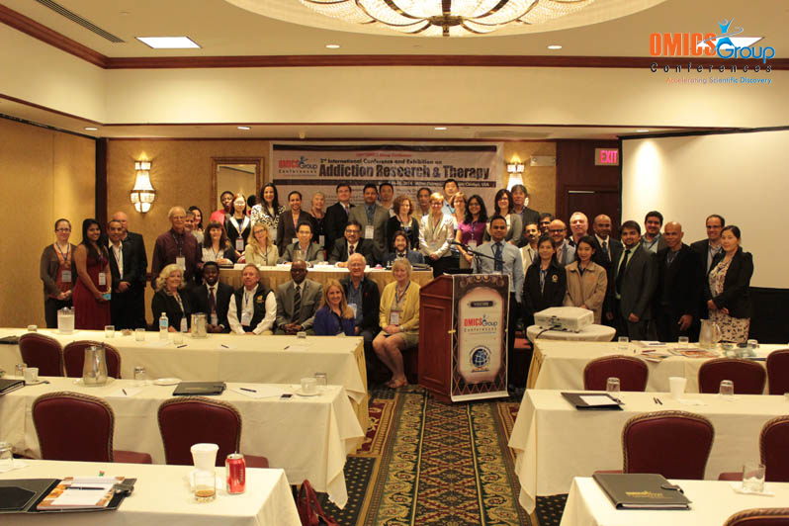
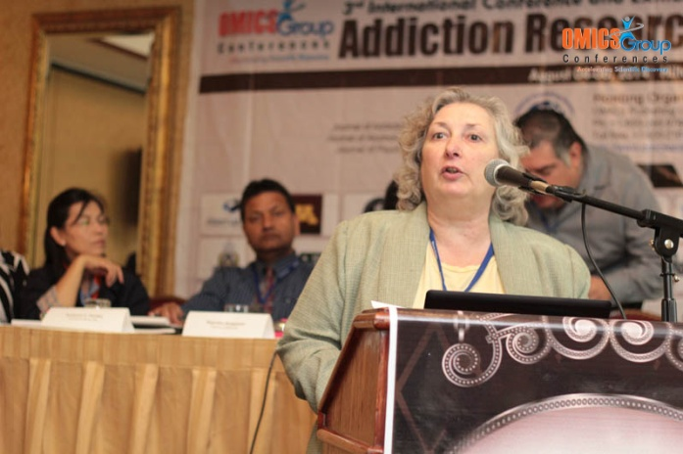
Addiction Therapy-2014 Chicago, USA August 4 - 6, 2014
Kathy Sexton-Radek

Slide 2
Behavioral Interventions compared to Medical only Intervention for Substance Use Disorders
Kathy Sexton-Radek, Ph.D., C.BSM
Elmhurst College/Suburban Pulmonary & Sleep Associates

Slide 3
Abstract
Behavioral interventions used to treat substance use disorder will be presented. The literature indicates efficacy with a number of approaches that are applied tin the private practice and inpatient settings. The differences between the approaches will be discussed. Varying degrees of successful outcomes exist by substance use disorder-substance use type. The comparison to medical interventions on future directions will be discussed.

Slide 4
References
References available upon request (NIMH, NSF, SAMSA)

Slide 5
The Hallmark of Addiction
The 4 ‘C’s
-Loss of Control of use of the substance
-Compulsive use or Craving
-Continued use despite adverse Consequences

Slide 6
Addiction
A primary, chronic disease characterized by impaired control over the use of a psychoactive substance or behavior.
Clinically the manifestations occur along biological, psychological, social & spiritual dimensions.
Like other chronic diseases, it can be progressive, relapsing & fatal.

Slide 7
Treatment
Too often, addiction goes untreated: According to SAMHSA's National Survey on Drug Use and Health (NSDUH), 23.2 million persons (9.4 percent of the U.S. population) aged 12 or older needed treatment for an illicit drug or alcohol use problem in 2007. Of these individuals, 2.4 million (10.4 percent of those who needed treatment) received treatment at a specialty facility (i.e., hospital, drug or alcohol rehabilitation or mental health center). Thus, 20.8 million persons (8.4 percent of the population aged 12 or older) needed treatment for an illicit drug or alcohol use problem but did not receive it. These estimates are similar to those in previous years.1

Slide 8
Treatment needed and works
As a result of scientific research, we know that addiction is a disease that affects both brain and behavior. We have identified many of the biological and environmental factors and are beginning to search for the genetic variations that contribute to the development and progression of the disease. Scientists use this knowledge to develop effective prevention and treatment approaches that reduce the toll drug abuse takes on individuals, families, and communities.

Slide 9
Contributing Factors : Opioid Risk Tool
Family Hx of Substance Abuse
Alcohol
Illegal Drugs
Rx Drugs
Personal Hx of Substance Abuse
Alcohol
Illegal Drugs
Rx Drugs
History of Preadolescent Sexual Abuse
Psychological Disease
ADHD, OCD, Bipolar, Schizophrenia
Depression
Webster LR 2005

Slide 10
Common Behavioral Interventions
12 Step Model
Motivational Interviewing
Relapse Prevention
Harm Reduction
Matrix Model
Transtheoretical
Stages of Change Matrix

Slide 11
Behavioral Interventions
Cognitive Behavioral Therapy seeks to help patients recognize, avoid, and cope with the situations in which they are most likely to abuse drugs.
Contingency Management uses positive reinforcement such as providing rewards or privileges for remaining drug free, for attending and participating in counseling sessions, or for taking treatment medications as prescribed.
Motivational Enhancement Therapy uses strategies to evoke rapid and internally motivated behavior change to stop drug use and facilitate treatment entry.
Family Therapy (especially for youth) approaches a person’s drug problems in the context of family interactions and dynamics that may contribute to drug use and other risky behaviors.

Slide 12
Behavioral treatments
Cognitive–behavioral therapy, which seeks to help patients recognize, avoid, and cope with the situations in which they are most likely to abuse drugs.
Multidimensional family therapy, which was developed for adolescents with drug abuse problems—as well as their families—addresses a range of influences on their drug abuse patterns and is designed to improve overall family functioning.
Motivational interviewing, which capitalizes on the readiness of individuals to change their behavior and enter treatment.
Motivational incentives (contingency management), which uses positive reinforcement to encourage abstinence from drugs.

Slide 13
Relative Incidence of causes of Preventable death in the United States
4% Motor vehicle accidents
2% Sexual behavior
3% Firearms
5% Toxic agents
7% Microbial agents
32% Diet/activity
2% Illicit drug use
7% Alcohol
38% Tobacco

Slide 14
Some numbers about Substance Use
2.4 average number of hours of popular music listened to each day by American adolescents aged fifteen to eighteen years
84 approximate number of explicit references to substance use heard per day in listening to the most popular music in 2005, based on 2.4 hours of music listening per day
333 percentage of the most popular songs of 2005, in all categories, containing explicit references to substance use
Primack et al. (2008)

Slide 15
Some effective self-help organizations
Alcoholics Anonymous
Adult Children of Alcoholics
Al-Anon & Alateen
Cocaine Anonymous
Narcotics Anonymous
Smart Recovery
Forensic: Drug courts, reentry program, Jail and Prison-based substance abuse programs

Slide 16
Primary Prevention Behavioral Programs
Project DARE
Self-Esteem Enhancement and Affective Education
Peer-Refusal Skill Training/School-based prevention
Social Skills and Personal Decision Making
Community based programs
Media influences

Slide 17
Efficacy and Outcome
Programs must address polydrug use
Co-occurring psychiatric problems of depression, bipolar disorder and anxiety disorders
Drug courts utilizing newer laws of criminal penalties for drug trafficking depending on the schedule of controlled substance are adjudicated through supervised treatment rather than incarceration

Slide 18
Efficacy and Outcome
School based programs that incorporate peer-refusal skill training, relaxation and stress management, training in social skills and personal decision making
Life Skills Training such as The Drug Abuse Resistance Education (DARE) with its newer approaches.
Community based programs that use a broader range of resources, including community leaders and public figures as positive role models, media to high risk populations.

Slide 19
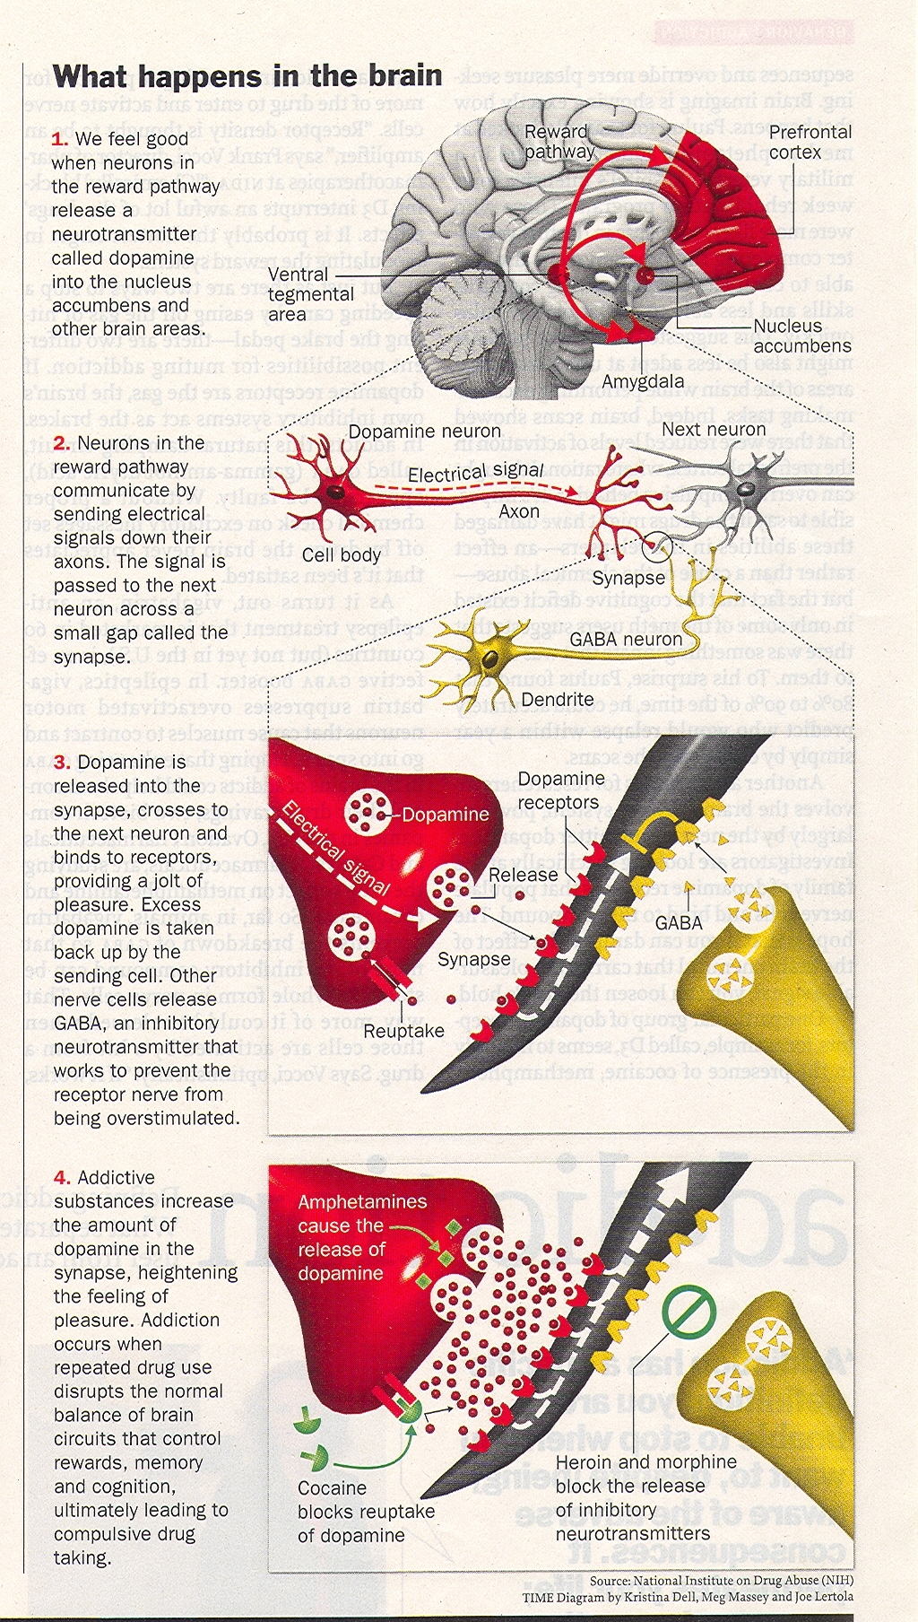
Notes:
Opiod agonist mediates the inhibition of release of GABA - results in disinhibition of the dopamine neurons - Increased dopamine release at NA

Slide 20
Withdrawal
Neurophysiological rebound in the organ systems on which opioids have their primary actions
CNS suppression --CNS over activity
Increased CNS noradrenergic hyperactivity primarily at the nucleus ceruleus
Notes:
Large body of research evidence supports this. Methadone Maintenance is associated with reduced use of illicit opiates, reduced IV use , improved health, reduced crime & improved social function re work & family function

Slide 21
Opiate Withdrawal
Dilated pupils
Nausea, vomiting, cramps & diarrhea
Bone pain, headache
Chills, sweats, piloerection - “going cold turkey”
Anxiety, emotional lability, craving
Irritable & insomnia
NOT life-threatening (except risk of suicide)
NO seizures

Slide 22
Medical Approaches
In-patient programs
Detoxification programs
Outpatient programs—day hospital and outpatient programmatic-time limited
Public Health Indicatives

Slide 23
Addiction Treatment Works
Many medical practitioners have a negative attitude towards dealing with addiction
Patients DO respond to brief interventions in the doctor’s office, to rehabilitation programs, & to methadone maintenance programs
Despite the research evidence our patients still have to deal with the stigma which is attached to the diagnosis of addiction & methadone treatment
Notes:
. Large body of research evidence supports this. Methadone Maintenance is associated with reduced use of illicit opiates, reduced IV use , improved health, reduced crime & improved social function re work & family function Within the community at large & within the medical community
Our goal is to educate & improve the understanding of addiction & its treatment

Slide 24
How best to treat Addiction?
Can addiction be treated successfully?
Yes. Addiction is a treatable disease. Research in the science of addiction and the treatment of substance use disorders has led to the development of evidence-based interventions that help people stop abusing drugs and resume productive lives.
Can addiction be cured?
Not always—but like other chronic diseases, addiction can be managed successfully. Treatment enables people to counteract addiction’s powerful disruptive effects on their brain and behavior and regain control of their lives.

Slide 25
Human Molecular Genetics
5 single nucleotide polymorphisms have been identified in the coding region of the human mu opioid gene
3 of these lead to amino acid changes in the receptor
Some receptor variants have been associated with increased potency of activation of the receptor
Some have some association with increased vulnerability to dependence
Notes:
You are actually inheriting a pattern of responding to the drug differently from the non-addict More research needed

Slide 26
Treatments work
Comparison of Relapse Rates Between Drug Addiction and Other Chronic Illnesses Source: JAMA, 284:1689-1695, 2000
Relapse rates for people treated for substance use disorders are compared with those for people with diabetes, hypertension, or asthma. Relapse is common and similar across these illnesses (as is adherence/non-adherence to medication). Thus, drug addiction should be treated like any other chronic illness; relapse serves as a trigger for renewed intervention..

Slide 27
Medical treatments
In the medical model, the physician is the primary person delivering treatment and abstinence from the chemical is seen as the ultimate goal, and although the doctor might refer the patient to a psychologist, not as much attention is paid to other potential aspects of the disease, e.g., psychological and social problems. The treatment of choice for this model involves dealing with the physical consequences of the addiction through nutrition, etc., and the use of medications such as disulfiram (Antabuse) and naltrexone (Revia) to ensure abstinence.

Slide 28
Medical treatments
Medications
Medications can be used to help with different aspects of the treatment process.
Withdrawal. Medications offer help in suppressing withdrawal symptoms during detoxification. However, medically assisted detoxification is not in itself "treatment"—it is only the first step in the treatment process. Patients who go through medically assisted withdrawal but do not receive any further treatment show drug abuse patterns similar to those who were never treated.
Treatment. Medications can be used to help reestablish normal brain function and to prevent relapse and diminish cravings. Currently, we have medications for opioids (heroin, morphine), tobacco (nicotine), and alcohol addiction and are developing others for treating stimulant (cocaine, methamphetamine) and cannabis (marijuana) addiction. Most people with severe addiction problems, however, are polydrug users (users of more than one drug) and will require treatment for all of the substances that they abuse.

Slide 29
Medical treatments
Opioids: Methadone, buprenorphine and, for some individuals, naltrexone are effective medications for the treatment of opiate addiction
Tobacco: A variety of formulations of nicotine replacement therapies now exist—including the patch, spray, gum, and lozenges—that are available over the counter. In addition, two prescription medications have been FDA–approved for tobacco addiction: bupropion and varenicline
Alcohol: Three medications have been FDA–approved for treating alcohol dependence: naltrexone, acamprosate, and disulfiram. A fourth, topiramate, is showing encouraging results in clinical trials.

Slide 30
Medical treatments
The disease model of addiction describes an addiction as a disease with biological, neurological, genetic, and environmental sources of origin.[1] The traditional medical model of disease requires only that an abnormal condition be present that causes discomfort, dysfunction, or distress to the individual afflicted. The contemporary medical model attributes addiction, in part, to changes in the brain's mesolimbic pathway.[2] The medical model also takes into consideration that such disease may be the result of other biologic, psychologic, or sociologic entities despite an incomplete understanding of the mechanisms of these entities.
According to the disease model, the onset and development of addiction are influenced though genetic predisposition and environmental factors. These hypotheses would explain the result of adoption and twin studies that have been carried out, indicating that twins separated at birth have a higher likelihood of concordance for addictive disease than would be expected were there not a genetic component, and indicating that these twins have a lower likelihood of concordance for addictive disease than do twins who remain together in identical environments.[3]

Slide 31
Core components of effective care
Substance use/abuse alters the brain’s structure and functioning; treatment and risk for relapse have to be addressed
No single approach for everyone.
Treatment needs to be readily available with early intervention as optimal
Multiple needs of the individual, --their substance abuse, medical, psychological, social, vocational and legal problems have to be addressed
Substantial period of time in treatment, three months is minimum.
Addressing the relapse prevention needs of the socialization of the individual to a substance free lifestyle

Slide 32
Core components of effective care
Medical care and medication guided/tapered detoxificaton and treatments when combined with Behavioral approaches are effective
Individual plans are modified on an ongoing basis throughout their life
Ongoing medical conditions should be expected
Medically assisted detoxification is only the first stage of addiction treatment and by itself does little to change long–term drug abuse.
Treatment does not need to be voluntary to be effective.
Drug use during treatment must be monitored continuously, as lapses during treatment do occur.
Treatment programs should assess patients for the presence of HIV/AIDS, hepatitis B and C, tuberculosis, and other infectious diseases as well as provide targeted risk–reduction counseling to help patients modify or change behaviors that place them at risk of contracting or spreading infectious diseases.

Slide 33
Future directions
National Longitudinal Study of Neurodevelopmental Consequences of Substance Use will require tracking a large cohort of young people (approximately 10,000 individuals) for a decade, beginning in late childhood, and collecting mental health, genetic, and behavioral data on substance use, school achievement, IQ, and cognition, and crucially, using brain imaging. The array of neuroimaging and genetic tools now available enables us to study the nature of the brain changes that arise from substance use and shed light on causal mechanisms, to a degree never before possible. Among its many goals, the study should illuminate interactions between substances, identify neurodevelopmental pathways that link drug abuse with mental illnesses, and disentangle the effects of individual substances as well as characterize their combined effects.

Slide 34
Substance Abuse Treatment information
National Clearinghouse for Alcohol and Drug Information (NCADI)
Substance Abuse and Mental Health Services Administration (SAMHSA)

Slide 35
Meet the eminent gathering once again at Addiction Therapy-2015 Florida, USA August 3 - 5, 2015
Addiction Therapy – 2015 Website:
addictiontherapy.conferenceseries.com

