Slide 1
Phenotypic Characterization of EMS Induced Mutants in Wheat (Triticum aestivum L.)
Karnam Venkatesh
Co-authors: SK Pawar, R Kumar, R Singh, SK Singh, V Tiwari and I Sharma
Directorate of Wheat Research
Karnal (Haryana)

Slide 2
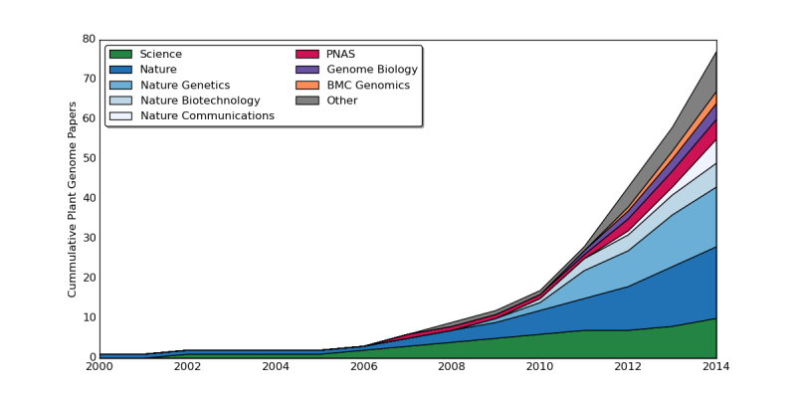
Relevance of Mutant Phenotypes
Ever Increased No. of Genome Sequencing Projects
Trends in Plant Science April 2014, Vol. 19, No. 4

Slide 3
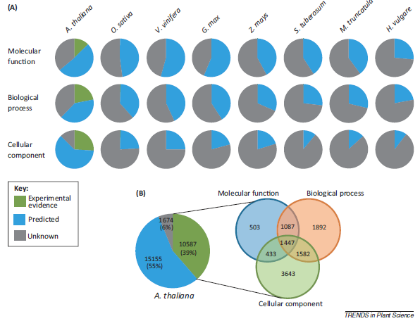
Large No. of genes are Unknown
Only 9% of genes in Arabidopsis are experimentally proven
Most of the genes in all other sequenced genomes are only predictions
E. Coli (43%) and in S. cerevisiae (30%)
Trends in Plant Science April 2014, Vol. 19, No. 4

Slide 4
Material and Methods
DPW-621-50 : Released for IR-TS conditions of NWPZ
Treated with 0.7 % ethyl methanesulfonate (EMS) at DWR, Karnal.
4000 mutants generated
600 M₂ plants studied for altered phenotypes: IPGRI wheat phenotype descriptors.

Slide 5
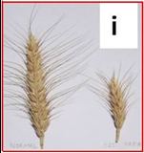
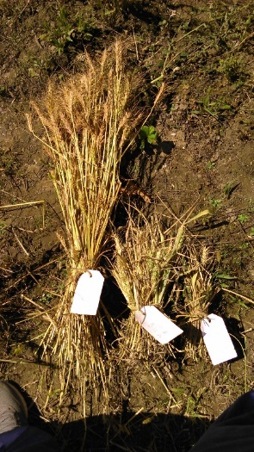
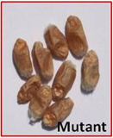
Traits Studied
Phenology
Floral mutants
Yield Traits
Days to heading
Days to Maturity
Colour/pigmentation
Height
Spike length
Symmetry
Threshability
Color
Size
Shape
Floral parts

Slide 6
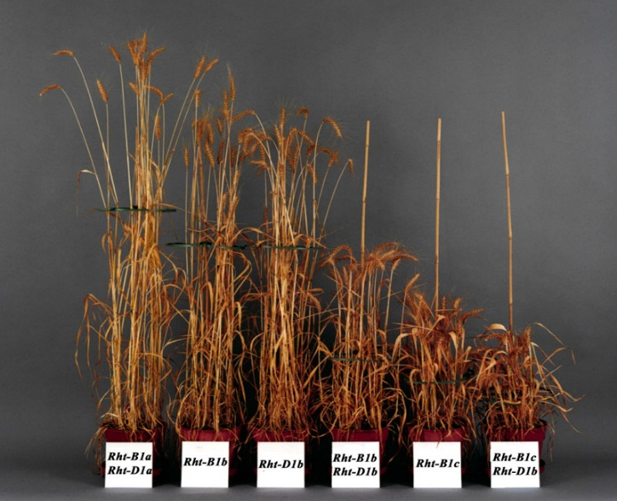
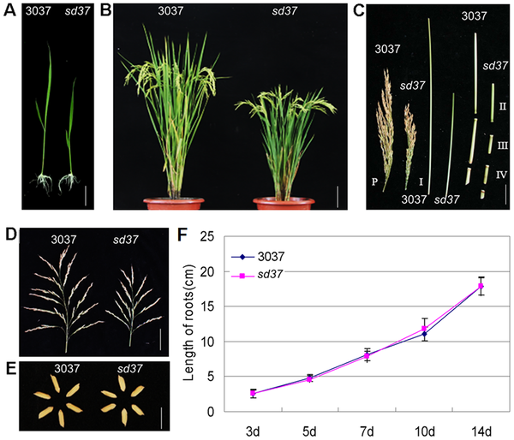
Results: Altered Phenotypes
Height mutant
Wheat: Plant Height
Rice: Plant Height
Zhang J, Liu X, Li S, Cheng Z, et al. (2014) The Rice Semi-Dwarf Mutant sd37, Caused by a Mutation in CYP96B4, Plays an Important Role in the Fine-Tuning of Plant Growth. PLoS ONE 9(2
Range: 15 -150 cm

Slide 7
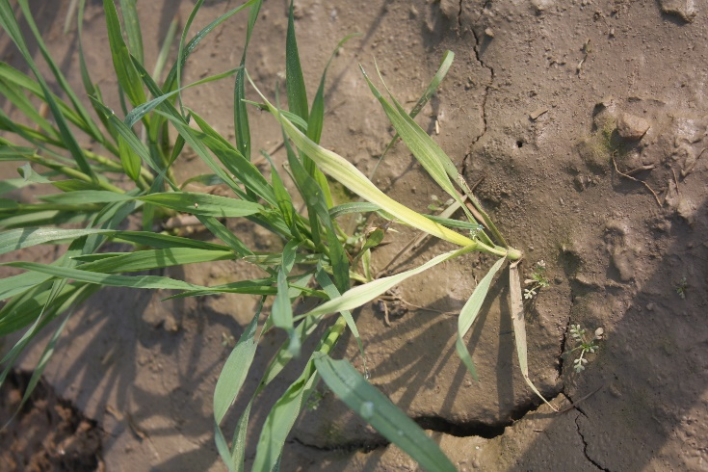
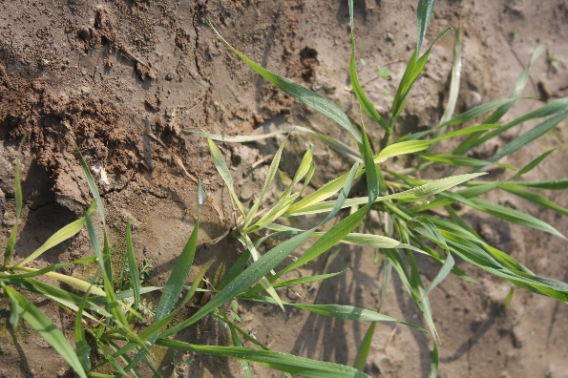
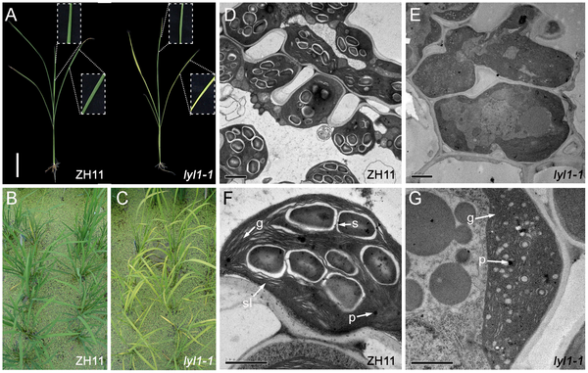
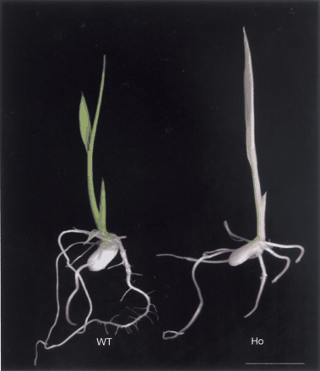
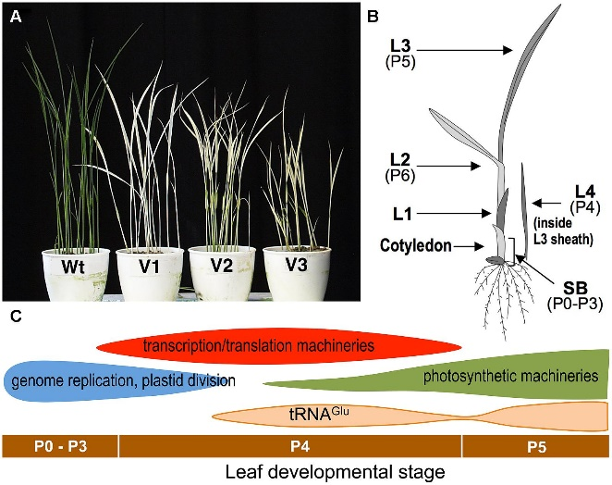
Results: Altered Phenotypes
Chlorophyll mutants
OsCHLH
Light-Induced Yellow Leaf 1 Gene
http://www.plosone.org/article/info:doi/10.1371/journal.pone.0075299
Plant Cell Physiol (2003) 44 (5): 463-472.
Front. Plant Sci., 11 August 2014 |
doi: 10.3389/fpls.2014.00386

Slide 8
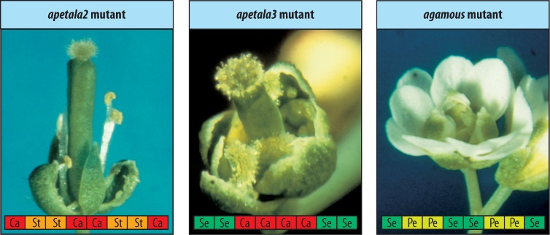
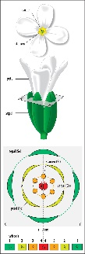
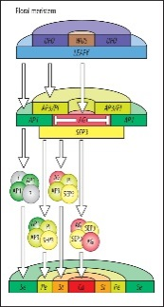
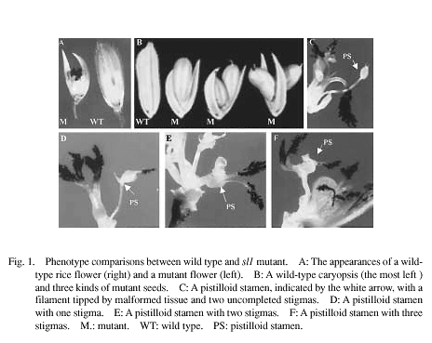
Spike Variations
Open floret, deformed glume, twisted awns etc..
Spikelet symmetry variations
ABCDE model of flower development
Stamen less mutant of Rice
Coen, E.S. and E.M. Meyerowitz, 1991. The war of the whorls: genetic interactions controlling flower development. Nature 353: 31-37.

Slide 9
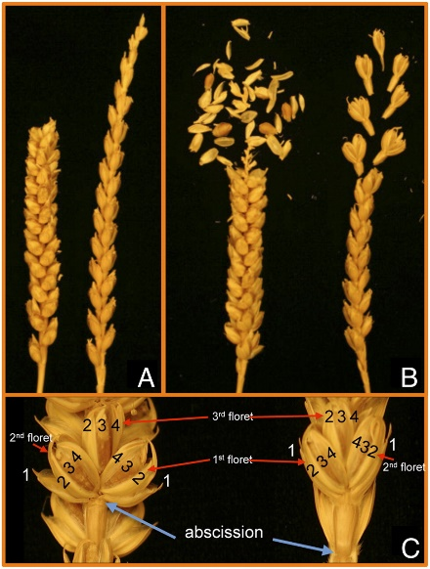
Spike Variations
Threshability: Easy and Hard
Q gene copy no variations
Free threshing Q gene mutants in wheat
Zhang Z et al. PNAS 2011;108:18737-18742

Slide 10
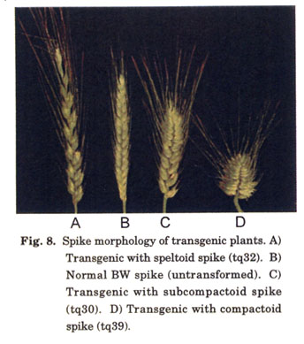
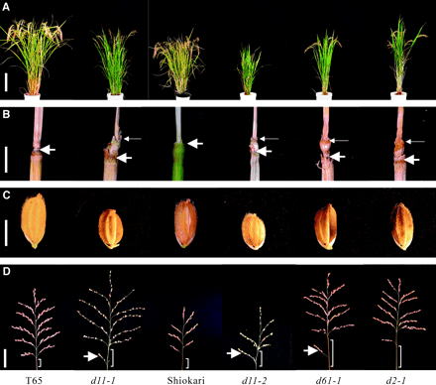
Spike Variations
Range: 2 -18 cm
Spike length variations
Rice: dwarf11 loci mutants
Brasinosteroid biosynthesis pathway
The Plant Cell March 2005 vol. 17 no. 3 776-790
Q gene mutants in wheat

Slide 11
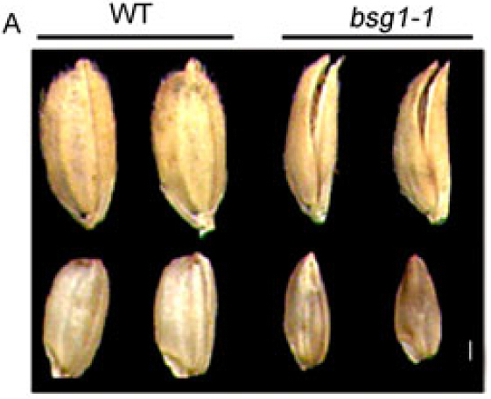
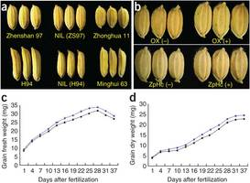
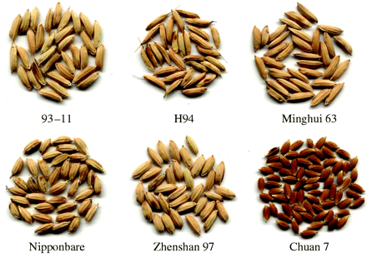
Source-Sink Variations
Shrivelled and unfilled grains
Beak Shaped Grain mutant
GS5 encodes a putative serine carboxypeptidase and functions as a positive regulator of grain size
http://ricewiki.big.ac.cn/index.php?title=Os02g0811000&oldid=173111 (Last update: May 27, 2014)

Slide 12
Conclusions
Identified altered phenotypes for a large number of traits
Role in breeding for wheat improvement (High Tiller and Bold grain mutants)
Understanding the functional basis of genes
Openness of spikelet’s and male sterility could possibly find a role in hybrid wheat development

Slide 13
Acknowledgements
Omics Group
Research fellows
Colleagues at DWR-Karnal
Thank you

