Slide 1







Autoantibodies from single circulating plasmablasts react with citrullinated antigens and Porphyromonas gingivalis in rheumatoid arthritis
Kaihong Su, Ph.D.
Associate Professor

Slide 2
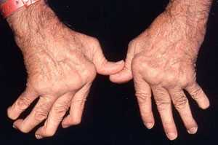
Rheumatoid Arthritis (RA)
A chronic, systemic, autoimmune inflammatory disorder that principally attacks synovial joints.
Affects about 1% of the general population worldwide, women three times more often than men.
Reduces the lifespan of patients by a range of 3 to 12 years.
Notes:
Pain or tenderness in the joints
Swelling in one or more joints
Warmth and redness in a joint
Stiffness

Slide 3
Etiology of RA
Genetic factors (50-60%):
  HLA-DR4
  PTPN22
  PAD4
Environmental factors (40-50%):
  Smoking
  Microbial infection ( eg. Porphyromonas gingivalis)
  Aberrant physiological process (apoptosis, NETosis)
Notes:
The etiology of RA is not clear. Association studies we generally think the genetic factors account to 50-60% and environmental factors account to 40-50% of the cause of RA. And the factors work cooperately. For example, ,,,,

Slide 4
Autoantibodies in RA
*Rheumatoid factor (RF, anti-immunoglobulin Fc, 1940)
Anti-collagen II antibody
Anti-glucose-6 phosphate isomerase (GPI) antibody
Antibodies to heat shock protein (HSP) antibody
*Anti-citrullinated protein antibody (ACPA, 1999), over 90% specificity for RA
RF and ACPA are serological diagnostic criterion for RA (2010 ACR/EULAR)
Notes:
RA is also considered as autoimmune disease because the production of autoantibodies by RA patients. The first autoantibody discovered in RA was rheumatoid arthritis, which recognize the Fc part of other IgG antibodies. it has 70% sensitivities, which means 70% RA patients have detectable this antibody, but the specificity is very low. Healthy people and other patients may also have this antibody. after that, some other autoantibodies, such as … were discovered.

Slide 5
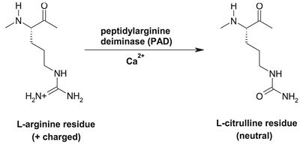
Anti-citrullinated protein antibody (ACPA) in RA
1964 Anti-perinuclear factor antibody (APF)
1979 Anti-keratin antibody (AKA)
1995 Anti-filaggrin antibody
1999 Citrulline is essential for autoantibody recognizing filaggrin
2001 Anti-cit-fibrinogen
2004 Anti-cit-vimentin
2005 Anti-cit-collagen
2005 Anti-cit-α-enolase
2012 Anti-cit-Bip
2014 Anti-cit-histone
Commercial kits
1. 2001 Anti-cyclic
citrullinated peptides(CCP) assay
2. 2004 Anti-CCP2 assay
3. 2007 Anti-mutated vimentin (AMV) assay
Notes:
Autoantibodies bind to perinuclear granules in the superficial cells of the human buccal mucosa epithelium
Anti-keratin antibody 50%
Until 1995, Filiggrin was the target of APF and AKA
The non classical amino acid citrulline is a product of post-translational modification of arginine. This conversion process needs peptidylarginine deiminase (PAD).
After that, many citrullinated antigens were discovered…. And commercial kits were invented to detect the ACPA. 70-80% sensitivity with 98% specificity. Included in the ra diagnosis criteria in 2010.

Slide 6
Pathogenicity of ACPAs in RA
ACPAs precede years before the clinical diagnosis of RA and predict RA with a higher OR than RF and HLA SE.
ACPAs identify subgroups of early RA patients with a more severe disease course.
Passive transfer of ACPAs enhanced tissue injury in collagen-induced arthritis (CIA) mice.
Citrullinated antigens have increased arthritogenicity in animal models of arthritis.
ACPAs induce macrophages to secret tumor necrosis factor alpha (TNFα), a dominant inflammatory cytokine in RA.
Notes:
Hundreds studies focus on ACPA were done, but the characteristic and the trigger of ACPAs is not clear.

Slide 7
Central questions
What are the molecular features of ACPAs?
Where are the cells that produce ACPAs?
What triggers the generation of ACPAs?
Notes:
Short-lived plasmablasts provide a first line of defense to infections, primarily secreting IgM; In GC, somatic mutation for affinity maturation and class-switch occurs.
Plasmablasts are antibody-secreting cells undergoing proliferation. Plasma cells are not proliferating. About 80% of CD19dimCd27 high cells in blood are plasmablasts (express high levels of HLA-DR) and the rest 20% are plasma cells (express low levels of HLA-DR).

Slide 8
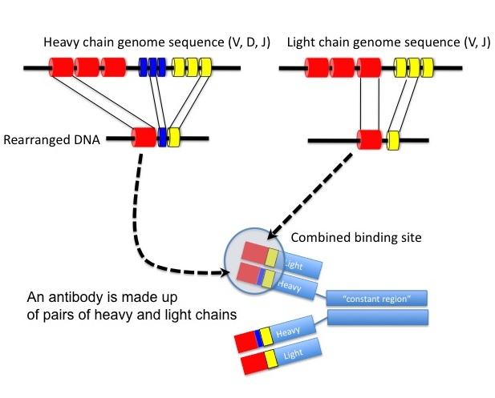
VDJ recombination and somatic mutation contribute to antibody repertoire
Germline gene
Somatic mutation
Notes:
VDJ recombination happens in bone marrow like this

Slide 9
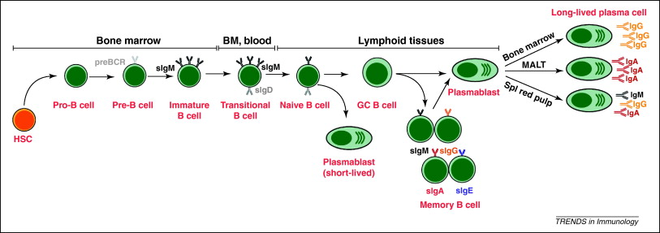
Development of B Lymphocytes
Tangve SG, Trends in Immunol, 2011
Notes:
Short-lived plasmablasts provide a first line of defense to infections, primarily secreting IgM; In GC, somatic mutation for affinity maturation and class-switch occurs.
Plasmablasts are antibody-secreting cells undergoing proliferation. Plasma cells are not proliferating. About 80% of CD19dimCd27 high cells in blood are plasmablasts (express high levels of HLA-DR) and the rest 20% are plasma cells (express low levels of HLA-DR).

Slide 10
Frequency of circulating plasmablasts is increased in RA patients
A
B
Healthy control
RA patient
***p < 0.001
1%
48%
4%
12%
CD27
Frequency of plasmablasts
in CD19⁺ B cells (%)
45%
83%
CD19
Control
RA

Slide 11
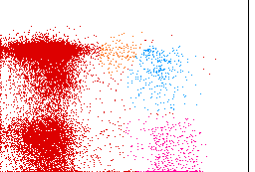
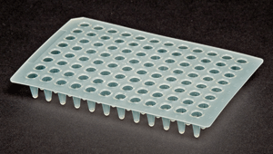
Single Cell RT-PCR
A
Single-Cell RT PCR
CD27
FACS
sort
CD19
Two more rounds of PCR to amplify IgH and IgL genes
B
CMV
CMV
CMV
V_{H}DJ
Cγ
VkJk
Cκ
VlJl
Cλ
γ
κ
λ
DNA sequencing
and analysis
ELISA to test the reactivity of Ab
293T cells
Recombinant Ab

Slide 12
Circulating plasmablasts in RA patients produce anti-CCP Abs
A
Healthy control (n = 4)
CCP⁺ RA (n = 6)
CCP⁻ RA (n = 1)
CCP2
Cut-off for positivity
U95
U110
U111
U113
RA78
RA70
RA79
RA40
RA97
RA89
RA88
20.7%
(6/29)
4.8%
(1/21)
15.2%
(5/33)
18.2%
(6/33)
8.3%
(4/48)
3.2%
(1/31)
0%
(0/22)
CCP2⁺ / total
0.0% (0/107)
***P < 0.001
11.8% (23/195)
B
*p < 0.05, R² = 0.548
Frequency of
CCP2⁺ antibodies (%)
Serum anti-CCP2 (RU/mL)
Notes:
And we found these corelation between the frequency of ccp+ antibodies and the serum CCP titer

Slide 13
Fine specificity of ACPAs
A
Healthy
Control
RA78
RA70
RA79
RA40
RA97
RA89
RA88
cFib
cEno
cVim
0%
(0/107)
31.0%
(9/29)
4.8%
(1/21)
27.3%
(9/33)
21.2%
(7/33)
18.8%
(9/48)
3.2%
(1/31)
0%
(0/22)
cFib/Eno/Vim+
18.5% (36/195)
cFib/Eno/Vim+
B
CCP2⁺ only
cFib/Eno/Vim⁺ only
CCP2⁺ and cFib/Eno/Vim⁺
Control
RA78
RA70
RA79
RA40
RA97
RA89
RA88
0%
(0/107)
31.0%
(9/29)
4.8%
(1/21)
27.3%
(9/33)
24.2%
(8/33)
18.8%
(9/48)
6.5%
(2/31)
0%
(0/22)
ACPA⁺
p < 0.0001
p = 0.1641
p < 0.0001
p < 0.0001
p < 0.0001
p < 0.05
p = 1.0000
19.5% (38/195)
ACPA⁺
****p < 0.0001
Notes:
We did elisa for fine specificity, in the result, each lane is result from one person or patients, the first lane is test of cEno……we in deed find some antibodies that bind with the citurllinated peptide but fail to bind the native form. For example, The cutoff is .5 for them according to the data from healthy control. There are some antibodies that bind with cEno but not Eno., especially in RA 78 79 97. same thing also occurs in fib and vim.

Slide 14
The generation of ACPA is antigen-driven
A
B
VH
VL
S mutation
R mutation
Absolute mutation numbers
Mutation rate (%)
V_{H}
V_{L}
V_{H}
V_{L}
ACPA
Non-ACPA
C
D
cFib
cEno
cVim
CCP2
Notes:
In summary, we found parts of antibodies from 6 RA patients are ACPA by fine specificity, but not in the CCP- patient and 3 HCs.

Slide 15
RA patient-derived ACPAs react with
P. Gingivalis antigens
A
ACPA
(n = 38)
Non-ACPA
(n = 43)
Control Abs
(n = 43)
P. ging. OMAs
39.5%
(15/38)
2.3%
(1/43)
0%
(0/43)
B
C
P. Intermedia
OMAs
F. Nucleatum
OMAs
ACPA
(1/38)
Non-ACPA
(1/43)
Control
(0/43)
ACPA
(0/38)
Non-ACPA
(1/43)
Control
(0/43)

Slide 16
RA patient-derived ACPAs react with citrullinated P. Gingivalis enolase
A
ACPA
(n = 38)
Non-ACPA
(n = 43)
Control Abs
(n = 43)
cPgEno
52.6%
(20/38)
0%
(0/43)
0%
(0/43)
B
C
**p < 0.01
R² = 0.221
cPgEno
cEno
cEno
cPgEno
Notes:
Next, we want to know the reason of the RA-specific presence of ACPA in plasma cell compartment. we tried to test whether the B cell tolerance checkpoints are defective in RA.

Slide 17
The generation of ACPAs may be initiated by anti-P. Gingivalis responses
P. ging. OMAs
cPgEno

Slide 18
Summary
Circulating plasmablasts from serological CCP⁺ RA patients preferentially express ACPAs (~20% ranging from 5-31% in CCP⁺ RA vs 0% in CCP⁻ RA and healthy controls).
The reactivities of RA patient-derived ACPAs are generated by somatic hypermutation.
The evolvement of ACPA-encoding B cells in RA patients is an antigen-driven process.
RA patient-derived ACPAs, but not non-ACPAs or control antibodies, react with P. Gingivalis antigens.
Anti-P. Gingivalis immune responses in RA patients may initiate the generation of ACPAs.

Slide 19


Acknowledgements
Su lab members
Song Li, M.D., Ph.D.
Yangsheng Yu, Ph.D.
Yinshi Yue
Chunyi Zhou
Chuck Hay, M.S.
Jessica Thai
UNMC
Geoff Thiele, Ph.D.
James O’Dell, M.D.
Ted Mikuls, M.D.
Michelene Holmes, M.D.
Lynell Klassen, M.D.
Amy Cannella, M.D.
Karen Gould, Ph.D.
Yunqin Lu, Ph.D.
Zhang Lab members
Hongyan Liao, M.D.
Wanqin Xie
Dallas Jones
Keri Xu
Erin Wang, M.S.
Miles Lange, Ph.D.
Ling Huang, Ph.D.
Dominican Republic
Esthela Loyo, M.D.
UAB
Robert Kimberly, M.D.
S. Lou Bridges, M.D., Ph.D.
University of Kiel
Philip Rosenstiel, M.D.
Harvard University
Hongbo Luo, Ph.D.

