Slide 1
About OMICS Group
OMICS Group International is an amalgamation of Open Access publications and worldwide international science conferences and events. Established in the year 2007 with the sole aim of making the information on Sciences and technology ‘Open Access’, OMICS Group publishes 400 online open access scholarly journals in all aspects of Science, Engineering, Management and Technology journals. OMICS Group has been instrumental in taking the knowledge on Science & technology to the doorsteps of ordinary men and women. Research Scholars, Students, Libraries, Educational Institutions, Research centers and the industry are main stakeholders that benefitted greatly from this knowledge dissemination. OMICS Group also organizes 300 International conferences annually across the globe, where knowledge transfer takes place through debates, round table discussions, poster presentations, workshops, symposia and exhibitions.

Slide 2
About OMICS Group Conferences
OMICS Group International is a pioneer and leading science event organizer, which publishes around 400 open access journals and conducts over 300 Medical, Clinical, Engineering, Life Sciences, Pharma scientific conferences all over the globe annually with the support of more than 1000 scientific associations and 30,000 editorial board members and 3.5 million followers to its credit.
OMICS Group has organized 500 conferences, workshops and national symposiums across the major cities including San Francisco, Las Vegas, San Antonio, Omaha, Orlando, Raleigh, Santa Clara, Chicago, Philadelphia, Baltimore, United Kingdom, Valencia, Dubai, Beijing, Hyderabad, Bengaluru and Mumbai.

Slide 5
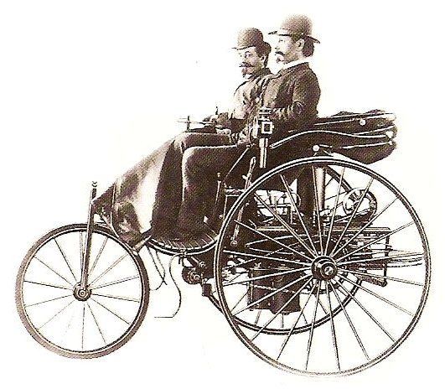
Abstract
Automotive industry has developed rapidly in the last 50 years but before this development machinery was the most important substructure for this industry. For the centuries, people found new resources for living an easy life but to reach them, transportation was the first degree requirement. So they developed engines to do that. After that they make covers and seats to use it for transportation. In the beginning of this, they used hammers to make covers.
Humankind liked this easiness and some people had this vehicles. But it’s not enough to produce this vehicle for everybody. That’s why they understood that hammers and labor can not solve this problem and they started to develop machinery and it’s called by ‘press’. This system was enough to give shape to the steels and other components by minimum labor but they saw that big parts need strong transportation. So they developed robots to decrease labor for transportation. By the time robot technology was not enough the reach the production speed they want. So transfer press’s been developed. In this development safety was more important than the speed. So automotive industry started to use more strong steels for production. But cold stamping press was not enough strong to produce that. So they developed hot stamping technology.

Slide 6
Abstract
This research summaries;
Technology and automation development in manufacturing, their technical details and their history.
Increasing production speed and control methods due to technological development
PLC's and communications (SCADA, Rapid etc...)
Safety improvements on all press technologies.
All intelligent manufacturing systems and their benchmarks
Keywords: Presses, technologies, communications, safety, capacities

Slide 7
Press Production Speed Equation
1. Press Production Speed Equation
Too many press types and technologies have been developed in history but basic working methods're similar. So before analysis these; assuming a formula generally for press production will be useful (a result speed which includes spm-stroke per minute, rpm of all components of system and all loses);
FSPM = SPM – ΣFL – ΣOL – ΣRL [spm]
(1)
FSPM - Final SPM value which includes all loses (reel spm)
SPM - SPM value which's been described on technical specification of press
ΣFL - Feeding loses of production before stamping operation (like operator, conveyor, robot, destacker or another machine delaying)
ΣOL - Operation loses during stamping operation (slide movement delaying like link-drive types, automation delaying like transfer types or robotic types, comminucation delaying like PLC's, press input and output degrees etc...)
ΣRL - Removing loses after stamping operation (like finished part controls, boxing operation etc...)

Slide 8
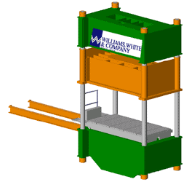
Press Types
2. Press Types
2.1 Universal presses
Universal presses are characterized by their high degree of flexibility. They are suitable both for blanking and forming operations. In combination with individual, progressive blanking, compound and transfer dies, this opens up a wide range of application possibilities for the production of small to medium-sized parts. To increase the number of formed parts and so enhance the cost-effectiveness of the production process, universal presses are equipped with coil lines, scrap disposal systems and stacking units for finished products. Fully automatic die change plays an important role in ensuring economical production.
2.2 Hybrid presses
Mechanical hydraulic presses, also known as hybrid presses, represent a new development in the field of press engineering. This type of press combines the benefits of mechanical and hydraulic presses. The hybrid drive system allows gentle impact of the top die on the workpiece, and also optimum control of the force exerted during the forming process.

Slide 9
Press Types
2.3 Universal presses with modified top drive
system
If an operating sequence involves a wide variety of work processes such as drawing, blanking, bending, stamping or reducing, it is rarely possible to achieve ideal working conditions for the respective forming process when using conventional press drive systems. And if we talk about technological substructure; we can assume 5 different technology;
1. Manuel-tandem presses
2. Progressive presses
3. Robotic lines
4. Transfer presses
2.4 Manuel-tandem presses
They are also a singular universal presses which only controlled by operator. It means feeding is directly linked to conveyor (or other tooling) and operators. So
for manuel presses; we may assume FSPM like this;

Slide 10
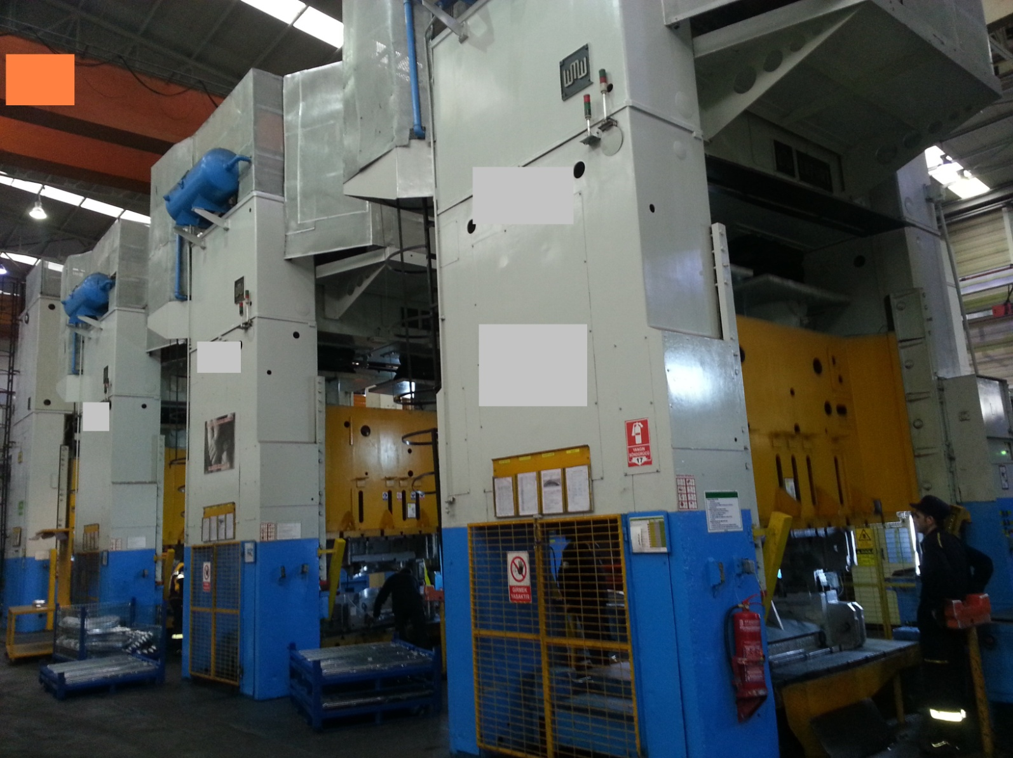
Manuel Tandem Line

Slide 11
Manuel Tandem Line
FSPM = SPM – (|CD| + OD) – ΣOL – (QCD + BD) [spm] (2)
CD – Conveyor delaying
Conveyors are generally cycling with their own structre components. So;
CD = ((n_{c} . D_{c}) / a) - SPM [spm] (3)
n_{c} - Revolution per minute of conveyor motor / handwheel
D_{c} - Diameter of conveyor handwheel
a – Distance between 2 components which'll be stamped on conveyor
NOTE : If CD>0 we'll take it 0. Because it means conveyor has enough speed so there is no delaying. If it's smaller than 0 we'll take absolute of the value. And if there is no conveyor it means components are in the box or a similar stuff. So there's a manuel operation. It means it's operator delaying.
OD – Operator delaying
ΣOL – We may assume operation losses 0. Because there is no automation on manuel press.
QCD – Quality control losses (another type of operator delaying)
BD – Boxing operation losses, it's also operator delaying too.

Slide 12
Manuel Tandem Line
We can add all operator delayings to OD. So final form of calculation;
FSPM = SPM – (| ((n_{c} . D_{c}) / a) - SPM | + OD) [spm] (4)
2.5 Progressive presses
These group have coil feeder unit and a high-speed press. So it can produce without feeding losses on high spm values. Progressive dies have all mold operation in only 1 mold. It means dimensions and stamping forces are not large like other stamping technologies. FSPM calculation;
FSPM = SPM – ΣFL– ΣOL – ΣRL [spm] (1)

Slide 13
Progressive Press

Slide 14
Progressive Presses
ΣFL – Coil feeder and press have common link but they are seperated type units. So each of them have their own SPM. Coil feeder step value should be enough to feed press SPM and input degree values're correct press speed
ΣFL = 0.
ΣOL – is a function of coil feeder radial speed and step of coil feeder. As we described a coil feeder which can enough to feed progressive press is main rule of this system so generally there is no losses on feeding in these systems. We can assume that this value equals to 0.
ΣRL – There are always conveyors or outrun metal holes after the progressive mold. So there is no loses after the progressive operation. It means this value it zero too. So final calculating of progressive presses is like this;
FSPM = SPM [spm] (5)
So; we can say that this is the most effective system for stamping operation. There is only one disadvantage; dimensions of product. As we said we can not product gross parts in these systems.

Slide 15
Robotic Press Lines
2.6 Robotic press lines
“Robot” is a word which came from feudal age that used for the people who should work in the farms belong to wealthy people before their farm. Most bibliographies say the word’s from Russia but the thing is it’s started to use in Czechoslovakia. In 1920, a writer Karel Capek used this word in his theater which referred for an artificial humanlike creatures built for being inexpensive workers. This theater was “Rossum’s Universal Robots”.
After that; robots’ve been staged on industrial production. Today industrial robots and robotic systems are key components of automation. More than 1.1 million industrial robots are operating in the factories all over the world:
• Improving quality of work for employees
• Increasing production output rates
• Improving product quality and consistency
• Increasing flexibility in product manufacturing
• Reducing operating costs.

Slide 16
Robotic Press Line

Slide 17
Robotic Press Lines
Software of robots; In this age; most robotic systems use The RAPID program. The RAPID program templates for a robot executes a pick-and-place cycle for one of the configured flows in every loop. The selection of flow is made in priority order among the flows which currently are ready to execute, that is, having targets generated for the next operation on both the infeeder and the outfeeder. The robot movements and the I/O events on the infeeder and outfeeder are performed according to the configured operation sets and formats. The RAPID program templates inludes functionality to generate safe intermediate positions for the movements between infeeders, outfeeders and the home position.mTo run a PickMaster project you need RAPID program modules and system modules, which are described in this section.
RAPID template modules: The PickMaster installation includes the following two RAPID template modules:

Slide 18
Robotic Press Lines
• PmMain, which is a program module that contains basic code to execute the operations in different work areas.
• PmUtility, which is a program module that contains home positions and intermediate positions.
The RobotWare option Prepared for PickMaster, together with the sub-option PickMaster 5, includes the following two RAPID template modules:
• PmProjMgr, which is a program module that contains basic code to execute the commands from PickMaster I/O interface.
• PmProjServer, which is a program module that contains basic code to execute the commands from PickMaster I/O interface, executed in a semi-static RAPID task.

Slide 19
Robotic Press Lines
2.6 Robotic press lines
PmMain module: This section describes the routines and variables in the PmMain module. The module contains the main procedure for the PickMaster RAPID execution, and it is where the program starts the execution. This section procedures are like these; Main, OperateSequence, Operate. Each module includes the routines. The routine is re-executed for every new pick and place cycle. The error handler is used to recover an error when running a pick and place cycle including a stack search on the master work area. To recover PM_ERR_JOB_EMPTY, follow these directions:
1 - Move back the robot in the negative search direction.
2 - Eliminate the cause of the error, for example, fill up with new pallets.
3 - The position request DO signal is set on the master work area after an empty stack is detected. Generate a new job on the master work area.
4 - Recover the error in the error handler using RETRY. As a result the robot will start the new job and a new pick and place cycle is started.

Slide 20
Robotic Press Lines
Sample of a routine code;
PROC Main()
IF FirstMainLoop THEN
MoveHomePos;
FirstMainLoop:=FALSE;
ENDIF
PmWaitProjStart;
OperateSequence;
ERROR
IF ERRNO = PM_ERR_JOB_EMPTY THEN
RETRY;
ENDIF
ENDPROC
For FSPM calculation;
FSPM = SPM – ΣFL - ΣOL – ΣRL [spm]
(1)

Slide 21
Robotic Press Lines
ΣFL – Feeding systems are generally destacker and centering system in press lines. These are the slowest point of the line. Destacker losses effect centering losses and it effects input robot's losses before the first
press. So we can assume that feeding losses equal to input robot's losses (RD_{i})
ΣOL – Robots are works due to 2 order. Input and output. For robotic press lines this values are main flywheel's degrees. If it's well optimisated robot goes to inside of press before 360º and 180º. So we can say delaying equals to variation of flywheel degrees. So we can say that only losses in here are robot delayings (RD) due to communication adjustments (input-outpout degrees)
ΣOL = RD [spm]
(6)
ΣRL - Generally companies want to adjust final robot within not delaying to main system (press or others) . For wielding or transporting plants there're always delaying because of final robots but for a robotic press line; final robot always take the part from last press and put it on a conveyor which placed in the nearest point to the robot. So there is no delaying for removing part from last press. So final form of calculation is like this;

Slide 22
Robotic Press Lines
FSPM = SPM – RD_{i –} RD [spm]
(7)
Robotic press lines are specific cell type press lines. They generally include more than 1 press and robot. So we can assume a more handy formula for these lines. Cycling time is the identifier parameter. So total cycle time is related to summary of robot and press slide's cycling time.
FSPM = 3600/ (t_{ri} + t_{s} + t_{ro} ) [spm]
(8)
t_{ri} - Cycling time of the input robot which puts the part in to the press. Total cycle time doesn't include input robot's delaying. It's only related to output values. So input robot's cycling time always equals to 0.
t_{s} – Slide's cycling time. It's respected to basic RPM value.
t_{ro} - Cycling time of the input robot which puts the part in to the press.So final calculation is like this;
FSPM = 3600/ (t_{s} + t_{ro} ) [spm]
(9)

Slide 23
Robotic Press Lines
Note: Output robot's cycling time always equals to slowest robot's cycling time. In the other words; in normal conditions final robot is the fastest one because of it doesn't need an output degree. But the slowest robot in the line sends its effect to the all robots on the next stations. So final robot shows same characteristics with it. So if we want to optimise cycle time, we should optimise slowest robot's values.
2.7 Transfer presses
Transfer presses have several distinguishing features that suit them for many types of medium to high volume work. Most operations use precut blanks, although there are combined operations in which the first stations are coil-fed where blanking and other operations are transfer operations.
Many different sizes of transfer presses are used. The first type of transfer press, the eyelet machine, because the first application produced small metal items such as eyelets for shoes. Today some small transfer presses are termed eyeleting machines, although great varieties of parts run on them.

Slide 24
Transfer Press Line

Slide 25
Transfer Presses
Large transfer presses have force capacities of 3500 tons (35.136 mN) or more. Transfer press operations have several common factors. These include:
1. There is an individual die for each operation.
2. Reciprocating transfer feed bars on each side of the press move the parts between the dies with mechanical fingers.
3. The feed bars run in synchronism with the press motion.
The automotive and appliance industries are the principle users of this type of machine. All stamping operations required to complete large parts as automotive hoods and roof panels are completed in such presses. Flat blanks are de-stacked and automatically fed into the right end of the press. The transfer feed bar fingers move the parts from die to die. The completed stampings emerge from the left end where they are placed in storage racks or conveyed to the assembly operation.

Slide 26
Transfer Presses
Transfer Feed Motion: Two types of transfer motion are used. The simplest system uses dual-axis motion. Only in and out motion is used to grasp the part. The second axis of motion transfers the part from die to die. In older designs, the transfer feeder bars are mechanically driven synchronously with the slide motion. The fingers inserted into the transfer feeder bars hold the parts during indexing. In some cases, the fingers use pneumatic jaw clamps to grasp the parts. Wherever possible, simple scoops that rely upon gravity are used. The application of dual-axis transfer feeder bar motion is limited to relatively flat parts having only shallow formed features. The lack of up and down motion results in the parts being dragged across the top of the lower die surfaces when transferred. The system works very well within these limitations. The advantages compared to a tri-axis system are lower initial cost, less maintenance expense and faster cycle times. Tri-axis transfer is needed for parts having deeply formed features. Here, the part must be lifted out of a die cavity or a die forming detail before transfer to the next die can occur.

Slide 27
Transfer Presses
For FSPM calculation;
FSPM = SPM – ΣFL – ΣOL – ΣRL [spm]
(1)
ΣFL – Feeding is always with conveyor or coil driver in this unit. In both situation they should be faster than press and transfer bars. So there is no losses on feeding system and it equals to 0.
ΣOL – It includes transfer bar cycling losses. For best performance; there should be no delaying because of the transfer bars. It means; tansfer bar movements on X,Y,Z axises should be minimum too. (L_{x}, L_{y}, L_{z}) Y axis movement put in to words distances between molds. For minimum movement it should have mininmum distances from the design of the molds. X and Z axises movements can be adfust by press operators.
ΣRL – There's always conveyor on the output point of transfer presses. So this value equals to 0.
So final form of FSPM calculation is like this;
FSPM = SPM – (L_{x} + L_{y} + L_{z}) [spm]
(10)

Slide 28
Benchmarking
3. Bechmarking of Press Types
We can make a table to benchmark for press technologies. Due to all information on the former papers we choose categories, operators, machine park, costs, product mass and production rates and results are like these;

Slide 29
Safety
4. Safety Issues
By the technological developments; safety improvement've developed too. They've been described below;
Overload devices
Safety cloumns
Safety sensors
Safety picketings- safety doors
Slide lockings
Cubic space scanners
Softwares for safety

Slide 30
TEŞEKKÜRLER
THANKS...
GRACIAS...
MERCI...
DANKE SCHÖN...
SPASIBO...
XIE XIE...
SUKRIYA...
KAMSAHAMNIDA...
ARIGATO...
.

