Slide 1
About OMICS Group
OMICS Group International is an amalgamation of Open Access publications and worldwide international science conferences and events. Established in the year 2007 with the sole aim of making the information on Sciences and technology ‘Open Access’, OMICS Group publishes 400 online open access scholarly journals in all aspects of Science, Engineering, Management and Technology journals. OMICS Group has been instrumental in taking the knowledge on Science & technology to the doorsteps of ordinary men and women. Research Scholars, Students, Libraries, Educational Institutions, Research centers and the industry are main stakeholders that benefitted greatly from this knowledge dissemination. OMICS Group also organizes 300 International conferences annually across the globe, where knowledge transfer takes place through debates, round table discussions, poster presentations, workshops, symposia and exhibitions.

Slide 2
About OMICS Group Conferences
OMICS Group International is a pioneer and leading science event organizer, which publishes around 400 open access journals and conducts over 300 Medical, Clinical, Engineering, Life Sciences, Phrama scientific conferences all over the globe annually with the support of more than 1000 scientific associations and 30,000 editorial board members and 3.5 million followers to its credit.
OMICS Group has organized 500 conferences, workshops and national symposiums across the major cities including San Francisco, Las Vegas, San Antonio, Omaha, Orlando, Raleigh, Santa Clara, Chicago, Philadelphia, Baltimore, United Kingdom, Valencia, Dubai, Beijing, Hyderabad, Bengaluru and Mumbai.

Slide 3
Obesity- and metabolic syndrome-related biomarkers as predictors of development and progression of type 2 diabetes
K.V. Ovsyannikov
A.I.Evdokimov Moscow State Medical & Dental University, Russia
Дата

Slide 4
Diabesity

Slide 6
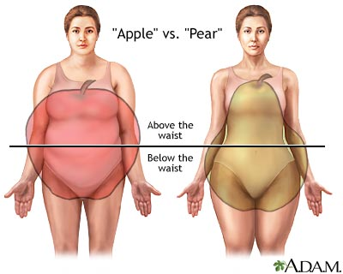

Slide 7
The DM type 2 epidemic is happening now and the situation is getting worse day by day
58 378 222
DM patients in Europe in 2010
98 637 900
DM patients in Europe by 2020

Slide 8
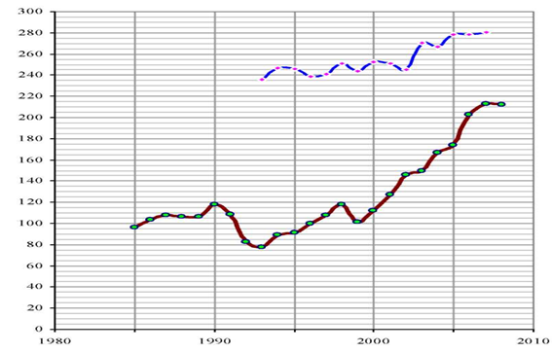
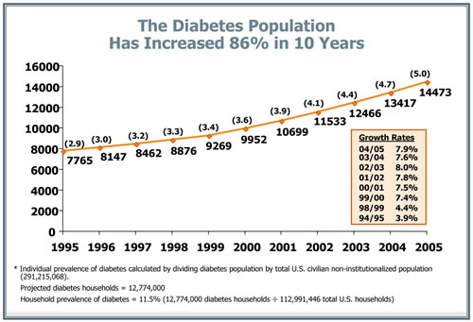

Slide 9
Our future?

Slide 11
Taxes!!!

Slide 12
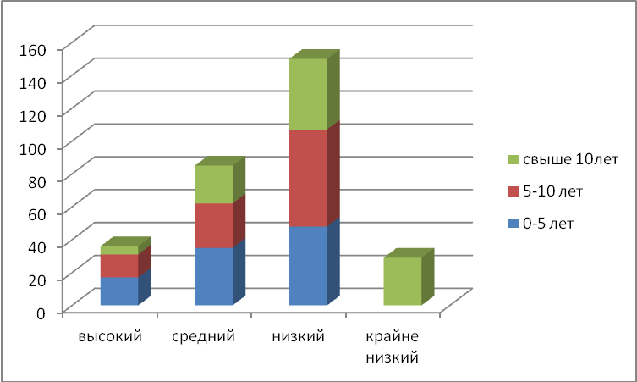
The average levels of the motivation component in the professional actions studed in primary care doctors (in depending of the durings medical work)

Slide 13
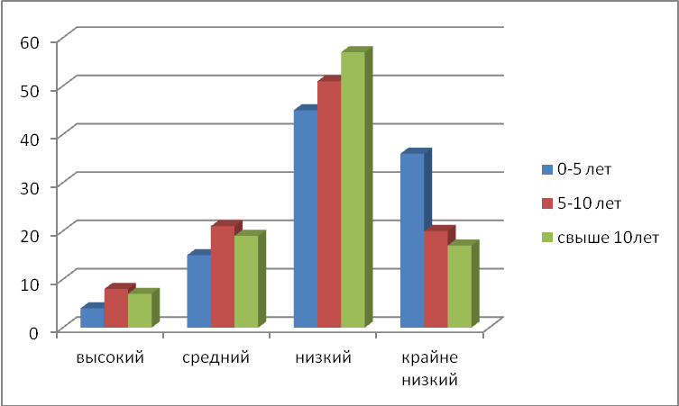
The average levels of the cognitive component in the professional actions studed in primary care doctors (in depending of the durings medical work)

Slide 14
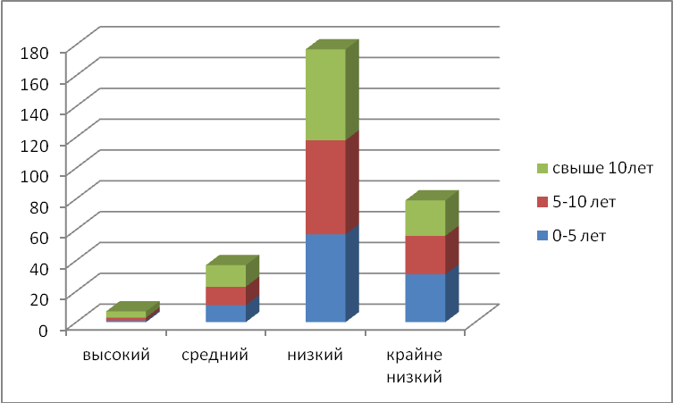
The average levels of the motivation component in the professional actions studed in primary care doctors (in depending of the durings medical work)

Slide 15
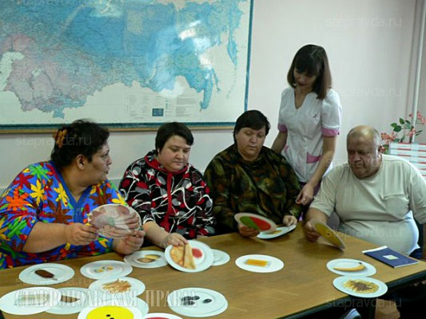
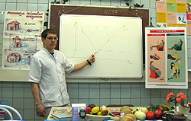

Slide 16
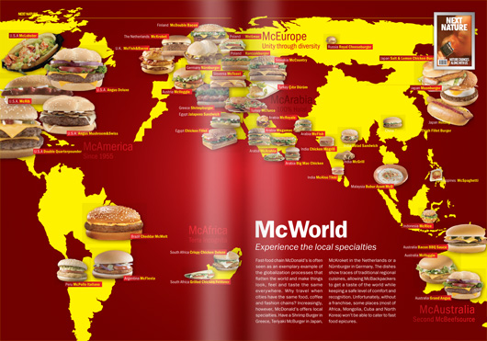

Slide 18
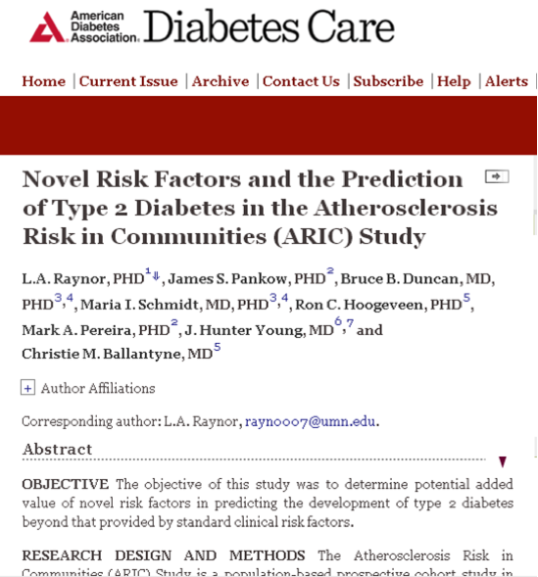
Total adiponectin High-molecular-weight adiponectin Leptin γ-Glutamyl transferase (GGT) Alanine aminotransferase Fetuin A Ferritin C-reactive protein Intercellular adhesion molecule 1 (ICAM-1) Orosomucoid Sialic acid Interleukin-6 Interleukin-18 Complement C3 Asymmetric dimethylarginine (ADMA) Retinol binding protein 4 (RBP-4) Free fatty acids Oxidized LDL Lactate

Slide 19
Metabolic syndrome: a comprehensive perspective based on interactions between obesity, diabetes, and inflammation. Dandona P¹, Aljada A, Chaudhuri A, Mohanty P, Garg R. Circulation. 2005 Mar 22;111(11):1448-54.
Paresh Dandona MD, PhD

Slide 20
Evaluation of food-based dietary guidelines of Germany
concerning their potential of chronic disease prevention
with suggestions for improvement:
Results from the EPIC-Potsdam study
vorgelegt von
Diplom-Ernährungswissenschaftlerin,
Master of Public Health
Anne von Rüsten
von der Fakultät VII – Wirtschaft und Management der Technischen Universität Berlin
zur Erlangung des akademischen Grades
Doktorin der Gesundheitswissenschaften / Public Health
- Dr. P.H. -
genehmigte Dissertation
Promotionsausschuss:
Vorsitzende: Prof. Dr. Jacqueline Müller-Nordhorn
Gutachter: Prof. Dr. Heiner Boeing
Gutachter: Prof. Dr. Reinhard Busse
Tag der wissenschaftlichen Aussprache: 18. Juni 2012
Berlin 2012
D 83

Slide 21
Дата

Slide 22
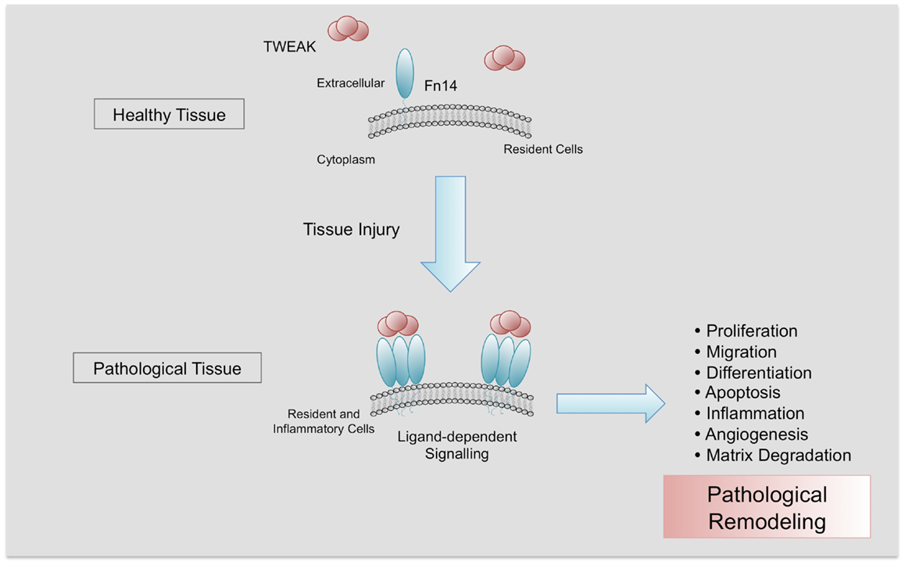

Slide 23
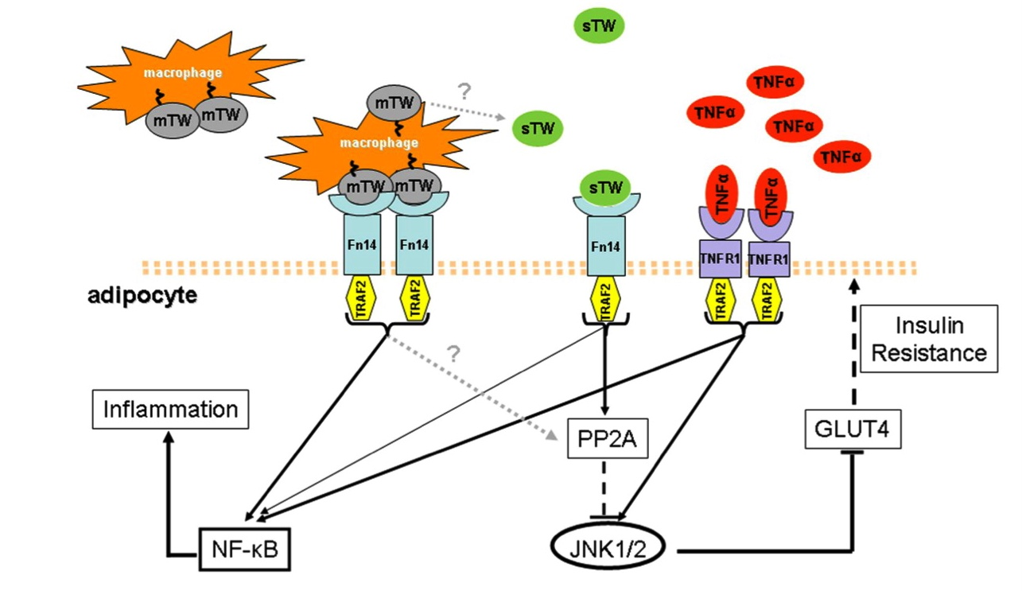

Slide 24
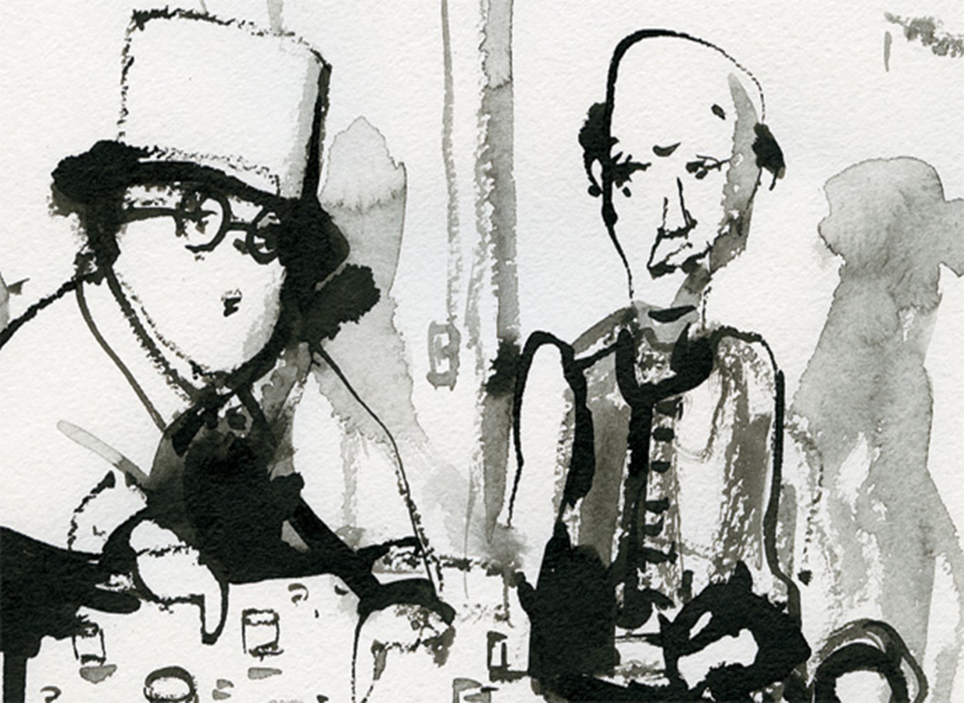
PURPOSE
Fasting hyperinsulinemia (FGI)- a potential biomarker to predict development of t2DM in MS patients?

Slide 25
Materials and Methods
Hyperinsulinemia (fasting) > 15 mkMU/ml 247 MS patients: 115 male 132 female Age (average) : 56 ± 5,8 years
Observation 3 years

Slide 26
Results
After 3 years 54 patients had t2DM

Slide 27
Results
78% of t2DM manifistated had fasting gyperinsulinemia befoure

Slide 28
t2DM-free patients
14% t2DM-free had FGI befoure

Slide 29
Conclusion
Fasting insulin level can be regarded as a biomarker of t2DM
Insulin level measurement is technically simple and inexpensive
Fasting insulin level can be used as a screening method among the persons in high risk of CVD and t2DM

Slide 30
Thank you

Slide 31
Let Us Meet Again
We welcome you all to our future conferences of OMICS Group International
Please Visit: www.omicsgroup.com
www.conferenceseries.com
http://biomarkers.conferenceseries.com/

