Slide 1
Human Pathogenic Bacteria Associated With Vegetables & Advances in Their Control Strategies
Dr. Ranjitha K
Division of Post Harvest Technology
ICAR-Indian Institute of Horticultural Research, Bangalore

Slide 2
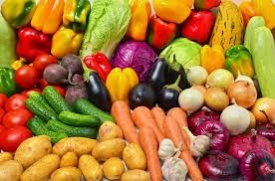
Treasure trove of nutrients
(CH₂O)_{n} - Most vegetables,
Proteins – Legumes
Antioxidants - Phenolics, Vitamins
Phytochemicals - specific to the commodity
Eg. Glucosinilates in cabbage, momordicin in bittergourd
Dietary fibres : Most F&V
Role in immunomodulation, possess functional properties –
antidiabetic, anticancerous, prebiotic
“Integral part of diet world wide contributing taste and diversity ”

Slide 3
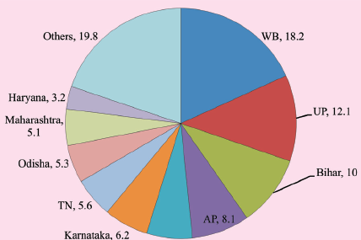
Production scenario
China
India
Source : FAO
Source : NHB, India
“Production and consumption forms a complex network; which makes quality control at consumer level difficult”

Slide 4
F&V consumption linked disease outbreaks
128,000 hospitalization and 3000 deaths each year
46% of all food borne illnesses 1998-2008 were attributable to fresh produce
Leafy green vegetables as the highest priority in terms of fresh produce safety from a global perspective. (WHO, 2008).
Source: CDC, USA
India lacks similar surveillance system; and the situation might be more precarious

Slide 5
Pathogens of concern
http://www.cspinet.org

Slide 6
FSANZ guidelines for microbiological examination of ready to eat foods
Microorganisms | Microbiological quality
 | Satisfactory | Marginal | Unsatisfactory | Potentially hazardous
APC | N/A | N/A | N/A | N/A
E.coli/g(indicator organisms) | <3 | 3-100 | >100 | **
Salmonella sp. /25g | Not detected in 25g | - | - | Detected
Listeria monocytogenes | Not detected in 25g | Detected but < 10² |  | >10²
Bacillus cereus/g | <10² | 10²⁻10³ | 10³ -10⁴ | >10⁴

Slide 7
E coli population in Salad vegetables from Bangalore market

Slide 8
Distribution of food borne pathogens in vegetables from Bangalore market
10+ (?)
0.4 %+ve
1.7% (+)
0.4%
90% (-)
35% (-ve)
65% (+?)
90%
Salmonella sp
Listeria monocytogenes
2%
High no. of presumptive positives for enterobacteriaceae pathogens
Could not detect Bacillus cereus (n=75)
30% -
70(+?)
30 (-)
Yersinia enterocolitica

Slide 9
Routes of Contamination
Contamination can happen at any point of production and handling

Slide 10
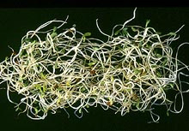
Routes of Contamination Contd..
Seed as source of contamination in seed sprouts
Conducive environment for the multiplication of pathogens

Slide 11
Do the human pathogens interact with plants : Cross kingdom pathogens?
Salmonella and E coli gets internalized in the plant tissues- Chemotaxis
Role of animal pathogenicity genes on the survival in plants is proven (Schikora et al., 2011)
Immune suppression has been observed in Arabdiopsis infected with Salmonella
A cross kingdom pathogen?
Internalization of E. coli in leaf stomata (Berger et al., 2010).

Slide 12
Survival of food borne pathogens in fresh-cut produce
The studies using standard MTCC strains showed the growth of Listeria monocytogenes MTCC839 and the mere survival of Salmonella enterica MTCC 3219 in the minimally processed cabbage at low temperature storage (7⁰C)

Slide 13
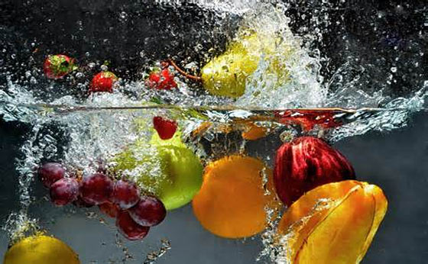
Control strategies
“Prevention is better than corrective measures”
Good agricultural practices
Quality of Irrigation water is most important
Properly composted manure: Temperature
sh’d reach between 55 and 77 ⁰ C for 5 days
Good Handling practices
Washing is the critical control point
Hygienic handling of the produce
Proper storage

Slide 14
Sanitizing methods
Chlorine
Most popular decontaminant
Available as hypochlorite, chlorite
Effective in 50-200ppm for >1 minute exposure
Efficacy is <2 log reductions. So not useful in pathogen elimination
Standard for testing newer methods
Residual toxicity- So banned in fresh cut industry
0.75%
1%
In vitro inhibition of vegetable isolate of salmonella by chlorine

Slide 15
Sanitizing methods Contd.
Chlorine dioxide
Max permitted concentration is 5ppm
Results in 6 log reduction in bacterial count
Tested against different pathogens in diverse F&V
But requires treatment time 10minutes to 2hrs; Temperature >22 ⁰ C.
Peroxy acetic acid
40-80 ppm recommended by FDA
Disinfection efficiency is similar to chlorine

Slide 16
Sanitizing methods Contd.
Ozone
Disinfection capacity is equal to chlorine; but no residual effect.
5ppm is typically used
Approved disinfection agent
But corrosive, highly unstable, on site production is required
Studies on using in packaging is under progress
Hydrogen peroxide
No residue (GRAS), 0.5-2,5% is used
Cause browning

Slide 17
Efficacy of disinfectants in removing Salmonella from fresh-cut cucumber
Sanitizer | After 6 days (cfu/g) storage at 8⁰ C | Marketability after 6 days
Control | 145X10⁴ | 2/5
100 ppm chlorine | 12X10² | 3/5
2000ppm H₂O₂ | 104×10³ | 2/5
Calcium propionate | 37×10² | 4/5
population in the dip solution: 32X10⁶/ml in dip solution

Slide 18
Irradiation
Gamma irradiation approved in leafy vegetables for E. coli & Salmonella decontamination (FDA, 1999, 2008).
Up to 10k Gy is permitted. > 1 kGY is likely to affect the shelf life
Presence of oxygen improves the sensitivity of organisms
Initial washing is necessary
Requires high investment
UV radiations (200-280nm) are also germicidal on the surface
(Gomes et al, 2009)

Slide 19
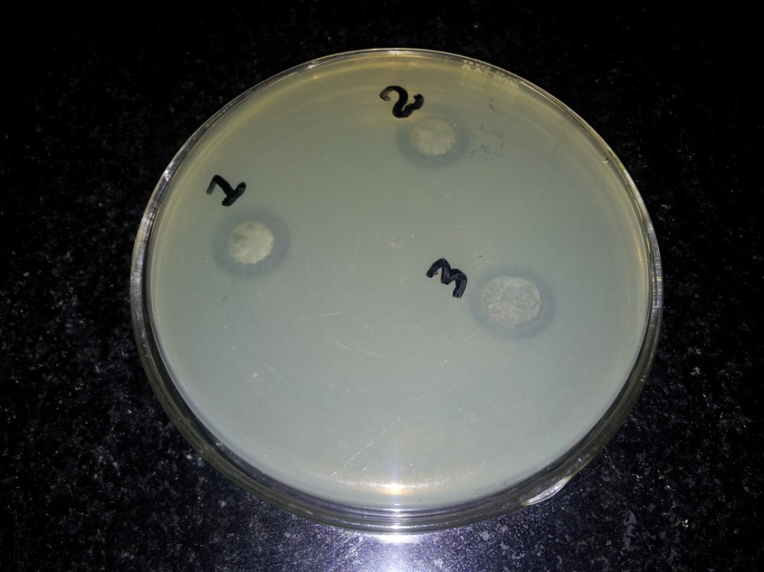
Bio-preservation
Lactic acid bacteria: Through competition, production of antimicrobials like bacteriocins, H₂O₂
In vitro inhibition of salmonella cultures by lactic acid bacteria

Slide 20
Electrolyzed water
Generated by the electrolysis of a diluted NaCl solution passing through the anode of a membrane electrolyzer.
AEW has a strong bactericidal effect on most known pathogenic bacteria due to its low pH (2–4) and high oxidation–reduction potential and because it also contains active oxidizers like hypochlorous acid
Hsu, 2003)

Slide 21
Other methods
Detergent solutions
Organic acids
Electrostatic applications of organic acids, Ultrasound, Pulsed light
“ Decontamination efficacy is variable with type of produce, adhering particles, biofilm formation & extent of tissue damage”
“Every sanitization method has some drawbacks”

Slide 22
Thank You !

Slide 23
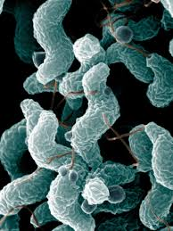
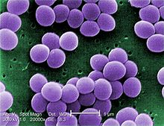
Other Food borne Bacterial Pathogens
Yersinia enterocolitica :Grows at chilling temp
Shigella sonneii & S. flexnerii: Diarrohea in children
Bacillus cereus
Campylobacter : diffuse, bloody, edematous, and exudative enterititis
Staphylococcus aureus
Staphylococcus aureus
Campylobacter jejuni

Slide 24
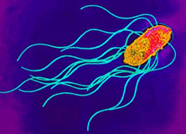
Salmonella: Most frequent pathogen in F&V
Family : enterobacteriaceae
Salmonella enterica are human pathogenic
S. enterica has 6 subspecies &>2500 serotypes
Causes non-typhoidal salmonellosis
Responsible for 76%, 60% and 30% of outbreaks caused by fruits, seed sprouts and leafy vegetables, respectively
Self limiting diarrhoea, abdominal cramps, fever
Infectious dose 10-10000 cells
Subclinical levels of population always present in cattle gut

Slide 25
Pathogenic E coli
Shigatoxigenic E. coli (STEC) is one of the pathotypes. It causes symptoms ranging from mild to severe and bloody diarrhoea.
Enterohaemorrhagic E. coli (EHEC):subset of STEC typically associated with bloody diarrhoea and HUS, which produce cytotoxins, known as verotoxins (VT) or Shiga-like toxins (Stx).
In relation to public health, E. coli (O157:H7) strain is the most important EHEC serotype linked to foodborne disease, resulting in a high incidence of EHEC infections and deaths each year.
Microbiological criteria for fresh produce by several countries insists the absence of E. coli (O157:H7) in the sampling unit of food

Slide 26
Routes of Contamination Contd..
Soil is natural habitat for many pathogens
Eg. Bacillus cereus, L. mono, Campylobacter
Animal manure adds to the load
Eg. Salmonella and E coli population in feces ranges from 2-5 log cells
Survival in solid manure : Campylobacter < Listeria < Salmonella < Ecoli O157:H7 (Nicholson et al., 2005)
Moist clayey soil enhances their survival chances
Spray and flood irrigation increases the contamination levels

Slide 27
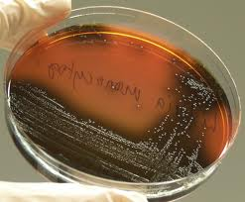
Listeria monocytogenes
G +ve, facultative anaerobes, motile at <30 °C
Identified as foodborne in 1981 in Canada, where listeriosis was linked to the contaminated cabbage consumption
Estimated 1,600 illnesses and 260 deaths in the United States (U.S.) annually.
Psychrotrophic
Infectious dose <10 cells

