Slide 1
Efficacy of combination mucosal vaccination and immunotherapy strategies for the treatment of HPV-associated cancers
Jagan Sastry, PhD
Professor, Department of Immunology
Professor, Department of Veterinary Sciences
The University of Texas MD Anderson Cancer Center
Associate Development Core Director
UT-Baylor Center for AIDS Research

Slide 2
Most pathogens are transmitted via mucosal routes: Genital, Oral, Nasal
Viruses:
  HIV, HPV, Genital Herpes (sexual transmission)
  Rota Virus, Hepatitis-A virus (oral)
  Influenza Virus, Respiratory syncytial virus (pulmonary)
  Bacteria:
  Mycobacterium tuberculosis (pulmonary)
  Salmonella (oral)
  Helicobacter pylori (oral/GI)
  E. coli (oral/GI)
  Neisseria gonorrhea (sexual tranmission)
  Fungi/Yeast:
  Aspergillus fumigatus: Aspergillosis (pulmonary)
  Candida albicans: Candidiasis (oral thrush and vaginitis)
  Histoplasma capsulatum: Histoplasmosis (pulmonary)
  Coccidioides immitis: Coccidioidomycosis (pulmonary)
  Cryptococcus neoformans: Cryptococcosis (pulmonary, GI)

Slide 3
Mucosal tissues are targets for primary and/or metastatic tumors
  Because of the circulatory pattern and the selective affinity of the endothelium for cancer cells, the lung is the second most commonly targeted organ for metastases after liver
  Pulmonary metastases are frequent in melanoma, breast, colorectal, head and neck, prostrate and renal cancers
Important concern:
In general, most pre-clinical cancer vaccine studies rely on extrapolating the observations of protection in mouse models against subcutaneous tumors to mucosal tumors

Slide 4
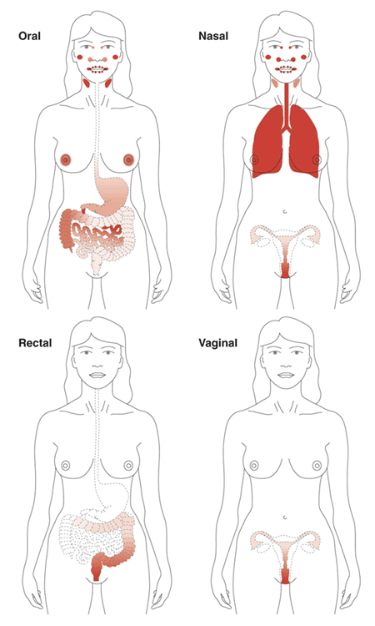
Common Mucosal Immune System
Vaccination at the easily assessable oral/nasal mucosal surfaces induces immunity at the local as well as distant difficult to reach genital mucosal tissues
Holmgren J., Czerkinsky C., Nature Medicine 2005.
Because of the potential to induce more wide-spread immune responses in addition to the ease of application, the oral and nasal routes are more popularly explored for mucosal delivery of antigens

Slide 5
Mucosal Immunity
Mucosal immune cells:
  protect the host from potentially harmful pathogens
  Most mucosal immune cells are educated at specific inductive sites in the local mucosal-associated lymphoid tissues (MALT) and subsequently move into and protect mucosal barriers
However:
  prevent development of immune responses to commensal microbiota and harmless food and environmental antigens: tolerogenic
  Hence, stimulation of mucosal immunity necessitates inclusion of ADJUVANTS

Slide 6
Adjuvants
Adjuvants enhance immune responses to co-administered antigens
  Adjuvants typically function by activating innate immune cells such as Dendritic Cells (DC)
  Currently, only the alum adjuvant has been FDA approved for use in vaccines in the US
  Bacterial toxins (and their mutant versions) are potent mucosal adjuvants; but the toxicity (despite mutations) is a concern for human use approvals
  There is a need for the development of more adjuvants, particularly those that can modulate innate immunity and also administered by mucosal routes

Slide 7
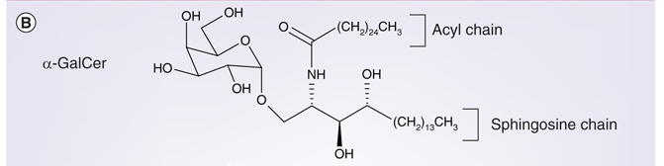
Alpha-Galactosylceramide
Kim S et al., Expert Rev Vaccines 2008.
The synthetic glycolipid alpha-glactosylceramide (α-GalCer) is a potent activator of natural killer T (NKT) cells.
NKT cells are a major innate immune mediator cell type effective in inducing maturation of dendritic cells (DC) for efficient presentation of co-administered antigens
Notes:
Talk about analogs

Slide 8
Alpha-Galactosylceramide
The a-GalCer adjuvant functions as a ligand to activate NKT cells when presented by the CD1d molecule, particularly on dendritic cells.
Presentation of a-GalCer by DC leads to rapid IFN-g production and proliferation by the NKT cells.
This is followed by activation of DC that are activated to present antigens to T cells and their proliferation and function
A-GalCer is safe for human use
DC
NKT-Cell
αGalCer
IL-4, IFNγ, IL-2
+ Antigen
T-Cell
T-Cell
T-Cell
T-Cell
T-Cell
Fujii, SI et. al. Activation of Natural Killer T Cells by a-Galactosylceramide Rapidly Induces the Full maturation of Dendritic Cells in vivo and Thereby Acts as an Adjuvant for Combined CD4 and CD8 T Cell Immunity to a Coadministered Protein. J. Exp. Med. 2003.

Slide 9
Intranasal Immunization using α-GalCer Adjuvant
T cell responses
IFNγ ELISPOT Assay
Day 0
Day 5
Day 10
Day 15
Immunize
Immunize/Sacrifice
Immunize/Sacrifice
Sacrifice
Antibody responses
Courtney AN, et al. Vaccine 2009.
Multiple immunizations by the intranasal mucosal route using aGalCer adjuvant Induces Progressively Increasing Antigen Specific Immune Responses

Slide 10
Mucosal vaccination against
Human papillomavirus (HPV)-associated cancers
The 150+ different types of HPV are broadly classified as
Low Risk
HPV6, 11,
(Warts)
High Risk
HPV16, 18,
(Cervical Cancer)
The pre-cancerous lesions are described as cervical intraepithelial neoplasia (CIN) and are classified based on disease severity:
CIN I: low-grade dysplasia
CIN II: moderate dysplasia
CIN III: high-grade dysplasia
CIS: carcinoma in situ
ICC: Cervical Cancer

Slide 11
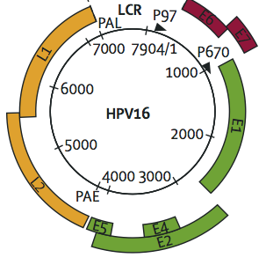
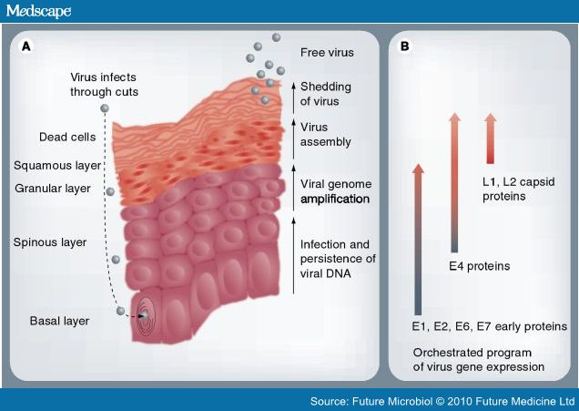
Human papillomavirus (HPV)
The HPV genome encodes for six different early proteins (E1, E2, E4, E5, E6, and E7) and two late proteins (L1 and L2).
Schiffman Lancet (2007) 370:890-907
E6 and E7
The L1 and L2 proteins are important for virus binding and entry into epithelial cells.
In infected cells, the E6 and E7 proteins of high-risk serotypes cause degradation of cellular tumor suppressor proteins p53 and pRB and oncogenic transformation
L1, L2
The currently approved vaccines are based on the L1 gene and therefore can prevent initial infection but can not protect against the pre- and cancer lesions where only the E6 and E7 genes of the virus are expressed

Slide 12
Human papillomavirus (HPV)
The pre-cancerous lesions of the cervix: Cervical Intraepithelial Neoplasia (CIN)
Typically, these precancerous lesions regress spontaneously
Under conditions of immunodeficiency (AIDS/Transplatation) — CIN may eventually progress to invasive cervical cancer (ICC)
HPVs also cause some cancers of the anus, vulva, vagina, penis, and the oropharynx (throat, soft palate, the base of the tongue, and the tonsils)

Slide 13
Treatments for HPV-CIN
Methods commonly used to treat cervical lesions include cryosurgery (freezing that destroys tissue), LEEP (loop electrosurgical excision procedure, or the removal of tissue using a hot wire loop), and conization (surgery to remove a cone-shaped piece of tissue from the cervix and cervical canal)
However, a significant number of patients (13-19%) experience recurrence and it is not clear what the reasons are or what if any is the relation to HPV-specific immunity.
Hypothesis: Immune memory to HPV, specifically to the E6 and E7 oncoproteins, is necessary for recurrence-free survival post-treatment for HPV-associated CIN.
To test this hypothesis we conducted a cross-sectional study in HPV patients

Slide 14
Cross-sectional Study population
Group 1. (HPV⁻/CIN⁻)
Control women: negative for both HPV and cervical intraepithelial neoplasia (CIN⁻): n=6
Group 2. (HPV⁺/CIN⁺)
Women HPV⁺ and with newly diagnosed CIN lesions (CIN⁺): n = 33
Group 3. (Recur⁻)
Disease-free after excisional/ablative treatment for HPV-CIN (at least six months post-treatment): n = 22
Group 4. (Recur⁺)
Exhibiting recurrence or persistence of disease after excisional/ablative treatment for HPV-CIN (at least six months post-treatment): n = 10
T cell proliferation response in the blood

Slide 15
Dominant proliferative responses in Recur⁻ subjects
E6 peptide:
  Q15L (43-57) QLLRREVYDFAFRDL
E7 peptide:
  Q19D (44-62) QAEPDRAHYNIVTFCCKCD
It has been reported that:
Production of TH1-type of cytokines (e.g. IL-12 and IFN-g) was defective in women with extensive HPV infection.
Progression to CIN was associated with a shift from TH1- to TH2- or immunosuppressive-type (e.g. IL-4 and IL-10) of cytokine production

Slide 16
Outcome from the cross-sectional study
Peptides Q15L and Q19D, corresponding to the E6 and E7 oncoproteins of HPV-16, respectively could potentially be useful as:
  Indicators of protective immunity, (prognostic bio-markers)
  Immunotherapy (therapeutic vaccine)
To validate these results from the cross-sectional study we performed a prospective study with 250 patients
BL 1 Mo 4 Mo 6 Mo 9 Mo 12 Mo 18 Mo 24 Mo
Diagnosis
CIN II or CIN III
LEEP = Loop Electrosurgical Excision Procedure

Slide 17
Treatment influence on HPV immunity
      E6 Peptide: Q15L (43-57) QLLRREVYDFAFRDL
      E7 Peptide: Q19D (44-62) QAEPDRAHYNIVTFCCKCD
Vaccination with these HPV E6 & E7 peptides to induce/enhance HPV-specific immunity for protection against HPV lesions is a potential option
The immunity needs to be specifically at the genital mucosal tissues: i.e. Mucosal T cell Immunity

Slide 18
Intranasal immunization with HPV peptide
Day 0
Day 5
Day 10
Immunize
Immunize
Sacrifice/Tumor Challenge
HPV peptide vaccine primes mucosal immunity and Tumor protection

Slide 19
Therapeutic intranasal immunization with HPV vaccine against HPV tumors
Peptides Q15D and Q19D with aGalCer adjuvant
HPV peptide vaccine significantly reduced HPV tumor growth resulting in survival advantage
While effective in reducing tumor growth, the HPV peptide vaccine was inefficient in eliminating the tumor
This may be because of the immunosuppressive tumor microenvironment

Slide 20
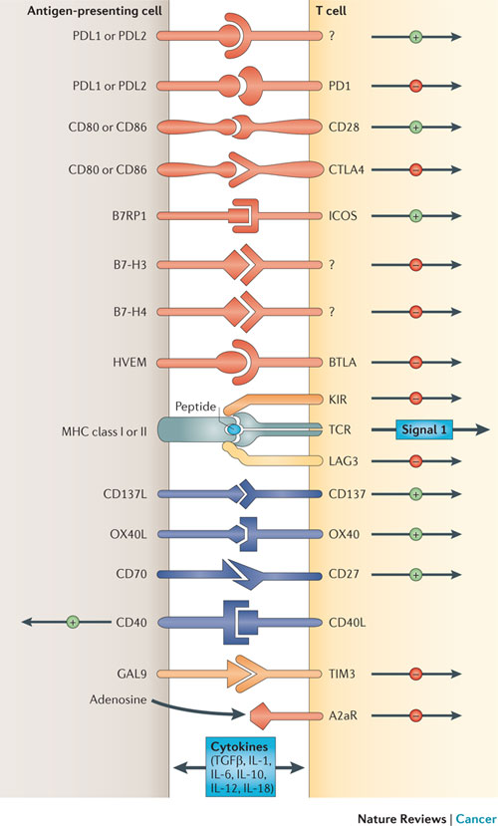

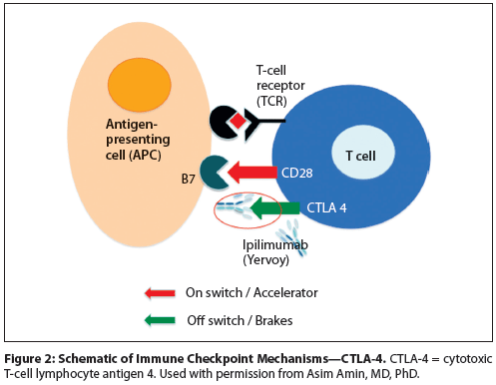
Tumor microenvironment
Immune suppressive with
  Accumulated regulatory T cells
  Decreased/compromised
    Antigen presentation, and
  Exhausted/inhibited Effector T cell responses
Or
Tumor cell
Professor and Chair
Department of Immunology
The UT MD Anderson
Cancer Center

Slide 21
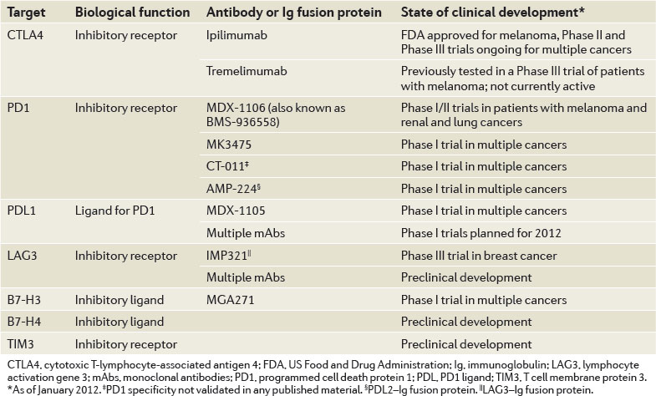

Slide 22
Vaccine + immunotherapy of HPV tumors
Intranasal Vaccine:
E6 and E7 peptides
(100ug each in PBS)
Intraperitoneal injections of
Immune check point antibodies:
Antagonistic antibodies to
CTLA-4 and PD-1
Agonistic antibody to 4-1BB
*
**
Scheme
Collaborators: Michael Curran, PhD, James Allison, PhD; Immunology

Slide 23
Vaccine immunotherapy of Vaginal HPV tumors

Slide 24
Vaccine immunotherapy of Vaginal HPV tumors

Slide 25
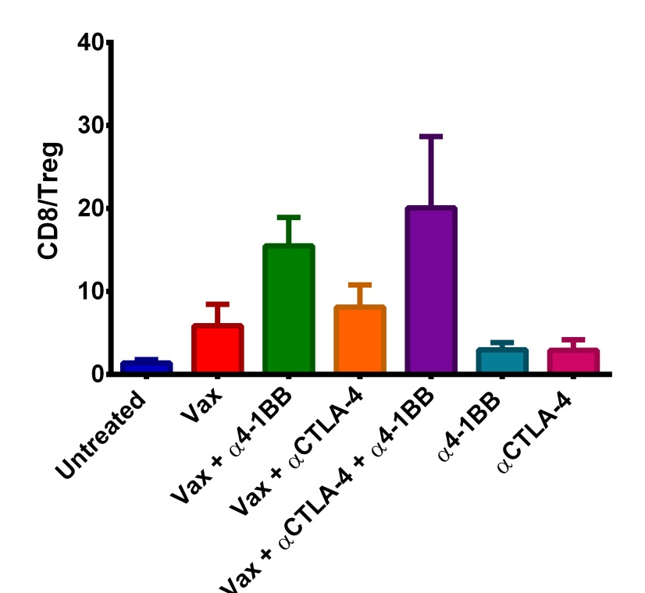
Vaccine immunotherapy of HPV tumors
Combination of 4-1BB and CTLA-4 antibodies
This combination augmented HPV E6/E7 vaccine by increasing CD8 infiltration and decreasing T_{regs} in tumors

Slide 26
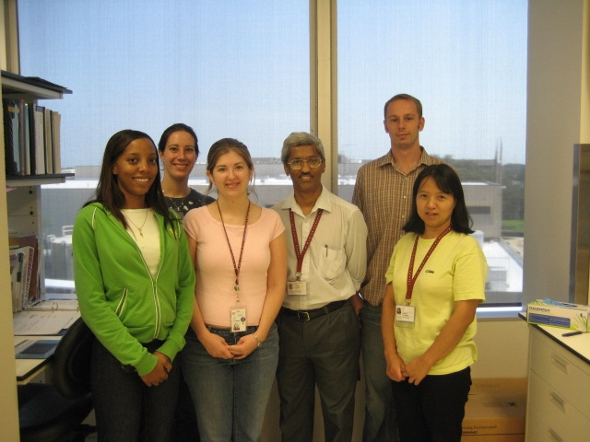
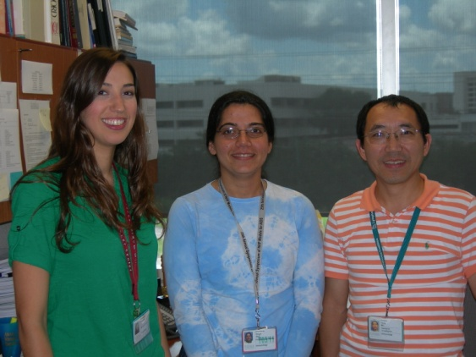
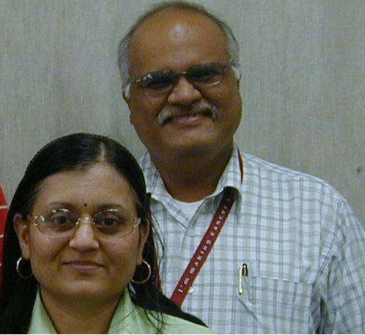
Acknowledgements
Drs. Michael Curran and James Allison
Immunology
Shailabala Singh
Post-Doctoral Fellow
Ameerah Wishahi
Graduate Student
Seth Wardell
Res. Technician
Guojun Yang
Research Investigator
Corinne Bell
MS student
Amy Courtney
PhD student
Danielle Fonenot
PhD student
Dr. Hong (Helen) He
Res. Investigator
Dr. Michael Barry, Mayo Clinic, Rochester, MN
Dr. Chun Wang, Univ. Minnesota, Minneapolis, MN
Pramod Nehete, PhD, Assoc. Prof
Bharti Nehete, Research Asst.

