Slide 1
About OMICS Group
OMICS Group International is an amalgamation of Open Access publications and worldwide international science conferences and events. Established in the year 2007 with the sole aim of making the information on Sciences and technology ‘Open Access’, OMICS Group publishes 400 online open access scholarly journals in all aspects of Science, Engineering, Management and Technology journals. OMICS Group has been instrumental in taking the knowledge on Science & technology to the doorsteps of ordinary men and women. Research Scholars, Students, Libraries, Educational Institutions, Research centers and the industry are main stakeholders that benefitted greatly from this knowledge dissemination. OMICS Group also organizes 300 International conferences annually across the globe, where knowledge transfer takes place through debates, round table discussions, poster presentations, workshops, symposia and exhibitions.

Slide 2
About OMICS Group Conferences
OMICS Group International is a pioneer and leading science event organizer, which publishes around 400 open access journals and conducts over 300 Medical, Clinical, Engineering, Life Sciences, Phrama scientific conferences all over the globe annually with the support of more than 1000 scientific associations and 30,000 editorial board members and 3.5 million followers to its credit.
OMICS Group has organized 500 conferences, workshops and national symposiums across the major cities including San Francisco, Las Vegas, San Antonio, Omaha, Orlando, Raleigh, Santa Clara, Chicago, Philadelphia, Baltimore, United Kingdom, Valencia, Dubai, Beijing, Hyderabad, Bengaluru and Mumbai.

Slide 3
Change of The Physical Properties of Colored High Density Polyethylene by Effect of Environment
K.E. Shady & F.M. Tera
National Institute For Standards- Giza- Egypt

Slide 4
Change of The Physical Properties of Colored High Density Polyethylene by Effect of Environment
Introduction:
Environmental conditions exposure on the high polymers causes molecular chain scission at the exposed surface , serious reduction in mechanical properties , discoloration and fading ( 1-4 ) The most responsible weather features for photo degradation are light particularly of near ultraviolet wave length ( 5.6 ) , moisture in the liquid of vapor form , temperature and oxygen ( 6-8 ) . The rate of photochemical degradation is greatly increased with the temperatures and moisture of the sroudings (9). The polyethylene showed high resistance to chemical, moisture and other environ ments (10).
This work studied and discussed the change in the mechanical properties and colour of orange high density polyethylene polymer in the net form produced by the effect of different environmental conditions and
liquids.

Slide 5
Change of The Physical Properties of Colored High Density Polyethylene by Effect of Environment
Experimental:
Samples: Orange ½ nets- density polyethylene polymer. ( Ten Samples)
Weathering: A group of samples were directly exposed to environmental conditions at an urban site in Egypt for one month.
Environmental Liquids:
Tap Water (30 days).
Acid Solution (P.H. 5.5).
Another set (kaline solution P.H. 9, same period).
Soil Burying:
Muel-Soil-Burying: (strips-February 2013-damped mud soil- 40cm)
Sand-Soil- Burying: (sand soil- same period- same depth)

Slide 6
Change of The Physical Properties of Colored High Density Polyethylene by Effect of Environment
Heating:
Damped- hot surrounding: ( strip samples dipped in Ajar- oven 40C – 10 hrs- another set- 70 C- same duration.
Dry- hot surrounding: ( strip samples left in oven 50 C for 10 hrs)
Testing:
Mechanical Properties: ( air conditioned room 23 C- R.H. 65%- 24hrs- changes in tensile, strength and elongation %- assessed by tensile tester [ C.R.T])
Light Fastness: ( Visual Assessment to all sets)

Slide 7
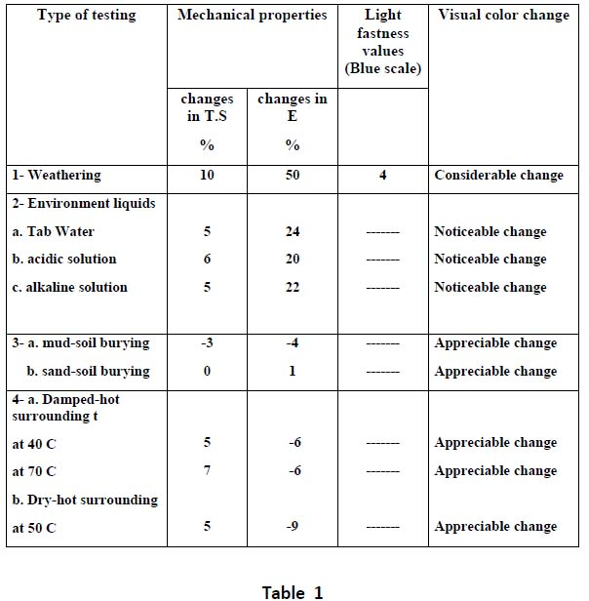
Change of The Physical Properties of Colored High Density Polyethylene by Effect of Environment
Results and Discussion:
Weathering:
Table 1 shows that exposing the orange net high density polyethylene samples directly to environmental conditions caused a considerable change in the mechanical properties, where a loss in tensile strength of about 10% was recorded. The extension was higher. It reached about one and a half times of the original length. And the light fastness decreased to be 4.

Slide 8
Change of The Physical Properties of Colored High Density Polyethylene by Effect of Environment
Environment Liquids:
the environment liquids showed an appreciable decrease in the tensile strength when the samples were immersed- for one month- in any of the tap water or either the acidic or alkaline solution. It can be seen clearly that the aqueous solution produced a considerable increment in the elongation percent of about 24% and this may be attributed to swelling of the polymer. The same effect was observed when the polymer was immersed in either acidic or alkaline solution. In addition, the environment liquids caused a noticeable change in color after immersion for one month.

Slide 9
Change of The Physical Properties of Colored High Density Polyethylene by Effect of Environment
Soil Burying:
Mud-Soil Burying: small change in either mechanical properties or color fastness by such a test.
Sand- Soil Burying: Least Change in all parameter.
Heating:
Damped Hot Surroundings: Raise in the temperature of surroundings (40 & 70 C) - increase with tensile strength of about ( 5-7%) - about 6% shrinkage- color was almost unaffected.
Dry- hot surroundings: Dry- hot surroundings at 50C -same change in tensile strengths as that of the damped one - for the elongation, the decrease was higher of about 9% indicating that the polymer became more brittle.

Slide 10
Change of The Physical Properties of Colored High Density Polyethylene by Effect of Environment
Conclusion:
Colored high-density polyethylene nets may be used safely for wearing and as an indicator for the underground pipes passage.
It’s color, also the mechanical properties are appreciable changed when exposed to severe conditions of environment liquids in the underground.
Direct Exposure to environmental conditions (weathering) was accompanied by a change in the mechanical properties- tensile strength suffered a loss of about 10%- for elongation , the loss was about 50%.
The light fastness values were reduced to 4.
When using such a polymer in the underground sites, it must be used directly there, and not to be left to weathering conditions.

Slide 11
Change of The Physical Properties of Colored High Density Polyethylene by Effect of Environment
REFERENCES
(1) SHADY K.E., Master of Applied Arts Thesis, "Damage Measurements of Some Unfinished Textile Fabrics Due to Weathering Conditions in Egypt". Textile Department, Helwan University, Cairo, (1983).
(2) MARY W. WEBB, J. Text. Inst. No. 3, 219, (1994).
(3) Influence of micro molecular structure on environmental stress cracking resistance of high density polyethylene Original Research Article. Tunneling and Underground Space Technology, Volume 26, Issue 4, July 2011, Pages 582-593.
Joyl. Change, Maria A. Polak, Alexander Penlidis.
(4) Influence of the temperature and strain rate on the tensile behavior of post consumer recycled high-density polyethylene.
Polymer Testing, Volume 32, Issue 8, December 2013, Pages 1576-1581
J.M.L. Reis, L.J. Pacheco, H.S. da costa Mattos.
(5) RUGGER G.R., ROSATO D.V. and SWARTZ J., N.Y. Interscience, 339,( 1998).
(6) SHAH C.D. and SRINIVASAN R., J. Textile. Inst. 66,249, (1995).
(7) SHAH C.D. and SRINIVASAN R., J. Textile Inst. 5, 99, (1998).
(8) EGERTON G.S and SHAH C.D., Part 1, Textile Res. J., 38, 130, (1998).
(9) SHADY K.E., Ph.D. of Applied Arts Thesis, "Scientific Aspects of the Different Changes Occurring to Some Textile Fabrics After Exposure to Various Irradiation Sources"., Textile Department, Helwan University, Cairo, (1989).
(10) More W.R., “ An Introduction to Polymer Chemistry, John Wiley and Sons, 2nd Ed., (1995).

Slide 12
Let Us Meet Again
We welcome you all to our future conferences of OMICS Group International
Please Visit: http://materialsscience.conferenceseries.com/
Contact us at
materialsscience.conference@omicsgroup.us
materialsscience@omicsgroup.com

