Slide 1
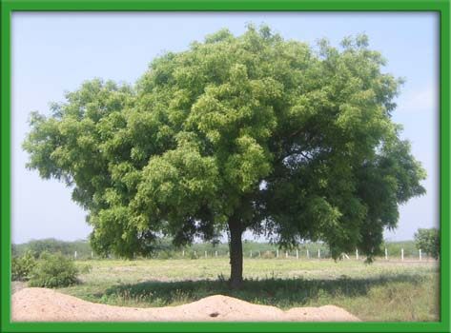
Evaluation Of Neem Leaf Powder Along With Spirulina As An Alternative To Antibiotic Growth Promoter In Broiler Production
Dr K. Bharavi Ph.D
Associate professor
Department of Pharmacology & Toxicology
NTR College of Veterinary Science,
Gannavaram, Krishna (dt)
Andhra Pradesh

Slide 2
Introduction
Antibiotic growth promoters Oxytetracycline,Chlortetracycline, Doxycycline,
Enrofloxacin, Ciprofloxacin,
Bacitracin,
Furazolidone,
Euramycin .(Falcao-cunha et al., 2007; CSE Report)

Slide 3

Introduction
CSE found Antibiotic residues in 40% of chicken samples from most of locations tested in Delhi-NCR

Slide 4
Introduction
Antibiotic residues in chicken samples from the locations of Delhi-NCR |  |  | ADI (µg/kg)
Antibiotic | % of Chicken with antibiotic | Level of antibiotic (µg/kg) | JECFA (FAO/WHO) | EMEA
Oxytetracycline | 11.4% | 8.25 - 15.16 | 0 – 30 Parent drugs, singly or in combination | 0.3
Chlortetracycline | 1.4% | 10.20
Doxycycline | 14.3% | 11.94 - 20.66
Enrofloxacin | 20% | 3.37 - 131.75 | 0 - 2 | 0.3125
Ciprofloxacin | 14.3% | 3.55 - 64.59

Slide 5
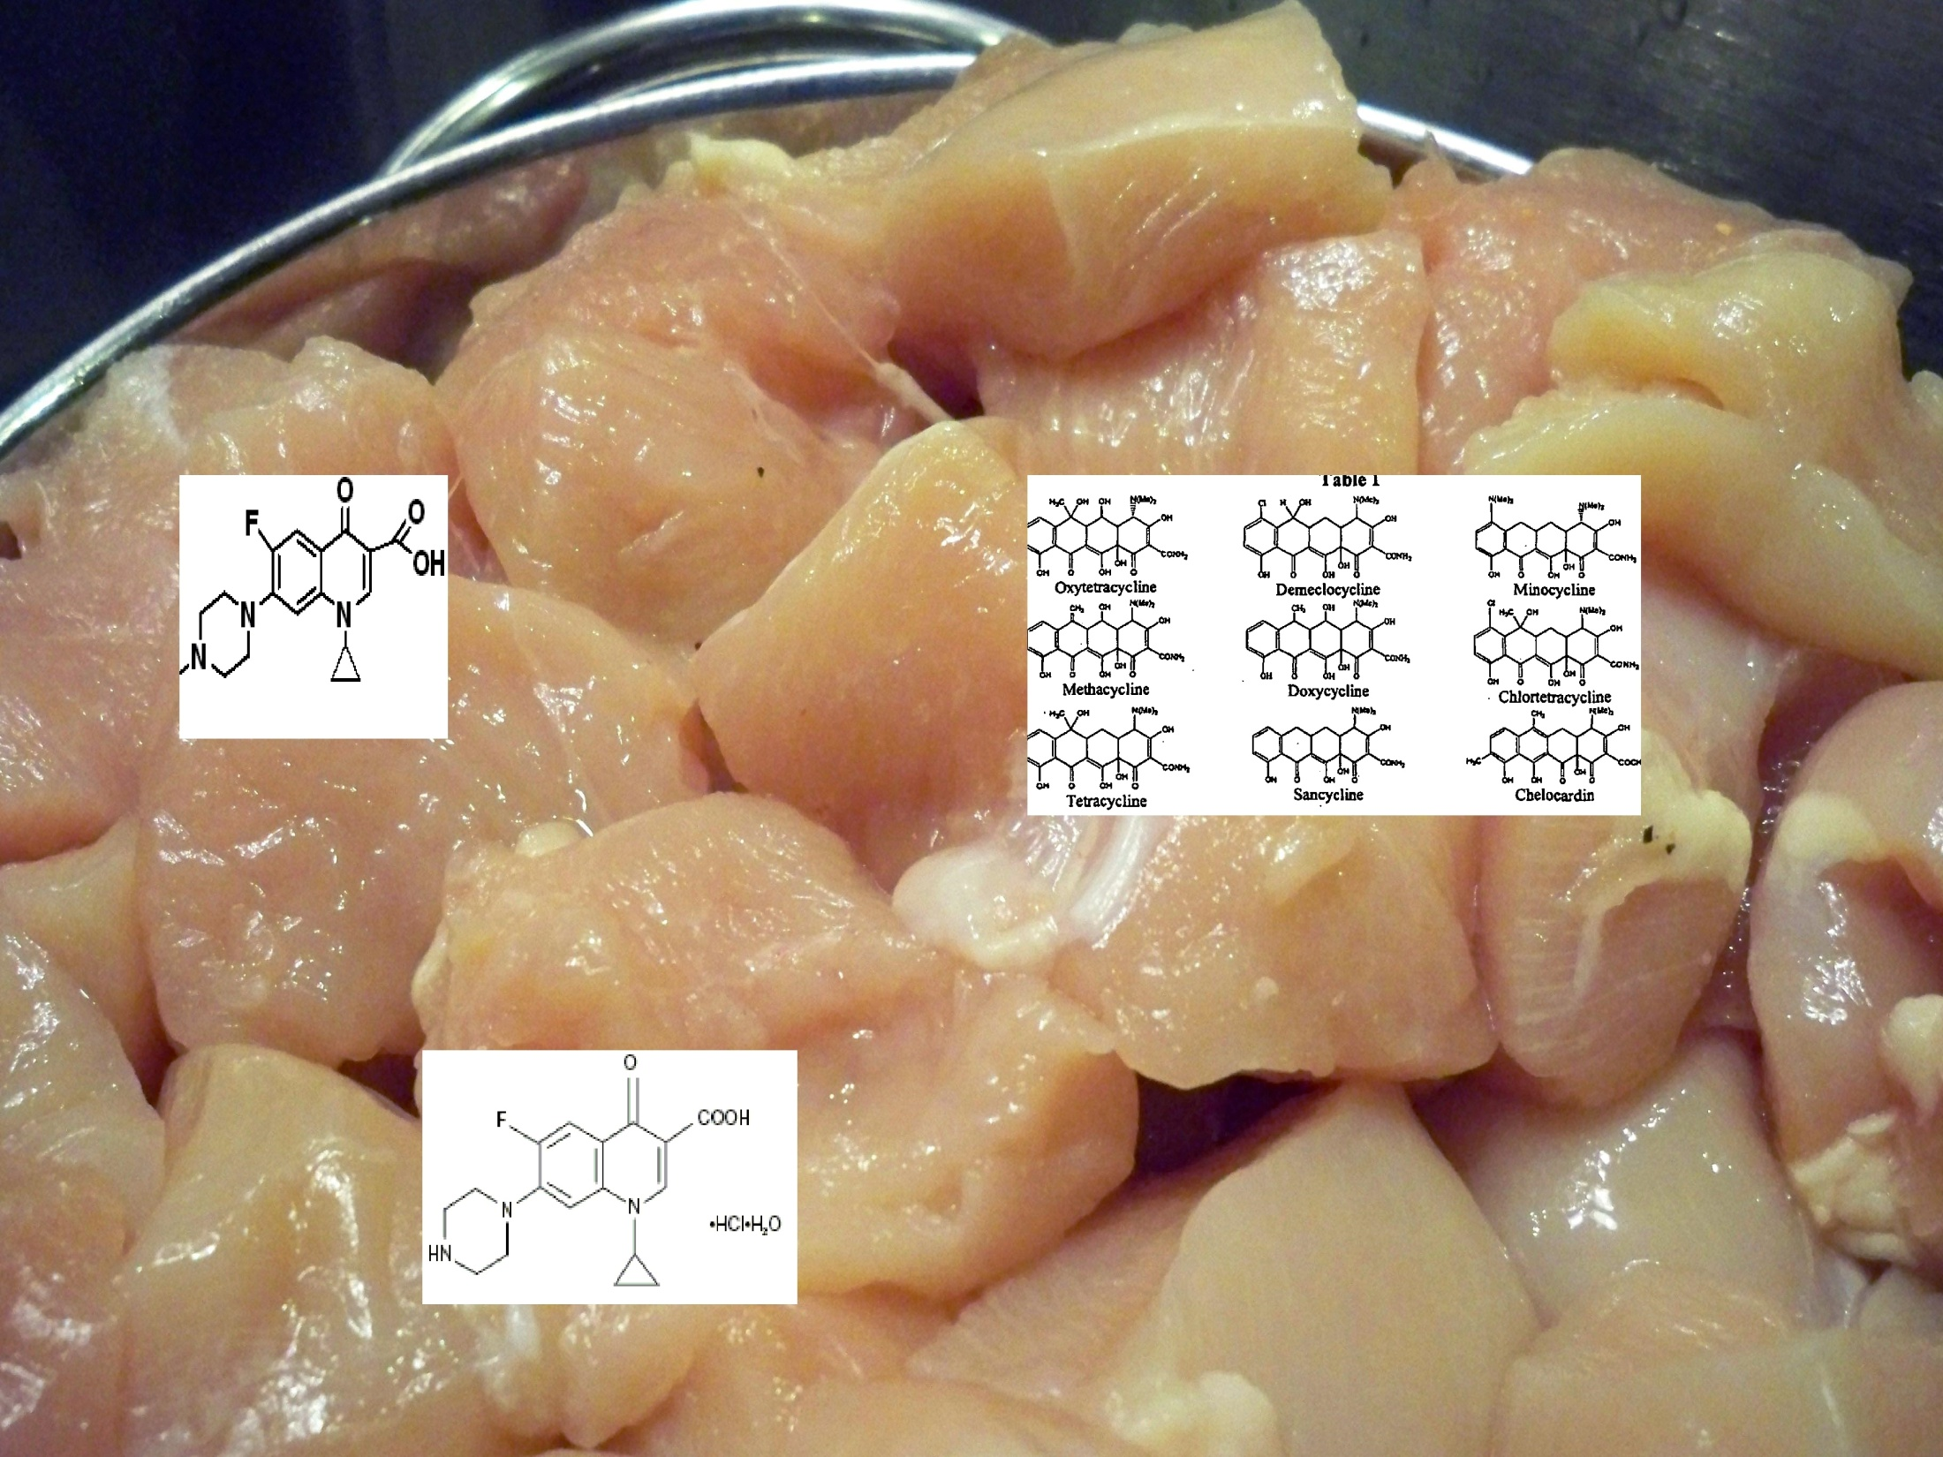
Introduction
Banned
increased microbial drug resistance,
drug residues in food,
allergic reactions & sensitization and drug toxicity. WHO, 1997; Cardozo, 2004)

Slide 6
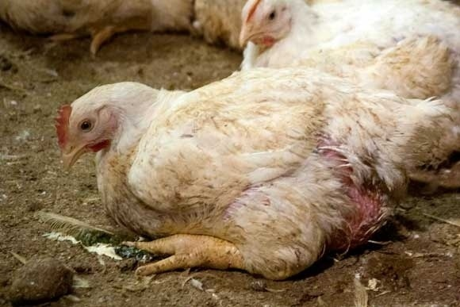
Introduction
Reduction in antibiotic growth promoters
cause
Deterioration of animal health
Results in increase in therapeutic / prophylactic use
(FAAIR, 2002)

Slide 7
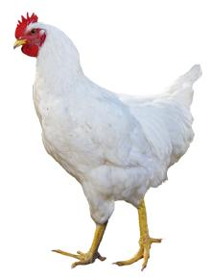
Introduction
Search for natural alternatives
Herbs
natural, less toxic, residue free. (Hashemi etal., 2008)
controls potential pathogens, relieves immune defence stress, increase the availability of essential nutrients for absorption.
Helps the animal grow better. (Windisch et al., 2014)

Slide 8
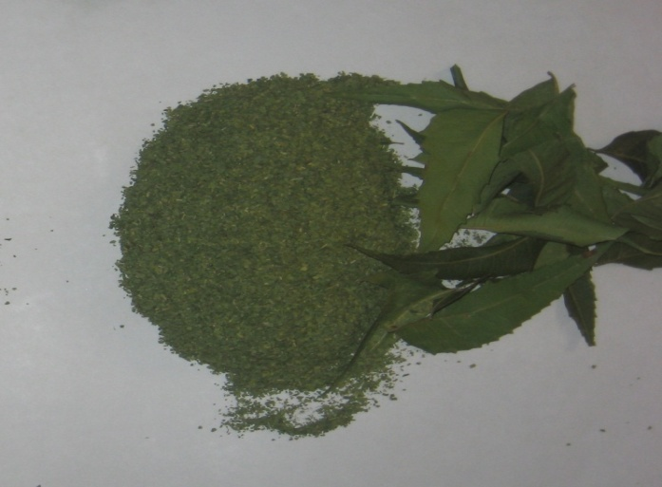
Introduction
Azadirachata indica A. Juss (Indian Neem)
Has many medicinal properties
wide spectrum of antibacterial activity
immune stimulant (Saradhajyothi & Subba Rao, 2004)

Slide 9
Introduction
Parts of Neem tree contains chemicals like azadiractin, nimbin, nimbindin, quercetin etc., which have antimicrobial, antihelminth, antioxidant, antifungal, insecticidal, antiprotozoa and spermicidal properties. (Elangovan et al., 2000)

Slide 10
Introduction
Neem leaf meal inclusion at 0.5% level in the diets of broilers showed increased AFBW, ADG,ADFI and FCR (Onyimonyi et al, 2009)
Bansu et al (2012) found b.wt gain was significantly higher in 1.5% NLM in diet compared to 2.0 & 2.5 % in diet.

Slide 11
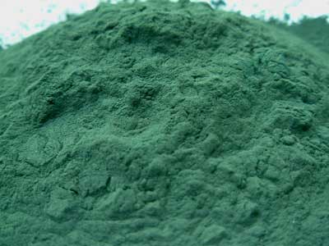
Introduction
Spirulina platensis: Rich in antioxidants
Dietary inclusion
Prevents lipid peroxidation (Manoj et al., 1992)
Counters adverse effects of Aflatoxin on growth rate (Rao et al., 2005)

Slide 12

Introduction
Present study planned to evaluate the Neem leaf powder alone and in combination with spirulina as alternative to commonly used antibiotic TM-200 (Terramycine) in the broiler production.
Growth promoter potentials were compared with standard antibiotic TM-200.

Slide 13

Methodology
90, Male broiler chicks of day old age were randomly divided into 6 groups each with 3 replicates consisting of 5 birds in each group & maintained under standard managemental condition.
Various experimental diets as detailed below, were fed for 42 days.

Slide 14
Methodology
Various experimental diets as detailed below, were fed for 42 days.
Group |  | Experimental diet
I | Normal control | Normal feed
II | Antibiotic control | Normal feed mixed with oxytetracycline-TM 200® @ 0.05% of feed
III | Neem control | Normal feed mixed with neem leaf powder @ 1.0% of feed
IV | Neem + Spirulina | Normal feed mixed with neemleaf powder @ 1.0% of feed and spirulina @ 1% of feed
V | Antibiotic + spirulina | Normal feed mixed with oxytetracycline-TM 200®@ 0.05% and spirulina @ 1% of feed
VI | Spirulina control | Normal feed mixed with spirulina@ 1% in feed

Slide 15
Methodology
Parameters estimated
Average Feed intake
Average body weight gain
Liver and kidney functional markers
Anioxidant markers: SOD and GSH
Peroxidation markers: TBARS,
Protein carbonyls

Slide 16
Results
Effect of Neem leaf powder in combination with Spirulina powder on mean body weight gain (g), mean feed consumption (g), mean feed conversion ratio (FCR) and mean dressed bird weight.
Group | Body weight gain (grams) | Feed consumption (grams) | Feed conversion ratio | Dressed bird weight (grams)
I | 266.12±61.37^{A} | 608.54±155.30^{A} | 2.20±0.07^{B} | 1355.27±28.46^{A}
II | 394.63±96.32^{C} | 757.11±193.22^{C} | 1.91±0.04^{A} | 1898.60±39.03^{D}
III | 352.69±86.88^{B} | 698.28±178.28^{B} | 1.97±0.03^{A} | 1530.20±32.25^{B}
IV | 365.48±89.28^{C} | 716.19±182.77^{C} | 1.95±0.04^{A} | 1682.93±57.43^{C}
V | 412.60±101.00^{C} | 778.47±198.67^{CD} | 1.89±0.05^{A} | 1928.73±24.28DE
VI | 349.60±86.22^{B} | 696.93±177.86^{B} | 1.99±0.03^{A} | 1501.27±17.60^{B}
Means with different superscripts, differ significantly (P<0.05)

Slide 17
Results
Effect Neem leaf powder in combination with Spirulina powder on peroxidation markers of various tissues of broilers
Group | TBARS (µm of MDA/mg protein) |  |  | Protein Carbonyls (nm/100 g of protein)
 | Liver | Kidney | Muscle | Liver | Kidney | Muscle
I | 4.50±0.14^{C} | 3.27±0.17^{C} | 2.49±0.07^{C} | 22.45±0.55^{B} | 13.15±1.30^{C} | 6.04±0.35^{C}
II | 2.79±0.17^{A} | 2.01±0.31^{A} | 1.37±0.21^{A} | 19.34±0.95^{A} | 10.65±0.95^{A} | 4.69±0.51^{A}
III | 3.34±0.08^{B} | 2.65±0.27^{B} | 1.85±0.13^{B} | 20.27±0.89^{A} | 11.43±1.01^{B} | 5.01±0.41^{B}
IV | 3.09±0.16^{B} | 2.35±0.14^{B} | 1.78±0.17^{B} | 19.89±1.21^{A} | 11.09±1.20^{B} | 4.85±0.35^{A}
V | 2.38±0.13^{A} | 1.90±0.12^{A} | 1.25±0.09^{A} | 18.79±1.02^{A} | 10.13±0.75^{A} | 4.36±0.47^{A}
VI | 3.76±0.21^{B} | 2.75±0.15^{B} | 1.96±0.11^{B} | 20.84±1.09^{A} | 11.87±0.45^{B} | 5.43±0.27^{B}
Means with different superscripts, differ significantly (P<0.05)

Slide 18
Results
Effect Neem leaf powder in combination with Spirulina powder on antioxidant markers of various tissues of broilers
Group | SOD (U/mg protein) |  |  | GSH (mg/g protein)
 | Liver | Kidney | Muscle | Liver | Kidney | Muscle
I | 9.84±0.29^{A} | 7.34±0.35^{A} | 6.49±0.21^{A} | 52.43±0.60^{A} | 56.81±0.40^{A} | 30.40±0.56^{A}
II | 12.75±0.48^{C} | 8.87±0.41^{B} | 7.85±0.31^{B} | 69.42±0.23^{D} | 72.88±0.32E | 41.85±0.21E
III | 11.76±0.25^{B} | 8.12±0.39^{B} | 7.21±0.28^{B} | 61.34±0.39^{B} | 63.93±0.35^{C} | 37.69±0.34^{C}
IV | 12.01±0.37^{C} | 8.35±0.35^{B} | 7.45±0.22^{B} | 65.41±0.41^{C} | 68.86±0.34^{D} | 39.46±0.29^{D}
V | 13.36±0.57^{D} | 9.02±0.47^{C} | 8.03±0.26^{C} | 70.60±0.52^{D} | 75.53±0.37^{F} | 44.05±0.37^{F}
VI | 11.14±0.39^{B} | 7.98±0.27^{A} | 7.11±0.36^{B} | 60.55±0.55^{B} | 62.10±0.16^{B} | 35.82±0.34^{B}
Means with different superscripts, differ significantly (P<0.05)

Slide 19
Results
Effect Neem leaf powder in combination with Spirulina powder on liver and kidney functional markers of various tissues of broilers
Group | Liver functional markers |  |  | Kidney functional markers
 | Total protein (g/dl) | Albumin (g/dl) | ALT (IU/L) | BUN (mg/dl) | Creatinine (mg/dl)
I | 3.75±0.06^{A} | 2.11±0.04^{A} | 20.46±0.76^{A} | 7.24±0.22^{A} | 0.67±0.02^{A}
II | 3.74±0.03^{A} | 2.13±0.02^{A} | 19.54±0.49^{A} | 6.91±0.19^{A} | 0.64±0.01^{A}
III | 3.80±0.04^{A} | 2.15±0.04^{A} | 20.39±0.58^{A} | 7.07±0.22^{A} | 0.66±0.01^{A}
IV | 3.84±0.03^{A} | 2.20±0.03^{A} | 19.27±0.35^{A} | 7.01±0.15^{A} | 0.65±0.02^{A}
V | 3.81±0.02^{A} | 2.19±0.03^{A} | 19.01±0.24^{A} | 6.89±0.17^{A} | 0.62±0.03^{A}
VI | 3.78±0.03^{A} | 2.12±0.02^{A} | 20.06±1.01^{A} | 7.05±0.25^{A} | 0.63±0.02^{A}
Means with different superscripts, differ significantly (P<0.05)

Slide 20

Discussion
Oxidative stress
Broilers, Stress is due to subclinical infection and high metabolic rate. Stress causes generation of Reactive Oxygen Speices (ROS) (Maybayer et al., 2006).
In the body 2-5 % of total oxygen intake has ability to form the superoxide radicals via electron escape (Sjodin et al., 1990).

Slide 21
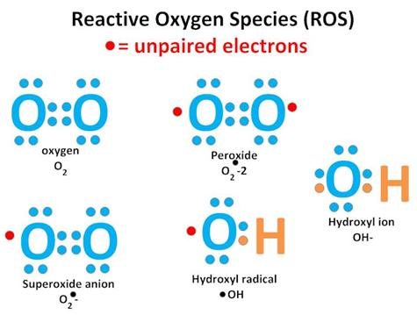
Discussion
some of the ROS are short lived extremely reactive and peroxidate lipids and proteins to aldehydes and carbonyles respectively.
If tissue peroxidation is very high and beyond the repair process then it may cause apoptosis and impairment of organ function.

Slide 22
Control group birds exposed to stress which is indicated by tissue peroxidation markers in liver, kidney and muscle.
NLP and spirulina individually reduced the tissue peroxidation levels compared to control due to thier antibacterial and antioxidant levels.
NLP + spirulina combination showed less peroxidation markers.
TM-200 and TM-200 in combination with spirulina showed less peroxidation markers compared to all groups.

Slide 23
Antioxidant markers are very less in control group and increasing in spirulina, NLP and their combinations, TM-200 and their combination with spirulina showed significantly high levels.

Slide 24
There is no significant difference in the functional markers of liver and kidney in all groups

Slide 25
TM-200 showed better performance similar to Nazirahmed et al, (1993) observation.
NLP alone and in combination with spirulina showed better performance than control but not as better as TM-200

Slide 26

Conclusion
TM-200 is acting as growth promoter
NLP has significant growth promoting effect but not as efficient as TM-200
NLP in combination with spirulina has some additional advantage as growth promoter
Since TM-200 is a synthetic antibiotic which is banned as growth promoter in poultry
NLP in combination with Spirulina can be used as alternative growth promoter in broiler production.

Slide 27
References
CSE Report on antibiotic residues in chicken.2014 Down to Earth1-15:26-29.
Cardozo, P.W., S. Calsamiglia, A. Ferret and C. Kamel, 2004. Effect of natural plant extracts on ruminal protein degradation and fermentation profiles in continuous culture. J. Anima. Sci., 82:3230-3236.
Elangovan, A.V., S.V.S Verma and V.R.B. Sastry, 2000. CAB International, Welling Ford, UK, pp:95
EMEA: European Agency for the Evaluation of Medicinal products. EMEA/MRL/338/98 , EMEA/MRL/023/95
FAAIR, Policy recommendations. 2002 Clinical Infectious Disease 34: 76-77.
Falcao-e-Cunha L, Castro-Solla L, Maertens L, Marounek M, Pinheiro V, Freire J and Mourao J L 2007 Alternatives to antibiotic growth promoters in rabbit feeding. A review: World Rabbit Sci. 15:127-140.
Joint FAO/WHO Expert Committee on Food Additive 2004 FAO food and nutrition paper 41/16:94-96
Manoj G, Venkataraman L V and Srinivas L 1992 Antioxidant properties of Spirulina (Spirulina platensis) .Spirulina MCRC, 48: 154-158.
Maybauer Marc O, Maybauer Dirk M, Herndon David N, Traber and Daniel L 2006. The Role of superoxide dismutase in systemic inflammation Shock 25: 206-207.
Maybauer Marc O, Maybauer Dirk M, Herndon David N, Traber and Daniel L 2006. The Role of superoxide dismutase in systemic inflammation Shock 25: 206-207.
Nazir Ahmed, Abid Ali Tipu, Ahsan-ul-Haq and Shahid Rasool 1993.Pak. J. Agri. Sci.,30(3):256-258.
Onyimonyi, A.E., A. Olabode and G.C.Okeke 2009. International Journal of Poultry Science, 8(3):256-259.
Rao S V R, Raju M V L N, Radhika K and Chawak M M 2005 Dietary supplementation of spirulina and its effects on broiler chicken exposed to aflatoxicosis. Indian Journal of Poultry Science 40: 36-40.
Saradhajyothi Koona, Subbarao Budida 2011 Not Sci Biol,3(1):65-69
Sjodin T, Westing Y H and Apple F S 1990 Biochemical mechanisms for oxygen free radical formation during exercise. Sports Medicine 10: 236-254.
WHO 1997 The medical impact of the use of antimicrobials in food animals. Report from a WHO meeting; Berlin, Germany Oct 13-17. Geneva: world Health Organization.
Windisch, W., Schedle, K., PlitznerK=,K and Kroismayr A, 2008. USe of Phytogenic products as feed additives for swine and poultry. Journal of Animal Sciences,86:140-148

Slide 28
