Slide 1
About OMICS Group
OMICS Group is an amalgamation of Open Access publications and worldwide international science conferences and events. Established in the year 2007 with the sole aim of making the information on Sciences and technology ‘Open Access’, OMICS Group publishes 500 online open access scholarly journals in all aspects of Science, Engineering, Management and Technology journals.
OMICS Group has been instrumental in taking the knowledge on Science & technology to the doorsteps of ordinary men and women. Research Scholars, Students, Libraries, Educational Institutions, Research centers and the industry are main stakeholders that benefitted greatly from this knowledge dissemination. OMICS Group also organizes 500 International conferences annually across the globe, where knowledge transfer takes place through debates, round table discussions, poster presentations, workshops, symposia and exhibitions.

Slide 2
About OMICS International Conferences
OMICS International is a pioneer and leading science event organizer, which publishes around 500 open access journals and conducts over 500 Medical, Clinical, Engineering, Life Sciences, Pharma scientific conferences all over the globe annually with the support of more than 1000 scientific associations and 30,000 editorial board members and 3.5 million followers to its credit.
OMICS Group has organized 500 conferences, workshops and national symposiums across the major cities including San Francisco, Las Vegas, San Antonio, Omaha, Orlando, Raleigh, Santa Clara, Chicago, Philadelphia, Baltimore, United Kingdom, Valencia, Dubai, Beijing, Hyderabad, Bengaluru and Mumbai.

Slide 3


The role of microRNA-125b in calcitriol-induced differentiation of human leukemia and lymphoma cells
Justyna Trynda
Ludwik Hirszfeld Institute of Immunology and Experimental Therapy
Polish Academy of Sciences
Wroclaw, Poland
4-6 August 2015
Valencia, Spain
Notes:
Good morning. Firstly I would like to thank the organizers for invitation. It is pleasure for me to be here. My name is Justyna Trynda and I work in Institute of Immunology and Experimental Therapy, Polish Academy of Science in Wroclaw. I’m going to talk about the role of miR-125b in calcitriol-induced differentiation of human leukemia and lymphoma cells.

Slide 4
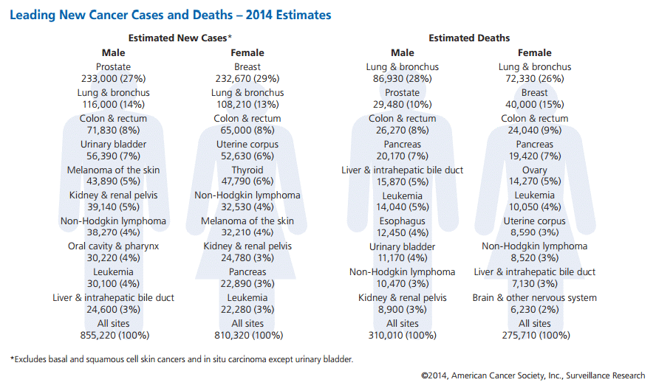
Adults leukemia and lymphoma incidents in 2014
From 2006 to 2010, overall leukemia incidence rates increased slightly (by 0.5% per year).
http://www.cancer.org/acs/groups/content/@research/documents/webcontent/acspc-042151.pdf
Notes:
In last year leukemia and lymphoma caused about 7% of all malignants in adults. These diseases are more often in men than women and usually arised after the age of 60. From 2006 to 2010, overall leukemia incidence rates increased slightly (by 0.5% per year).

Slide 5
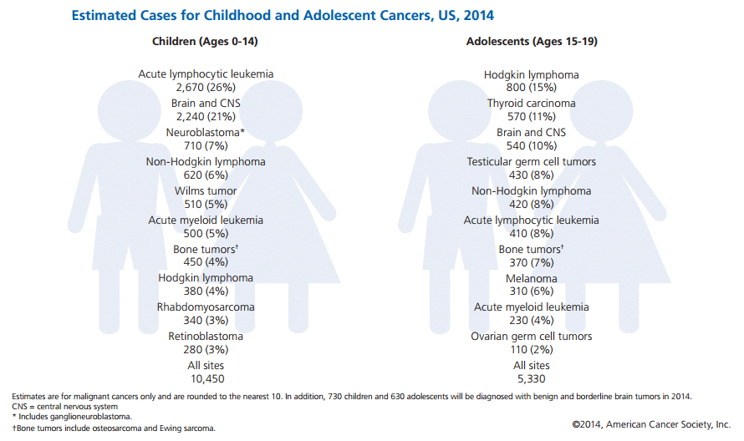
The most common cancers among children and adolescents
About 40 % of all cancer incidents in children are leukemias and lymphomas
http://www.cancer.org/acs/groups/content/@research/documents/webcontent/acspc-042151.pdf
Notes:
Cancers which are most common in children are acute lymphocytic leukemia about 26 % and the most common cancers among adolescents are Hodgkin lymphoma about 15%. Summarizing about 40 % of all cancer incidents in children and adolescents are different types of leukemias and lymphomas.

Slide 6
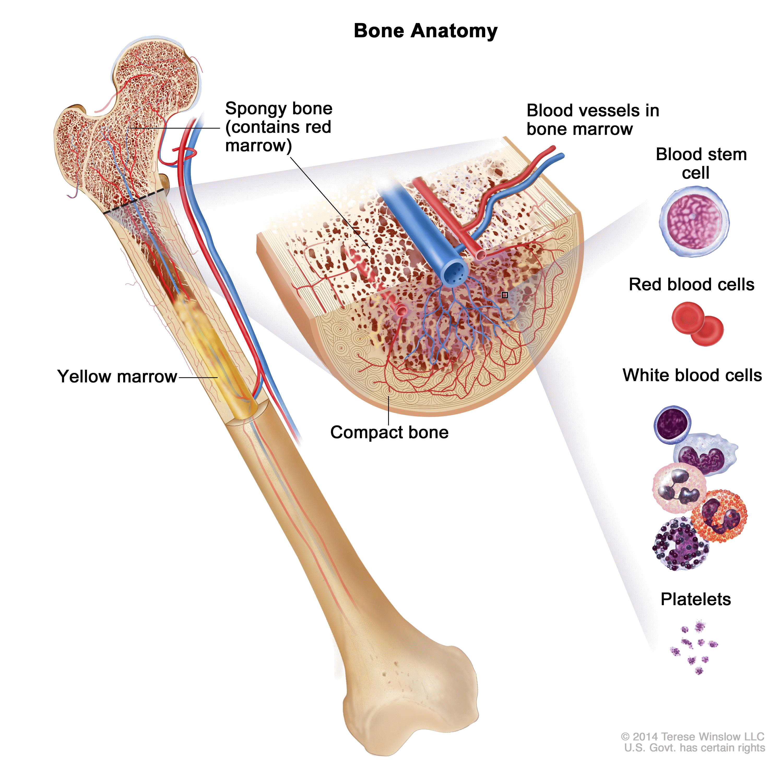
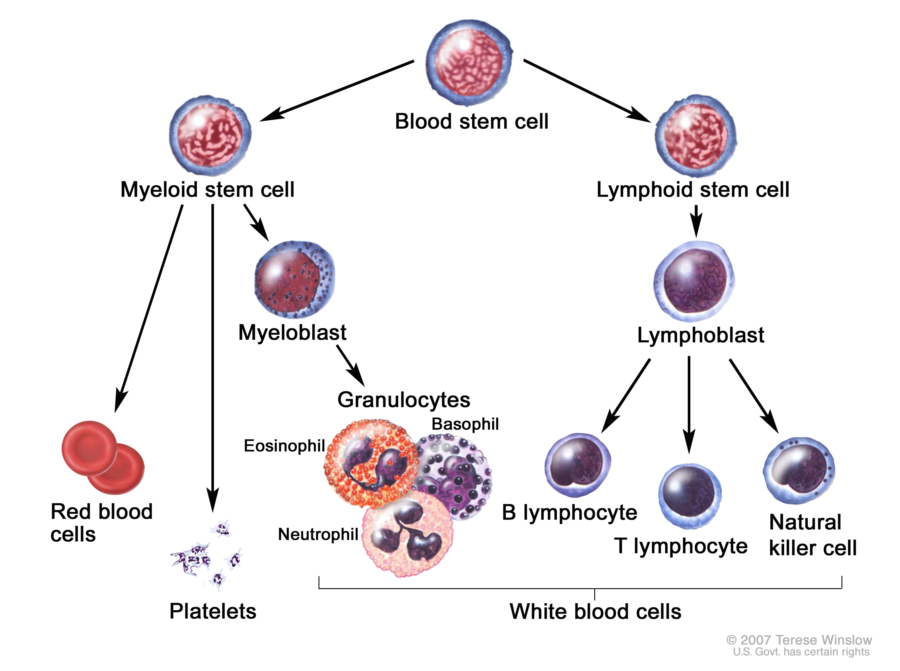
Hemopoiesis is the proliferation and differentiation of the
formed elements of blood
Classification of leukemia and lymphoma:
acute lymphocytic (ALL)
chronic lymphocytic (CLL)
acute myeloid (AML)
chronic myeloid (CML)
Winslow T: Chronic Lymphocytic Leukemia Treatment. Cancer December 30, 2014
Notes:
Leukemia is a cancer of the bone marrow and blood. All formed elements arise from stem cells of the bone marrow. One daughter of these cell remains a hemopoietic stem cell, allows hemopoiesis to continue. The other daughter cell becomes either of two types of more specialized stem cells
Lymphoid stem cells give rise to a class of leukocytes known as lymphocytes, which include the various T cells,
B cells, and natural killer (NK) cells, all of which function in immunity.
Myeloid stem cells give rise to all the other formed elements, including the erythrocytes; megakaryocytes that produce platelets; and a myeloblast lineage that gives rise to monocytes and three forms of granular leukocytes: neutrophils, eosinophils, and basophils.
Hematological malignaces are classified into four main groups according to cell type and rate of growth: acute lymphocytic (ALL), chronic lymphocytic (CLL), acute myeloid (AML), and chronic myeloid (CML).

Slide 7
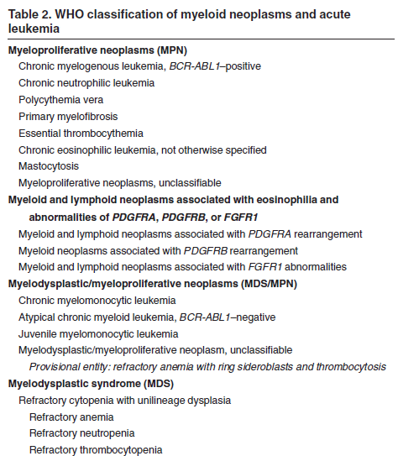
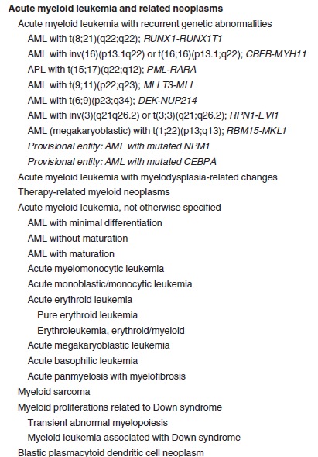
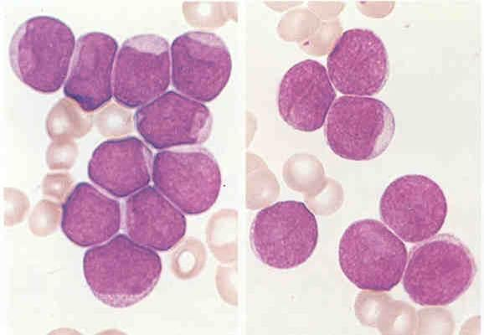
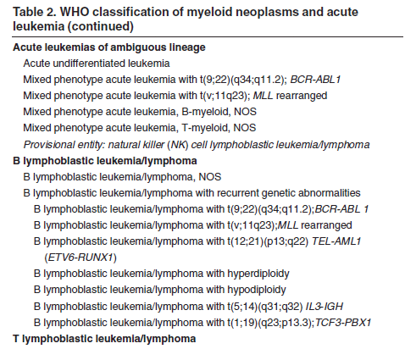
The human leukemia and lymphoma WHO classification
The WHO classification system is based on recently published, peer-reviewed data
Vardiman J. et al.: The 2008 revision of the World Health Organization (WHO) classification of myeloid neoplasms and acute leukemia: rationale and important changes Blood Jul 2009, 114 (5) 937-951; DOI: 10.1182/blood-2009-03-209262
Notes:
These 4 basic groups are divided into many subgropus, but all the time the new informations are accumulating and this calssification is changed.
The WHO leukemia and lypmhoma classification system is based on recently published data for better recognition and treatment of that diseaes.

Slide 8


What causes leukemia and lymphoma ?
Genetic aberrations
Signal transduction
Progenitor cell
Transcription factors
Growth factors
Epigenetic disorder
miRNA
miRNAs have important role in the development of chemosensitivity or chemoresistance in cancer including leukemia and lymphoma
Leukemia cell
Notes:
The main factors which causes malignant transformation are genetic aberration, which leads to changes in signal transduction, transcription and growth factors expression. Nowadays more attenions has focused on the role of miRNAs in the development of cancers. Growing evidence confirmed that miRNA are responsible for cancer development.There is also known that specific miRNAs have important role in the development of chemosensitivity or chemoresistance in different cancer.The miRNAs have been shown to repress the expression of important cancer-related genes, what might prove usefulness in the diagnosis and treatment of cancer

Slide 9
Treatments of human leukemia and lymphoma
AML Acute myeloid leukemia | CML Chronic myelogenous leukemia | Lymphoblastic leukemias and lymphomas
idarubicin cytosine arabinoside | tyrosine kinase inhibitors imatinib (Gleevec), dasatinib | antimetabolites; 6 - mercaptopurine, fludarabine, methotrexate topoisomerase inhibitors; idarubicin, daunorubicin and doxorubicin, etoposide alkylating agents; cyclophosphamide allkaloidy vinca; vincristine and vinblastine monoclonal antibodies; rituximab , alemtuzumab, gemtuzymab
When there are no signs of leukemia for 5 years, a person is usually considered cured. But if the leukemia doesn't go into remission, or if it comes back within the first few years, treatments may include more chemotherapy, a stem cell transplant, or joining a clinical trial for new treatments
Notes:
The goal of treatment for leukemia is to destroy the leukemia cells and allow normal cells to form in bone marrow. Treatment decisions are based on the kind of leukemia, its stage, patient age and general health. Induction therapy kills leukemia cells in the blood and bone marrow to induce remission. Treatments include standard protocol of chemotherapy. But some people who have leukemia cells with a gene changes are treated with a tyrosine kinase inhibitor. Treatment is often continued for up to 3 years, but during this time, most people are able to go back to being as active as they were before beginning treatment. When there are no signs of leukemia for 5 years, a person is usually considered cured. But if the leukemia doesn't go into remission, or if it comes back within the first few years, treatments may include more chemotherapy, a stem cell transplant, or joining a clinical trial for new treatments.

Slide 10
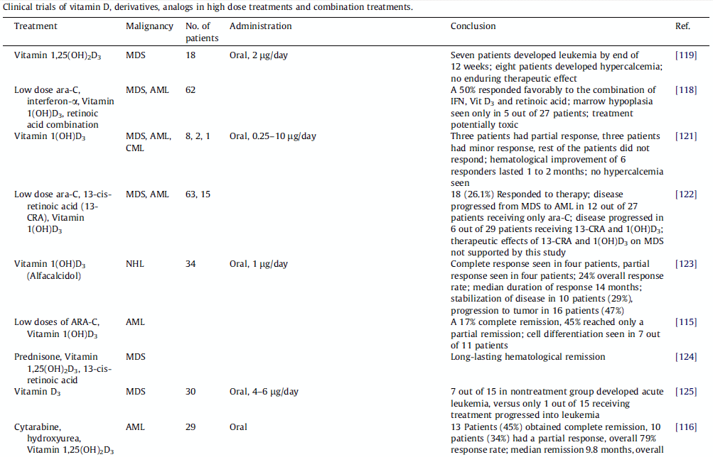
The role of vitamin D in the inhibition of malignant cell proliferation in hematological malignancies is indicative of its future use in cancer therapy
Kim M. et al.: Application of vitamin D and derivatives in hematological malignancies. Cancer Letters, 319; 8–22; 2012
Notes:
One of compounds which has been met with few successes in hematological malignaces clinical trials is vitamin D and its analogs. The role of vitamin D in the inhibition of malignant cell proliferation in hematological malignancies is indicative of its future use in cancer therapy. An understanding of the biochemical mechanism by which vitamin D and its analogs exert their effects will prove to be useful in the development of clinically applicable therapies involving vitamin D. For these reasons, a focus on current understanding of role of vitamin D and its analogs in hematologic malignancies is relevant and the goal for future studies.

Slide 11
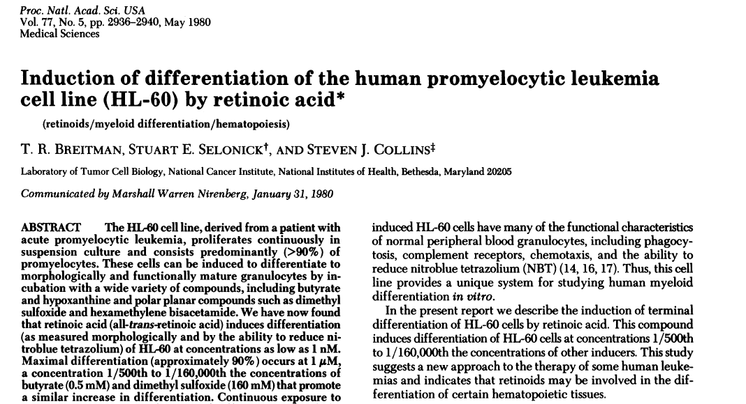
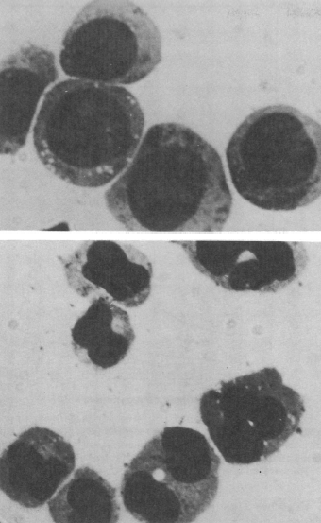
First therapy using retinoic acid to differentiate the human leukemia cells
Notes:
Characteristic abnormality in leukemic cells is the blockade at an early stage of their development and failure of differentiation into functional mature cells. Since the 1980 attempts have been made to treat various cancers with differentiation-inducing drugs thus establishing the preliminary theoretical foundation for subsequent clinical therapy. To date, the only example of successful differentiation therapy is the use of all-trans retinoic acid (ATRA). However, ATRA causes frequent remission of acute promyelocytic leukemia (APL) by inducing the promyelocyte differentiation and often results in differentiation syndrome (formerly named: retinoid acid syndrome).

Slide 12
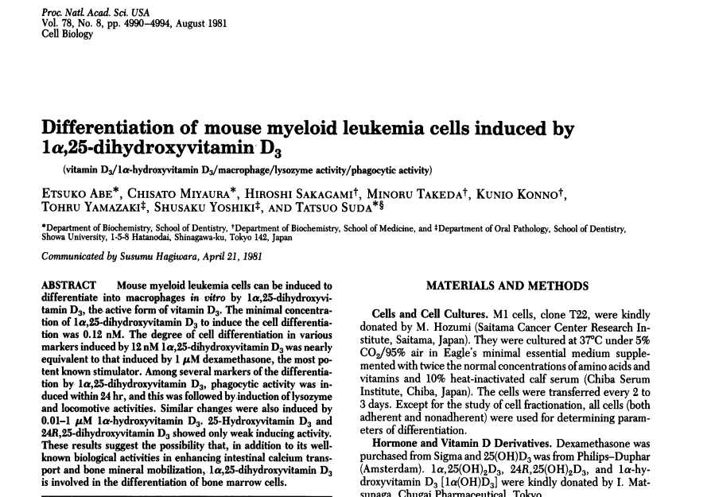
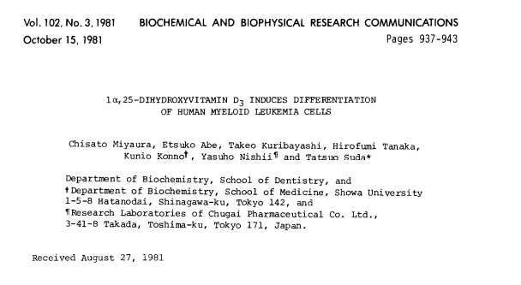
Witamin D active form calcitriol induces differentiation of human leukemia cells
Notes:
Serching on differentiation-inducing drugs was started 30 years ago and then discovered that one of inducing cell differentiation agents is active form of vitamin D calcitriol which was first noted to induce murine leukemia cell differentiation. These mouse myeloid leukemia cells were induced to differentiate in vitro into macrophages.

Slide 13
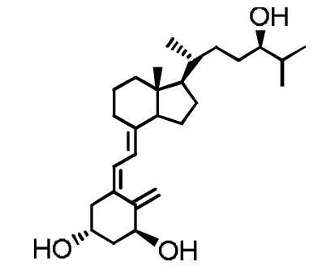

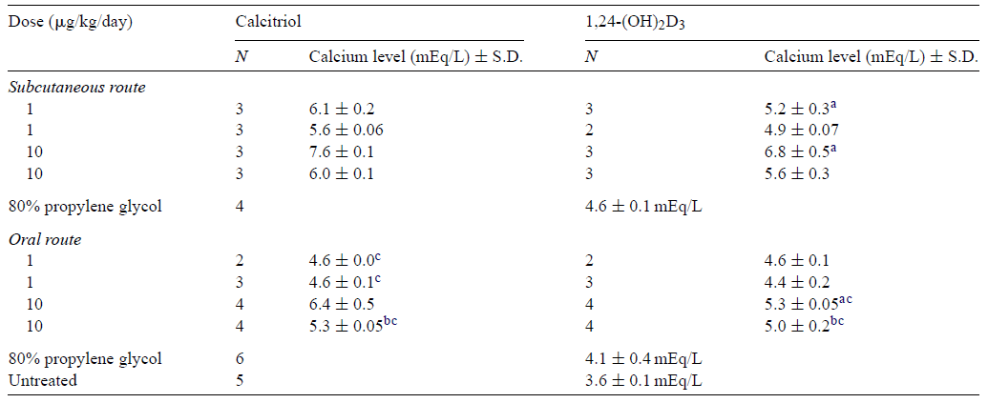
One of such active and less toxic vitamin D analog is 1,24-dihydroxyvitamin D₃, tacalcitol (1,24-(OH)₂D₃)
PRI-2191
tacalcitol- PRI-2191
http://www.huidziekten.nl/zakboek/dermatosen/ptxt/Psoriasis.htm
Wietrzyk J. et al.: Toxicity and antineoplastic effect of (24R)-1,24-dihydroxyvitamin D3 (PRI-2191), Steroids 69 , 629–635, 2004
Notes:
The issue of hypercalcemia, which occurs when the concentrations of calcitriol greatly exceed the physiological range and has previously limited its clinical applications can be addressed by the dual strategy of developing analogs of calcitriol with reduced calcium mobilizing properties.
Apart hypercalcemia, there is also other issue limiting calcitriol or its analogs effectiveness in clinical trials: unknown all factors, that are responsible for poore clinical responce to such differentation therapy. Therefore, studies aiming analysis of possible molecules/factors that can serve for appropriate patients selection and/or served as additional targets improving effectiveness of therapy are of interest.

Slide 14
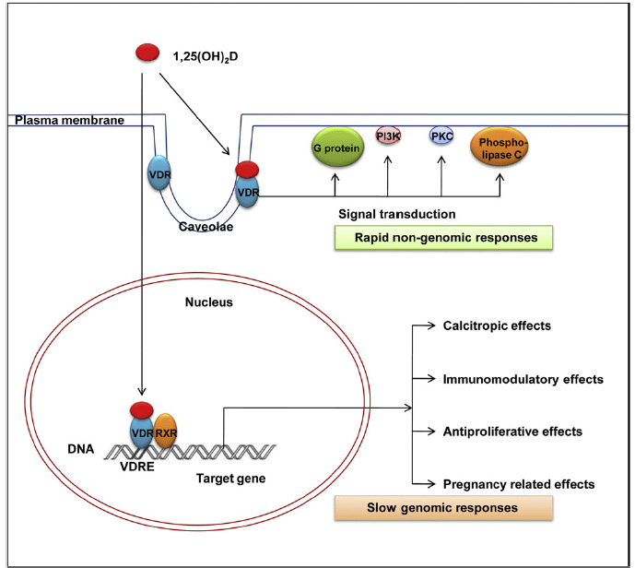
Genomic and non-genomic responses of vitamin D receptor binding to 1,25(OH)₂D₃
Shin J. et al.: Vitamin D effects on pregnancy and the placenta. Placenta 31; 1027-1034; 2010
Notes:
The biological activity of vitamin D occurs via two pathways, a slow genomic response and a rapid, non-genomic response. Both involve binding of calcitriol with the VDR, a member of the super family of nuclear receptors for steroid hormones. In the genomic response pathway, ligand-bound VDR then binds a partner receptor, typically the retinoid X receptor (RXR), and the heterodimer regulates the transcription of vitamin D target genes by binding with high affinity to vitamin D response elements (VDREs) in the promoter region of the gene influence on many biological effects.
In the non-genomic response pathway, calcitriol binds to VDR then activates one or more signaling cascades, including protein kinases , mitogen-activated protein kinases, phospholipases.

Slide 15
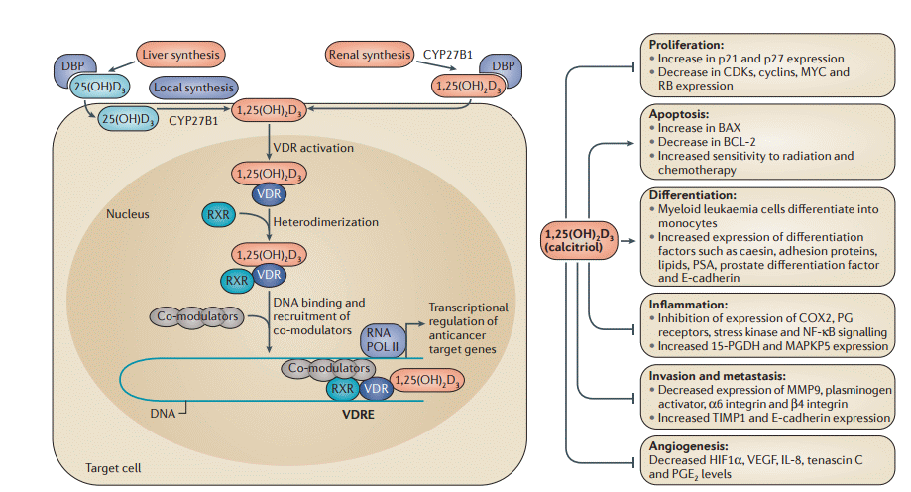
Vitamin D target genes are involved in diverse molecular pathways
Feldman D. et al.: The role of vitamin D in reducing cancer risk and progression. Nature Reviev, 12 (314-320), 2014
Notes:
The most important case is that vitamin D causes the recruitment of co‑activators or co‑repressors, which leads to positive or negative transcriptional regulation of gene expression responsible for profliferation, apoptosis, differentiation, infalmmation, invasion and metastasis and also angiogenesis.

Slide 16
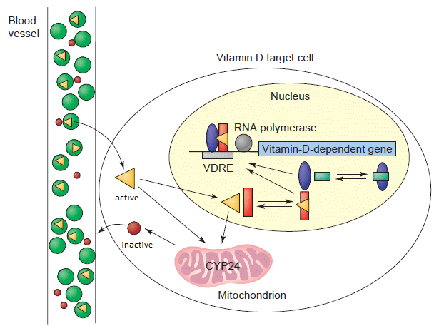
The intracellular concentration of calcitriol is determined by cytochrome P450 enzyme CYP24A1
Prosser D. and Jones G.: Enzymes involved in the activation and inactivation of vitamin D. Trends in Biochemical Sciences, 29, 12:2004
Notes:
Vitamin D receptor is the most important molecule which binding vitamin D and its analogs. But in cell there is enzyme CYP24A1 functions to protect the body from excess calcitriol. It is a mitochondrial P450 enzyme that is expressed in all cells that are responsive to calcitriol.
CYP24A1 mRNA is highly induced by calcitriol via a vitamin D receptor (VDR)-mediated genomic pathway. In normal tissue, the expression of CYP24A1 rapidly returns to basal levels once the calcitriol stimulus is removed. What is more both VDR and CYP24 expression is controled by miRNA molecules.

Slide 17
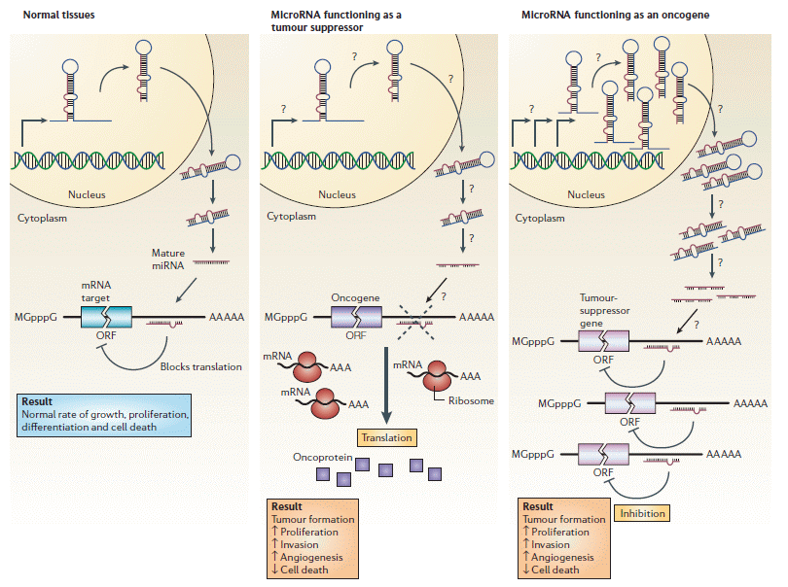
MicroRNAs can function as tumour suppressors and oncogenes
Esquela-Kerscher A. and Slack F.: Oncomirs — microRNAs with a role in cancer. Nature Rewievs, Cancer 6, 2006
Notes:
In normal tissues, proper microRNA (miRNA) transcription, processing and binding to complementary sequences on the target mRNA results in the repression of target-gene expression through a block in protein translation. The overall result is normal rates of cellular growth, proliferation, differentiation and cell death.
The reduction or deletion of a miRNA that functions as a tumour suppressor leads to tumour formation. A reduction in or elimination of mature miRNA levels can occur because of defects at any stage of miRNA biogenesis (indicated by question marks) and ultimately leads to the inappropriate expression of the miRNA-target oncoprotein (purple squares). The overall outcome might involve increased proliferation, invasiveness or angiogenesis, decreased levels of apoptosis, or undifferentiated or de-differentiated tissue, ultimately leading to tumour formation.
The amplification or overexpression of a miRNA that has an oncogenic role would also result in tumour formation. In this situation, increased amounts of a miRNA, which might be produced at inappropriate times or in the wrong tissues, would eliminate the expression of a miRNA-target tumour-suppressor gene (pink) and lead to cancer progression.

Slide 18
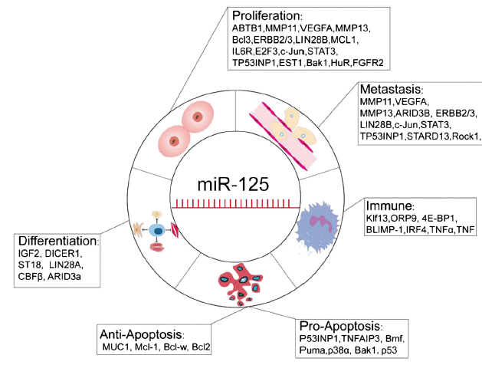
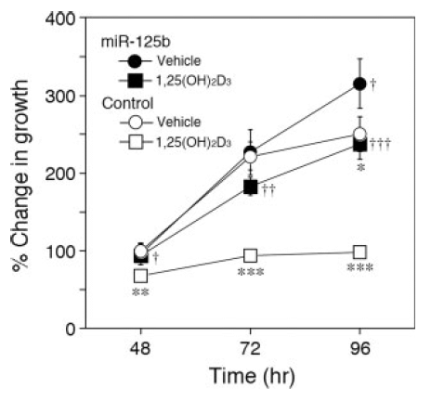
The targets of miR-125 are involved in different types of disease pathogenesis
Antiproliferative effects of 1,25(OH)₂D₃
in MCF-7 cells
miR-125 consists of three homologs miR-125a, miR-125b-1 hsa-miR-125-2 and miR-125b regulates vitamin D receptor and CYP24 expression
Sun Y. et al. Diverse functions of miR-125 family in different cell contexts. Journal of Hematology & Oncology 2013, 6:6
Mohri T. et al. :MicroRNA regulates human vitamin D receptor. Int. J. Cancer: 125, 1328–1333 (2009)
Notes:
One of very important miRNA is miR-125 which is a highly conserved miRNA throughout diverse species from nematode to humans, consists of three homologs miR-125a, miR-125b-1 and miR-125-2. Members of this family have been validated to be down-regulated, exhibiting its disease-suppressing properties in many different types of diseases, while they also have disease-promoting functions in certain contexts.
MiR-125 targets a number of genes such as transcription factors, matrix-metalloprotease, members of Bcl-2 family and others, aberrance of which may lead to abnormal proliferation, metastasis and invasion of cells, even carcinomas.
But the most importnat case is that miR-125b significantly decreased the endogenous VDR protein level in MCF-7 cells to 40% of control. Calcitriol drastically induced the CYP24 mRNA level in MCF-7 cells, but the induction was markedly attenuated by the overexpression of miR-125b. In addition, the antiproliferative effects of calcitriol in MCF-7 cells were significantly abolished by the overexpression of miR-125b.
These results suggest that the endogenous VDR level was repressed by miR- 125b, so conclusions is that miR-125b posttranscriptionally regulated human VDR and CYP24. Since the miR-125b level is known to be downregulated in cancer, such a decrease may result in the upregulation of VDR in cancer and augmentation of the antitumor effects of calcitriol and its analog.

Slide 19
Differences between sensitivity of leukemia and lymphoma cells to calcitriol and its analog
Human myeloid leukemia and lymphoma cells
HL-60 – acute promyelocytic leukemia (M2)
KG-1 - acute promielocytic leukemia (M1)
K562 – chronic promielocytic leukemia (M6)
MV-4-11 - bifenotype mielomoncytic leukemia (M5)
Thp-1 – acute monocytic leukemia (M5)
Daudi – Burkitt's lymphoma
Raji – Burkitts lymphoma
Jurkat – acute T cells lymphoma
U2932 - diffuse large B-cell lymphoma
CYP24
VDR
miR-125b
IC50 nM | HL-60 | Thp-1 | MV-4-11
calcitriol | 42,40 ± 14,47 | 39,22 ± 19,50 | 21,49 ± 6,32
tacalcitol (PRI-2191) | 8,7 ± 2,4 | 6,43 ± 2,3 | 2,77 ± 0,99
Proliferation inhibiton (%) | K562 | KG-1 | U₂₉₃₂ | Jurkat | Daudi | Raji
calcitriol 1000 nM | 30,12 ± 13,83 | 1,25 ± 1,77 | 6,09 ± 8,61 | 11,24 ± 7,71 | 19,75 ± 14,40 | 23,55 ± 0,44
tacalcitol (PRI-2191) 1000 nM | 32,16 ± 10,06 | 18,27 ± 6,24 | 0,48 ± 0,68 | 17,72 ± 2,14 | 11,70 ± 13,99 | 27,64 ± 13,11
Notes:
We decided to check what is the level of VDR, CYP24 and miR-125b in human leukemia and lymphoma cells. We have choosen nine different types of leukemia and lymphoma cells in different stage of differentiation and we treated them with calcitriol and its analouge.
We observed that only 3 from nine were sensitive to calcitriol and its analouge and calcitriol showed the strongest antiproliferative activity on three HL-60, MV4-11, Thp-1 of human leukemia cells and were less potent in antiproliferative activity against other leukemia and lymphoma cells. MV4-11 cells was the most sensitive to calcitriol and its analog. The human leukemia cells was unsensitive and we mesure only proliferation inhibition in the hihest used in experiment 1000 nM.

Slide 20
The expression level of CYP24, VDR and miR-125b in MV-4-11 bifenotype mielomoncytic leukemia sensitive to calcitriol and its analog
Cell morphology after 120 h with 10 nM calcitriol and analog treatment.
May- Grunwald Giemsa staining, 100 x.
Real Time PCR analysis of VDR and CYP24 mRNA and miR-125b expression
using TaqMan Gene Expresion Assay TaqMan MicroRNA Expresion Assay, ΔΔC_{T} method

Slide 22
The expression level of CYP24, VDR and miR-125b in Thp-1 acute monocytic leukemia sensitive to calcitriol and its analog
Cell morphology after 120 h with 10 nM calcitriol and analog treatment.
May- Grunwald Giemsa staining, 100 x.
Real Time PCR analysis of VDR and CYP24 mRNA and miR-125b expression
using TaqMan Gene Expresion Assay TaqMan MicroRNA Expresion Assay, ΔΔC_{T} method

Slide 24
The expression level of CYP24, VDR and miR-125b in Jurkat acute T cells lymphoma cells unsensitive to calcitriol and its analog
CYP24 expression was undetectable before and after calcitriol and its analog treatmetnt
Cell morphology after 120 h with 10 nM calcitriol and analog treatment.
May- Grunwald Giemsa staining, 100 x.
Real Time PCR analysis of VDR and CYP24 mRNA and miR-125b expression
using TaqMan Gene Expresion Assay TaqMan MicroRNA Expresion Assay, ΔΔC_{T} method

Slide 25
The expression level of CYP24, VDR and miR-125b in U2932 diffuse large B-cell lymphoma unsensitive to calcitriol and its analog
CYP24 expression was undetectable before and after calcitriol and its analog treatmetnt
Cell morphology after 120 h with 10 nM calcitriol and analog treatment.
May- Grunwald Giemsa staining, 100 x.
Real Time PCR analysis of VDR and CYP24 mRNA and miR-125b expression
using TaqMan Gene Expresion Assay TaqMan MicroRNA Expresion Assay, ΔΔC_{T} method

Slide 26

Conclusions
The most sensitive to calcitriol and its analog human leukemia and lymphoma cells express CYP24, VDR and miR-125b
In Daudi, Jurkat and U2932 human lyhmpoma cell lines calcitriol and its analog didn’t induce CYP24 expression despite of VDR expression
The highest changes in the expression of CYP24 was observed in the most sensitive cell line MV-4-11 (fold change about 25 000)
In human leukemia cells the VDR expression was similar both on mRNA and protein level independently of treatment
This presentation was supported by Wroclaw Centre of Biotechnology, programme
The Leading National Research Centre (KNOW) for years 2014-2018
Notes:
This presentation was supported by Wrocław Center of Biotechnology, because our Institute is in the programme the Leading National Research Centre.

Slide 27
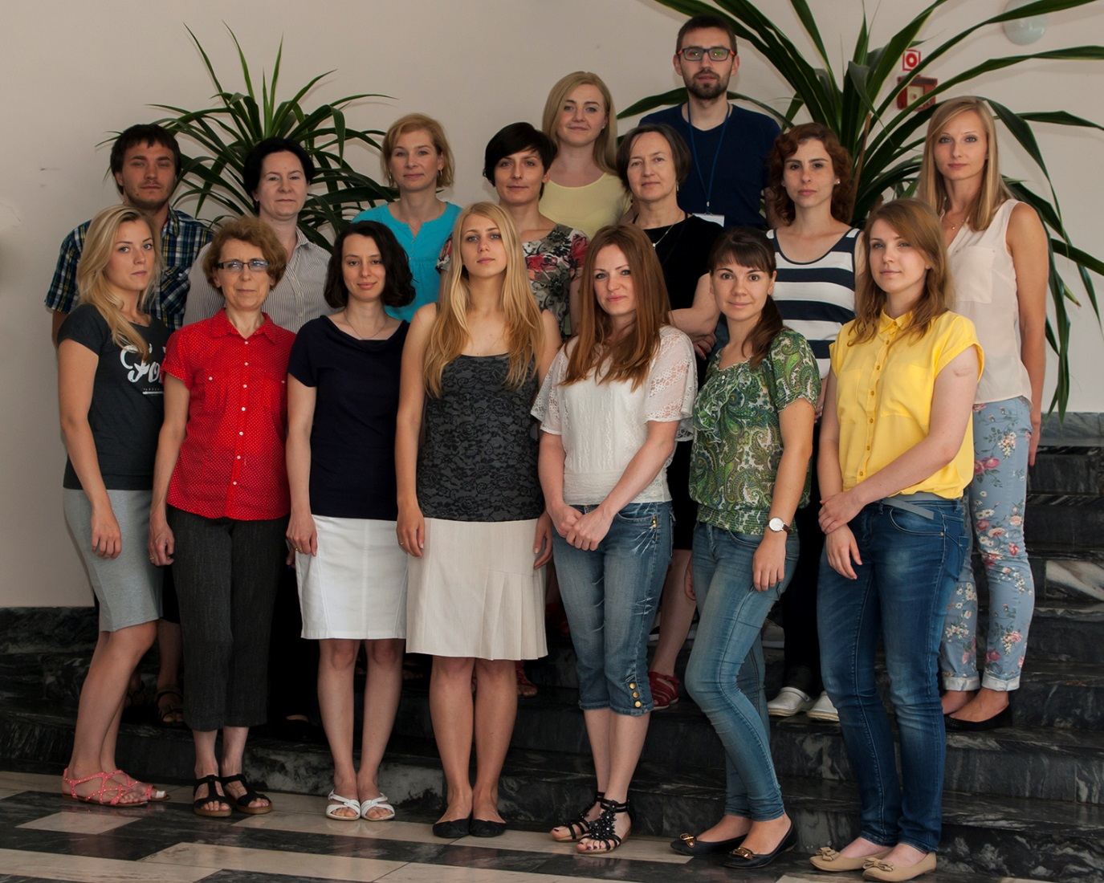
Laboratory of Experimental Anticancer Therapy
Joanna Wietrzyk, Prof. head
Dagmara Kłopotowska
Magdalena Milczarek
Beata Filip-Psurska
Mateusz Psurski
Marta Świtalska
Agnieszka Błażejczyk
Ewa Maj
Magdalena Maciejewska
Anna Nasulewicz – Goldeman Katarzyna Szczaurska-Nowak
Eliza Turlej
Joanna Sadowska
Artur Anisiewicz
Agata Pawlik
Diana Papiernik
Ksenia Porshneva
Pharmaceutical Research Institute, Warsaw, Poland
Andrzej Kutner, Prof.
Notes:
This is our team of Laboratory of Experimental Anicancer Therapy. We also collaborate with many reserach instituts and one of them is the Pharmaceutical Research Institute in Warsaw, where prof. Kutner syntesis the claictriol and its analogs.

Slide 28


Thank you for your attention
Notes:
Thank you for your attention

Slide 29
Let Us Meet Again
We welcome you all to our future conferences of OMICS International
Please Visit:
http://integrativebiology.conferenceseries.com/
http://conferenceseries.com/
http://www.conferenceseries.com/genetics-and-molecular-biology-conferences.php

