Slide 1


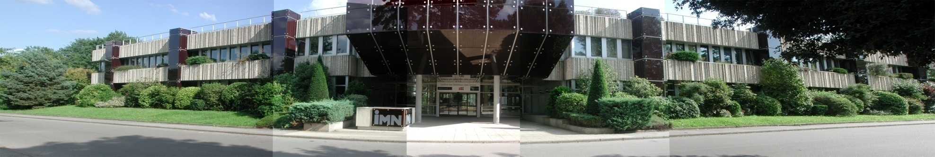

Resistive switching in Mott insulators: from phenomenology to Mott memories
INSTITUT DES MATERIAUX JEAN ROUXEL IMN UMR CNRS 6502 - Université de Nantes
J. Tranchant, E. Janod, B. Corraze, M.P. Besland, P. Stoliar, L. Cario
Institut des Materiaux Jean Rouxel, Nantes (France)
December 3rd 2014
Nanotek 2014 conference
San Francisco, USA

Slide 2


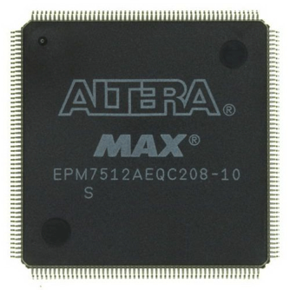


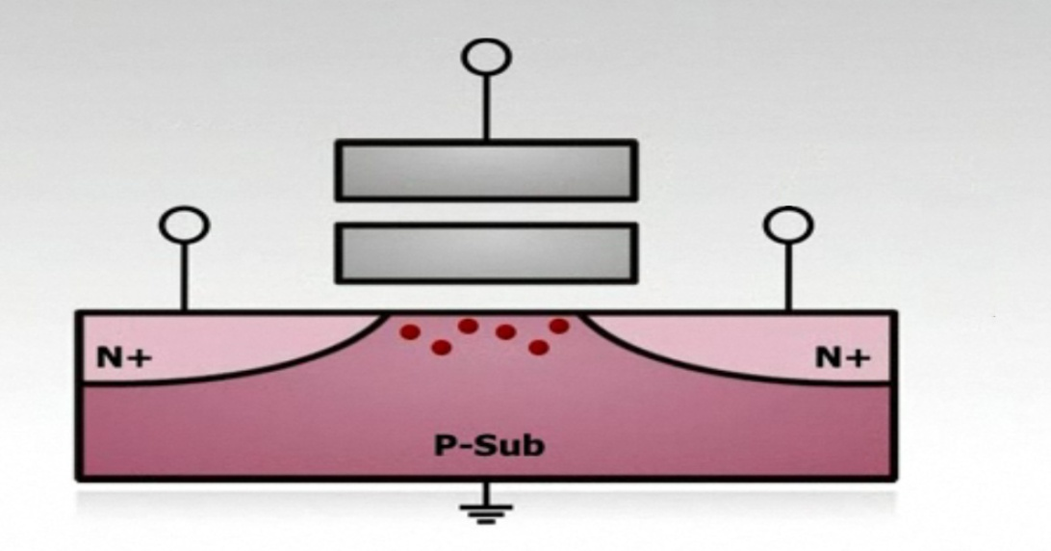
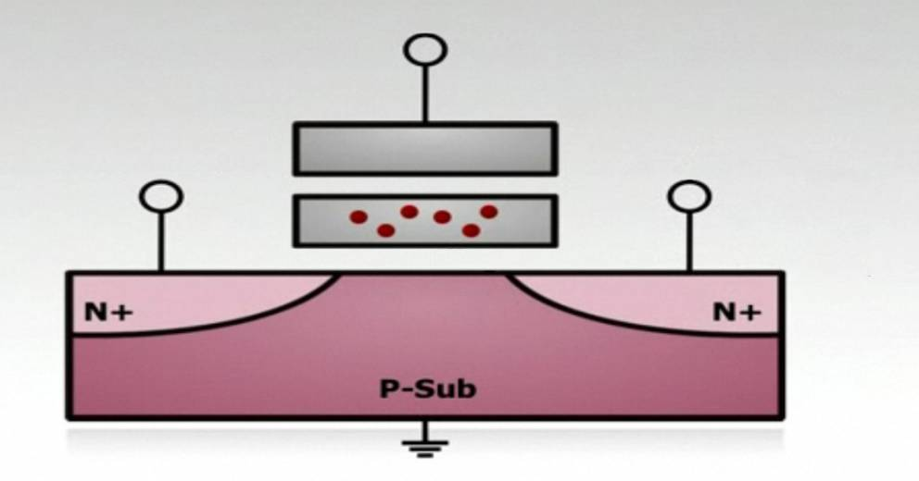
What after Flash Memories ?
Flash memories : fantastic advances…
Control gate
"1"
Control Gate
"0"
Floating gate
Floating gate
Source
Drain
Source
Drain
… but physical limits are close !
Notes:
Tout d’abord, pour situer les enjeux :
Le développement extraordinaire de l’électronique portable (téléphonie, MP3/4, GPS, appareils photo numéraiques, pour n’en citer que qqes uns) au cours de la dernière décennie est étroitement lié à la miniaturisation de la mémoire qui équipe tous ces appareils, la mémoires Flash. Or, le stockage de l’information sous forme de zéro et de un dans des unités mémoires de type Flash repose sur la présence ou l’absence d’électrons dans une grille flottante. Or, les limites de miniaturisation des Flash vont d’ici 3-5 ans être atteinte, puisque le nombre d’électrons stockés dans cette grille devient trop faible : il est actuellement d’une centaine et diminuer ce nombre va entrainer de gros problèmes de stabilité de l’information stockée.

Slide 3
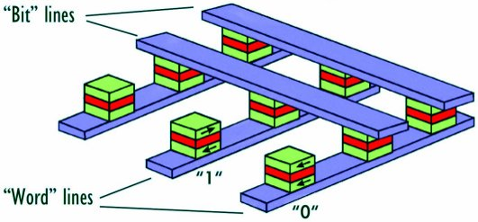
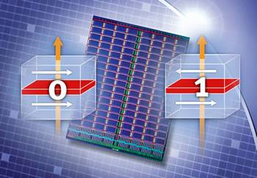
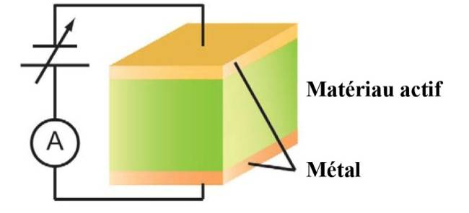
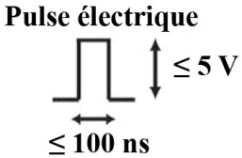
Some candidates to succeed Flash memories
Magnetic RAM (MRAM) ?
Phase-Change Memories (PCM) ? Phase transition between amorphous state(R_{high}) ⇔ crystalline (R_{low})
  → Thermal mechanism
« 1 » « 0 »
"1"
"1"
R_{high}
Resistive RAM (ReRAM) ?
"0"
Active material
R_{low}
Electric pulse
Metal
~µs

Slide 4
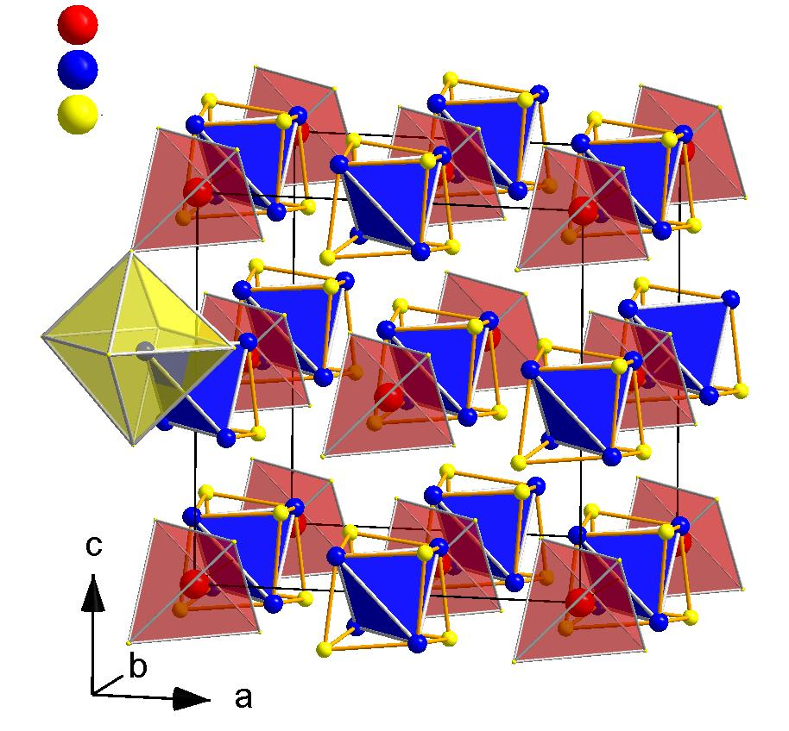
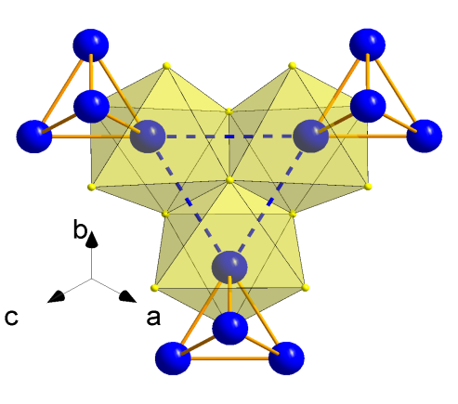
The Mott Insulator compounds AM₄Q₈
Clustered lacunar spinel structure :
2.96 Å
Tetrahedral Clusters (GaV₄S₈)
3.98 Å
With coulombian repulsion U
Energy
Molecular Orbitals
UHB
U
E_{F}
LHB
SG F-43m
A = Ga, Ge
DOS
M = V, Nb, Ta
Gap ~ 0.25 eV
Q = S, Se
Ben Yaich, H.; Jegaden, J. C.; Potel, M.; Sergent, M.;
Rastogi, A. K.;Tournier, R.
J. Less-Common Met. 1984, 102, 9.
AM₄Q₈ : Narrow Gap Mott Insulators
Pocha, R. et al., J. Am. Chem. Soc. 127, 8732 (2005)
Notes:
Juste en commentaire : a typical example of Mott insulators is found in the family of AM4Q8 compounds. Ajouter la répulsion coulombienne

Slide 5
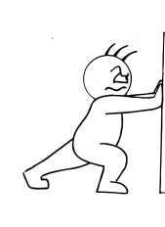

Bandwidth and filling control
Insulator to Metal Transition
Pressure
E(eV)
Temperature (K)
Resistance
E_{F}
Insulator
U
W
Quasi
particle peak
W
Metal
Mott
Insulator
DOS
Correlated
Metal
Temperature
Doping x
E(eV)
Resistance
7
Insulator
U
Supercond.
E_{F}
E_{F}
0
6
U
Pressure (GPa)
Metal
DOS
Temperature
Exotic properties at the (Mott) insulator to metal transition
Notes:
Largeur de bande W directement proportionnelle au recouvrement des orbitales
Pic de quasi particule = prédiction de la DMFT non prédite par le 1er modèle de Mott

Slide 6
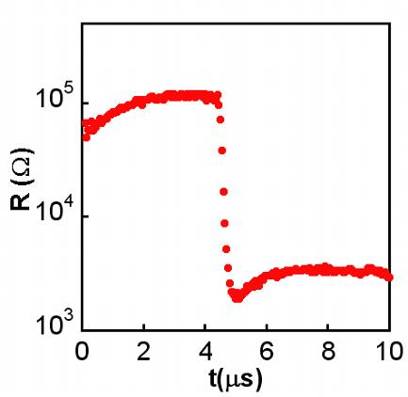
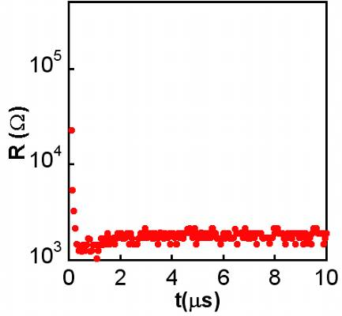
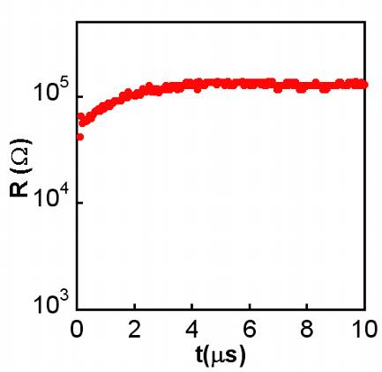
Resistive switching in AM₄Q₈
1
2
V
3
V
V
E_{threshold}
t
t
t
t
R₀
R_{after}
t_{délai}
t_{delay}
Volatile Resistive switching
Non-volatile resistive switching
No transition
→ E > E_{threshold}≅ 2.5 kV/cm
→ E ≅ 10 kV/cm
(> > E_{threshold} )
Evidence of a volatile resistive switching

Slide 7
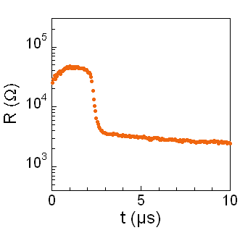
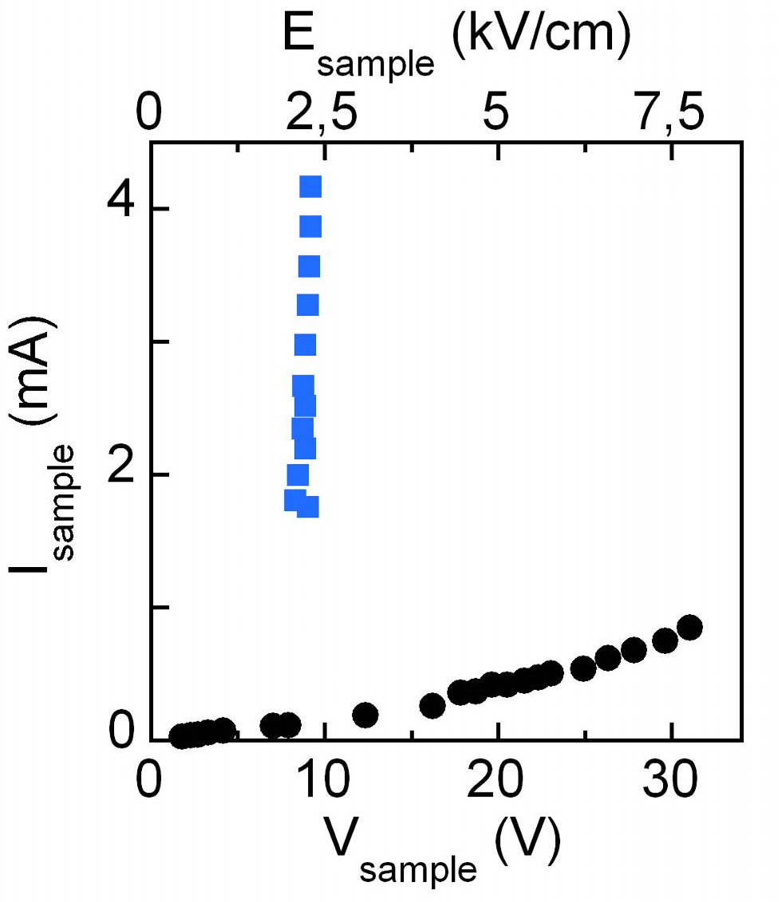
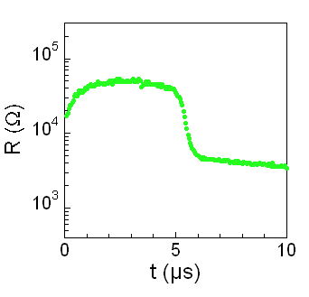
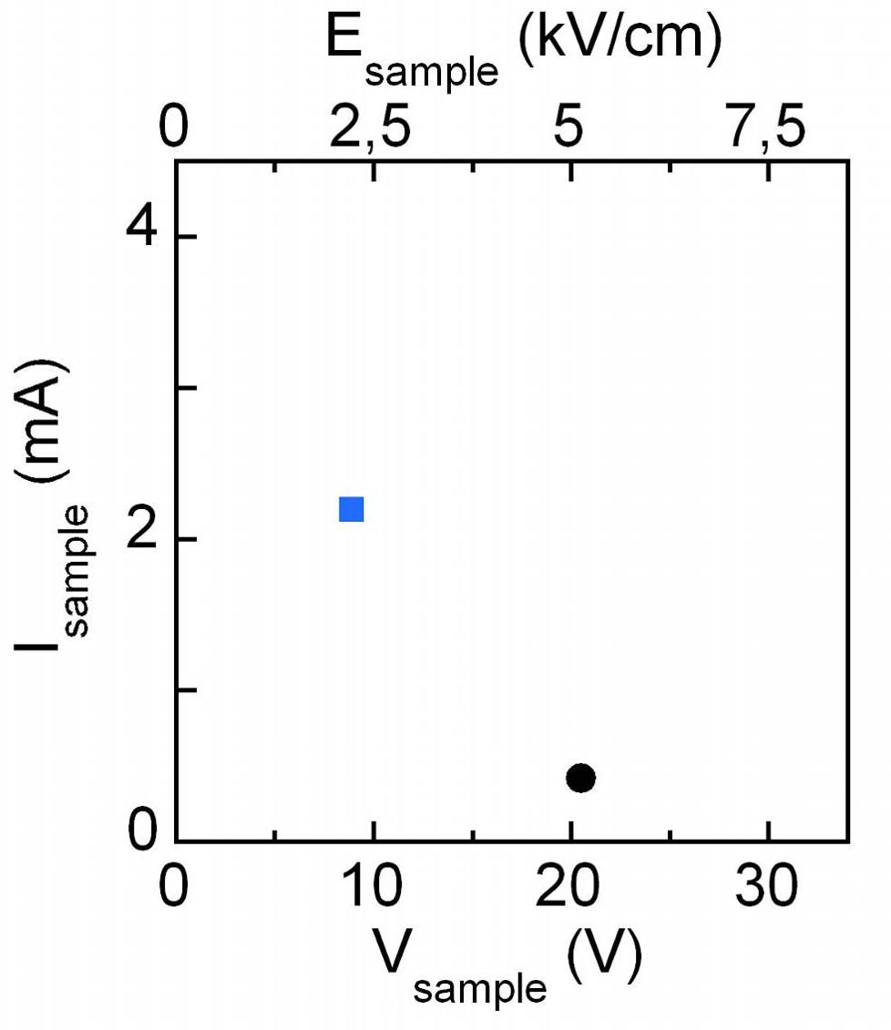
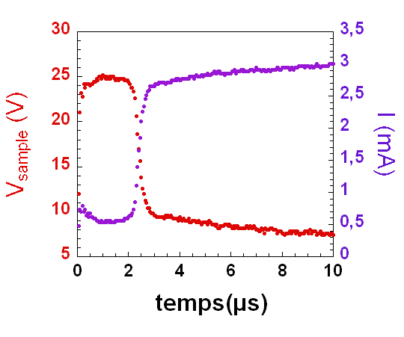
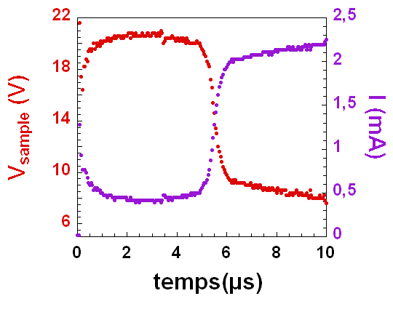
Electric field triggered electronic transition
"conducting" state
Threshold field
insulating
t (µs)
Electric field effect !
L. Cario et al., Advanced Materials 22, 5193-5197 (2010)
Notes:
Transition avec le slide suivant :
Cette propriété est associée à la transition isolant-metal dans ces isolants de Mott, et donc liée au gap dans ces composés. On peut maintenant se demander s’il est possible de faire varier le gap?

Slide 8
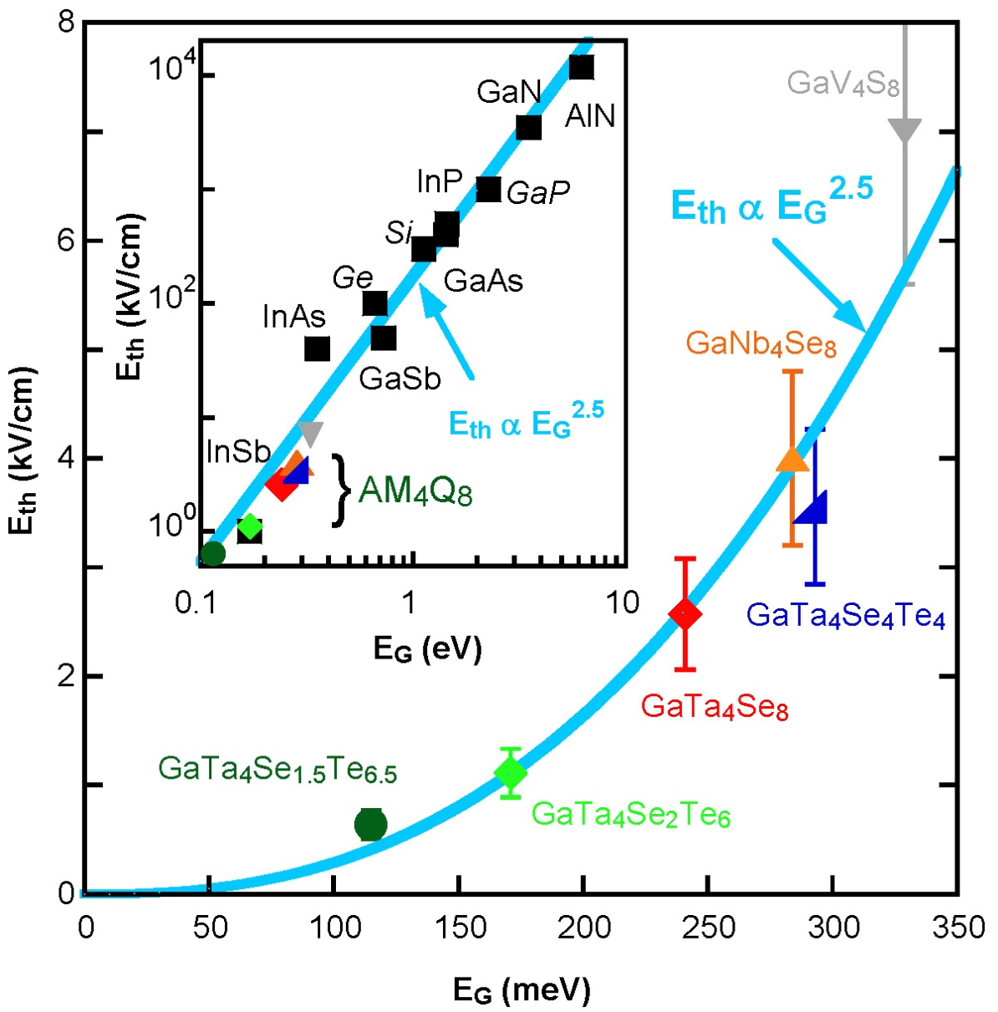

Volatile resistive switching in AM₄Q₈
"conducting" state
Threshold field
insulating
Resistive switching above E_{threshold} (≈ 1-10 kV/cm)
Avalanche breakdown mechanism… in a Mott insulator!
E_{threshold} ∝ E_{gap}^{2.5}
I(V) similar to InSb/Si/Ge…
V. Guiot et al. Nature Communications (2013) DOI: 10.1038/ncomms2735
P. Stoliar et al. Adv. Mater. (2013) DOI: 10.1002/adma.201301113
Notes:
Dire que la modélisation montre un mécanisme filamentaire

Slide 9
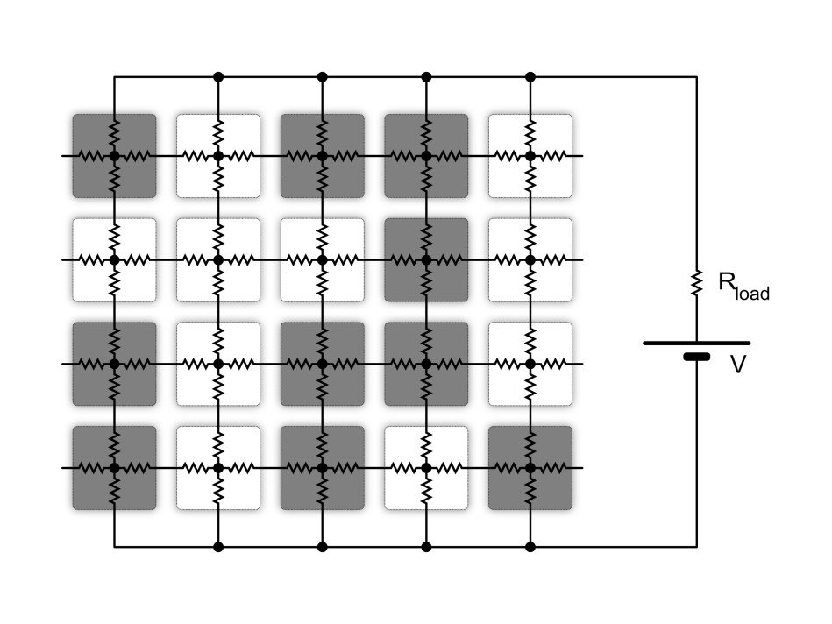
Modeling of the resistive switching:
a simple assumption
E
Correlated
Metal
Mott
Insulator
Local voltage drop destabilises the insulating cells

Slide 10
Time evolution of the resistor network
E
V<V_{th}
V>V_{th}

Slide 11
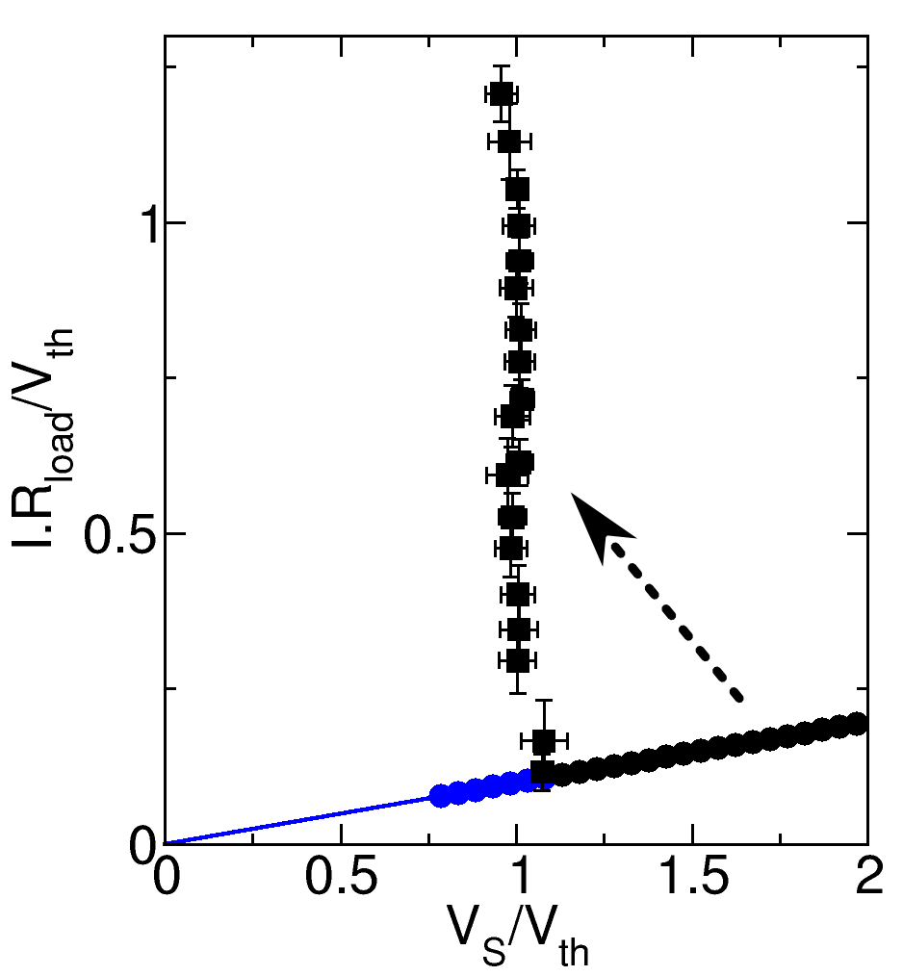
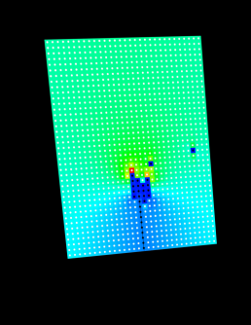

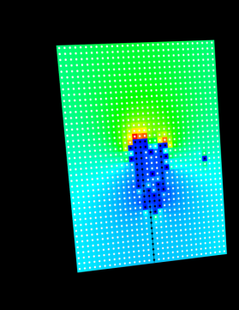
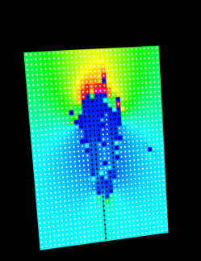
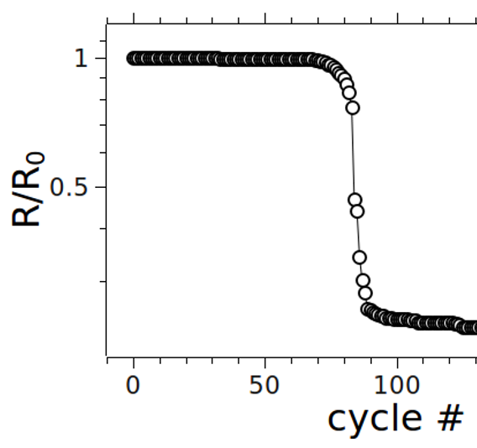
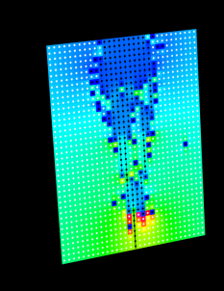
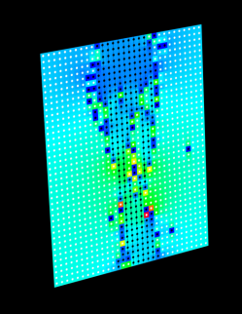
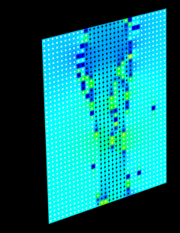
Modeling of the resistive switching
P. Stoliar et al.
Adv. Mater. 25, 3222 (2013)
Electric Field
Experimental data
Experimental data
I (a.u.)
Time (cycle #)

Slide 12
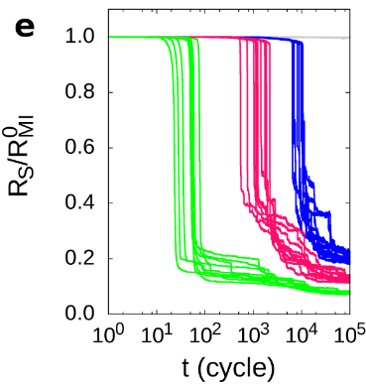
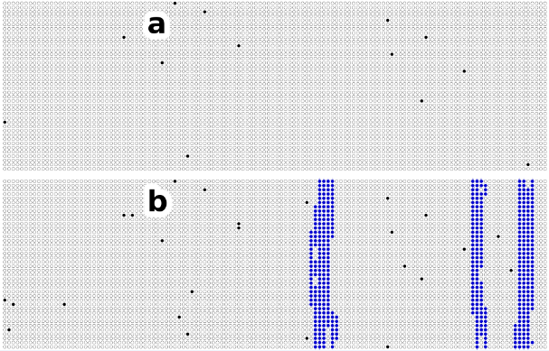
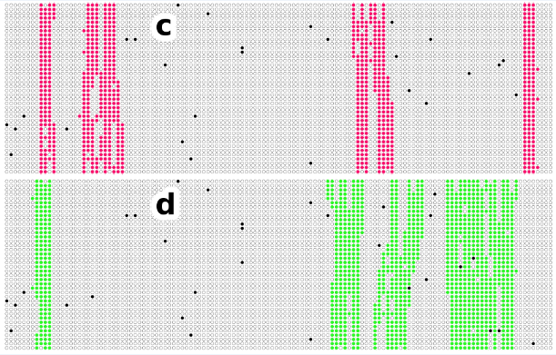
From volatile to non-volatile resistive switching
Model
Experiments
P. Stoliar et al.
Adv. Mater. 25,
3222 (2013)
V
V_{S}/ V_{th}=
0.7
1.1
1.4
1.8
t
V
Volatile
t_{delay}
t
V
Non
Volatile
t
➔ Non Volatile for large
metallic filaments ?
Notes:
Pour cela revenons à la phénoménologie de la RS : nous avons vu que cette transition NV apparaît pour des champs élevés, que prédit le modèle utilisé pour la volatile à ce sujet?

Slide 13
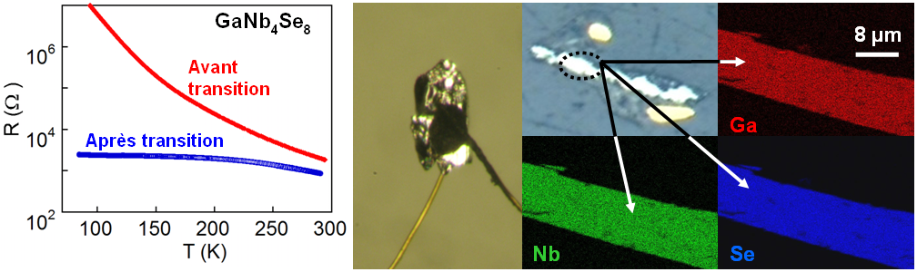
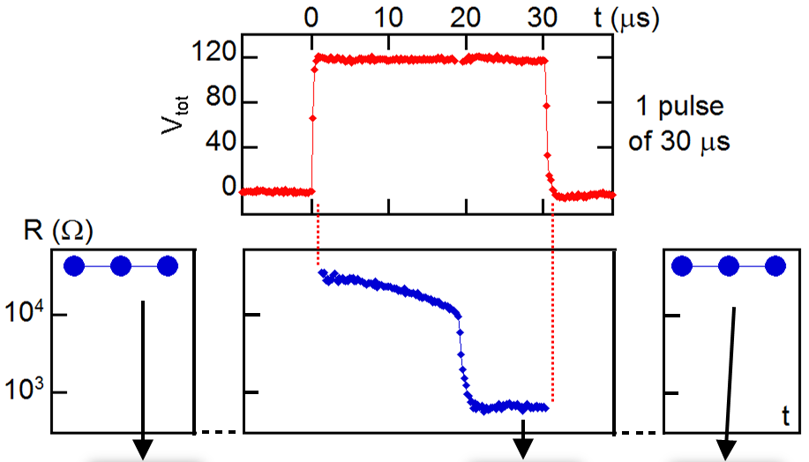
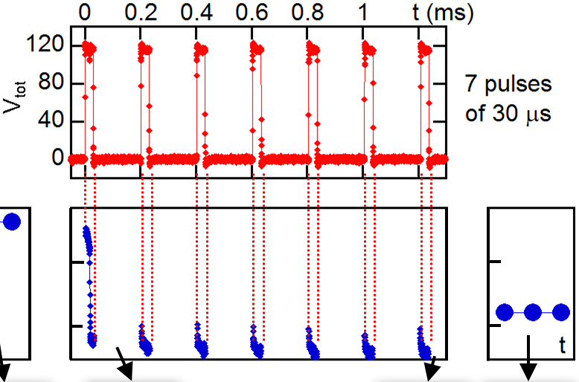





Control of SET and RESET transitions
SET = Field assisted creation of large filaments
Pristine state
Volatile
Pristine-like state
Volatile
Non-volatile
J. Tranchant et al., Phys. Status Solidi A, DOI:10.1002/pssa.201400158 (2014)
E. Janod et al., review to be published in Adv. Funct. Mater. (2015)

Slide 14
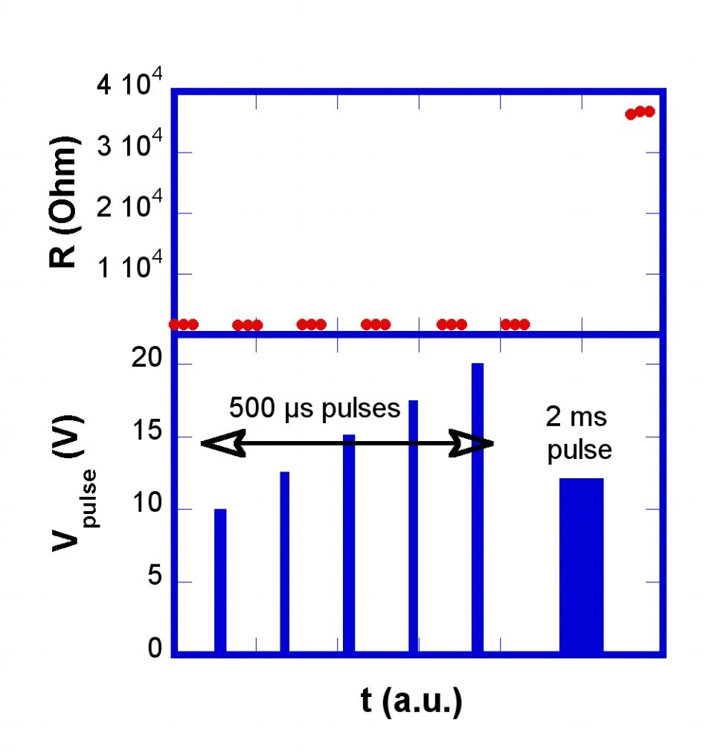
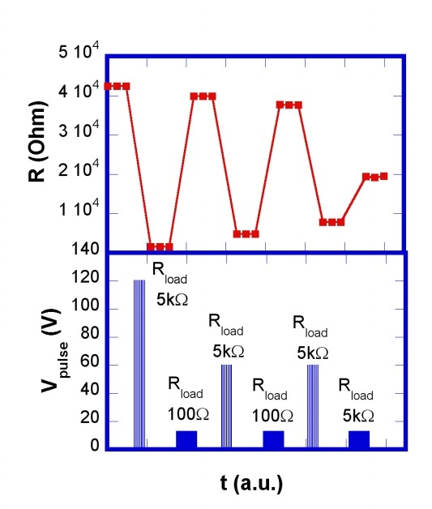



SET and RESET transitions
RESET = purely thermal
effect
J. Tranchant et al., Phys. Status Solidi A, DOI:10.1002/pssa.201400158 (2014)
Towards multilevel switching and memristive behavior

Slide 15
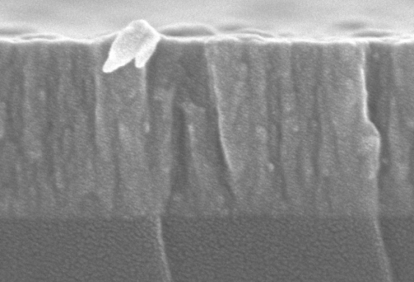
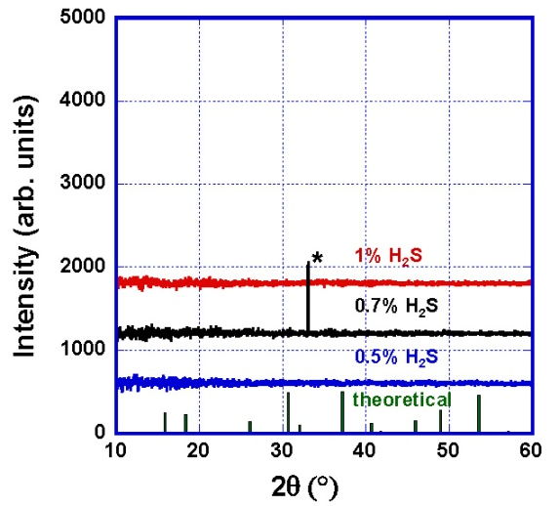

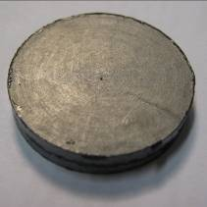
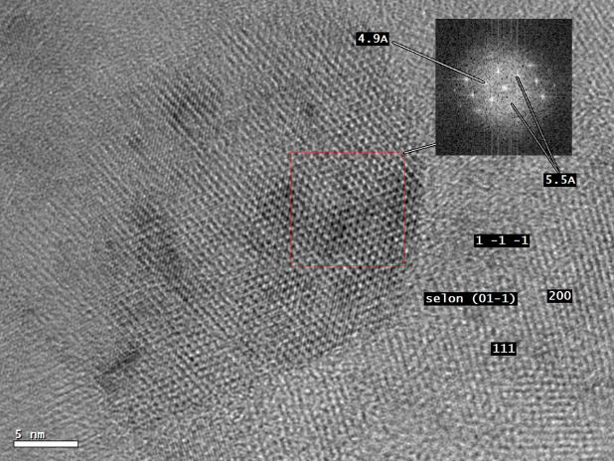
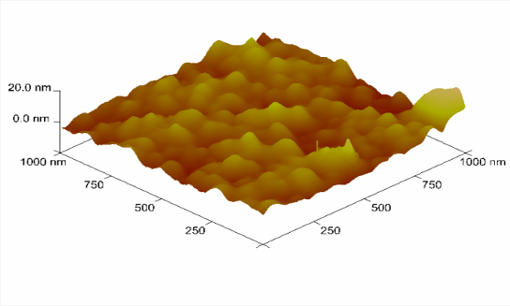
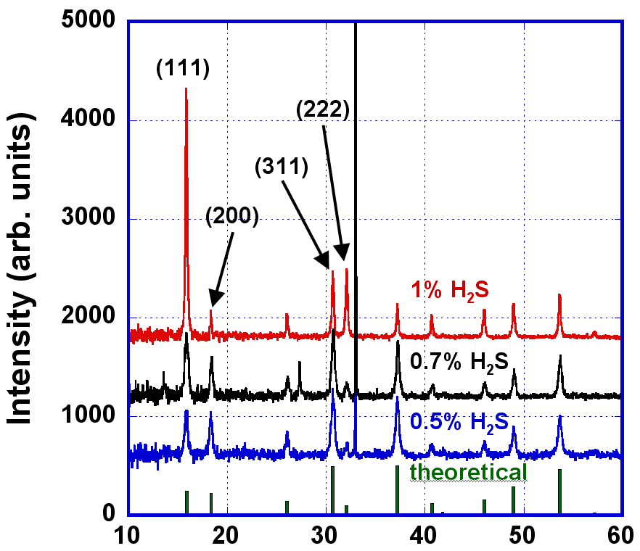
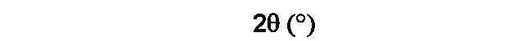
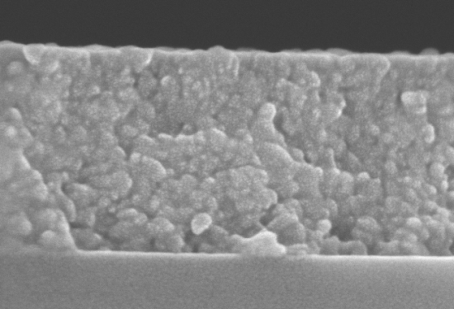
GaV₄S₈ thin films deposition
Spark Plasma Sintering of a home synthesized GaV₄S₈ target
Ar/H₂S reactive sputtering
XRD
100 nm
R_{OFF}/R_{ON}= 5-7
amorphous thin films
AFM
R (Ω)
Reversible resistive switch!
annealing
450-600°C
RMS roughness = 3 nm
XRD
5 nm
time
Average grain size = 30 nm
100 nm
J. Tranchant et al., J. Phys. D: Appl. Phys. 47, 065309 (2014)
Polycrystalline GaV₄S₈ thin films

Slide 16
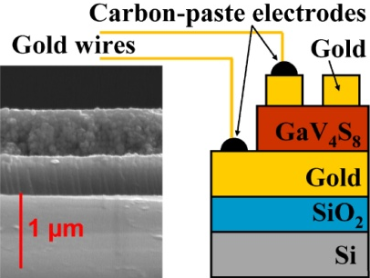
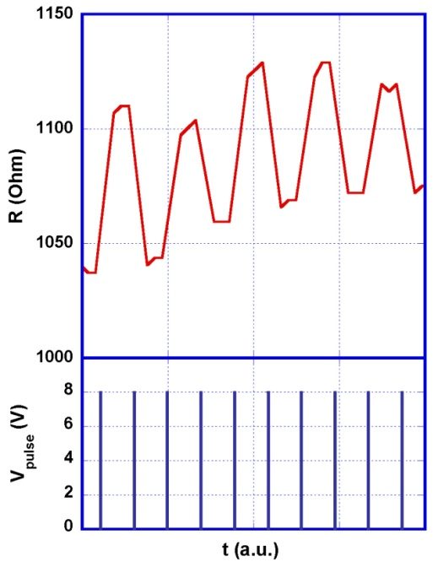
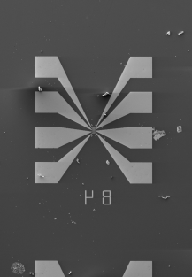
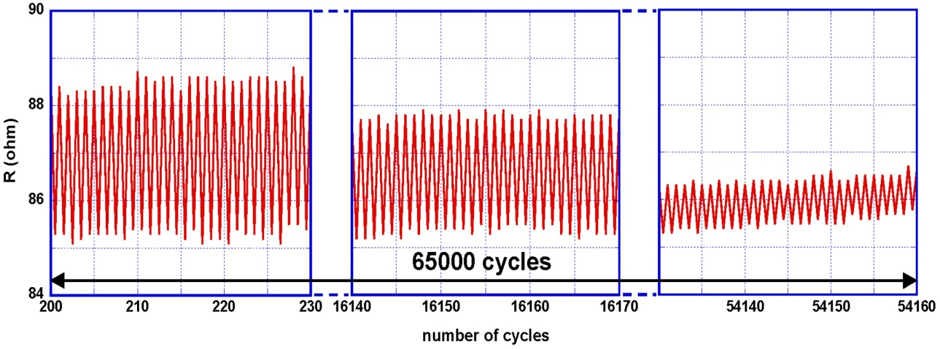







Electrical performances of GaV4S8 for Mott memories
Resistive switch cycling endurance
Writing / erasing times ≤ 100 ns
2V / 1ms pulses on 50x50µm² MIM structures
GaV₄S₈
8V / 100ns pulses on
20x3 µm² planar structures
, error rate < 0,1 ‰
+ writing / erasing voltage ≤ 2V
20 µm
Data retention : high and low resistance states > 10 years
Increase of R_{on}/R_{off} with downscaling
(extrapolation on
2x2 µm² MIM structures)
J. Tranchant et al. Thin Solid Films, 533 (2013) 61

Slide 17








Conclusion
Resistive Switching in the AM₄Q₈ Mott Insulators
Electric field triggered
avalanche phenomena
Filamentary paths
Non Volatile RS
Promising memory performances of thin films
Volatile
Non-volatile
2011/13
Emerging
Research Devices
A new type of Mott Memory !

Slide 18











Acknowledgments
Paris
V. Dubost, F. Debontridder, T. Cren, D. Roditchev
Orsay
V. Guiot, C.Vaju,
E. Souchier, J. Martial
S. Salmon, J. Tranchant,
P. Moreau, L. Lajaunie,
M.P. Besland, B. Corraze,
E. Janod, L. Cario
Tours
Nantes
P. Stoliar, V. Bouet,
M. Rozenberg
Cluj University
E. Dorolti, V. Pop
ICR Rennes
S. Cordier, M.G. Viry
UBA
C.Acha
NC St. Univ.
H. Koo, E. Kan, M. Whangbo
V. Ta Phuoc, M. Chligui
ANR NV-CER (2005-08)
ANR NanoMott (2009-13)
ANR Mott-RAM (2012-14)
ANR Gold-RAM (2013-2016)
Financial
supports :

Slide 19

Thank you for your attention

Slide 20
AM₄Q₈ Mott insulators
1 electron per site, band theory :
Solid :
Energy
→ metal!
E_{F}
W
Electronic confinement ➔ coulombian repulsion :
Solid :
U = coulombian repulsion between electrons
Energy
→ insulator
W
W < U
E_{F}
U
W
Gap ~ 0.20 eV
for AM₄Q₈
AM₄Q₈ = narrow gap Mott insulators
Pocha, R. et al., J. Am. Chem. Soc. 127, 8732 (2005)

Slide 21

AM₄Q₈ Mott insulators
Temperature (K)
Insulator-metal
Transition
Mott
insulator
metal
Mott Transition
7
superconductor
0
6
Pression (GPa)
Transition Mott insulator – metal under pressure
Superconductivity (T°_{C} = 5-7K)
Abd-Elmeguid et al., Phys. Rev. Lett. 93, 126403 (2004); R. Pocha et al., J. Am. Chem. Soc. 127, 8732 (2005)

Slide 22




Bandwidth control MIT in the AM₄Q₈
Mott Insulator
GaTa₄Se₈
UHB
Temperature (K)
LHB
Pressure
Mott
Insulator
Correlated
Metal
s(w)
Correlated Metal
s(w)
UHB
7
LHB
Supercond.
0
6
Pressure (GPa)
Abd-Elmeguid et al.,
Phys. Rev. Lett. 93, 126403 (2004)
Vinh Ta Phuoc et al. Phys Rev Let. 110, 037401 (2013)
R. Pocha et al.,
J. Am. Chem. Soc. 127, 8732 (2005)
Mott insulator – metal transition under pressure
Notes:
Effet de la pression suggère transition isolant metal, mais ce n’est pas suffisant pour prouver qu’il s’agit bien d’une transition isolant-metal de Mott.
Pour cela on va sonder les excitations de basse énergie via la conductivité optique

Slide 23
Context : Mott insulators and Insulator to Metal Transition
Metal
Correlated
metal
Mott insulator
U
U << W
U ~ W
U >> W
E_{F}
E_{F}
E_{F}
Quasi-particule peak
DOS
DOS
DOS
U
LHB
UHB
LHB
UHB
W
Energy
W
Energy
W
Energy
LHB (UHB) = Lower (Upper) Hubbard Band

Slide 24
Context : universal phase diagram of Mott insulators
Canonical Mott Insulators:
(V_{1-x}Cr_{x})₂O₃
McWhan et al., Phys. Rev. B 1970
Ni(S_{1-x}Se_{x})₂
Miyasaka et al., J. Phys. Soc. Jap. 2000
AM₄Q₈
Corraze et al., Eur. Phys. J. ST 2013
Mott insulator at equilibrium: well described by
Dynamical Mean-Field Theory (DMFT).
See e.g. Kotliar & Vollhardt, Physics Today 57, 53 (2004)
Notes:
Dans l’introduction sur la « Mott MIT physics » :
montrer tout d’abord le diagramme T – pression, tout d’abord générique puis celui de V2O3
montrer qu’il y a un saut de volume (transition de 1° ordre) à la transition de Mott, mais sans changement de symétrie cristallographique (insister sur ce point, pour marquer la différence avec TMI de VO2) : data existent dans V2O3, mais peut être montré de manière schématique ➔ facilite la compréhension quand, à la fin du talk, on présente les conclusion données dans le EPJ-ST sur « zones compressées = métalliques » et « zone en extension = superisolantes »

Slide 25


T-induced MIT (VO₂, NbO₂, Ca₂RuO₄,…):
pure Mott physics ?
VO₂
Universal Mott phase diagram
Science 318,
1750 (2007)
PRL 105, 177203
Ca₂RuO₄
Temperature-induced Insulator to Metal Transition ➔ non-universal Mott behavior

Slide 26



Non linear phenomena in the AM₄Q₈ : comparison with existing models
Effet Zener
Avalanche
E_{th} > MV/cm
Charge density wave depinning (CDW)
NbSe₃
E_{th} comparable
E_{th} ≈ 1-100 kV/cm
I(V) similar
Monceau et al.,
PRL 37, 602 (1976)
E_{th} ≈ 1-10 kV/cm
Gap ~ 0.2 eV
Electronic
Non homogeneous
Possible
Mechanism
E_{th}< 1 V/cm
I(V) different
No strutural transition

Slide 27






Modeling of the resistive switching :
implementation of a resistor network
max
min
Electric field
Trial number ≈ Time scale

Slide 28




Non-volatile resistive switching :
Chemical or structural changes ?
« Transited » crystal GaV₄S₈
TEM Images (IMN)
EDXS Chemical
Analysis
Before transition
FIB / SEM Images
After transition
4 nm
no chemical or structural change (< 10-1000 nm)
Corraze et al., Eur. Phys. J. Spec. Top. 222, 1046 (2013).

Slide 29
AM₄X₈ : interfacial phenomena ?
Gold
Silver
Carbone
2 contacts measurements
4 contacts measurements
“bulk” phenomena

Slide 30




Two resistances model
Before
Electric
Pulse
After
Experiments
Simulation
ρ_{gm}=ΑT^{-α}
R_{gm}
R_{i}
ρ_{i}=ρ_{i0}exp-E_{a}/k_{B}T
C. Vaju et al.,
Microelectronic Engineering, 85, 2430 (2008)

Slide 31



Two resistances model : a filamentary conduction
Before
Electric
Pulse
After
Experiments
Simulation
Electric pulses create and reorganize some filamentary paths
Electric pulse induced
filamentary conduction

Slide 32
Electric pulse driven superconductivity ?
260 µm
Current pulse
applied at 70 K
4 points
Measurements
100 mA
1.4 mA
4.4 mA
7K
6.3 mA
25 mA
Low bias resistivity
ΔR/R ≈ 20%
40 mA
C. Vaju et al., Advanced Materials 20, 2760 (2008); Microelectronic Engineering, 85, 2430 (2008)

Slide 33

Volatile Resistive Switching = local Mott transition
The phenomenology is general to all Mott insulators !
P. Stoliar et al. Adv. Mater. 25, 3222 (2013)
L. Cario et al. – Patent PCT/EP2013/057500. April 2012

Slide 34

Non-volatile resistive switching :
electronic phase separation
STM study of GaTa₄Se₈
V. Dubost, F. Debrontrider,
T. Cren, D. Roditchev
Before electric pulse
After electric pulse
50 nm
100 nm
Electronic phase separation
C. Vaju, et al. Advanced Materials 20, 2760 (2008)

Slide 35










Pulse application through the STM tip:
large electro-mechanical coupling
Pulses applied through STM
Nano-writing : 1 Tdots / cm² !
surface inflation
Gigantic electro-mechanical Effect
V. Dubost et al. Adv. Funct. Mater. 19, 2800-2804 (2009)

Slide 36

Electronic phase separation :
an STS study
‘Super-
Insulating’
Electric pulse
V. Dubost et al. Nanoletters 13, 3648 (2013).
Metal
Insulator metal transition at the nanoscale !
Notes:
Les inhomogénéités présentées ici font 50 nm et sont donc > 10 nm (cf. 2 slides plus tôt)
Conductance différentielle en chaque point
Dire qu’effet électro-strictif et supprimer slide 19?

Slide 37



Pulse application through the STM tip:
writing and erasing at the nanoscale
Successive spectroscopic Voltage ramps 600 mV
High
Electronic writing
with electric pulses
Lateral Scale (nm)
Low
V. Dubost et al.
Nanoletters 13, 3648 (2013).
Reversible insulator metal transition at the nanoscale !

Slide 38
Compression or expansion of domains
under electric field
Extended superinsulating domains
Compressed metallic domains

Slide 39



Towards a model of the
non-volatile resistive switching in the AM₄Q₈
Corraze et al., Eur. Phys. J. Spec. Top. 222, 1046 (2013).
E > E_{th}
Avalanche
Local Mott
Transition
Metallic Compressed Zone
Expanded insulating domain
Electrode
A local Mott transition with volume contraction
creates both metallic and superinsulating domains

Slide 40
Towards a model of the
non-volatile resistive switching in the AM₄Q₈
Corraze et al., Eur. Phys. J. Spec. Top. 222, 1046 (2013).
Voronoi diagram assuming total volume conservation
Contracted
domains
Expanded
domains
Breakdown
path
A local Mott transition with volume contraction
creates both metallic and super-insulating domains
Notes:
Diagramme Voronoi : si on crée une ligne autour de laquelle s’auto-organisent des zones en tension et en compression en imposant une conservation de volume, on observe le même type d’organisation que nos observations.
Transition avec le slide suivant : ce modèle microscopique suggère un lien fort entre transition volatile et non-volatile, mais comment s’opère le passage d’un type de transition à l’autre?

Slide 41





Metal/Insulator/Metal (MIM) Structure
Au
GaV₄S₈
Au
SiO₂
Si
300 nm
200 µm
10 µm
Si
SiO₂
Au
TEM
Au
GaV₄S₈
Pt
E. Souchier et al., PSS-RRL 5, 53 (2011)
Notes:
Dire que 1ères études sur or mais derniers résultats obtenus sur TiN (article à venir)

Slide 42









Fabrication of a Mott memory device
6x6 crossbar array GaV₄S₈ device
Plateforme Technologie Amont
(CNRS/CEA, Grenoble)
→ Cell sizes from 100 nm to 1 µm for scaling evaluation
1 µm cell
250 nm cell
1 µm
1 µm
630 nm cell
190 nm cell
1 µm
1 µm
400 nm cell
100 nm cell
➔ First electrical characterizations currently running
1 µm
1 µm

