Slide 1
A Smartphone Mobile Application to Improve Diagnosis
6th International Conference on Proteomics
March 29, 2016
Atlanta, GA
Julie R. Taylor, Ph.D.
The findings and conclusions in this report are those of the authors and do not necessarily represent the official position of the Centers for Disease Control and Prevention.
Center for Surveillance, Epidemiology, and Laboratory Services
Division of Laboratory Systems

Slide 2
Overview
CLIHC™*
Vision
Team Members
Knowledge Gap Identified
Mobile Application Development Process
Evaluation
*Clinical Laboratory Integration into Healthcare CollaborativeTM
Notes:
Add –
Visions of quality – lab medicine
Gold, diamonds, crystal clear water falls
I say the word garbage – think garbage in garbage out -

Slide 3
Overview
CLIHC™
Vision
Team Members
Knowledge Gap Identified
Mobile Application Development Process
Evaluation
Notes:
Add –
Visions of quality – lab medicine
Gold, diamonds, crystal clear water falls
I say the word garbage – think garbage in garbage out -

Slide 4
CLIHCTM Vision
Laboratory medicine is fully integrated in the healthcare system resulting in better patient care and improved patient outcomes
http://www.cdc.gov/ophss/csels/dls/eblm/index.html

Slide 5
The Path to Better Test Utilization Why Labs Should Step-up Physician Education, Consultation Diagnostics Diagnosis Survey Shows Doctors' Challenges, Labs' Opportunities in Better Test Ordering and Interpretation By Genna Rollins
http://www.aacc.org/publications/cln/2012/September/Pages/TestUtilization.aspx#
http://www.aacc.org/publications/cln/2014/august/Page/Diagnostics-Diagnosis.aspc#
Notes:
Cln surveyed their members to ask them why test utilization is a problem and
74% Limited teaching about lab testing in medical school
72% of the respondents rated “failure to collectively organize best practices around lab test selection and result interpretation” as highly important . If you are interested

Slide 6
CLIHCTM Workgroup Members
Co-Lead: John Hickner, MD, MSc
University of Illinois Chicago
Co-Lead: Michael Laposata, MD, PhD
University of Texas Medical Branch
Paul Epner, MEd, MBA
Paul Epner, LLC
Marisa B. Marques, MD
University of Alabama at Birmingham
Jim L. Meisel, MD, FACP
Boston University Medical Center
Elissa Passiment, EdM
American Society for Clinical Laboratory Science

Slide 7
CDC CLIHCTM Team
Nancy Cornish, MD
Manjula P. D. Gama Ralalage, MBBS, MSc
Ira Lubin, PhD (Acting Chief, LREB)
Allison McAlister, MPH, CPH
Pam Thompson, MS MT (ASCP)
Karlyn Wilson, MPH, CPH

Slide 8
Overview
CLIHC™
Vision
Team Members
Knowledge Gap Identified
Mobile Application Development Process
Evaluation
Notes:
Add –
Visions of quality – lab medicine
Gold, diamonds, crystal clear water falls
I say the word garbage – think garbage in garbage out -

Slide 9
Clinical Laboratory Testing - 1970
30-50
lab tests
1970
1980
1990
2000
2010
Michael Laposata, AACC 2010

Slide 10
Clinical Laboratory Testing - Today
30-50
lab tests
RIAs
for hormones
Intro of
molecular testing
>3500
lab tests
1970
1980
1990
2000
2010
Intro of
automated
instruments
Immunoassay
automation
Major expansion
of molecular
testing
Michael Laposata, AACC 2010

Slide 11
National Academy of Medicine, 2015

Slide 12
Diagnostic Errors Harm Patients
Outpatient Care
5 percent of U.S. adults
Postmortem examination
10 percent of patient deaths
Medical record reviews
6 to 17 percent of hospital adverse events
Paid medical malpractice claims
2 times more likely to result in patient death
Highest proportion of total payments
National Academies of Sciences, Engineering, and Medicine. 2015. Improving Diagnosis in Health Care. Washington, DC: The National Academies Press.

Slide 13
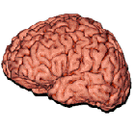
Many diagnostic errors occur here.
Has the right test been ordered?
Was the test result correctly interpreted?
Action
Ordering
Interpretation
Collection
Reporting
Identification
Analysis
Transportation
Preparation
The nine steps in the performance of any laboratory
test. The brain-to-brain turnaround time loop.
Lundberg,G; Acting on Significant Laboratory Results, JAMA. 1981; 245(17):1762-3

Slide 14
Importance of Ordering the Right Test
Underutilization more prevalent than overutilization
True cost of laboratory testing is downstream:
Prescriptions
Surgeries
Hospital stays
Reduce errors and improve care by:
Improving initial test ordering
Education
Clinical Decision Support (CDS) tools
Improving laboratory utilization should lead to more cost-effective care
Zhi, M et al. (2013) The landscape of inappropriate laboratory testing: a 15-year meta-analysis. PLoS ONE 8(11): e78962. doi:1-.1371/journal.pone.0078962

Slide 15
Survey of Clinicians’ Challenges Project Leads – John Hickner, MD, MSc and Paul Epner, MEd, MBA
Goal:
Publish an article to highlight the challenges clinicians face for test ordering and result interpretation
Methods:
Phase 1 - Conduct focus groups
Phase 2 - Design a national survey of family physicians and internal medicine physicians
CLIHCTM Clinicians’ Challenges Team

Slide 16
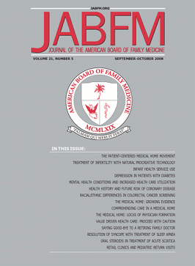
Hickner J, Thompson P, Wilkinson T, Epner P, Sheehan M, Pollock A, Lee J, Duke C, Jackson B, and Taylor J.
Primary care physicians' challenges in ordering clinical laboratory tests and interpreting results.
J Am Board Fam Med. 2014; 27:268-74.
http://www.jabfm.org/content/27/2/268.full

Slide 17
Physician Uncertainty
Physicians ordered tests for 31.4% of patient encounters and were uncertain about:
Test ordering in 14.7% diagnostic patient encounters
Interpreting results in 8.3% diagnostic patient encounters
Potential to impact millions of patients

Slide 18
Diagnostic Algorithms Project Leads – Michael Laposata, MD, PhD and Marisa B. Marques, MD
Goals:
Develop diagnostic algorithms for selected scenarios for appropriate laboratory testing to guide diagnosis and patient care
Develop information technology tools to guide appropriate laboratory test selection
CLIHCTM Diagnostic Algorithms Team

Slide 19
Gap Identified Prolonged partial thromboplastin time (PTT)
PTT testing is required for managing bleeding & clotting problems
PTT testing is complicated and requires quick follow-up action
Consultative services from experts in the field are not universally available
Training on the appropriate coagulation laboratory testing is not readily available in emergent situations

Slide 20
Goal 1: Algorithm Design*
External Author Licensing
Form Expert Design Group
Expert Algorithm Design
Scientific Review
Legal Review
CDC Scientific
Clearance
Peer Reviewed
Publication
*CLIHCTM Algorithm Team
*CDC Division of Laboratory Systems

Slide 21
Vetting Process Timeline Example
Finalize approach, experts, and timeline
Contact individuals
Review comments
Refine and finalize algorithms
3/24
4/15
4/28
5/4
6/8
6/15
7/1
Develop review materials
Distribute review materials to positive respondents
Engage experts to discuss comments

Slide 22
CDC Clearance
External Author Licensing²
Legal Review¹
CDC Scientific
Clearance³
Form Expert Design Group
Expert Algorithm Design
Scientific Review
Peer Reviewed
Publication
CDC required:
¹ Legal review of the design process
² Author approval to use the algorithms
³ Clearance through the Office of the Associate Director for Science

Slide 23
Publication
External Author Licensing
Peer Reviewed
Publication
Form Expert Design Group
Expert Algorithm Design
Scientific Review
Legal Review
CDC Scientific
Clearance

Slide 24
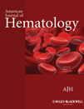
American Journal of Hematology
Test of the Month
The isolated prolonged PTT
Oxana Tcherniantchouk
Michael Laposata and
Marisa B. Marques
Top 12 most down-loaded article from journal during 2011 - 2015
Am J Hematol. 2012; 88(1): 82-85

Slide 25
Percent Effort - Design Process *

Slide 26
Lessons Learned
First - identify knowledge gap
Prepare plan to address the gap, include in the plan:
How to identify scientific experts
Develop scientific content
Review/evaluate/vet the scientific content
Review process according to your institution guidelines
Scientific
Legal
Evaluate your processes

Slide 27
Overview
CLIHC™
Vision
Team Members
Knowledge Gap Identified
Mobile Application Development Process
Evaluation
Notes:
Add –
Visions of quality – lab medicine
Gold, diamonds, crystal clear water falls
I say the word garbage – think garbage in garbage out -

Slide 28
CLIHCTM Workgroup Meeting
Left to Right: Mike Laposata, Elissa Passiment, Paul Epner, Marisa Marques, Bob Hoffman, John Hickner, Brian Jackson, Brian Smith
Not Photographed: Scott Endsley and Jim Meisel

Slide 29
Goal 2: Develop IT Tools
CDC Innovations Award Partnership:
CLIHCTM Algorithm Team
CDC Division of Laboratory Systems
CDC Public Health Surveillance & Informatics Program Office
IT Tool to educate users on:
Appropriate follow-up tests to evaluate patients
Prolonged partial thromboplastin time (PTT)
Normal prothrombin time (PT) laboratory result
Target audience:
Physicians
Laboratory professionals

Slide 30
Mobile App Design*
Legal Review
Algorithm Design
App Design & Development
User Beta Testing
Security & Privacy Review
App Store Publication

Slide 31
App Design & Development
Legal Review
App Design & Development
Algorithm Design
User Beta Testing
Security & Privacy Review
App Store Publication
Identify target audience
Determine format
Web app or mobile app
Determine app mobile software code
iOS, Android, Windows, Mac, Others
Partner with app developer or obtain funding to pay for development

Slide 32
User Beta Testing
Legal Review
User Beta Testing
Algorithm Design
App Design & Development
Security & Privacy Review
App Store Publication
Develop questionnaire
Ease of use
Amount of information supplied
Format and language
Identify end users
Target audience
Contact information
Determine how to share the app with beta testers

Slide 33
Security & Privacy Review
Legal Review
Security & Privacy Review
Algorithm Design
App Design & Development
User Beta Testing
App Store Publication
No information stored on app
Patient information
Sensitive data
Settings related to patients
Does it need to have privacy impact assessment? http://www.hhs.gov/pia/

Slide 34
What is EULA?

Slide 35
Legal Review
Legal Review
Algorithm Design
App Design & Development
User Beta Testing
Security & Privacy Review
App Store Publication
End User License Agreement (EULA)
Assure the terms of the mobile App store
Expectations of users
Open source code
Special software development license
http://www.phiresearchlab.org/?p=2005
CDC apps have to be reviewed by CDC’s Office of the General Counsel (OGC)

Slide 36
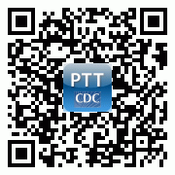
PTT Advisor App
Legal Review
App Store Publication
Algorithm Design
App Design & Development
User Beta Testing
Security & Privacy Review
Quick Read Code
http://itunes.apple.com/us/app/ptt-advisor/id537989131

Slide 37
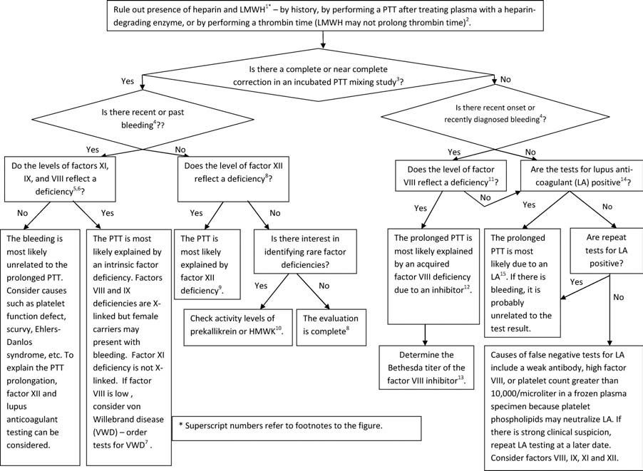
The mobile app takes what is below and turns it into ----

Slide 38
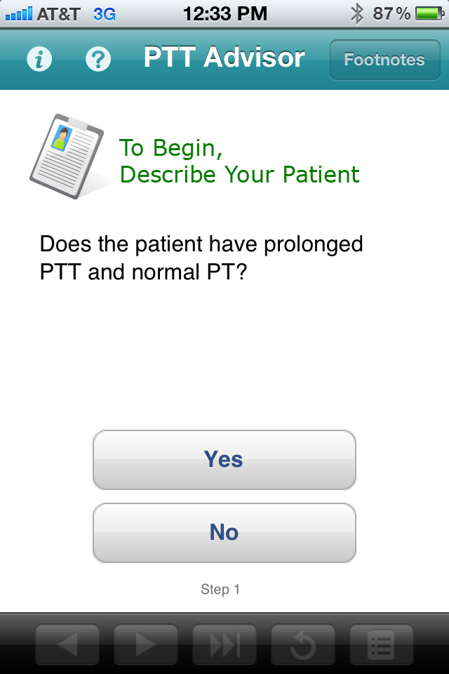

Slide 40
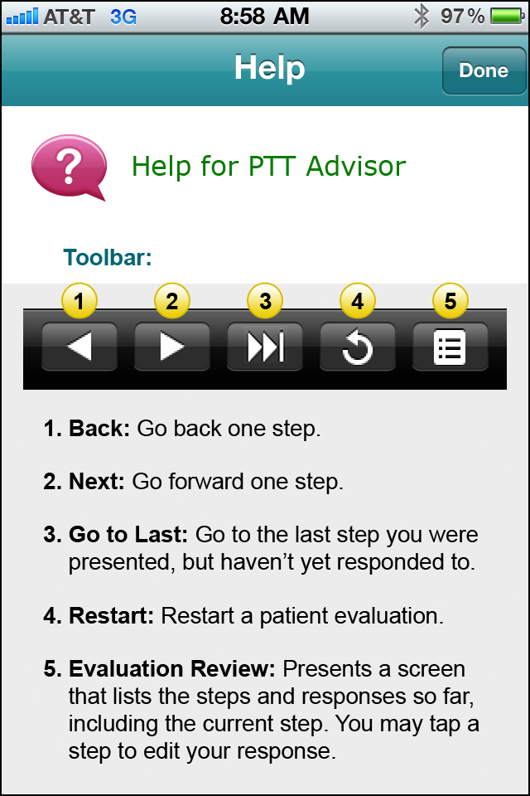

Slide 41
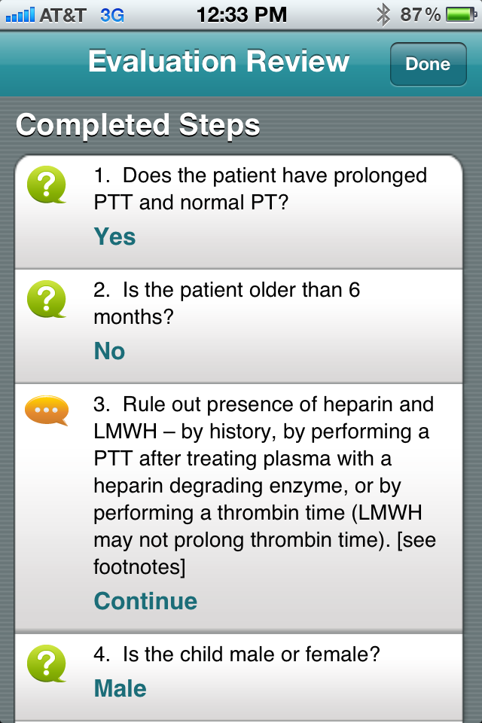

Slide 43
App Development Staffing Effort*

Slide 44
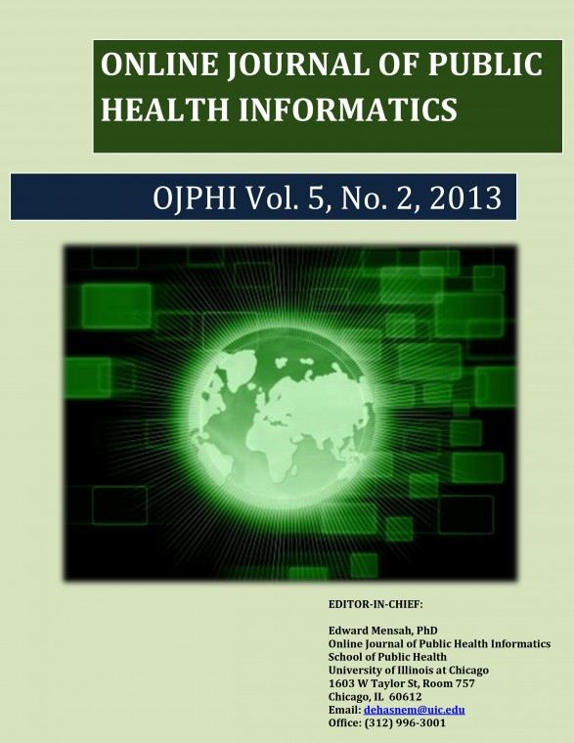
Savel, TG; Lee, BA, Ledbetter, GS; Brown, SE; Taylor, JT; Thompson, PJ. PTT Advisor: A CDC-supported initiative to develop a mobile clinical laboratory decision support application for the iOS platform. OJPHI. 2013, Vol 5(2).
http://ojphi.org/ojs/index.php/ojphi/article/view/4363

Slide 45
PTT Advisor Modality Advantages
Free
Always available from app store
Unlimited supply
Mobile, can be used anytime
Access anywhere – no need for internet or cell tower
Searchable in app store
Updated easily

Slide 46
Overview
CLIHC™
Vision
Team Members
Knowledge Gap Identified
Mobile Application Development Process
Evaluation
Notes:
Add –
Visions of quality – lab medicine
Gold, diamonds, crystal clear water falls
I say the word garbage – think garbage in garbage out -

Slide 47
Evaluate App Educational Tool
Kirkpatrick’s Hierarchy Level
Learner’s reactions
2a. Modification of attitudes/perceptions
2b. Acquisition of knowledge/skills
3. Change in behavior
4a. Change in organizational practice
4b. Benefits to patients/clients

Slide 48
PTT Advisor Evaluation Case Format
Case: A 33-year-old man with prolonged PTT found during a routine evaluation
PATIENT: 33-year-old man
CHIEF COMPLAINT:
MEDICAL HISTORY:
FAMILY HISTORY:
DRUG HISTORY:
PHYSICAL EXAMINATION:
Laboratory Results:
Questions related to the PTT Advisor:

Slide 49
Lessons Learned Summary
Identify knowledge gap and target audience
Decide training modality
Identify experts to develop and review scientific content
Follow clearance process for your institution
Scientific, security/ privacy, legal
Partner with app developer or obtain funding to pay for app development
Determine how to share app with Beta testers
Evaluate processes and app educational tool

Slide 50
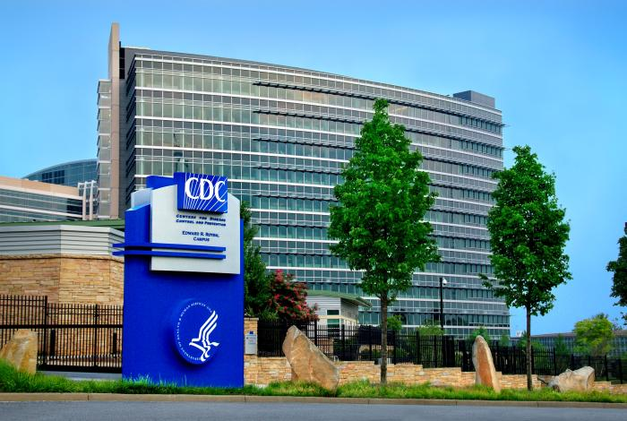
“Knowing is not enough; we must apply.
Willing is not enough; we must do”
Goethe
For More Information Please Contact:
Julie Taylor, Ph.D. - Jtaylor1@cdc.gov
Center for Surveillance, Epidemiology, and Laboratory Services
Division of Laboratory Systems

