Slide 1

Guidelines proposal for nanomaterials hemocompatibility
Julie Laloy
December 1st, 2014
Nanotek & Expo 2014 – San Francisco

Slide 2

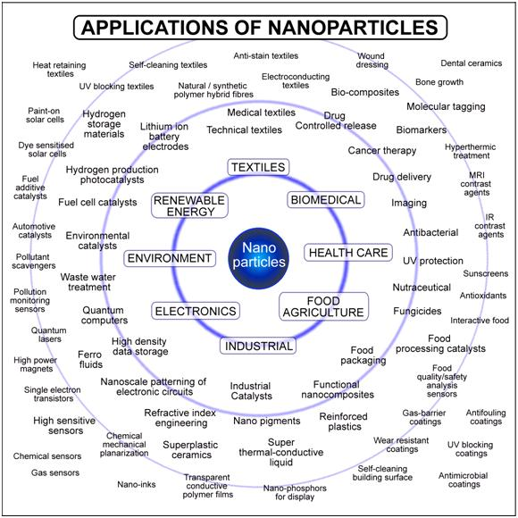
Why studying hemocompatibility?
Introduction – Hemolysis – Primary haemostasis – Secondary haemostasis – Fibrinolysis - Conclusion

Slide 3
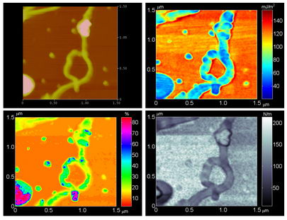
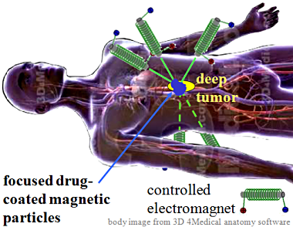
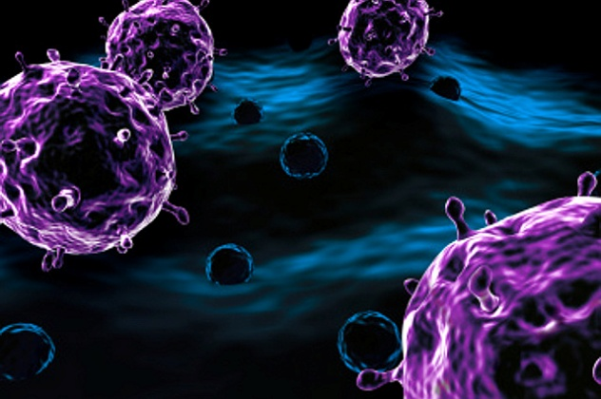
Why studying hemocompatibility?
Applications in nanomedicine
Imaging
Drug delivery
Targeting
Diagnostic agent
Introduction – Hemolysis – Primary haemostasis – Secondary haemostasis – Fibrinolysis - Conclusion
Notes:
Hazard identification
materials typically possess nanostructuredependent properties (e.g., chemical, mechanical, electrical, optical, magnetic, biological), which make them desirable for commercial or medical applications. However, these same properties potentially may lead to nanostructure- dependent biological activity that differs from and is not directly predicted by the bulk properties of the constituent chemicals and compounds. This
Biocompatibility (ability of a biomaterial to perform its desired function with respect to a medical therapy, without eliciting any undesirable local or systemic effects, hemocompatibility
Nanomaterial-based products such as nanocomposites, surface coatings and electronic circuits are unlikely to present a direct risk as exposure potential
will be low to negligible. Nanomaterials that are most likely to present a health risk are nanoparticles, agglomerates
of nanoparticles, and particles of nanostructured material
NP may be administered directly to the intravascular compartment by injection, or a nanomaterialbased
device may be implanted intravascularly, or to extravascular tissues. Another type of
direct exposure is the use of nanomaterials in surgery or trauma, use of nanomaterials in
different extracorporeal circulation techniques (hemodialysis, apheresis, cardiopulmonary
bypass (CPB), extracorporeal membrane oxygenation (ECMO)), and finally, exposure of
nanomaterials to blood during collection, processing and storage of blood transfusion
products.
Besides direct exposure of nanomaterials to blood, traffic of NP to intravascular
compartment or to bone marrow (BM) after other types or exposure (oral, inhalation, dermal)
should also be considered.

Slide 4

Why studying hemocompatibility?
Exposition
Air, water, clothes
Drug delivery
Air
Food, water
deposition
injection
inhalation
ingestion
Routes of exposure
Skin - eyes
Respiratory tract
Nasal/
tracheo-bronchial/ alveolar
Gastrointestinal tract
neurons
CNS
neurons
PNS
neurons
Lymph
Translocation and distribution
Blood
(platelets, monocytes, red blood cells, endothelial cells)
Lymph
Liver
Bone marrow
Other sites
(muscle, placenta)
Kidney
Spleen
Heart
Excretion
Urine
Breast milk
Faeces
  No OECD or other guidelines available
  Limited data from the literature
Oberdörster et al., 2005a (Review)
Oberdörster et al., 2005b (Review)
Nel et al., 2006
Introduction – Hemolysis – Primary haemostasis – Secondary haemostasis – Fibrinolysis - Conclusion
Notes:
The scheme show biokinetics of nanosized particles. While many uptake and translocation routes have been demonstrated, others still are hypothetical and need to be investigated.
Oral, dermal, inhalation, and injection routes of exposure are included recognizing that exposure of nanomaterials may occur by any of these routes.
Three key elements of the toxicity screening strategy: physiscochemical characteristics, in vitro assays and in vivo assays.
Pulmonary: Inhaled particles induce inflammation in respiratory tract, causing tissue damage. Example: silica particles causes “silicosis” in industrial workers”.
Oral: NPs can accumulate in the liver and may cause liver damage. Excessive immune/inflammatory responses cause permanent liver damage.
Dermal: Particles may enter body through the skin. Potential hazards are unknown at present.
Others: ocular, ….
Biokinetics of Nano-sized Particles. While many uptake and translocation routes have been demonstrated, others still are
hypothetical and need to be investigated. Largely unknown are translocation rates as well as accumulation and retention in critical
target sites and their underlying mechanisms. These as well as potential adverse effects will be largely dependent on physicochemical
characteristics of the surface and core of nano-sized particles. Both qualitative and quantitative changes in nanosized
particles' biokinetics in a diseased or compromised organism need also to be considered. Reproduced with permission
from Environmental Health Perspectives.
It has been demonstrated that NPs have the ability to enter the circulatory system once translocation from site of entry has occurred
The biocompatibility of materials in contact with blood involves specific requirements included under the term « hemocompatibility »
• Permit the conservation acid-base osmotic equilibrium of blood ;
• Not alter by consumption or denatured plasma proteins ;
• Not alter blood cells or cells of the vascular tissue ;
• Not activate the system of hemostasis and the complement.
Any NM applied in drug delivery nanosystems, imaging nanoprobes and
diagnostic biosensors which is in contact with blood should be non toxic and
biocompatible. Little is known about the toxicity of NMs introduced into the
bloodstream (Simak, 2009). Interactions of foreign materials with blood and its
elements constitute a key point of any biocompatibility studies (Dobrovolskaia et
al., 2008a; Dobrovolskaia et al., 2008b; Simak, 2009). Furthermore, standardized
and validated protocols for testing the NP biocompatibility are needed
(Dobrovolskaia et al., 2008b). Because of this important lack of knowledge, we
attempted to clarify the issue of hemocompatibility of NPs by investigating their
potential impact on red blood cells, platelet function and coagulation cascade.
Interesting regarding potential exposure of human :
Ingestion → Blood
Inhalation → Blood (Nemmar et al., 2001; Hoet et al., 2004)
Nanomedicine
To validate relevant tests to study NP hemocompatibility
Hemocompatibility studied for drugs, should be done for nanomaterials

Slide 5
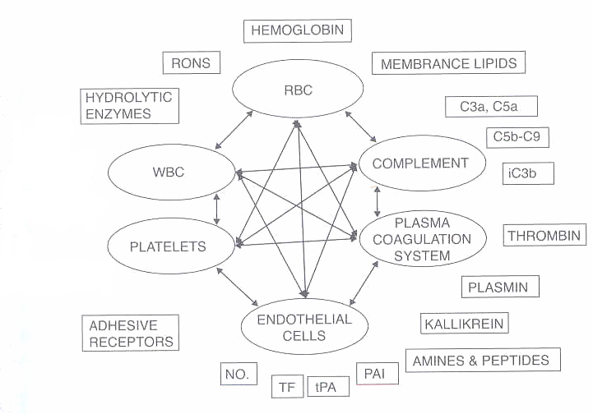
Human hemocompatibility
NP impact on …
TF
CYTOKINES
CHEMOKINES
LIPID MEDIATORS
From « Nanotoxicity » SC Sahu and DA Casciano – Ed Wiley - 2009
Introduction – Hemolysis – Primary haemostasis – Secondary haemostasis – Fibrinolysis - Conclusion
Notes:
Main intravascular components participating in the acute inflammatory response and examples of their potentially autoaggressive mediators. RBC, red blood cells; WBC, white blood cells; NO., nitric oxide; TF, tissue factor; tPA, tissue plasminogen activator; PAI, plasminogen activator inhibitor; iC3b, complement factor with opsonizing activity; C3a, C5a, complement factors anaphylatoxins; C5b-C9, complement membrane attack complex; RONS, reactive oxygen and nitrogen species.

Slide 6
Human hemocompatibility
NP impact on …
TF
CYTOKINES
CHEMOKINES
LIPID MEDIATORS
From « Nanotoxicity » SC Sahu and DA Casciano – Ed Wiley - 2009
Introduction – Hemolysis – Primary haemostasis – Secondary haemostasis – Fibrinolysis - Conclusion
Notes:
Main intravascular components participating in the acute inflammatory response and examples of their potentially autoaggressive mediators. RBC, red blood cells; WBC, white blood cells; NO., nitric oxide; TF, tissue factor; tPA, tissue plasminogen activator; PAI, plasminogen activator inhibitor; iC3b, complement factor with opsonizing activity; C3a, C5a, complement factors anaphylatoxins; C5b-C9, complement membrane attack complex; RONS, reactive oxygen and nitrogen species.

Slide 7
Human hemocompatibility
NP impact on …
Red blood cells hemolysis
Haemostatic system
Primary haemostasis (Platelets aggregation)
  Light transmission aggregometry (Turbidimetry)
  Impedance aggregometry (Multiplate® analyzer)
  Platelet function analysis (PFA-100®)
  Shear stress (Impact-R®)
  Electron microscopy (FEG-SEM, TEM)
  Secondary haemostasis (Coagulation)
  Chronometric assays (Clotting time assays)
  Chromogenic assays (Thrombin generation tests)
  Fibrinolysis
  Rotem®
  Euglobulin clot lysis time
Introduction – Hemolysis – Primary haemostasis – Secondary haemostasis – Fibrinolysis - Conclusion

Slide 8
NPs identification and characterization
Nanoparticles recommanded by OECD for toxicological assessment
Fullerenes (C₆₀) | Aluminium oxide (Al₂O₃)
Single-walled carbon nanotubes (SWCNT) | Titanium oxide (TiO₂)
Multi-walled carbon nanotubes (MWCNT) | Cerium oxide (CeO₂)
Silver nanoparticles (AgNP) | Zinc oxide (ZnO)
Iron nanoparticles (FeNP) | Silicon dioxide (SiO₂)
Gold nanoparticles (AuNP) | Nanoclays
Dendrimers
→ NPs selected due to their worldwide distribution and their numerous applications
OECD, 2010
Introduction – Hemolysis – Primary haemostasis – Secondary haemostasis – Fibrinolysis - Conclusion
Notes:
Physicochemical properties that may be important in understanding the toxic effects of test materials include particle size and size distribution, agglomeration state, shape, crystal structure, chemical composition, surface area, surface chemistry, surface charge, and porosity.
Sonication makes dramatic changes in material characteristics. Some studies are performed with nanomaterials resuspended in the presence of a detergent. Every additive or impurity turns the experiment into a different story. Another important issue is stability of the resuspended nanomaterial, including oxidative and other chemical changes. Strong advice is to involve a material scientist early in the project and work with a well-characterized nanomaterial. Otherwise, interpretation of results will be very problematic and value of the study compromised.
Tyrode : osmotically compatible buffer with blood cells
Pluronic F108 : well dispersed NPs
Choice of concentration based on available biocompatibility studies concerning gadolinium NPs, carbon NMs and other NMs
Besides NP evaluation in hemocompatibility assays, a complete characterisation of NP was done given that it is essential. In fact, significant
alterations of their properties including their size and state of dispersion may occur after their preparation in physiological solutions for toxicological assessment,
thereby modulating their biological behaviour (Jiang et al., 2009; Mayer et al., 2009; Nel et al., 2009).
Soniquer : ne reflète pas la réalité et induit changements physico-chimiques
FEG: field emission gun
8

Slide 9
NPs identification and characterization
Identification & related information | Name Molecular structure Morphology Use Catalytic activity Production process
Physicochemical properties & material characterisation | Chemical composition Agglomeration/aggregation state Solubility, density, porosity Crystal structure Particle size and its distribution Specific surface area Zeta potential Catalytic activity Redox potential Free radical inducer
→ Importance of NP physicochemical characterization for inter-studies comparison and understanding of their related toxic effects
Introduction – Hemolysis – Primary haemostasis – Secondary haemostasis – Fibrinolysis - Conclusion
Notes:
Physicochemical properties that may be important in understanding the toxic effects of test materials include particle size and size distribution, agglomeration state, shape, crystal structure, chemical composition, surface area, surface chemistry, surface charge, and porosity.
Sonication makes dramatic changes in material characteristics. Some studies are performed with nanomaterials resuspended in the presence of a detergent. Every additive or impurity turns the experiment into a different story. Another important issue is stability of the resuspended nanomaterial, including oxidative and other chemical changes. Strong advice is to involve a material scientist early in the project and work with a well-characterized nanomaterial. Otherwise, interpretation of results will be very problematic and value of the study compromised.
Tyrode : osmotically compatible buffer with blood cells
Pluronic F108 : well dispersed NPs
Choice of concentration based on available biocompatibility studies concerning gadolinium NPs, carbon NMs and other NMs
Besides NP evaluation in hemocompatibility assays, a complete characterisation of NP was done given that it is essential. In fact, significant
alterations of their properties including their size and state of dispersion may occur after their preparation in physiological solutions for toxicological assessment,
thereby modulating their biological behaviour (Jiang et al., 2009; Mayer et al., 2009; Nel et al., 2009).
Soniquer : ne reflète pas la réalité et induit changements physico-chimiques
FEG: field emission gun
9

Slide 10


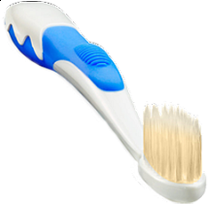
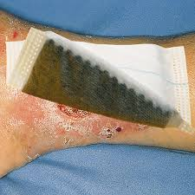
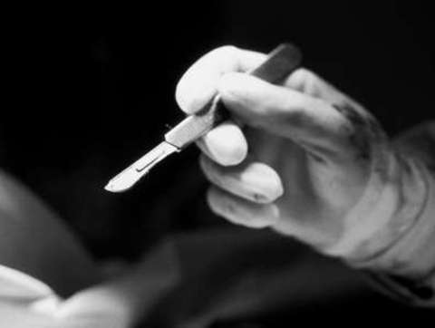
Example of Silver NPs
Highly bactericide, highest commercialised NPs
Consumer applications :
Anti-odor socks
Disinfectants, deodorants
Water purificants
Cosmetics
Food contact materials (refrigerator surfaces, storage bags…)
Biomedical applications :
Coated on cardiovascular and neurosurgical catheters, orthopedic and cardiovascular implants, surgical instruments
Wound and burn dressings
Bone substitute biomaterials
Perspectives for drug delivery systems and targeting
Introduction – Hemolysis – Primary haemostasis – Secondary haemostasis – Fibrinolysis - Conclusion
Notes:
Effet antibactérien bien plus amplifié pr nano que micro
Example with the most commercialised NP
Actif contre virus du sida

Slide 11
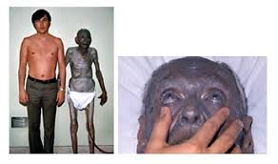
Example of Silver NPs
Since 19th century : use of « colloidal silver » to treat various diseases. These are silver nanoparticles.
Regular consumption of a large-particle silver compound is a likely causative agent of argyria
Are silver NPs hemocompatible?
Introduction – Hemolysis – Primary haemostasis – Secondary haemostasis – Fibrinolysis - Conclusion
Notes:
Actif contre virus du sida
Médicament miracle, pas très fondé
interrompue dans les années 1940, à cause du développement d'antibiotiques

Slide 12
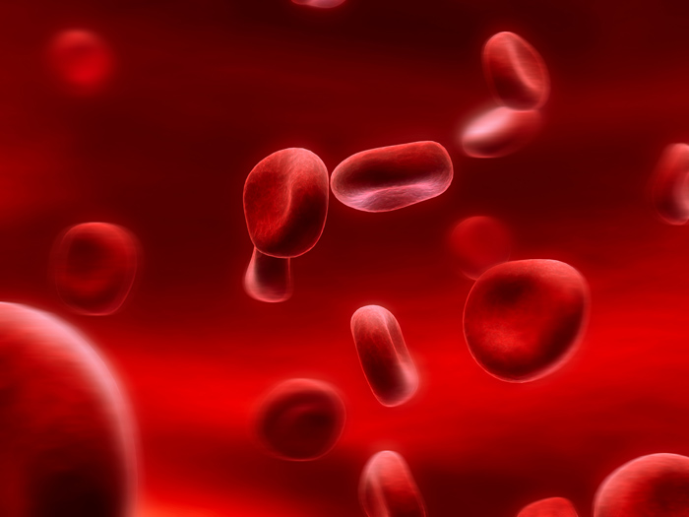
Hemolysis : definition
- Red blood cells hemolysis : breakdown of the membrane
Anemia, hypoxia…
Major factor to be studied
Introduction – Hemolysis – Primary haemostasis – Secondary haemostasis – Fibrinolysis - Conclusion
Notes:
Hemolysis → decreased of RBC count → decrease hemoglobin content in circulating blood = hemolytic anemia → failure of oxygen delivery to tissues
Morover hemoglobin released can induce extensive oxidative damage intravascularly and may lead to renal failure (minetti et al 2007; cimen 2008)
(Maton et al., 1993).

Slide 13
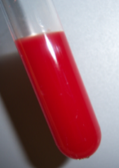
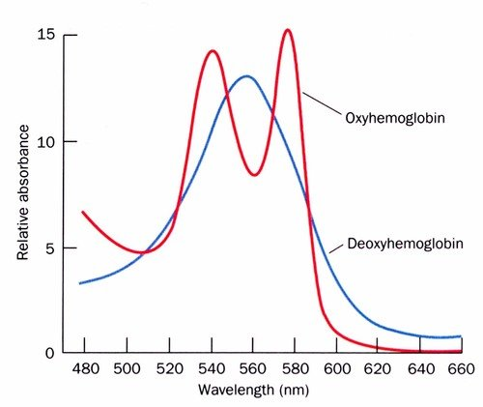
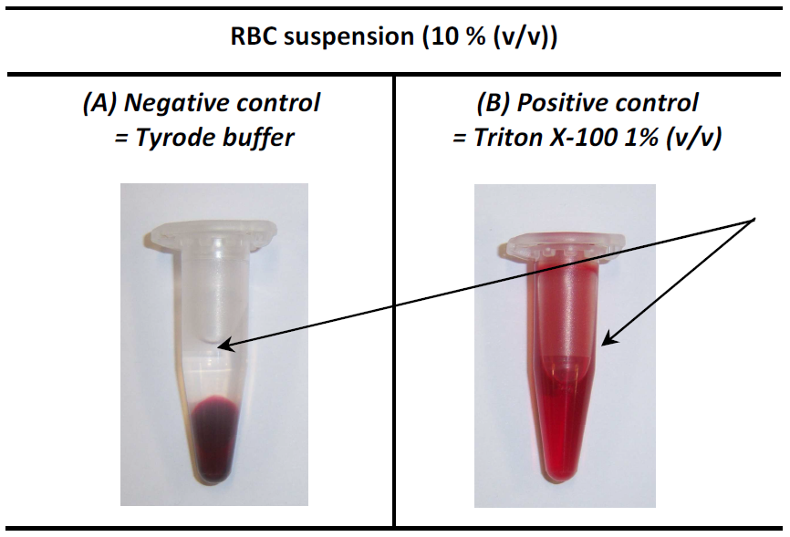
Hemolysis : test
Red blood cells in contact with NPs, centrifugation, OD_{550 nm} measurement of the supernatant (hemoglobin)
Introduction – Hemolysis – Primary haemostasis – Secondary haemostasis – Fibrinolysis - Conclusion
Notes:
Injection produit dangereux

Slide 14
Hemolysis : test
Mix RBC 10% (v/v) (190 µL) and NP (10 µL)
Shaking @ rt for 1h
Centrifugation 5 min @ 10,000 g
OD_{550 nm} measurement of the supernatant
Introduction – Hemolysis – Primary haemostasis – Secondary haemostasis – Fibrinolysis - Conclusion
Notes:
Injection produit dangereux
Manip plus représentatives de la réalité (Sg total)
Manip plus sûr niveau toxicité (GR 10% lavés)
Mechanism
Disagreements of protocols in the literature :
Detection principle
Dilution in the assay
Interferences taken into account (absorbance, nano pellet with hemoglobin)
Time effect : different mechanisms?
Temperature effect
Interindividual variability
Corona effect
Different NPs tested
2 protocols proposed

Slide 15
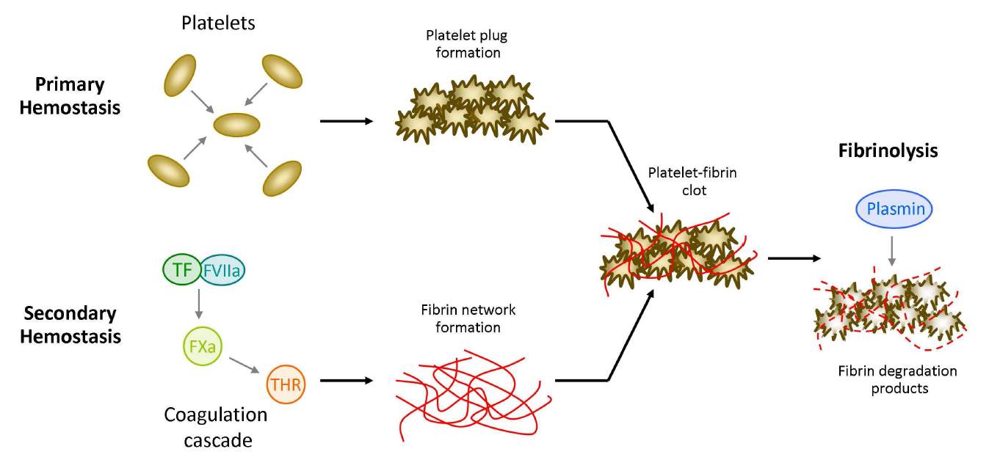
Haemostatic system : definition
Steps of haemostasis : Primary haemostasis - Secondary haemostasis - Fibrinolysis
Introduction – Hemolysis – Primary haemostasis – Secondary haemostasis – Fibrinolysis - Conclusion

Slide 16
Primary haemostasis : definition
Steps of haemostasis : Primary haemostasis - Secondary haemostasis - Fibrinolysis
Introduction – Hemolysis – Primary haemostasis – Secondary haemostasis – Fibrinolysis - Conclusion
Notes:
Thrombogenicity = ability of a material to induce or promote the formation of thromboemboli
thrombotic and hemorrhagic symptoms caused by dysregulation of hemostatic balance in the organism, which is maintained by the interplay of vascular endothelium, platelets and the plasma coagulation system (McGuigan and Sefton, 2007).
As shown in Figure 11.1, such interplay is not isolated from other systems forming inflammatory response. Thus, hemostasis is an integral part of inflammation and has to be understood in this context.
Dysregulation of hemostatic balance leads to a disorder with either thrombotic or hemorrhagic symptoms prevailing. It is important to note that in several types of hemocoagulation disorders, we may clinically observe thrombosis and bleeding at the same time (i.e. thromboembolic symptoms may be associated with failure of posttraumatic hemostasis). Therefore an understanding of underlying mechanisms of dysregulation of hemostatic balance is essential. In the evaluation of effects of a biomaterial on the hemocoagulation balance, the aim is to learn how the tested biomaterial interacts with, or affects functions of, three systems – endothelial cells, the plasma coagulation system, and platelets. Interaction of biomaterials with endothelium has been a focus of extensive research (McGuigan and Sefton, 2007). Several studies of effects of different nanomaterials on cultured endothelial cells in vitro

Slide 17
Primary haemostasis : assays
Assessment of six functional tests to study the potential impact of NMs on platelet functions (adhesion/activation/aggregation)
Techniques known as « quantitatives » :
  Light transmission aggregometry (LTA)
  Impedance aggregometry (Multiplate®)
  Platelet function analysis (PFA-100®)
  Shear stress (Impact-R®)
Techniques known as « qualitatives »:
  Contrast microscopy,
  Scanning (FEG-SEM) or transmission (TEM) electron microscopy
Introduction – Hemolysis – Primary haemostasis – Secondary haemostasis – Fibrinolysis - Conclusion
Notes:
They are several types of assays for evluating platelet hemostaicfunctions – adhesion, aggregation and release reaction, based on various principles but there is no standard planel of platelets assays for nanomaterial evaluation available
Most available techniques are not suitable for high NP concentration

Slide 18
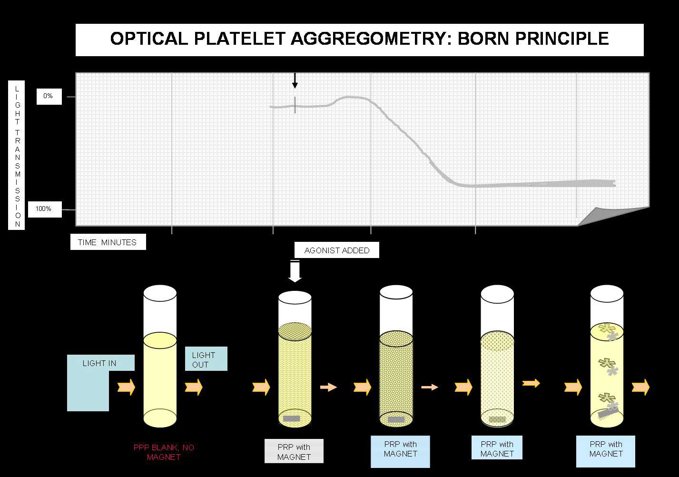
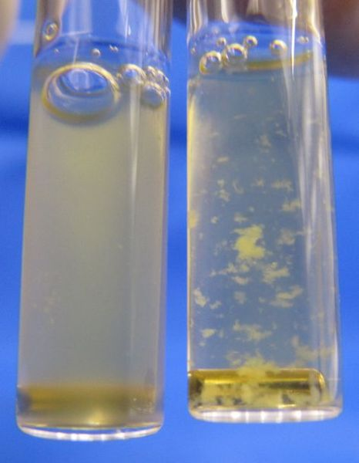
Light transmission aggregometry : principle
Turbidimetry measure : spectrophotometer (620 nm)
http://www.practical-haemostasis.com/
Introduction – Hemolysis – Primary haemostasis – Secondary haemostasis – Fibrinolysis - Conclusion
Notes:
Optic aggregometry (based on the principle of turbidimetry),
Platelet aggregation testing measures the ability of various agonists to platelets to induce in vitro activation and platelet-to-platelet activation. Classically Born aggregometry uses platelet rich plasma [PRP] but whole blood aggregometry can be also used.
In the Born aggregometer, PRP is stirred in a cuvette at 37°C and the cuvette sits between a light course and a photocell. When an agonist is added the platelets aggregate and absorb less light and so the transmission increases and this is detected by the photocell.
Transmission of light through the PRP sample is set as 0 % aggregation, while a transmission through platelet-poor plasma (PPP) is set to 100 %.
Measuring the OD in a glass cuvette at 37°C under stirring (1,000 rpm)
Turbidimetry (the name being derived from turbidity) is the process of measuring the loss of intensity of transmitted light due to scattering effect particles suspended in it. Light is passed through a filter creating a light of known wavelength which is then passed through a cuvette containing a solution. A photoelectric cell collects the light which passes through the cuvette. A measurement is then given for the amount of absorbed light.^{[1]}

Slide 19
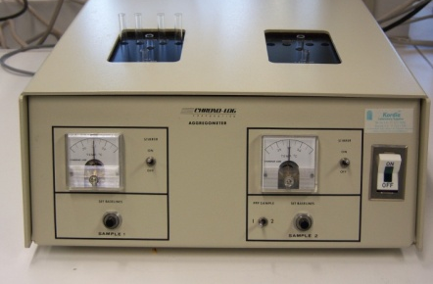
Light transmission aggregometry : protocol
Principle
Platelet-rich plasma (PRP) preparation (3.10⁵ PLT.µL⁻¹)
PRP stirred at 1,000 rpm (37°C)
+ NP suspension
+ inducer
(ADP / collagen / AA)
+ NP suspension
+ inducer
(ADP / collagen / AA)
OD_{620 nm} measurement
Spontaneous
Aggregation
(Pro-aggregating activity)
Check platelet
response
Induced
Aggregation
(Anti-aggregating activity )
Introduction – Hemolysis – Primary haemostasis – Secondary haemostasis – Fibrinolysis - Conclusion
Notes:
Effects of NPs on spontaneous and induced aggregation
Inducers alone were also used before any experiment to check the aggregation ability of platelets. Platelet poor plasma (PPP) served as blank (reference).
Chronolog two-channel recorders connected to a computer.
ADP (5 µM)
arachidonic acid (600 µM)
collagen (190 µg.mL⁻¹)

Slide 20
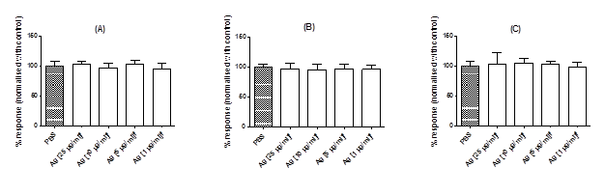
Primary hemostasis : LTA
Light transmission aggregometry : no effect
Introduction – Hemolysis – Primary haemostasis – Secondary haemostasis – Fibrinolysis - Conclusion

Slide 21
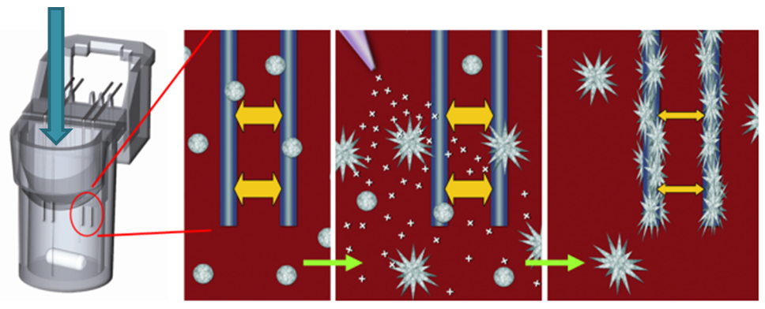
Impedance aggregometry :
Principle and interference
Whole blood impedance aggregometry
Electrode resistance enhanced by adhered platelet aggregates
Unactivated PLT
PLT activation
PLT adhesion
→ Tyrode buffer and NPs alone increase impedance
High variability
Adsorption of NPs on electrodes
Introduction – Hemolysis – Primary haemostasis – Secondary haemostasis – Fibrinolysis - Conclusion
Notes:
In this assay, whole blood is stirred in a cuvette and changes of impedance between two electrodes are measured. The increase in impedance is proportional to platelet aggregation, since platelet aggregates adhere to electrodes. Whole blood impedance aggregometry has several advantages over LTA, including no need for PRP preparation, so blood is minimally manipulated before testing, and smaller volumes are required for testing.
L'impédance électrique mesure l'opposition d'un circuit électrique au passage d'un courant alternatif sinusoïdal.

Slide 22
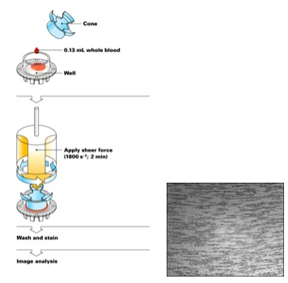
Impact-R® : principle
Image analysis
Monitoring
Platelet
Adhesion
Cone & Plate
Technology
Platelet adhesion and aggregation
Introduction – Hemolysis – Primary haemostasis – Secondary haemostasis – Fibrinolysis - Conclusion
Notes:
Imitation of the forces present at a vascular breach
Testing principle : Thrombogenic Surface Formation
Laminar flow over the polystyrene surface of the well is achieved following to the Cone and Plate principal.
Upon application of a blood sample (130 µL) into the polystyrene well, plasma proteins immediately adhere to the well surface and become attractive for platelets, resulting in platelet adhesion and aggregation on the well surface under flow conditions.
Following washing of excess blood and staining of the adhered platelets, a quantitation of the results is performed by an image analyzer.

Slide 23
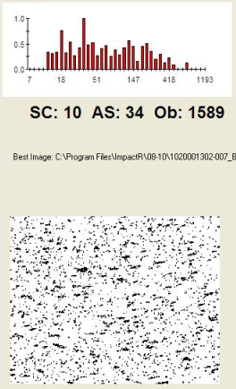
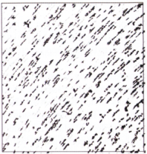

Impact-R® : protocol/ principle
180 µL of citrated whole blood
20 µL of
NP
collagen
β₂-glycoprotein I
2 min
37°C
i) NaCl 0.9% washing
ii) May-Grünwald staining
iii) Drying
108,000 rpm
2 min
Image scanning
& analyzing (n = 7)
Introduction – Hemolysis – Primary haemostasis – Secondary haemostasis – Fibrinolysis - Conclusion

Slide 24
Impact-R® : principle
Results are expressed as :
SC (%) : surface covered
= platelet adhesion
AS (µm²) : average size of aggregates
= platelet aggregation
Ob (Ob) : number of objects
= platelet aggregation
Introduction – Hemolysis – Primary haemostasis – Secondary haemostasis – Fibrinolysis - Conclusion

Slide 25
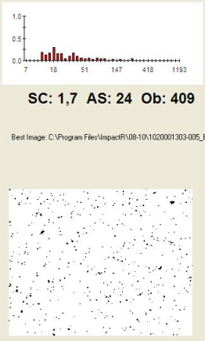
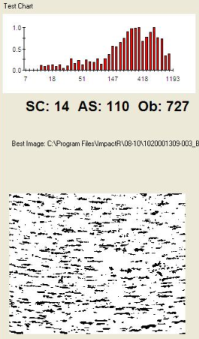
Impact-R® : protocol
Validation of the technique using an inducer (collagen) and an inhibitor (β₂-glycoprotein I) of platelet function and a negative control (tyrode buffer).
+ β₂-glycoprotein I
(2.2 µM)
Citrated whole blood
+ collagen
(3.2 µg.mL⁻¹)
SC: 1.7 AS: 24 Ob: 409
SC: 10 AS: 34 Ob: 1589
SC: 14 AS: 110 Ob: 727
Anti-aggregating
control
Pro-aggregating
control
Introduction – Hemolysis – Primary haemostasis – Secondary haemostasis – Fibrinolysis - Conclusion
Notes:
2-Glycoprotein I inhibits von Willebrand factor–dependent platelet adhesion and aggregation

Slide 26
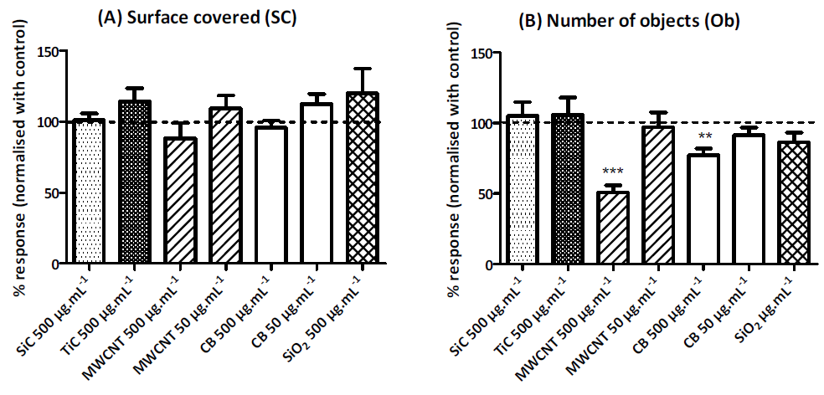
Impact-R® : results
NP impact on platelet adhesion (SC) and the number of objects (Ob)
MWCNT and CB had an impact on platelet aggregation at 500 µg.mL⁻¹ by reducing the number of aggregates without affecting the surface covered. This effect disappered at 50 µg.mL⁻¹
SiC, TiC and SiO2 had no effect on Ob indicating that these 3 NPs had no impact on platelet function.
Introduction – Hemolysis – Primary haemostasis – Secondary haemostasis – Fibrinolysis - Conclusion
Notes:
In Tyrode buffer, all the tested NPs increased AS, except CB which enhances also SC and Ob parameters
NP investigated : MWCNT, SWCNT, C₆₀ and mixed carbon NPs.
NPs studied except C₆₀, stimulated platelet aggregation.
All particles resulted in upregulation of GPIIb/IIIa in platelets.
Conclusion :
=> Some carbon NPs have the ability to activate platelets and enhance vascular thrombosis. Nanoparticle-induced platelet aggregation and vascular thrombosis
1Anna Radomski, 1Paul Jurasz, 1David Alonso-Escolano, 2Magdalena Drews, 3Maria Morandi,
2Tadeusz Malinski & *,1,4Marek W. Radomski

Slide 27
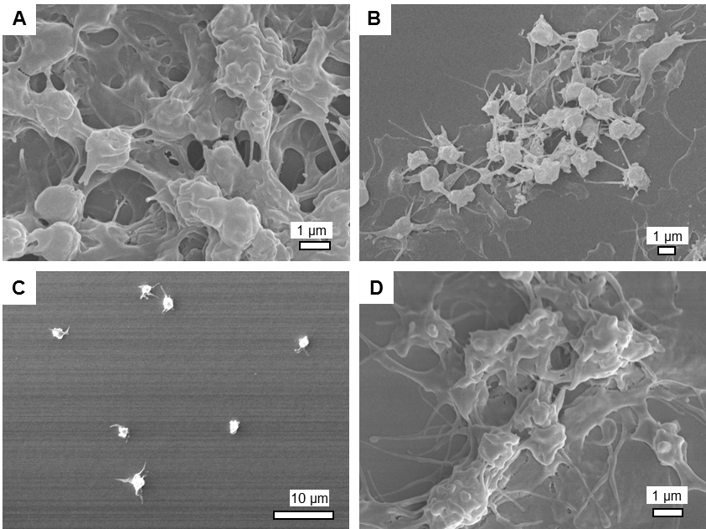
Scanning electron microscopy : validation
Whole blood alone
Whole blood with β2-glycoprotein I
Whole blood with tyrode buffer
Whole blood with Collagen
Introduction – Hemolysis – Primary haemostasis – Secondary haemostasis – Fibrinolysis - Conclusion

Slide 28
Scanning electron microscopy : validation
No clear difference can be observed between whole blood (A) and whole blood with the addition of collagen (D).
Tyrode buffer had no effect on platelet function (C).
A reduction of platelet adhesion was observed with β₂-glycoprotein I (B).
Introduction – Hemolysis – Primary haemostasis – Secondary haemostasis – Fibrinolysis - Conclusion
Notes:
28

Slide 29
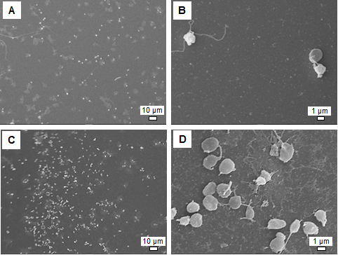
Primary hemostasis : LTA
SEM pictures of platelets adhesion without (A-B) or with Ag NPs at a final concentration of 50 µg/mL (C-D) : increased of adhesion
Introduction – Hemolysis – Primary haemostasis – Secondary haemostasis – Fibrinolysis - Conclusion
Notes:
Example with the most commercialised NP

Slide 30
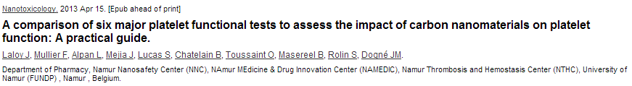
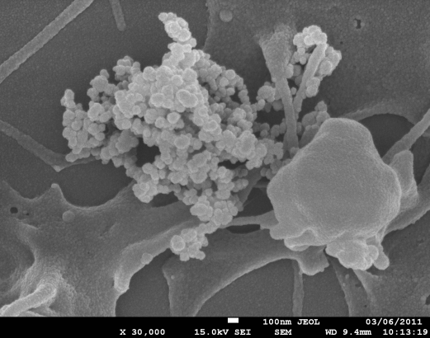
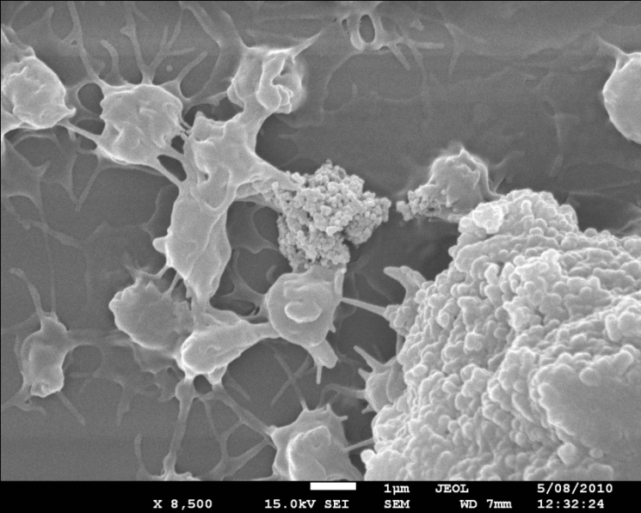
Conclusion of primary haemostasis
The Impact-R® method used in combination with FEG-SEM can be recommended for the evaluation of NP impact on platelet function
NPs
Aggregated platelets
NPs
100 nm
Introduction – Hemolysis – Primary haemostasis – Secondary haemostasis – Fibrinolysis - Conclusion

Slide 31
Haemostatic system : definition
Secondary haemostasis consists in the formation by the coagulation cascade of a fibrin network that stabilizes the platelet plug.
Introduction – Hemolysis – Primary haemostasis – Secondary haemostasis – Fibrinolysis - Conclusion

Slide 32
Coagulation cascade
Negatively
charged
surface
Introduction – Hemolysis – Primary haemostasis – Secondary haemostasis – Fibrinolysis - Conclusion
Notes:
A biomaterial may interact with coagulation factors and nhibitors at different stages of the activation process in PCS in coagulation and fibrinolytic pathway.
Thrombin-mediated positive feedback

Slide 33

Thrombin generation assays
Thrombin-antithrombin (TAT) complexes
Chromogenic thrombin generation assay
Flurorometric calibrated thrombin generation test (cTGT)
Light absorbance detection
Assay selected
Introduction – Hemolysis – Primary haemostasis – Secondary haemostasis – Fibrinolysis - Conclusion
Notes:
As the activity of thrombin in plasma is primary regulated by antithrombin (AT) by forming covalent TAT complexes, these latter complexes are surrogate markers of thrombin generation. They can be measured in the plasma through an enzyme-linked immunosorbent assay (ELISA) at 490 nm (Pelzer et al., 1988).
Initially, thrombin generation assays in clotting plasma were performed with thrombin-specific chromogenic substrate using spectrophotometric detection of thrombin activity. This detection technique limits measurements into citrated defibrinated platelet-poor plasma (or in plasma spiked with a fibrin polymerization inhibitor) (Hemker and Beguin 1999).

Slide 34
Thrombin generation assay : principle
Thrombin activity measurement - cTGT
Plasmatic
Prothrombin
A thrombin-specific fluorogenic substrate is added to clotting plasma
Thrombin hydrolyzes AMC from substrate (Z-GGR-AMC)
No linear relation between thrombin activity and fluorescence
→ thrombin calibration curve
ZGGR-AMC
Thrombin
AMC
Inactivated thrombin
Hemker et al., 2002
Hemker et al., 2003
Robert et al., 2009
Introduction – Hemolysis – Primary haemostasis – Secondary haemostasis – Fibrinolysis - Conclusion
Notes:
Studies performed on human normal pool plasma:
Presence or absence of NP (CNT, SiC, TiC, SiO₂)
Tested at final concentrations of 0, 5, 10, 25, 50, 100, 250 and 500 µg/mL in tyrode buffer (without sonication or surfactant).
Plasma clotting is triggered by the addition of calcium chloride to human platelet-poor plasma in contact with specific coagulation inducer.
Three specific coagulation inducers were used in this study to target the coagulation pathway :
Global functional test for measuring hyper- and hypocoagulability.
More sensitive than the mechanical coagulometer
Another advantage of the cTGT over the RCT with the KC10 coagulometer is the 96-well plates format (vs 10 individual cuvettes) allowing to rapidly screen a larger number of materials with a low intra- and inter-assay variability. Moreover, cTGT explores all the dynamic of thrombin formation and extensively characterises it with various parameters (i.e. lag time, Cmax, ETP) whereas RCT only provide an indication of the plasma clotting time which is close to the lag phase of cTGT. Thus, cTGT is more relevant to in vivo blood coagulation process for which the rise of thrombin activity constitutes one of the most interesting parameter to monitor (Hemker et al., 2006; Laloy et al., 2012; Robert et al., 2009).

Slide 35
Secondary hemostasis - cTGT
The acquired data are automatically processed by the Thrombinoscope® software to give thrombin generation curves and measurement parameters as lag time, C_{max}, ETP et T_{max}
Lag Time (min)
C_{max} (nM)
[Active thrombin] (nM)
ETP (nM.min)
0
10
20
30
Fibrin clot formation
Minutes
C_{max} = maximal concentration;
Lag time = time for fibrin clot formation;
ETP = endogenous thrombin potential
Hemker et al., 2002
Laloy et al., 2012
Introduction – Hemolysis – Primary haemostasis – Secondary haemostasis – Fibrinolysis - Conclusion
Notes:
The generation of thrombin is a fundamental part of the clotting cascade and as such an estimation of an how well a particular individual can generate thrombin may correlate with either a risk of bleeding or thrombosis.

Slide 36
Thrombin generation assay : control parameters
 | Lag time (min) | C_{max} (nM) | ETP (nM.min)
TF pathway | 2.5 | 335 | 1650
TF and contact pathways | 6.4 | 156 | 1262
Contact pathway | 13.7 | 164 | 1146
C_{max} = maximal concentration;
Lag time = time for fibrin clot formation;
ETP = endogenous thrombin potential
Introduction – Hemolysis – Primary haemostasis – Secondary haemostasis – Fibrinolysis - Conclusion
Notes:
A technical problem encountered with this method was the absence of a direct linear relation between thrombin activity and the fluorescent signal due to the plasma colour, the substrate consumption and the non-linearity of fluorescence intensity with increasing concentration of fluorescent molecules (also called ‘inner filter effect’). This problem was overcome by running simultaneously a thrombin calibration curve. A known amount of α2-macroglobulin-thrombin was added to non-clotting plasma and was compared to the clotting plasma sample in which thrombin generation takes place. This α2-macroglobulin-thrombin does not contribute to the coagulation cascade since it is not able to hydrolyse fibrinogen or clotting factors, and it is not inhibited by AT. From this known amount of thrombin, the thrombin concentration in the clotting sample was calculated (Baglin, 2005; Hemker et al., 2003).

Slide 37
Secondary hemostasis - cTGT
Procoagulant activity
Laloy et al., 2014
Laloy et al., 2012
Introduction – Hemolysis – Primary haemostasis – Secondary haemostasis – Fibrinolysis - Conclusion
Notes:
Example with the most commercialised NP

Slide 38
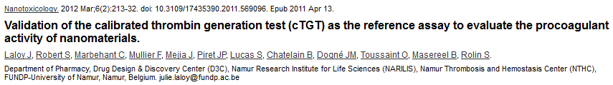
Conclusion of secondary haemostasis
“Thus, the cTGT appears as a reference assay to investigate the nanoparticle (NP) procoagulant activity in human plasma.”
Introduction – Hemolysis – Primary haemostasis – Secondary haemostasis – Fibrinolysis - Conclusion
Notes:
With 4 µM PL (contact pathway):
SiO₂ > TiC – SiC > CuO > CB > MWCNT – SWCNT – C₆₀
, giving the following rank-order in Tyrode
Buffer: SiO2 > TiC = SiC > CB > MWCNT (Table 6-8 and Table 6-9). Lower procoagulant effect is found when using TF as clotting inducer. Indeed, the contact pathway is considered to be the main initiator of the coagulation cascade when blood is in contact with biomaterial surfaces. This rapid activation is initiated when plasma proteins, especially prekallikrein and FXII, are absorbed and bound to the biomaterial (Hong et al., 1999). The old idea that activation of the contact coagulation pathway is not physiologically relevant has given a rough ride since the recent discovery in FXII-KO mice that FXII selectively contributes to thrombus formation in occlusive diseases, but not to normal hemostasis (Renne and Gailani, 2007). However, the implications of these findings in the context of the hemocompatibility of biomaterials still remain to be established and especially if contact activation of FXII by foreign materials would lead to thrombotic events in humans.
Physico-chemical explanations :
This important fraction of agglomerates can act as an inert or biocompatible element
since the blood plasma, which is rich in oligo-elements, ions and organic
compounds as nutrients, metabolic waste and proteins, can functionalized them in
a non-controlled way. The strong adsorption of the plasma elements onto the CB
surface can be achieved due to the massive presence (87 %) of carbon on the CB
surface, with a high affinity for blood elements together with the high specific
surface area value of the CB particles. Such phenomenon of protein adsorption is
reported as the first event in blood-material interactions. In addition, it is generally
considered that cellular responses to materials in a biological medium reflect the
adsorbed biomolecule layer, rather than the material itself (Lynch and Dawsons,
2008; Nel et al., 2009).
Taken together, these results indicate that, even some parameters seem
to decrease the NP procoagulant activity (i.e. large specific surface area, high
fraction of remaining agglomerates and low content in surface oxygen), none of the
studied physicochemical parameters can explain by itself the effects on contact
pathway induced coagulation. It is probably a combination of all these multiple
features of the NMs that activate blood clotting. Thus, it seems extremely difficult
to draw structure-toxicity relationships and to pull out specific design rules that can
be applied to the development of engineered hemocompatible NPs.

Slide 39
Fibrinolysis : definition
Fibrinolysis is the process by which fibrin is removed from damaged blood vessels.
Introduction – Hemolysis – Primary haemostasis – Secondary haemostasis – Fibrinolysis - Conclusion
Notes:
Fibrinolysis is also important in tissue remodelling and repair after injury.

Slide 40
Fibrinolysis : assays
Overall assays
Euglobulin clot lysis time (Von Kaulla)
Rotem®
Specific assays
D-Dimer Assay
Plasminogen Assay
Alpha-2-Antiplasmin (Alpha-2-Plasmin Inhibitor) Assay
Plasminogen/antiplasmin Assay
T-PA Assay
PAI-1 Assay
TAFI Assay
Specific assays could not be used in vitro.
Introduction – Hemolysis – Primary haemostasis – Secondary haemostasis – Fibrinolysis - Conclusion
Notes:
Fibrinolysis is also important in tissue remodelling and repair after injury.

Slide 41
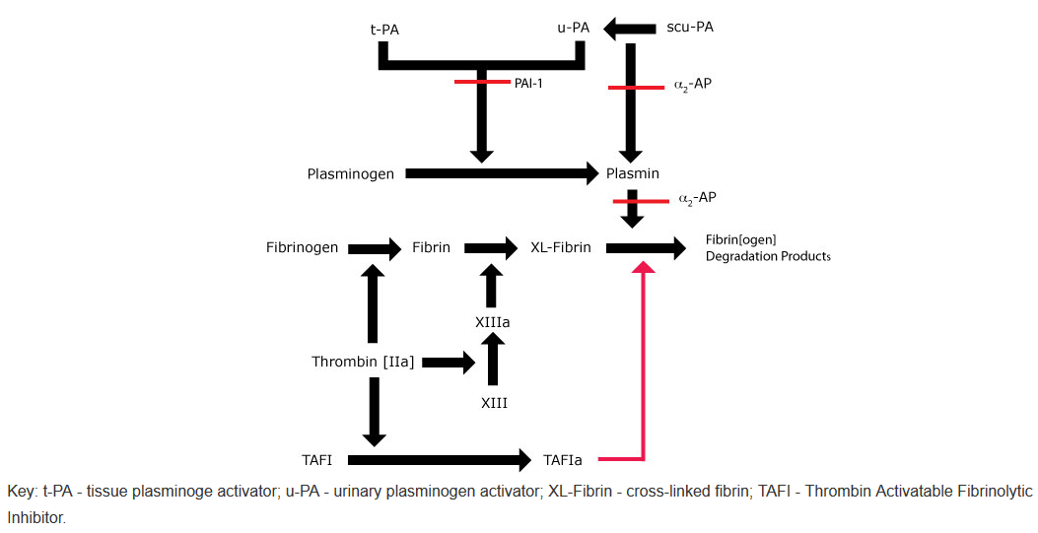
Euglobulin clot lysis time
Principle : Acidification and dilution of plasma causes precipitation of euglobulins (fibrinogen, activator of plasminogen, plasminogen) → quicker evalution of fibrinolysis.
Introduction – Hemolysis – Primary haemostasis – Secondary haemostasis – Fibrinolysis - Conclusion
Notes:
The euglobulin clot lysis time is a test that reflects the overall fibrinolytic activity of plasma.

Slide 42
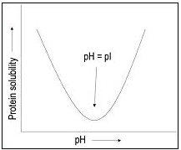
Euglobulin clot lysis time : principle
Plasma collected, diluted with acetic acid and incubated on ice for 15 minutes and then centrifuged.
A precipitate forms [the euglobulin fraction of plasma] which contains plasminogen, plasminogen activators [primarily t-PA] and fibrinogen.
Introduction – Hemolysis – Primary haemostasis – Secondary haemostasis – Fibrinolysis - Conclusion

Slide 43
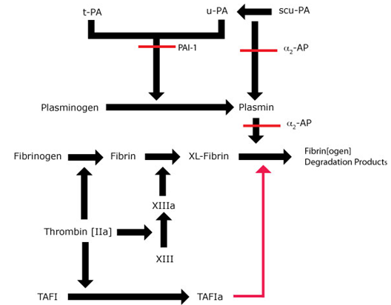
Euglobulin clot lysis time : principle
- Plasminogen inhibitors eliminated
Plasminogen, plasminogen activators and fibrinogen preserved
Thrombin added
Differential separation in order to accelerate fibrinolysis
Introduction – Hemolysis – Primary haemostasis – Secondary haemostasis – Fibrinolysis - Conclusion
Notes:
Limitation : in most cases, intravascularly exposed biomaterials affect the generation of plasmin activity indirectly through stimulation of the release of plasminogen activators, like tPA or inhibitors (PAI) from WBC and endothelial cells. Therefore, the evauation of fibrinolytic activity in vitro in plasma exposed to materials has a very limited use. In vitro whole blood experiments and better endothelial and macrophage tissue culture assays may be more useful.

Slide 44
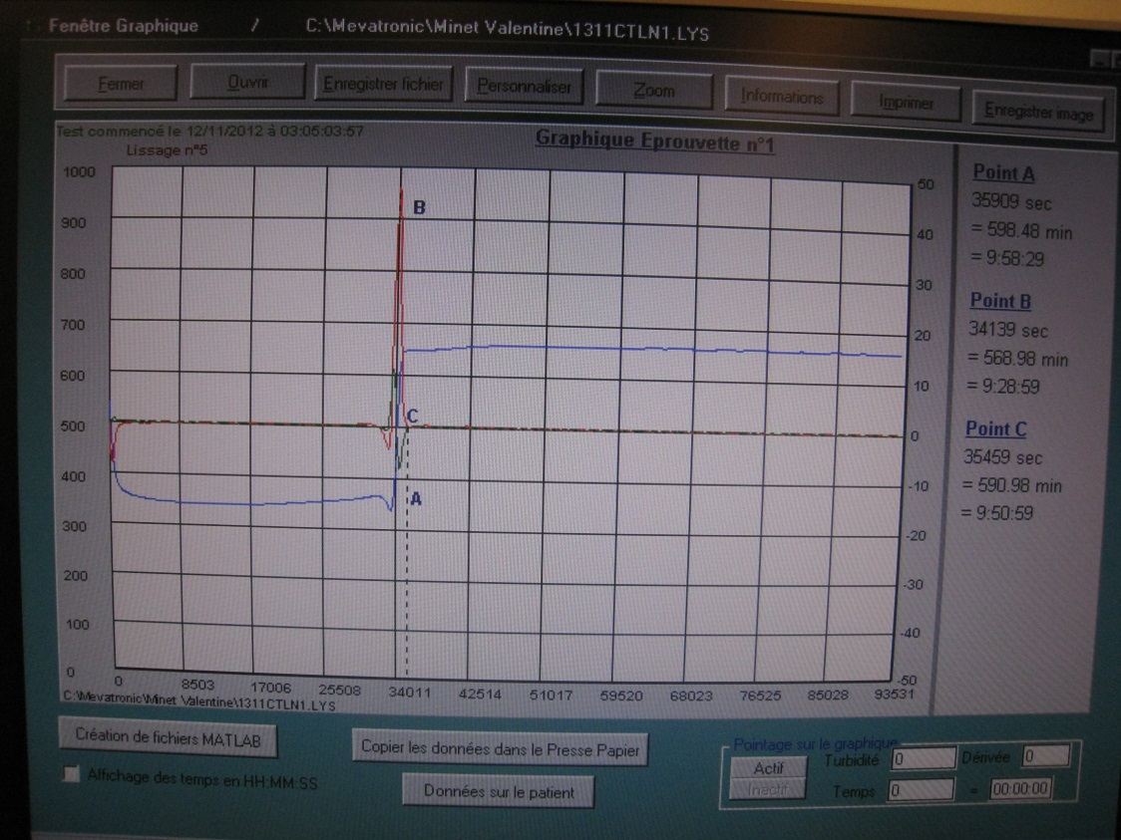
Euglobulin clot lysis time : principle
Precipitate of euglobulins diluted and placed in a cuvette.
Thrombin is added.
The machine measures the time to clot lysis by infrared (890 nm)
Reference :
Normal : 210 – 540 min
Hyperfibrinolysis : < 30 min
Hypofibrinolysis : > 540 min
3
1
2
Introduction – Hemolysis – Primary haemostasis – Secondary haemostasis – Fibrinolysis - Conclusion

Slide 45
Euglobulin clot lysis time : results
n≥2, t-test performed
Decrease of lysis time
Introduction – Hemolysis – Primary haemostasis – Secondary haemostasis – Fibrinolysis - Conclusion
Notes:
Poster Hemocompatibility of silver nanoparticles
Julie Laloy, Valentine Minet, Lutfiye Alpan, Bernard Chatelain, François Mullier and Jean-Michel Dogné, University of Namur, Belgium

Slide 46
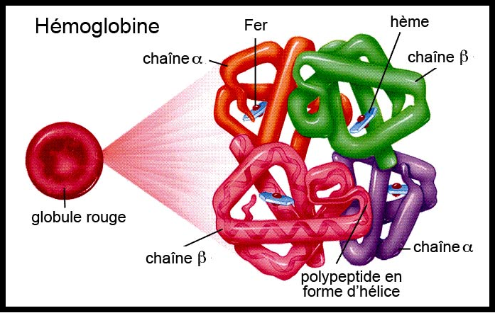
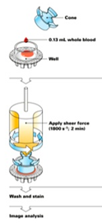
Human hemocompatibility
NP impact on …
OD_{550 nm} haemoglobin released
Calibrated thrombin generation test
TF
CYTOKINES
Impact-R® + FEG-SEM
CHEMOKINES
LIPID MEDIATORS
Euglobulin clot lysis time
Introduction – Hemolysis – Primary haemostasis – Secondary haemostasis – Fibrinolysis - Conclusion
Notes:
Photo pr rappeler manip
Most available techniques used to study platelet adhesion/aggregation are not suitable for high NPs concentrations (interferences).

Slide 47
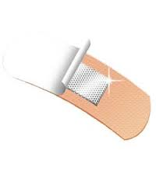
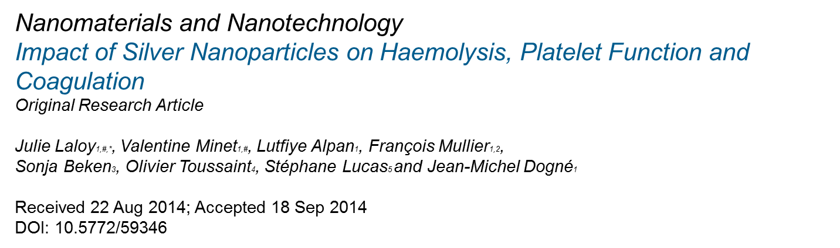

Conclusions
Silver NPs :
  hemolytic potential
  procoagulant activity
  Induction of platelet adhesion
Impact on applications :
  Local exposure : benefits (platelets, cicatrisation…)
  Systemic exposure : Safety margins
In collaboration with
Introduction - Hemocompatibility – Hemolysis - Hemostasis - Perspectives
Notes:
Virus sida, brulure, blessure
Incohérences ds la littérature (effet du a l’absorbance des nano d’Ag, au stabilisant utilisé)

Slide 48






Thank you for your attention!
Department of Pharmacy

Slide 49
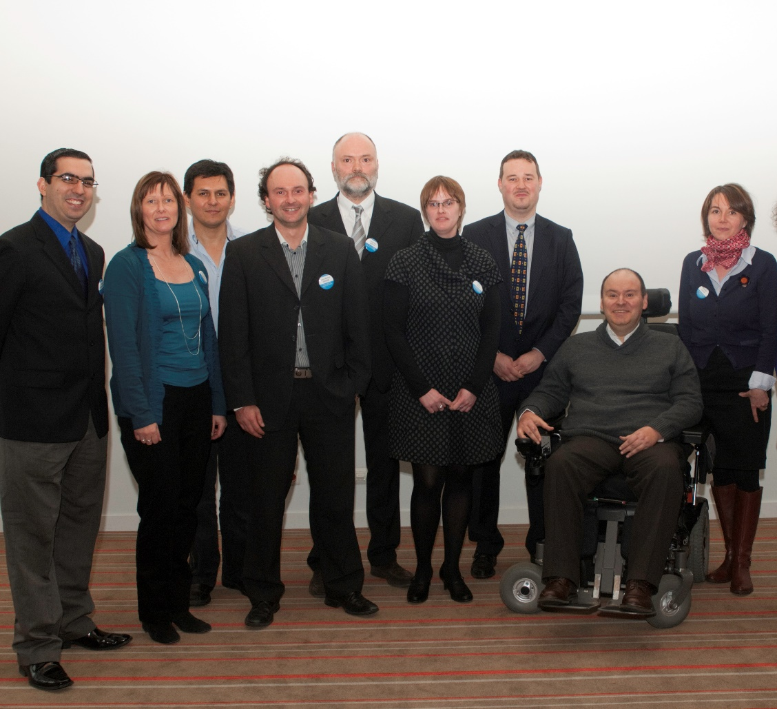

Namur Nanosafety team
julie.laloy@unamur.be
49
Notes:
49

