Slide 1
Effects of Temperature and Sodium Hyaluronate on Fluorescence of type I Calfskin Collagen Solutions at Physiological pH
Julian M Menter, PhD
Morehouse School of Medicine
Atlanta GA 30310

Slide 2
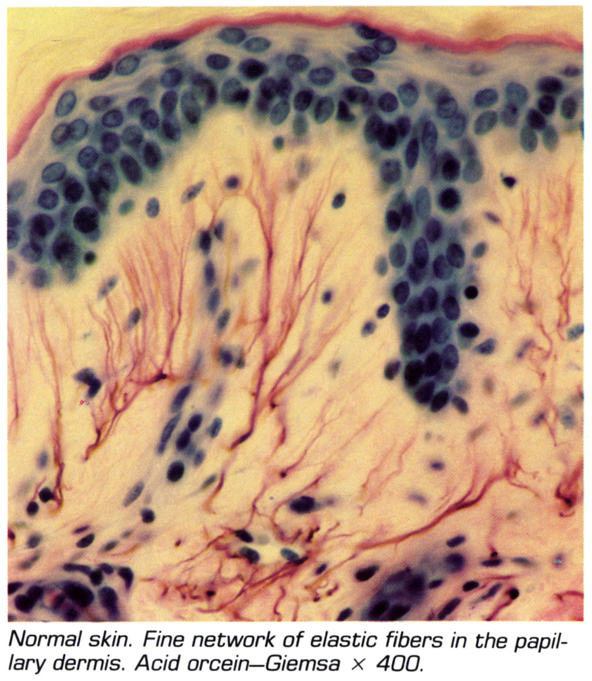
Histology of Normal Human Skin

Slide 3
What Photochemical Fluorescence Spectra and Fading Properties Can Also Tell Us
Can give insight into collagen molecular dynamics (e.g. changes in physical state, helix – coil transition, photochemical transformations)
Can give insight into photophysical properties (properties and energy levels of fluorescent and photo – reactive states)

Slide 4
Some properties of skin collagens
Skin collagens belong to a genetically distinct group of structural proteins.
Type I and Type III Collagens Are the Predominant Collagens in the Dermis, in the Ratio ~ 85:15.
In this work, we focus on Type I collagen

Slide 5
Structural Aspects of Type I Collagen (1)
Tropocollagen is the basic structural unit of skin collagen; it consists of 2 α chains and 1 β chain. These chains have a left – handed helical structure, and they are wound in a right – handed superhelix.
It has the general formula X – Y – Gly, and contains ~10 – 15% each of Proline and Hydroxyproline

Slide 6
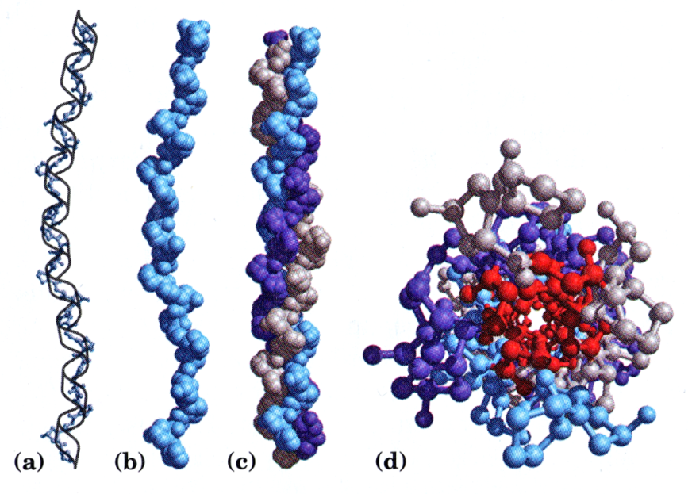

Slide 7
Structural Aspects of Type I Collagen (2)
Tropocollagen forms fibrils by cross – linkage with other tropocollagen molecules.
These “normal” linkages can involve one of several molecules, but the “fundamental” linkage involves the formation of Schiff base between free amino groups of (hydroxy)lysine and nearby aldehydes (formed by lysyl oxidase on some of the (hydroxy)lysine residues

Slide 8
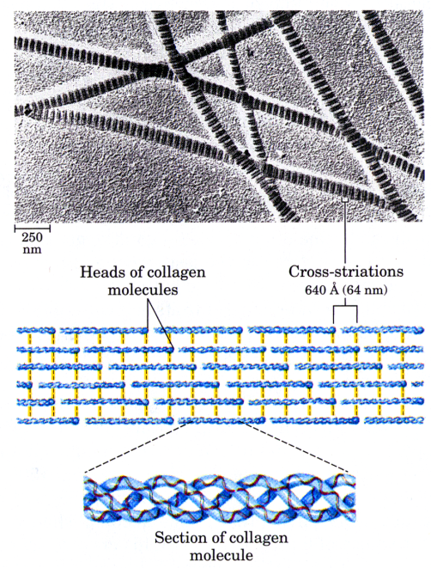

Slide 9
Telopeptides are Non – Helical Portions and the N- and C- Terminal Ends of the Collagen Molecule
(a) Telopeptides have an antiparallel β – pleated sheet*
(b) Telopeptides are high in tyrosine and phenylalanine residues, low in arginine and (hydroxy)lysine residues**
(c) Tyrosine residues in favorable position to form dimers, “excimers” and higher oxidation products**
(d) Telopeptides (Mainly N- telopeptides) are necessary for fibrillogenesis
* D. Helseth et al, Biopolymers 18 3005 – 3014 (1979)
* *A.L. Rubin et al, Science 139 37 – 38 (1963)

Slide 10
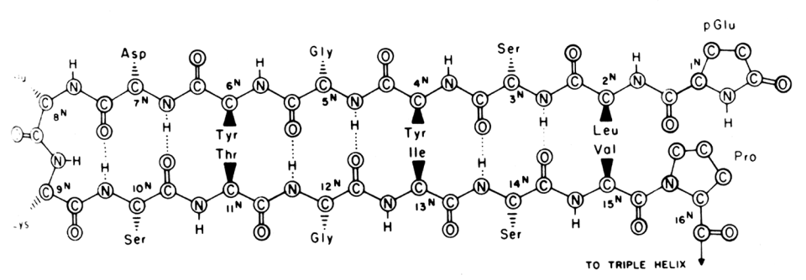
Proposed Structure of Collagen N-Telopeptide Note that the hydrophobic AA face in towards the center of the molecule and the hydrophilic AA face out towards the surface
Schematic representation of proposed secondary structure of N - telopeptide

Slide 11
Tyrosine Can be Degraded by Thermal Oxidation or UV radiation. Degraded Collagen Has Different Fluorescence Properties than Normal

Slide 12
Spectral Differences in Calf Skin Collagen Depend on Previous History
Lot# 121 (5 years old; kept in refrigerator in dark at 4o C)
Lot# 159 “New” (obtained Feb 2012 and used July 2012)

Slide 13
Temperature Dependence of Collagen Photochemical Fluorescence Fading
(1) Fluorescent State (radiative) not the same as the photochemical state (radiationless)
(2) In general, fluorescence intensity decreases with temperature with concomitant increase of photochemical or other radiationless transistions (e.g. vibration) back to the ground state.

Slide 14
Autoxidation vs. UV Photolysis
Autoxidation is Oxygen – Dependent
UV Photodimerization Does Not Depend on Oxygen

Slide 15
Effect of Temperature on Fading and Fluorescence Emission
Higher Temperatures Favor Photochemical Reaction (“Fading”) and Disfavor Fluorescence Emission
Lower Temperatures Favor Fluorescence Emission and Disfavor Photochemical Fading

Slide 16
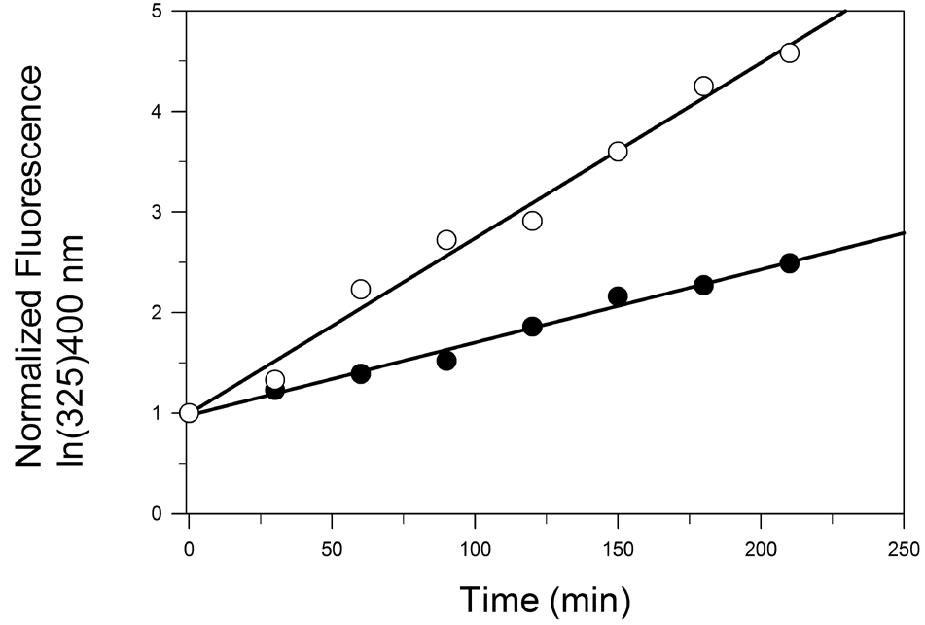
Tyrosine Dimerization to Dityrosine Decreased in Autoxidized Collagen
Fresh Collagen was irradiated with UVC (254 nm) as a function of time.
Black Dots - “aged” collagen sample
White Dots - fresh collagen sample
See O Shimizu Photochem Photobiol 18(3) 123 – 133, 1973

Slide 17
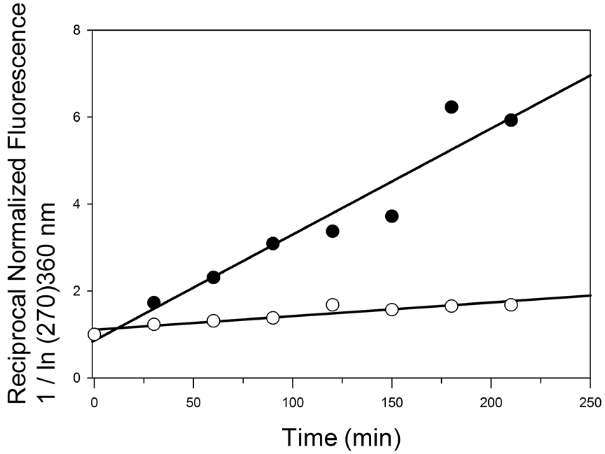
Photodestruction of DOPA Oxidation Product is Increased in Autoxidized Collagen
Oxidized Sample “aged” in dark at 4 C for ~ 5 years was irradiated with UVC (254 nm) as a function of time
Black Dots – “aged” collagen sample
White Dots - new collagen sample

Slide 18
Discussion:
Common Intermediate is A*:
Oxidation to AO2 takes place at the expense of dityrosine formation

Slide 19
Discussion: (2)
Photolability of Oxidation Product Indicates That Thermal Oxidation Destablizes Collagen Molecule
Dityrosine is Unstable to Longer UVA Wavelengths (not shown)

Slide 20
Kinetics of dityrosine formation
Reaction
(1) A + hγ ----> A*
(2) A* ----> A + Δ
(3) A* + A ----> A – A
(a) Rx (3) is slow step in UV photodimerization.
(b) System (3) must “build up” to a steady – state that requires t > 0
(c) As t ----> 0 , rate of A-A formation is maximum; dA*/dt ~ k[A] and is quasi - linear (A* is << A)
Rate
Iabs Φrx = k*[A]
- kT [A*]
- kAA [A][A*]

Slide 21
Effect of ECM on Collagen Fading
Important because ECM surrounds collagen in dermal tissue
(2) ECM has ionic interactions with collagen
(3) We wish to inch towards the “physiological condition”

Slide 22
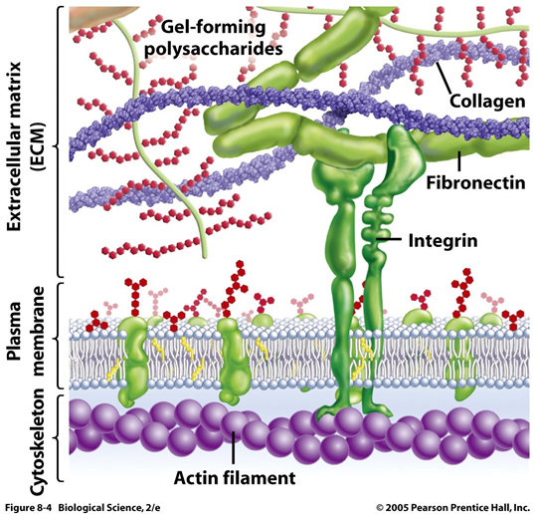
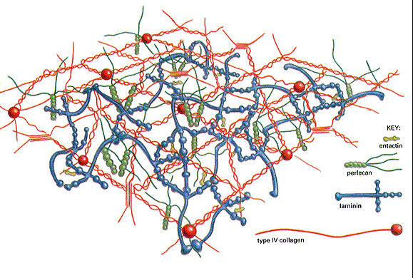
What is THE “extracellular matrix (ECM)”?
The ECM is a network of macromolecules that fill the space between cells
Two main macromolecules make up the ECM
Polysaccharide chains of glycosaminoglycans (GAG) that is usually linked to proteins to form proteoglycans.
Fibrous proteins of two functional types:
a) mainly structural (e.g. collagen and elastin)
b) mainly adhesive (e.g. fibronectin and laminin)

Slide 23
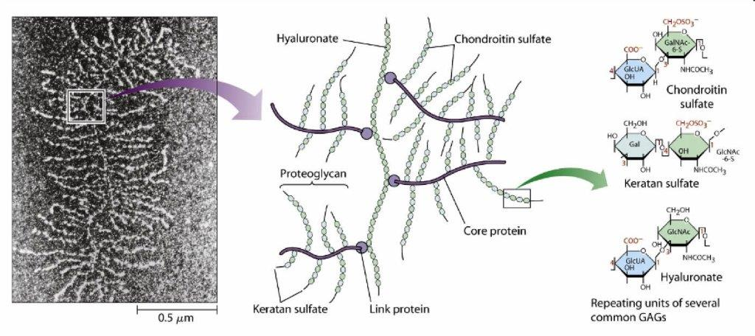
DERMAL PROTEOGLYCAN AGGREGATE

Slide 24
Preliminary Data (on HA)
Excess Hyaluronate Does Not Seem to Affect Collagen Fading Rate as Evidenced By:
(1) Fluorescence Spectral Shape
(2) Fluorescence Fading/Buildup Rate
(3) Arrhenius Plots

Slide 25
Hyaluronate Has Only Marginal Effect on Fluorescence Fading of DOPA – Oxidation Product
(1) Curved regression line in Arrhenius plot reflects collagen change of phase (melting) at ~ 36 C
(2) There is no statistical difference between Collagen alone and Collagen + Added HA at the 95% confidence level

Slide 26
Possible Reasons
Tyrosine is buried in hydrophobic region of telopeptide
Photochemical reaction involves free radical mechanism
Collagen/HA molecules are not packed close enough to each other as they are in skin. (C. Nagorski et al Res. Comm. Mol .Pathology and Pharm 89(2) 179 – 186

Slide 27
Acknowledgements
Isaac Willis M.D.
Abrienne M Patta
Natalya Silvestrov
Latoya Freeman
Otega Edukuye
Gina Chu
Many Other Colleagues

Slide 28
Supported in part by
DOD Grant # W911NF-10-1-0445 from the US Army Research Office
RCMI Grant # 8G12 MD007602 to Morehouse School of Medicine

