Slide 1
About OMICS Group
OMICS Group is an amalgamation of Open Access Publications and worldwide international science conferences and events. Established in the year 2007 with the sole aim of making the information on Sciences and technology ‘Open Access’, OMICS Group publishes 500 online open access scholarly journals in all aspects of Science, Engineering, Management and Technology journals. OMICS Group has been instrumental in taking the knowledge on Science & technology to the doorsteps of ordinary men and women. Research Scholars, Students, Libraries, Educational Institutions, Research centers and the industry are main stakeholders that benefitted greatly from this knowledge dissemination. OMICS Group also organizes 500 International conferences annually across the globe, where knowledge transfer takes place through debates, round table discussions, poster presentations, workshops, symposia and exhibitions.

Slide 2
OMICS International Conferences
OMICS International is a pioneer and leading science event organizer, which publishes around 500 open access journals and conducts over 500 Medical, Clinical, Engineering, Life Sciences, Pharma scientific conferences all over the globe annually with the support of more than 1000 scientific associations and 30,000 editorial board members and 3.5 million followers to its credit.
OMICS Group has organized 500 conferences, workshops and national symposiums across the major cities including San Francisco, Las Vegas, San Antonio, Omaha, Orlando, Raleigh, Santa Clara, Chicago, Philadelphia, Baltimore, United Kingdom, Valencia, Dubai, Beijing, Hyderabad, Bengaluru and Mumbai.

Slide 3

Design, Synthesis and Investigation of Aryl Derivatives of Alaptide as Potential Transdermal Permeation Enhancers
Josef Jampílek
Faculty of Pharmacy, University of Veterinary and Pharmaceutical Sciences Brno,
Czech Republic

Slide 4
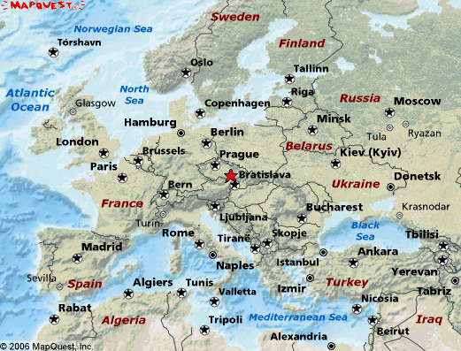
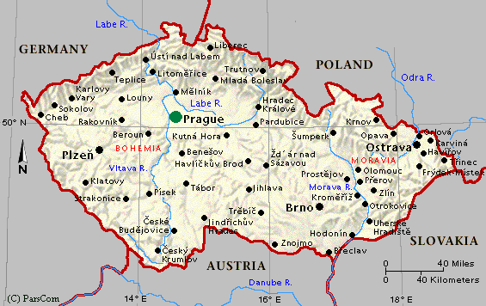

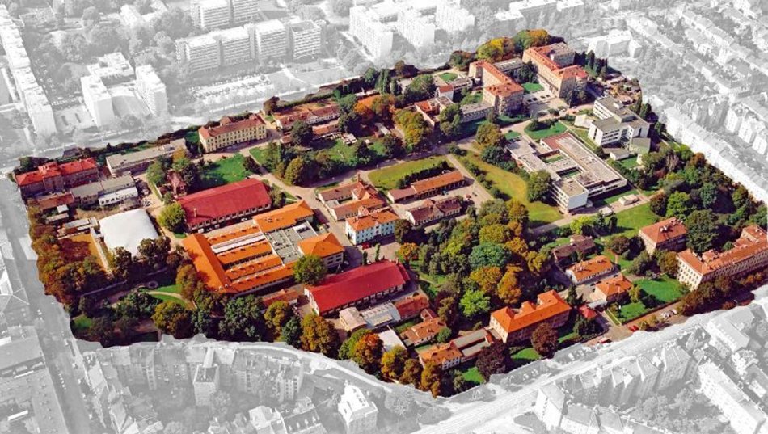


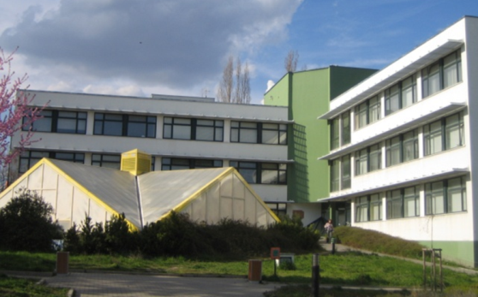

Slide 5
Content
Transdermal administration
Structure of skin
Transport through skin
Chemical penetration/permeation enhancers
Alaptide derivatives as CPEs

Slide 6
Transdermal administration
The advantages of transdermal administration include:
good pharmacokinetic properties of application systems
the ability to maintain long-lasting steady-state plasma concentration of active substances (including drugs with short biological half-lives)
reduction of undesirable side effects occurring as a result of considerable fluctuations of drug plasma concentration
protection from presystemic elimination of the applied drug (first-pass effect) and from pH change in GIT and interactions with other simultaneously applied pharmaceutics or food
possibility to apply drugs with a narrow therapeutic window and to interrupt drug delivery into the system immediately when an undesirable effect occurs
very simple and painless application
non-invasive alternative to parenteral, subcutaneous and intramuscular injections

Slide 7
Transdermal administration
The disadvantages of transdermal administration include:
possibility of local skin irritation or allergisation by an active substance or excipient
variable intra and interindividual absorption depending on skin conditions and on the place of application
(differences in skin structure and thickness on different body parts cause absorption diversity)
long-term transdermal application on the same place can damage the skin by affecting its microflora and enzymes
longer time of effect onset connected with the need to overcome the skin barrier

Slide 8
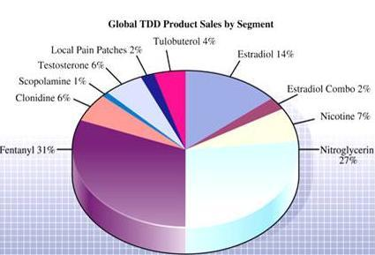
Drugs in transdermal therapeutic systems approved by FDA
Drug (molecule) | Approved (year)
scopolamine | 1979
glycerol trinitrate | 1981
clonidine | 1984
estradiol | 1986
fentanyl | 1990
nicotine | 1991
testosteron | 1993
estradiol/noretisterone acetate | 1998
norelgestromin/ethinyl estradiol | 2001
estradiol/levonorgestrel | 2003
oxybutinin | 2003
selegiline | 2006
metylfenidate | 2006
rotigotine | 2007
rivastigmine | 2007
granisetron | 2008
buprenorphine | 2010
sumatriptan | 2013
Under development:
paroxetine, physostigmine,
flurbiprofen and other NSAIDs

Slide 9
Transdermal administration
The number of drugs that can be applied transdermally is limited by some requirements on the drug.
The ideal properties of a molecule that effectively penetrates through the skin include drug:
solubility
penetrability (drug gets into the skin)
permeation (drug passing through the skin)
resorption in blood or lymphatic vessels

Slide 10
Transdermal administration
Requirements to the drug:
applied drug dosage <25 mg/day
biological half-life <10 h
molecular weight <500 Da
log P 1– 3 (ideal 2.5)
melting temperature <200°C
saturated aqueous solution pH 5–9
should not cause any skin irritation or immunity reactions
Only about 5% of drugs are suitable for administration through the skin.

Slide 11
Skin
anatomically and physiologically specialized barrier
forms integrated external surface of human body
skin surface of adult is 1.6-2 m², thickness is 1.5–4 mm, its weight is 3 kg
contains ca 72% of water
The skin has a number of different functions; the most important is protection from:
excessive water loss
mechanical, chemical, microbial and physical impacts.

Slide 12
Skin
The skin consists of three basic functional layers:
epidermis (the upper layer) – external corneous layers
- impermeable to water and chemically inert, primary barrier
against mechanical damage, drying and penetration of
microbes, xenobiotics
- consists of four layers: stratum basale, stratum spinosum,
stratum granulosum, stratum corneum
dermis (curium) – is formed by fibroblasts and extracellular matrix and is rich in capillaries and nerve endings; fibroelastic layer ensures mechanical strength, elasticity, tensibility and tensile strength thanks to tangled structure of collagen fibres
hypodermis (subcutaneous tissue)

Slide 13
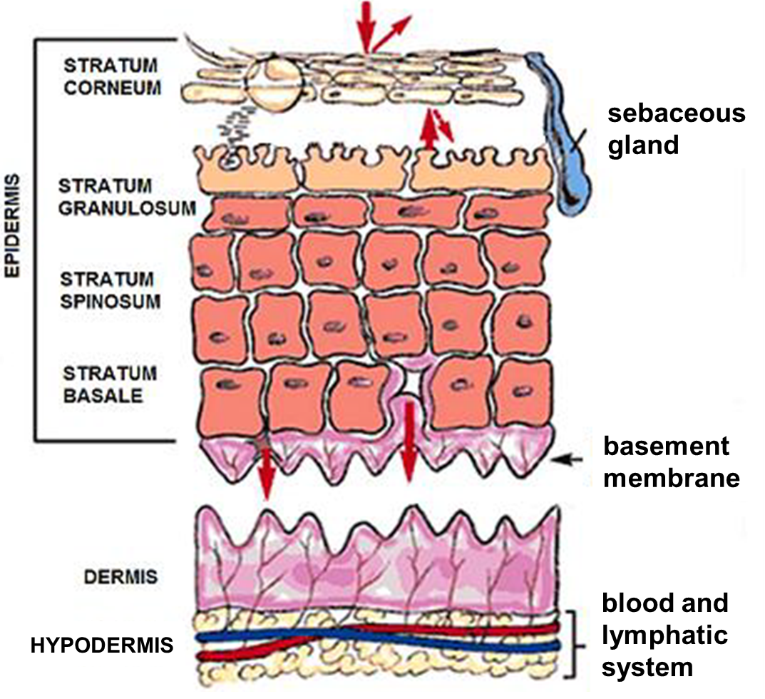
Skin

Slide 14
Skin
Stratum corneum (horned layer):
final product of differentiation of epidermal cells
outermost layer of skin (responsible for barrier function)
formed by 18–21 cell layers and intercellular substance consisting of specific lipids (50% ceramides, 25% cholesterol, 10% free fatty acids, cholesterol esters, cholesterol sulfate and glucosylceramides)
have “brick and mortar” structure, where corneocytes represent “bricks” and lipid matrix in intercellular space represents “mortar”
horned layer is formed by proteins (75-80%), lipids (5-15%), other organic compounds and water

Slide 15
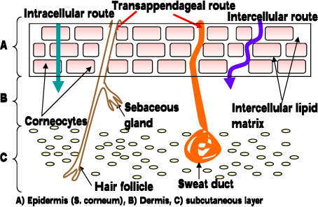
Skin
Drugs can permeate to internal environment by:
transcellular way (through cell bodies)
intercellular way (through intercellular space)
through accessory skin organs (follicles, sebaceous/ sweat glands)
} transepidermally

Slide 16
Skin
The permeation through the least permeable layer, the SC, is limiting.
To solve this critical issue various approaches for overcoming the skin barrier were developed.
These approaches can be classified as:
chemical (modification of drugs (prodrugs), using transdermal chemical permeation enhancers)
physical (modification of drug particles size to nanosize, physical enhancement techniques).

Slide 17
Skin
Another classification can be based on:
optimization of drug/vehicle
SC modification.
Optimization of drug/vehicle consists in preparation/application of:
lipophilic prodrugs or ion pairs
eutectic systems
complexes of drugs with cyclodextrins
liposomes and other vesicles (transfersomes, ethosomes, niosomes, etc.)
solid lipid nanoparticles and other nanoparticles and/or nanodelivery systems
saturated and supersaturated solutions

Slide 18
Skin
Another classification can be based on:
optimization of drug/vehicle
SC modification.
Modification (i.e., hydration/lipid fluidization/disrupting) of SC, means:
application of transdermal chemical permeation enhancers
overall optimization of formulation using non-hydrophobic excipients
application of physical enhancement techniques (electrically assisted methods), such as iontophoresis, electroporation, acoustic methods – ultrasound (phonophoresis, sonophoresis), microneedles, magnetophoresis or photomechanical wave

Slide 19
Chemical penetration/ permeation enhancers (CPEs)
–compounds (excipients) specifically affecting intercellular space between corneocytes or modifying corneocytes by hydration or denaturation of keratin.
CPEs can be divided into 10 categories:
anionic surfactants (e.g. sodium lauryl sulfate)
cationic surfactants (e.g. alkyl ammonium bromides)
zwitterionic surfactants (e.g. dodecyl betain)
non-ionic surfactants (e.g. polysorbate, poloxamers)
fatty acids (e.g. oleic acid, palmitic acid)
sodium salts of fatty acids (e.g. sodium octyl sulfate)
fatty esters (e.g. isopropyl myristate)
fatty amines (e.g. long-chain alkyl amines)
Azone-like compounds
others (e.g. menthol, urea, cyclodextrins)

Slide 20
CPEs
The heterogeneity of molecular structures of CPEs limits simple explanation of their action.
Several possible mechanisms of action were hypothesized, but exact mechanisms have not been elucidated. It is almost certain that CPEs exhibit multiple effects:
interact with the intercellular lipid matrix (especially ceramides)
interact with proteins (influencing the conformation of keratin in corneocytes or proteins in desmosomes)
promote partitioning (influencing the SC nature leads to raising the penetrant concentration gradient and thus increasing the flux, i.e. increasing the concentration of the drug in the skin)

Slide 21
CPEs
Ideal enhancer should:
be nontoxic, non-irritating and cause no allergic reactions
have reversible influence on the skin barrier
possess rapid onset of action, predictable and repeatable effect
be pharmacologically and chemically inert
act one way (ensuring drug entrance to the body)
be physically and chemically compatible with drugs and other excipients
be cosmetically acceptable with convenient organoleptic properties
have uncomplicated and inexpensive synthesis
meet recently imposed additional biodegradability requirements

Slide 22
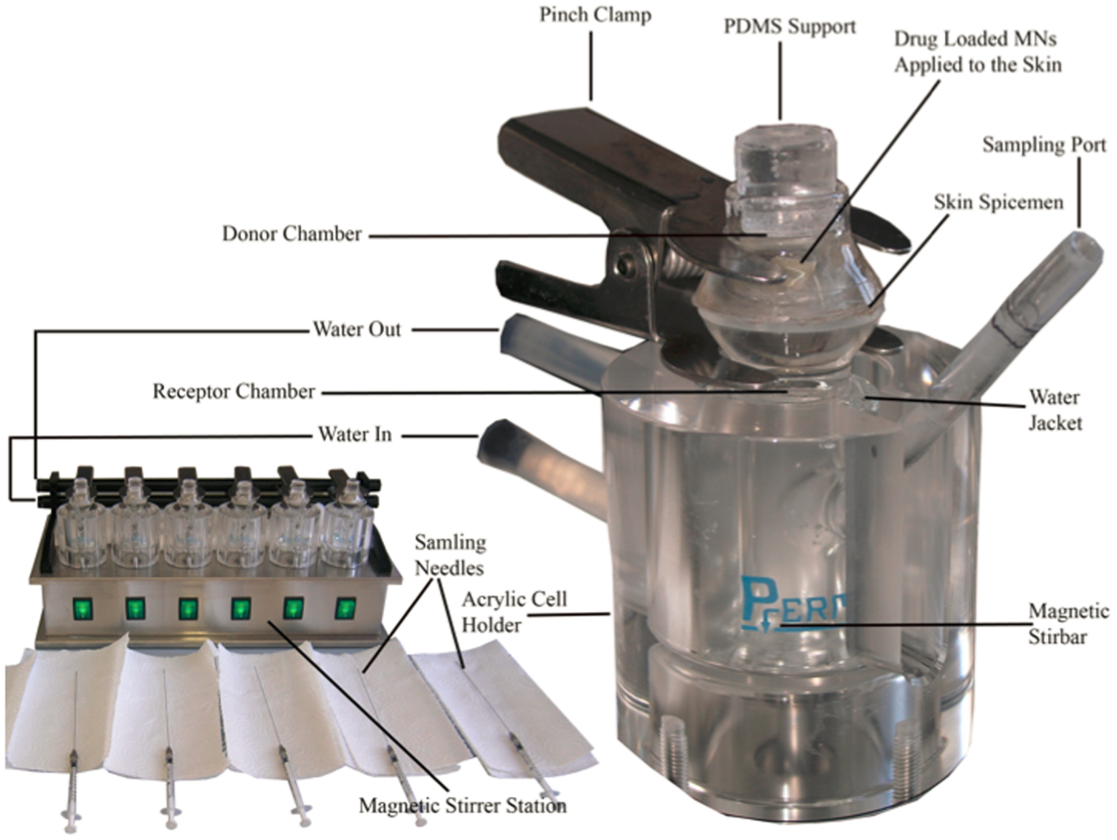
Testing of CPEs
Primary in vitro (ex vivo) screening is performed using:
Franz diffusion cell
skin of different animals (snake, hairless mice, rat, rabbit, guinea pig, pig, monkey) or human skin
different drugs
(theophylline – the most
frequent model drug;
hydrocortisone,
indomethacin,
5-fluoruracil,
antipsychotics,
cardiovascular drugs,
etc.)
HPLC

Slide 23
Testing of CPEs
skin samples obtained from porcine ear
Franz diffusion cell (SES – Analytical Systems, Germany), donor surface area of 0.635 cm² and receptor volume of 5.2 ml
receptor compartment filled with phosphate buffered saline
(pH 7.4), 37±0.5 °C
donor samples were prepared by dissolving the tested enhancer, theophylline or drug in medium (propylene glycol/water (1:1), formulations)
control sample was prepared in the same manner without enhancers
samples (0.5 ml) of the receptor phase withdrawn at time intervals 1, 2, 4, 6, 8, 12 and 24 h and the cell refilled with an equivalent amount of fresh buffer solution
five determinations were performed using skin fragments from 2 animals for each compound

Slide 24
Testing of CPEs
analysis of samples for theophylline/drug content was performed using an Agilent 1200 series HPLC system, equipped with a diode array detection (DAD) system; data acquisition was performed using ChemStation chromatography software
Waters Symmetry® C8 5 μm, 4.6×250 mm (Waters Corp., Milford, MA, USA) chromatographic column was used
The cumulative amounts of theophylline/drug that penetrated through the skin into the receptor compartment [μg/cm²] were corrected for sample removal and plotted against time [h].
Steady state fluxes [μg/cm²/h] were calculated using the linear region of the plots.
Enhancement ratios (ERs) were calculated as ratios of theophylline flux with and without the enhancer.

Slide 25
Why alaptide?

Slide 26
Alaptide
(S)-8-Methyl-6,9-diazaspiro[4.5]decan-7,10-dione
piperazine-2,5-dione / spirocyclic cyclodipeptide
synthesized at the Research Institute for Pharmacy and Biochemistry (former Czechoslovakia, now the Czech Republic) in the 80s of the 20th century
designed as analogues of melanocyte-stimulating hormone release-inhibiting factor (MIF-1, known as l-prolyl-l-leucylglycinamide)
showed significant curative effect in different therapeutic areas
demonstrated very low acute toxicity; no subchronic and chronic toxicity, genotoxic, teratogenic and embryotoxic effects were observed
its enantiomers do not induce the biotransformation enzymes of the cytochrome P450 superfamily 1A1, 1A2 and 1B1 in hepatocytes
Kasafírek E. et al. CS 231227, 1986
Kasafírek E. et al. Drugs Fut. 1990, 15, 445-447.
Jampílek J. et al. WO/2014/019556 A1.

Slide 27
Alaptide – effects
reduced the number and extent of experimental gastric ulcers
expressed stimulating effect on growth and breeding of human embryonic cells without transformation changes in their morphology
increased cell proliferation and epidermal regeneration
regenerated fast in vivo experimental skin injury in pigs and accelerated curing of experimental skin injuries in rats
Probable mechanism of action (under investigation):
alaptide negatively affects the inhibition of the release of melanocyte-stimulating hormone and thus increases the concentration of melanocytes in epidermis. Melanocytes significantly influence the creation and function of keratinocytes by means of melanosomes.

Slide 28
CPEs
- from the chemical point of view CPEs are heterogeneous.
However, it is possible to observe certain common elements in their structure. They often contain a fragment of the natural moisturizing factor (NMF), which is physiologically present in highly differentiated flattened keratinocytes.
The NMF is a mixture of hygroscopic compounds that help to maintain skin hydration and is capable of retaining water in the horny layer.
Other substances contained in the NMF with a special water binding capacity are derived from sweat and sebaceous oils, e.g., urea, proline, oxoproline, histidine, glutamine, urocanic acid.

Slide 29
CPEs
NMF components contain a characteristic fragment of heteroatoms X−CO−N=, where X is −CH2−, −NH2 or −NH−.
this fragment can be found in many CPEs.
A hypothesis was proposed that small polar molecules may break the intermolecular H-bonds that hold the ceramide molecules together in the SC.
Also small molecules derived from NMF components can increase the water binding capacity, and hence moisten the skin and facilitate permeation of compounds through the skin.

Slide 30
CPEs
Based on these characteristics and the knowledge of the structure and properties of NMF and CPEs, the hypotheses of CPE mechanism of action and the previous experience with several other groups of CPEs we decided to evaluate alaptide as a potential transdermal permeation enhancer.
Jampílek J. & Brychtová K. Med. Res. Rev. 2012, 32, 907-947.

Slide 31
Alaptide
investigated as a potential CPE of many anti-inflammatory drugs, antimicrobial chemotherapeutics, sex hormones/genital system modulators or drugs of central/vegetative nervous system
expressed no skin irritability and excellent enhancement effect (till the 3rd hour by several orders of magnitude higher compared with drugs without alaptide)
Jampílek J. et al. Czech Patent PV 2011-232, 2011
Jampílek J. et al. Czech Patent PV 2012-72, 2012.
Jampílek J. et al. Czech Patent PV 2012-511, 2012.
Jampílek J. et al. WO/2013/020527 A1, 2013.
Jampílek J. et al. Czech Patent PV 2013-1000, 2013.
Jampílek J. et al. Czech Patent PV 2013-1001, 2013.
Jampílek J. et al. Sci. World J. 2013, Article ID 787283.
Jampílek J. et al. WO/2014/019556 A1, 2014.
Jampílek J. et al. Czech Patent PV 2014-416, 2014.
Jampílek J. et al. ADMET 2014, 2, 56-62.
Jampílek J. et al. Mil. Med. Sci. Lett. 2014, 83, 34-39.
Jampílek J. et al. ADMET 2014, 2, 248-253.
Jampílek J. et al. Czech Patent CZ 304915 B6, 2014.

Slide 32
Alaptide
New compounds were prepared by a multi-step synthetic pathway from modified amino acids.

Slide 33
Aryl alaptide derivatives
Comp. | R | ER_{Theo(24h)} | Comp. | R | ER_{Theo(24h)}
1 |  | 56.5±4.07 | 5 |  | 26.5±5.01
2 |  | 14.2±5.08 | 6 |  | 42.2±4.13
3 |  | 7.0±3.21 | 7 |  | 47.0±3.19
4 |  | 16.4±5.17 | 8 |  | 20.8±5.12

Slide 34
Aryl alaptide derivatives
Comparison of the permeation of theophylline (Theo) through the skin from propylene glycol/water (1:1) without and with the presence of 0.1% (in relation to Theo amount) of AADs in time.

Slide 35
Aryl alaptide derivatives
Comparison of the permeation of indometacin (IND) through the skin from carbomer gel without and with the presence of 0.1% (in relation to IND amount) of phenyl (1), 4-methyl-1H-imidazole (5),
4-hydroxybenzyl (6), 4-fluorobenzyl (7) and 3-methyl-1H-indol-5-ol (8) derivatives in time.

Slide 36
Aryl alaptide derivatives
Comparison of the permeation of ibuprofen (Ibu) through the skin from carbomer gel and hydro-cream (Neo-Aquasorb®) without and with the presence of 0.1% (in relation to Ibu amount) of phenyl (1) and 4-fluorobenzyl (7) derivatives in time.

Slide 37
Aryl alaptide derivatives
Comparison of the permeation of sumatriptane (SMT) through the skin from 70% dimethicone (simulation of TTS) without and with the presence of 1% (in relation to SMT amount) of phenyl (1) and 4-fluorobenzyl (7) derivatives in time.

Slide 38
Conclusion
Series of original (S)-8-aryl-6,9-diazaspiro[4.5]decan-7,10-diones were prepared by a multi-step synthetic pathway from modified amino acids and characterized.
All discussed compounds were tested for their in vitro transdermal permeation enhancement effect using a vertical Franz diffusion cell and full-thickness pig ear skin.
Some of the tested compounds expressed significant permeation enhancement effect though the skin.
They also expressed no skin irritability (in vivo test on mice) and no in vitro toxicity (IC50 >50 μmol/l) against cervical cancer cells HeLa, T-lymphoblastic leukaemia CEM, breast adenocarcinoma MCF7, human Caucasian malignant melanoma G361 and human foreskin fibroblasts BJ.

Slide 39

Thank you for your kind attention
This study was supported by the Technology Agency of the Czech Republic TA04010065.

Slide 40
Let us meet again..
We welcome you all to our future conferences of OMICS International
4th Annual Conference on European Pharma Congress
June 18-20,2016, Berlin, Germany.
http://europe.pharmaceuticalconferences.com/

