Slide 1
About OMICS Group
OMICS Group International is an amalgamation of Open Access publications and worldwide international science conferences and events. Established in the year 2007 with the sole aim of making the information on Sciences and technology ‘Open Access’, OMICS Group publishes 400 online open access scholarly journals in all aspects of Science, Engineering, Management and Technology journals. OMICS Group has been instrumental in taking the knowledge on Science & technology to the doorsteps of ordinary men and women. Research Scholars, Students, Libraries, Educational Institutions, Research centers and the industry are main stakeholders that benefitted greatly from this knowledge dissemination. OMICS Group also organizes 300 International conferences annually across the globe, where knowledge transfer takes place through debates, round table discussions, poster presentations, workshops, symposia and exhibitions.

Slide 2
About OMICS Group Conferences
OMICS Group International is a pioneer and leading science event organizer, which publishes around 400 open access journals and conducts over 300 Medical, Clinical, Engineering, Life Sciences, Phrama scientific conferences all over the globe annually with the support of more than 1000 scientific associations and 30,000 editorial board members and 3.5 million followers to its credit.
OMICS Group has organized 500 conferences, workshops and national symposiums across the major cities including San Francisco, Las Vegas, San Antonio, Omaha, Orlando, Raleigh, Santa Clara, Chicago, Philadelphia, Baltimore, United Kingdom, Valencia, Dubai, Beijing, Hyderabad, Bengaluru and Mumbai.

Slide 3
POSTMORTEM CHANGES IN TROPICAL ENVIROMENTS
José Vicente Pachar Lucio
Instituto de Medicina Legal y Ciencias Forenses de Panamá
3rd International Conference on
Forensic Research and Technology
October 06-08, 2014 San Antonio, USA

Slide 4
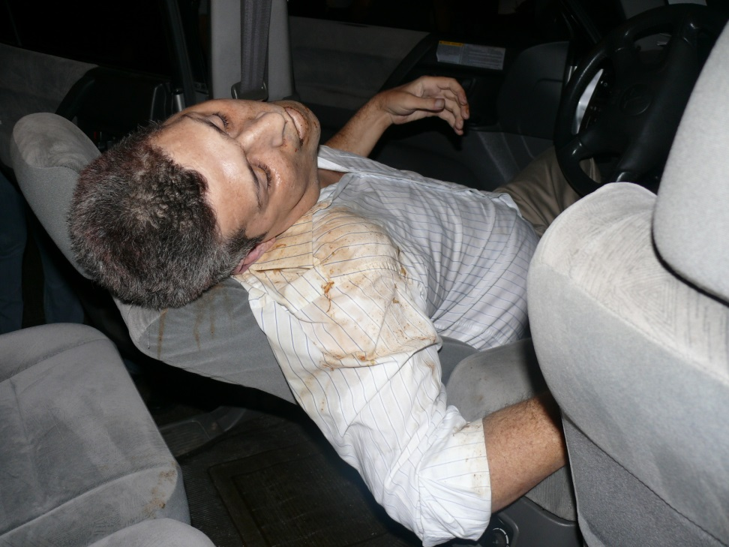
INTRODUCTION
After death, the morphology and appearance of the corpse are modified and deteriorate progressively until the emergence and development of the cadaveric phenomena and by artifacts resulting from the action of internal and external factors: enviromental conditions, damage peri and post mortem.

Slide 5
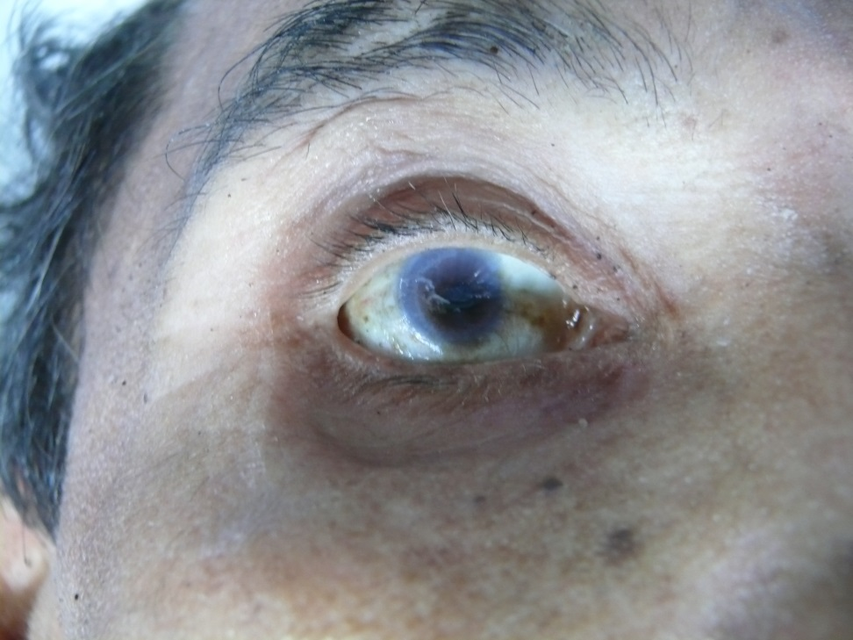
INTRODUCTION
Post mortem changes are progressive
Critical importance in estimating the post mortem interval in conjuntion with the history, terminal events and scene findings.

Slide 6
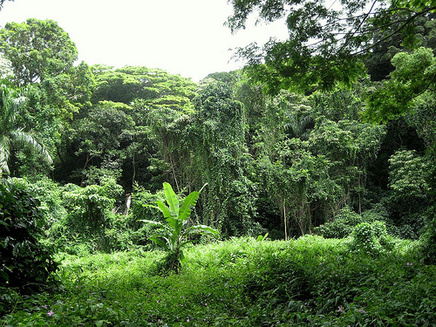
INTRODUCTION
In conditions of tropical enviroment bodies will decompose more quickly

Slide 7
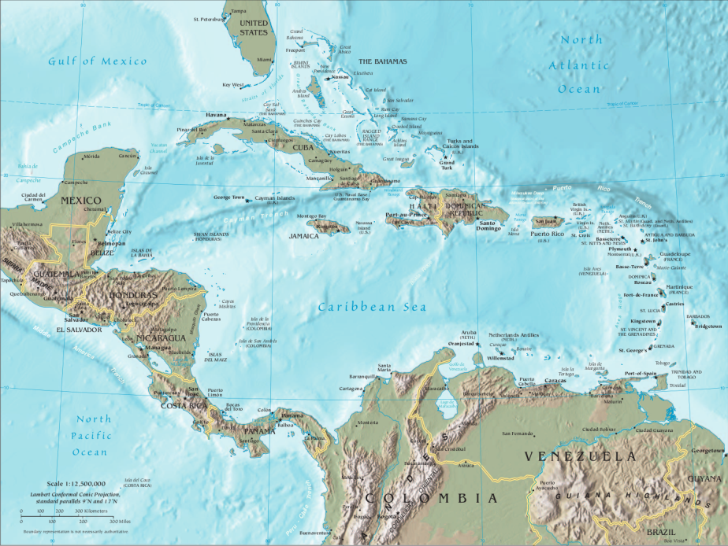
THE REPUBLIC OF PANAMA
Located in the southeastern part of Central America between paralels 7° 11 and 37 9° North latitude

Slide 8
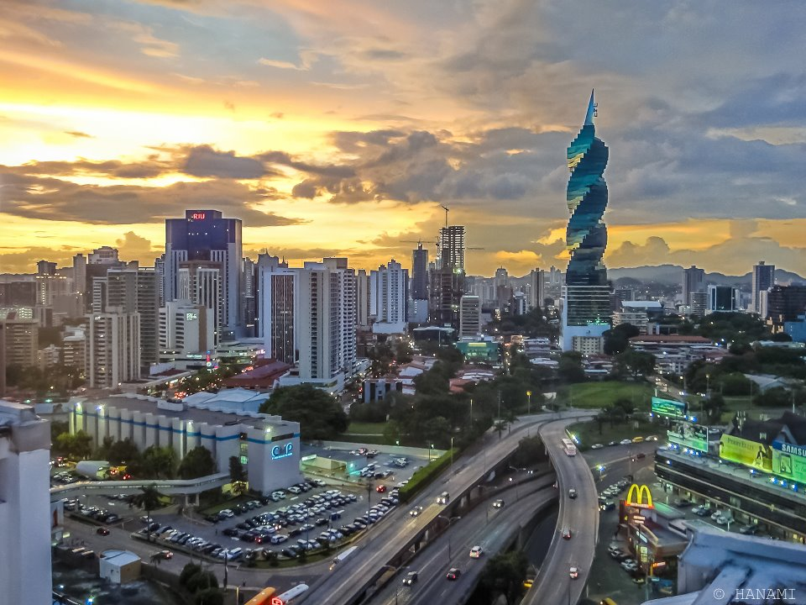
CIUDAD DE PANAMÁ
1.5 million inhabitants
On the shores of the Pacific Ocean
Tropical climate
Average temperatures 21 – 34.5 °c
Extensive rain regime
Relative humidity > 80%

Slide 9
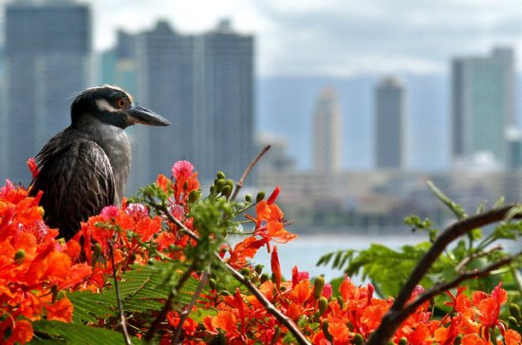
CIUDAD DE PANAMA
Urban areas
Marginal districts
Tropical rainforest
Rivers
Mangroves
Beaches
Biodiversity

Slide 10
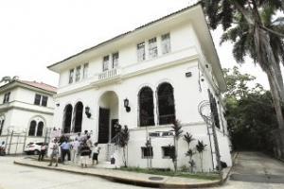
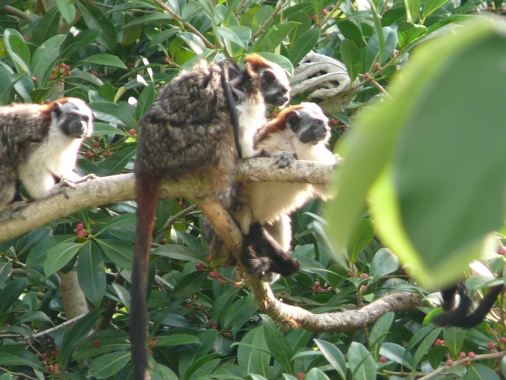
FORENSIC PATHOLOGY
Forensic Sciences and Medico Legal Institute of Panamá
Forensic Pathology Department
1.200 autopsies per year
10% decomposed bodies

Slide 11
DECOMPOSITION STUDIES
Most of the available studies refer to decomposition in temperate enviroments or with marked seasonal variations.
Important to consider specific local factors in conditions of high temperature and humidity
Other factors: animal activity, dificulties and handling and transportation and preservation of the body

Slide 12
AUTOR | COUNTRY | INCIPIENT CHANGES | MODERATE CHANGES
Di Maio | USA | Horas | < 72 horas
Pachar | Panamá | Horas | < 72 Horas
Dolinack | Estados Unidos | Horas | <72 horas
Perper | Estados Unidos | Horas | < 72 Horas
Basile | Argentina | Horas | Días
Quai | Rumania | Horas | < 72 Horas
Carrera | Perú | Ø 24 horas | Meses
Grandini | México | Ø 24 horas | < 72 horas
Griest | Estados Unidos | 1-72Horas | Ø 1 Semana
Gisbert Calabuig | España | Ø 24 horas | Meses
Shkrum – Ramsay | Canada | 24-48 horas | Ø 1 Semana
Vargas Alvarado | Costa Rica | Ø 24 horas | Días
Pounder | Reino Unido | 36-72 horas | Ø 1 Semana
Sheperd | Reino Unido | Días | Semanas
Quiróz Cuaron | México | Días | Semanas
Prokop | Alemania | Días | Semanas

Slide 13
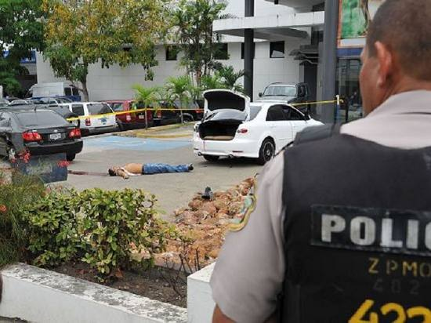

Slide 14
DECOMPOSITION STUDIES
Evaluation of cadaveric phenomena and perimortem artifacts must be made by medical experts and researchers who know the climatic and enviromental conditions of the geographic area in which is located the body.
High temperature and humidity affect the rapid deterioration of the corpse increasing the possibility of the emergence of artifacts that complicate the interpretation of the lesions.
The optimum temperature: 21-38 °c

Slide 15
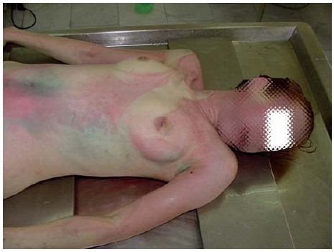
POST MORTEM CHANGES
Postmortem changes, specially those related to putrefaction appear and evolve sooner than described in other climatic conditions.
Green abdominal discoloration over the cecum may appear in matter of hours.

Slide 16
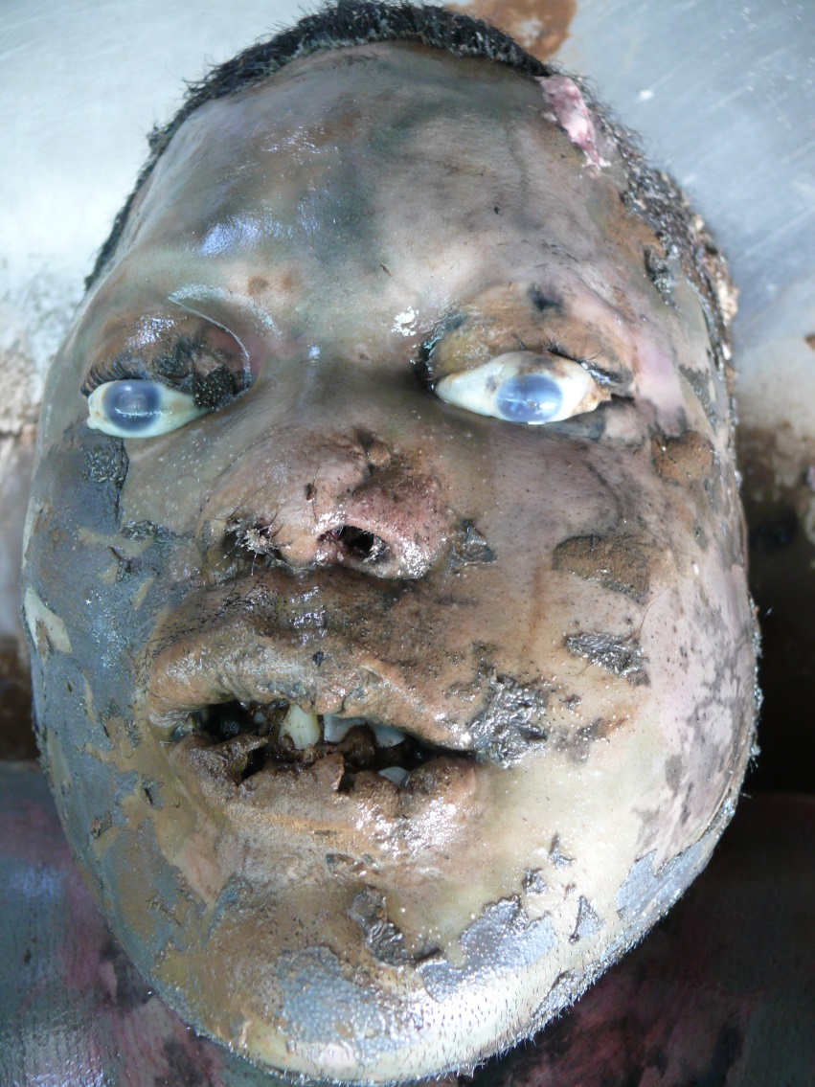
POSTMORTEM CHANGES
Moderate to advance putrefaction (chromatic – enphysematosus changes) occur in up to 72 hours.
High temperature, humidity, exposure to the sun

Slide 17
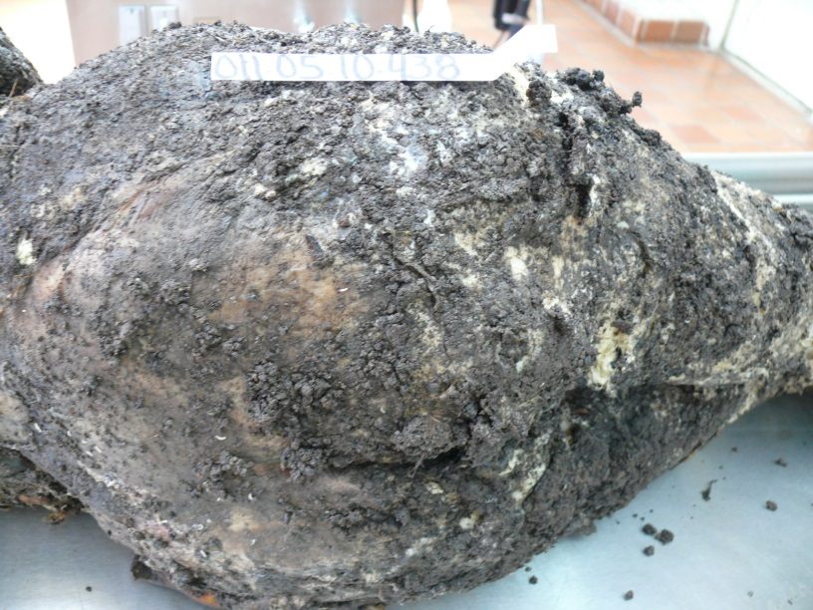
POSTMORTEM CHANGES
Adipocira can occur partially or completely in weeks

Slide 18
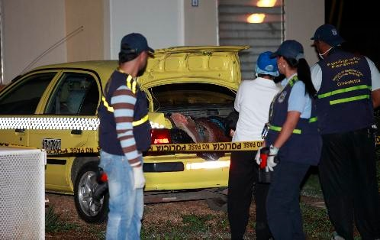
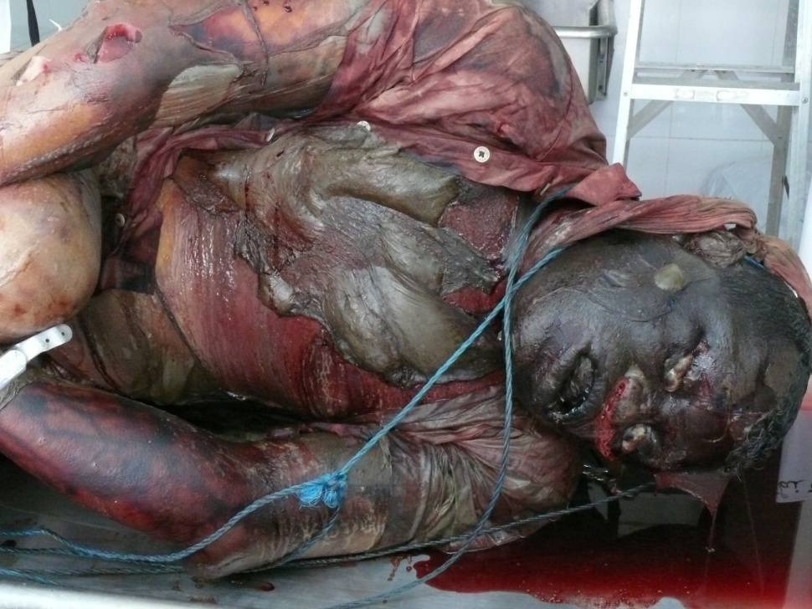
Case example 1

Slide 19
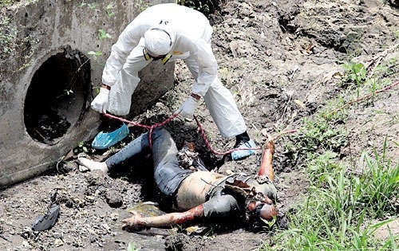
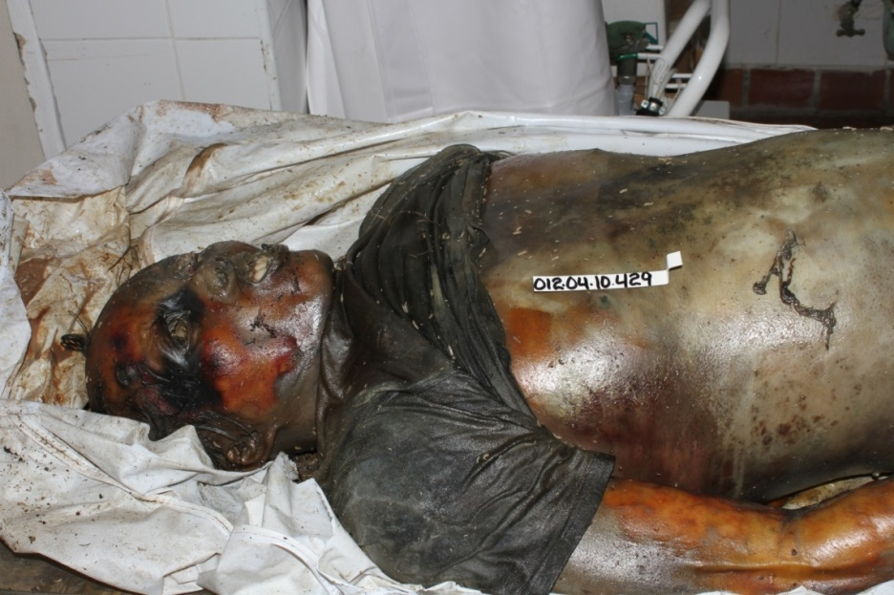
Cae example 2

Slide 20
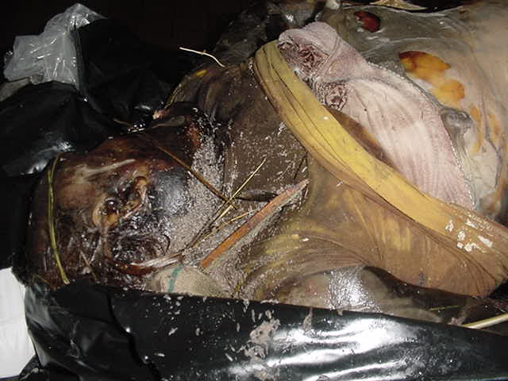
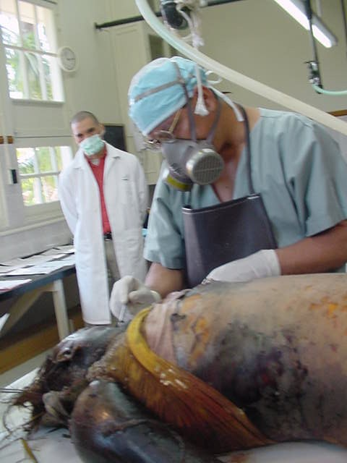
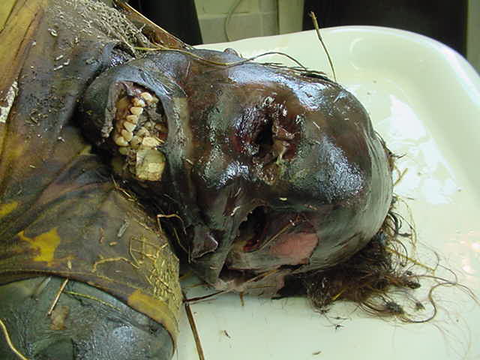
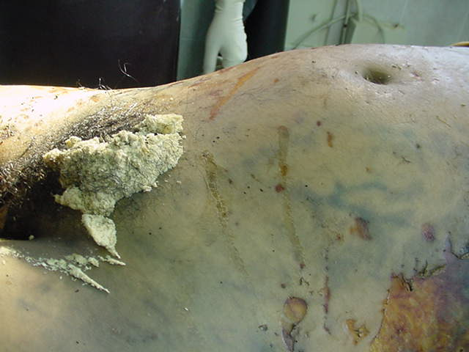
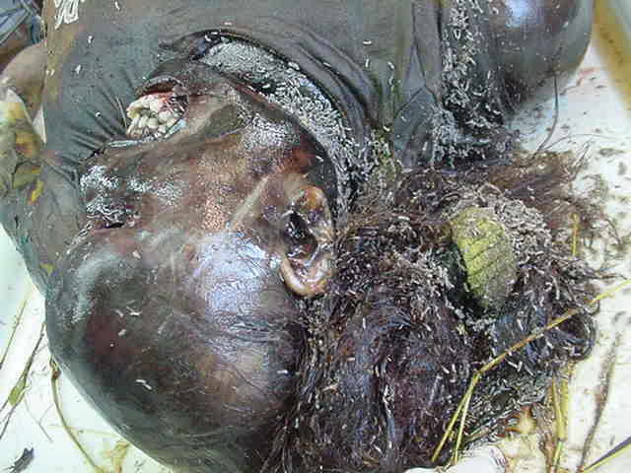
Case example 3

Slide 21
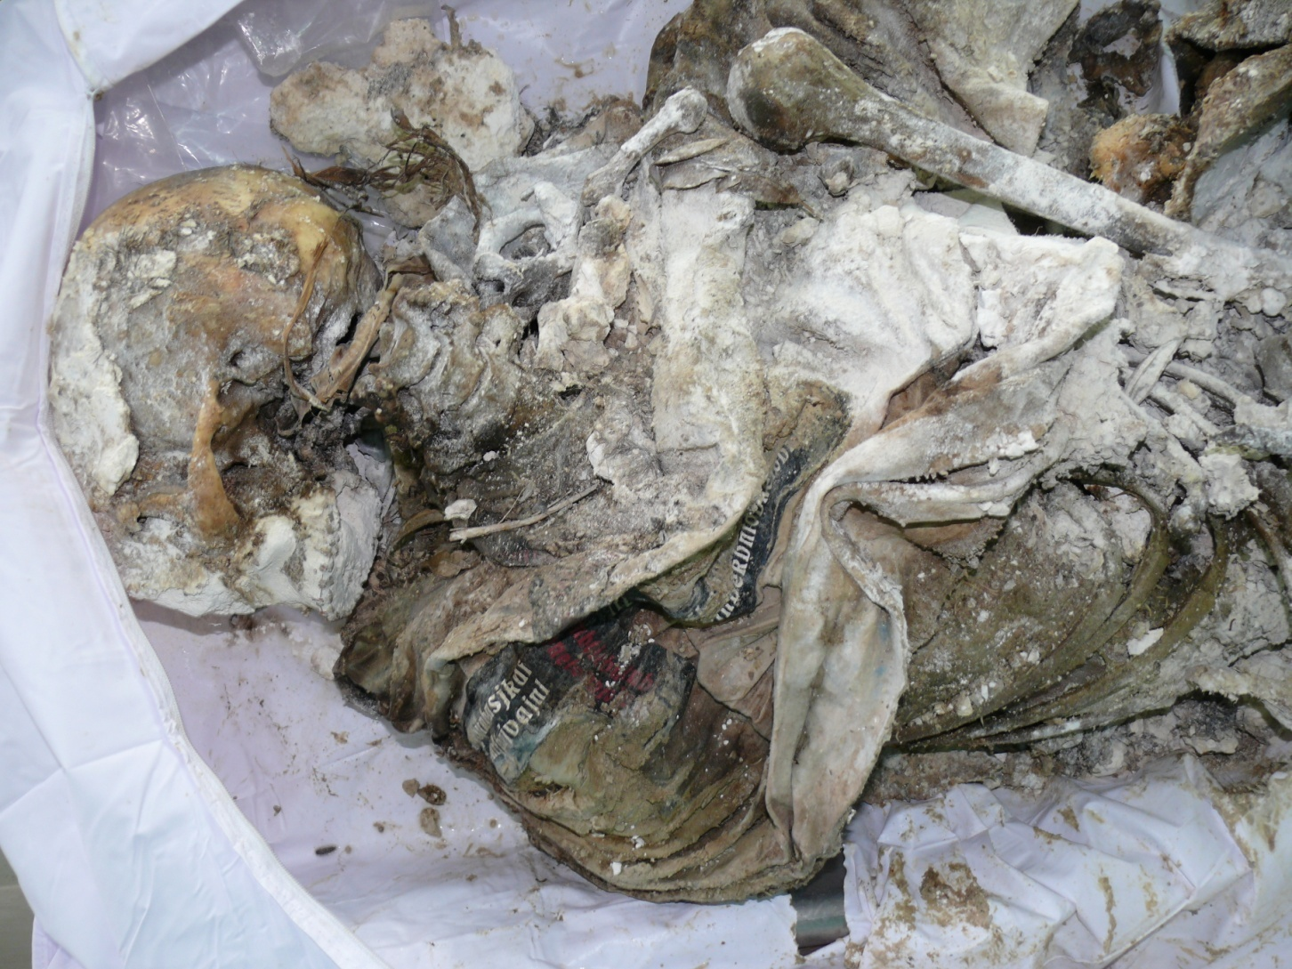
Case example 4

Slide 22
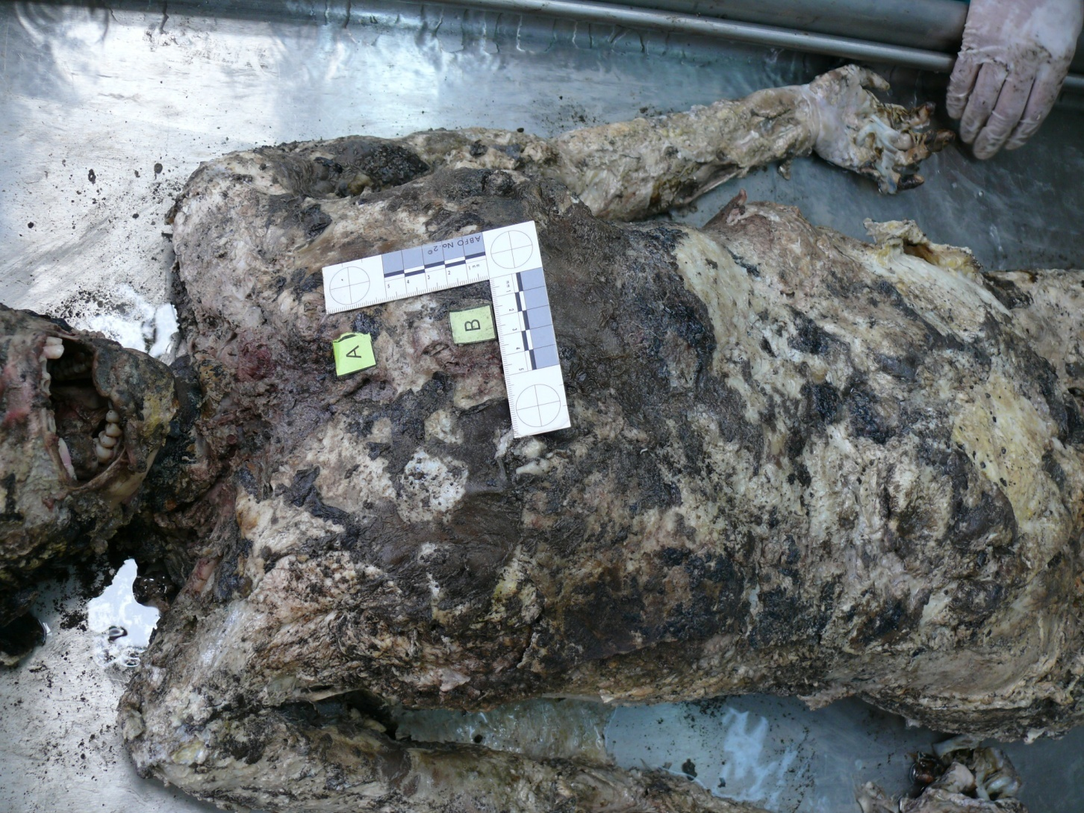
Case example 5

Slide 23
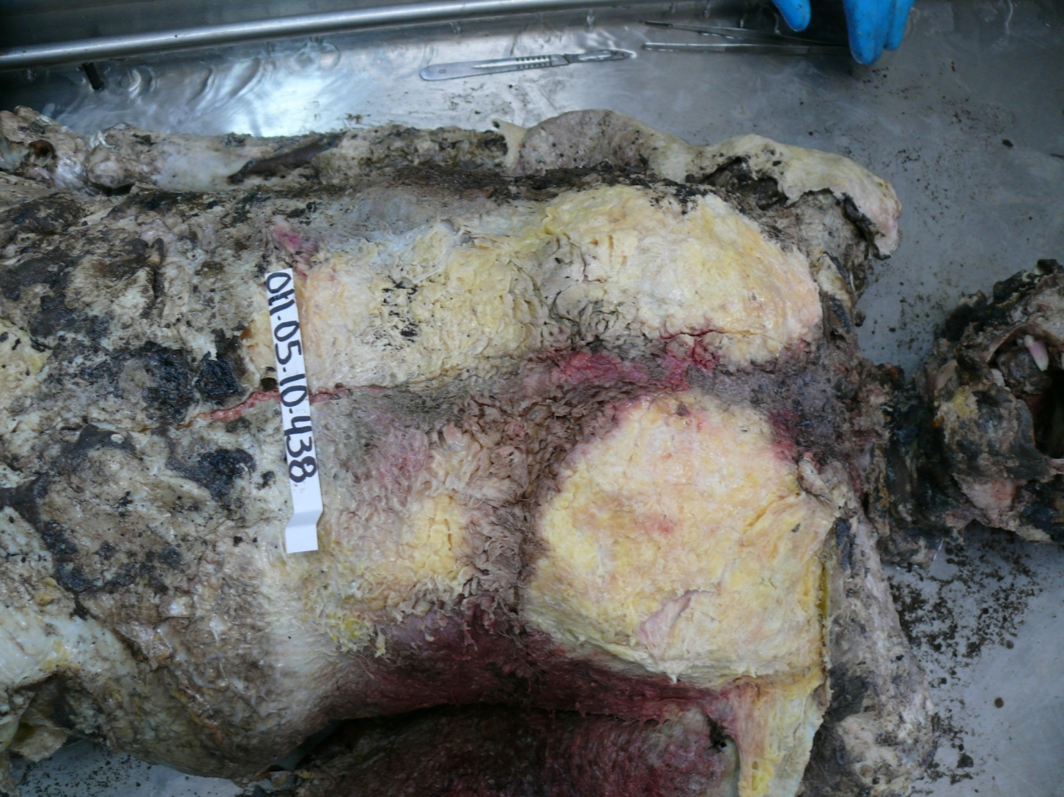
Case example 5

Slide 24
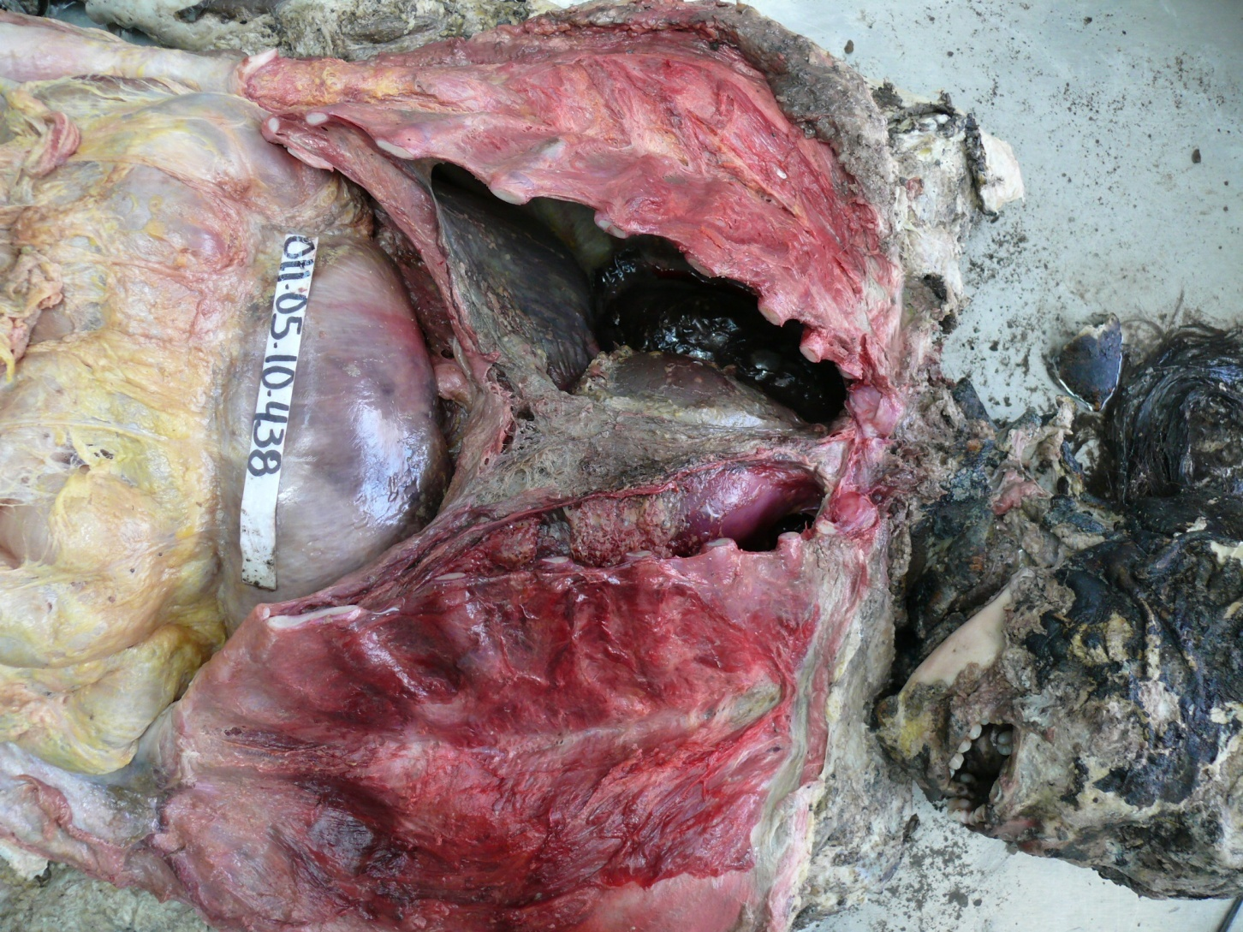
Case example 5

Slide 25
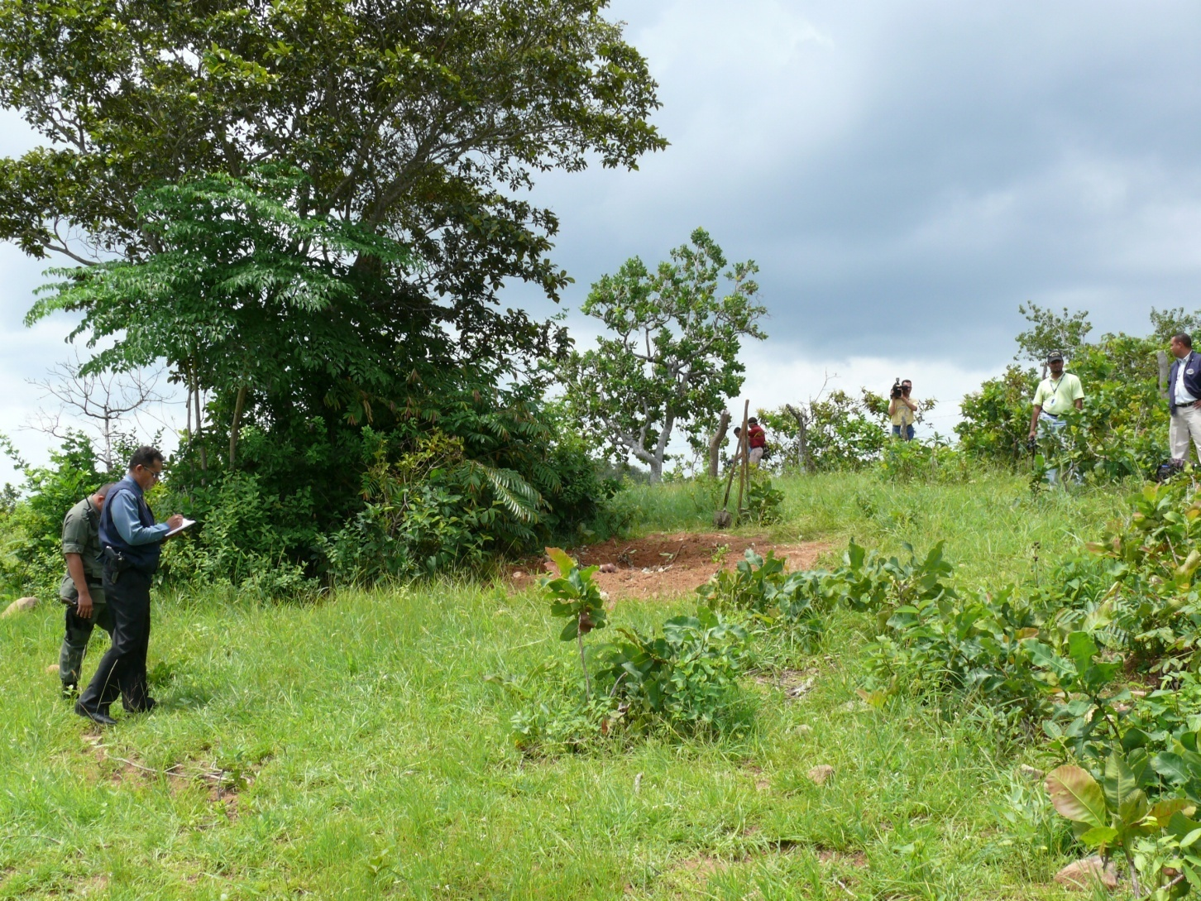
Case example 6

Slide 26
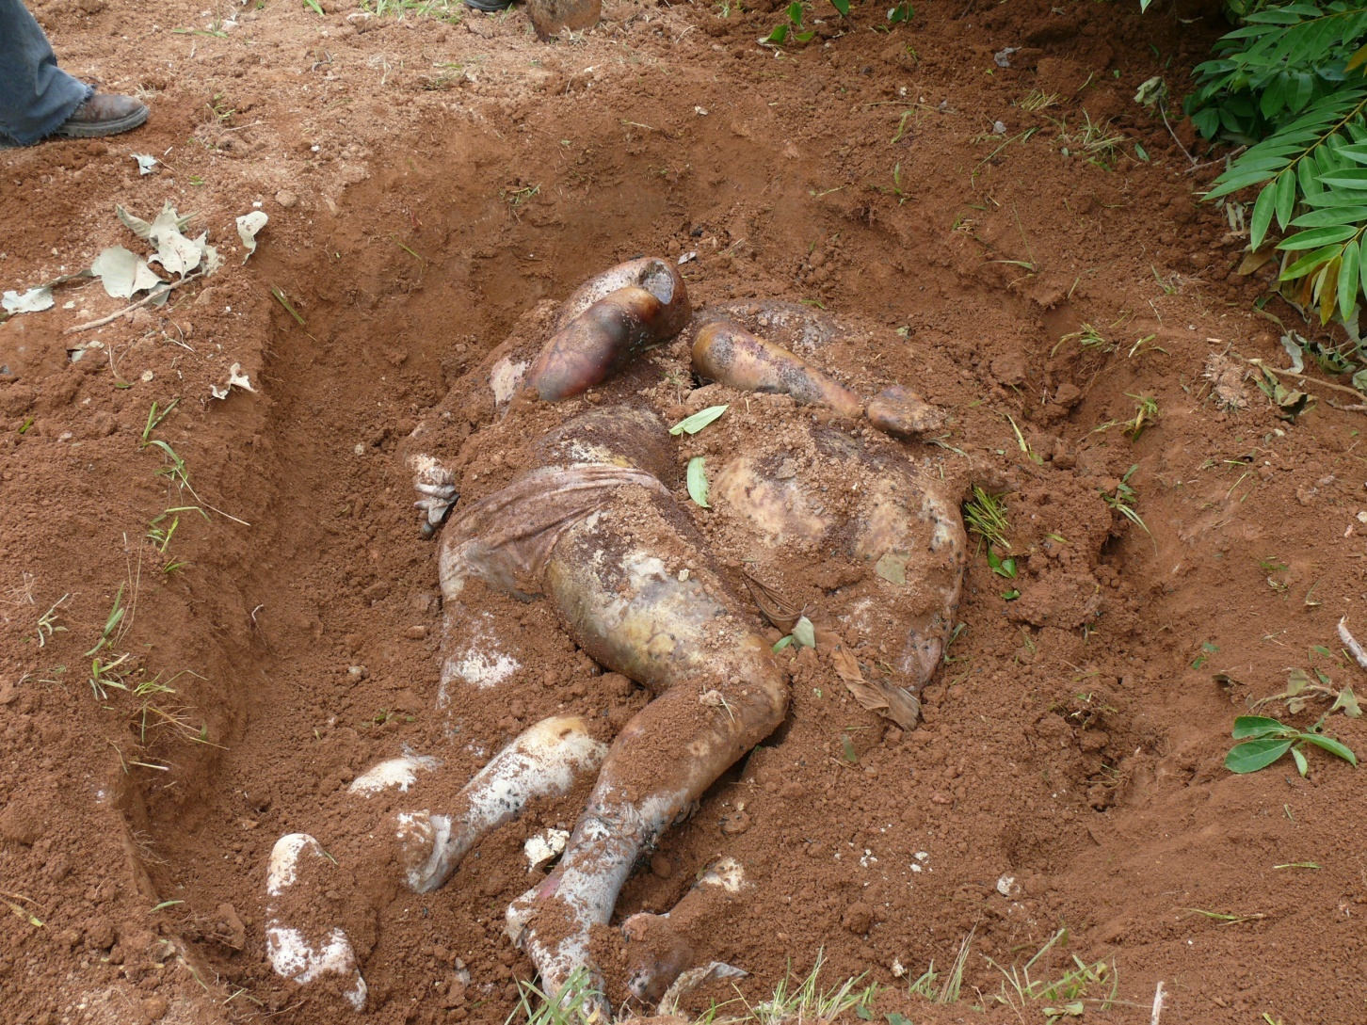
Case example 6

Slide 27
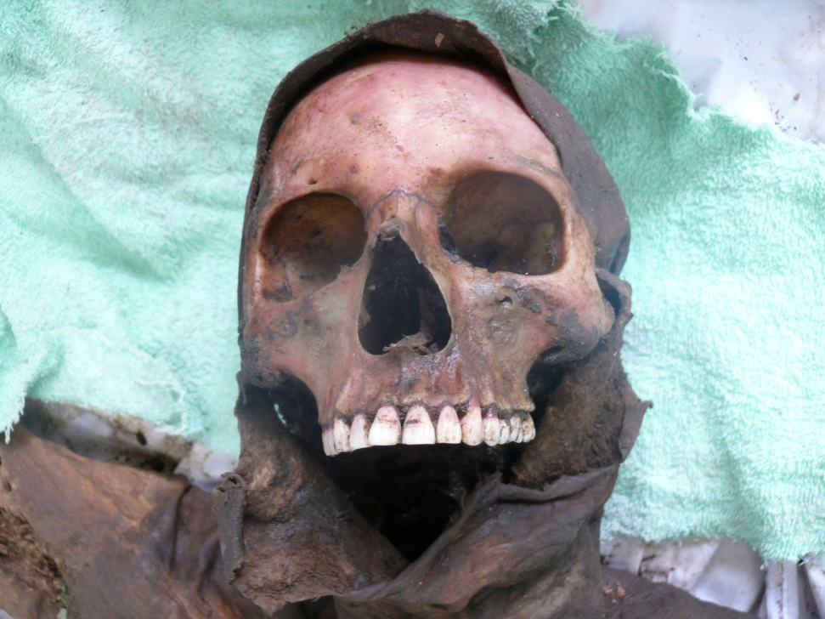
POST MORTEM CHANGES
Partial spontaneous momification
Total skeletal reduction in less than 2 months

Slide 28
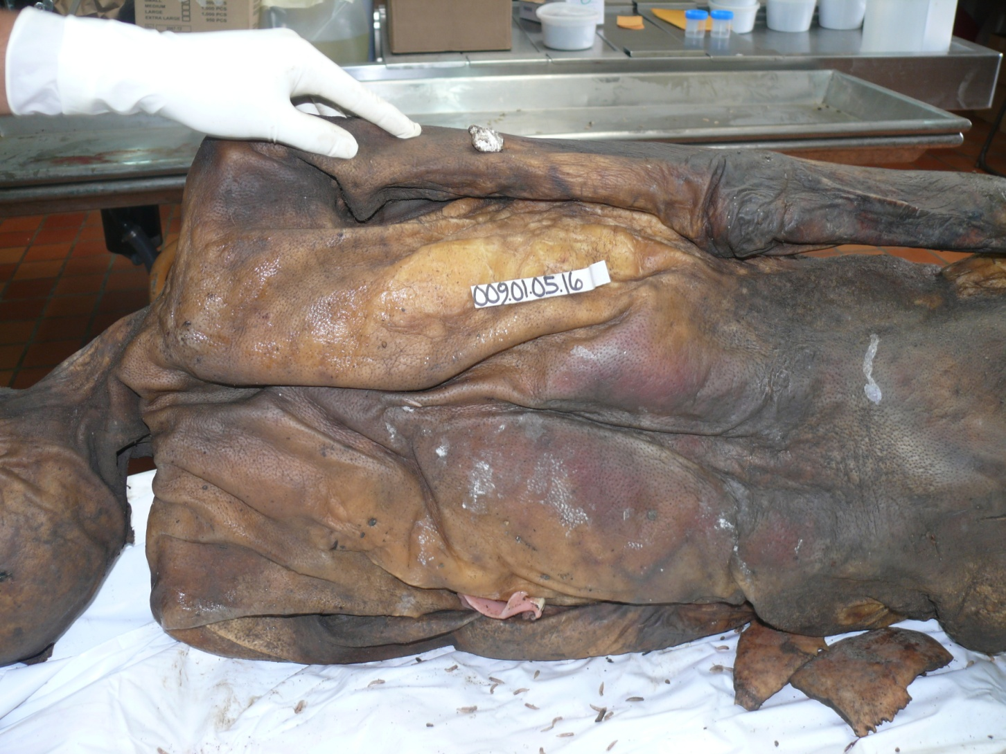
Spontaneous mummification

Slide 29
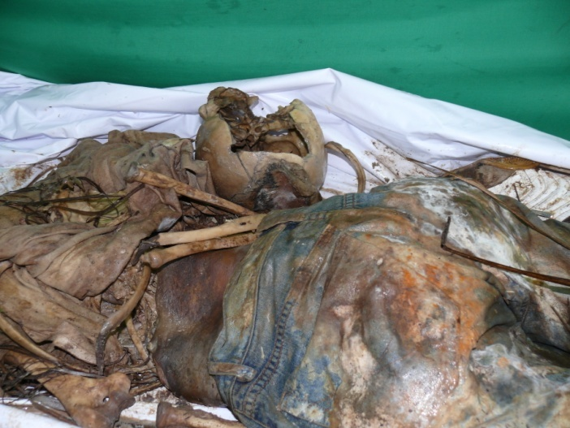
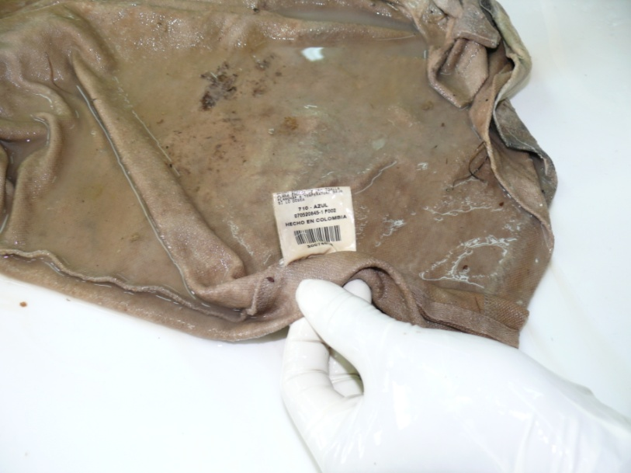
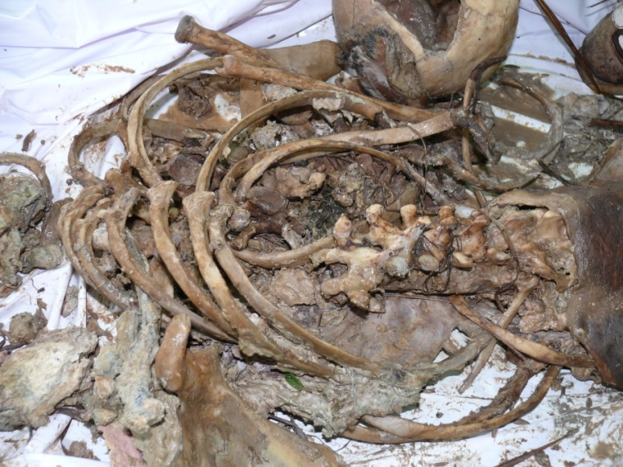
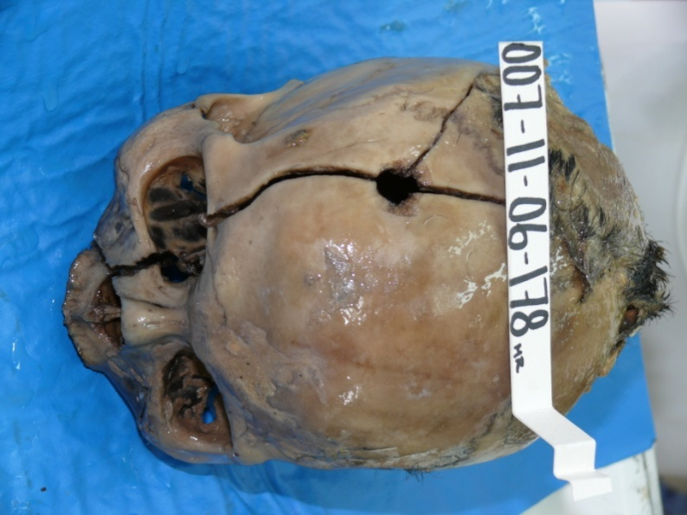
Complete skeletal reduction

Slide 30
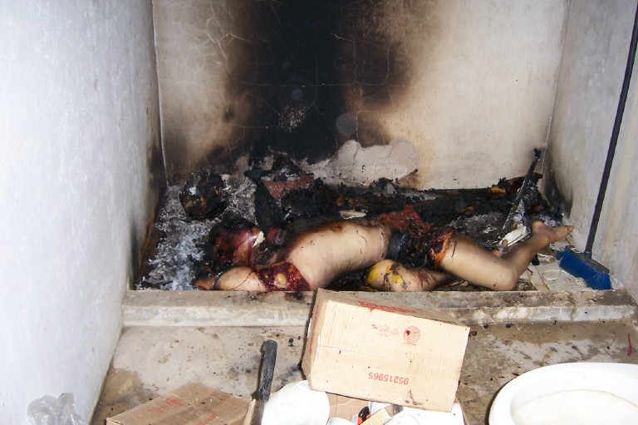
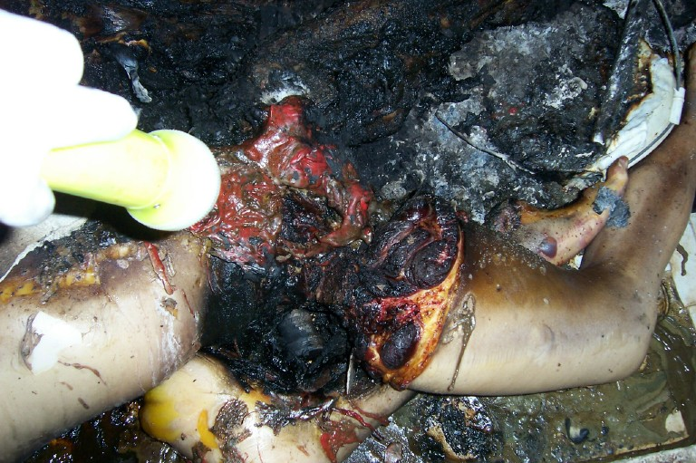
Postmortem mutilation

Slide 31
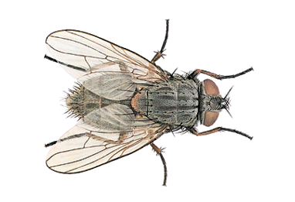
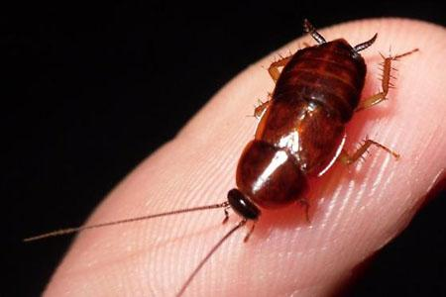
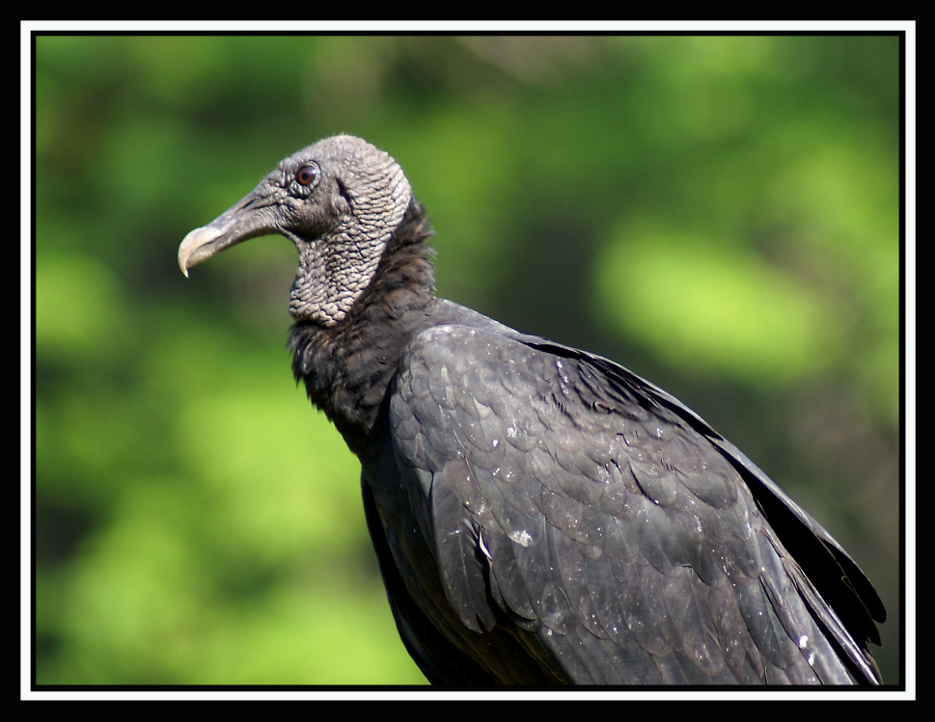
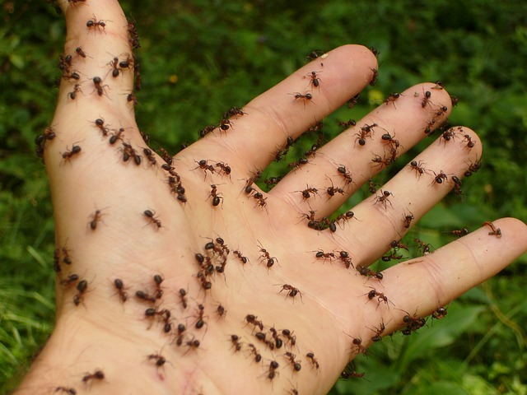
Animal activity

Slide 32
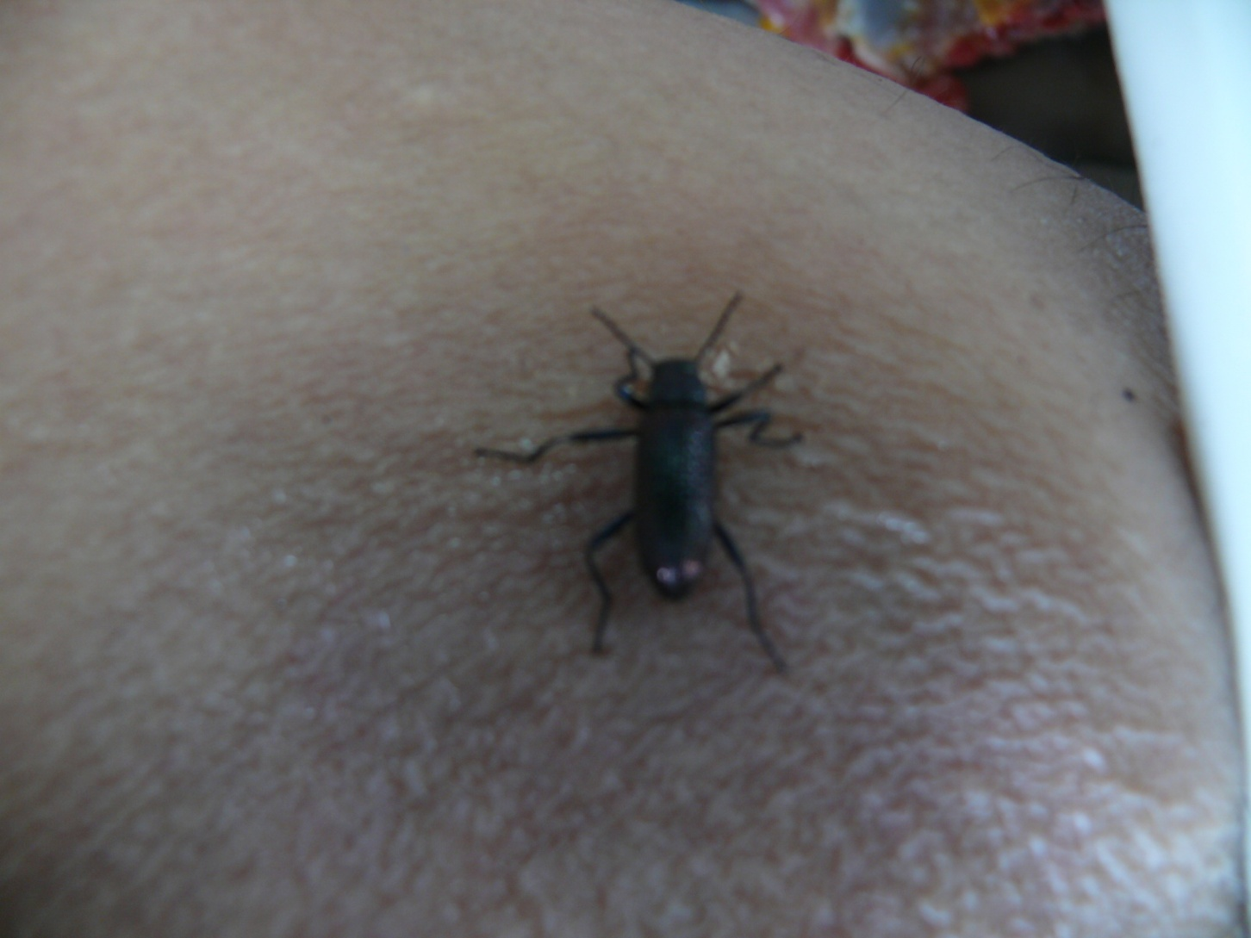
Tropical animal activity

Slide 33
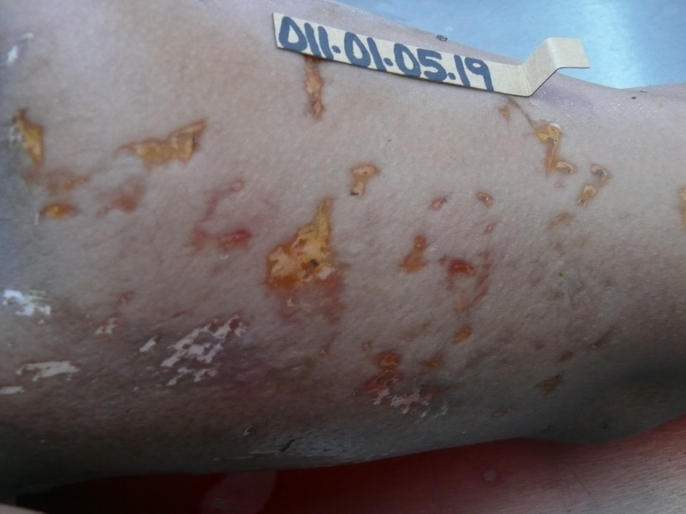
Example 1

Slide 34
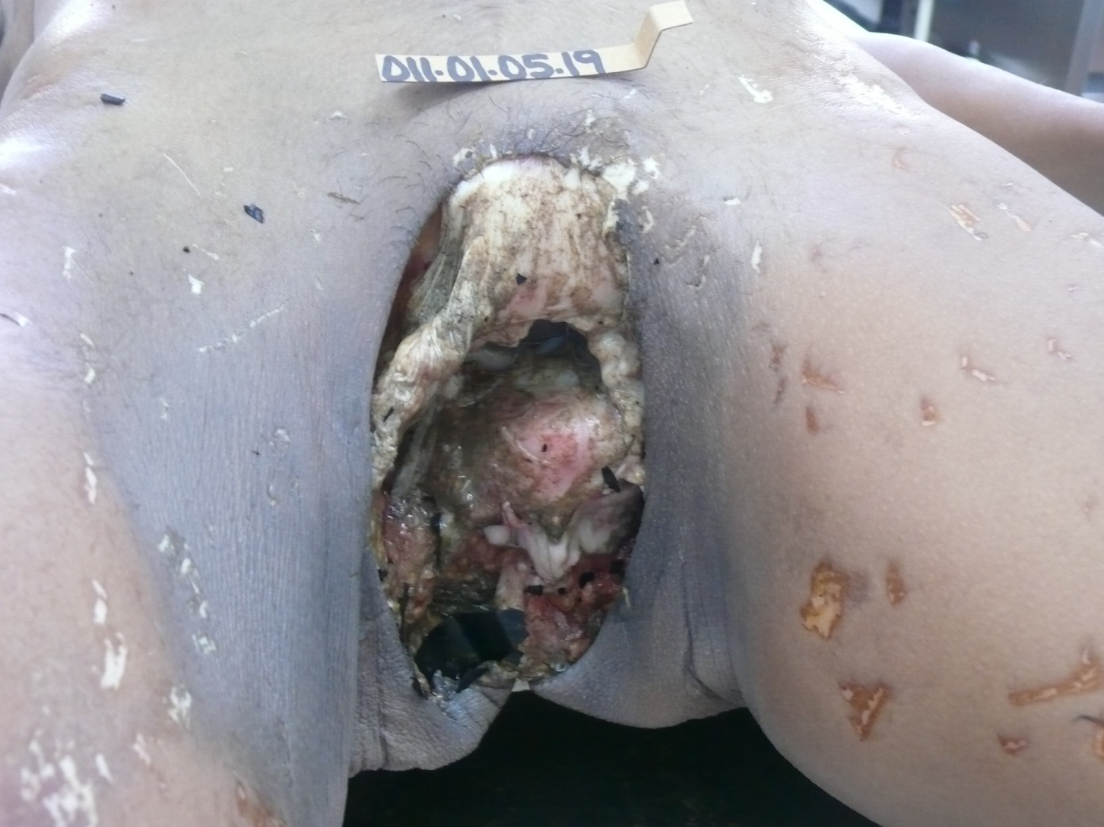
Example 2

Slide 35
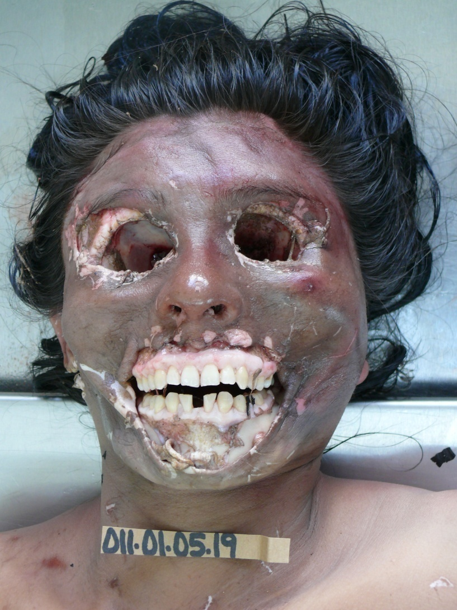
Example 3

Slide 36
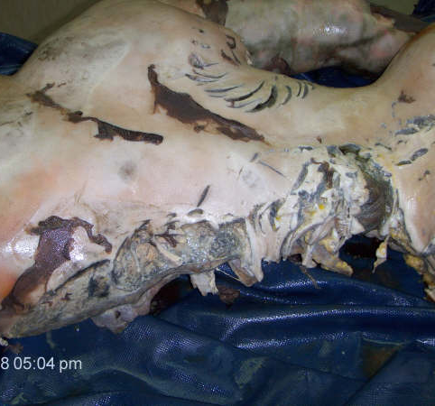
Example 4

Slide 37
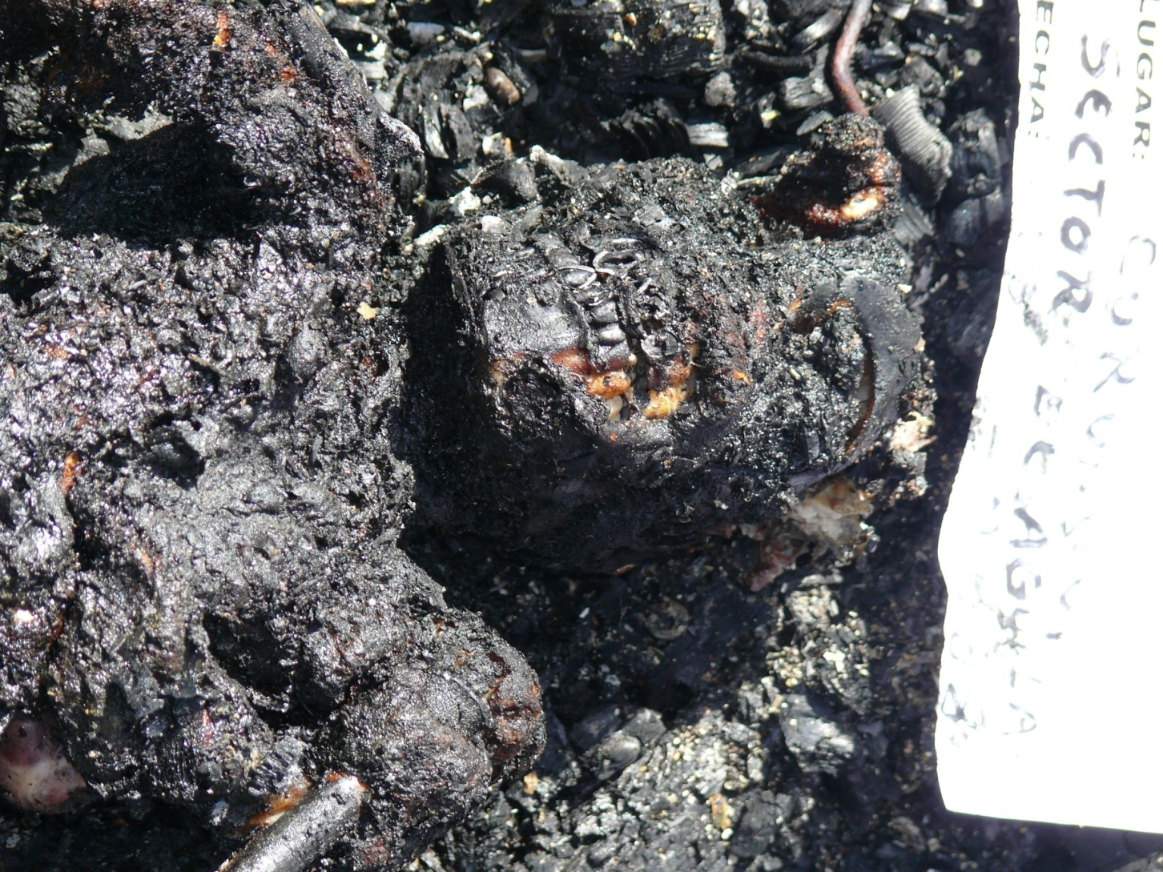
Charried bodies

Slide 38
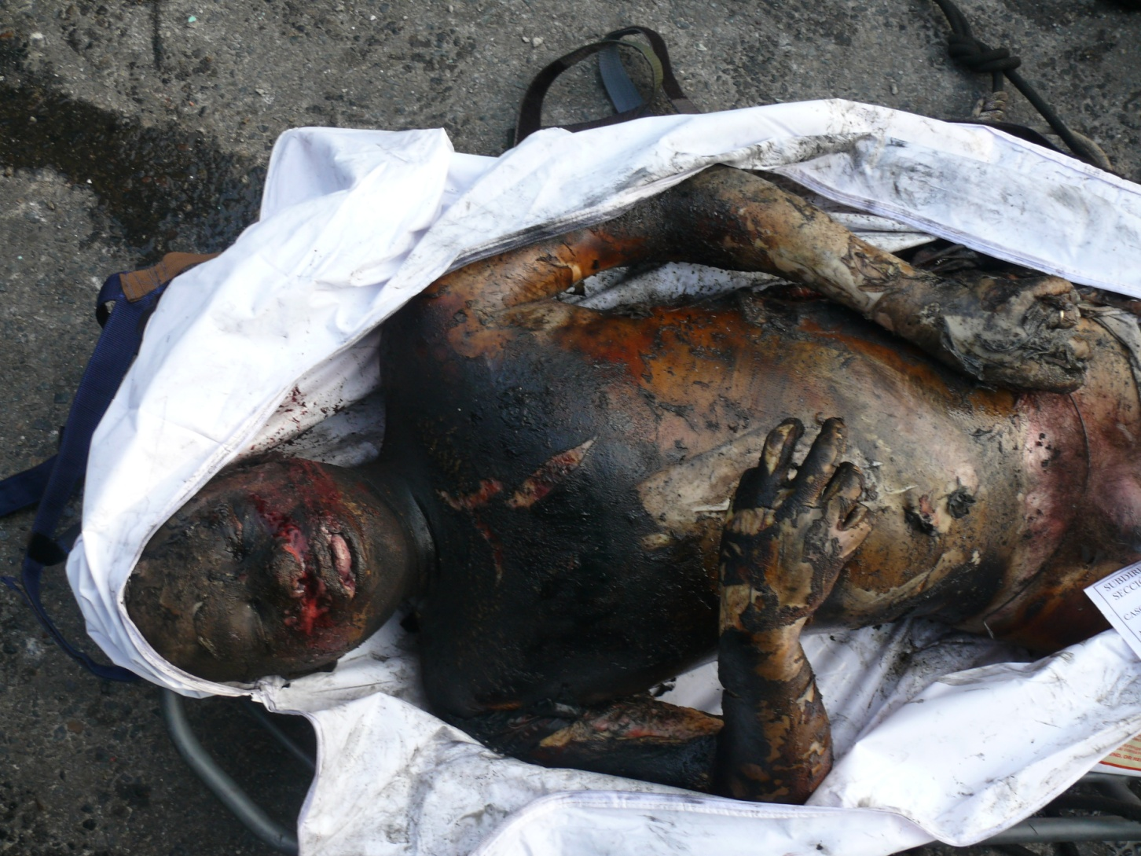
Charried bodies

Slide 39
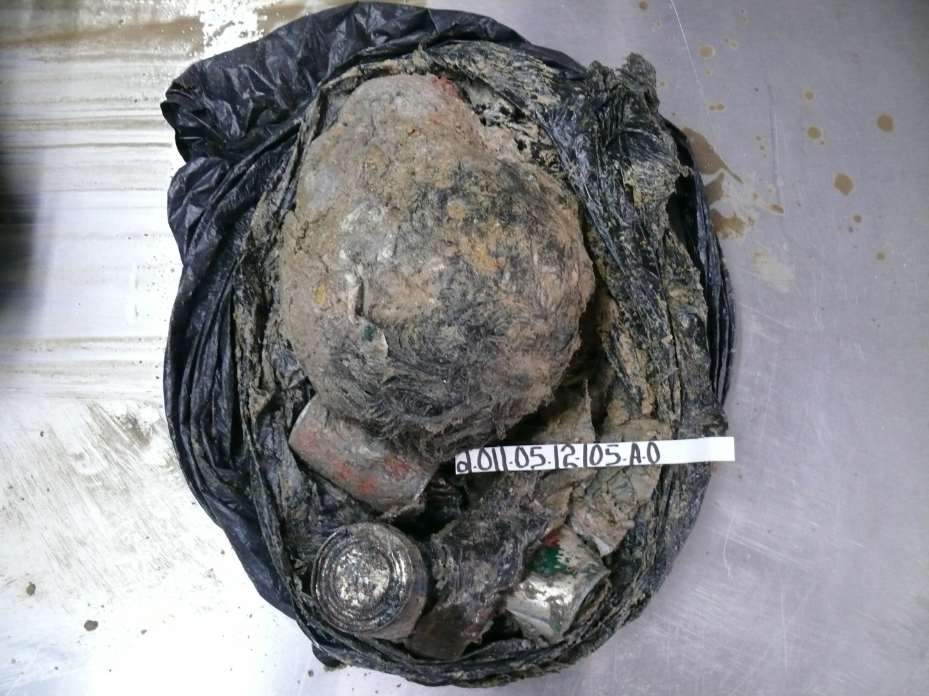
Mutilated bodies

Slide 40
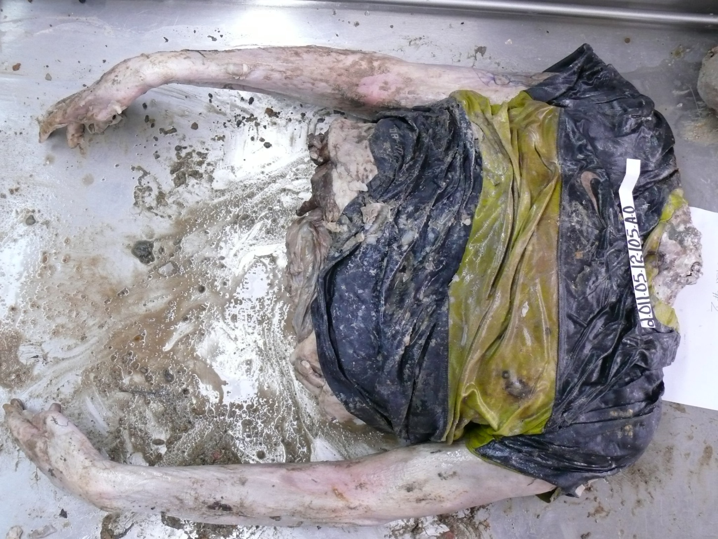
Mutilated bodies

Slide 41
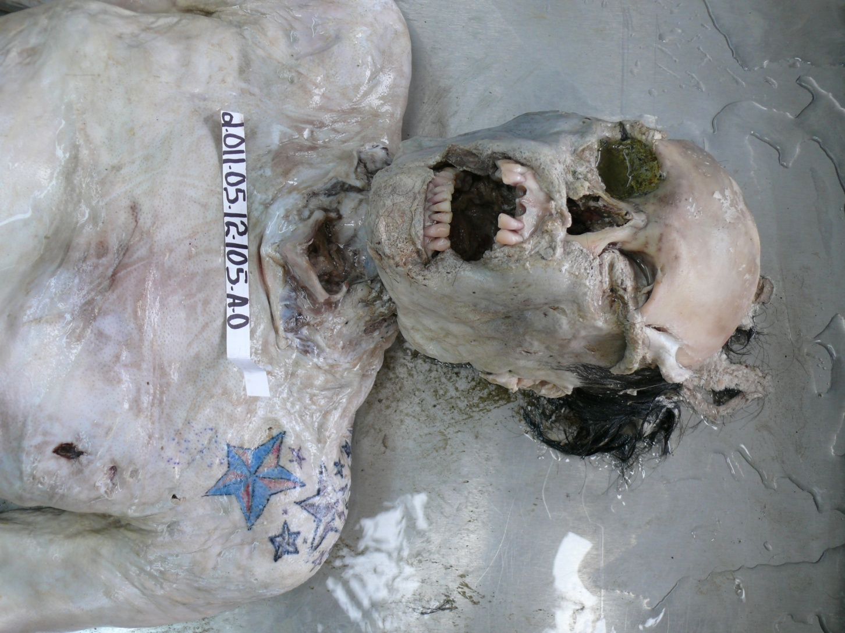
Mutilated bodies

Slide 42
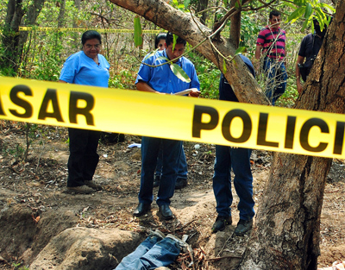

Slide 43
Research proyect
The American forensic anthropologist Arpad Vass proposes the use of universal formulas for estimating the time of death in decomposed human bodies.
His proposal summarizes 20 years of studies in the "farm bodies" Research Center of Anthropology, University of Tennessee, United States.
Vass recommends the application of these formulas in different conditions to its geographical environment.

Slide 44
Research proyect
Information from the inspection and removal of the corpse was analyzed, autopsies were performed and two universal formulas were applied to estimate the time of death in days: one for a body exposed outdoors (aerobic) and one for a body buried (anaerobic conditions).

Slide 45
Research proyect
For the objective evaluation of the degree of cadaverous decomposition amendment proposed by the author, the combined ratio calculation soft tissues and viscera Aufderheide was applied.
This index measures, in percentages, the degree of deterioration of bone, soft tissue and viscera of the body.
The average values ​​of temperature and humidity used were published in the Bulletin Hydrometeorological ETESA Panama.

Slide 46
Results
CASE 1: Unknown Elder found in an advanced state of putrefaction. Last seen 8 days ago.
In aerobic conditions:
    1285 x (decomposition/100) 1285 x 0.75
    __________________________ ________________ 32.48 days
    0.0103 x temperature x humidity 0.0103 x 32 x 90
    In anaerobic conditions:
    CASE 2: Female 28 years old, killed and buried in moist clay soil within one meter deep 6 days before the discovery
    1285 x 0.75 x 4.6 x 1 4.433.25
    __________________ ____________ 134.5 days
    0.0103 x 32 x 100 32

Slide 47
Research proyect conclusion
As they are structured, the formulas proposed by Vass not applied in tropical environments with high temperature and humidity, as in the case of Panama. To be applicable in our environment modifications should consider factors specific to our geographic area, to develop research project at the Institute of Legal Medicine and Forensic Sciences.

Slide 48



Slide 49
REFERENCES
1. Vass Arpad A. The elusive universal post-mortem interval formula. For Sci Int 2011 (204): 34-40.
2. Aufderheide AC. The Scientific Study of Mummies. Cambridge University Press, Cambridge UK, 2003.
3. Panamá. Contraloría General de la República. Recuperado el 04-04-2013 de: http://www.contraloria.gob.pa
4. Dolinack, D., Matshes, E. & Lew, E. (2005). Postmortem Changes. In “Forensic Pathology”. USA: Elsevier.
5. Luna, A. (2010). La data de la muerte, un desafío no resuelto. Rev Esp Med Legal, 36(2), 47-48
6. Saukko, P. & Knigth, B. Knigth’s Forensic Pathology. (3º ed). London: Oxford University Press, 20
7. Byard, R.W., Farrell, E. & Simpson, E. (2008). Diagnostic yield and characteristic features in a series
of decomposed bodies subject to coronial autopsy. Forensic Science, Medicine, and Pathology, 4, 1, 9-14
8. Pachar, J.V. (2012). Tanatología Forense. Panamá, ARTICSA.
9. Garamendi, et al. (2008). Lesiones post mortales por fauna cadavérica. La acción de las hormigas
sobre el cadáver. Cuad Med Forense, 14(52), 155-159
10. Byard, R.W., James, R.A. & Gilbert, J.D. (2002). Diagnostic problems associated with cadaveric trauma
from animal activity. Am J Forensic Med Pathol. 23(3), 238-244.
11. Harding, B.E. & Wolf, B.C. (2006). Alligator attacks in southwest Florida. J Forensic Sci 51, 674-677
12. Mendieta, C. y Duarte, A. (2009). Ataque por animales acuáticos (tiburón y cocodrilo). A propósito de
dos casos fatales en la provincia de Bocas del Toro (Panamá). Cuad Med Forense, 15(58), 309-315.
13. Powers, R..H. (2005). The decomposition of Human Remains. In Forensic Medicine of the lower
Extremity. Ed Rich J., Dean D.E., Powers R.H.. New Jersey, USA: Human Press.
14. scan, M.Y. & McCabe, B.Q. (2000). Animal Effects on Human Remains. In: “Encyclopedia of Forensic
Sciences”. USA: Elsevier.
15. Di Maio, J.M. & Dana, S.E. (2007). Time of Death – Decomposition. In “Handbook of Forensic Pathology”.
USA: CRC.
16. Perper, J.A. (1993). Time of Death and Changes After Death. Anatomical Considerations. In “Medico
Legal Investigation of Death”. (3º ed). Springfield, USA: Spitz.

Slide 50
REFERENCES
17- Basile, A. y Waisman, D. (1989). Agonología Tanatología en “Fundamentos de Medicina Legal”. Buenos
Aires, Argentina: El Ateneo.
18. Quai, I., Terbancea, M. y Margineanu, V. (1978). Tanatología Médico Legala. In “Introducere in Teoria
si Practica Medico – Legala”, Rumania: Dacia Cluj Napoca,.
19. Carrera, R. (2009). Medicina Legal. Perú: AFA.
20. Grandini, J. (2004). Tanatología en “Medicina Forense”. México: McGraw-Hill Interamericana.
21. Griest, K.J. (2010). Timing of Death and Injuries in Infants and Young Children. In “Pediatric Homicide
medical Investigation”Griest KJ. USA, CRC.
22. Calabuig, J.A. (2004). Fenómenos cadavéricos. En “Medicina Legal y Toxicología”. (6º ed.)
España: Masson.
23. Shkrum, M.J. y Ramsay, D.A. (2008). Postmortem Changes. The “Great Pretenders”. In “Forensic
Pathology of Trauma: Common Problems for the Pathologist”. USA: Humana Press.
24. Shepherd, R. (2003). Changes after Death. In “Simpsom s Forensic Medicine”. (12º ed). London: Arnold Pub
25. Dix, J. & Graham, M. (2000). Time of Death, Decomposition and Identification. USA: CRC.
26. Pounder, D.J. (2000). Postmortem Interval. In “Encyclopedia of Forensic Sciences”, USA: Elsevier
27. Gunn, A. y Ch, L. (2009). The decay, discovery and recovery of human bodies. In “Essential Forensic
Biology” (2º ed). USA: Wiley.
28. Prokop, O., Reimann, W. y Hinderer, H. (1987). Signos de muerte y fenómenos cadavéricos.
En “Vademecum de Medicina Legal”, Cuba: Científico Técnica.
29. Vargas, E. (1996). Cadáver. En “Medicina Legal”. México: Trillas.
30. Quiroz, A. (1986). Tanatología Forense. En “Medicina Forense”. (5º ed). México: Porrúa.
31. Patitó, J.A. (2000). Tanatología. En “Medicina Legal”. Buenos Aires, Argentina: Centro Norte.
32. Chawla, H., Lal, B. & Paliwal, P.K.(2011, Abril-June). Meticulous Examination of Body Pays. J Indian
Acad Forensic Med., 33, 2.
33. LeMoyne, S. (1991). Estimación de la época de la muerte. En “Investigación de Hoomicidios”.
México: Limusa.
34. Raffo, H. O. (1993). Examen del lugar del hecho. En “La Muerte Violenta”. Buenos Aires,
Argentina: Universidad.

Slide 51

Muchas gracias

Slide 52
Let Us Meet Again
We welcome you all to our future conferences of OMICS Group International
Please Visit:
www.omicsgroup.com
www.conferenceseries.com

