Slide 1


Bimetallic Nanostars (Ag@Au) with High Surface Enhanced Raman Scattering (SERS) Performance: Detection of β-Amyloid and Its Marker Thioflavin T
García-Leis, A.
García-Ramos, J.V.
Sánchez-Cortés, S.
jvicente.g.ramos@csic.es
Instituto de Estructura de la Materia
Serrano 121, 28006. Madrid-Spain

Slide 2
Outline
Introduction
Fabrication and Characterization of SERS substrates
Nanostars
Synthesis
Characterization
Alzheimer Disease Markers
β-amyloid
Direct SERS Detection
Dyes (Congo Red and Thioflavin T)
SERS characterization
ThT - β-amyloid interaction
Indirect SERS Detection of β-amyloid
Tailoring the size and shape of Silver Nanostars
Ag@AuNS using AgNS as seeds
Conclusions

Slide 3
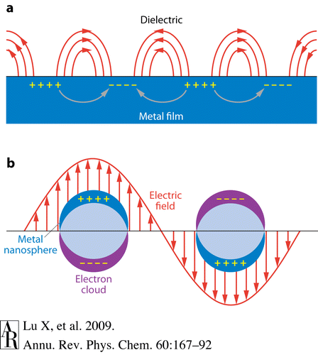
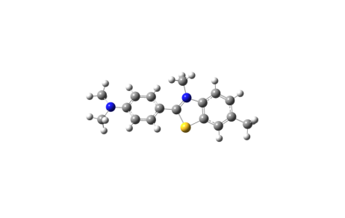
Surface Enhanced Raman Spectroscopy
Nanoparticle
Localized Surface Plasmon Resonance
Ag Au Cu
Twofold
Enhancement
Laser
Detector
Electromagnetic mechanism
ν₀
ν_{R}

Slide 4
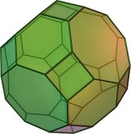
Metal nanostructures
Metal Electrodes
Ag
Ag+
Metal Films
Redox Cycles
Deposition: Evaporation, Laser photoreduction
-
Metal Colloids
-
-
-
-
-
-
-
-
-
-
-
-
-
-
-
-
-
-
-
-
-
-
-
-
-

Slide 5
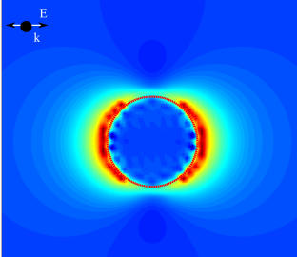
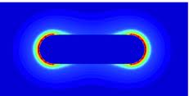
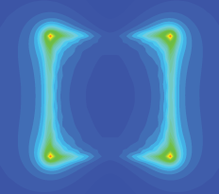
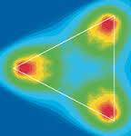
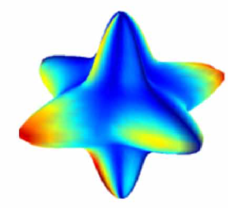
Colloids
Non reproducibility
Variation in signal/noise
Need external aggregation to detect low concentrations
SERS sensitive substrates with complex morphology
Enhanced Electromagnetic Field

Slide 6
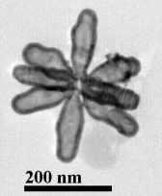
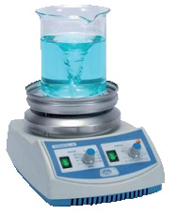
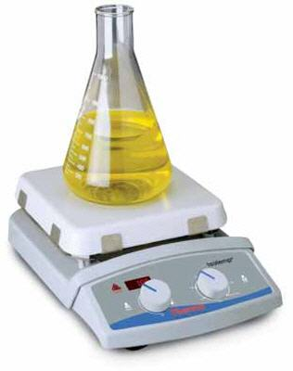
Nano-Stars and nano-spheres Fabrication
AgNO₃ or HAuCl₄* 3H₂O
Hydroxylamine
NEW!!!
Citrate
Borohydride
Hydrochloride Hydroxylamine
Nano-Stars
NS-Ag / NS-Ag@Au
Nanospheres
A. Garcia-Leis, J.V. Garcia-Ramos and S. Sanchez-Cortes. JPC C. (2013) DOI: 10.1021/jp401737y

Slide 7
Characterization of nanoparticles
50 nm
300 nm

Slide 8
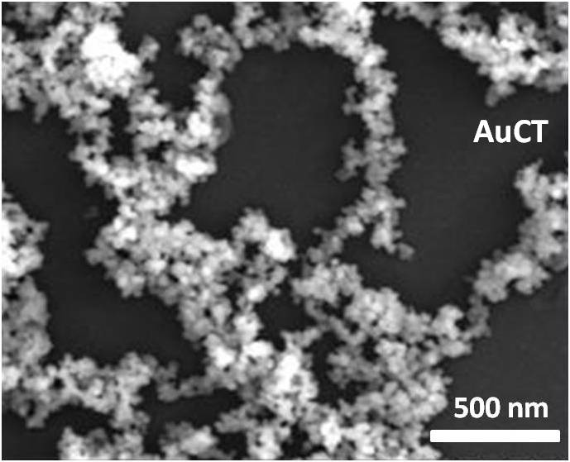
Nanospheres
AgCT
(SEM)
AuCT
(SEM)

Slide 9
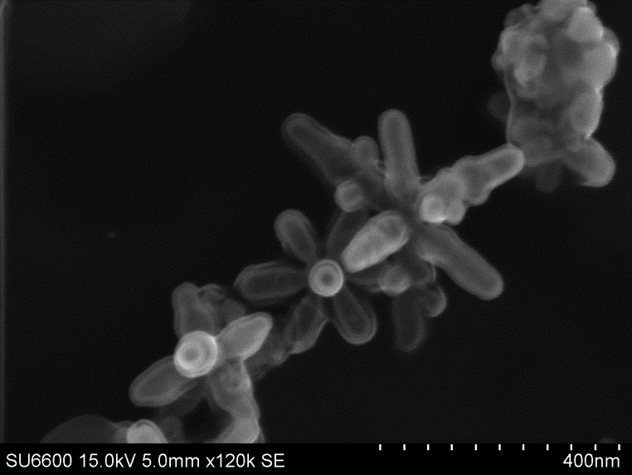
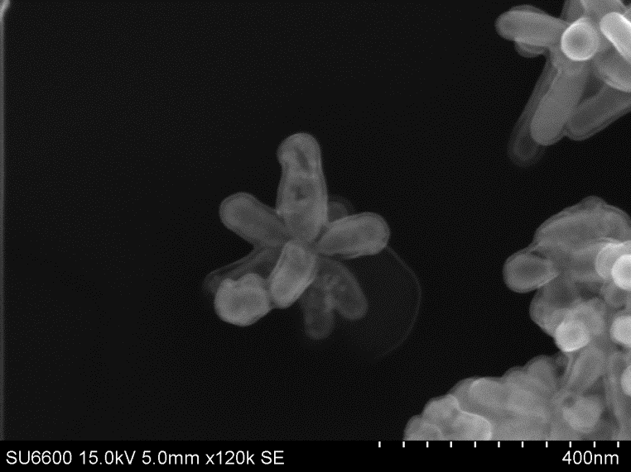
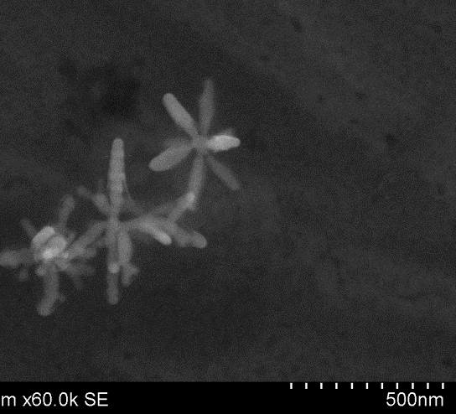
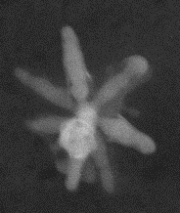
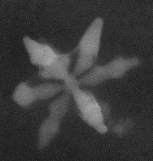
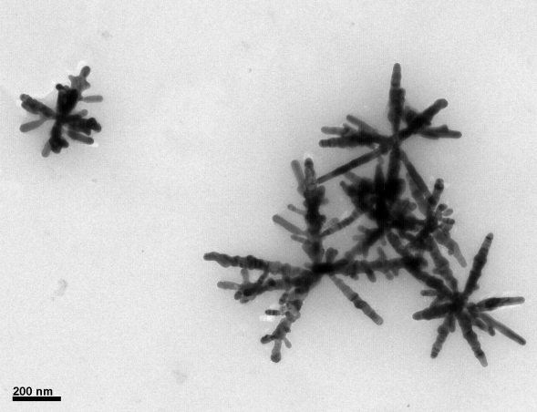
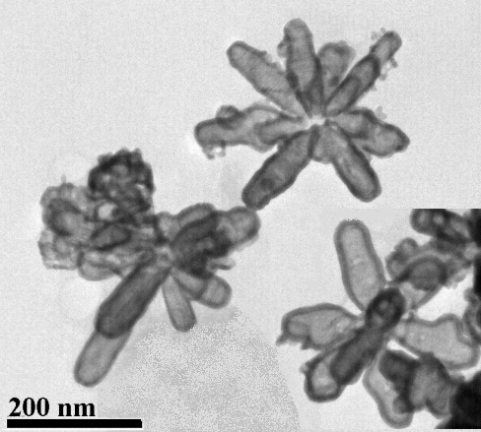
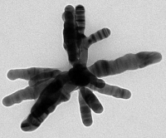
Nano-stars
(TEM and SEM characterization)
NS-Ag@Au
NS-Ag
SEM
SEM
TEM
TEM
200 nm

Slide 10
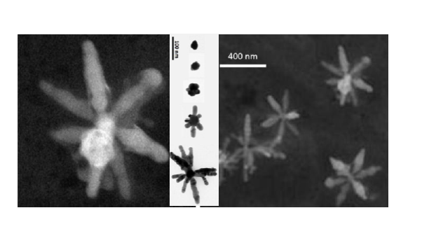
Nano-stars
(TEM and SEM characterization)
SERS active substrates without aggregation!!
A. Garcia-Leis, J.V. Garcia-Ramos and S. Sanchez-Cortes. JPC C. (2013) DOI: 10.1021/jp401737y

Slide 11
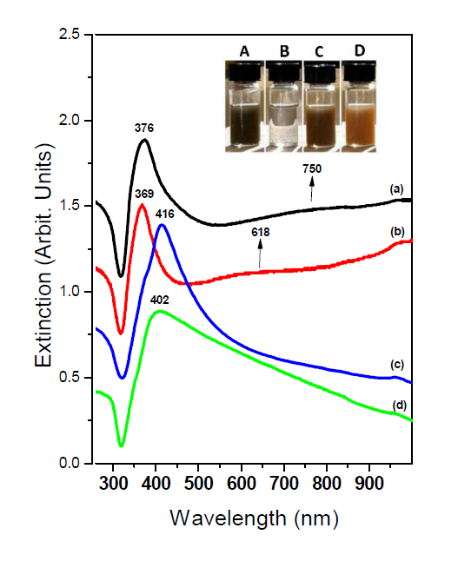
Nano-stars
(Plasmon characterization)
[Ag⁺]/[HA]/[citrate]
A: 2.17/ 7.0 / 1.0
B: 0.21/ 7.0 / 1.0
C: 2.17/ 3.6 / 1.0
D: 2.17/ 7.0 / 0.0
SERS active substrates without aggregation!!
A. Garcia-Leis, J.V. Garcia-Ramos and S. Sanchez-Cortes. JPC C. (2013) DOI: 10.1021/jp401737y

Slide 12
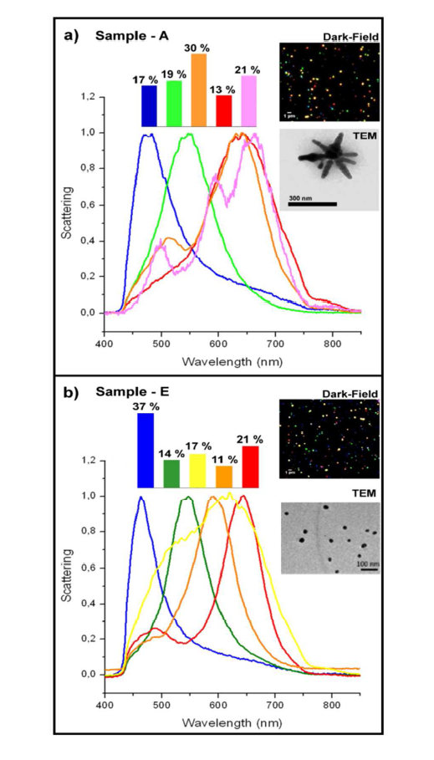
Nano-stars
(Dark-Field scattering)
Nano-stars
Nanospheres
A. Garcia-Leis, J.V. Garcia-Ramos and S. Sanchez-Cortes. JPC C. (2013) DOI: 10.1021/jp401737y

Slide 13
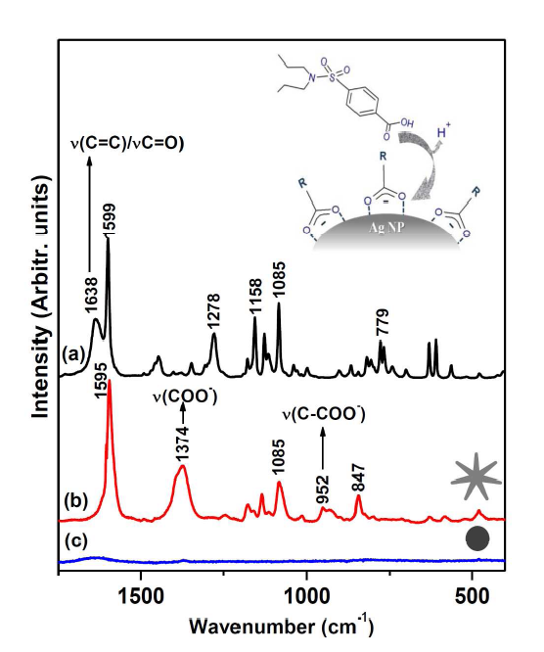
Nano-stars
SERS activity using probenecid (sulfamide) as probe molecule
Raman in solid state (λ_{exc}= 1064 nm)
}
SERS (λ_{exc}: 532 nm)
A. Garcia-Leis, J.V. Garcia-Ramos and S. Sanchez-Cortes. JPC C. (2013) DOI: 10.1021/jp401737y

Slide 14
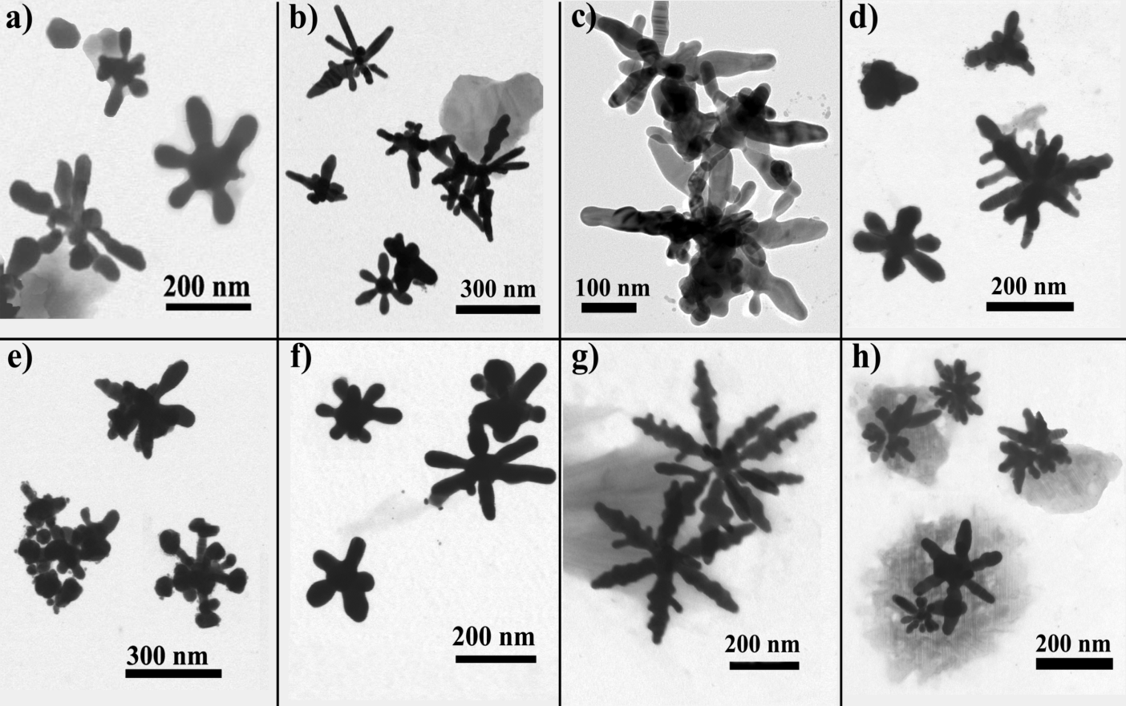
Tailoring the size and shape of Silver Nanostars

Slide 15
Preparation of a colloidal suspension of Silver Nano Stars
Chemical reduction of Ag⁺ in two steps:
Step 1: Reduction agent is a neutral Hydroxilamine solution
Step 2: After a time T1, a 1% citrate solution is added.
The great novelty of this method is the use of neutral HA and the no use of strong surfactant agents.
Experimental Conditions
24 different samples of AgNS
T1
5 min.
60 m0.11 mM
10 µL
30 min.
in.
[HA]
30.1 mM
60.2 mM
130 mM
[Ag+]
1.11 mM
V(CIT)
100 µL
[HA] = concentration of hydroxylamine solution
[Ag⁺] = concentration of silver nitrate solution
V(CIT) = added volume of 1% citrate solution
T1 = the waiting time before adding the CIT solution

Slide 16
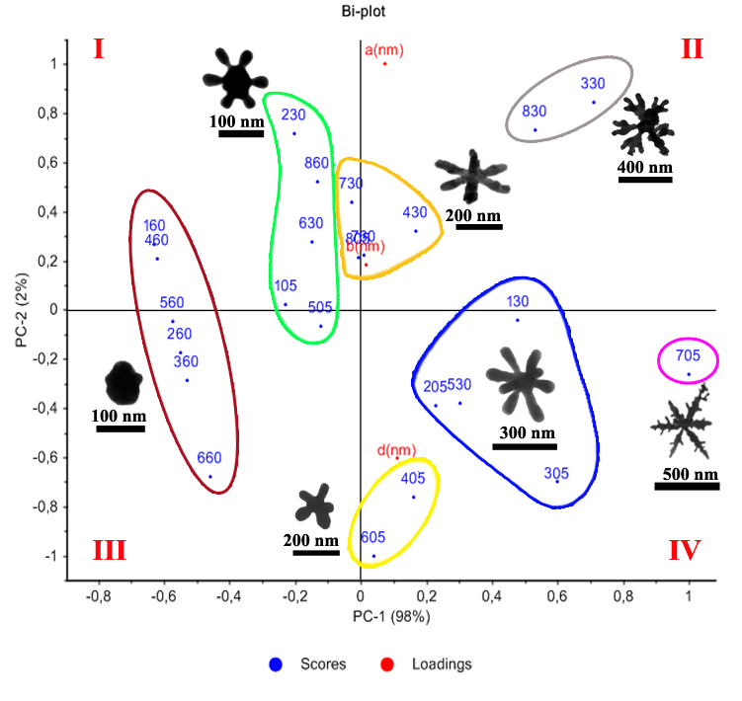
PCA graphic of scores and loadings of data obtained from morphological features of 24 AgNS samples.
PCA data can be classified in seven groups formed by samples with similar features depending of: size (bigger or smaller), type of arm (longer or shorter) and type of tip (spiky or rounded).

Slide 17
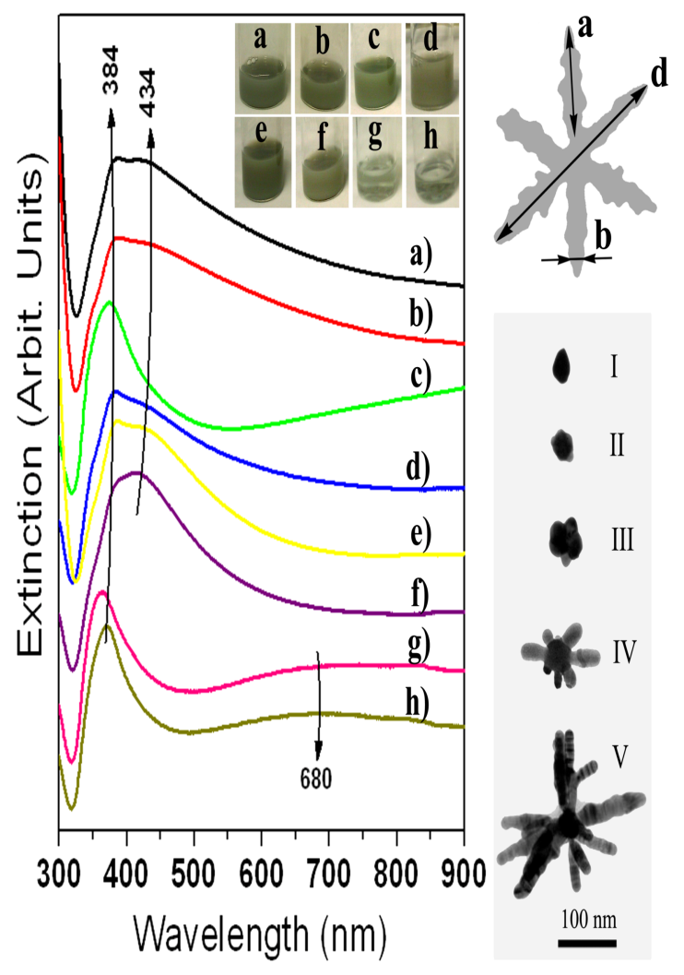
Extinction Spectra
A)
B)
Scheme of possible mechanism of growing nanoparticles based on TEM images.
C)

Slide 18
SERS Study
E.F. (x10⁵)
a) 3.10, b) 3.93, c) 11.6, d) 35.4, e) 3.52, f) 42.5, g) 12.1 and h) 15.8
SERS spectra of thiophenol at 1μM on different colloids samples of AgNS: a) 105, b) 205, c) 305, d) 405, e) 505, f) 605, g) 705, h) 805 and i) Raman spectra of pure thiophenol. Excitation 532 nm.

Slide 19
CONCLUSIONS: The reported fabrication method gives rise to silver star-shaped nanoparticles with good plasmonic properties to afford a large SERS intensification. The PCA study allowed the lump together of NPs by different groups, taking account the morphological parameters. The best Ag NS according to SERS EF are those bearing an intermediate size (200 nm) displaying a moderate number of arms.

Slide 20
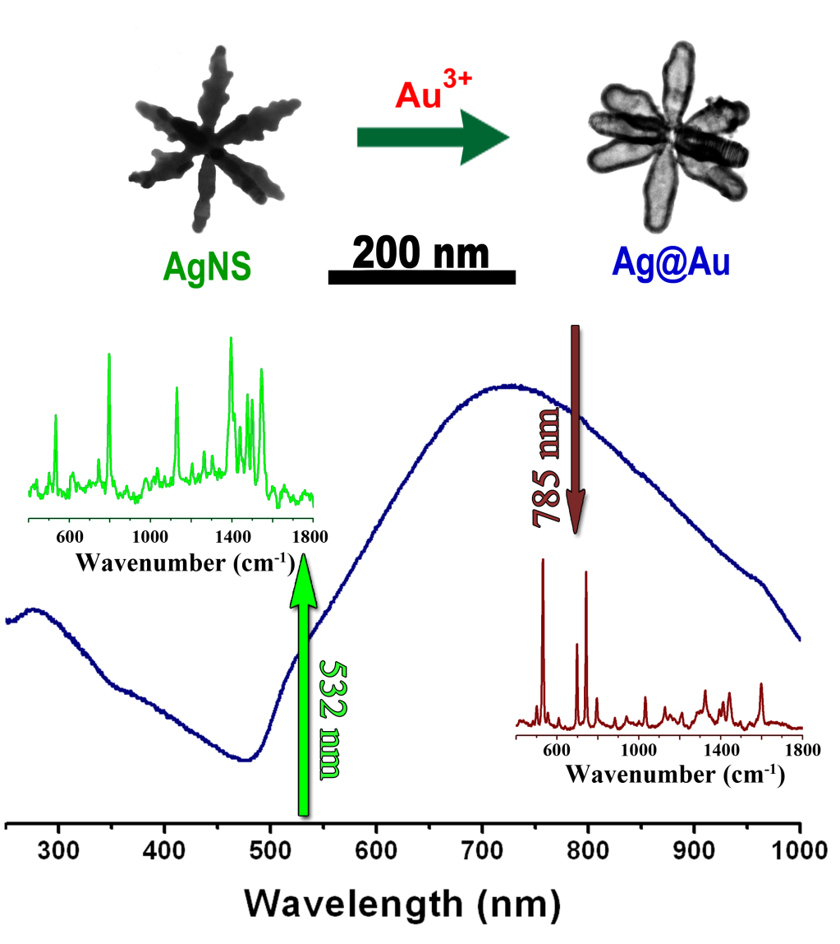
Final morphology of Ag@AuNS using AgNS as seeds
532 nm
(ThT resonant wavelength)
785 nm
(ThT non-resonant wavelength)

Slide 21
Concentrations of reagents employed for the preparation of samples A-E and final pH of colloids solutions.
[Reagent]/ mM | A | B | C | D | E
[AgNO₃] | 0.073 | 0.37 | 0.73 | 0 | 0
[HAuCl₄·3H₂O] | 0.27 | 0.27 | 0.27 | 0.4 | 0.2
[HA] | 3.0 | 3.0 | 3.0 | 3.0 | 0
[CIT] | 0.26 | 0.26 | 0.26 | 0.26 | 0.77
pH | 5.0 | 5.0 | 4.7 | 4.4 | 5.5

Slide 22
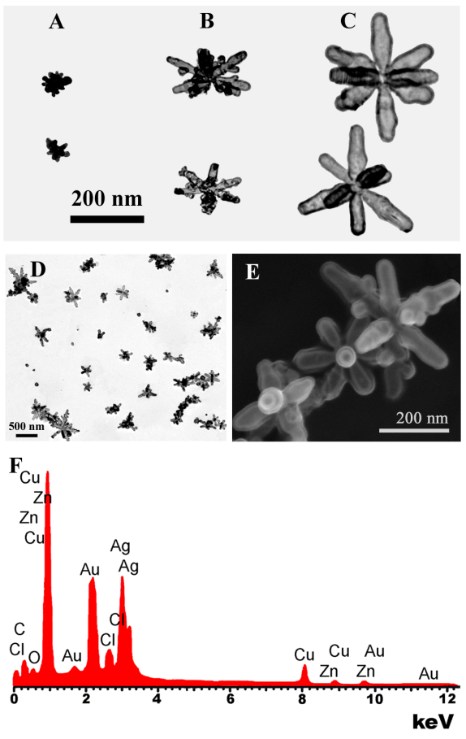
Micrograph of Ag@Au NS obtained by TEM of A (A), B (B), C (C) and (D) is a general view of sample C. (E) SEM micrograph of Sample C. (F) EDX spectra of Sample C.

Slide 23
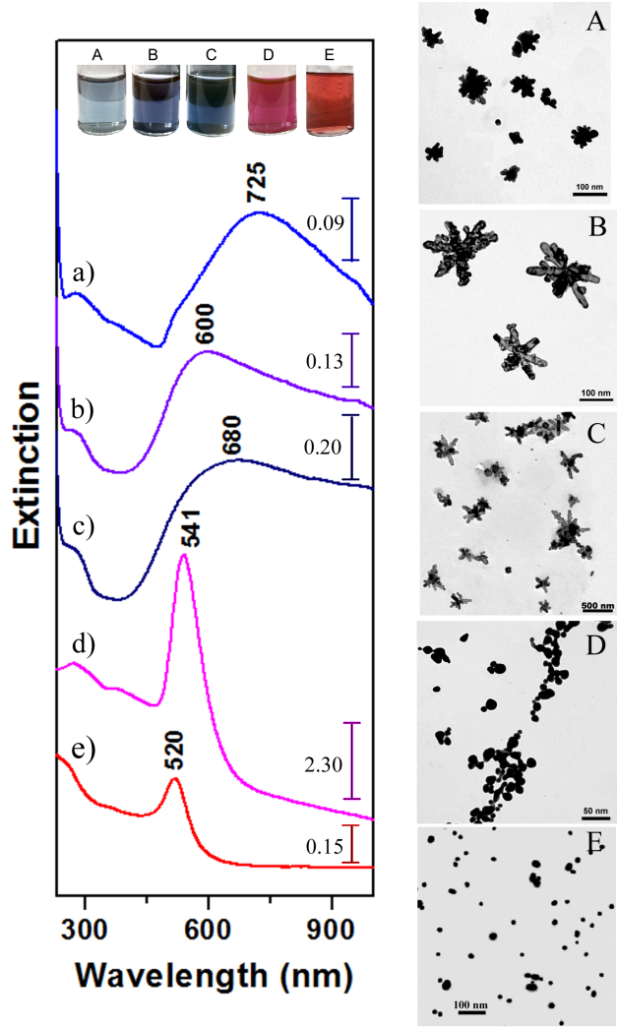
Extinction spectra (left) and TEM images (right) corresponding to the samples: A (a), B (b), C (c), D (d) and E (e).
Inset: Pictures of the colloids obtained by methods A, B, C, D and E.

Slide 24
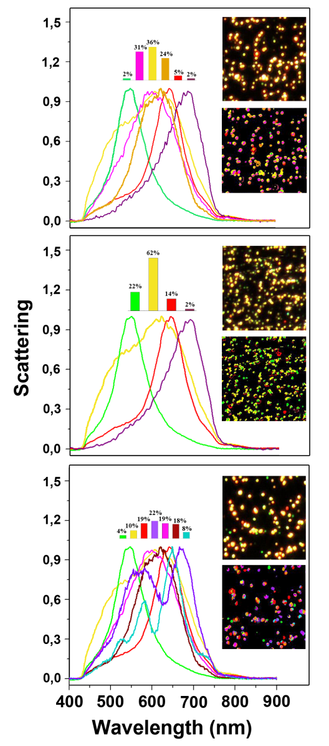
Dark-field (DF) hyperspectral image
Spectral angle mapper (SAM) image
Dark-field scattering spectra observed in samples:
A, C and D.

Slide 25
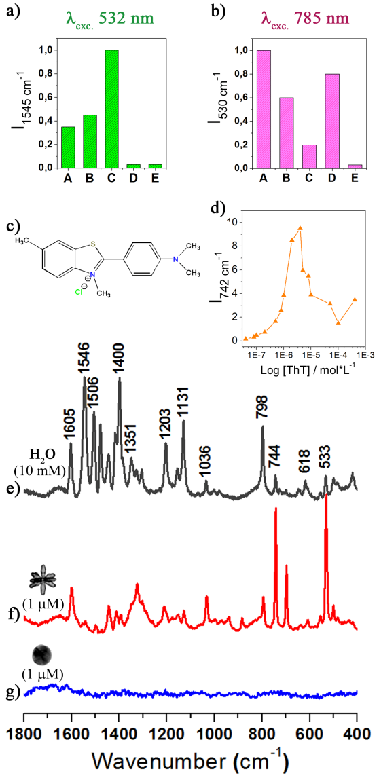
SERS enhancement dependence on the excitation wavelength and the substrate: 532 nm (a) and 785 nm (b). Chemical formula of ThT (c).
Adsorption isotherm of ThT on sample B (d). Raman spectrum of ThT 10 mM (e). SERS spectrum of ThT 1 μM on sample B (g) and sample E (g). Excitation 785 nm.

Slide 26
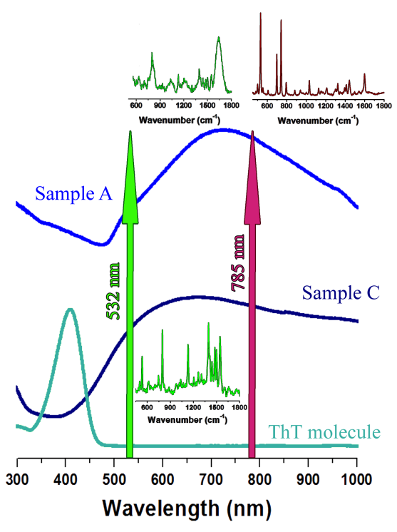
b)
a)
c)
f)
d)
e)
SERS spectra of ThT on Samples A and C exciting at 532nm (b and d, respectively) and 785nm on Sample A (a).
The extinction spectra of samples A (c) and C (e) and the absorption spectrum of ThT (0.1 M) in water (f) is also shown for comparison.

Slide 27
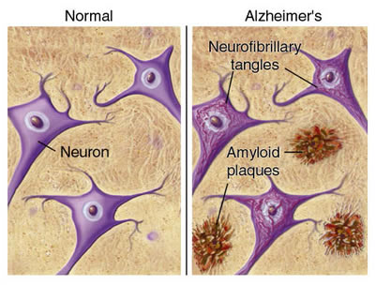
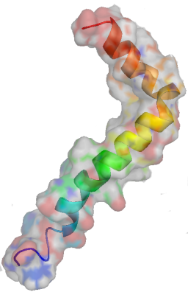
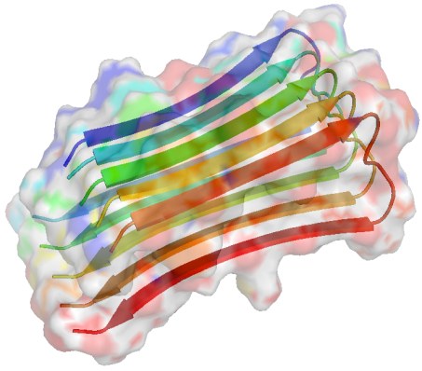
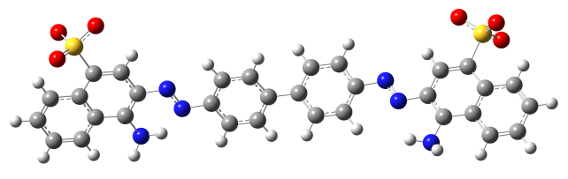

Alzheimer disease
Neurodegenerative disease
β-amyloid
Peptide with 36-43 aa
Histological dyes used to demonstrate the presence of amyloidal deposits in tissue
Congo Red
Thioflavin T

Slide 28
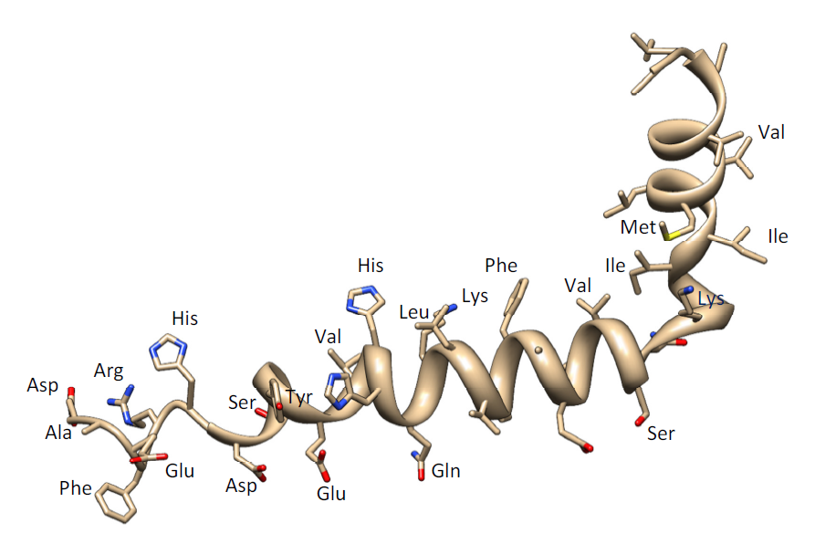
β–amyloid (1-42)
Asp-Ala-Glu-Phe-Arg-His-Asp-Ser-Gly-Tyr-Glu-Val-His-His-Gln-Lys-Leu-Val-Phe-Phe-Ala-Glu-
Asp-Val-Gly-Ser-Asn-Lys-Gly-Ala-Ile-Ile-Gly-Leu-Met-Val-Gly-Gly-Val-Val-Ile-Ala

Slide 29
SERS of β–amyloid(1-42) on Silver Nano-Stars

Slide 30
Wavenumber / cm⁻¹ |  |  | Assignments
Solid Raman (λexc.= 633 nm) | SERS NSAg pH 9 (633nm) | SERS AgCT pH 9 (785nm)
1669 vs | - | - | Am I
- | 1623 | 1623 | ν(C=O)
1606 m | - | - | Phe, ν(C=C)
1585 w | 1595 | 1581 | Phe, Tyr
1565 w | 1558 | 1567 | Am II
- | 1483 | 1494 | His
1469 sh | 1463 | - | His (deprotonated)
1444 s | 1433 | 1441 | δ(CH₂), δ(CH₃)
1408 sh | 1413 | 1401 | δ(C_{α}-H)
- | 1344 | 1347 | t_{w}(CH₂) or ρ(CH₂)
1264 w | 1261 | 1268 | Am III (β-sheet)
1236 w | 1237 | -
1185 vw | 1191 | - | Phe, Tyr
1179 w | 1172 | 1171 | ω(C-C)
1123 w | 1127 | 1128 | v (C-C)
1091 vw | 1091 | - | His, Lys, Arg
- | 1068 | 1064 | ν(C-C) aliphatic side chains
1031 m | - | 1034 | Phe
1003 vs | - | 1001 | Phe
969vw | 968 | 961 | δ_{op}(=C-H)

Slide 31
Poor SERS spectra to be used for β-amyloid direct detection!!!

Slide 32
Nano-stars
Use of Dyes to detect amyloid fibril formation
Congo Red
Thioflavin T

Slide 33
Detection of Congo Red by SERS
υC=C
NS-Ag
υC=C
υC-N
υN=N
NS-Ag

Slide 34
Detection of Thioflavin T by SERS
NS-Ag@Au
υC=C
δCCC
δCH₃
υC-S
υC-N; υCSC
NS-Ag@Au

Slide 35

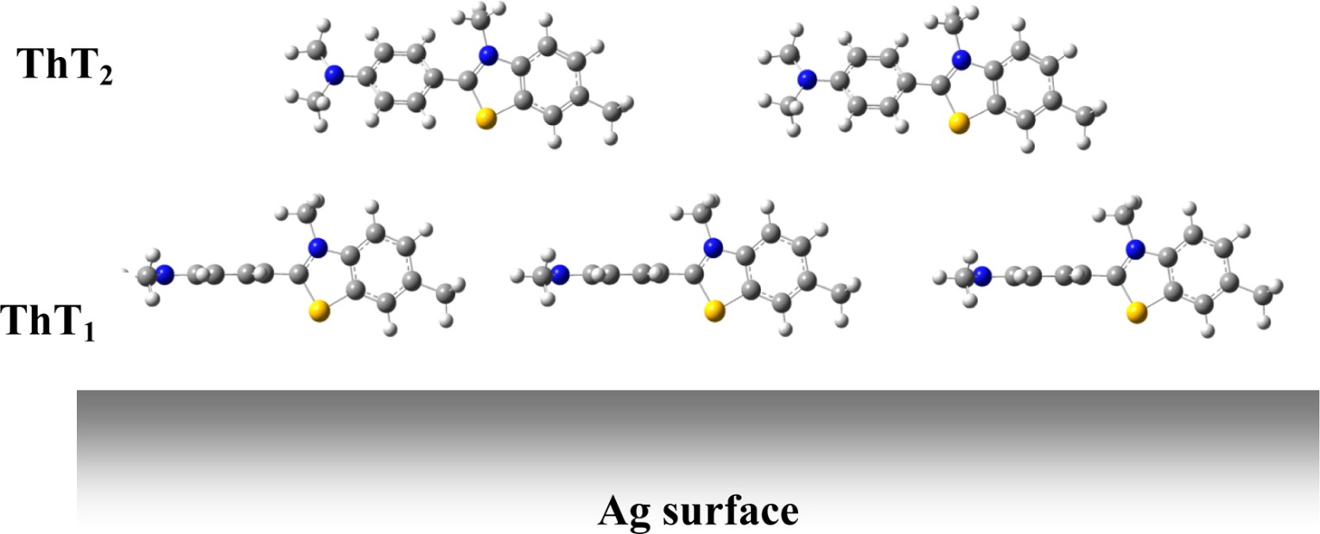
Scheme of the adsorption of the ThT1 and ThT2 species on the Ag surface which implies a rotation of the ϕ angle to 90°
Published in: Eduardo Lopez-Tobar; Marian Antalik; Daniel Jancura; Maria Vega Cañamares; Adianez García-Leis; Diana Fedunova; Gabriela Fabriciova; Santiago Sanchez-Cortes; J. Phys. Chem. C 2013, 117, 3996-4005.
DOI: 10.1021/jp310619c
Copyright © 2013 American Chemical Society

Slide 36
Detection by SERS
Langmuir Adsorption Isotherm
I_{s} - SERS Intensity
K_{ad} - Adsorption constant
I_{sm}- Maximum concentration of adsorbed analyte
[Analyte]- Molecule concentration
Concentration (10⁻⁴ M - 10⁻⁹ M)
λ excitation (532 nm, 785 and 633 nm)

Slide 37
Detection by SERS
Langmuir adsorption isotherm
CR
ThT

Slide 38
Detection by SERS
Linear Region
SERS Sensitivity
Congo Red
Thioflavin T

Slide 39
Absorption spectra of the studied systems

Slide 41
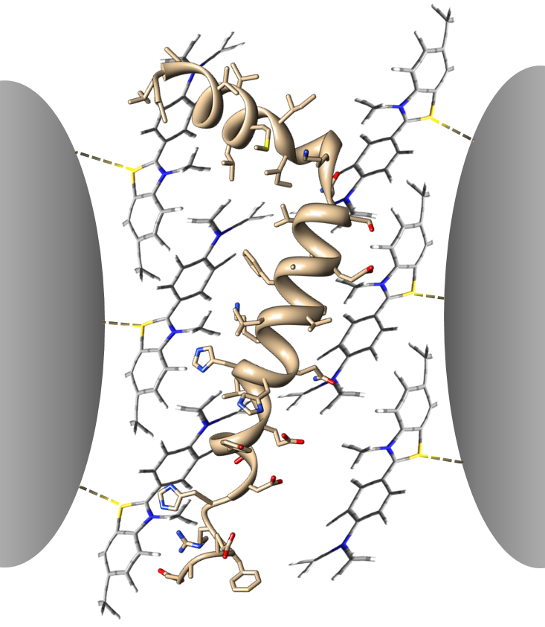
ThT- β-amyloid complex
The effect of [β-amyloid] on the SERS spectra on Ag nanostars

Slide 43
Conclusions
A simple method of nanostructure fabrication with high sensitivity in SERS technique has been developed.
This method allows higher reproducibility in SERS measurements without aggregation.
Congo Red and Thioflavine T dyes were detected at low concentrations.
The adsorption isotherm of ThT over nano-stars follows a Langmuir model
SERS of β-amyloid peptide has been obtained through its interaction with ThT.

Slide 44






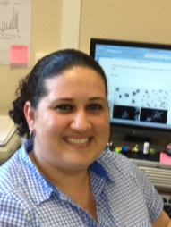



CSIC: Consejo Superior de Investigaciones Científicas
Instituto de Estructura de la Materia
Spectroscopy of Surfaces and Plasmon Photonics Group:
José V.
Garcia-Ramos
Santiago
Sánchez-Cortés
José A.
Sanchez-Gil
M. Vega
Cañamares
Sagrario
Martínez-Ramirez
Paz Sevilla
Eduardo
López Tobar
Adianez
García-Leis
Elisa Corda
Diego Romero Abujetas

Slide 45


Acknowledgements
Ministerio de Economía y Competitividad
Project FIS2010-15405
Grant: JAE-Pre 2011 (A.G-L.)

