Slide 1


Storage of foods under mild pressure (hyperbaric storage) at variable (uncontrolled) room temperature – a possible new preservation concept and an alternative to refrigeration
Jorge A. Saraiva
University of Aveiro

Slide 2
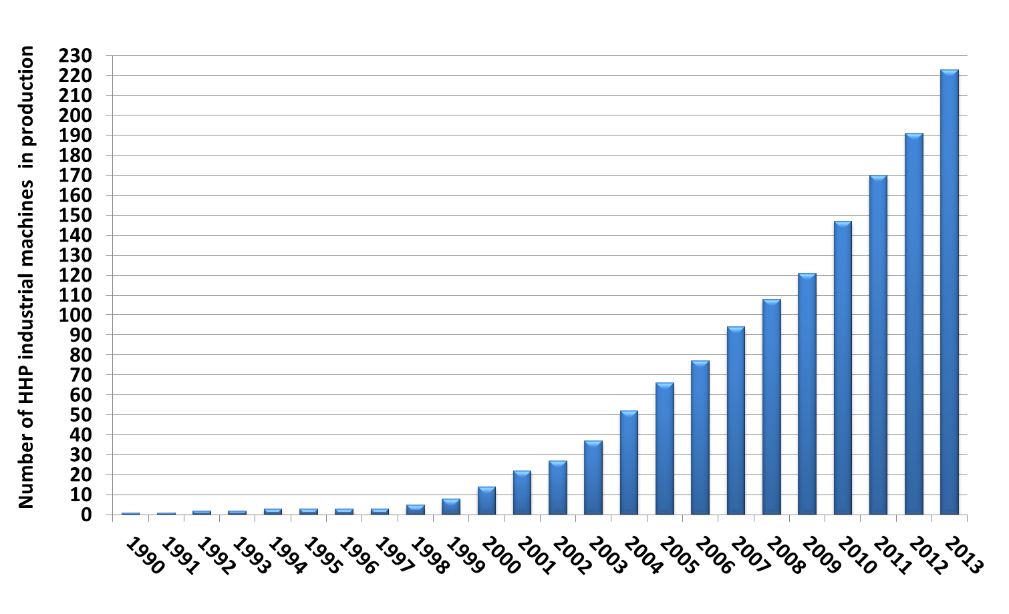
Introduction
High pressure room temperature/cold pasteurization by microbial inactivation
2
Notes:
2

Slide 3
Introduction
First observations:
40 years ago the Sub-marine Alvin sank to a depth of ~ 1,540 m (~ 15 MPa at ~4 ºC)
When rescued 10 months later, well-preserved foods (bouillon, sandwiches and apples) were recovered
Possible improvement of refrigeration by additional microbial growth inhibition
Still energy consumption throughout the storage period
3
Notes:
3

Slide 4
Introduction
What about storage under pressure at ~ room temperature?
Advantages
No energy consumption during storage
Energy needed only for compression and decompression
Reduced ecological footprint and better environmental sustainability
4
Notes:
4

Slide 5
Introduction
Questions
Q1 - Can food storage under pressure (Hyperbaric Storage - HS) be used as a food preservation methodology by slowing down/inhibiting microbial growth similarly to refrigeration?
Q2 - Can HS work at and above room temperature conditions and so under naturally variable (uncontrolled) room temperature conditions and basically energetically costless?
5
Notes:
5

Slide 6
Introduction
First observations:
Tilapia ﬁllets at controlled 25 ºC
12 h at 101 MPa total plate counts similar to the initial (~ 4.7 Log CFU/g); at 203 MPa a reduction to 2.0 Log CFU/g
Same results for psychrophilic bacteria 101 and 203 MPa
K value - at 203 MPa showed a higher freshness than control (0.1 MPa)
Posthyperbaric storage for 12 h at 25 ºC - enzymes were active and microorganisms could grow
  inhibitory effect caused by pressure was not caused by microbial inactivation but by growth inhibition
Ko WC, Hsu KC (2001). J Food Protect 64(1):94–98
6
Notes:
6

Slide 7
Introduction
Recent observations:
Strawberry juice (acid food) at controlled 20ºC for 15 days
At 0.1 MPa after - microbial loads increased by > 3 Logs (total aerobic mesophiles and yeasts/moulds), with unpleasant smell and gas production
Under refrigeration (5 º) C - 2 Log units increase for total aerobic mesophiles
Under pressure (25, 100 and 220 MPa ) - microbial loads below the detection limits
Segovia-Bravo et al. (2012) Innov Food Sci Emerg Technol 15:14–22
7
Notes:
7

Slide 8
Experimental Strategy and Methods
Our experiments:
Constrains
Very long experimental times to compare with refrigeration results
  Long use of pressure equipments needed for other experiments
Strategy
  Highly perishable foods (non acid & high a_{w}) as proof-of-concept case-studies
  First experiments with watermelon and melon juices
  Followed by other foods at and above room temperature
  First experiments in an industrial high pressure equipment
8
Notes:
8

Slide 9
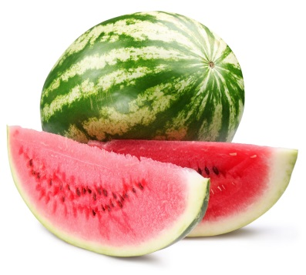
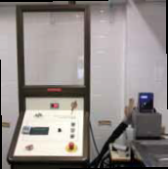
Methodology
A
8, 16, 24 and 60 hours:
0.1 MPa at 5 ºC
100 MPa at ≈ 20 ºC
Microbiological Analyses:
Total aerobic mesophiles
Enterobacteriaceae
Yeasts and moulds
Physicochemical Analyses:
pH
Titratable acidity
Browning degree
Cloudiness
Total soluble solids
9
Notes:
9

Slide 10
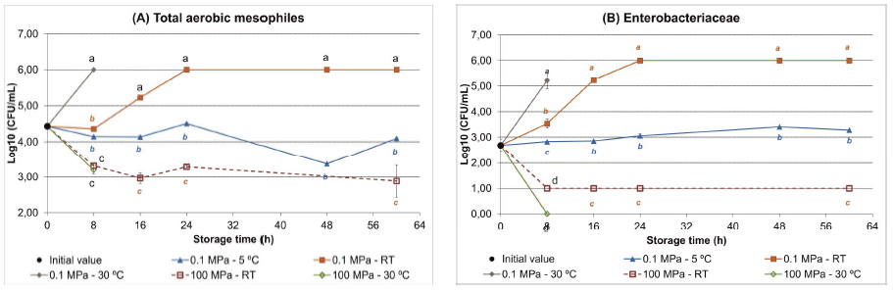
A. Microbiological Analyses
0.1 MPa, 30 ºC
0.1 MPa
Refrigeration
100 MPa
100 MPa, 30 ºC
Values shown as 6 and 1 log units are meant to be higher than 6 and lower than 1 log units, respectively.

Slide 11
A. Microbiological Analyses
0.1 MPa, 30 ºC
0.1 MPa
Refrigeration
100 MPa
100 MPa, 30 ºC
Values shown as 6 and 1 log units are meant to be higher than 6 and lower than 1 log units, respectively.
11
Notes:
11

Slide 12
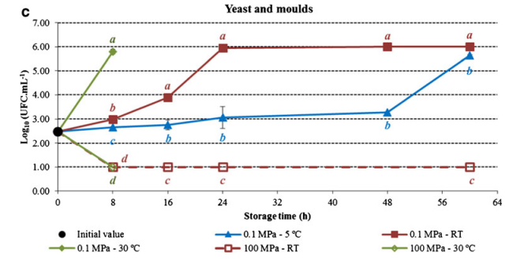
A. Microbiological Analyses
0.1 MPa, 30 ºC
0.1 MPa
Refrigeration
100 MPa
100 MPa, 30 ºC
Values shown as 6 and 1 log units are meant to be higher than 6 and lower than 1 log units, respectively.
12
Notes:
12

Slide 13
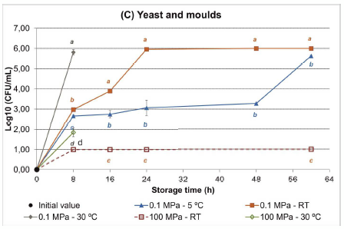
A. Microbiological Analyses
Storage at atmospheric pressure (0.1 MPa; 20 ºC):
  After 24h, microbial levels were already aboved quantification levels and unacceptable for consumption
Hyperbaric storage (100 MPa; 20 ºC):
  After 8h, the initial microbial loads were reduced and remained thereafter unchanged up to 60h of storage
Values shown as 6 and 1 log units are meant to be higher than 6 and lower than 1 log units, respectively.

Slide 14
A. Microbiological Analyses
Storage at atmospheric pressure (0.1 MPa; 30 ºC):
  Faster microbial growth after 8h, compared to 20 ºC
Hyperbaric storage (100 MPa; 30 ºC):
  Similar results compared to 20 ºC
  Can foods be preserved under pressure above room temperature?
Values shown as 6 and 1 log units are meant to be higher than 6 and lower than 1 log units, respectively.
14
Notes:
14

Slide 15
A. Physicochemical Analyses
Hyperbaric storage:
Attenuates the increase of titratable acidity (verified at 0.1 MPa);
Higher colour changes (than 0.1 MPa):
  Higher lightness;
Lower browning degree (than 0.1 MPa).
The other parameters analyzed showed generally no statistical differences between the different samples.
Fidalgo et al. (2013). Food and Bioprocess Technology. DOI 10.1007/s11947-013-1201-x

Slide 16
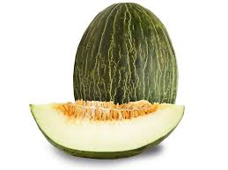
Methodology
A
8, 16, 24 and 60 hours:
0.1 MPa at 5 ºC
100 MPa at ≈ 20 ºC
Microbiological Analyses:
Total aerobic mesophiles
Enterobacteriaceae
Yeasts and moulds
Physicochemical Analyses:
pH
Titratable acidity
Browning degree
Cloudiness
Total soluble solids
B
8 hours:
0.1 MPa at 4 ºC
0.1, 50, 75 and 150 MPa at 25 ºC
0.1, 25, 50, 75 and 150 MPa at 30 ºC
0.1 and 100 MPa at 37 ºC
16
Notes:
16

Slide 17
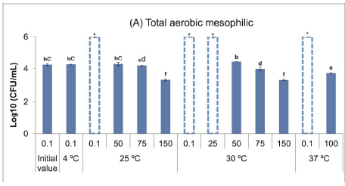
B. Microbiological Analyses
Bars with * and # are indicative of values higher than 6 and lower than 1 Log10(CFU/mL), respectively.

Slide 18
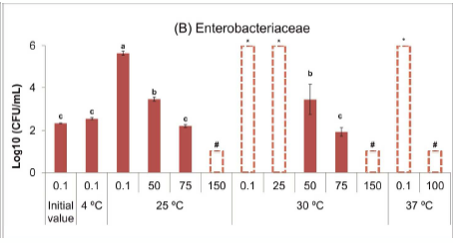
B. Microbiological Analyses
Bars with * and # are indicative of values higher than 6 and lower than 1 Log10(CFU/mL), respectively.
18
Notes:
18

Slide 19
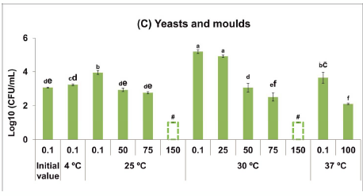
B. Microbiological Analyses
Bars with * and # are indicative of values higher than 6 and lower than 1 Log10(CFU/mL), respectively.
19
Notes:
19

Slide 20
B. Microbiological Analyses
Hyperbaric storage at 25 MPa showed no relevant microbial inhibition;
After 8 hours of hyperbaric storage at 50/75 MPa, the microbial counts were similar to refrigeration
After 8 hours of hyperbaric storage at 100/150 MPa, the microbial counts were lower than refrigeration, due to microbial inactivation and microbial growth inhibition
Temperature at 20-37 ºC seems to be irrelevant
  Food preservation under naturally variable (uncontrolled) room temperature and above
Bars with * and # are indicative of values higher than 6 and lower than 1 Log10(CFU/mL), respectively.

Slide 21
B. Physicochemical Analyses
pH
Titratable acidity
Browning degree
Cloudiness
Total soluble solids
These parameters did not show a clear variation trend with pressure
Hyperbaric storage effects on physicochemical parameters were similar to those observed with refrigeration
Queirós et al. (2014). Food Chemistry, 147, 209–214.

Slide 22
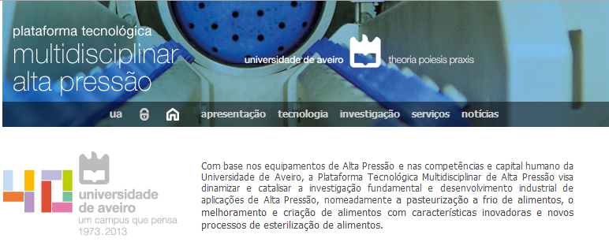
High Pressure@University of Aveiro
University of Aveiro High Pressure Based Multidisciplinary Technological Platform:
Platform website: http://www.ua.pt/ptaltapressao/

Slide 23
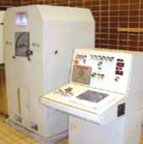
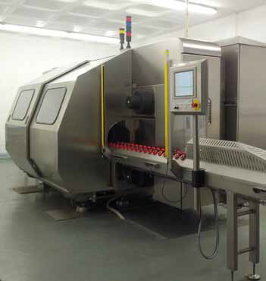
High Pressure@University of Aveiro
University of Aveiro High Pressure Based Multidisciplinary Technological Platform:
Portfolio of three equipments:
Laboratorial scale
Pilot scale
Industrial scale
Platform website: http://www.ua.pt/ptaltapressao/

Slide 24
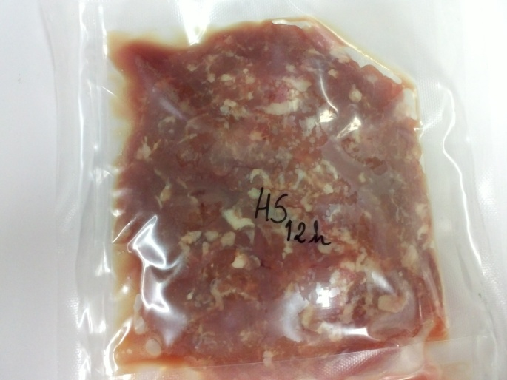
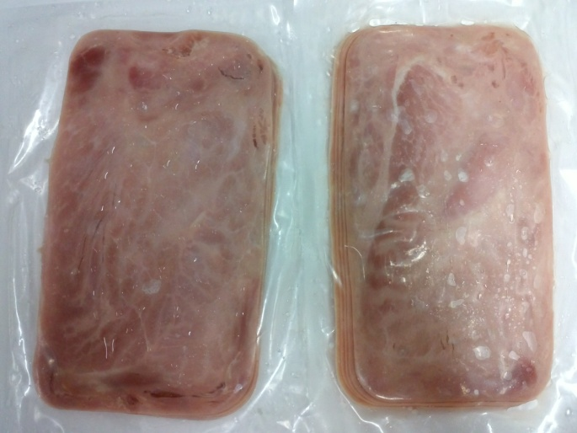
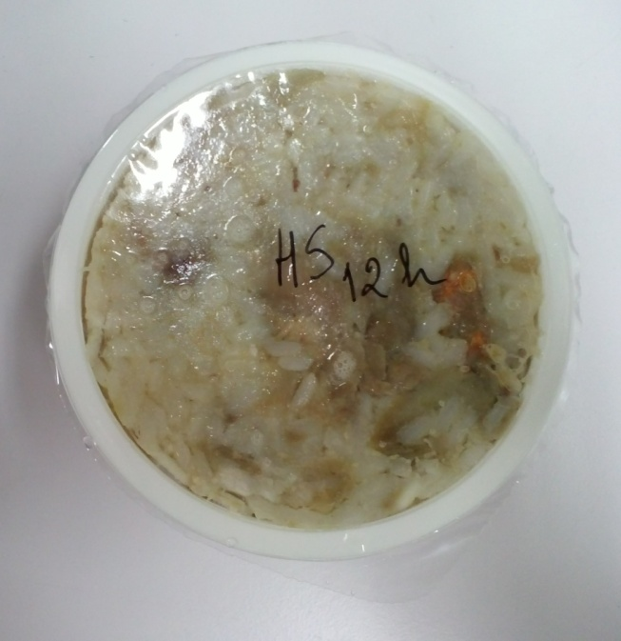
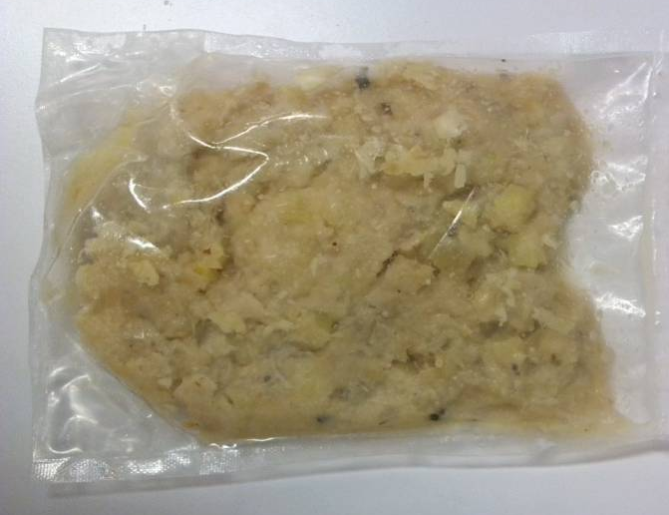
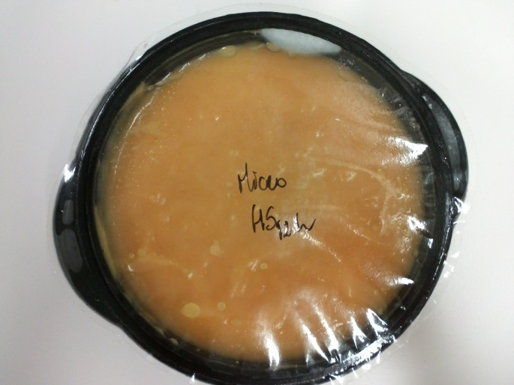
Studies with different products
Minced meat
Sliced cooked ham
RTE meal (duck rice)
RTE meal (cod fish with potatoes and cream
RTE Soup
Notes:
Confirmar nomes dos alimentos em inglês

Slide 25
Conclusions
Food preservation by microbial growth inhibition under pressure - hyperbaric storage (HS)
Minimum of 50-75 MPa to have microbial growth inhibition
At 100-150 MPa, additional inactivation effect, resulting in microbial loads lower than refrigeration
At 20-37 ºC no relevant effect of temperature
Pressure can be used as a variable to slowdown/inhibit microbial proliferation – a novel conceptual food preservation methodology?
Fernandes et al. (2014). Food preservation under pressure (hyperbaric storage) as a possible improvement/alternative to refrigeration: a review. Food Engineering Reviews. DOI 10.1007/s12393-014-9083-x

Slide 26
Further Research
As a novel recent possibility for food preservation, study:
Other microrganims, e. g., pathogens
Other quality parameters, e. g., enzymes
Other food matrixes (with different pH and a_{w})
Quantitative effect and mathematical modeling of pressure/temperature on microbial growth inhibition and inactivation as influenced by food characteristics (pH, a_{w}, etc)
Longer storage experiments for shelf life determination
Sensorial analyses
Economical data to compare with refrigeration, including sustainability issues and ecological footprint
26
Notes:
26

Slide 27
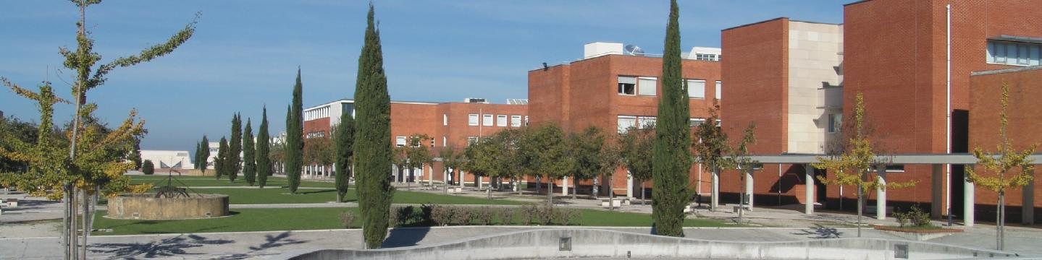
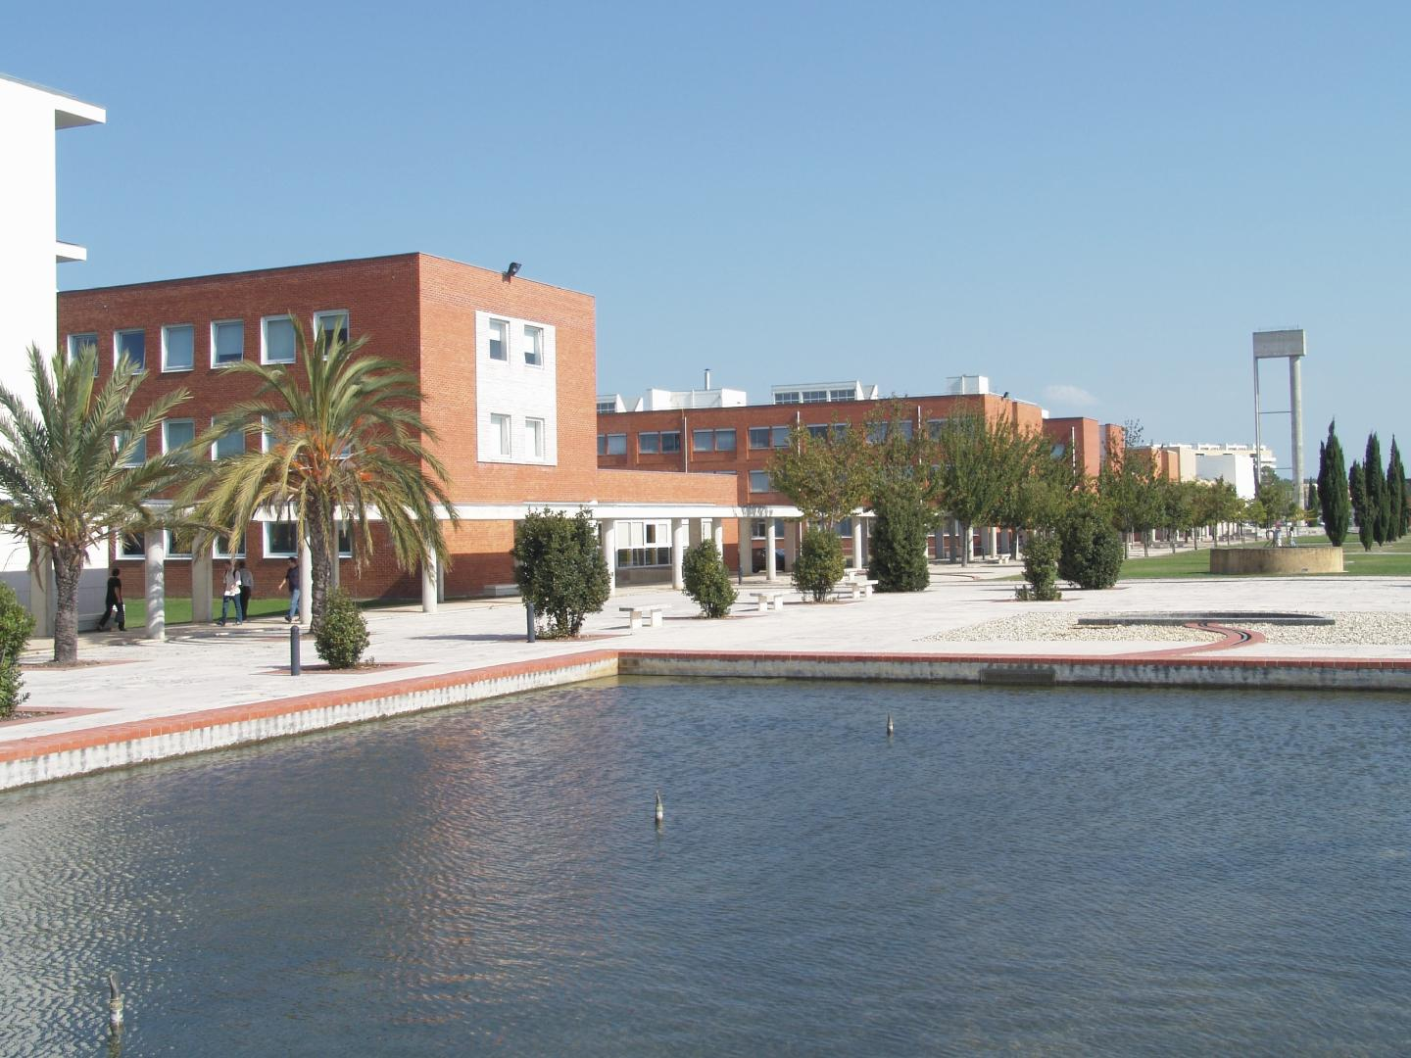
40 years old University, ≈15 000 students

Slide 28




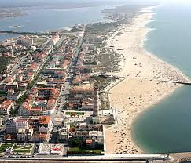
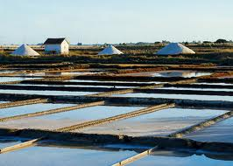
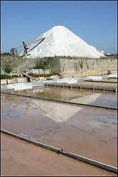
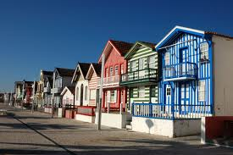


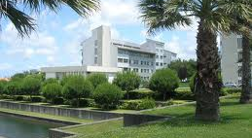
Aveiro – the Portuguese Venice

Slide 29
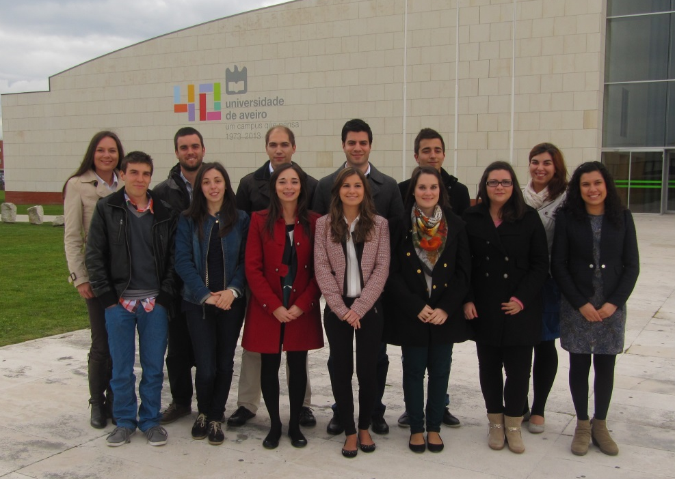
High Pressure Research Team
(Food and Biotechnological Applications)

