Slide 1

About OMICS Group
OMICS Group International is an amalgamation of Open Access publications and worldwide international science conferences and events. Established in the year 2007 with the sole aim of making the information on Sciences and technology ‘Open Access’, OMICS Group publishes 400 online open access scholarly journals in all aspects of Science, Engineering, Management and Technology journals. OMICS Group has been instrumental in taking the knowledge on Science & technology to the doorsteps of ordinary men and women. Research Scholars, Students, Libraries, Educational Institutions, Research centers and the industry are main stakeholders that benefitted greatly from this knowledge dissemination. OMICS Group also organizes 300 International conferences annually across the globe, where knowledge transfer takes place through debates, round table discussions, poster presentations, workshops, symposia and exhibitions.

Slide 2
About OMICS Group Conferences
OMICS Group International is a pioneer and leading science event organizer, which publishes around 400 open access journals and conducts over 300 Medical, Clinical, Engineering, Life Sciences, Pharma scientific conferences all over the globe annually with the support of more than 1000 scientific associations and 30,000 editorial board members and 3.5 million followers to its credit.
OMICS Group has organized 500 conferences, workshops and national symposiums across the major cities including San Francisco, Las Vegas, San Antonio, Omaha, Orlando, Raleigh, Santa Clara, Chicago, Philadelphia, Baltimore, United Kingdom, Valencia, Dubai, Beijing, Hyderabad, Bengaluru and Mumbai.

Slide 3
Design for Reliability of Mechatronic Systems Supported by Knowledge-Based Systems in Design Process Early Phases
Paulo Ricardo Telles Rangel, MSc. Jonny Carlos da Silva, Dr.Eng.
Electronics Department, IFSC Mech. Engineering Dept. UFSC

Slide 4




Where are we located?
State Santa Catarina
  One of the highest standards of living in Latin America
  293 cities

Slide 5
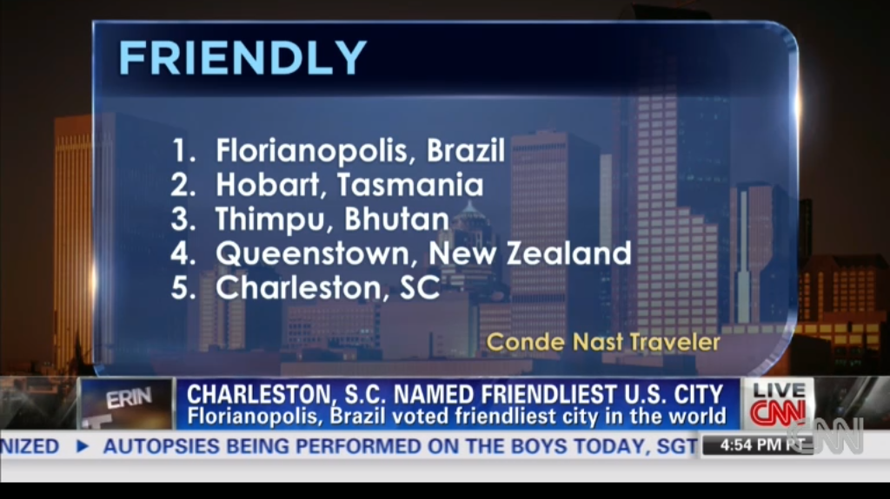

State Capital Florianopolis
Source: CNN August 2013

Slide 6
Structure
Why tackle mechatronic systems design?
Why the early stages?
What is a Knowledge-Based System?
Examples of KBS projects developed
Some decisions related to the current prototype
Conclusion and some works ahead

Slide 7
Why mechatronic system design?
Faults in mechatronic systems > many causes.
Classification of sources performance variability:
(1) manufacturing processes;
(2) the operating environment;
(3) product deterioration.
Electromagnetic may cause simple malfunction or even the physical destruction.

Slide 8
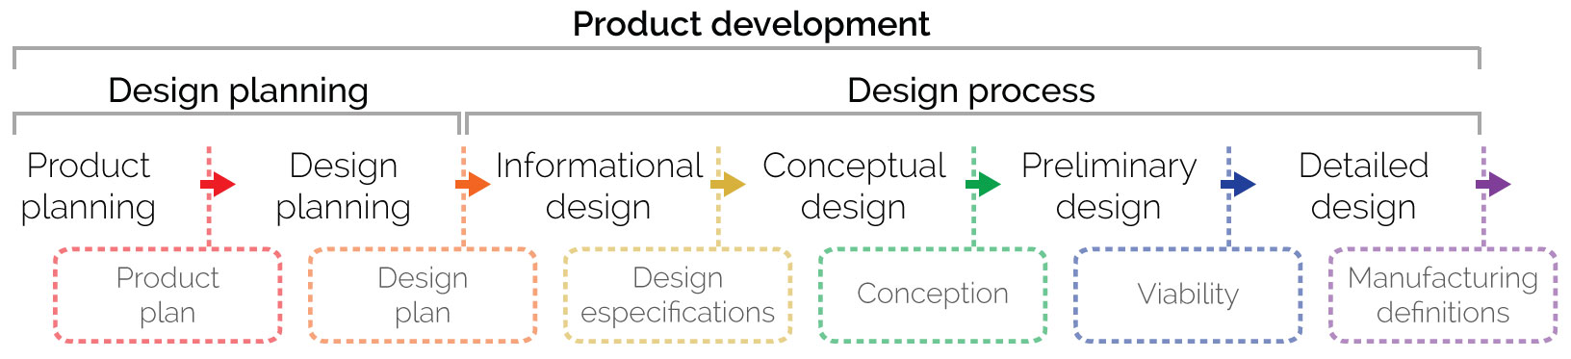
Typical design process

Slide 9
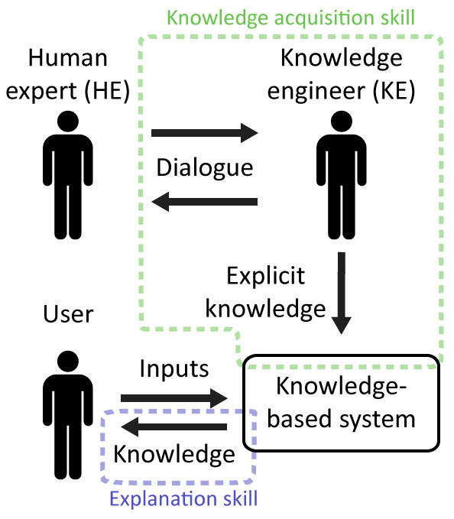
KBS definition / development process
feasibility study
knowledge acquisition
knowledge representation
implementation
verification and validation
[Waterman, 1986]
“… an intelligent computer program that uses knowledge and inference procedures to solve problems that are difficult enough to require significant human expertise for their solution” Prof. Edward Feigenbaum

Slide 10
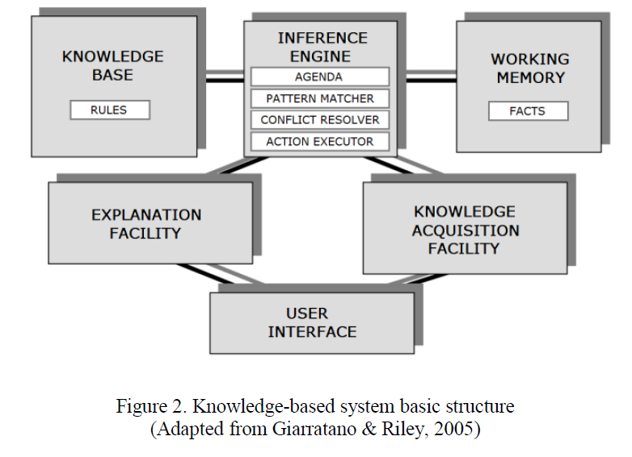
KBS Structure

Slide 11
Some KBS projects developed
fluid power system design (Silva and Back, 2000),
cogeneration power plants design (Matelli, et al., 2009),
hermetic compressors diagnosis (Pedroso and Silva, 2014)
detection, disambiguation and mitigation of faults in sensors (Silva et al 2012)

Slide 12
Initial Project
Expert System for design of hydraulic systems focusing on concurrent engineering perspective

Slide 13
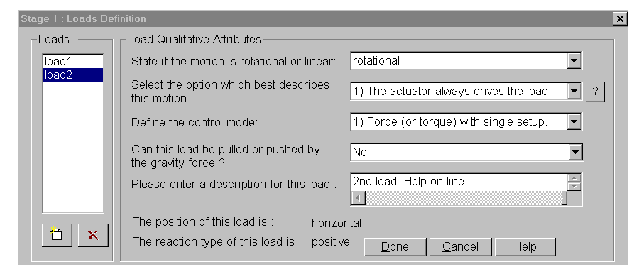
Hydraulic Systems Design- Concurrent Engineering
Load qualitative attributes
Automatic alternative generation

Slide 14
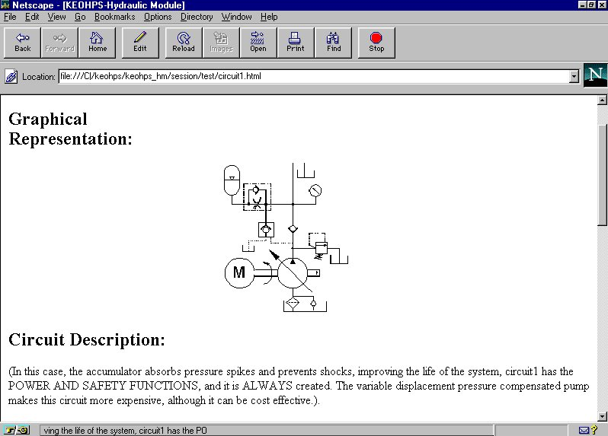
Circuit representation

Slide 15
ProSisc- Exp. Sist. Cogeration Power Plant Design
Definition of different plant diagrams based on utilities:
  electricity,
  saturated steam,
  hot water
  chilled water
specification and sizing of the plant components;
economic feasibility and sensitivity analysis;

Slide 16
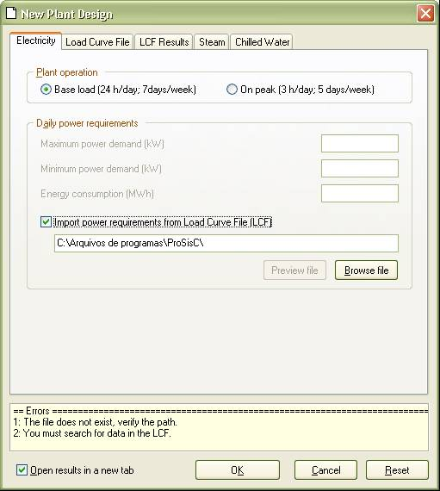
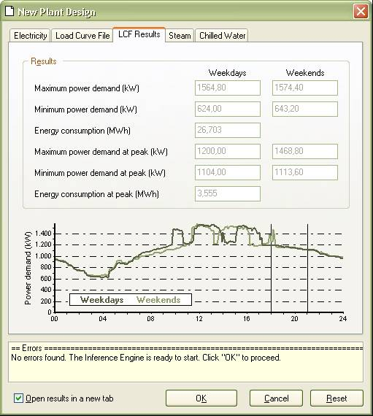
Interface examples
input data- power demand

Slide 17
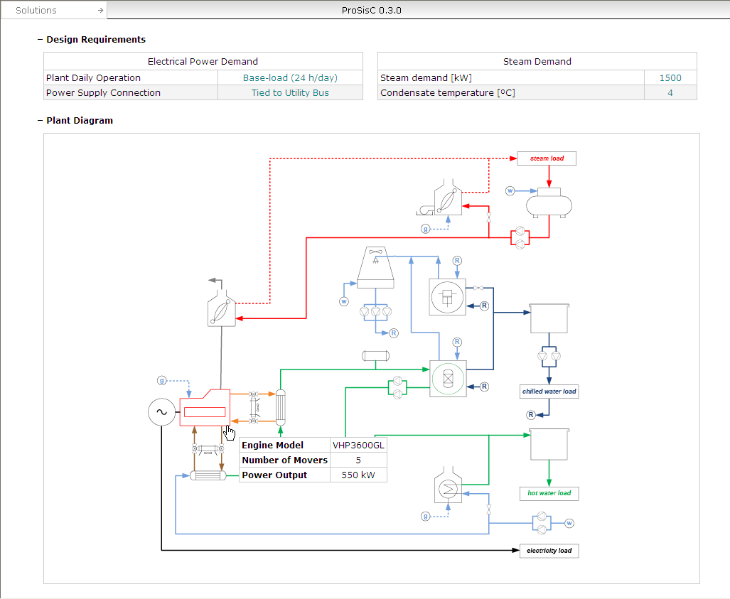
Output interface- Scheme with specifications

Slide 18


Slide 19
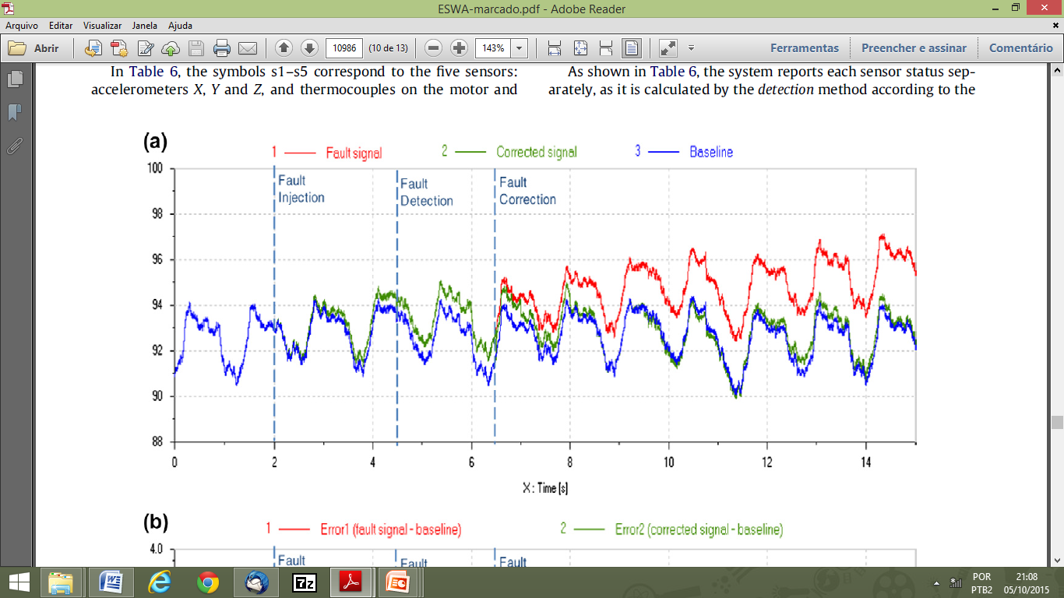
Drift fault: parameters calculation and mitigation via a KBS

Slide 20
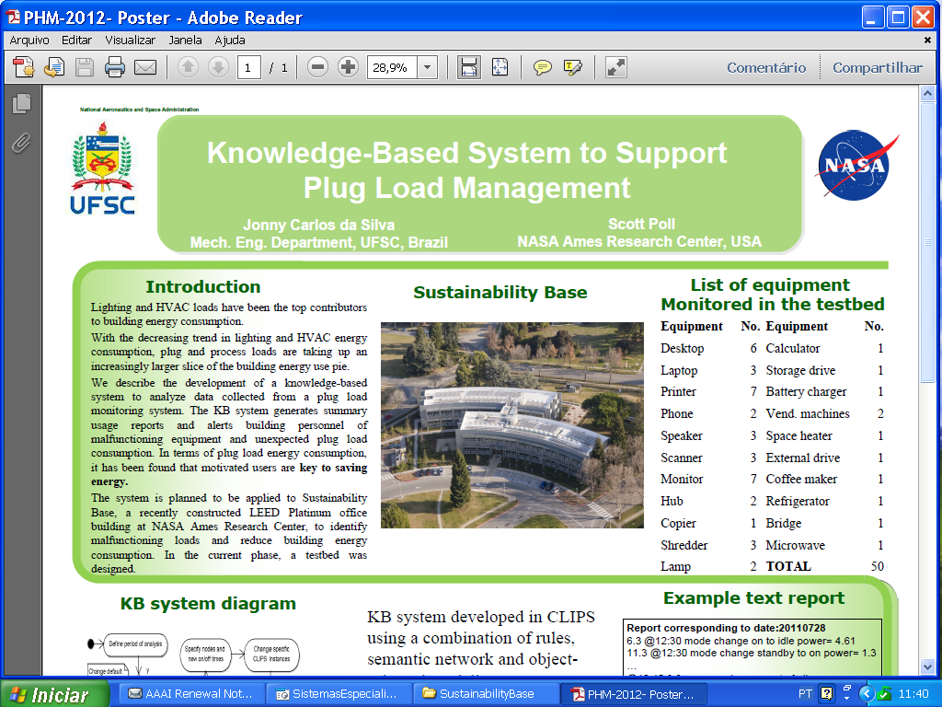

Slide 21
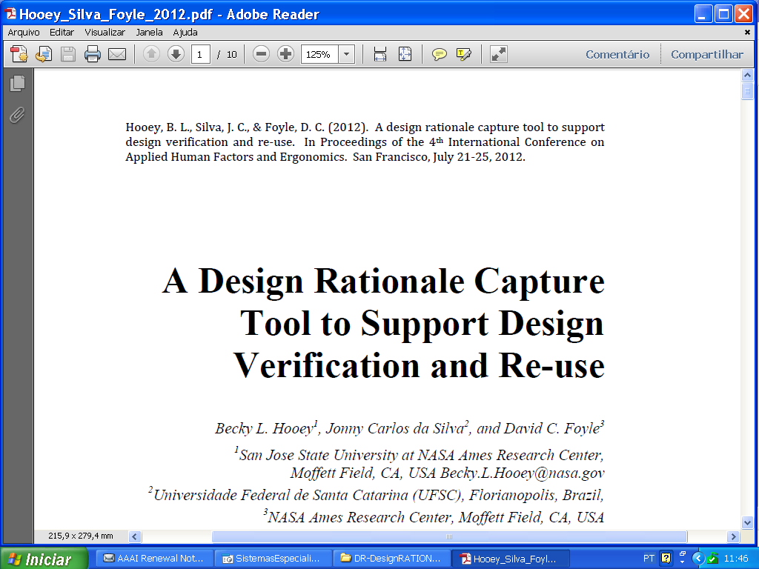

Slide 22
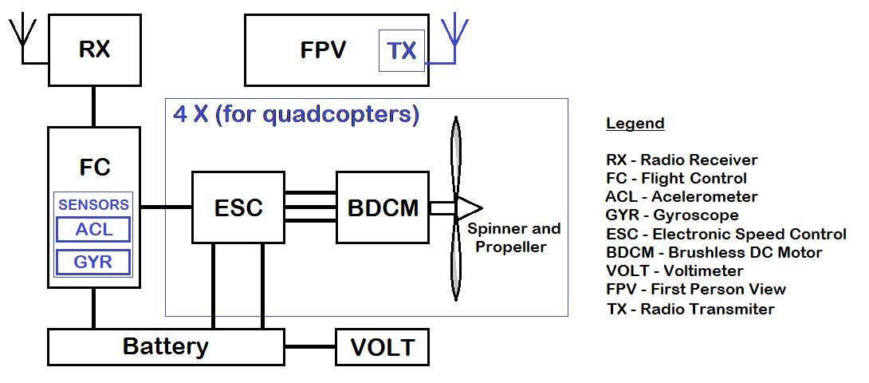
Current Project- scope definition
Possible EMI Problems
drone block diagram
If EMI coupling ACL/GYR sensors
  Reliability may be compromised
  malfunction in sensors
    noise signal to controller
  Danger to circuitry integrity
  EMI currents can produce excessive heat

Slide 23
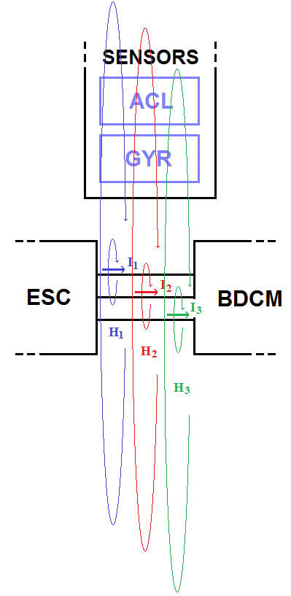
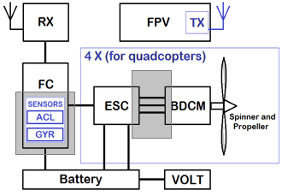
Rule example: stray inductance
b)
a)
a) functional diagram b) magnetic coupling due proximity
If ESC circuit drives strong switching currents to BDCM
  f ≅ 10 kHz and I > 20A
  Then EMI is radiated and may cause malfunction or degradation
  (stray inductance)

Slide 24
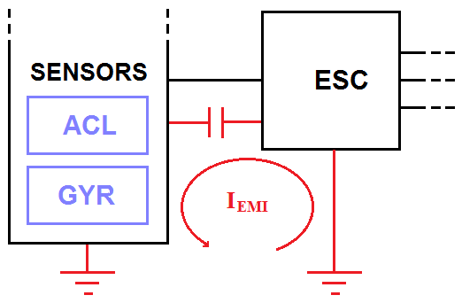
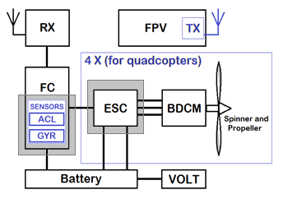
Rule example: stray capacitance
a)
b)
a) functional diagram b) electric coupling due proximity
If AC voltages are present at solder pads in a PCB
  Then EMI is conducted and may cause malfunction or degradation
  (stray capacitance)

Slide 25
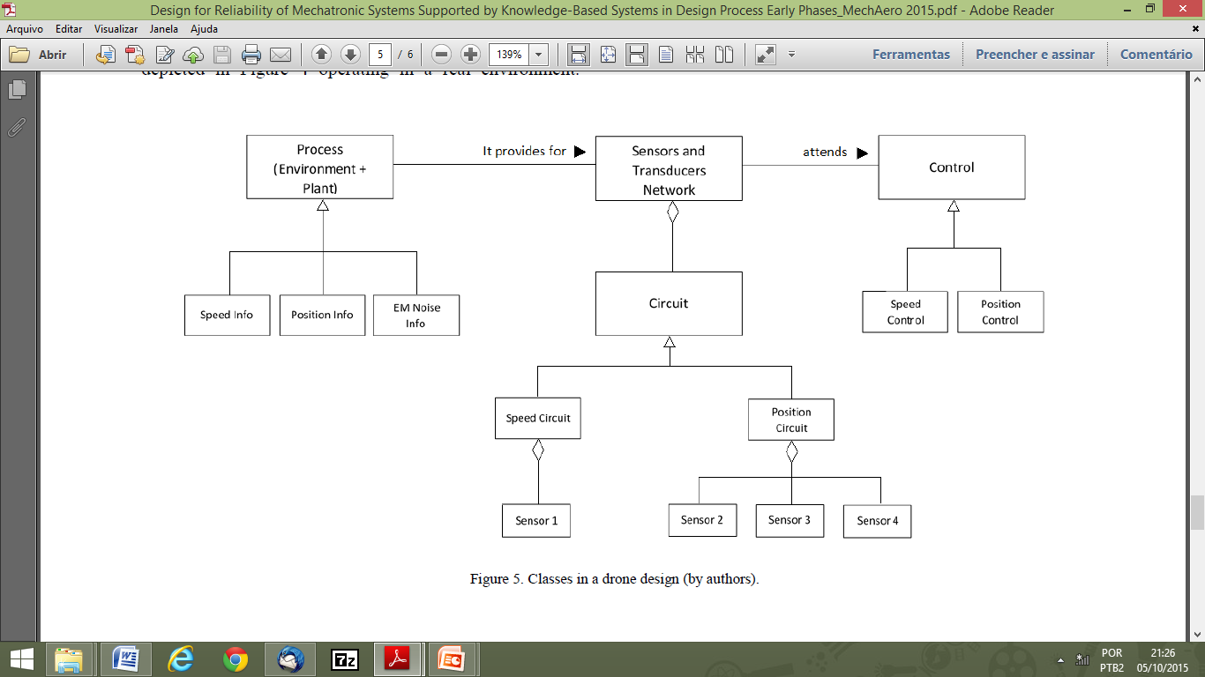
Classes in a drone design

Slide 26
Common Points
Incremental approach
Combination of
  Rules
  Oriented Modeling objects and
  Semantic networks as techniques of knowledge representation
Effective participation of experts in the systems validation
Implementation in CLIPS (KBS shell)

Slide 27
Conclusion
A rapid prototype has been implemented.
Current functionality comprises:
  evaluation of topologies and technologies applied to the drive circuits (ESC), PCB layout,
  separation between circuitry potentially interfering and victim circuits,
  modes of operation in switched circuits (described by frequency, switching times, and duty cycle)
  and the need for filters and shields to interfering circuits.
Potential to assist designers in EMC criteria for the development of mechatronic products

Slide 28


If knowledge is power to create KBS is a valuable strategy!
Thank you!
coach.jonny
coachjonny
jonny.silva@ufsc.br

Slide 29
References
BARBIERI, G., FANTUZZI C., and BORSARI R. “A model-based design methodology for the development of mechatronic Systems”. Mechatronics, volume 24, Issue 7, Pages 833-843, October 2014.
DE SILVA, C.W. and BEHBAHANI, . “A design paradigm for mechatronic systems”. Mechatronics, Volume 23, Issue 8, Pages 960-966, December 2013.
DOROCIAK R. Early probabilistic reliability analysis of mechatronic systems. Proceedings of Annual Reliability and Maintainability Symposium (RAMS), Reno, Nevada. January 23-26, 2012.
FU, C., ZHOU, J., ZHANG, X., CUI, C. Electromagnetic compatibility design of intelligent circuit breaker. 3th International Conference on Measuring Technology and Mechatronics Automation (ICMTMA). January 6-7, 2011.
GIARRATANO, J.C. and RILEY, G.D., 2005. Expert Systems: Principles and Programming. Thomson Course Technology, Boston, 4th edition.
HERNANDEZ N.V., KREMER, G.O., SCHMIDT, L.C. and HERRERA, P.R.A. “Development of an expert system to aid engineers in the selection of design for environment methods and tools”. Expert Systems with Applications, Volume 39, Issue 10, Pages 9543-9553, August 2012.
HUBING, T. “EMC Expert Systems for Evaluating Automotive Designs”. 2006 IEEE International Symposium on Electromagnetic Compatibility, EMC 2006, Volume 3, Pages 840-841, 2006.
JANFREI, J., YUBO, Y., LIHIUI, W., LEI, G. Analysis and countermeasure on abnormal operation of one 110kV intelligent substation merging unit. 2013 International Conference on Mechatronic Sciences, Electric Engineering and Computer (MEC). December 20-22, 2013, Shenyang, China.

Slide 30
References
KHEIR, N.A. et all “Automotive Mechatronic Systems : A Curriculum Outline” (disponible in http://www.itrack-llc.com/Publications/IFAC%20Education.pdf).
LEWIS, E.E. “Introduction to reliability engineering”. 2nd Edition. John Wiley & Sons, 1996.
MA, C., SU, D., JIA, Y. and NI, Z. “An EMC quantitative evaluation system for airborne electronic equipment subsystem”. 2010 9th International Symposium on Antennas Propagation and EM Theory (ISAPE), Pages 1023-1026, 2010.
MATELLI, J.A. “Conceptual design of biomass fired cogeneration plant through a knowledge based system”. Journal of the Brazilian Society of Mechanical Sciences and Engineering, March 2015. Springer (disponible in http://link.springer.com/article/10.1007%2Fs40430-015-0326-4).
MATELLI, J.A., BAZZO, E. and SILVA, J.C. “An expert system prototype for designing natural gas cogeneration plants”. Expert Systems with Applications, Volume 36, Issue 4, Pages 8375-8384, May 2009.
MONTICOLO, D., MIHAITA, S., DARWICH, H. and HILAIRE, V. “An agent-based system to build project memories during engineering projects”. Knowledge-Based Systems, Volume 68, Pages 88-102, September 2014.
PEDROSO, A.P. and SILVA, J.C. “Knowledge‑based system to support product development focusing on diagnosis of low performance in hermetic compressors”. The Brazilian Society of Mechanical Sciences and Engineering 2014. Springer, 2014
RIBARIC, S., MARCETIC, D. and VEDRINA, D.S. “A knowledge-based system for the non-destructive diagnostics of fac_ade isolation using the information fusion of visual and IR images”. Expert Systems with Applications, Volume 36, Issue 2, Part 2, Pages 3812-3823, March 2009.
SILVA, J.C. and BACK, N. “Shaping the Process of Fluid Power System Design Applying an Expert System”. Research in Engineering Design. Springer-Verlag, 2000.
SILVA, J.C., MATELLI, J.A. BAZZO, E. and “Development of a knowledge-based system for cogeneration plant design: Verification, validation and lessons learned”. Knowledge-Based Systems, volume 67, Pages 230-243, May 2014. Elsevier 2014.
SILVA, J.C., SAXENA, A., BALABAN, E. and GOEBEL, K. “A knowledge-based system approach for sensor fault modeling, detection and mitigation”. Expert Systems with Applications, volume 39, issue 12, Pages 10977 – 10989, Sptember 2012.
SMITH, D.J., 2011. Reliability, Maintainability and Risk: Practical methods for engineers. Elsevier Ltd, 8th Edition.
ZHENG, C., BRICOGNE, M., LE DUIGOU, J. and EYNARD, B. “Survey on mechatronic engineering: A focus on design methods and product models”. Advanced Engineering Informatics, Volume 28, Issue 3, Pages 241-257, August 2014. Elsevier, 2014.

Slide 31
References
SILVA, J.C. and BACK, N. “Shaping the Process of Fluid Power System Design Applying an Expert System”. Research in Engineering Design. Springer-Verlag, 2000.
SILVA, J.C., MATELLI, J.A. BAZZO, E. and “Development of a knowledge-based system for cogeneration plant design: Verification, validation and lessons learned”. Knowledge-Based Systems, volume 67, Pages 230-243, May 2014. Elsevier 2014.
SILVA, J.C., SAXENA, A., BALABAN, E. and GOEBEL, K. “A knowledge-based system approach for sensor fault modeling, detection and mitigation”. Expert Systems with Applications, volume 39, issue 12, Pages 10977 – 10989, Sptember 2012.
SMITH, D.J., 2011. Reliability, Maintainability and Risk: Practical methods for engineers. Elsevier Ltd, 8th Edition.
ZHENG, C., BRICOGNE, M., LE DUIGOU, J. and EYNARD, B. “Survey on mechatronic engineering: A focus on design methods and product models”. Advanced Engineering Informatics, Volume 28, Issue 3, Pages 241-257, August 2014. Elsevier, 2014.

