Slide 1
About OMICS Group
OMICS Group International is an amalgamation of Open Access publications and worldwide international science conferences and events. Established in the year 2007 with the sole aim of making the information on Sciences and technology ‘Open Access’, OMICS Group publishes 400 online open access scholarly journals in all aspects of Science, Engineering, Management and Technology journals. OMICS Group has been instrumental in taking the knowledge on Science & technology to the doorsteps of ordinary men and women. Research Scholars, Students, Libraries, Educational Institutions, Research centers and the industry are main stakeholders that benefitted greatly from this knowledge dissemination. OMICS Group also organizes 300 International conferences annually across the globe, where knowledge transfer takes place through debates, round table discussions, poster presentations, workshops, symposia and exhibitions.

Slide 2
About OMICS Group Conferences
OMICS Group International is a pioneer and leading science event organizer, which publishes around 400 open access journals and conducts over 300 Medical, Clinical, Engineering, Life Sciences, Phrama scientific conferences all over the globe annually with the support of more than 1000 scientific associations and 30,000 editorial board members and 3.5 million followers to its credit.
OMICS Group has organized 500 conferences, workshops and national symposiums across the major cities including San Francisco, Las Vegas, San Antonio, Omaha, Orlando, Raleigh, Santa Clara, Chicago, Philadelphia, Baltimore, United Kingdom, Valencia, Dubai, Beijing, Hyderabad, Bengaluru and Mumbai.

Slide 3
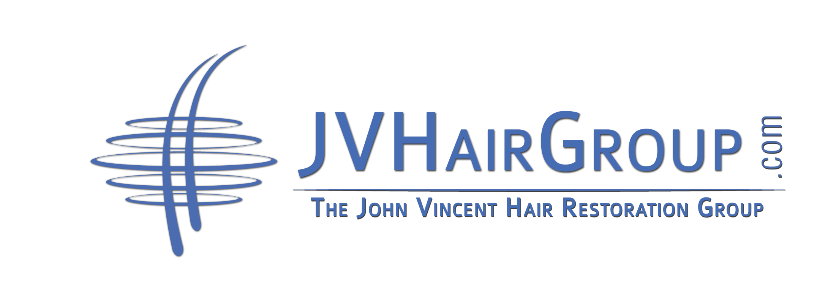

Slide 4
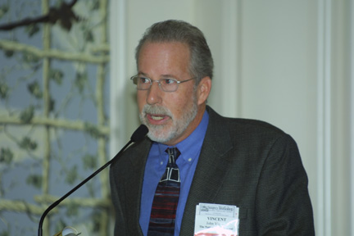
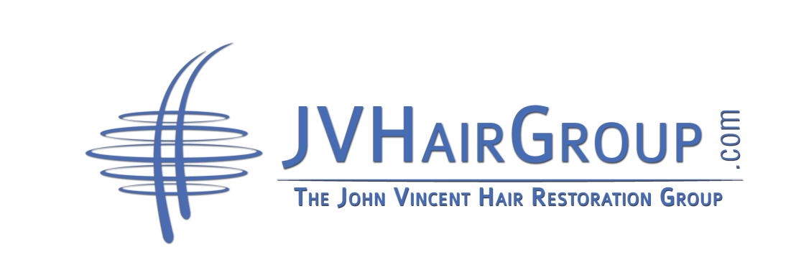
John Vincent
President
AHLC Master Hair Restoration Specialist
Internationally-known authority on hair restoration options.
Notes:
Update with photo of me lecturing and a Before pic

Slide 5
WHY LASER HAIR THERAPY SHOULD BE A PART OF HAIR LOSS MANAGEMENT PROGRAM
Safe, Risk-Free* Options
Combine with Hair Treatments for Better Results
Substantial Revenues
Generous Profit Margins
Happy Clients
*Class 2 and Class 3 lasers (similar to a laser pointer)

Slide 6
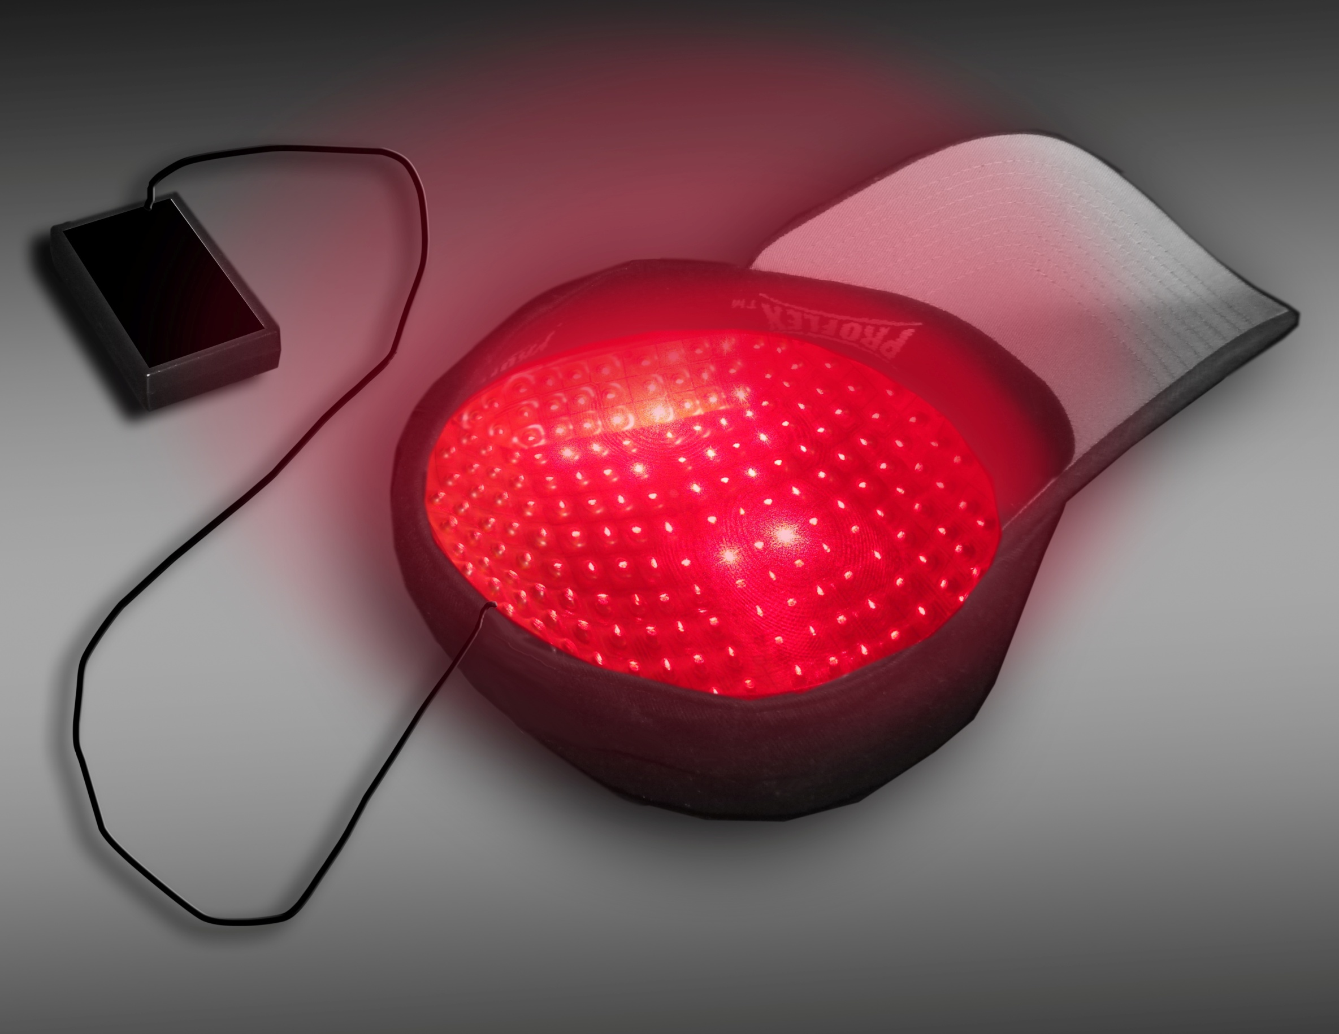
LEADING AUTHORITY ABOUT THE USE OF LOW LEVEL LASER HAIR THERAPY (LHT)

Slide 7
Before
After
Notes:
Remove watermark, indicate ‘before’ and
‘after’ . Move lower before to upper and place after of the same pose below

Slide 8
COMPREHENSIVE TRAINING PROGRAM FOR SELLING LHT
Technology & Credentials
The Best LHT Products
Client Education Process

Slide 9
IN ORDER TO BE SUCCESSFUL…
You need:
Supporting Science & Technology
The Best and Most Effective Products
A Road Map for Education & Client Results Monitoring

Slide 10
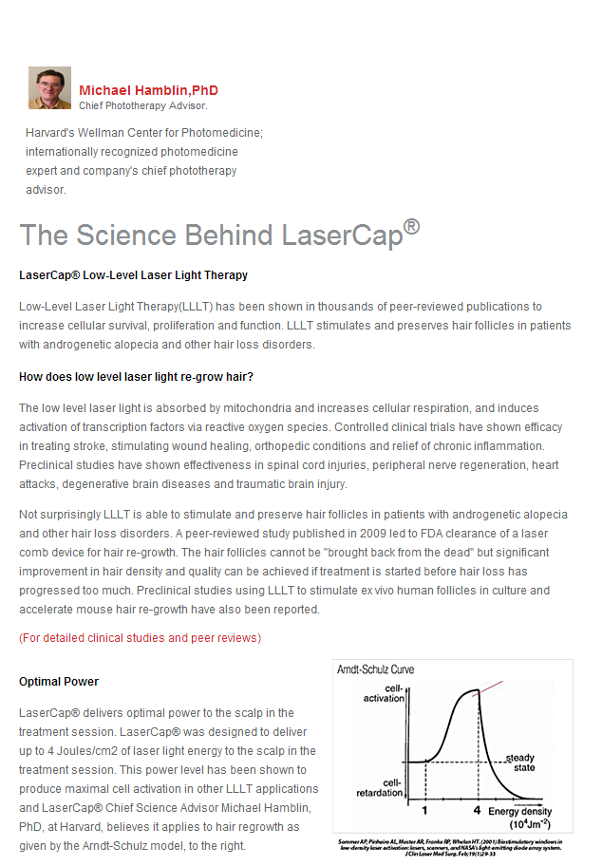
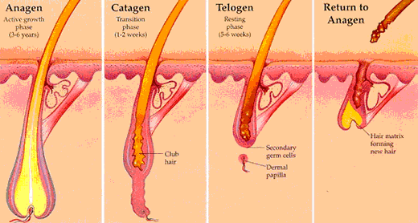
FACTS ABOUT COMMON HAIR LOSS AND ANSWERS
The stages of Hair Growth/Loss
Used in the U.S. for 20 years
1st FDA cleared device in 2007, many followed
Using the Authority of Others (Hamblin, et al)
Notes:
The Evolution of Low Level Laser Light Hair Therapy Device: The Ultimate Anti-Aging Treatment For Thinning Hair
By John Vincent,
American Hair Loss Council Master Certified Hair Restoration Specialist
LLLT devices, like most electronic products, have evolved greatly since they were introduced in to the U.S. more than two decades ago.
The first LLLT machines were large and bulky, contained in-the-neighborhood of two dozen laser diodes and were placed in a rotating mechanism to allow the few number of diodes to cover the entire scalp. The machine had to be lowered to a position which enclosed the client’s hair bearing area. For some patients, that led to a sense of claustrophobia. These machines were very expensive and were typically located in salons and clinics.
Next, flat panel lasers were introduced in the market place. These comparatively sleek surfaces- with no moving parts other than the adjustable arms to hold the head unit--contained upwards of a 100 laser diodes and effectively treated the entire hair loss area when placed at the sides back and top of the head. Being less bulky, patients did not feel ‘enveloped’ by the machines--much like comparing an “closed”. MRI machine to the newer “open” MRI. Also costly and sizable in stature, these machines also are typically housed in a clinical environment.
Eventually a more compact “home unit” LLLT device became available. These devices with, typically, between 50 and 100 diodes were designed with all components contained in the head unit. A simple supporting stand allowed the patient to move the device themselves and put it in a convenient or discreet area of the home.
The above-described devices used continuous wave (CW) power. CW mean the diodes are powered to run constantly to generate light (and, as a by-product, heat). CW was the standard for many years. Several years ago, a photo-medicine expert at Harvard University speculated that pulsed wave (PW) energy (think: blinking) which was already being used in other low level laser devices for other purposes, demonstrated a more effective way of delivering the light.
He and his study co-authors theorized Pulse wave could deliver a significant burst of energy with each ‘on’ cycle. Importantly, the short burst of energy target the scalp cells without unnecessarily heating the skin surface (when compared to CW).
However the most important finding in their observations revealed that PW energy penetrates Keratin fiber (what human hair consist of) more effectively than CW. Therefore, it is believed that the presence of hair in the area to be treated with LLLT does not sufficiently impede the efficacy of LLLT treatment.¹ (This effectively eliminated the need for the ‘teeth’ found in some hand held laser devices.)
Currently, only two Low Level Laser Light Hair Therapy devices incorporate pulse wave. Both are portable and battery-operated for use at the user’s convenience in any location. One is the $3000. LaserCap™ ,with 224 semiconductor laser diodes, and the other, Nutreve Personal Hair Therapy Laser™ - MSRP $499-containing 35.
How Laser Hair Therapy Works
The above-mentioned scientist, Dr. Michael Hamblin, Associate Professor of Dermatology of Harvard University and lead investigator at the Wellman Center for Photomedicine and Photodynamics, describes the mechanism of low level laser light therapy as affecting the growth of cells in the scalp, of which the hair cells are a key part¹. He maintains:
As DHT is the agent in the body that blocks cell growth, LHT is thought to open the pathways to the cells, increasing microcirculation of blood and allowing the cells to take in nutrients and release toxins. This process is necessary to reverse “miniaturization” of hair follicles by allowing cells to grow and replicate.
Another bi-product of LHT, as witnessed in clinical studies, is an increase in the body and fullness of hair follicles being treated. This is believed to be caused by the stimulation of the arector pili muscle-a tiny muscle found in every hair or follicular unit. The arector pili muscle is what gives hair support. Stimulated by LHT, the hair tends to regain its former support, providing lift to the hair.
Finally, the shine, luster and elasticity of the hair follicle are affected by the output of the sebaceous gland, the lubricating agent that allows the hair to penetrate the scalp. Clients of LHT often find their hair becoming shinier and more flexible, as opposed to dry and brittle. The effect of LHT on the sebaceous gland is thought to normalize the gland.²

Slide 11
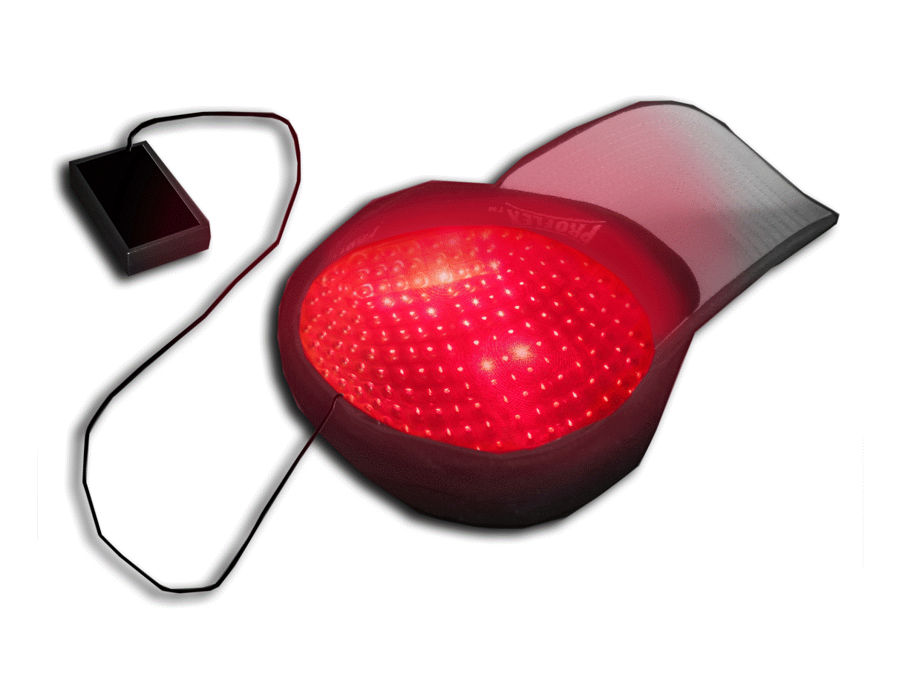
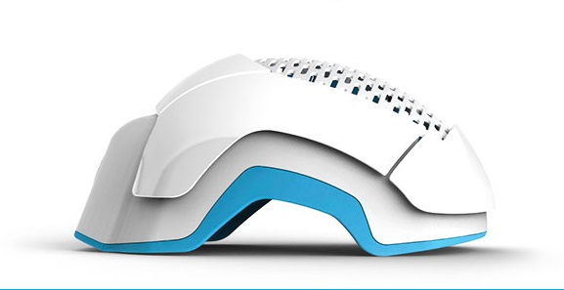
PROVEN LASER PRODUCTS & AT VARIOUS PRICE POINTS AND FEATURES
We offer 3 USA-made Laser Hair Therapy Devices

Slide 12
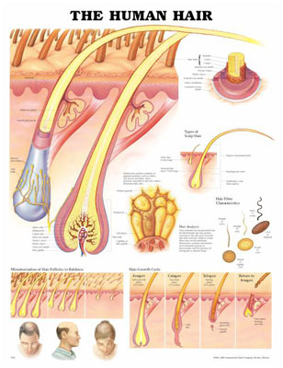
CLIENT EDUCATION PROCESS
Knowing how to Explain Laser Hair Therapy (LHT)
Understanding and Managing Client Expectations
Tools to Measure Progress
Helping Client Understand Results- Objectively and Subjectively
“No Further Loss is Success”

Slide 13
DISTRIBUTORS FOR THE BEST LHT DEVICES IN THEIR CLASS
Sunetics™: Clinical in-office treatment
Nutreve™: Hand-held
Theradome™: Wearable Budget Price Helmet
LaserCap®: Ultimate Discreet, Powerful

Slide 14
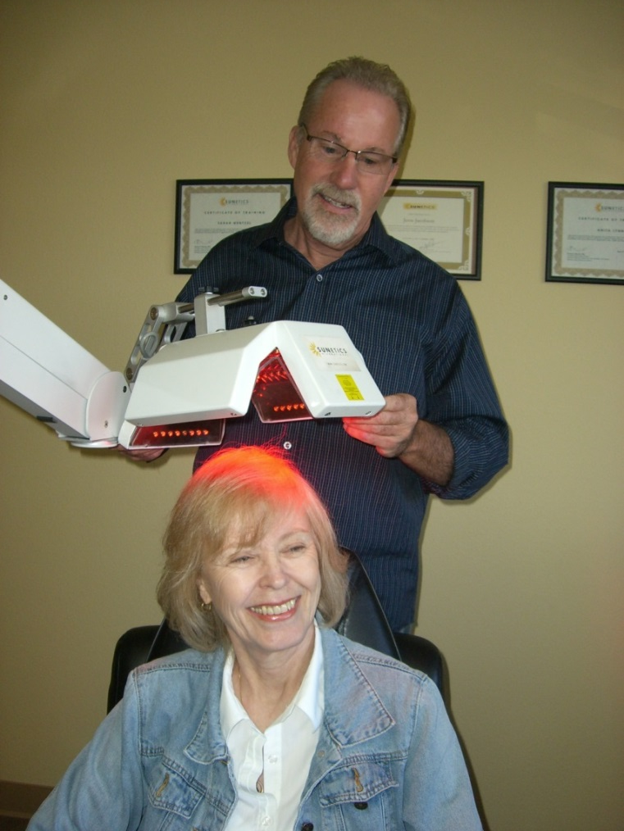
OUR PRODUCTS
Clinical in-Office
Sunetics™ Clinical In-Office LHT Device

Slide 16
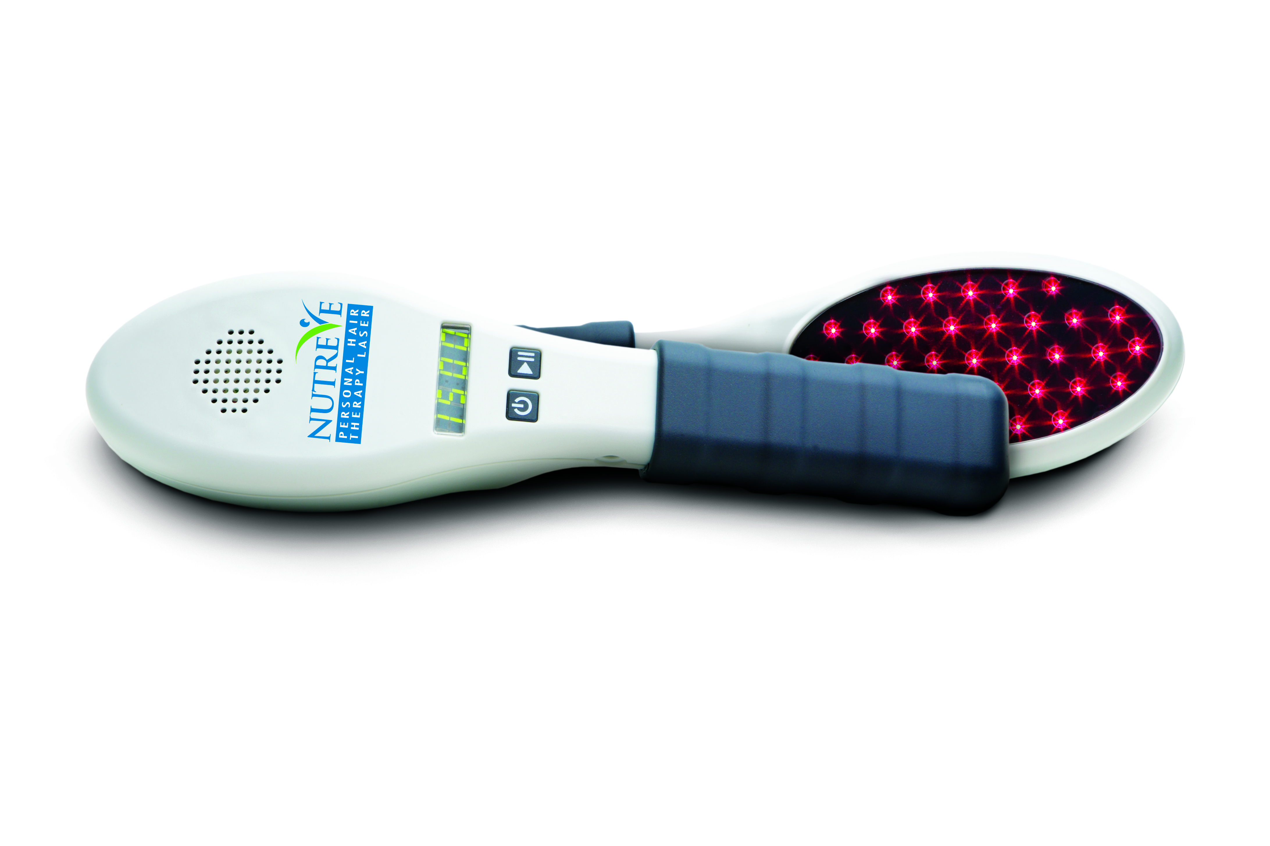
NUTREVE™

Slide 18
THERADOME™ HELMET-STYLE LLLHT DEVICE FDA Cleared

Slide 19
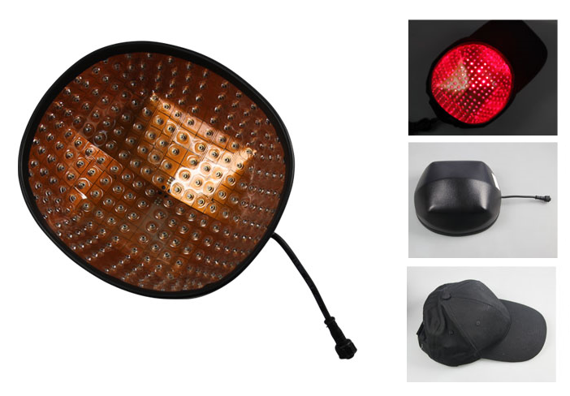
LASERCAP® Buy Physician Only

Slide 21
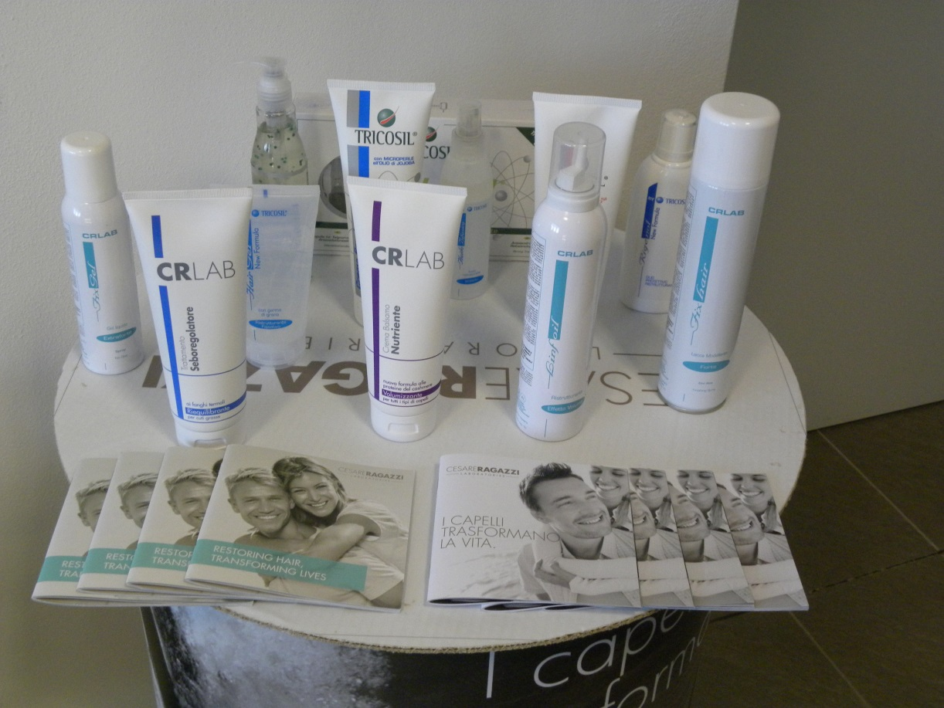
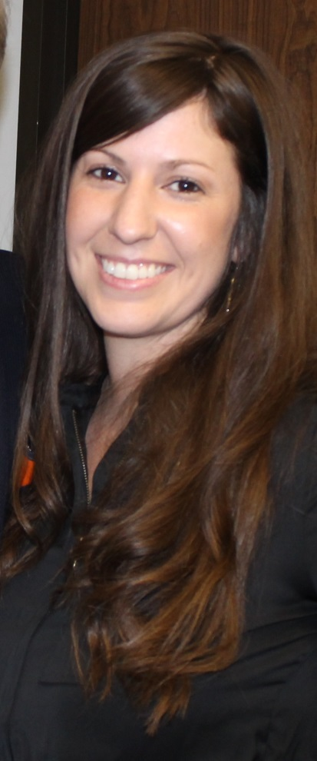
CESARE RAGAZZI LABORATORIES™

Slide 22
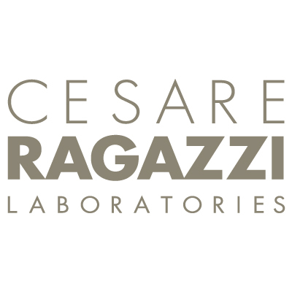
EXCLUSIVE DISTRIBUTOR FOR CESARE RAGAZZI LABORATORIES™

Slide 23
PHYSICIAN ONLY PROGRAM
Primary Distributor for LaserCap®
Invented by Dr. Michael Rabin
1st Pulse Wave LHT device
Sold worldwide
Only USA-made Device Sold by Physician Only
Your Clinic can be a retailer of this product if affiliated with a physician

Slide 24
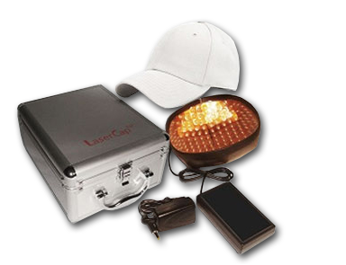
WHAT IS INCLUDED
Best wholesale pricing model and generous start-up kit to maximize your profit.

Slide 25
LOW COST CLIENT FINANCE OPTIONS
Patient Finance programs
No fees to the vendor
14 month interest free for customer (with 670 or more credit score)
Other financing for all levels of credit
Subprime financing not driven by credit score
Credit approval rate in excess of 93%

Slide 26
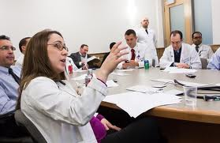
OUR STRENGTH IS EDUCATION AND SUPPORT
Direct access to our national consulting & education team.

Slide 27
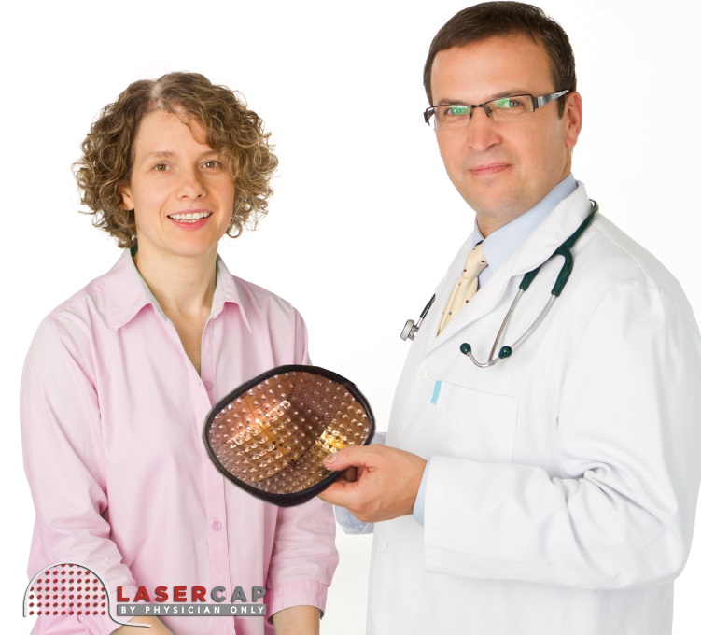
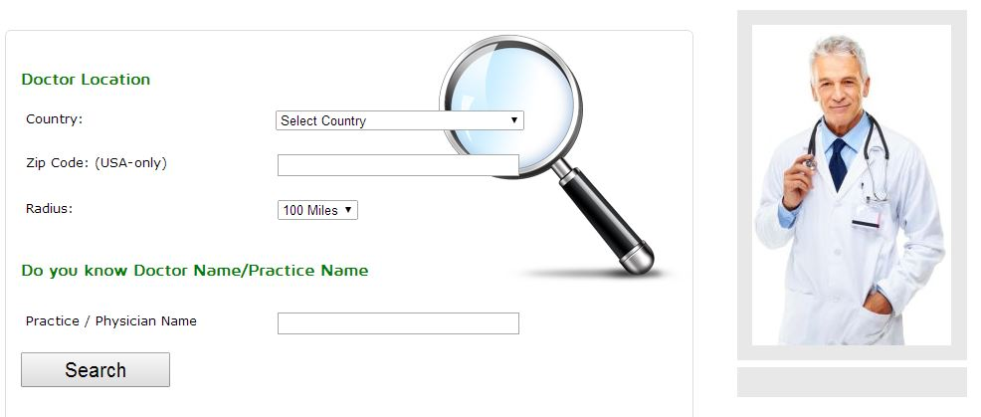
COMPREHENSIVE WEBSITE EVALUATION

Slide 28
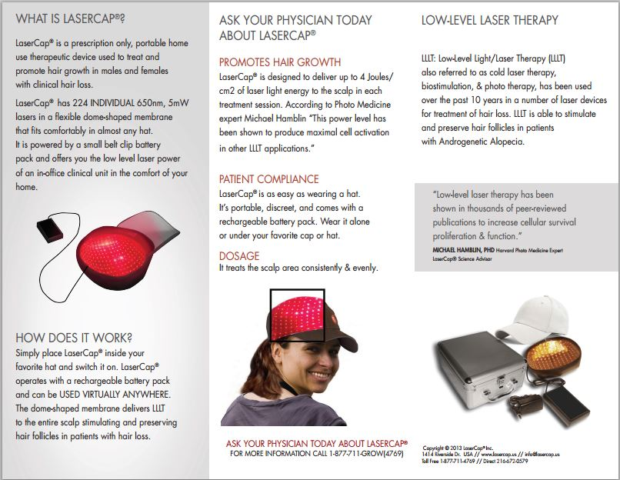
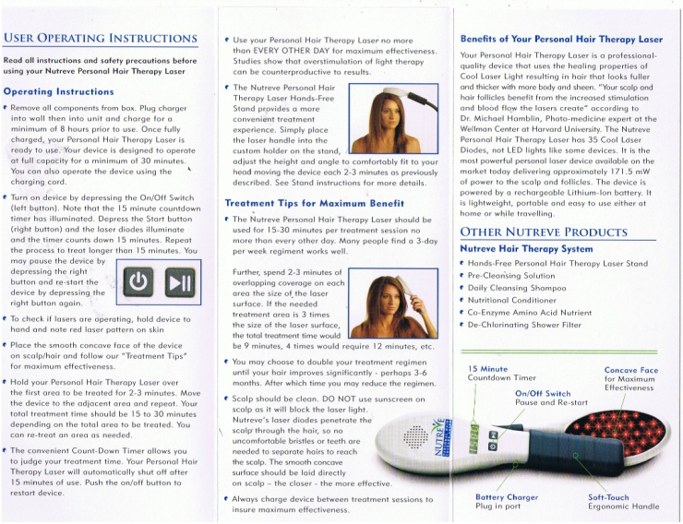
MARKETING MATERIALS, RESEARCH, & DISPLAY PRODUCTS

Slide 29
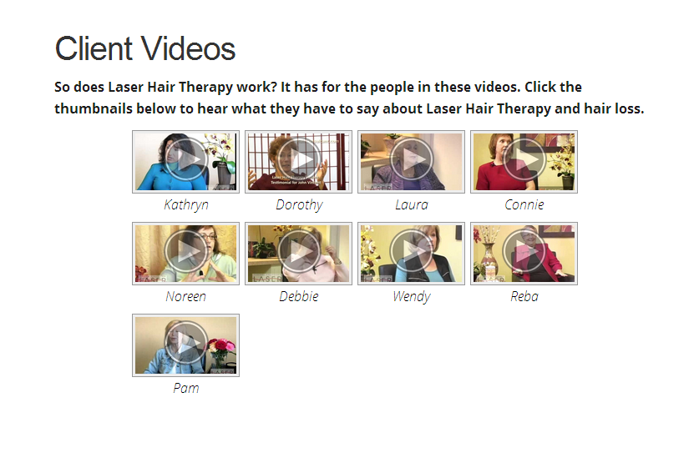
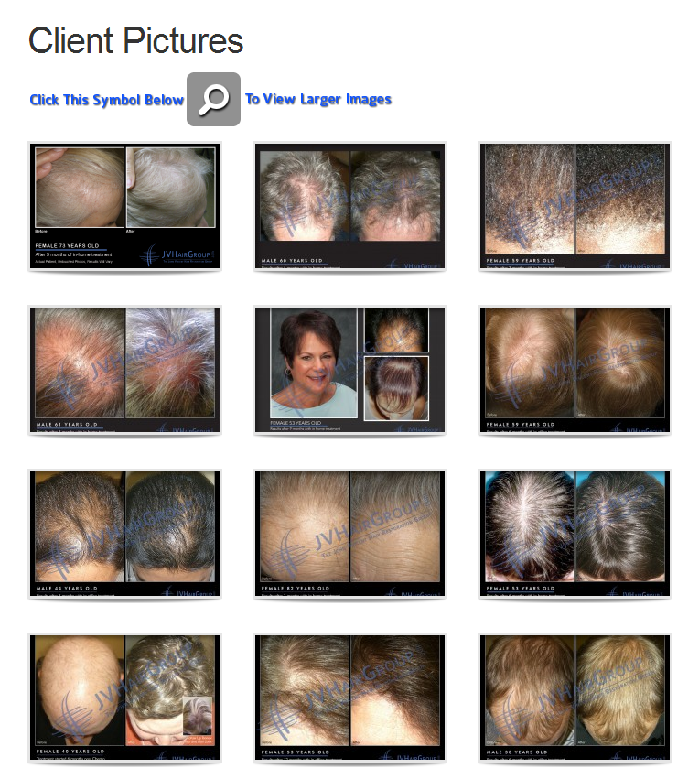
TESTIMONIALS, PROGRESS PHOTOS, WEBSITE VIDEOS & MORE

Slide 30
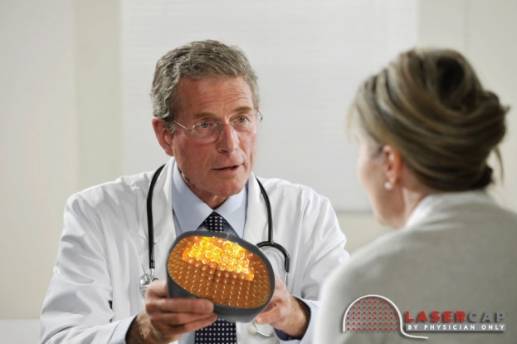
PRODUCT PRESENTATION TRAINING
Sample presentation script
Consultation training
Training Video

Slide 31
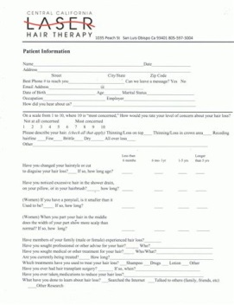
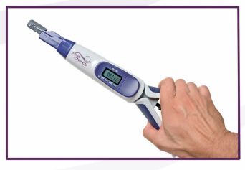
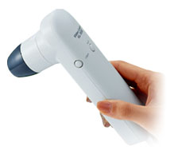
WHAT OUR TRAINING PACKAGE INCLUDES:

Slide 34
Notes:
Remove watermarks on slides

Slide 37
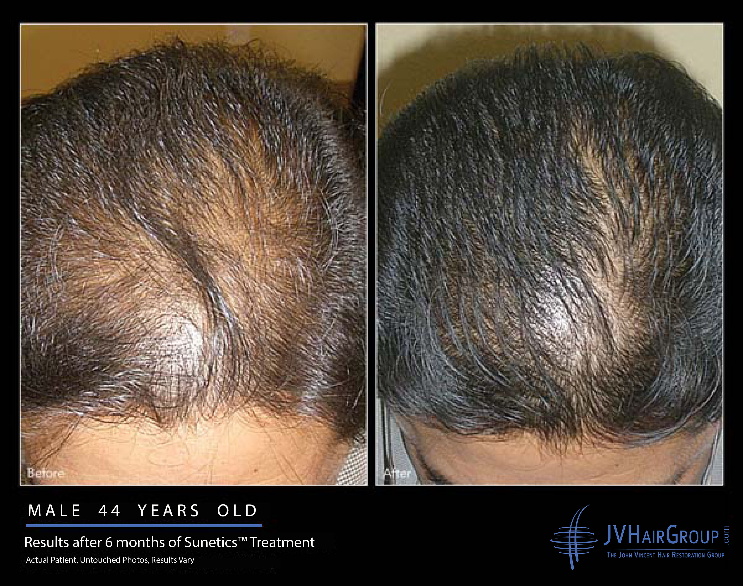
Look for picture

Slide 38
HOW TO GET STARTED
Fill out the form provided to get started and give us the information we need to help you. E-mail us at: info@jvhairgroup.com Call us at our office: (805) 597-3004

Slide 39
Lets Meet again at Cosmetology-2015
4th International Conference and Expo
On Cosmetology & Trichology
June 22-24, 2015 Philadelphia, USA
Theme: Cosmetology and Trichology: Tracking and Tackling its Consequences
Website: http://cosmetology-trichology.conferenceseries.com/

