Slide 1
“Study of antioxidant and antimicrobial activity of Chios mastic gum fractions (neutral, acidic) before and after encapsulation in liposomes”
Dr. John Tsaknis
Dr. Olga Gortzi
Department of Food Technology
Technological Educational Institutions (TEI)
of Athens

Slide 2
Mastic is a well-known natural resin from the trunk and branches, of Pistacia lentiscus var. chia (Anacardiaceae), which is grown as endemic only in the Greek island of Chios.
It has been used in traditional Greek medicine for various gastrointestinal disorders, while the plant has been mentioned by famous ancient Greek physicians (Dioscorides, Theophrastos, etc.) recommending its healing properties.

Slide 3
During this work, a total mastic gum extract was prepared after removal of the contained insoluble polymer in order to ameliorate solubility and enhance in vivo activity.
To overcome the drawbacks (i.e solubility, bioavailability, etc.) of mastic gum extracts (acidic and neutral fraction), the selection of a suitable carrier is crucial.

Slide 4
Three different methods of preparation, thin-film evaporation, freezing-thawing, and ethanol injection were used for the preparation of liposomes consisting of phosphatidylcholine (PC) and cholesterol (CH).
For the determination of the antioxidant activity two methods were used:
I) The Rancimat method where the protection factor was determined for each sample and compared with known antioxidants.

Slide 5
II) Differential Scanning Calorimetry (DSC) where the temperature of oxidation for each sample was determined.
The crude extract (EtOAc-MeOH) of mastic, as well as, its acidic and neutral fractions was assayed against a panel of 9 human and food pathogenic gram (±) bacteria and fungi.

Slide 6
Methods of characterization
FT-IR
Spectra in the transmission mode were carried out at the region of 4000-400 cm⁻¹. Potassium bromide (KBr) pellets were prepared by gently mixing 6 mg sample powder with 120 mg KBr using an hydraulic press.

Slide 7
SEM
Samples were lyophilized, coated with gold and palladium using a vacuum evaporator, and examined using SEM at 20 kV accelerating voltage.
Size distribution
Liposomes particle size was analyzed at 25ºC.

Slide 8
Methods for determining antioxidant activity
Rancimat
About 3.0 g of sample oil were weighed into the glass vessel and the appropriate amount for each sample liposome or known antioxidant (BHT or α-tocopherol) was added.
The conditions were set at 90 ºC and 15 L/h.
The protection factor (PF) was calculated as PF = (induction time with antioxidant)/(induction time without antioxidant).

Slide 9
A protection factor greater than one indicates inhibition of lipid oxidation. Higher PF value indicates better the antioxidant activity.
DSC
The thermal behavior was studied by heating of about 5.0 mg of each individual sample in a covered sample pan under nitrogen gas flow.
The investigations were carried out at a temperature range of 25-580 ºC and a heating rate of 10 ºC min⁻¹.

Slide 10
Methods for determining antimicrobial activity
In vitro antibacterial studies of crude extract (EtOAc-MeOH) of mastic, as well as, its acidic and neutral fractions were carried out by the dilution method by measuring the MIC values against:
Staphylococcus aureus,
S. epidermidis,
Pseudomonas aeruginosa,

Slide 11
Enterobacter cloacae,
Klebsiella pneumoniae,
Escherichia coli,
Candida albicans,
C. tropicalis and
C. glabrata

Slide 12
Results & Discussion
HS-SPME and GC-MS analysis
Through HS-SPME analysis:
α-pinene (25.6%),
verbenone (14.0%),
β-cymene and verbenene appeared as the most abundant constituents, representing 58% of the total, among the 27 identified volatile components of the mastic (Table 1).

Slide 13
Table 1. Mastic gum analysis through HS-SPME and GC-MS.
RT | Constituents | %
10.07 | α-pinene | 25.6
10.79 | verbenene | 8.6
11.70 | β-pinene | 0.7
21.03 | verbenone | 14.0
21.36 | β-cymene | 9.8
22.05 | p-mentha-1,5,8-triene | <0.5
23.68 | trans-α-ocimene | 2.0
23.77 | camphene | <0.5

Slide 14
Encapsulation Efficiency (EE)
Trapping efficiencies for AMGE (acidic mastic gum extract) and NMGE (neutral mastic gum extract) in colloidal carriers were determined by GC-MS and the results are presented below (Table 2).
Particle size distribution
The mean particle size and polydispersity of liposomes obtained with different methods and loaded with AMGE and NMGE are summarized in Table 2.

Slide 15
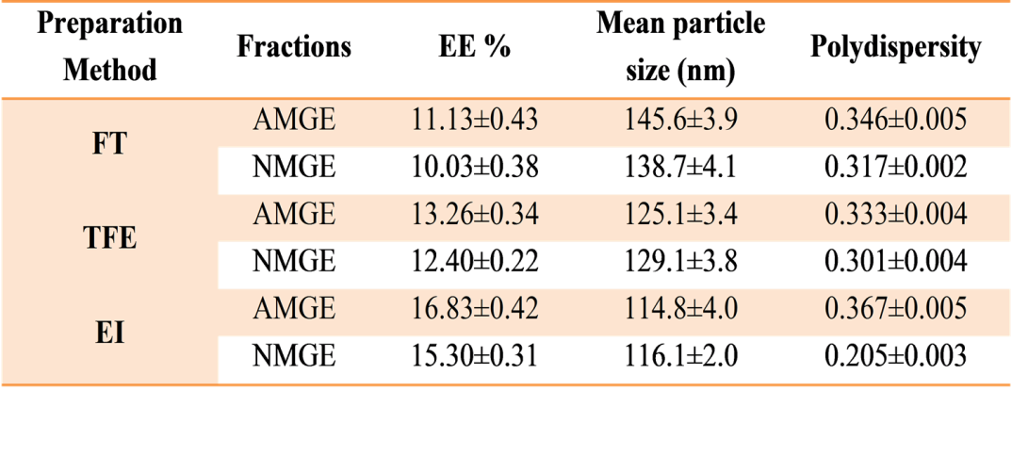
Table 2. Effect of different preparation methods and loading capacity on particle size distribution of AMGE and NMGE liposomes (EE%: percentage of encapsulation efficiency).

Slide 16
The freezing-thawing circles caused an amount of entrapped AMGE and NMGE to leak from the bilayers, which lead to lower encapsulation efficiency for FT liposomes.
Therefore, FT-IR, Rancimat and DSC studies are given only for the two other liposome preparations.

Slide 17
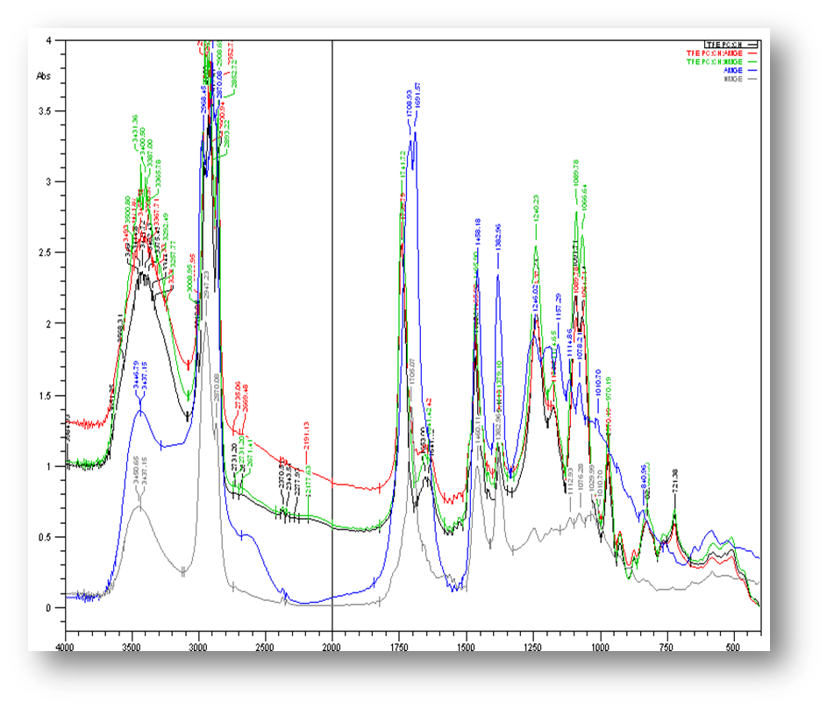
FT-IR
Fig. 1a. Comparative FT-IR graphs of TFE preparation

Slide 18
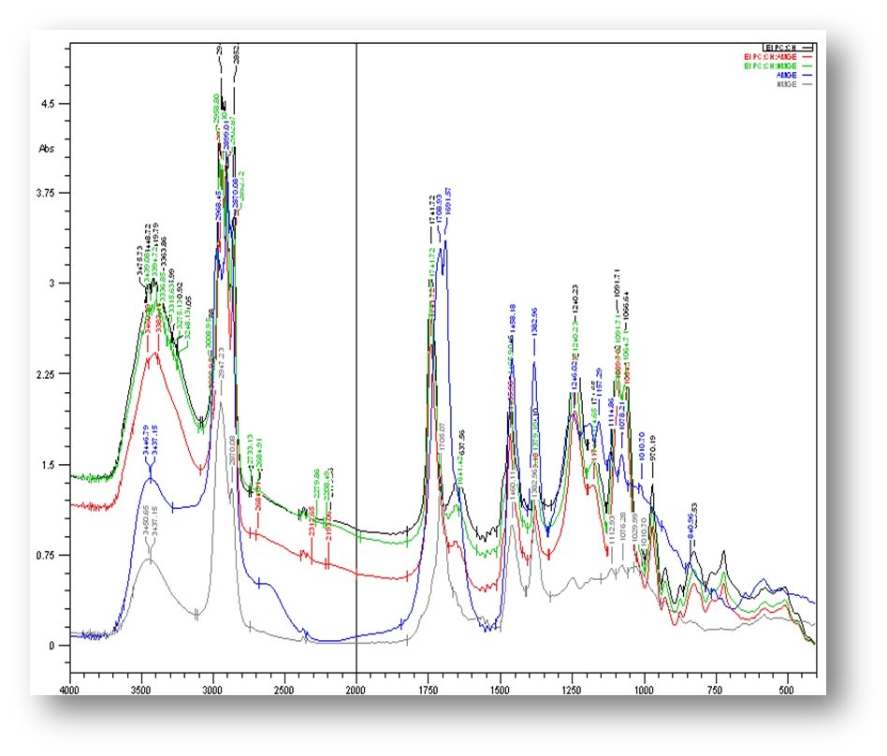
Fig. 1b. Comparative FT-IR graphs of EI preparation

Slide 19
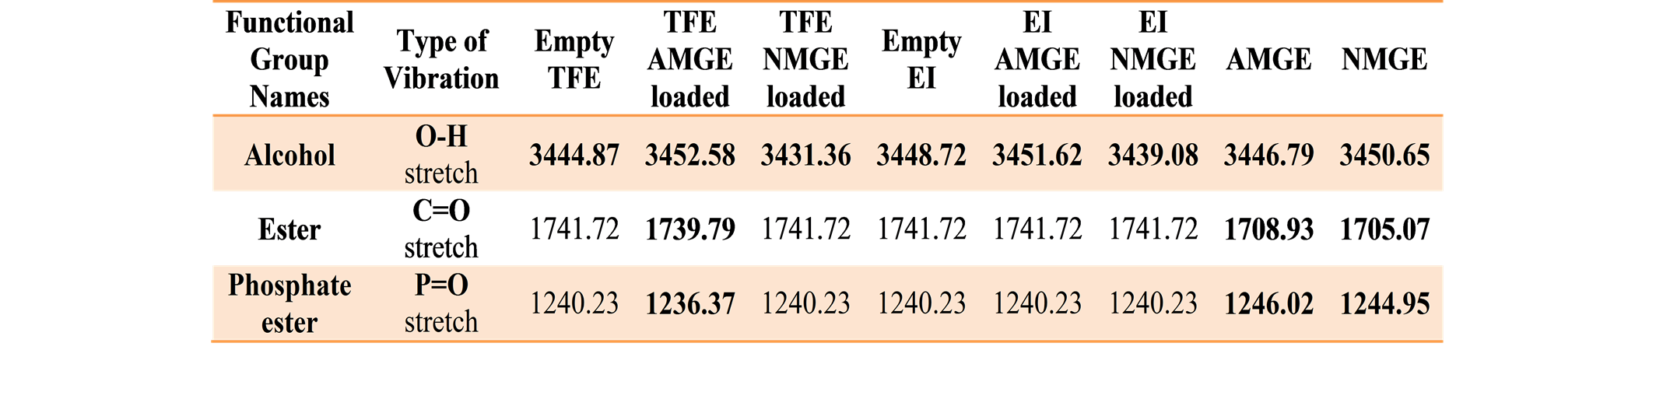
The characteristic functional groups with their frequencies were determined (Table 3)
Table 3. FT-IR interpretation of TFE and EI preparations (empty and AMGE & NMGE loaded)

Slide 20
The first aspect was detected in the vibration band located between 3600 and 3000 cm-1 (Figure 1).
This band is related to O-H stretching vibration and is much more pronounced in the liposomes formulations EI and TFE than in pure AMGE and NMGE.
This indicates that the OH groups of AMGE and NMGE components created hydrogen bonds with the containing phospholipids.

Slide 21
These bonds are probably related to the interaction among the O-H groups from AMGE and NMGE components and the polar groups of the phospholipids.
A second important characteristic was related to the peaks at 1236 cm-1 and 1720 cm-1, (Figure 1).
The first one is related to the stretching of P=O bond of the polar heads of phospholipids. The absorption band attributes to phosphate O-P-O asymmetric stretching vibrations and can also provide important clues about hydration and hydrogen bonding interactions at the surfaces phospholipid assemblies and AMGE components.

Slide 22
Also, in the case of the stretching of C=O of ester groups, observed modifications (decreases) reflect differences in the degrees of hydration and/or hydrogen bonding to the ester carbonyl groups in the case of AMGE loaded liposomes.

Slide 23
SEM
The SEM photograph of optimized formulation revealed that particles were roughly spherical.
Additionally, an uniformity was observed.
An average particle size below 120 nm could be achieved and reproduced.

Slide 24
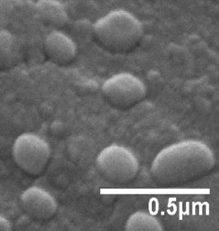
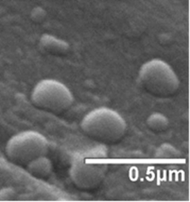
Empty EI NMGE loaded EI

Slide 25
Rancimat method
Based on the protection factor, the results are a comparative study of the antioxidant activity of the samples, liposomes and known antioxidants (BHT or α-tocopherol).

Slide 26
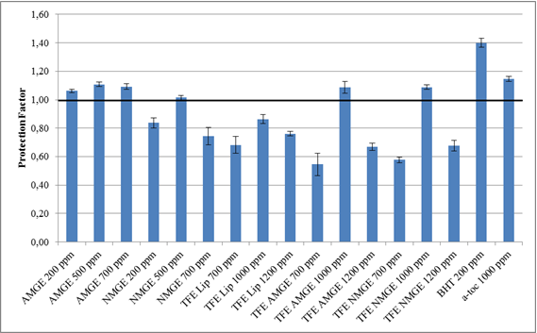
Fig. 2a. Protection factor of TFE preparation and known antioxidants (BHT and α-tocopherol) as determined by the Rancimat method.

Slide 27
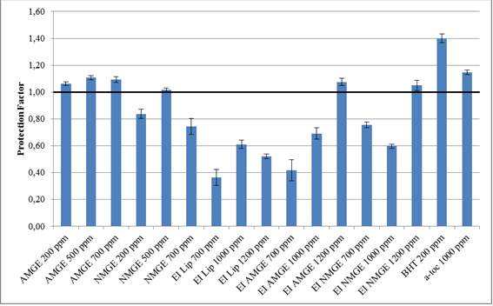
Fig. 2b. Protection factor of EI preparation and known antioxidants (BHT and α-tocopherol) as determined by the Rancimat method.

Slide 28
DSC
Thermal oxidative decomposition of AMGE and NMGE, TFE and EI preparations (empty and AMGE or NMGE loaded liposomes) was studied by the DSC method using the onset temperature (To) of curves at the point where the auto-oxidation process begins.
The results were in line with those reported by other researchers who also suggested that NMGE proved low oxidation stability.

Slide 29
The oxidative stability of both extracts was increased after encapsulation and depended on the method of preparation used (TFE and EI).
The following figures show Thermal profile of TFE and EI preparation as determined by the DSC.

Slide 30
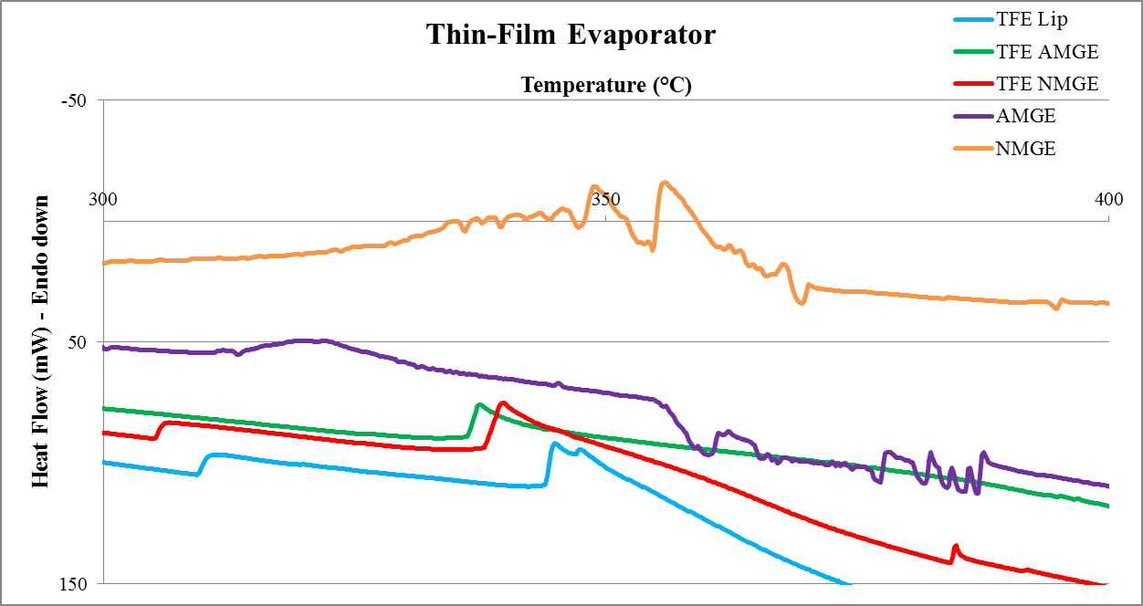

Slide 31
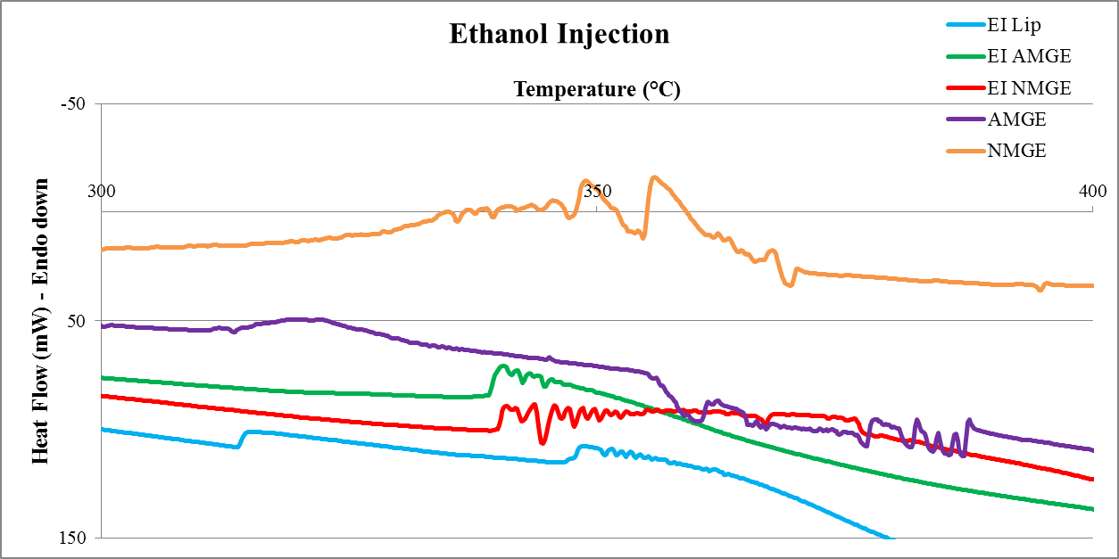

Slide 32
Antimicrobial activity
All tested extracts of mastic, as well as, its acidic and neutral fractions showed a very interesting antimicrobial profile against all 9 assayed microorganisms.
Moreover, the crude extract appeared as the most active, where it exhibited the strongest activity against Gram positive human pathogenic bacteria (MIC values 0.05-0.20 mg/mL).

Slide 33
Antimicrobial activity MIC (mg/ml) of the mastic gum
 | S. aureus | S. epidermidis | P. aeruginosa | E. cloacae | K. pnaumioniae | E. coli | C. albicans | C. tropicalis | C. glabrata
crude extract | 0.04 | 0.05 | 0.21 | 0.25 | 0.34 | 0.18 | 0.73 | 0.56 | 0.32
acidic fraction | 0.19 | 0.20 | 0.27 | 0.38 | 0.47 | 0.25 | 1.10 | 0.98 | 0.78
neutral fraction | 0.45 | 0.52 | 0.73 | 0.88 | 1.00 | 0.64 | 1.25 | 1.00 | 0.85
amphotericin | - | - | - | - | - | - | 1.0·10⁻³ | 0.5·10⁻³ | 0.4·10⁻³
5-flucytocine |  | - | - | - | - | - | 0.1·10⁻³ | 1.0·10⁻³ | 10·10⁻³
amoxicillin with clavulanic acid | 0.5·10⁻³ | 5.0·10⁻³ | 1.0·10⁻³ | 1.0·10⁻³ | 1.6·10⁻³ | 1.2·10⁻³ | - | - | -

Slide 34
Conclusion
During current study, colloidal systems (liposomes) containing AMGE and NMGE were successfully prepared with three different methods (TFE, FT, EI).
The comparison of preparation methods (using their physicochemical properties) revealed that lipid based carriers prepared by the TFE and EI methods showed better encapsulating efficiency.
From the experimental results it is concluded that the method of preparation has an impact on the release rate of constituents (i.e. terpenes, pinenes, etc.).

Slide 35
The encapsulated fractions of mastic gum (especially the acidic one) presented higher antioxidant activity in comparison to the non-encapsulated ones.

Slide 36
Acknowledgements
The study has been co-funded by 75% from E.E. and 25% from the Greek Government under the framework of the Education and Initial Vocational Training Program-Archimedes III.

