Slide 1

In utero transplantation: (IUT) an experimental window into immune self
Basic and applied implications
John S. Pixley, M.D.
Associate Professor and Director,
Rheumatology / Immunology Division
UNSOM and
Chief, Rheumatology Section
VA Sierra Health Care System

Slide 2
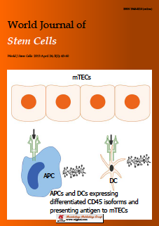

Slide 3
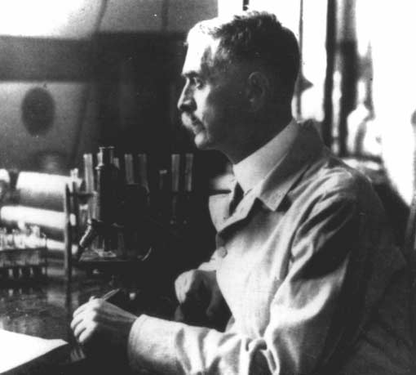
“... 1955–1965 [was] the decade marked by the question, ‘Does autoimmunity exist?’ ...”
N. R. Rose and I R. Mackay
Karl Landsteiner (1868–1943) in his Vienna laboratory in the early 1900s.
(Courtesy University of Wisconsin Middleton Library.)
Nature Immunology 2001, 2: 279-281.

Slide 4
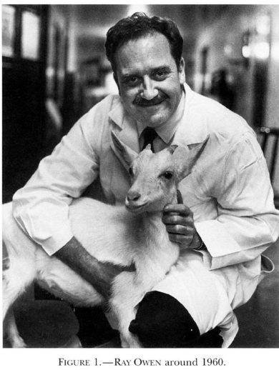
Immunogenetic Consequences of Vascular Anastomoses between Bovine Twins
Intermingling of siblings cells in placental circulation results in long-term chimerism
Immune tolerance is acquired during development
Existence of stem cells and their engraftment
Science, Vol. 102:400-401 (1945)

Slide 5
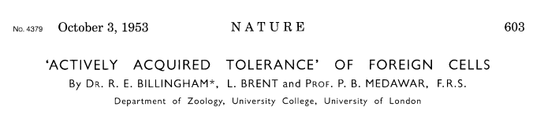
The inoculum from A-line male suspension in ringer’s solution of small organized tissue clumps, isolated cells and cell debris prepare by prolonged chopping with scissors of testis, kidney and splenic tissue
0.01 ml injected via intraperitoneal injection into day 15-16 fetuses of a CBA X CBA mating
After birth skin graft acceptance was determined
Summary
Cellular inoculum during development results in skin graft tolerance in adult life
The tolerance is donor specific (i.e. full ability to respond to 3rd party donor)

Slide 6
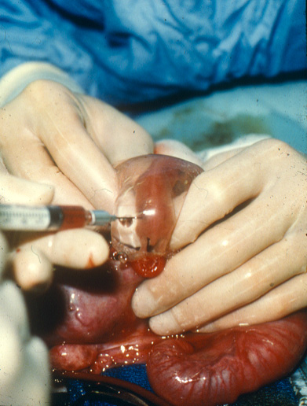
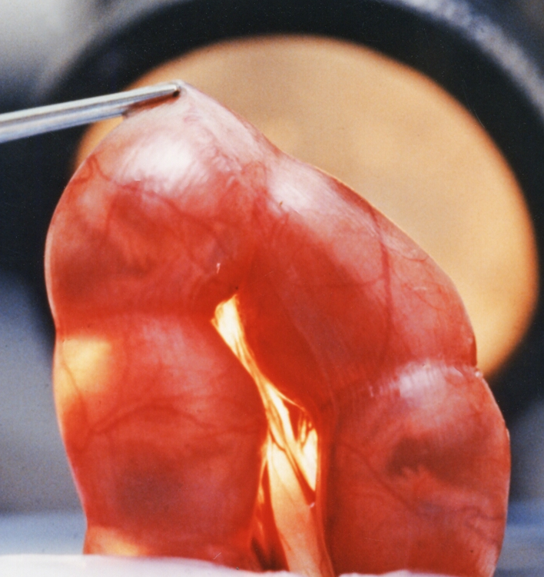
Intrauterine transplantation
IP injection
on day 58-65
IP injection
on day 14-16
SHEEP
MOUSE

Slide 7
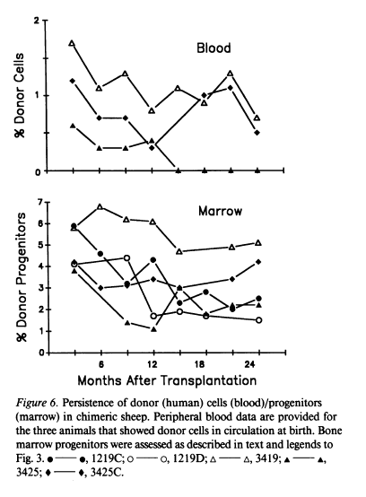
Engraftment and Long-term Expression of Human Fetal Hematopoietic Stem Cells in Sheep Following Transplantation in Utero
Fetal age at transplantation day 48-54 term gestation 145 days
J Clin Inv 1992; 89: 1178-88

Slide 8
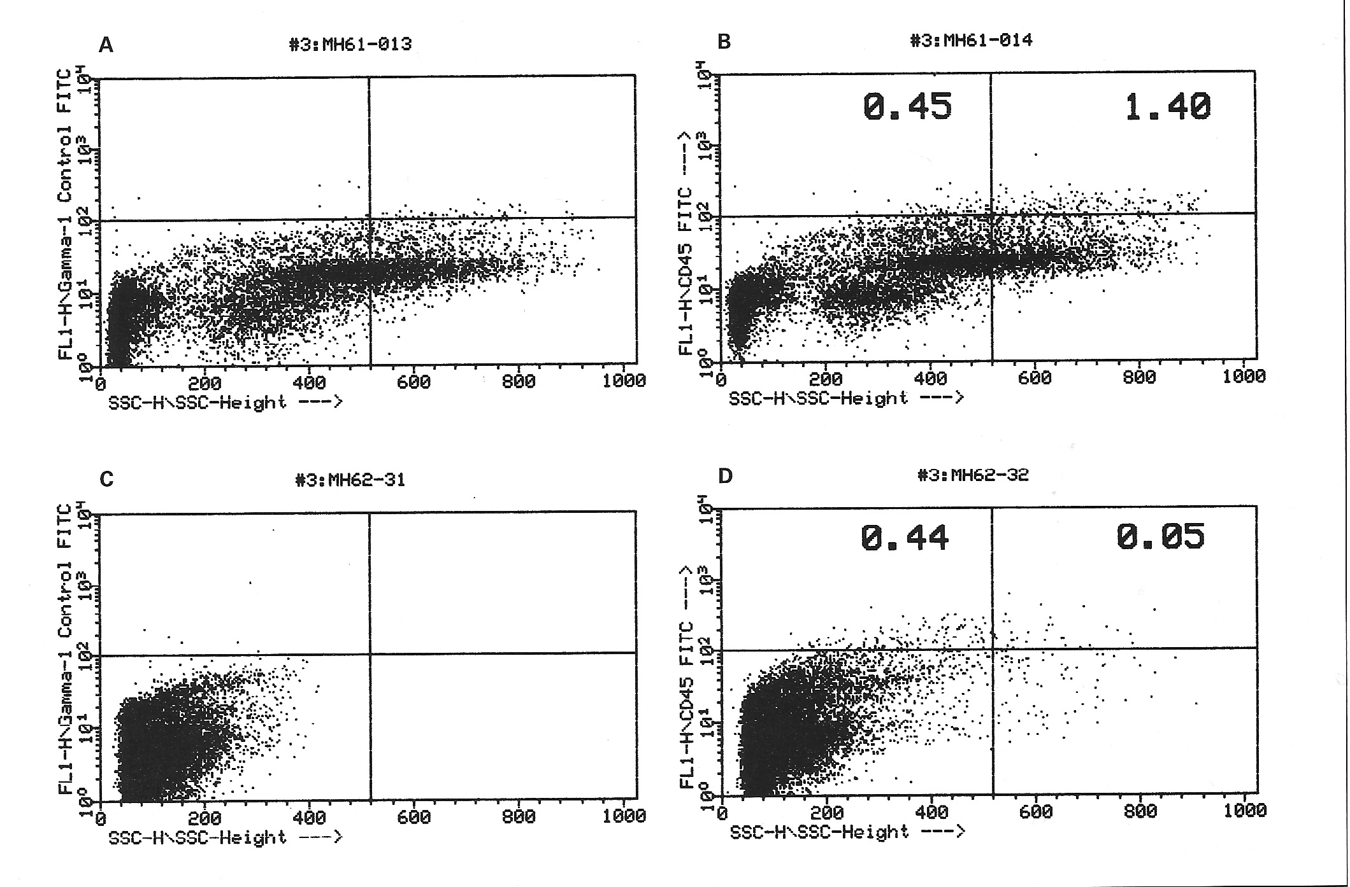
Prolonged hematopoietic chimerism in normal mice transplanted in utero with human hematopoietic stem cells
Peripheral blood
Human CD45
Thymus
Side scatter
Pathobiology 1998; 66: 230-39

Slide 9
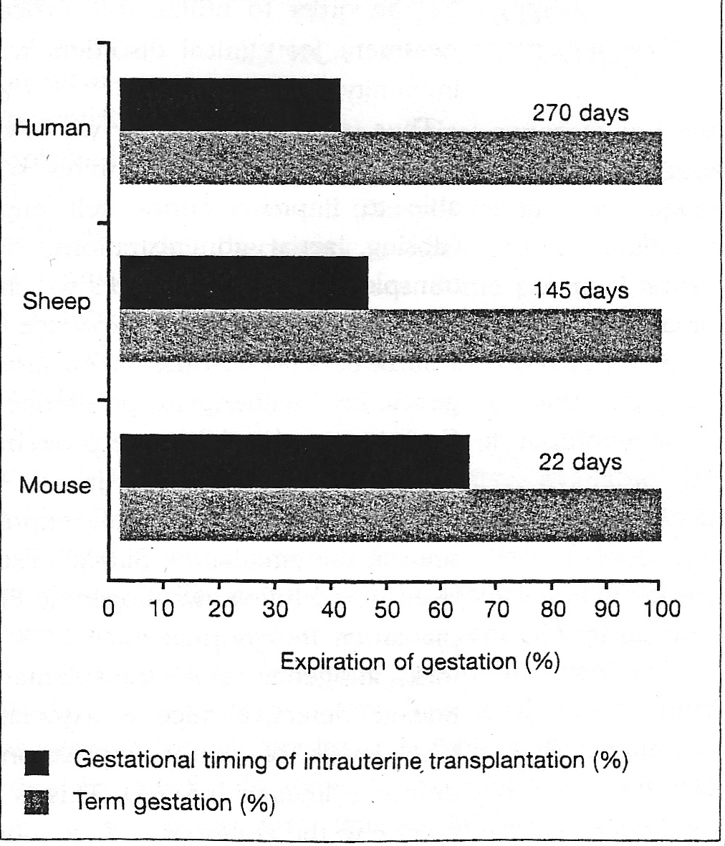
Day 54-65
Day 14-16
Reviews in Clinical and Experimental Hematology 8: 11-32, 1999

Slide 10
Silverstein A, Prendergast RA, Kraner K: Fetal
response to antigenic stimulus. IV. Rejection
of skin homografts by the fetal lamb. J
Exp Med 1964; 119: 955–964.
Day 71

Slide 11
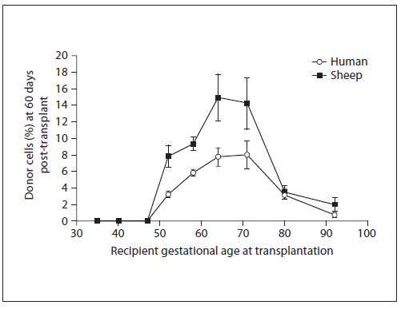
Engraftment receptivity is gestational age dependent
ENGRAFTMENT WINDOW: day 52-72
Fetal Diagn Ther 2009;25:102-110

Slide 12
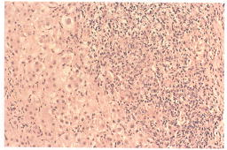
Interface hepatitis. The limiting plate of the portal tract is disrupted by a lymphoplasmacytic infiltrate. This histologic pattern is the hallmark of autoimmune hepatitis, but it is not disease specific. Hematoxylin and eosin, Å~200.

Slide 13
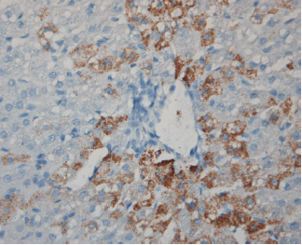
Liver section obtained at 11 months posttransplant from sheep transplanted with CB-derived CD34-Lin- cells and stained with anti-human hepatocyte antibody
Blood First Edition online July 1, 2004; DOI 10.1182/blood-2004-01-0259
Tolerance to solid organ antigens/ Where are sheep NK cells?
Blood 2004; 104: 2582-2590
[PMID: 15231580 DOI: 10.1182/blood-2004-01-0259]

Slide 14
Phenotypic study of sheep lymphocytes at
varying gestational ages
Critical time day 45-72

Slide 15
Bone marrow
Spleen
d39
Thymus
Ileum

Slide 16
DAY 39 DAY 45
Thymus CD4 X CD8
Days 39-45

Slide 17
Bone marrow
Ileum
d58
Liver
Peripheral blood

Slide 18
Thymus
d58
Antibody to sheep CD45 recognizes isoforms:
MW 225-190 Kilodaltons

Slide 19
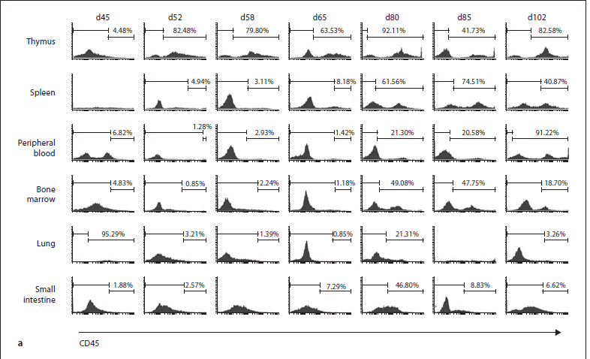
a Representative histograms showing percent expression of CD45 on fetal ovine thymus, PB, spleen, bone marrow, lung, and small intestine
at selected time points throughout gestation.
Fetal Diagn Ther 2009;25:102-110

Slide 20
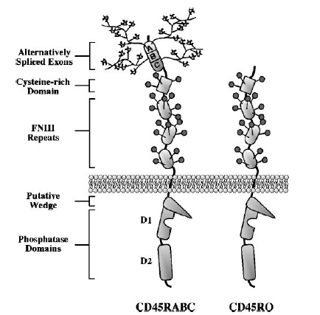
Annu Rev Immunol 2003. 21:107-37
CD45 one of the most abundant cell surface glycoproteins (10% of cell surface) expressed on nucleated hematopoietic cells
RABC (240 kDa -----> RO 180 kDa)
Protein tyrosine phosphatase
Controls the relative threshold sensitivity to external stimuli
Aberrancy in CD45 function may lead to autoimmunity, immunodeficiency and malignancy
Thymic selection generates T cells expressing
self-reactive TCRs in the absence of CD45. J Immunol 2000; 165:
3073–3079.

Slide 21
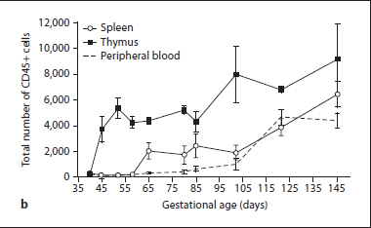
Figure 1. Expression of identifiable CD45 isoforms (225-190 kilodaltons) on cells of thymus and peripheral organs during sheep gestation.
b Cumulative data demonstrating expression of CD45 on cells from fetal ovine thymus, spleen, and PB throughout gestation. SEM is shown as error bars.
Fetal Diagn Ther 2009;25:102-110

Slide 22
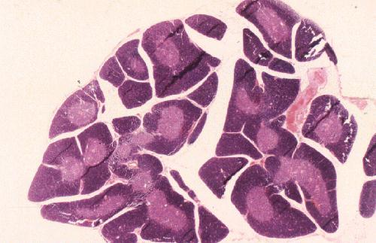
Embryology of the thymus:
At a defined stage in development the thymus demarcates and undergoes vascularization with formation of the medulla.
Gestational timing of demarcation:
Sheep beyond day 50
Mouse day 14-16
Immunology 1987; 62: 97–105.
Eur J Immunol 2000; 30:1948-1956 [PMID: 10940884]

Slide 23
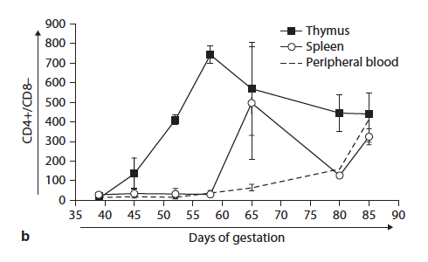
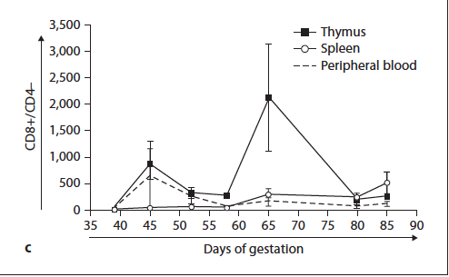
CD4+/CD8- Cells
Deletion?
CD4-/CD8+ Cells
Deletion?
Fetal Diagn Ther 2009;25:102-110

Slide 24
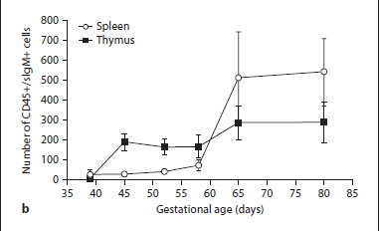
B cell Deletion?
Fetal Diagn Ther 2009;25:102-110

Slide 25
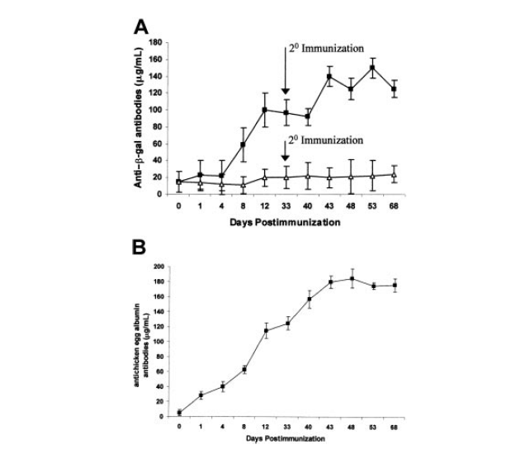
Induction of stable humoral tolerance to β-galactosidase following gene transplantation in utero
Anti-β−galactosidase
Control sheep
Experimental sheep
Anti-ovalbumin
Anti-ovalbumin
Response to ovalbumin both control and experimental sheep
Blood 2001 97;(7): 3417-23

Slide 26
Deletional phase
Cellular phase

Slide 27
Fetal tolerance: Deletion phase followed by cellular phase
Cellular phase
Day 3 after birth
Deletional phase

Slide 28
Fetal transplantation tolerance/self-tolerance requires both the acquisition of deletional and cellular tolerance
3 days post thymectomy → autoimmune disease in genetically susceptible mice ( Immunogenetics 14: 15-27 (1981))
Thymectomy up to day 3 in mice → Loss of T regulatory cells
  Development of autoimmune disease
  J Exp Med 161: 72-87 (1985)
Phenotypic identification of CD4/ CD25 cells in sheep during tolerance window
  Experimental Hematology 33 (7) Supplement 1 #351, 2005
In Utero Bone Marrow Transplantation Induces Donor-Specific
Tolerance by a Combination of Clonal Deletion and Clonal Anergy (In mice following allogeneic tx)
J Ped Surgery 34: 726-30 (1999)
In humans preponderance of T regulatory cell phenotype in third trimester
J of Immunology 152: 3098 (1994)
Science 322: 1562-65 (2008)

Slide 29
Ohki H, Martin C, Corbel C, Coltey M, LeDouarin NM:
Tolerance induced by thymic
epithelial grafts in birds.
Science 1987; 237:
1032–1035.
The developing (i.e. fetal) thymic epithelium is not static

Slide 30
Thymus medulla consisting of epithelial islets each derived from a single progenitor
Constructed chimeric mice by injecting embryonic stem (ES) cells into blastocysts using ES cells and blastocysts differing in their major histocompatibility complex (MHC) type.
The MHC class-II-positive medullary epithelium in these chimeras is composed of cell clusters, most of which derive from either embryonic stem cell or blastocyst but not mixed origin.
Thus, the medulla comprises individual epithelial `islets' each arising
from a single progenitor.
Islet formation can be recapitulated after implantation of
“reaggregated fetal thymic organs” into mice, which shows that
medullary `stem' cells retain their potential until at least day 16.5
in fetal development.
Thus, medulla ± cortex compartmentalization is established by
formation of medullary islets from single progenitors.
ROLE OF DENDRITIC CELLS!
Nature 414: 763-768 (2001)

Slide 31
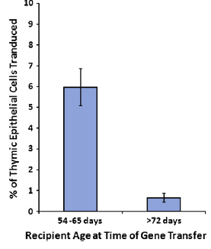
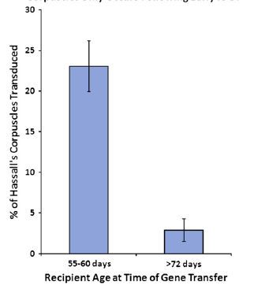
Retroviral vector transplantation during the tolerance window is associated with enhanced gene expression in thymic epithelial cells
or
Expression of gene product by thymic epithelial cells is gestational age dependent
Exp Hematol 2008 36:816-22

Slide 32
What tolerizes the lymphoid compartment?
Role of dendritic cells and APCs
Thymic epithelial cells (TEC)
Our phenotypic study points to the critical time! When immune competent cells undergo CD45 differentiation in the thymus after demarcation.

Slide 33
A short note on Natural Killer Cells
Liver biopsy shown earlier
?innate?
Education
Natural Killer Cells: Tolerance to Self and Innate
Immunity to Viral Infection and Malignancy
Biol Blood Marrow Transplant 16: S97-S105 (2010)
T cell– and B cell–independent adaptive immunity
mediated by natural killer cells
Nature Immunology 7: 507- 516 (2006)
NK-cell education: KIR-S come into play
Blood 115: 1110-1112 (2010)
NK cell development, homeostasis and function: parallels with CD8⁺ T cells
Nature Rev Immun 11: 645-657 (2011)
NKC development during tolerance window CD45 isoform differentiation

Slide 34
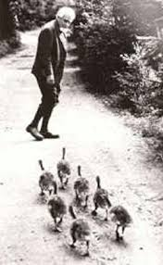
IMPRINTING
Rapid time-dependent irreversible behavioral learning that occurs during development
Der Kumpan in der Umwelt des Vogels [the companion in the bird’s world] Journal fuer Ornithologie. 83: 137-213
Abbreviated translation 1937 in Auk, 54, 245-273

Slide 35
Dr. Pixley’s theory of imprinting:
During development (i.e. prior to “adulthood”)
Cell potential response to stimulus is time dependent
Stimulus (antigen/
MHC?)
TIME
Irreversible Change / self-tolerance
Epigenetic changes to TEC?

Slide 36
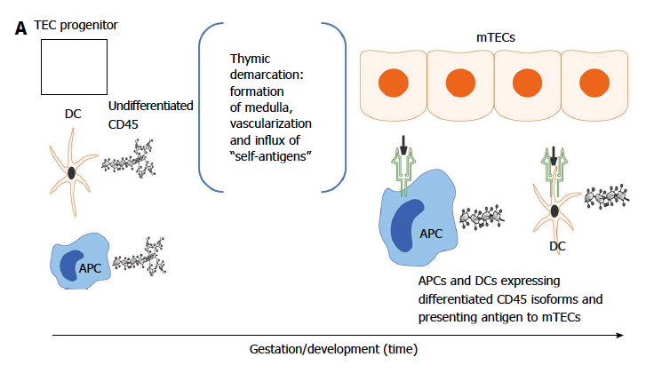
Developmental acquisition of self-tolerance: antigen exposure model
World J Stem Cells 2013 April 26; 5(2): 43-52
doi:10.4252/wjsc.v5.i2.43

Slide 37
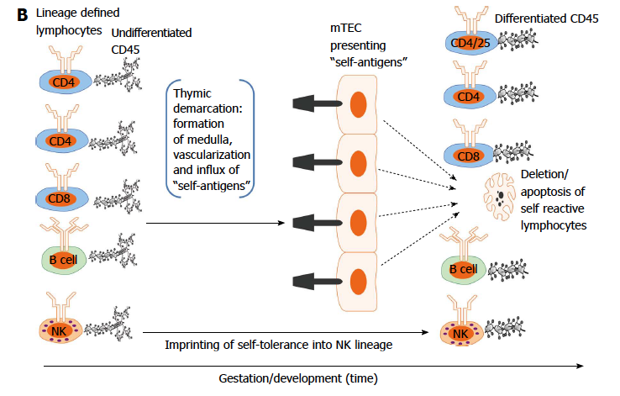
Developmental acquisition of self-tolerance: antigen exposure model
AIRE
World J Stem Cells 2013 April 26; 5(2): 43-52
doi:10.4252/wjsc.v5.i2.43

Slide 38
Summary
IUT: A powerful investigative method
1. Detailed understanding of mechanisms underlying self-tolerance
2. Applications in therapeutics

Slide 39
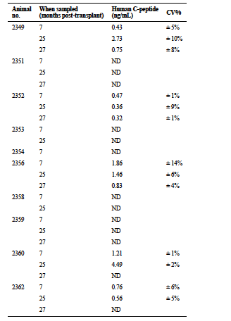
Circulating human insulin
in sheep!
Exp Hematol 2010; 38: 311-320 [PMID: 20170708 DOI: 10.1016/j.exphem.2010.02.005]

Slide 40

Acknowledgements
Alireza Torabi, M.D., Ph.D.
Jessica Reed, DVM, Ph.D.
Adel Ersek, Ph.D.
A Daisy Goodrich, Ph.D.
Esmail D Zanjani, Ph.D.
My Family: Janice, Aaron and Jedediah

