Slide 1
PRESENTATION TOPIC
Effectiveness of Community Based Learning Networks (CBLNs) in Provision Of Intergraded HIV/AIDS And Reproductive Health Services To Cross Boarder Mobile Population Case Study Of Busia Hot spot.
Presented in the 2nd International conference on HIV/AIDS and STds in Las Vegas from 26th-29th October 2014
By
John Francis Oketcho
Executive Director
Friends Of Christ Revival Ministries (FOC-REV)
Telephone: +256772647011/ 703106297
Email: ed@focrevministries. Org

Slide 2
Introduction
FOC-REV uses Community Based Learning Networks (CBLNs) in Provision Of Intergraded HIV/AIDS And Reproductive Health Services To Cross Boarder Mobile Population.

Slide 3
Introduction
CBLN mobilizes cross boarder mobile population and the
host communities for the access of;
Comprehensive HIV/AIDS prevention, care, treatment
Social support services including HIV Counseling and Testing
Health education
TB screening and referrals for treatment
Safe Male Circumcision(SMC)
STI/STD Case management and treatment at the wellness centre
Family Planning

Slide 4
Description of intervention
CBLNs works with Union of truck drivers, association of Commercial sex workers (CSWs) and health units existing within the Hot spot.
CBLN works with church leaders, Opinion leaders, peer educators and clubs in the community to disseminate messages for prevention of HIV/AIDS, testing and treatment.

Slide 5
Goal, Objectives of CBLN
Goal:
To foster collaboration, dialogue and learning among HIV/AIDS And Reproductive Health Services CSOs for improved delivery of services for mobile population and the host communities.

Slide 6
Objectives;
To improve information sharing among HIV/AIDS And Reproductive Health Services CSOs;
To strengthen the collective voice of HIV/AIDS,STIs And Reproductive Health Services CSOs in the hot spot
To strengthen referral mechanisms for HIV/AIDS,STIs And Reproductive Health Services in the hot spot

Slide 7
Objectives cont.
To improve coordination among CSOs and other service providers for enhanced service delivery for mobile population and the host communities
To create an avenue for resource mobilization strategies and sharing both human and logistical resources.

Slide 8
Description of intervention
As a result,
130 Home based care givers
255 peer educators
106 condom distributors were trained in peer education, HIV/AIDS prevention strategies and Moon light HIV Counseling and testing.

Slide 9
Cont’d Description of intervention
Between July 2013 and June 2014
total 4,006 individuals were reached with HCT
425 referred for different services including SMC, TB treatment, cotrimoxazole prophylaxis,STI treatment and other HIV related services among others in different health units including Busia Health Centre IV
2,732 Cross boarder mobile population(CBMPs)

Slide 10
Cont’d Description of intervention
Long distance truck drivers
Boda-boda riders
commercial sex workers
8,780 youths and married/cohabiting couples were reached with ABC and AB interventions.

Slide 11
Cont’d Description of intervention
CBLN focuses on the direct and indirect consequences of HIV/AIDS and STIs on the host communities
As a result ;-
3,200 People living with HIV/AIDS have been identified and provided with Home based care services.

Slide 12
IMPACT OF CBLN

Slide 13
IMPACT OF CBLN

Slide 14
Reproductive Health/Family Planning Method
CBLN has engaged in Mobilization of Busia community for Health Education talk and Family Planning Methods.
CBLN teams has continuously engaged with community Opinion leaders, Church leaders, VHTs, Expert clients
Dialogue meetings are conducted to share experiences among church leaders, Opinion leaders and community Volunteers

Slide 15
Reproductive Health/Family Planning Method
Male involvement in Reproductive health has Increased
CBLN has seen Men take lead in mobilization and sensitization of communities for Family Planning methods.
CBLN has advocated for improved access, affordable FP services and a wide rage of contraceptive methods.

Slide 16
Mothers Under a reproductive age (15-49) served with Family Planning Methods

Slide 17
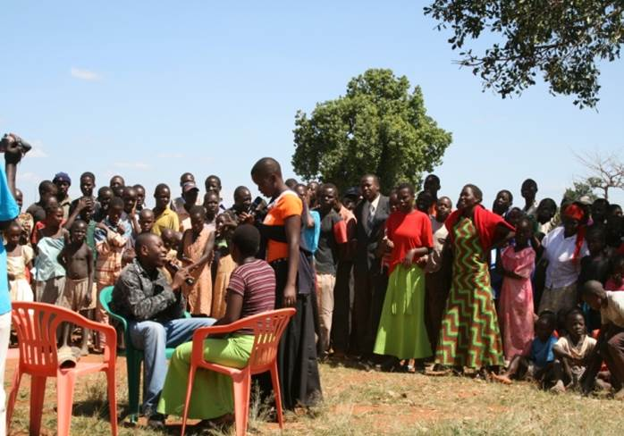
Trained CBLN Providing FP services to Mobile Population in the Hot spot of Busia.

Slide 18
Lessons Learnt
Moon light VCT offered from 6.0-10pm at the wellness Centre at the border point is accessible to truckers, CSWs and other cross border mobile population.
Use of peer educators in information disseminations, referral’s and mobilization is an effective way of reaching out to cross border mobile populations.
Stake holder's dialogue meetings have helped in advocacy and community mobilization.

Slide 19
Challenges faced
Poor coordination mechanism among CBLN team and Other CSO (HIV/AIDS and SRH Service Providers)
Social and Cultural Stereotypes
Poor Male Involvement
Inadequate Financial support
Political interference (local authorities)

Slide 20
Recommendations
Community HCT outreaches should be complemented by moon light VCT.
Harmonization of protocols in testing, treatment and referral for cross border mobile populations is required
Involvement of community structures and local leadership promotes sustainability
Male Involvement in HCT,FP and SRH should be emphasized during dialogue meetings

