Slide 1
Creating an Oligopoly in the Treatment of End Stage Renal Disease and the Subsequent Impact on Home Hemodialysis Therapies in the United States
John D Sullivan, Ph.D.
Boston University

Slide 2
Agenda
History
Disease & Modalities
Economics
Consolidation & the Oligopoly
Treatment Modality Trends

Slide 3
History
Technology vs. Cost
Cost was expected to be minimal:
Projected: $200,000,000 to Medicare in Year 1
Transplant technology would reduce expenditures
First Year cost to Medicare: 1 Billion
Social Security Amendment of 1972
Anyone that had paid into Social Security is eligible for coverage after a 33 month waiting period
Outpatient (less expensive than in-patient) clinics would become an extension of the physician practice

Slide 4
History
Expenditures continue to rise
Approximately $20 billion (2012) to Medicare covering < 1% of the Medicare population but consuming 7% of the Medicare Budget
1980s – Consolidation begins with small for-profit chains emerging
1990s – Consolidation continues with additional corporate structures that allow the physician to be a joint venture partner
2000s – Medicare continues a cost cutting strategy by not raising reimbursement rates with the thinking that commercial insurance companies (20% of the patient population) paying for most of the service
2010s – Medicare introduces a bundled payment establishing a single payment amount for each treatment in an attempt to control costs
Present patient trends within the United States project growth to escalate beyond the current 3% (with a mortality rate of 20%) as a result of diabetes, hypertension, and the aging population

Slide 5
Disease & Treatment Modalities
Almost 90% of patients with renal failure have diabetes or hypertension
Demographics – Incidence and prevalence in African Americans and Hispanics are significantly higher than whites
For patients with renal failure, there are four possible treatment modalities each with an economic benefit or cost
In-Center Hemodialysis
Peritoneal Dialysis
Home Hemodialysis
Transplantation

Slide 6
In-Center Hemodialysis
Patients are treated 3x per week in an outpatient setting for 3 to 4 hours each session
Patients typically fall out of the workforce while being treated causing an economic drain
Medicare pays a bundled rate and commercial insurance companies pay a negotiated rate typically more than three times the Medicare rate.
Economics: Facilities cost between $1 & $2 million – Large fixed cost structure requiring volume for profitability
Patient Outcomes – Mixed – there is considerable literature that argues that patients should be treated more frequently.

Slide 7
Peritoneal Dialysis
Patients dialyze in the home using a catheter and dialysis solutions 7 days a week
Economics: Low fixed costs, fewer drug needs, and higher variable costs
Outcomes: Patients tend to say in the workforce and are healthier – Risk of Peritonitis & Peritoneal membrane failure after 1 year of treatment

Slide 8
Home Hemodialysis
Patients dialyze at home 6x per week for 1 to 1.5 hours
Economics: Low Fixed Costs & Higher Variable Costs
Outcomes: Patients tend to stay in the workforce with lower drug needs with higher mobility (machine is portable)

Slide 9
Transplant
Best treatment for a patient
Economics: High upfront cost of over $200,000, may continue working, but with high immunosuppressive drug expenditures ($15,000 per year)
Outcomes: Likely the best for the patient with a higher probability of serious infection – Few transplants <15 thousand performed each year due to a lack of kidneys

Slide 10
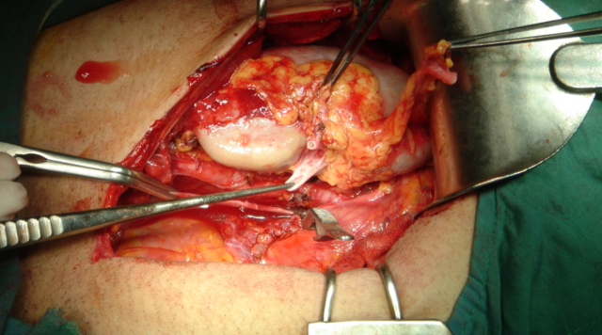
Transplant

Slide 11
Consolidation & the Oligopoly
Question: Has consolidation had an impact on the type of delivery for patients based on profit and expense considerations
Hypothesis: The creation of an oligopoly has created an environment that drives patients towards in-center home hemodialysis
Two largest providers control 70% of the service market
Data was collected from three sources:
United States Renal Data System (University of Michigan)
Financial Filings by the Publicly Traded Companies
Nephrology News and Issues data collection for the ten largest dialysis providers in the United States

Slide 12
Consolidation
Mergers & Acquisition Strategy
Small to Medium Size Targets
Revenue Enhancement
Commercial leverage to renegotiate third-party payer contracts through market leverage
Ancillary revenue through subsidiaries, if available
Expense Reduction
Roll-up – Elimination of Administrative overhead
Leverage in purchasing drugs and supplies

Slide 13
Formation of the Oligopoly as measured by Patients

Slide 14
Fresenius Medical Care
Based in Bad Hamburg, Germany
Serves patients through outpatient clincs (acquired nmc in 1997)
Manufactures dialysis medical equipment and supplies
Owns Venofir (iron sucrose drug company)

Slide 15
DaVita
2nd Largest operator of dialysis clinics in the United States
Owns DaVita Labs, the largest provider of dialysis lab analysis in the United States

Slide 16
Treatment Trends

Slide 17
Initial Conclusions
With the exception of transplantation, treatment modalities such as peritoneal dialysis and home hemodialysis remain an insignificant treatment modality in so far as numbers of patients.
Given profit incentives by large publicly traded companies such as Fresenius and DaVita, it can be inferred that this trend will continue
Given the Federal Government’s concern with Medicare expenditures, questions arise as to whether or not reductions or raises, previously taken by the pharma industry, will continue.
How will ARA’s public offering impact the industry – Does this make them a target and what is the private equity exit strategy?
US Renal and DSI merger – how much will be divested?
Does the Medical Director compensation model need to be changed to encourage other treatment modalities?

Slide 18
Further Study
Grant Application to study the economic cost shift from Medicare to commercial insurance carriers
Changes in FTC interpretations of Hart Scott Rodino testing
How are joint venture financing structures used to circumnavigate antitrust law.
Does joint venture structures with physicians contribute to incentives that lead to prescriptions for in-center hemodialysis
What is the true economic cost of patients unable to work

